Slide 1
Lecture 10, 10/10/13
Climate Dynamics 11:670:461
Alan Robock
Department of Environmental Sciences
Rutgers University, New Brunswick, New Jersey USA
robock@envsci.rutgers.edu
http://envsci.rutgers.edu/~robock

Slide 2
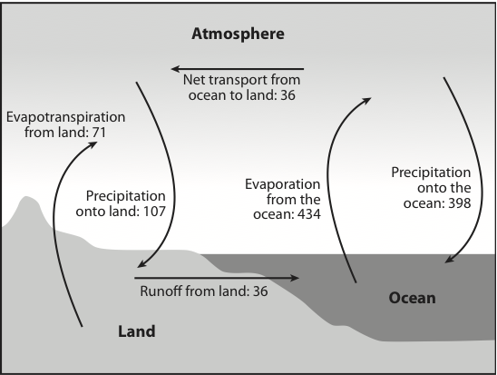
The hydrologic cycle – annual water fluxes (10¹⁵ kg/yr)
Fig. 2.24

Slide 3
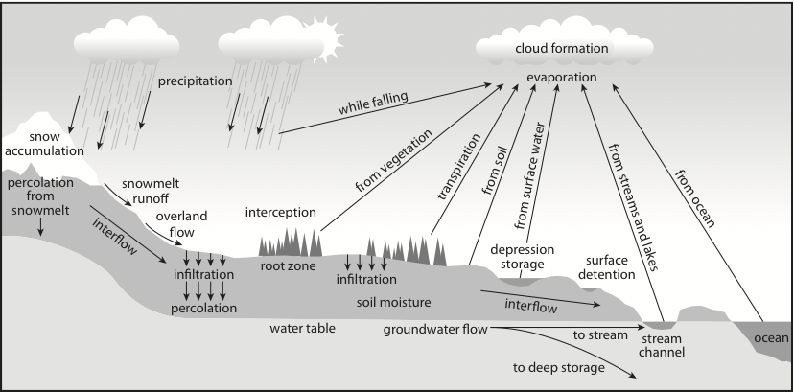
Hydrological Cycle
Fig. 9.1

Slide 4
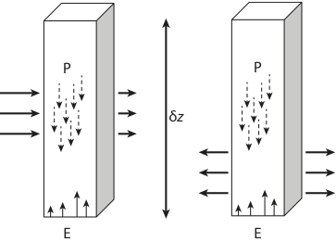
Atmospheric column water balance
Fig. 9.2

Slide 5
water depth (cm)
50 Total Capacity
35 Field Capacity
15 Wilting Level
0
GRAVITY
AVAILABLE
UNAVAILABLE
1 m
SOIL

Slide 6
1. Soil moisture affects the surface energy balance and surface temperature by affecting:
latent heat flux, and hence sensible heat flux
surface albedo
2. Soil moisture affects evaporation and precipitation. Month to month variations of soil moisture are as large as the other terms in the hydrologic balance, namely precipitation, evaporation, and runoff. Perhaps half of all precipitation is recycled water from the land.
3. Hence accurate soil moisture observations are needed for better weather forecasts.
Why study soil moisture?

Slide 7
Why study soil moisture?
4. Soil moisture affects runoff, and hence the thermohaline circulation of the ocean.
5. Soil moisture is the source of water for agricultural and natural vegetation.
6. Drought is a soil moisture deficiency.
7. Flooding is a soil moisture excess.
8. Soil moisture is the most important component of memory for the climate system over the land, and hence correct observation and modeling of soil moisture will lead to improved seasonal forecasts.

Slide 8
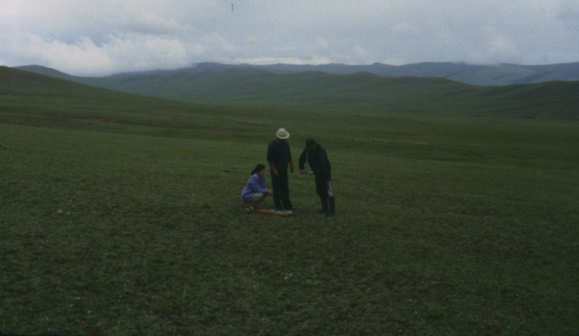
Soil moisture observations in Mongolia, 1999

Slide 9
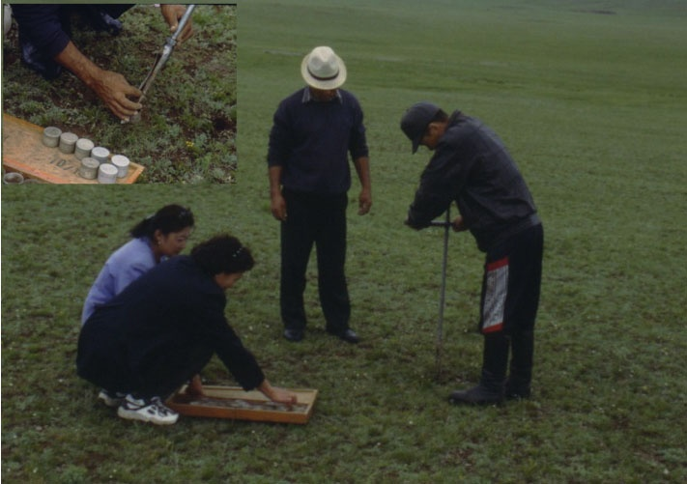

Slide 10
Boissy-le-Châtel
Hydrological station in the Orgeval catchment of the Seine Basin at 48.8°N, 3.1°E.
Twice daily soil moisture reading at 11 levels, from November 1996 - present
Uses TDR probe to measure soil moisture, which is calibrated with gravimetric readings.
(cm)

Slide 11
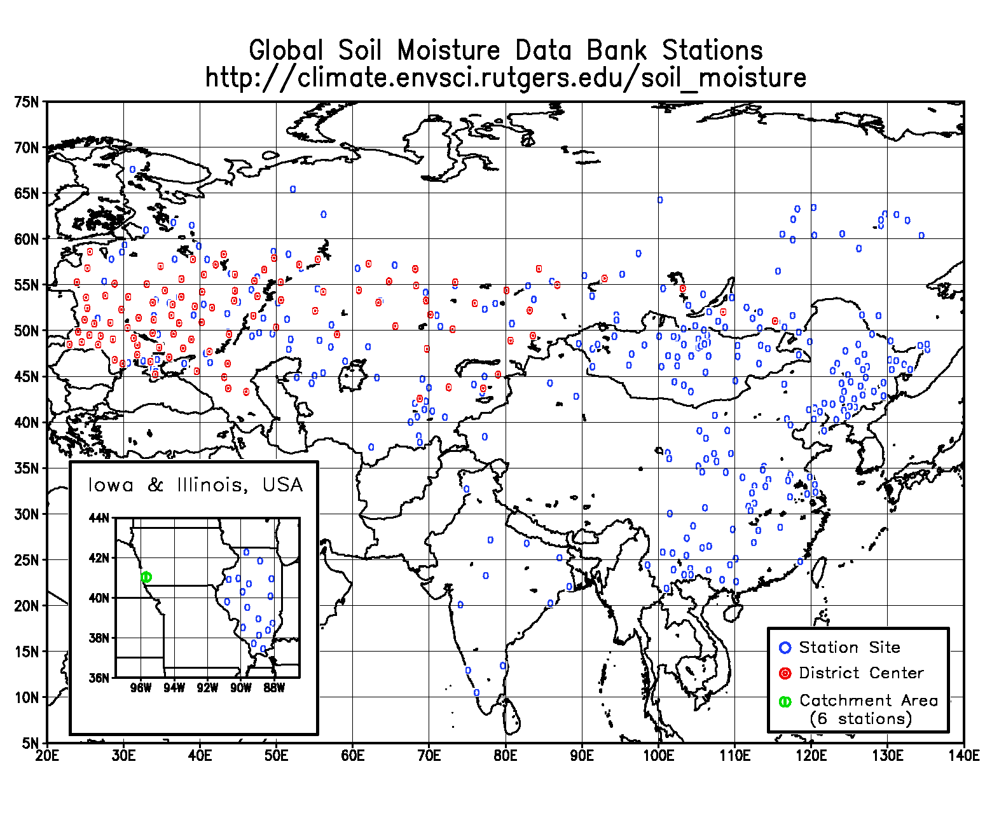
Ukraine: Now updated through 2004
Russia: Now being updated through 2003
Mongolia: Now updated through 2003
China: Now updated through 1999
India: Now updated through 1999
Data have been transitioned to the International Soil Moisture Network, http://ismn.geo.tuwien.ac.at/ismn/

Slide 12
Eurasian soil moisture data available at the International Soil Moisture Network, http://ismn.geo.tuwien.ac.at/ismn/

Slide 13
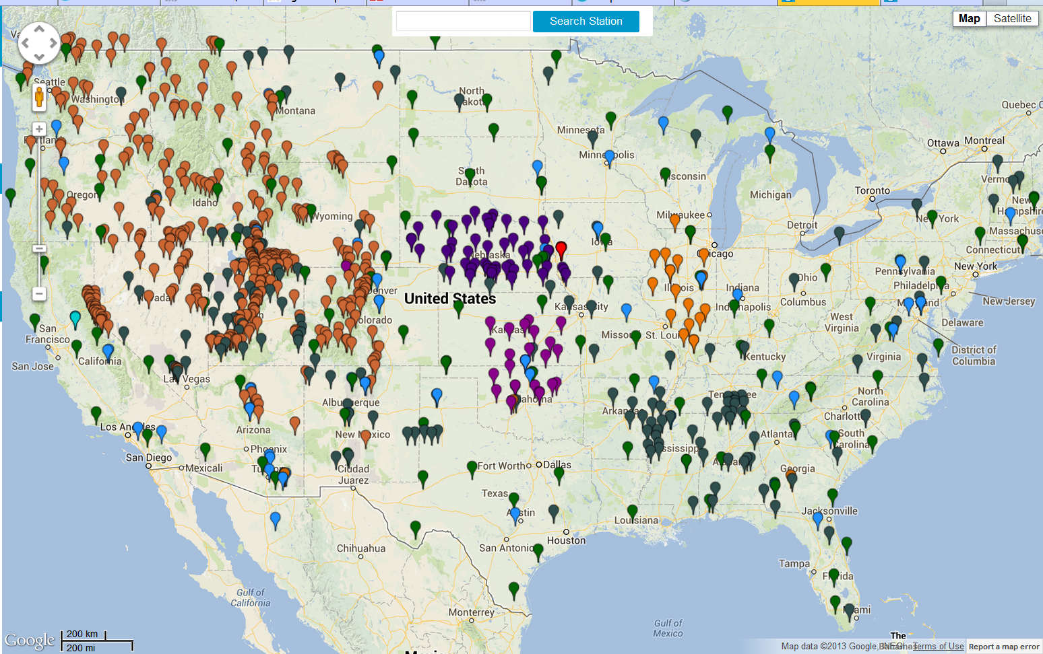
U.S. soil moisture data available at the International Soil Moisture Network, http://ismn.geo.tuwien.ac.at/ismn/

Slide 14
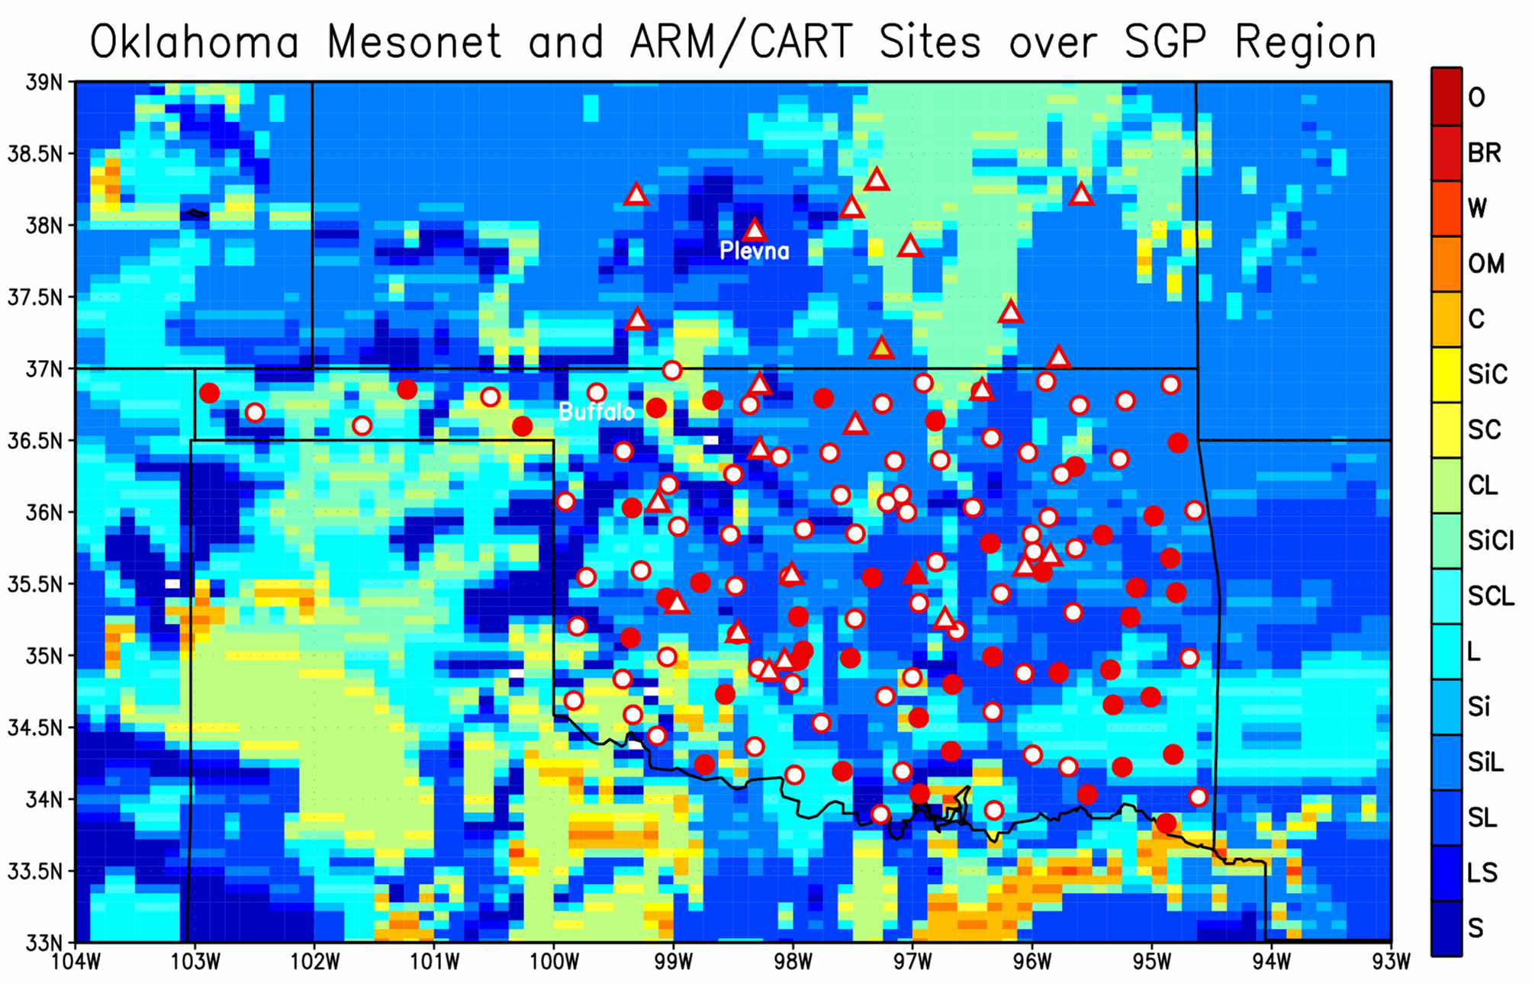
ARM/CART
Mesonet
Mesonet with soil moisture and soil temperature observations
In addition, the Oklahoma Mesonet has more than 100 stations. All now include soil moisture observations.

