Slide 1
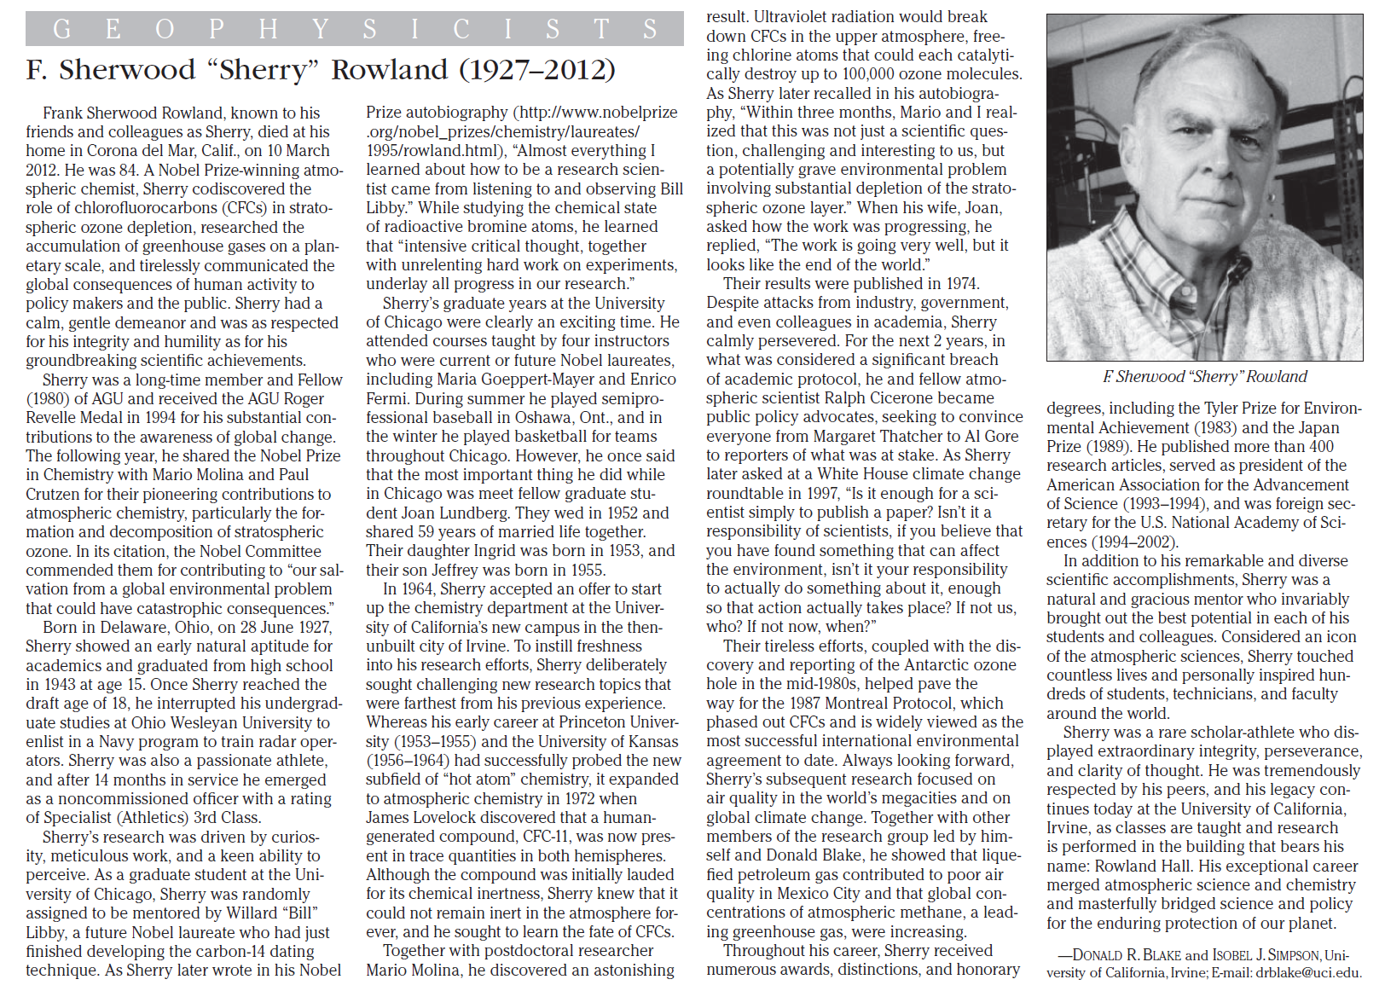
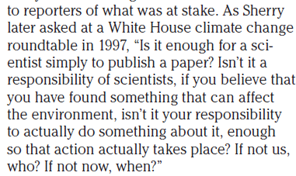
Eos, volume 93, number 41, October 9, 2012

Slide 2
Climatic Consequences and Agricultural Impact of Regional Nuclear Conflict
Alan Robock¹
Michael Mills², Owen Brian Toon³, and Lili Xia¹
¹Rutgers University, New Brunswick, New Jersey
²National Center for Atmospheric Research, Boulder, Colorado
³University of Colorado, Boulder
robock@envsci.rutgers.edu
Notes:
This presentation shows the environmental effects of both regional and arge-scale nuclear wars.
The greatest environmental threat in the world is the potential for nuclear winter. The current nuclear arsenal is still large enough to produce nuclear winter. Nuclear winter is still the accepted theory to predict the global environmental consequences of a nuclear holocaust.
More people would die in regions far removed from the targets than in the targeted regions.
Even a “smalll” nuclear war between India and Pakistan would produce climate change unprecedented in human history.

Slide 3
http://www.agu.org/journals/rg/
Reviews of Geophysics distills and places in perspective previous scientific work in currently active subject areas of geophysics. Contributions evaluate overall progress in the field and cover all disciplines embraced by AGU.
Authorship is by invitation, but suggestions from readers and potential authors are welcome. If you are interested in writing an article please talk with me, or write to reviewsgeophysics@agu.org, with an abstract, outline, and explanation of how the paper fits the goals of the journal.
Reviews of Geophysics has an impact factor of 12.364 in the 2011 Journal Citation Reports, highest in the geosciences.

Slide 4
This presentation is based on the following papers:
Mills, Michael J., Owen B. Toon, Richard P. Turco, Douglas E. Kinnison, and Rolando R. Garcia, 2008: Massive global ozone loss predicted following regional nuclear conflict. Proc. National Acad. Sci., 105, 5307–5312.
Özdoğan, Mutlu, Alan Robock, and Christopher Kucharik, 2013: Impacts of a nuclear war in South Asia on soybean and maize production in the Midwest United States. Climatic Change, 116, 373-387, doi:10.1007/s10584-012-0518-1.
Robock, Alan, 2011: Nuclear winter is a real and present danger. Nature, 473, 275-276.
Robock, Alan, Luke Oman, Georgiy L. Stenchikov, Owen B. Toon, Charles Bardeen, and Richard P. Turco, 2007: Climatic consequences of regional nuclear conflicts. Atm. Chem. Phys., 7, 2003-2012.
Robock, Alan, Luke Oman, and Georgiy L. Stenchikov, 2007: Nuclear winter revisited with a modern climate model and current nuclear arsenals: Still catastrophic consequences. J. Geophys. Res., 112, D13107, doi:10.1029/2006JD008235.
Robock, Alan, Owen B. Toon, Richard P. Turco, Luke Oman, Georgiy L. Stenchikov, and Charles Bardeen, 2007: The continuing environmental threat of nuclear weapons: Integrated policy responses needed. EOS, 88, 228, 231, doi:10.1029/2007ES001816.
Robock, Alan, and Owen Brian Toon, 2010: Local nuclear war, global suffering. Scientific American, 302, 74-81.
Robock, Alan, and Owen B. Toon, 2012: Self-assured destruction: The climate impacts of nuclear war, Bull. Atomic Scientists, 68(5), 66-74, doi:10.1177/0096340212459127.
Toon, Owen B., Richard P. Turco, Alan Robock, Charles Bardeen, Luke Oman, and Georgiy L. Stenchikov, 2007: Atmospheric effects and societal consequences of regional scale nuclear conflicts and acts of individual nuclear terrorism. Atm. Chem. Phys., 7, 1973-2002.
Toon, Owen B., Alan Robock, Richard P. Turco, Charles Bardeen, Luke Oman, and Georgiy L. Stenchikov, 2007: Consequences of regional-scale nuclear conflicts. Science, 315, 1224-1225.
Toon, Owen B., Alan Robock, and Richard P. Turco, 2008: Environmental consequences of regional and global nuclear war in the 21st century. Physics Today, 61, No. 12, 37-42.
Xia, Lili, and Alan Robock, 2013: Impacts of a nuclear war in South Asia on rice production in mainland China. Climatic Change , 116, 357-372, doi: 10.1007/s10584-012-0475-8.
http://climate.envsci.rutgers.edu/~nuclear
Notes:
These and other papers on the policy implications can be downloaded at http://climate.envsci.rutgers.edu/nuclear

Slide 5

This presentation is dedicated to Carl Sagan (1934-1996), who did more than anyone else to warn the planet of the dangers of nuclear winter, and who died much too young.
Notes:
This presentation is dedicated to Carl Sagan (1934-1996), who did more than anyone else to warn the planet of the dangers of nuclear winter, and who died much too young.
http://antwrp.gsfc.nasa.gov/apod/image/9612/sagan_uc_big.jpg

Slide 6
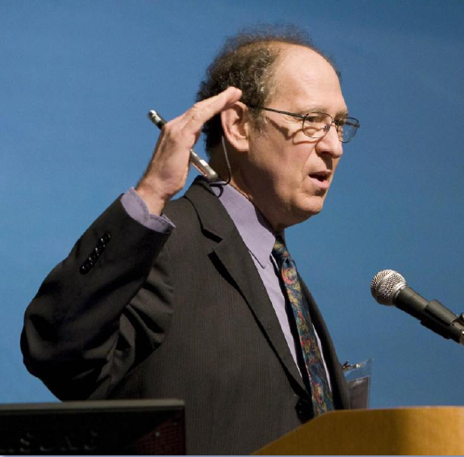
This presentation is also dedicated to Stephen Schneider (1945-2010), who helped warn the planet of the dangers of nuclear winter, and who also died much too young.
Photograph by Reed Hutchison at the Global Solutions/Climate Change Pavley-Waxman Hearing held at University of California at Los Angeles on August 21, 2009
Notes:
This presentation is dedicated to Carl Sagan (1934-1996), who did more than anyone else to warn the planet of the dangers of nuclear winter, and who died much too young.
http://antwrp.gsfc.nasa.gov/apod/image/9612/sagan_uc_big.jpg

Slide 7
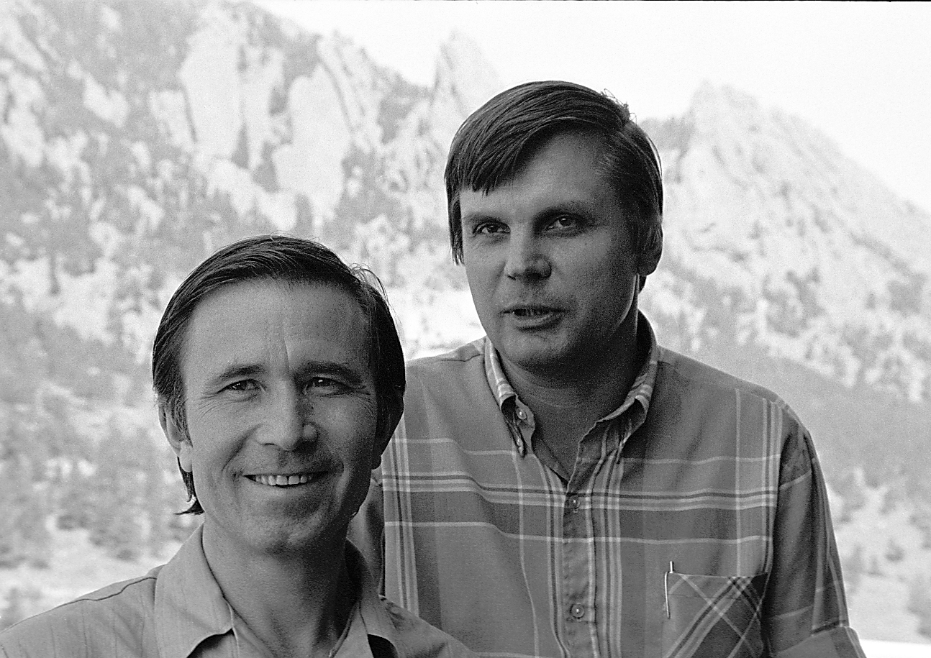
This presentation is also dedicated to Vladimir Aleksandrov (1938-1985?), who, with Georgiy Stenchikov, pioneered Soviet research on nuclear winter.
Vladimir Sergin and Vladimir Aleksandrov at NCAR, summer, 1978
Notes:
This presentation is dedicated to Carl Sagan (1934-1996), who did more than anyone else to warn the planet of the dangers of nuclear winter, and who died much too young.
http://antwrp.gsfc.nasa.gov/apod/image/9612/sagan_uc_big.jpg

Slide 8
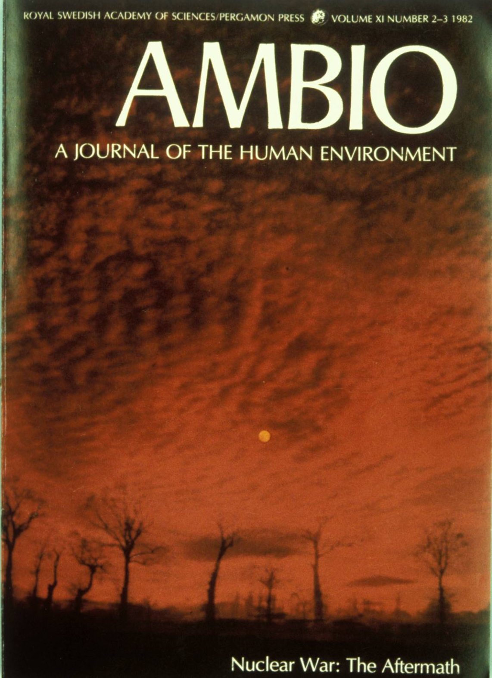
Paul Crutzen
and John Birks
discussed the effects of a nuclear holocaust on ozone.
They were the first to point out that there would be massive fires, and that the smoke from these fires could change climate.
Notes:
In 1982, the Swedish environmental journal, Ambio, commissioned an issue on the environmental effects of nuclear holocaust. Paul Crutzen, later to win the Noble Prize in Chemistry for his work on the discovery of the mechanisms of ozone depletion, and John Birks wrote an article on the effects of nuclear war on tropospheric air pollution. They pointed out that there would be massive emission of smoke from fires, and that it would block out so much sunlight that ozone formation in the troposphere, which requires ultraviolet sunlight, would be not an immediate serious problem. They also pointed out that this smoke would also affect climate, but did not calculate the amplitude of the climate effect.

Slide 9
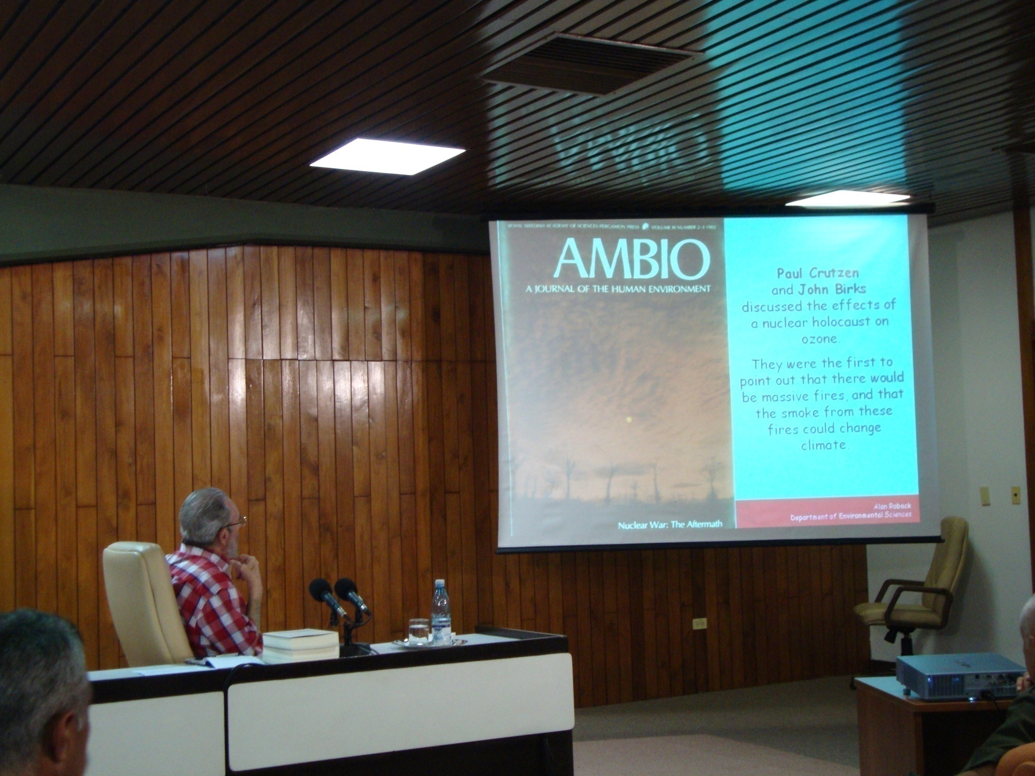

Slide 10
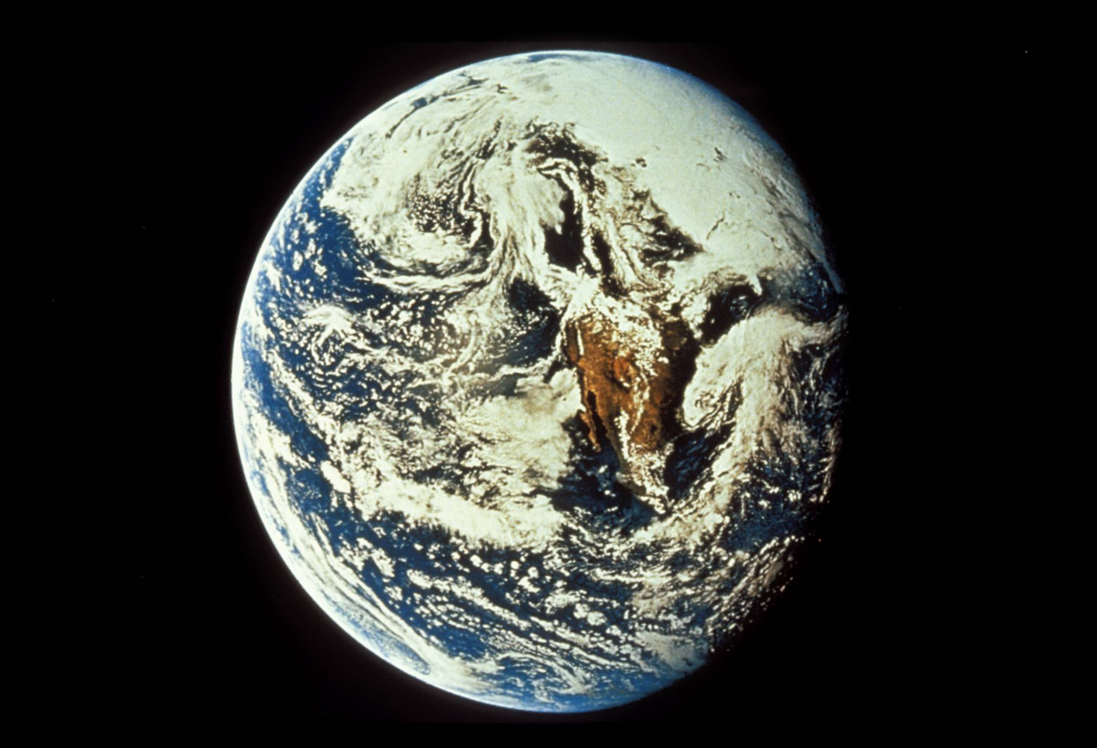
Notes:
An Apollo 10 view of Earth (May 18, 1969) from 26,000 nautical miles photographed from the spacecraft during its journey toward the Moon. You can see Mexico and Baja California in the center of the image. Above that, clouds cover most of the US, producing needed rainfall for the crops that are growing that year.
Photo courtesy of NASA (AS10-34-5013).

Slide 11
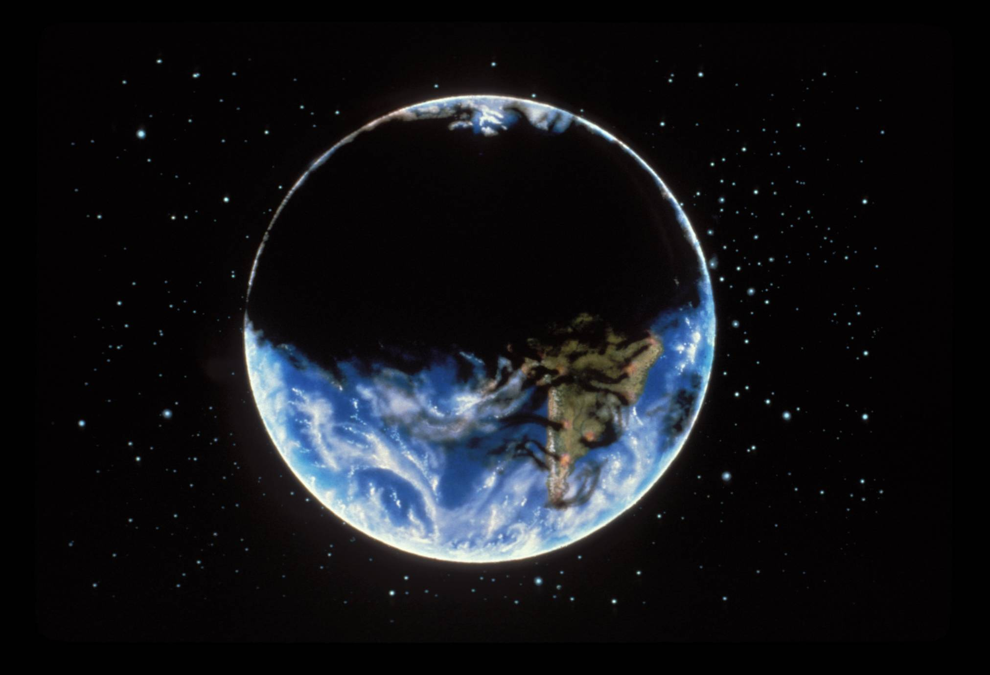
Illustration by Jon Lomberg
Notes:
This is what the world would look like, however, after a large-scale nuclear holocaust. Thick clouds of smoke from the resulting fires would initially cover the Northern Hemisphere, making it cold and dark at the Earth’s surface.
Image used by permission of the National Resources Defense Council.

Slide 12

Illustration by Jon Lomberg

Slide 13
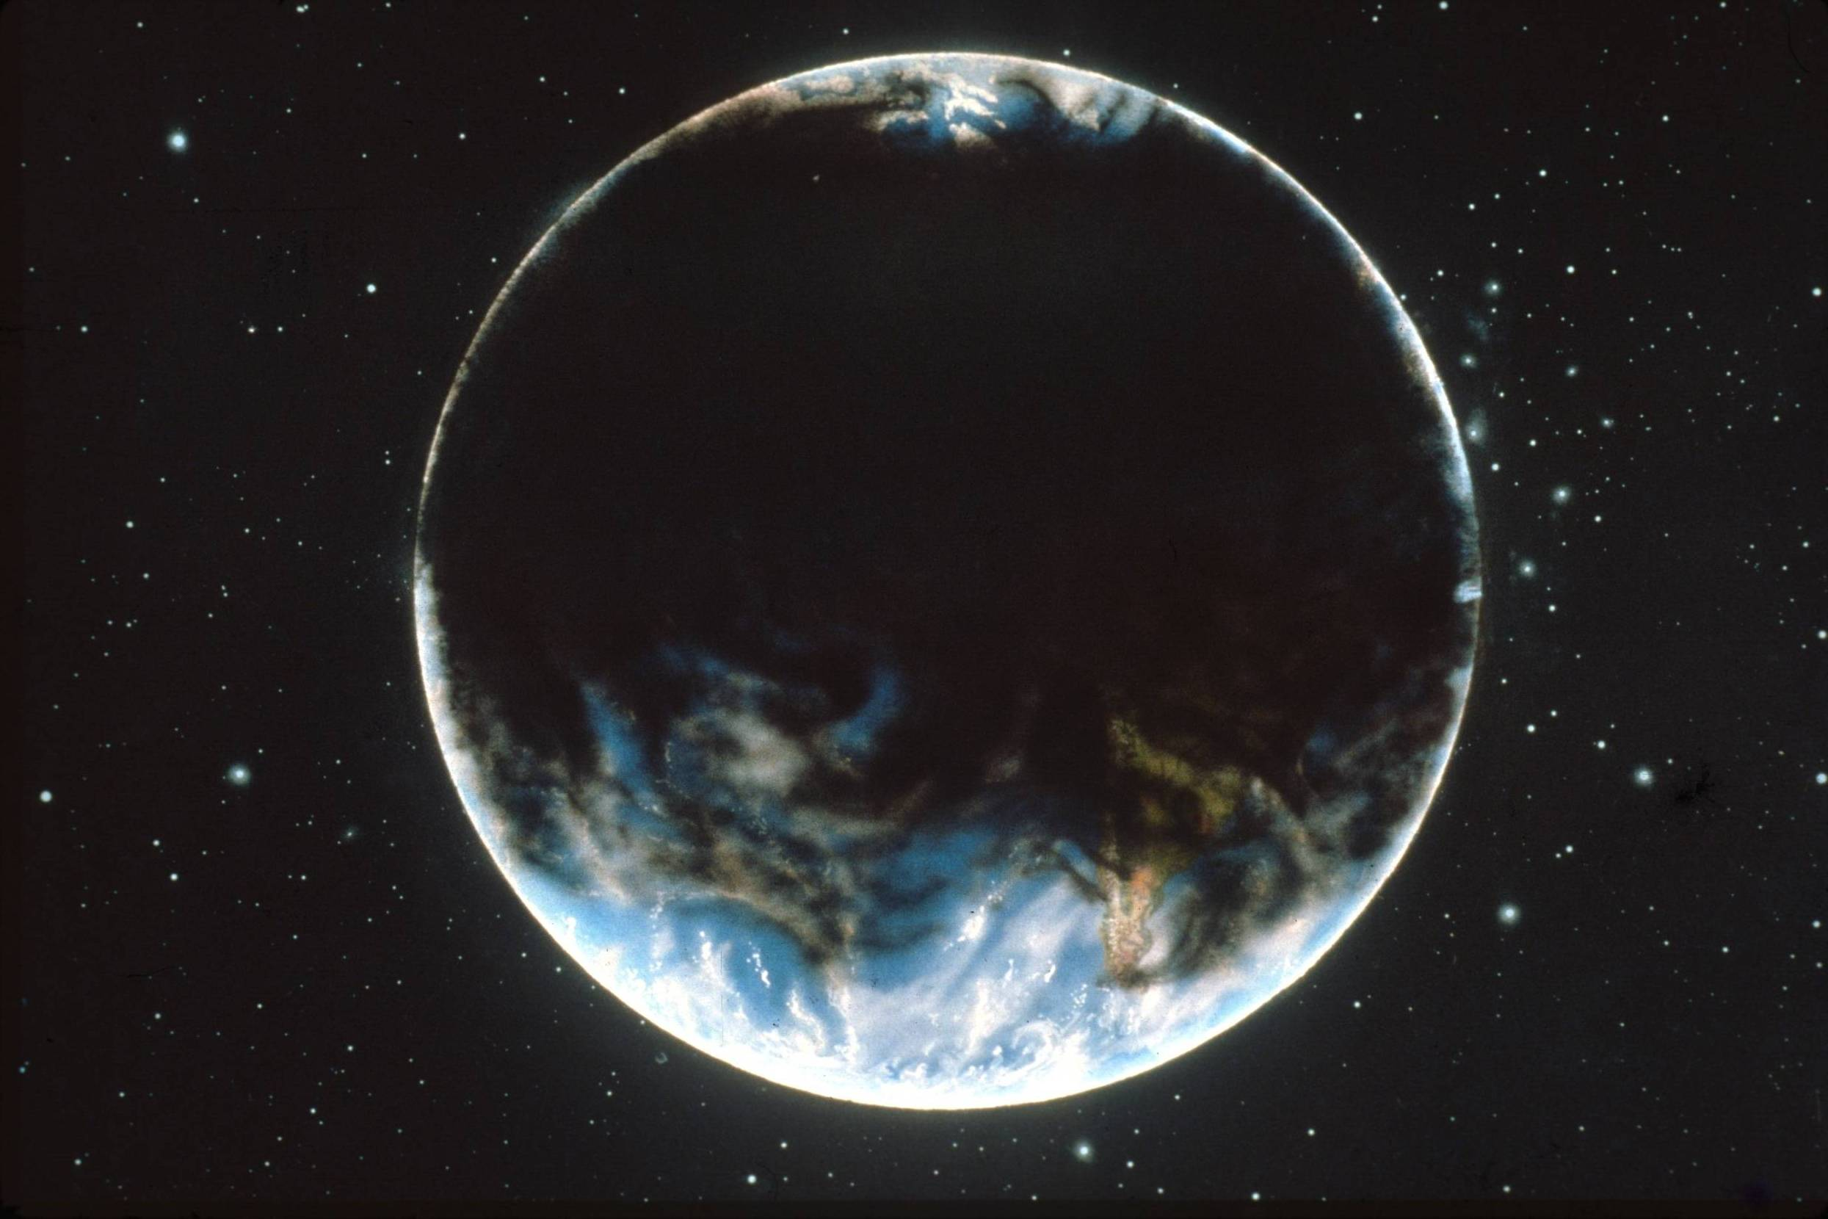
Illustration by Jon Lomberg

Slide 14
Nuclear Holocaust
Cities burn Ground bursts
Massive amounts of smoke Massive amounts of dust
Sunlight absorbed Sunlight reflected
Very little sunlight reaches the ground
Rapid, large surface temperature drops
“Nuclear Winter”
Notes:
The basic theory of nuclear winter is very simple. A nuclear holocaust would have two types of targets, “countervalue” (cities) and “counterforce” (military bases, missile silos on the ground), which would produce different types of particles in the atmosphere. Smoke from burning cities would absorb incoming sunlight heating the atmosphere. Dust from ground bursts would reflect sunlight back to space. But both would prevent sunlight from penetrating the atmosphere, making it cold and dark at the Earth’s surface. These rapid, large surface temperature drops would make it as cold at the surface in the summer as it gets in the winter.

Slide 15
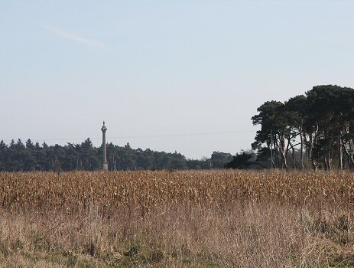
Nuclear Winter
Cold, dry, dark, and more UV
CROPS DYING and GLOBAL FAMINE
Notes:
Image from http://upload.wikimedia.org/wikipedia/commons/6/65/Maize_crop_on_the_Elveden_Estate_-_geograph.org.uk_-_715920.jpg

Slide 16
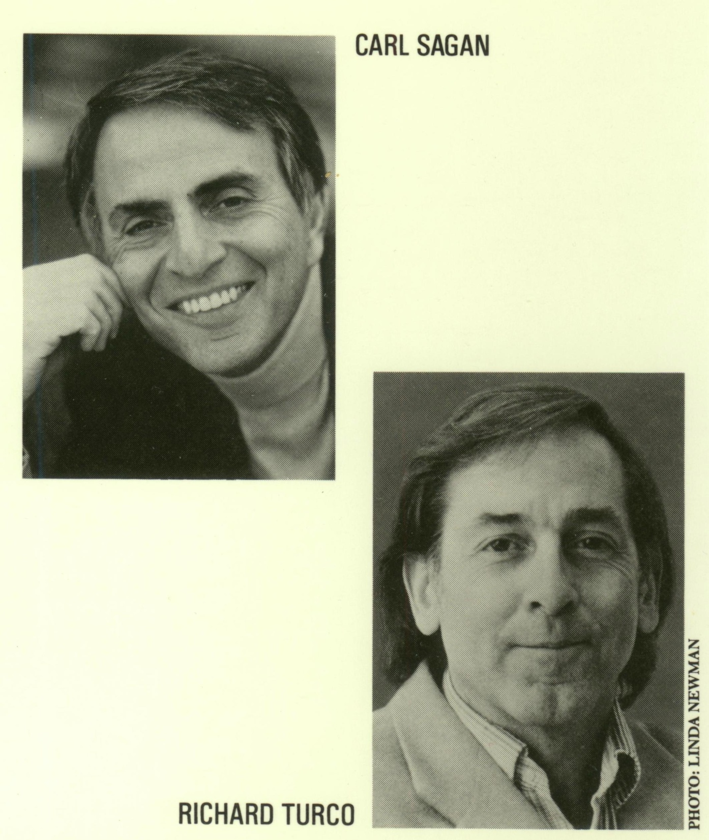
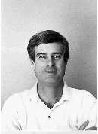

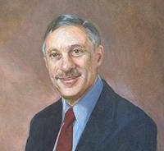
BRIAN TOON
TOM ACKERMAN
JIM POLLACK
Notes:
These are the authors of the famous TTAPS paper. Photos of Sagan and Turco are from the jacket cover of their book, A Path Where No Man Thought: Nuclear Winter and the End of the Arms Race (1990).
Toon: http://lasp.colorado.edu/planetary/faculty/briantoon.gif
Ackerman: http://picturethis.pnl.gov/im2/03090041-1cn_Tom_Ackerman0/03090041-1cn_Tom_Ackerman.tif
Pollack: Oil portrait - http://ails.arc.nasa.gov/Images/Historical/jpegs/AC88-0327-3_a.jpeg from http://ails.arc.nasa.gov/Images/Historical/AC88-0327-3.html

Slide 17
TTAPS
Richard Turco, Brian Toon, Tom Ackerman, Jim Pollack, and Carl Sagan, 1983: Nuclear winter: Global consequences of multiple nuclear explosions, Science, 222, 1283-1292.
The famous TTAPS paper – one of the two first climate model simulations of nuclear winter.
Gave Nuclear Winter its name.
Used a single column radiative-convective climate model which represented the entire Northern Hemisphere by one column and calculate the vertical distribution of temperature change for annual average radiation out to 300 days.
Notes:
This paper was published just after a Russian paper by Aleksandrov and Stenchikov which got similar results. Publicity from these results made nuclear winter well-known in the US and elsewhere.

Slide 18
Notes:
TTAPS calculated the climatic effects of several different scenarios. Their baseline case was 1/3 of the then current nuclear arsenal. They also included an attack where 100 kT weapons were used against the 1000 largest cities on the planet.

Slide 19
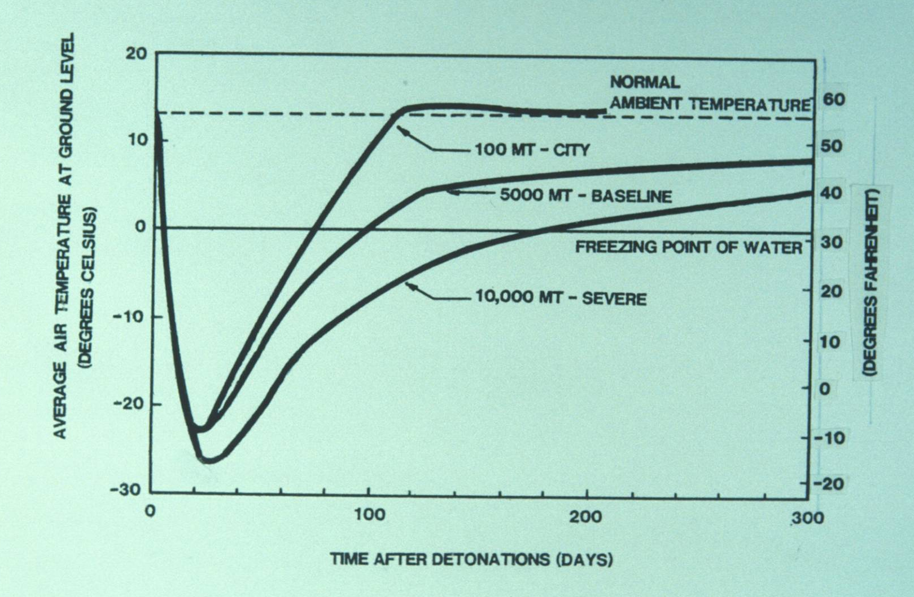
Notes:
These are the global average surface temperature changes for the TTAPS calculations. Now matter what the scenario, the surface temperature rapidly plunges below freezing and stays there for 2-3 months. The baseline and severe cases include dust which is lofted higher in the atmosphere and stays longer, producing a longer-lasting effect.

Slide 20
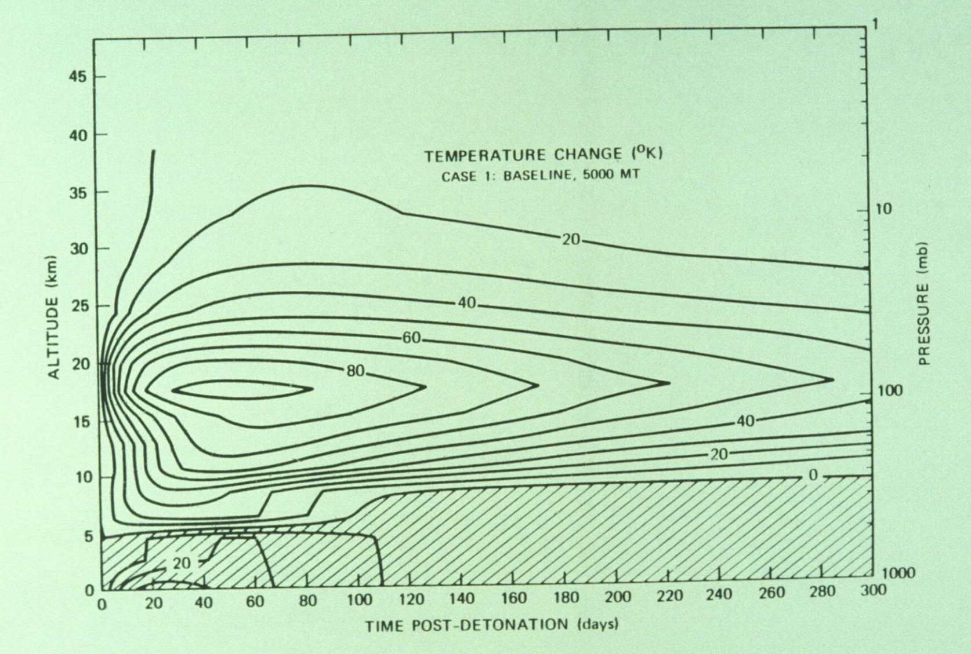
Notes:
This shows the vertical distribution of the temperature change for the baseline case. The upper atmosphere gets much warmer due to the absorption of sunlight by the dark smoke. But because little sunlight reaches the surface, the surface layers cool (shaded region).

Slide 21
Vladimir V. Aleksandrov and Georgiy L. Stenchikov, 1983: On the modelling of the climatic consequences of the nuclear war. Proc. Applied Math., Computing Centre, USSR Academy of Sciences, Moscow, 21 pp.
First published model simulation of nuclear winter.
First three-dimensional simulation using a general circulation model (GCM) – simulated 400 days with annual average radiation.
Used two-level Mintz-Arakawa GCM, with 12ºx15º lat-lon grid.
Notes:
The first nuclear winter paper to be published was by Vladimir V. Aleksandrov and Georgiy L. Stenchikov.

Slide 22
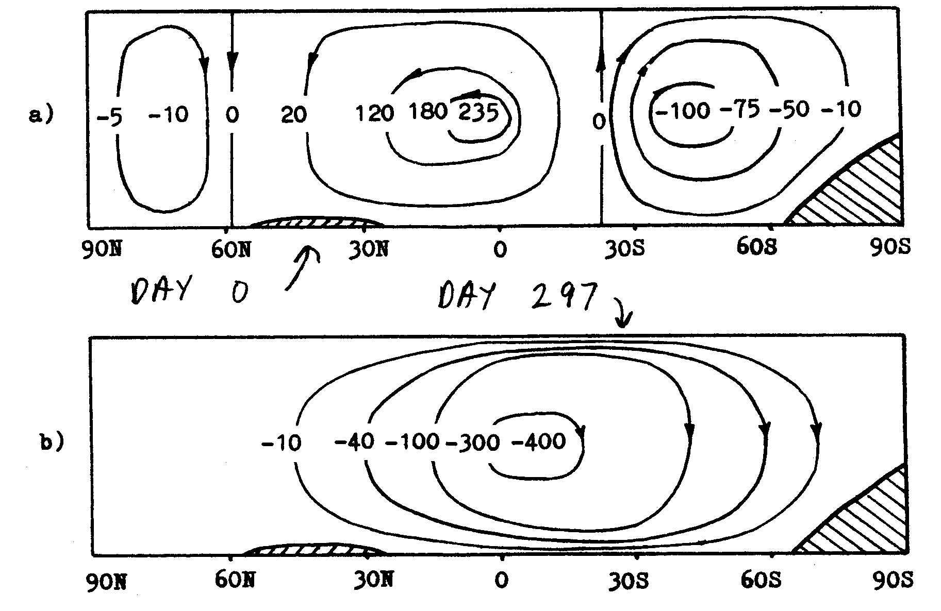
Streamfunction of zonally averaged mass flux [10¹² g s⁻¹]
Notes:
This figure shows how the normal Hadley Cell circulation in the atmosphere would be changed to a global scale circulation, which would transport the smoke and dust generated in the Northern Hemisphere into the remote Southern Hemisphere.

Slide 23
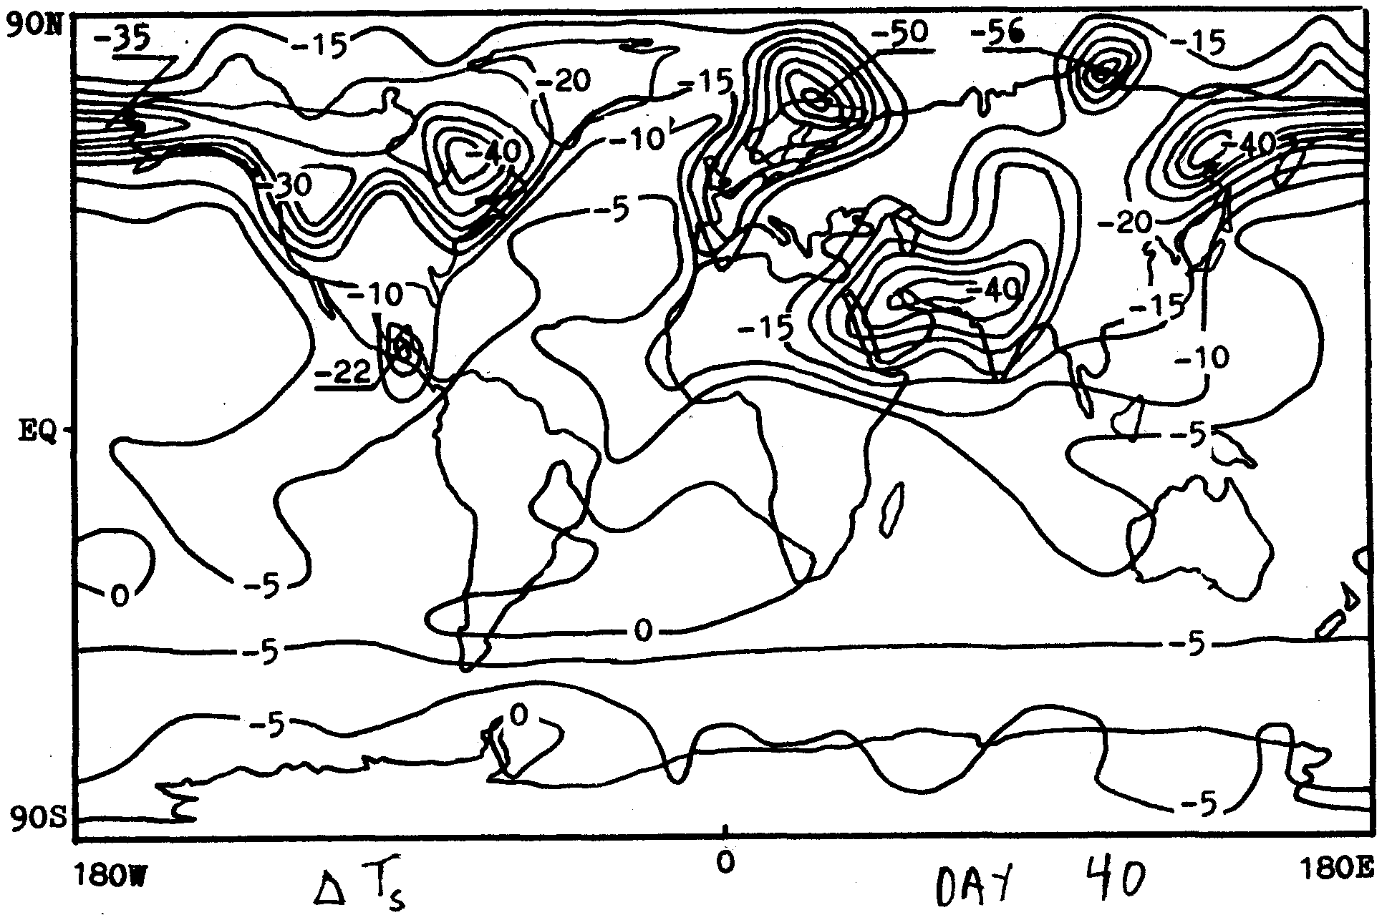
[K]
Notes:
These are surface temperature effects, showing dramatic cooling over continents 40 days after the initial smoke injection.

Slide 24
Robock, Alan, 1984: Snow and ice feedbacks prolong effects of nuclear winter. Nature, 310, 667-670.
Used an energy balance climate model and showed that snow and ice feedbacks prolong the surface temperature effects for several years.
Did simulations for nuclear holocaust starting in all four seasons.
Notes:
All the previous calculations were very short or did not go through the seasonal cycle. None had included ocean feedbacks or been calculated for more than one year. I used an energy balance model and found that ice and snow feedbacks would prolong the effects for several years.

Slide 25
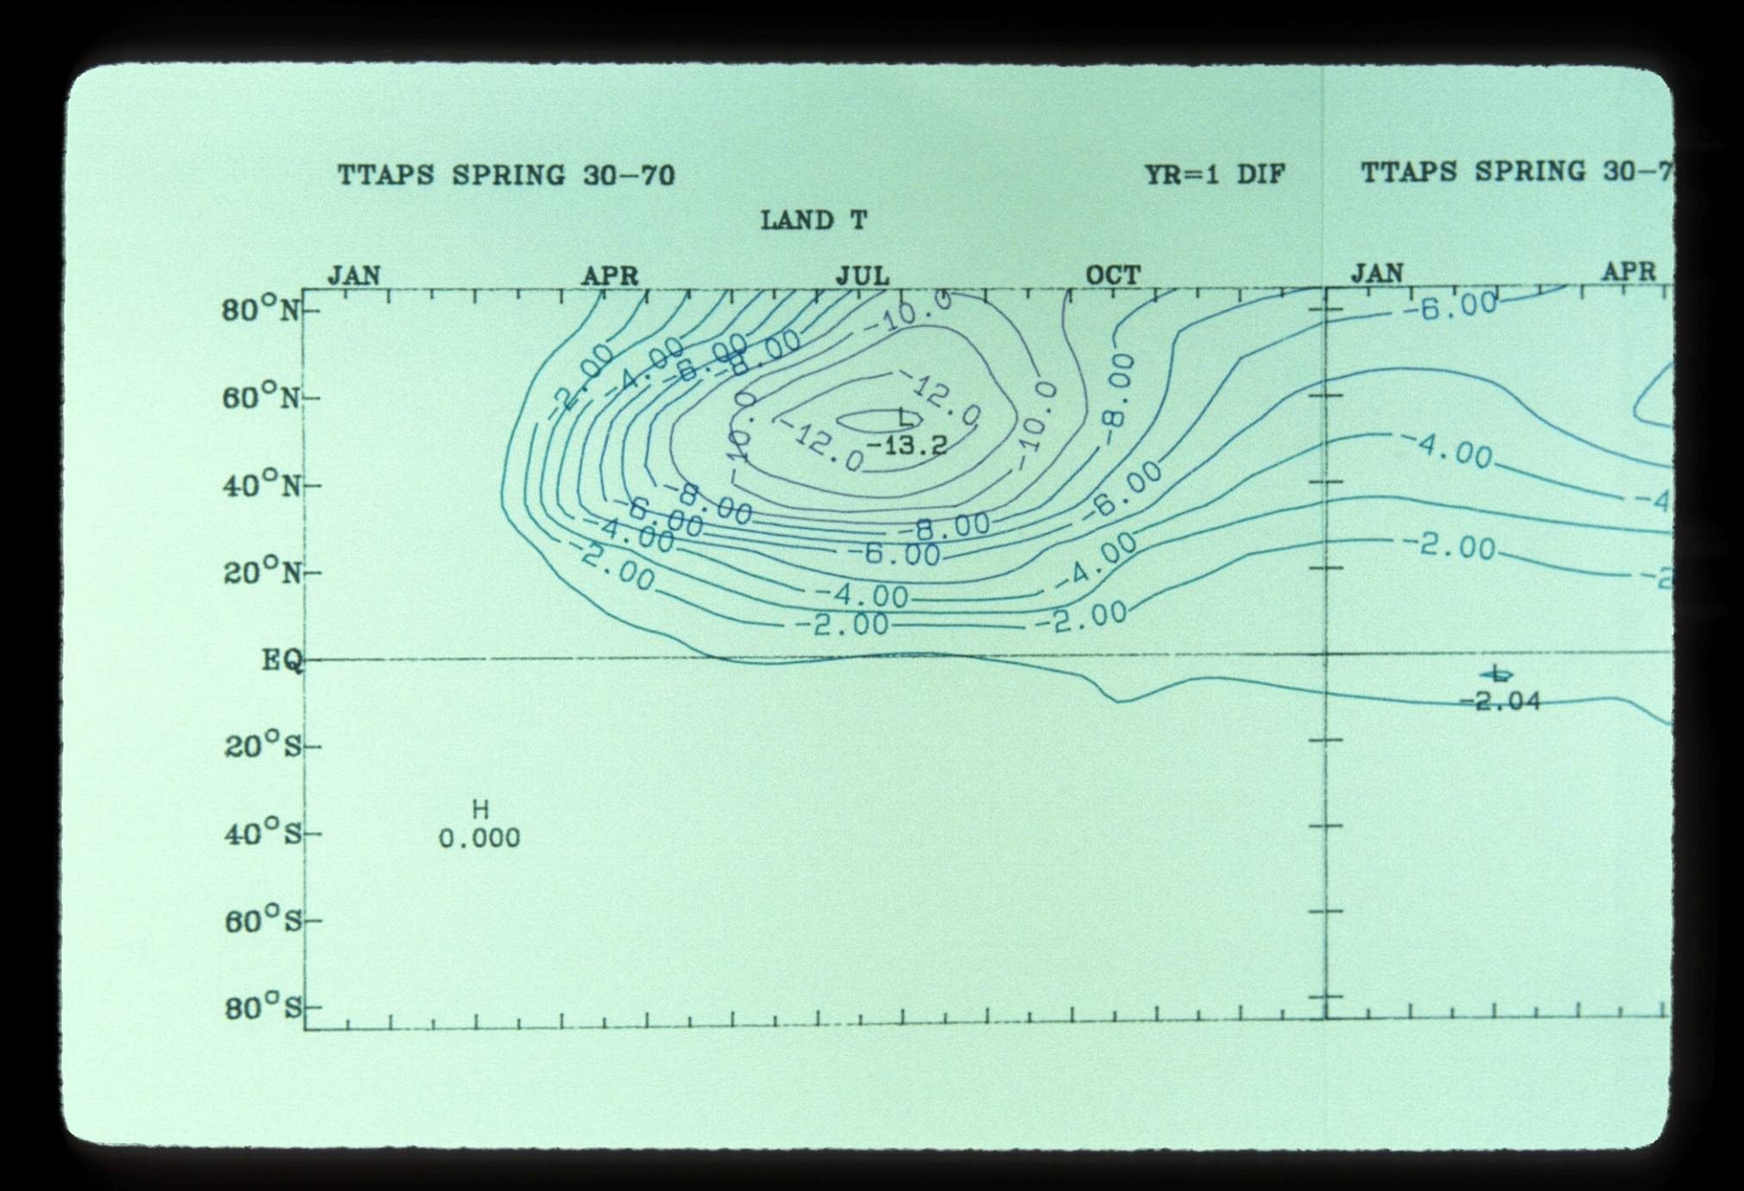
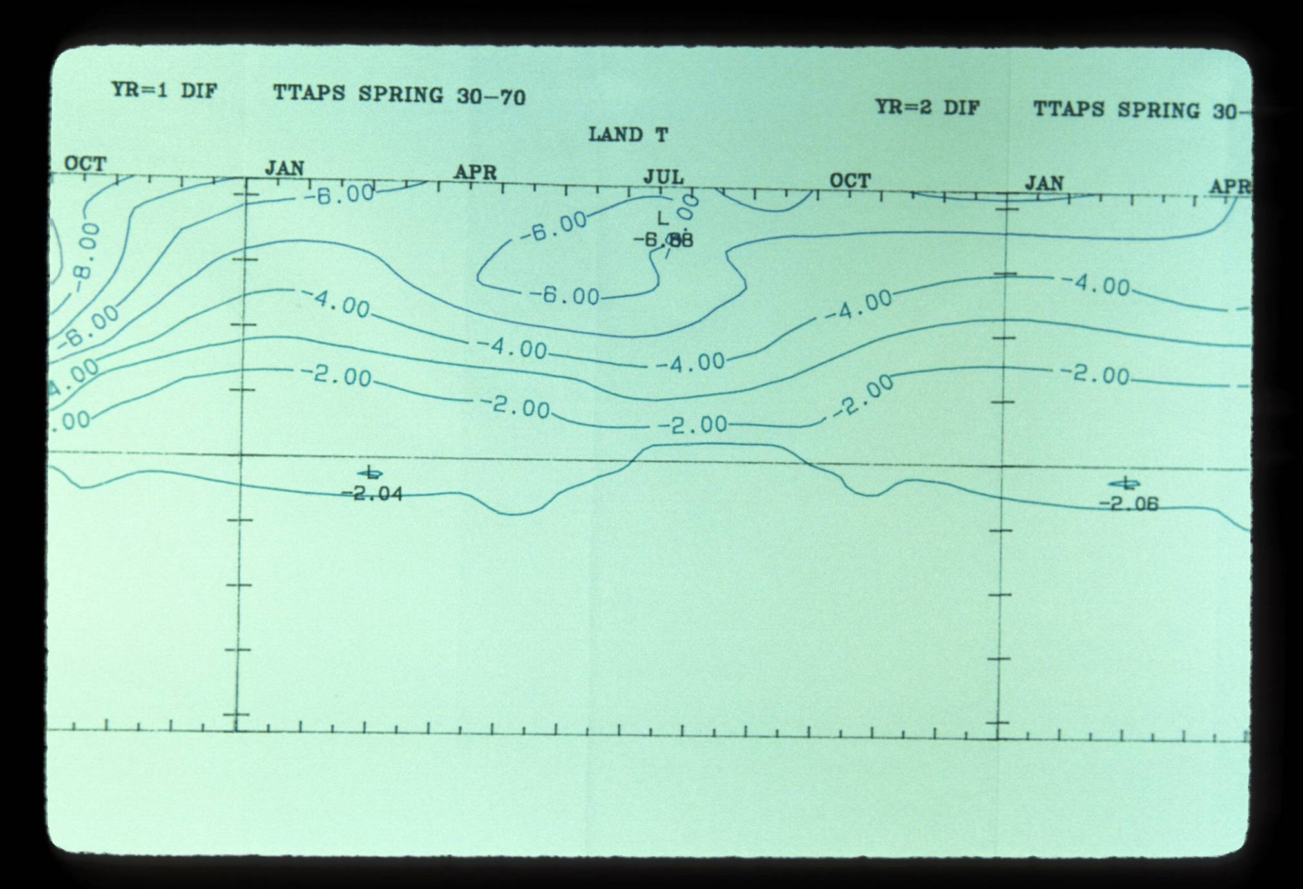
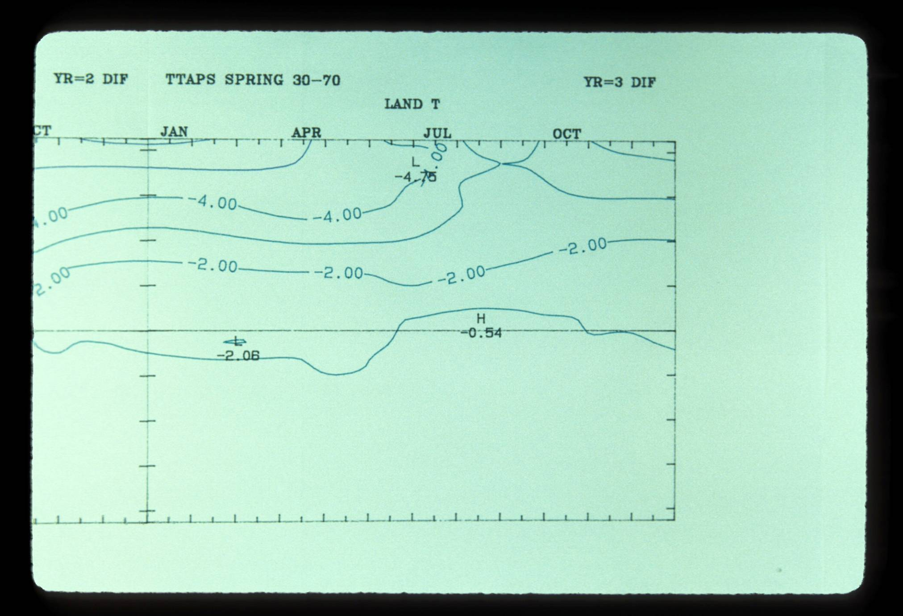
Snow-albedo feedback
Notes:
Even in the second summer after the holocaust, surface air temperatures over land would be more than 6°C (11°F) colder than normal. It is hard to imagine agriculture under those conditions.

Slide 26
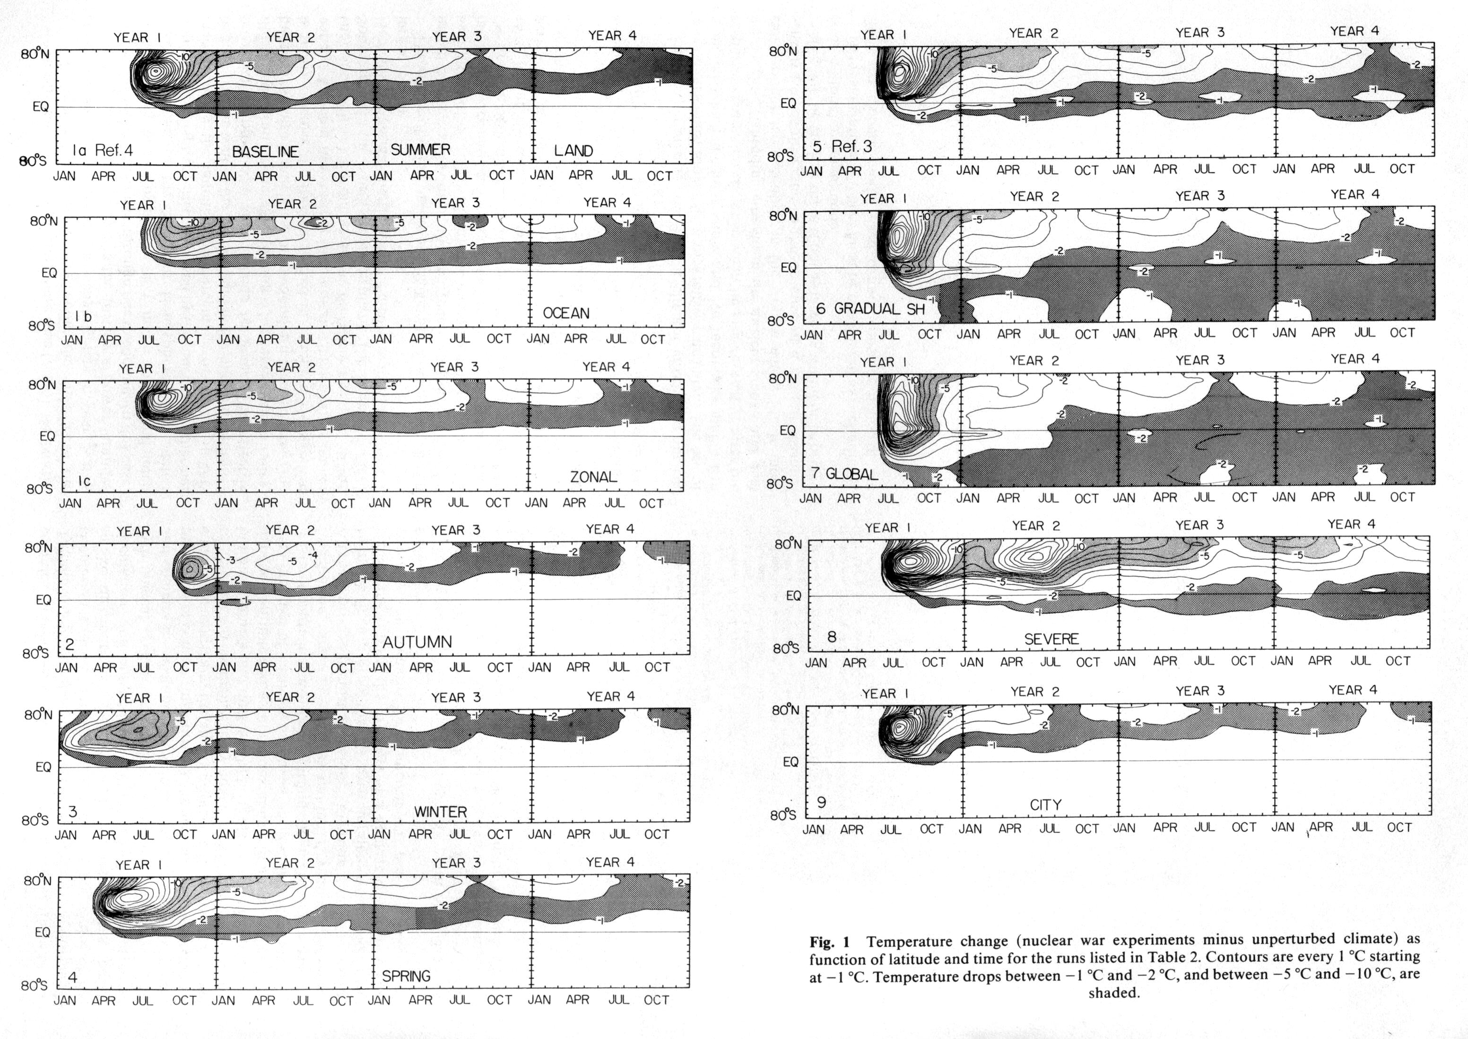
Notes:
The calculations were done for a large number of different cases, as listed in the captions here.

Slide 27
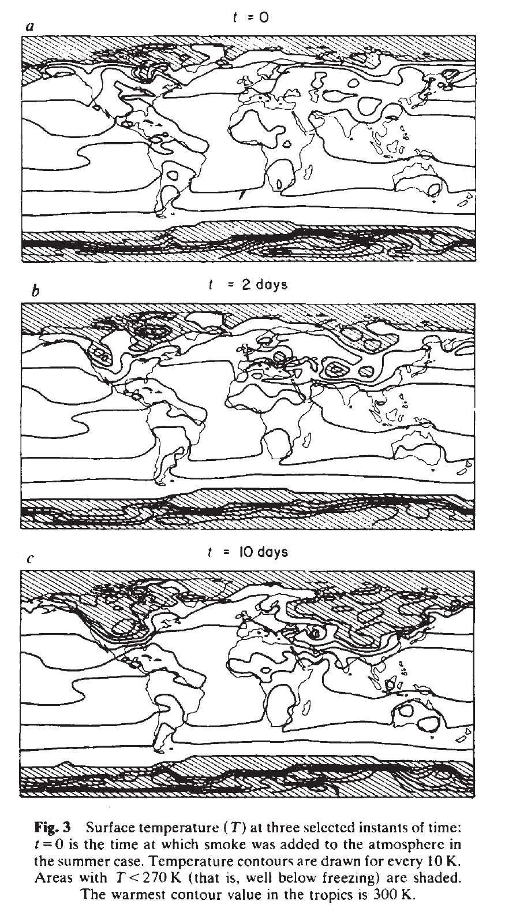
Curt Covey, Steve Schneider, and Starley Thompson, 1984: Global atmospheric effects of massive smoke injections from nuclear war: Results from general circulation model simulations. Nature, 308, 21-25.
Used NCAR GCM to simulate the temperature effects for 20 days for winter, spring, and summer conditions.
Notes:
An American group subsequently conducted a nuclear winter simulation with a three-dimensional climate model. They produced better-looking graphics, which illustrate the temperature effects.

Slide 28
Thompson, Starley L., 1985: Global interactive transport simulations of nuclear war smoke, Nature, 317, 35-39.
Used NCAR GCM to simulate the temperature effects for 20 days for winter, spring, and summer conditions.
Notes:
An American group subsequently conducted a nuclear winter simulation with a three-dimensional climate model. They produced better-looking graphics, which illustrate the temperature effects.

Slide 29
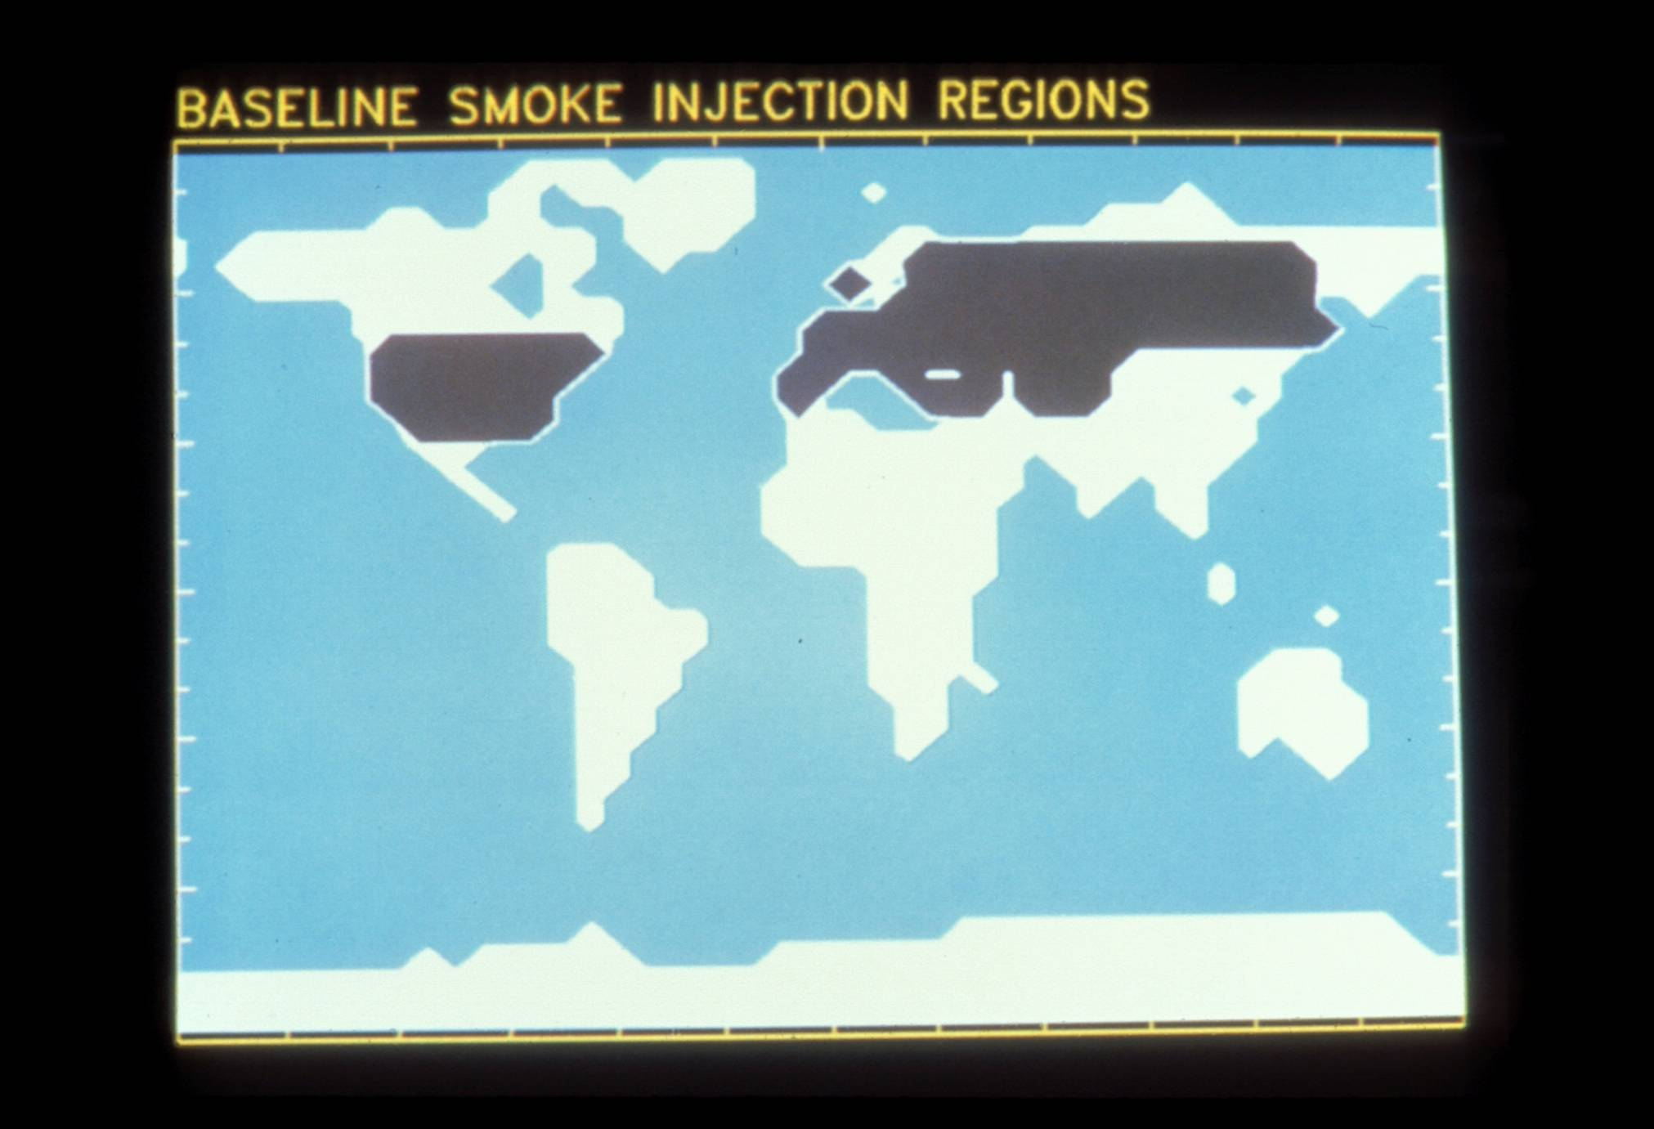
Notes:
These are the regions of smoke injection. Other experiments with injections in only one of the two regions produced similar results. In other words, if the US attacked Russia or Russia attacked the US, and there were no response, nuclear winter would still result.
Image used by permission of the National Resources Defense Council.

Slide 30
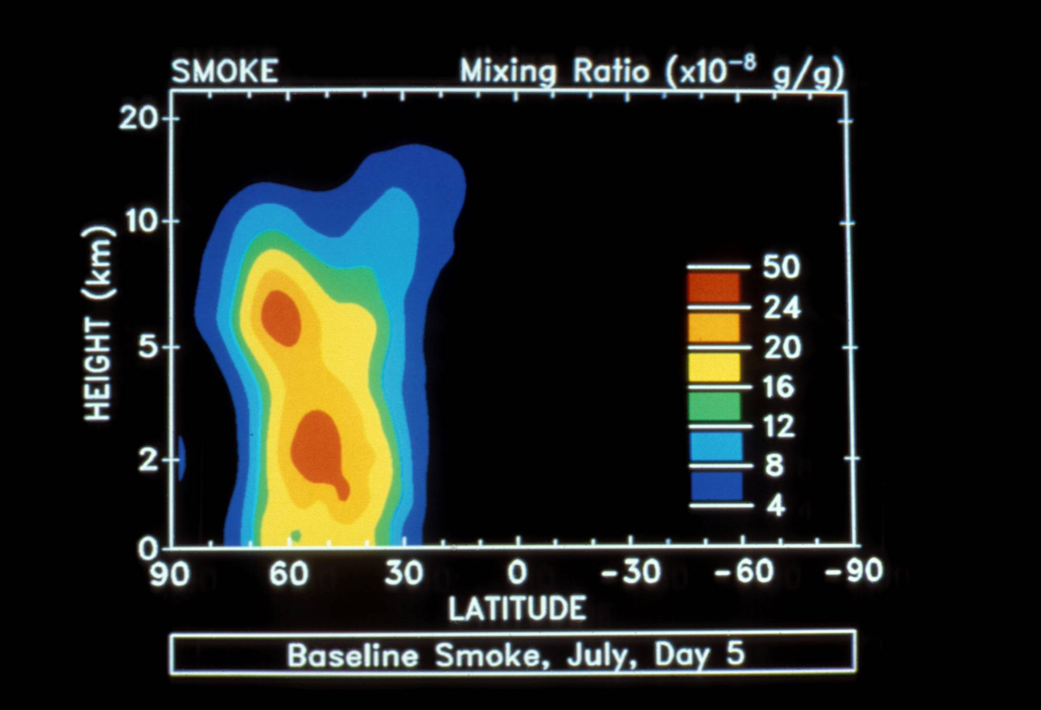
Notes:
This shows the smoke concentration as a function of height and latitude after 5 days for the summer case. Note that the smoke, which was initially injected only up to 7 km, is already starting to rise and head south.
Image used by permission of the National Resources Defense Council.

Slide 31
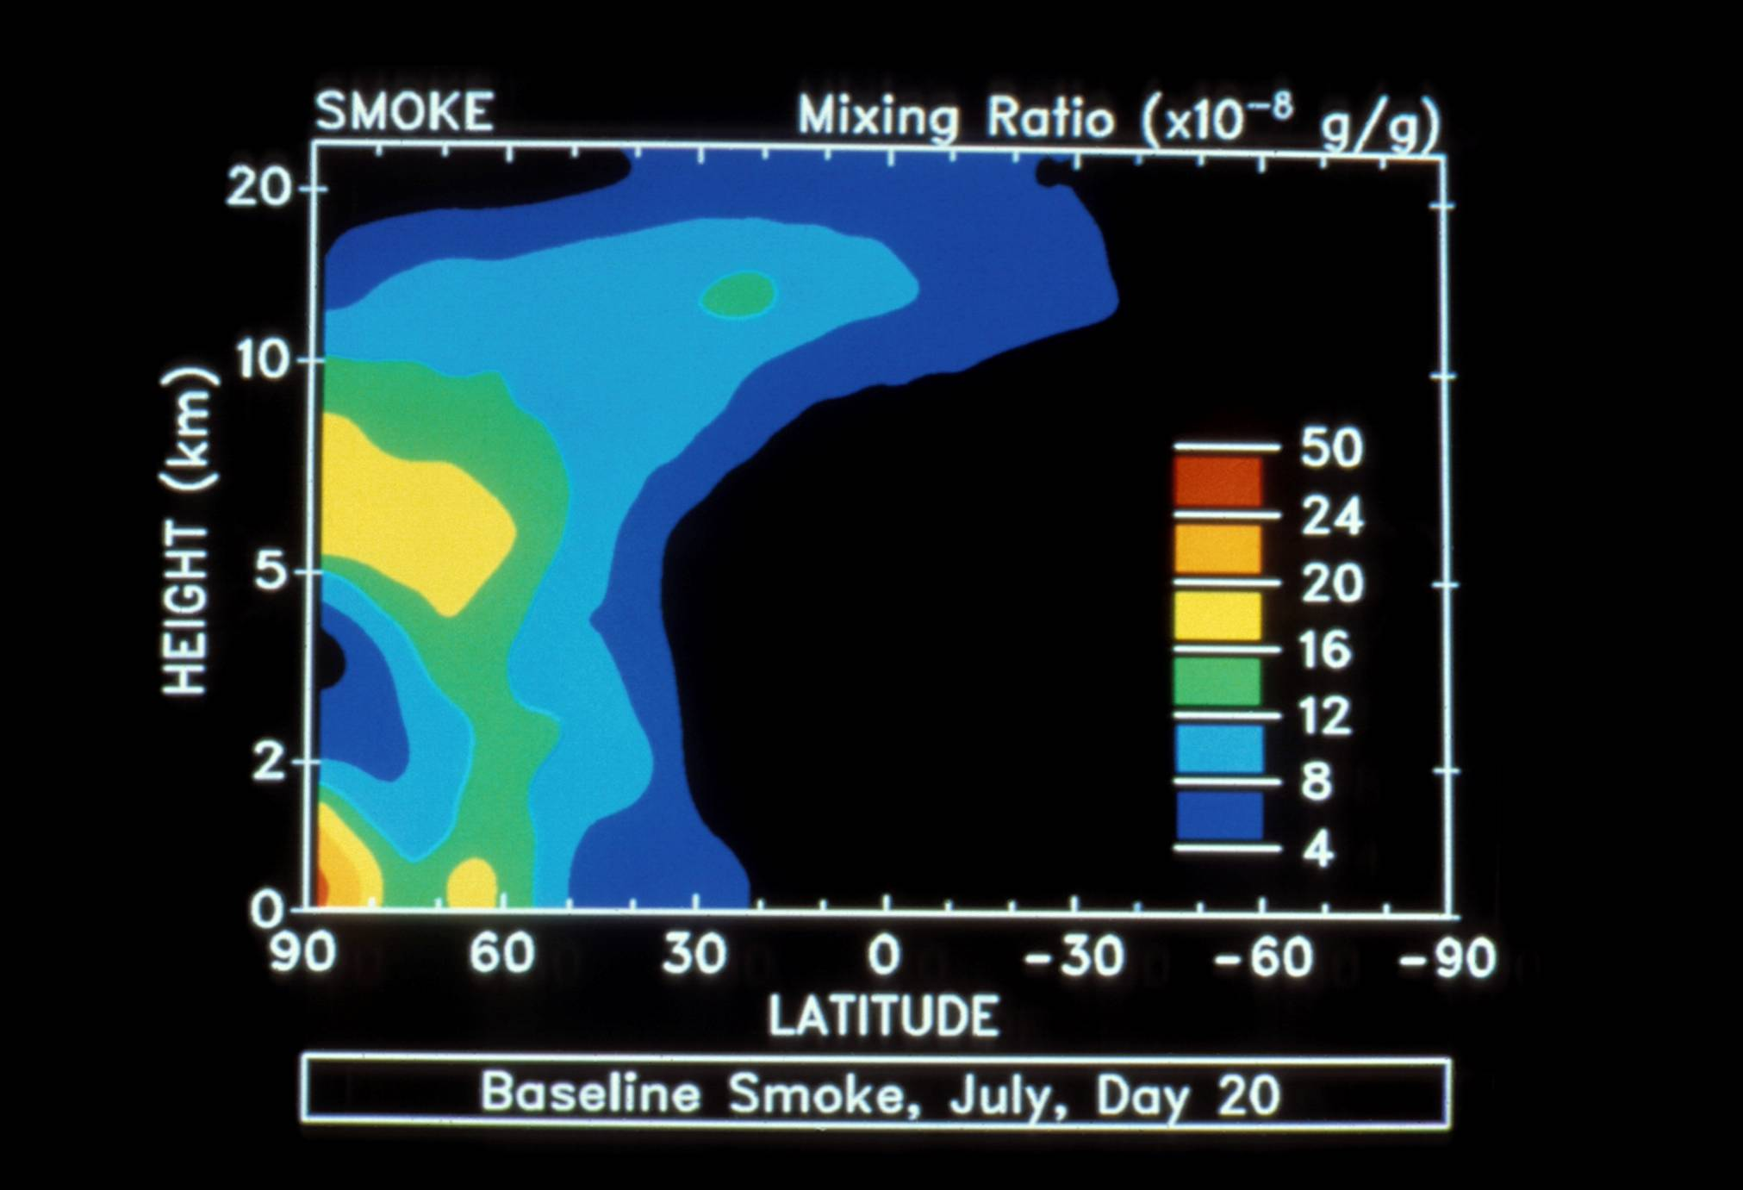
Notes:
After 20 days, substantial smoke has already crossed the Equator.
Image used by permission of the National Resources Defense Council.

Slide 32
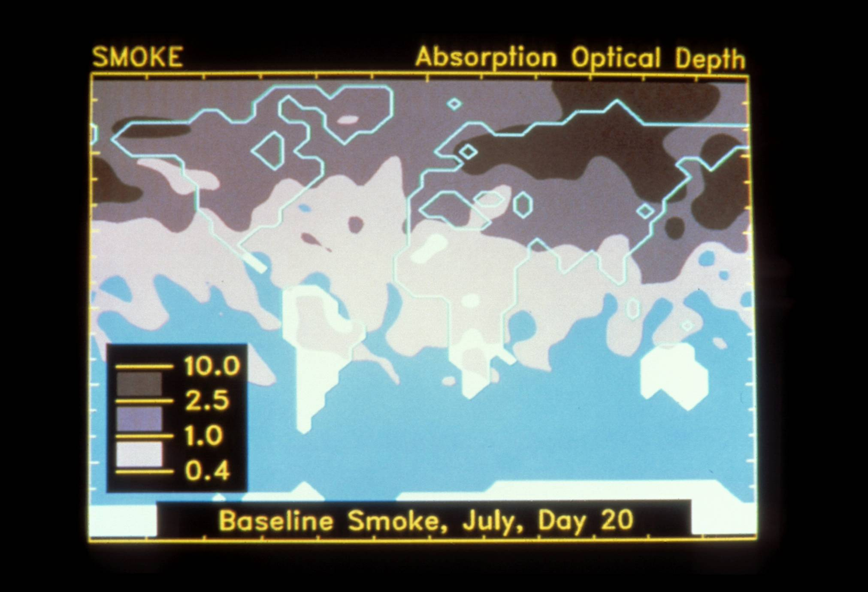
Light transmission
< 10%
< 40%
< 70%
Notes:
By Day 20, most of the continents are covered by smoke. In the darkest grey region, less than 10% of normal sunlight would get through. Even in the lightest shaded region, more than 30% of sunlight is blocked.
Image used by permission of the National Resources Defense Council.

Slide 33
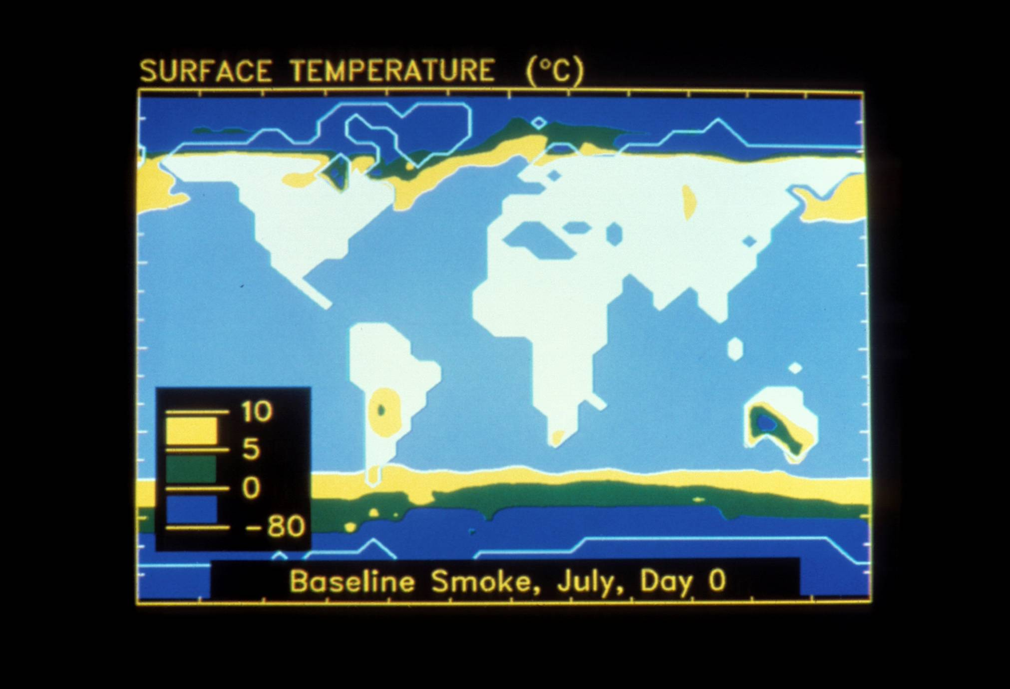
Notes:
These are the surface temperatures at the beginning of the experiment.
Image used by permission of the National Resources Defense Council.

Slide 34
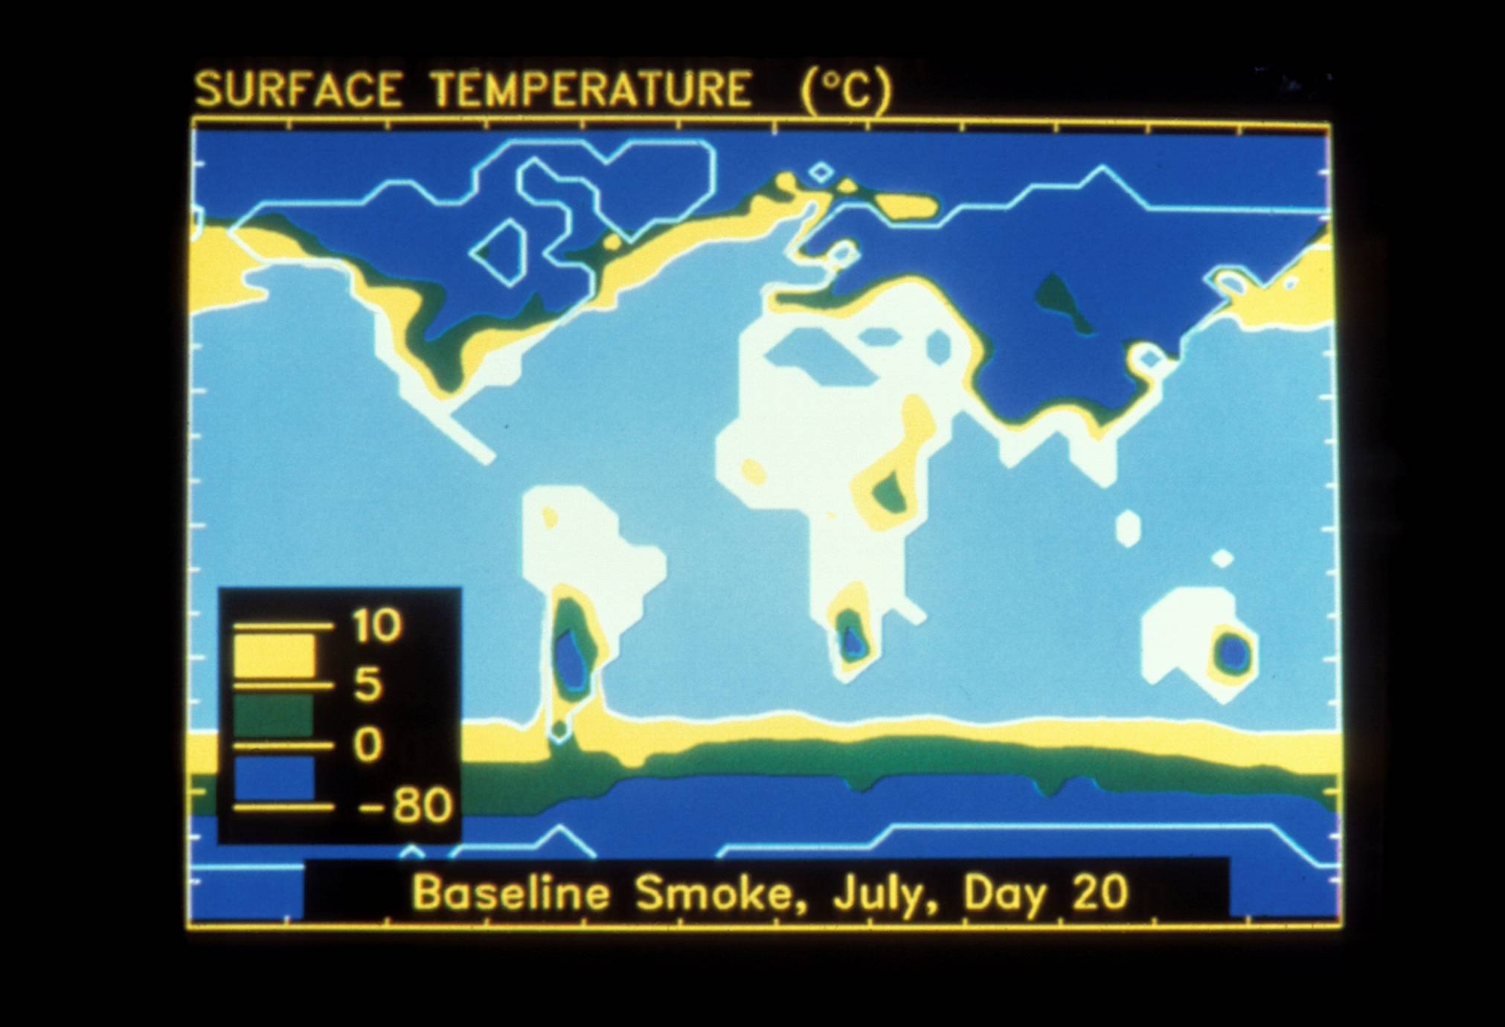
Notes:
These are the temperatures at Day 20. Much of Asia and North America is below freezing.
Image used by permission of the National Resources Defense Council.

Slide 35
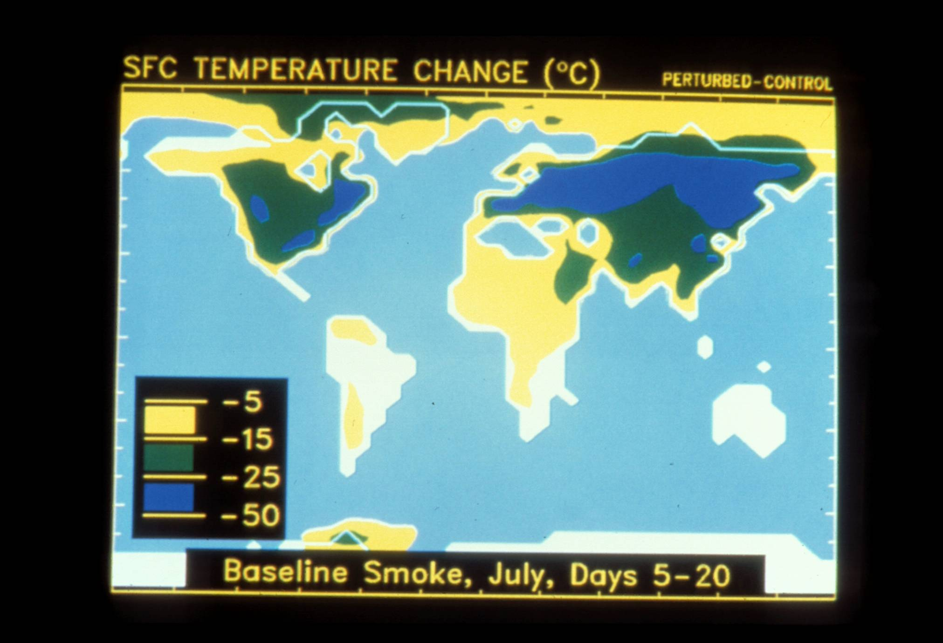
Notes:
These are the temperature changes. Everything yellow is 5 to 15 degrees Celsius (9 to 27 degrees Fahrenheit) colder. Even during the height of the last Ice Age 20,000 years ago when ice sheets covered Canada, Europe and parts of the US, the tropical temperatures were only 5 degrees Celsius colder than today.
Image used by permission of the National Resources Defense Council.

Slide 36
History of Nuclear Warheads
Aleksandrov and Stenchikov (1983), Turco et al. (1983)
Covey et al. (1984), Robock (1984)
Soviet Union Ends
Total
Russia
U.S.
R. S. Norris, H. M. Kristensen, Bull. Atom. Scientists, 66, 77 (2010).
Notes:
The number of nuclear weapons on the planet began to decrease after the intensive discussion of the direct and indirect effects of nuclear weapons in the 1980s, stimulated by the work on nuclear winter.

Slide 37

Ronald Reagan:
When asked about the effects of nuclear war in a February 12, 1985 interview in the New York Times said,
“A great many reputable scientists are telling us that such a war could just end up in no victory for anyone because we would wipe out the earth as we know it. And if you think back to ... natural calamities - back in the last century, in the 1800’s, ... volcanoes - we saw the weather so changed that there was snow in July in many temperate countries. And they called it the year in which there was no summer. Now if one volcano can do that, what are we talking about with the whole nuclear exchange, the nuclear winter that scientists have been talking about? It's possible ...”

Slide 38
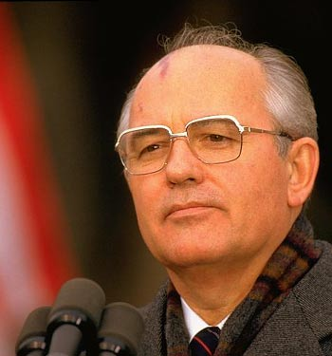
Mikhail Gorbachev:
commented in an interview in 1994 that when he received control over the Soviet nuclear arsenal,
“Perhaps there was an emotional side to it…. But it was rectified by my knowledge of the might that had been accumulated. One-thousandth of this might was enough to destroy all living things on earth. And I knew the report on ‘nuclear winter.’”

Slide 39
Mikhail Gorbachev:
“Mikhail Gorbachev explains
what's rotten in Russia”
by Mark Hertsgaard
Salon.com, Sept. 7, 2000
“Models made by Russian and American scientists showed that a nuclear war would result in a nuclear winter that would be extremely destructive to all life on Earth; the knowledge of that was a great stimulus to us, to people of honor and morality, to act in that situation.”
http://dir.salon.com/story/news/feature/2000/09/07/gorbachev/index.html

Slide 40
New NCAR Simulations
Thompson, S. L., and S. H. Schneider, 1986: Nuclear winter reappraised, Foreign Affairs, 64, 981-1005.
- “moderately black” smoke
included infrared effects of smoke
“about three-fourths of the smoke is removed from the model's atmosphere over the course of 30 days” because it was placed in the surface to 7 km layer
no diurnal cycle
specified constant sea surface temperatures

Slide 41
Steve Schneider, Science as a Contact Sport (2009),
p. 102, summarizing a discussion with Walter Orr Roberts about discussing their climate modeling results:
“But I wasn’t going to use that phrase ‘nuclear fall’ because I was media savvy enough to know that it would be used to attack Carl, conveniently ignoring the fact that a nuclear fall would be a disaster, too.”

Slide 42
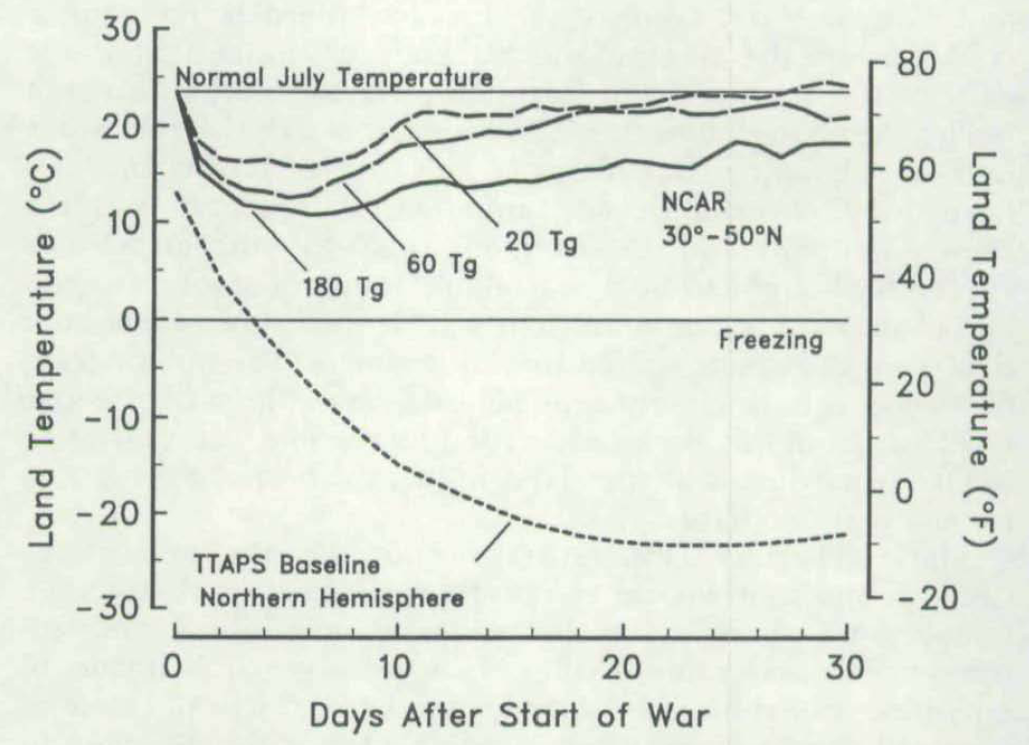
“These temperature changes more closely describe
a nuclear ‘fall’ than a nuclear winter.”
Thompson, S. L., and S. H. Schneider, 1986: Nuclear winter reappraised, Foreign Affairs, 64, 981-1005.

Slide 43
Thompson, S. L., and S. H. Schneider, 1986: Nuclear winter reappraised, Foreign Affairs, 64, 981-1005.
“... it can be misleading to interpret the curves on the figures without taking into account geographic and weather variability as well. Indeed, for certain biological impacts it would be sufficient to have only a few hours of temperature below some critical level-e.g., subfreezing for wheat, or 10-15ºC (50-59ºF) for rice.”
“... it is still quite plausible that climatic disturbances, radioactive fallout, ozone depletions and the interruption of basic societal services, when taken together, could threaten more people globally than would the direct effects of explosions in a large nuclear war.”

Slide 44
Schneider, Stephen H., and Starley L. Thompson, 1988: Simulating the climatic effects of nuclear war, Nature, 333, 221-227.
“Because autumn is the time that the growing season ends in the mid-latitudes of the northern hemisphere and the summer monsoons fade in Asia and northern Africa, we are willing to continue to use our 'nuclear fall‘ metaphor as an appropriate shorthand label for the magnitude and biological implications of the results from present models given presently accepted baseline estimates by smoke production.”

Slide 45
Turco, R. P., O. B. Toon, T. P. Ackerman, J. B. Pollack, and C. Sagan, 1990: Climate and smoke: An appraisal of nuclear winter, Science, 247, 166-176.
“Serious new environmental problems associated with soot injection have been identified, including disruption of monsoon precipitation and severe depletion of the stratospheric ozone layer in the Northern Hemisphere. The basic physics of nuclear winter has been reaffirmed through several authoritative international technical assessments and numerous individual scientific investigations.”

Slide 46
Turco, R. P., O. B. Toon, T. P. Ackerman, J. B. Pollack, and C. Sagan, 1990: Climate and smoke: An appraisal of nuclear winter, Science, 247, 166-176.
“Serious new environmental problems associated with soot injection have been identified, including disruption of monsoon precipitation and severe depletion of the stratospheric ozone layer in the Northern Hemisphere. The basic physics of nuclear winter has been reaffirmed through several authoritative international technical assessments and numerous individual scientific investigations.”

Slide 47
Turco, R. P., O. B. Toon, T. P. Ackerman, J. B. Pollack, and C. Sagan, 1990: Climate and smoke: An appraisal of nuclear winter, Science, 247, 166-176.
“Serious new environmental problems associated with soot injection have been identified, including disruption of monsoon precipitation and severe depletion of the stratospheric ozone layer in the Northern Hemisphere. The basic physics of nuclear winter has been reaffirmed through several authoritative international technical assessments and numerous individual scientific investigations.”
Why do we still remember that nuclear winter was disproven and that the results would be nuclear fall?

Slide 48
“How does it feel?”
Bob Dylan (1965), Like a Rolling Stone

Slide 49
Thirty years after the threat of nuclear winter was discovered, we ask:
1. Although the Cold War and its associated nuclear arms race are over, could remaining nuclear arsenals still produce nuclear winter?
2. What would be the consequences of the use of a much smaller number of nuclear weapons in a regional nuclear conflict?
Notes:
Twenty years after the threat of nuclear winter was discovered, we now ask:
1. Although the Cold War and its associated nuclear arms race are over, could remaining nuclear arsenals still produce nuclear winter?
2. What would be the consequences of the use of a much smaller number of nuclear weapons in a regional nuclear conflict?

Slide 50
Thirty years after the threat of nuclear winter was discovered, we now ask:
1. Although the Cold War and its associated nuclear arms race are over, could remaining nuclear arsenals still produce nuclear winter? YES, AND IT WOULD LAST LONGER THAN WE THOUGHT BEFORE.
2. What would be the consequences of the use of a much smaller number of nuclear weapons in a regional nuclear conflict?
Notes:
Twenty years after the threat of nuclear winter was discovered, we now ask:
1. Although the Cold War and its associated nuclear arms race are over, could remaining nuclear arsenals still produce nuclear winter? YES, AND IT WOULD LAST LONGER THAN WE THOUGHT BEFORE.
2. What would be the consequences of the use of a much smaller number of nuclear weapons in a regional nuclear conflict?

Slide 51
Thirty years after the threat of nuclear winter was discovered, we now ask:
1. Although the Cold War and its associated nuclear arms race are over, could remaining nuclear arsenals still produce nuclear winter? YES, AND IT WOULD LAST LONGER THAN WE THOUGHT BEFORE.
2. What would be the consequences of the use of a much smaller number of nuclear weapons in a regional nuclear conflict? NOT NUCLEAR WINTER, BUT MILLIONS DEAD FROM BLAST, RADIOACTIVITY AND FIRES, AND SEVERE IMPACTS ON GLOBAL AGRICULTURE FOR MORE THAN A DECADE.
Notes:
Twenty years after the threat of nuclear winter was discovered, we now ask:
1. Although the Cold War and its associated nuclear arms race are over, could remaining nuclear arsenals still produce nuclear winter? YES, AND IT WOULD LAST LONGER THAN WE THOUGHT BEFORE.
2. What would be the consequences of the use of a much smaller number of nuclear weapons in a regional nuclear conflict? NOT NUCLEAR WINTER, BUT MILLIONS DEAD FROM BLAST, RADIOACTIVITY AND FIRES, AND SEVERE IMPACTS ON GLOBAL AGRICULTURE FOR MORE THAN A DECADE.

Slide 52
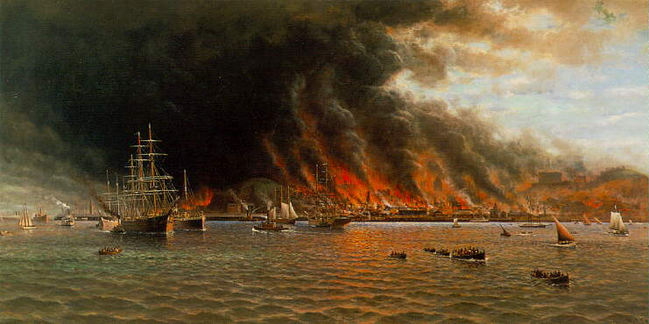
THE STORY OF AN EYEWITNESS
By Jack London
Collier's, the National Weekly
May 5, 1906
Within an hour after the earthquake shock the smoke of San Francisco’s burning was a lurid tower visible a hundred miles away. And for three days and nights this lurid tower swayed in the sky, reddening the sun, darkening the day, and filling the land with smoke.
... I watched the vast conflagration from out on the bay. It was dead calm. Not a flicker of wind stirred. Yet from every side wind was pouring in upon the doomed city. East, west, north, and south, strong winds were blowing upon the doomed city. The heated air rising made an enormous suck. Thus did the fire of itself build its own colossal chimney through the atmosphere. Day and night this dead calm continued, and yet, near the flames, the wind was often half a gale, so mighty was the suck.
Notes:
Jack London lived in Oakland, across the Bay from San Francisco. The 1906 earthquake broke water mains and started fires in the city. Here is his account. Thus we learn that firestorms can result from burning cities no matter how they are started. [I always read this to the audience, emphasizing the last part of the last sentence.]
Painting from http://www.sfmuseum.org/1906/coulter.html :
Lurid flames sweep San Francisco in William Alexander Coulter’s (1849-1936) panorama of the largest maritime rescue in United States history, where more than thirty-thousand people were taken from the shoreline between Fort Mason and the foot of Lombard Street. Mr. Coulter’s painting depicts the flotilla of rescue vessels ferrying survivors from the burning city to Sausalito.
Mr. Coulter painted from sketches drawn as he helped during the Dunkirk-like evacuation, and he took certain liberties with the San Francisco skyline to give this magnificent picture balance.
The eye, at first, is drawn to the large sailing ships highlighted against the thick, black smoke which obscured the downtown area. He moved the Hall of Justice near Chinatown to just left of center, the Call Building to just right of center, and depicted the burning of Nob Hill on the far right. True perspective would place almost all of these landmarks within the ominous smoke cloud.
This painting, executed on a 5 X 10-foot windowshade, hung for many years in San Francisco’s Commercial Club, and was later sold by Maxwell Galleries, Ltd.
Gladys Hansen
From Denial of Disaster

Slide 53
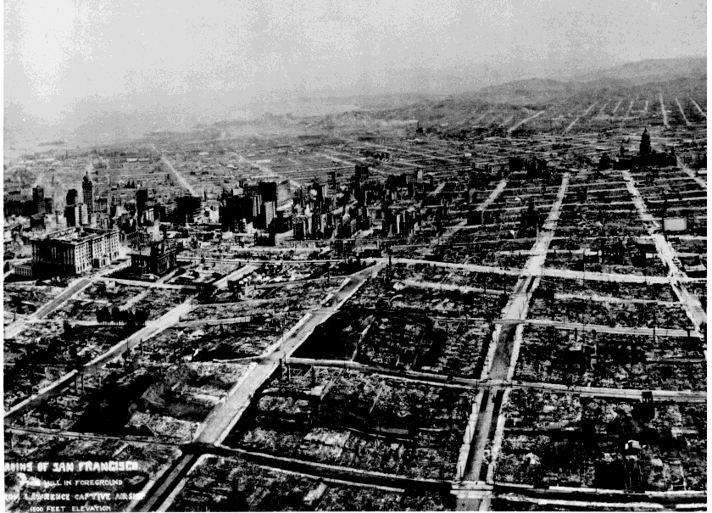
This photograph, taken from a series of kites five weeks after the great earthquake of April 18, 1906, shows the devastation brought on the city of San Francisco by the quake and subsequent fire. (photo courtesy of Harry Myers)
Notes:
This photograph, taken by George Lawrence from a series of kites five weeks after the great earthquake of April 18, 1906, shows the devastation brought on the city of San Francisco by the quake and subsequent fire. The view is looking over Nob Hill toward business district, South of the Slot, and the distant Mission. The Fairmont Hotel, far left. dwarfs the Call Building. (photo courtesy of Harry Myers).
http://earthquake.usgs.gov/regional/nca/1906/18april/images/sf06.city.html

Slide 54
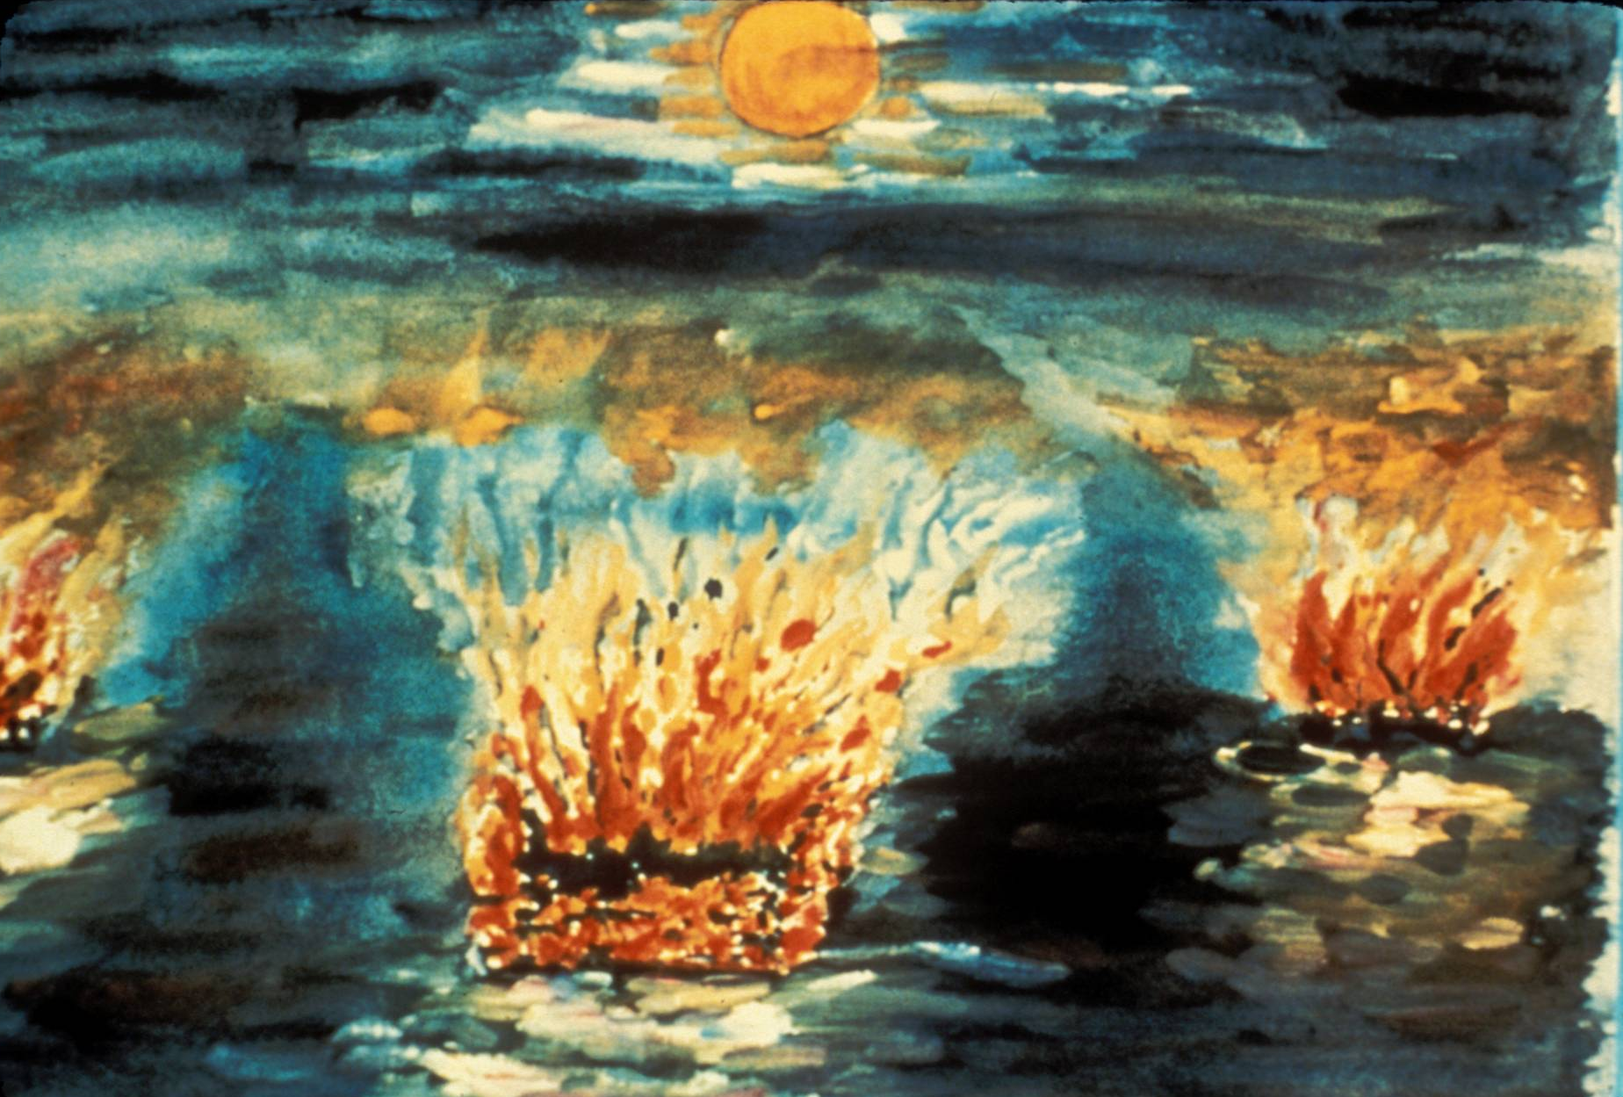
Notes:
This is a drawing made by a Japanese child who survived the bombing. What they remembered was the fire. In fact the atomic bomb, while blowing up a small area of the town, actually served as a match to start the city on fire.

Slide 55
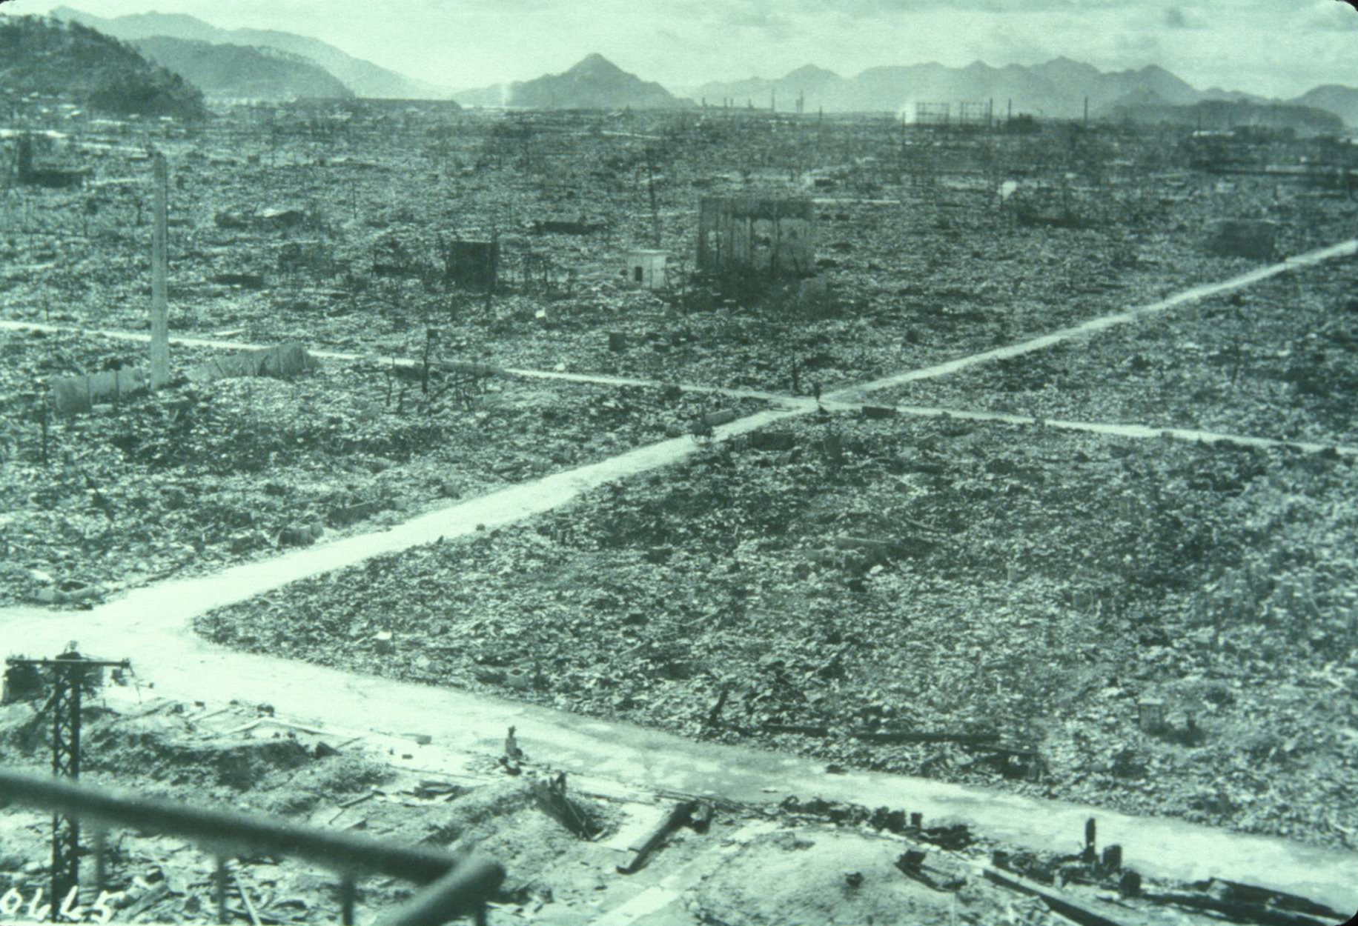
Notes:
This is a photograph of Hiroshima from the US Air Force photo library, showing the city after some roads were cleared off. As most of the buildings were wood and paper, they all burned in the resulting firestorm.
From this and the following examples, we learn that cities can burn, whether ignited by an atomic bomb or “conventional weapons.” In fact, in World War II, more people died from “conventional firebombing” than from nuclear firebombing.

Slide 56
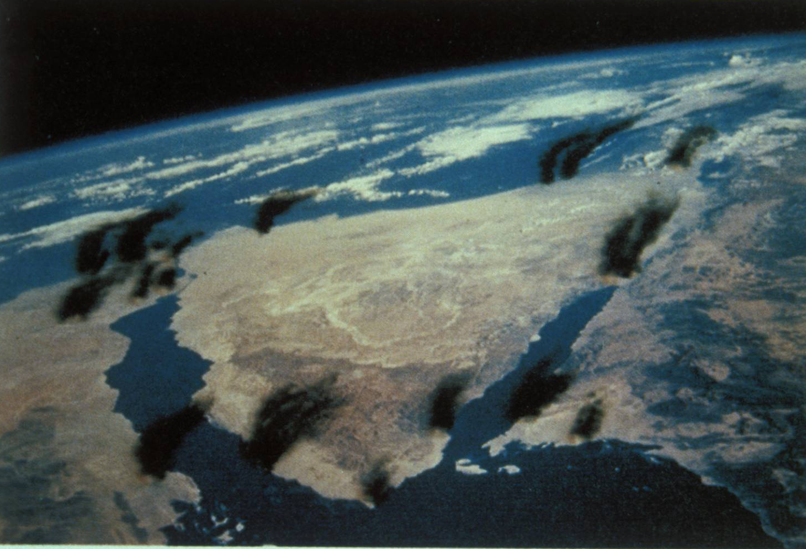
Illustration by Jon Lomberg
Notes:
Illustration of smoke plume from Egyptian and Israeli oil targets. How high the resulting smoke would get would depend on the weather and size of the fires.
Image used by permission of the National Resources Defense Council.

Slide 57
Schneider, Stephen H., and Starley L. Thompson, 1988: Simulating the climatic effects of nuclear war, Nature, 333, 221-227.
“Some preliminary studies [Robock, 1984; Covey, 1987] have implied that long-term [> 1 month] climate changes would be expected given plausible amounts of remnant smoke, but more credible quantitative conclusions must await the next generation of coupled atmosphere-ocean GCMs to be applied to the problem of nuclear smoke.”

Slide 58
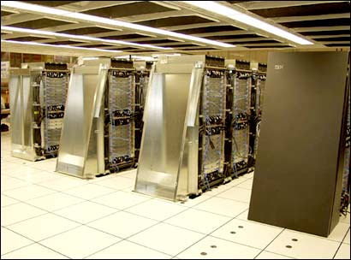
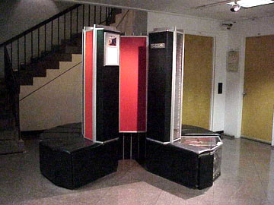
This is also a story of new scientific results made possible through the development of more sophisticated, detailed climate models and the computers to run them on.
Initial experiments were limited by available computer time, but pushed models to include aerosols for the first time.
Now we can use sophisticated climate models, even for initial exploratory work.
Cray 1-A
IBM Blue Gene/L
Notes:
http://www.cisl.ucar.edu/computers/gallery/cray/cray1.jsp
www.rediff.com/money/2005/jun/23super.htm

Slide 59
Comparison of climate models used for previous and current nuclear winter simulations.
Study | Model type | Horizontal resolution (lat x lon) | Vertical levels | Seasonal cycle?/ Continuous? | Model top | Length of simulation (x # of runs)
Aleksandrov and Stenchikov [1983] | AGCM | 12ºx 15º | 2 | no | Tropopause | 400 days (x 1)
Turco et al. [1983] | SCM | none | 60 | no | 38 km | 300 days (x 10)
Robock [1984] | EBM | 10º x 180º | 1 | yes/yes | – | 4 yr (x 9)
Covey et al. [1984] | AGCM | 4.5ºx 7.5º | 9 | yes/no | 20 km | 20 days (x 3)
Thompson [1985] | AGCM | 4.5ºx 7.5º | 9 | yes/no | 20 km | 20 days (x 3)
Malone et al. [1986] | AGCM | 4.5ºx 7.5º | 20 | yes/no | 32 km | 40 days (x 8)
Ghan et al. [1988] | AGCM | 4ºx 5º | 2 | yes/no | Tropopause | 30 days (x 21)
Pittock et al. [1989] | AGCM | 4.4ºx 7.5º | 9 | yes/no | 31 km | 105 days (x 2)
Ghan [1991] | AGCM | 4º x 5º | 2 | yes/yes | Tropopause | 1.5 yr (x 3)
Current work | AOGCM | 4º x 5º | 23 | yes/yes | 80 km | 10 yr (x 8)
AGCM = atmospheric general circulation model
SCM = single column model
EBM = energy balance model
AOGCM = atmosphere-ocean general circulation model
Notes:
Table 1 from:
Robock, Alan, Luke Oman, and Georgiy L. Stenchikov, 2007: Nuclear winter revisited with a modern climate model and current nuclear arsenals: Still catastrophic consequences. J. Geophys. Res., 112, D13107, doi:10.1029/2006JD008235.

Slide 60


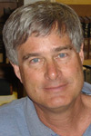

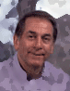
This work is done in collaboration with
Luke Oman and Georgiy Stenchikov
NASA King Abdullah
University of Science
and Technology
Brian Toon and Charles Bardeen
University of Colorado, Boulder NCAR
Richard Turco
University of California, Los Angeles
Notes:
The new research has been conducted in collaboration with Brian Toon, Richard Turco, Georgiy Stenchikov, Luke Oman, and Charles Bardeen.

Slide 62
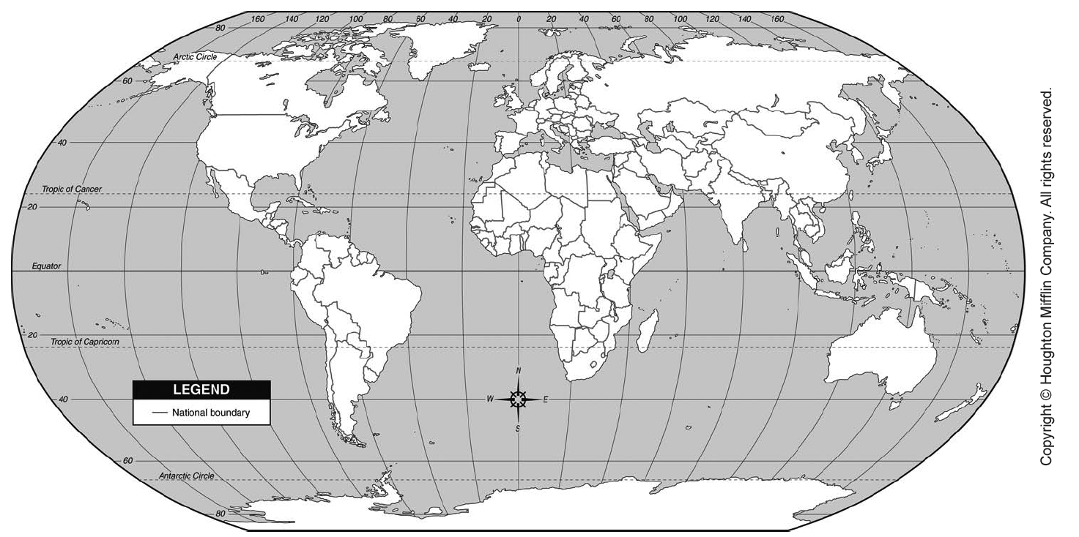
Even small nuclear states can have many warheads
[number of weapons, when first tested]
NWS
Israel, 116 (102-130)
DeFacto
North Korea, 10?, 2007
Pakistan, 52 (44-62), 1998
India, 85 (65-110), 1974, 1998
South Africa 7, dismantled 1989, 1979?

Slide 63
2011 Nuclear Arsenals
Country | No. of weapons
Russia | 11,000
United States | 8,500
France | 300
China | 240
Britain | 225
Israel | 80
India | 80-100
Pakistan | 90-110
North Korea | 10?
http://www.fas.org/programs/ssp/nukes/nuclearweapons/nukestatus.html
32 additional countries possess sufficient nuclear explosive materials that could allow them to construct more weapons, some in a relatively short period of time. The world could construct 100,000 more weapons with current material stockpiles. The totals for the United States and Russia do not include ~6,500 warheads awaiting dismantlement.

Slide 64
A Note About Language
People in the business of designing and planning the use of weapons designed for murdering millions of people tend to use sanitized terminology to insulate themselves from the horror of their work. For example:
Theater weapons – I think of the Kennedy Center, but they mean weapons for use in a battlefield- to country-size war, as opposed to intercontinental, such as cruise missiles.
Strategic weapons – Intercontinental missiles.
Countervalue targets – Cities where innocent people live.
Conventional weapons – As if it is fine and normal to use them.
Nuclear war – To make people imagine the scale of wars they know of, such as World War II or Vietnam. I use the term “nuclear holocaust,” to more appropriately describe the effects.
Notes:
A Note About Language
People in the business of designing and planning the use of weapons designed for murdering millions of people tend to use sanitized terminology to insulate themselves from the horror of their work. For example:
Theater weapons – I think of the Kennedy Center, but they mean weapons for use in a battlefield- to country-size war, as opposed to intercontinental, such as cruise missiles.
Strategic weapons – Intercontinental missiles.
Countervalue targets – Cities where innocent people live.
Conventional weapons – As if it is fine and normal to use them.
Nuclear war – To make people imagine the scale of wars they know of, such as World War II or Vietnam. I use the term “nuclear holocaust,” to more appropriately describe the effects.

Slide 65
One megaton (MT) is the explosive power of a million tons of TNT.
1 MT = 1000 kT = 10⁶ tons = 10⁹ kg = 10¹² g
= 1,000,000,000,000 g = 1 Tg
1 MT = 10¹⁵ calories = 4.2 x 10¹⁵ joules
Notes:
First for some terminology. The explosive power of a “conventional” explosive, tri-nitro-toluene (TNT), is used to measure the power of nuclear weapons. One megaton (MT) is the explosive power of a million tons of TNT.

Slide 66
World Arsenals (1985)
 | Warheads | MT
USA | 9,800 | 4000
USSR | 8,600 | 6000
Others | 300 | 200
“Strategic” | ~19,000 | ~10,000
USA | 16,000 | 2000
USSR | 14,000 | 3000
Others | 600 | 150
“Theater” | ~30,000 | ~5,000
Grand Total | ~50,000 | ~15,000
Total yield of all explosive bombs used in World War II (including Hiroshima and Nagasaki) = 2-3 MT!
Total yield of all explosive bombs used in all warfare in the history of the world = 10 MT!
Notes:
This is a table of the explosive power of the global nuclear arsenal at the height of the Cold War. “Strategic weapons,” including intercontinental missiles with large warheads had a total explosive power of about 10,000 MT. There were more smaller weapons intended for battlefield use, and the total explosive power was about 15,000 MT.
To get a feel for how much this is, the total yield of all explosive bombs used in World War II (including Hiroshima and Nagasaki), during which 50,000,000 people were killed, was 2-3 MT! The total yield of all explosive bombs used in all warfare in the history of the world was 10 MT!

Slide 67
Today’s arsenal (2013) is about 1/3 of the 1985 arsenal. It (5,000 MT) is the equivalent of the explosive power of
5,000,000,000,000 kg
(11,000,000,000,000 lbs)
of TNT.
If we divided this up and gave everyone on the planet his or her share, each person would have the equivalent of
700 kg (more than 1400 lbs)
of TNT.
Notes:
Ask each person in the audience what she would do with her share.

Slide 68
Notes:
This gives a graphical representation of the incredible size of the current nuclear arsenal.

Slide 69
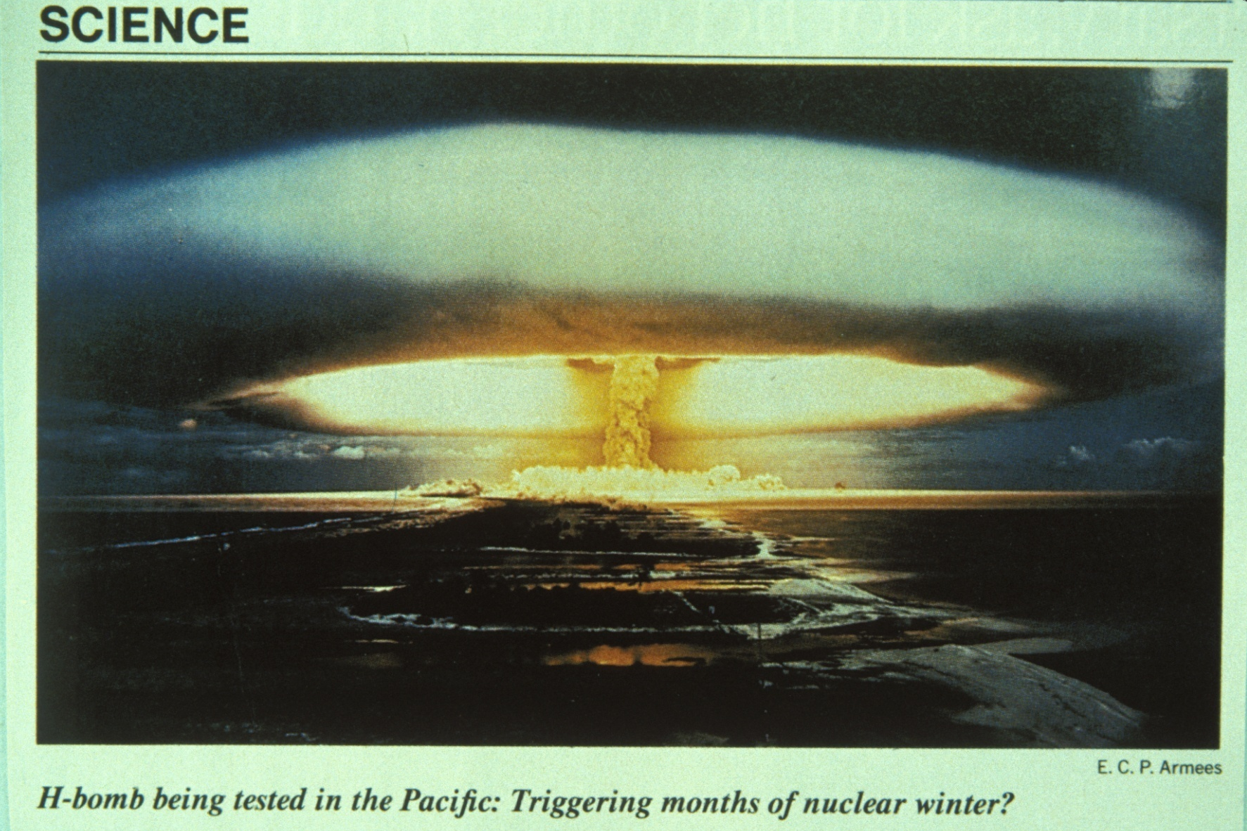
Notes:
Image from Newsweek.

Slide 70
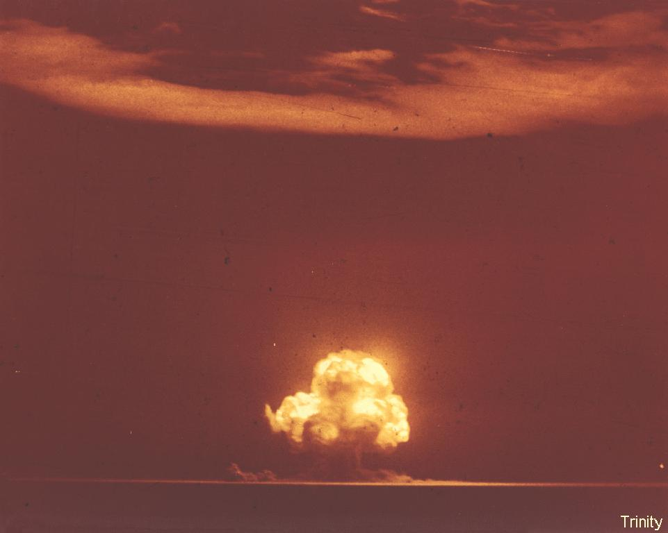
First atomic bomb test, July 16, 1945
Notes:
Photo courtesy of National Nuclear Security Administration / Nevada Site Office.
http://www.nv.doe.gov/library/photos/

Slide 71
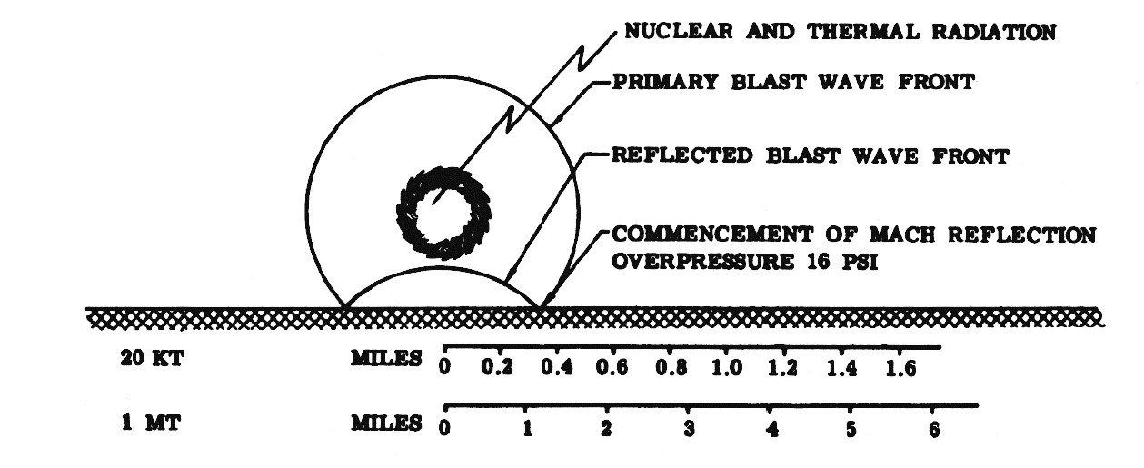
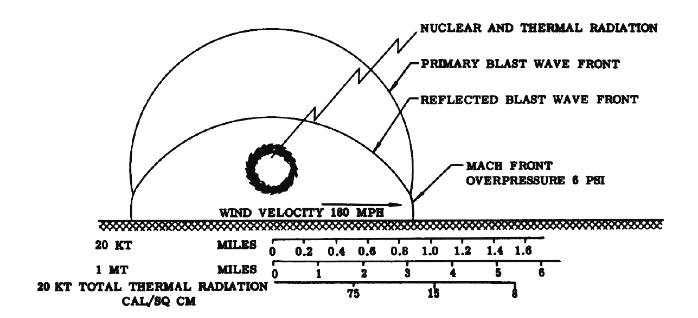
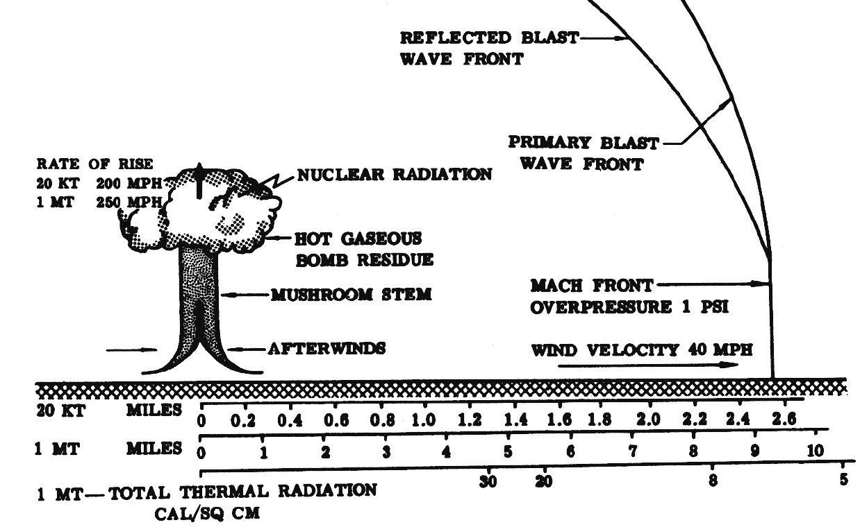
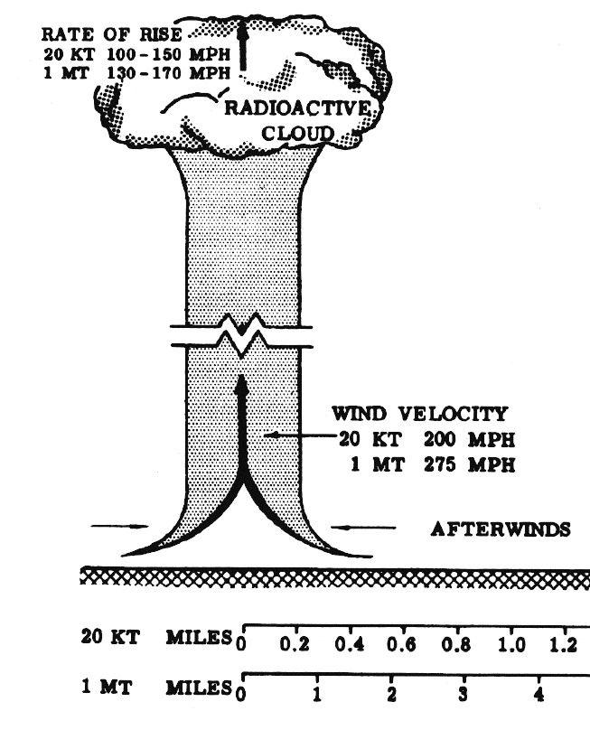
Time sequence of 20 kt airburst
20 kt airburst, 1.25 s
20 kt airburst, 3 s
20 kt airburst, 10 s
The Effects of Nuclear Weapons, Samuel Glasstone, ed., USAEC, Washington, DC, April 1962; Revised Edition reprinted February 1964.
http://www.cddc.vt.edu/host/atomic/nukeffct/
20 kt airburst, 30 s
Notes:
The Effects of Nuclear Weapons, Samuel Glasstone, ed., USAEC, Washington, DC, April 1962; Revised Edition reprinted February 1964.
http://www.cddc.vt.edu/host/atomic/nukeffct/

Slide 72
Hiroshima
August 6, 1945
A 15 kT bomb killed 150,000 people
Note: 15 kT = 0.015 MT = 1/1,000,000 of the 1985 world arsenal
= 3/1,000,000 of the current world arsenal
While current weapons are mostly more powerful than the initial one, if one Hiroshima-sized bomb were dropped every two hours from the end of World War II to today, it would still not use up the current arsenal.
Notes:
During the first nuclear war, Hiroshima and Nagasaki were destroyed by what today we would call very small atomic bombs. About 150,000 people died from the blast, radiation, and subsequent fires in Hiroshima, started by a 12 kT bomb.
If you want to use another method to illustrate the size of the current arsenal, buy a supply of 500,000 BBs, and drop them one at a time into a metal pail. Tell the audience that the first one represents the Hiroshima bomb. All the rest are the current arsenal. Drop them at first slowly and at the end dump the rest in a huge loud cascade. If you have a microphone, put it close the pail.

Slide 73
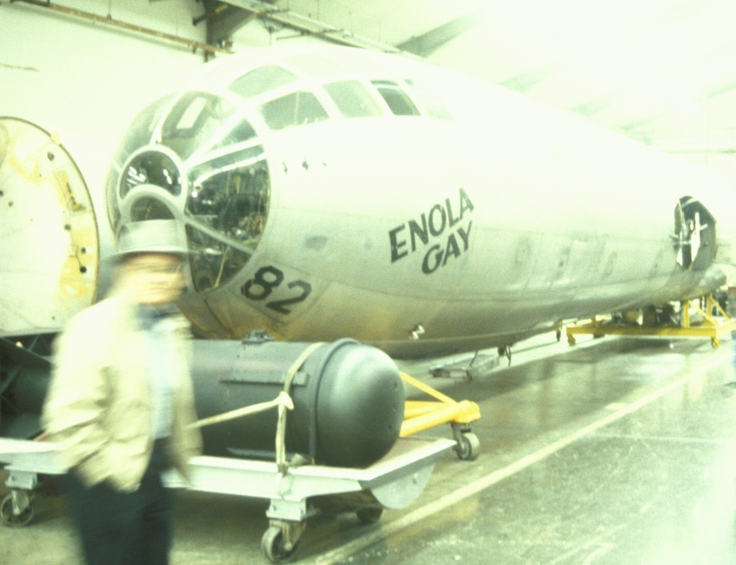
Notes:
This is the front half of the Enola Gay, the airplane used to drop the atomic bomb onto Hiroshima. It is now on display at the Smithsonian Museum in Washington. In front is a model of the bomb. They are much smaller today.
Photograph © Alan Robock

Slide 74
Notes:
This is a drawing made by a Japanese child who survived the bombing. What they remembered was the fire. In fact the atomic bomb, while blowing up a small area of the town, actually served as a match to start the city on fire.

Slide 75
Notes:
This is a photograph of Hiroshima from the US Air Force photo library, showing the city after some roads were cleared off. As most of the buildings were wood and paper, they all burned in the resulting firestorm.
From this and the following examples, we learn that cities can burn, whether ignited by an atomic bomb or “conventional weapons.” In fact, in World War II, more people died from “conventional firebombing” than from nuclear firebombing.

Slide 76
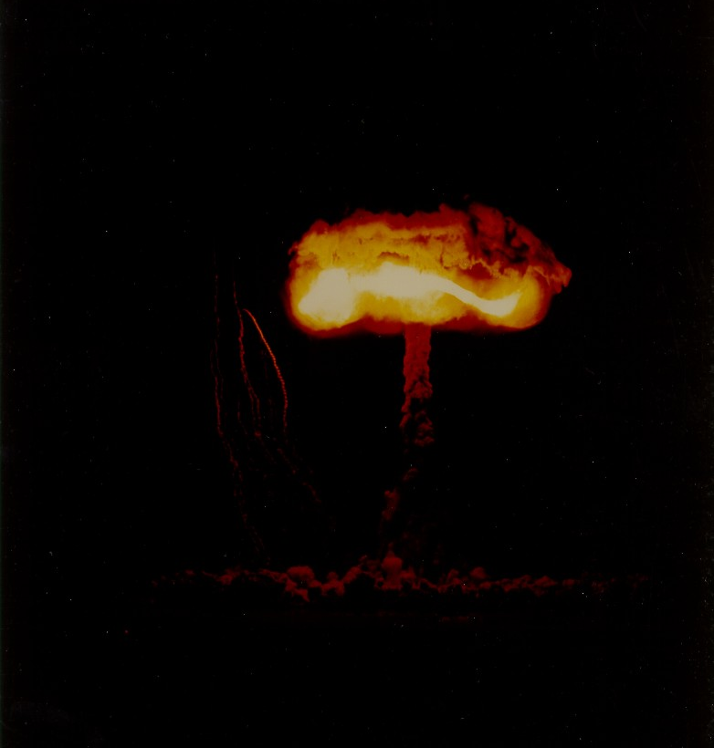
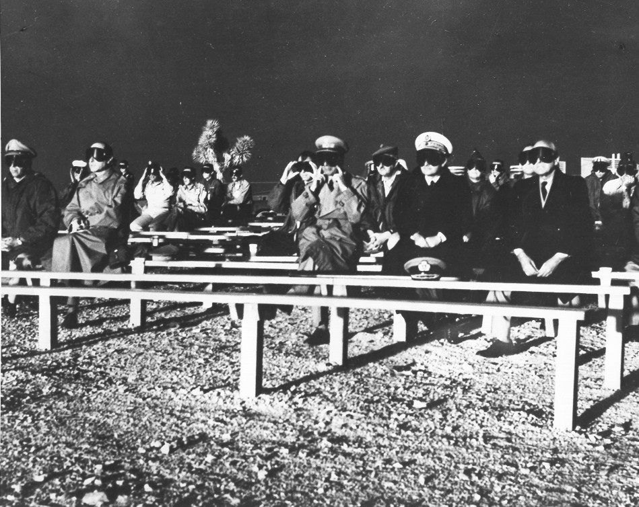
UPSHOT-KNOTHOLE
Nevada Proving Ground - Complete destruction of House No. 1 located 3,500 feet from ground zero, by the March 17, 1953 atom blast at Yucca Flat. The time from the first to last picture was 2 1/3 seconds. The camera was completely enclosed in a 2-inch lead sheath as a protection against radiation. The only source of light was that from the bomb.
Photos courtesy of National Nuclear Security Administration / Nevada Site Office.
http://www.nv.doe.gov/library/photos/
Notes:
Click on the movie icon to show the movie of this test. You will need to download the file effct01a.mov and make the hyperlink to the location of that file on your computer.

Slide 77

Photo courtesy of National Nuclear Security Administration / Nevada Site Office.
Notes:
About one third of the energy of an atomic bomb is in the form of light. It is like bringing a piece of the Sun to the Earth for a fraction of a second.
Photo courtesy of National Nuclear Security Administration / Nevada Site Office.

Slide 78

Photo courtesy of National Nuclear Security Administration / Nevada Site Office.
Notes:
The sequence begins with the house illuminated by the light of the explosion.
Photo courtesy of National Nuclear Security Administration / Nevada Site Office.

Slide 79

Photo courtesy of National Nuclear Security Administration / Nevada Site Office.
Notes:
As the fireball rises in the sky, the shadow gets shorter. At the same time the house starts to burn from the intense heat
Photo courtesy of National Nuclear Security Administration / Nevada Site Office.

Slide 80

Photo courtesy of National Nuclear Security Administration / Nevada Site Office.
Notes:
The blast wave hits, like thunder following lightning. Even if it blows out the fire, electrical wires would be broken and gas lines shattered, and hot embers would restart the fires.
Photo courtesy of National Nuclear Security Administration / Nevada Site Office.

Slide 81

Photo courtesy of National Nuclear Security Administration / Nevada Site Office.
Notes:
Photo courtesy of National Nuclear Security Administration / Nevada Site Office.

Slide 82

Photo courtesy of National Nuclear Security Administration / Nevada Site Office.
Notes:
Photo courtesy of National Nuclear Security Administration / Nevada Site Office.

Slide 83

Photo courtesy of National Nuclear Security Administration / Nevada Site Office.
Notes:
Photo courtesy of National Nuclear Security Administration / Nevada Site Office.

Slide 84

Photo courtesy of National Nuclear Security Administration / Nevada Site Office.
Notes:
Photo courtesy of National Nuclear Security Administration / Nevada Site Office.

Slide 85


Scenes from the
1992 Gulf War
Notes:
More oil smoke, from Newsweek.

Slide 86
Illustration by Jon Lomberg
Notes:
Illustration of smoke plume from Egyptian and Israeli oil targets. How high the resulting smoke would get would depend on the weather and size of the fires.
Image used by permission of the National Resources Defense Council.

Slide 87

Uncertainty
(Error bar)
(1990)
Current Global Arsenal (2005)
Substantial nuclear winter
Climatic disturbances and enhanced UV radiation lasting for years, most people on the planet in jeopardy of starvation, extinction of many species.
Nominal nuclear winter
Significant cooling and darkening, average 10°C (18°F) global cooling, collapse of agriculture and famine, 1,000,000,000 to 2,000,000,000 people in jeopardy of starvation.
Sagan and Turco (1990)
Notes:
The best way to summarize the effects is this figure from Sagan and Turco (1990), two of the inventors of nuclear winter theory. It shows the level of environmental effects as a function of the number of warheads and types of targets. The current nuclear arsenal is still large enough to cause devastating effects.
This was the state of our knowledge until our 2007 studies using a modern climate model.
Sagan, Carl, and Richard P. Turco, 1990: A Path Where No Man Thought: Nuclear Winter and the End of the Arms Race, Random House, 499 pp.

Slide 88
Sooty smoke generation from 50, 15 kT weapons

Slide 89
Sooty smoke generation from 50, 15 kT weapons
Nuclear Weapons States

Slide 90

What if India and Pakistan had a nuclear war?
Imagine a skirmish in Kashmir escalating, due to poor communication, misunderstanding, panic, and fear.
http://upload.wikimedia.org/wikipedia/commons/0/0e/Kashmir_map.jpg
Notes:
Toon, Owen B., Richard P. Turco, Alan Robock, Charles Bardeen, Luke Oman, and Georgiy L. Stenchikov, 2007: Atmospheric effects and societal consequences of regional scale nuclear conflicts and acts of individual nuclear terrorism. Atm. Chem. Phys., 7, 1973-2002.
Robock, Alan, Luke Oman, Georgiy L. Stenchikov, Owen B. Toon, Charles Bardeen, and Richard P. Turco, 2007: Climatic consequences of regional nuclear conflicts. Atm. Chem. Phys., 7, 2003-2012.

Slide 91
What would be the consequences of a regional nuclear war using 100 15-kT (Hiroshima-size) weapons?
This would be only 0.03% of the current world arsenal.
Scenario: Weapons dropped on the 50 targets in each country that would produce the maximum smoke.
20,000,000 people would die from direct effects, half of the total fatalities from all of World War II.
Portions of megacities attacked with nuclear devices or exposed to fallout of long-lived isotopes would likely be abandoned indefinitely.
5 Tg of smoke injected into the upper troposphere, accounting for fuel loading, emission factors and rainout.
Notes:
Toon, Owen B., Richard P. Turco, Alan Robock, Charles Bardeen, Luke Oman, and Georgiy L. Stenchikov, 2007: Atmospheric effects and societal consequences of regional scale nuclear conflicts and acts of individual nuclear terrorism. Atm. Chem. Phys., 7, 1973-2002.
Robock, Alan, Luke Oman, Georgiy L. Stenchikov, Owen B. Toon, Charles Bardeen, and Richard P. Turco, 2007: Climatic consequences of regional nuclear conflicts. Atm. Chem. Phys., 7, 2003-2012.

Slide 92
What would be the consequences of a regional nuclear war using 100 15-kT (Hiroshima-size) weapons?
We use the NASA GISS ModelE atmosphere-ocean general circulation model.
- 4ºx5º lat-lon horizontal resolution
- 23 vertical levels including stratosphere and mesosphere, extending 0-80 km, 13 layers in ocean
- 5 Tg of smoke into the 300-150 mb layer (upper troposphere) at 30ºN, 70ºE on May 15
- 30-yr control run
- 3-member ensemble for 10 yr
Notes:
Toon, Owen B., Richard P. Turco, Alan Robock, Charles Bardeen, Luke Oman, and Georgiy L. Stenchikov, 2007: Atmospheric effects and societal consequences of regional scale nuclear conflicts and acts of individual nuclear terrorism. Atm. Chem. Phys., 7, 1973-2002.
Robock, Alan, Luke Oman, Georgiy L. Stenchikov, Owen B. Toon, Charles Bardeen, and Richard P. Turco, 2007: Climatic consequences of regional nuclear conflicts. Atm. Chem. Phys., 7, 2003-2012.

Slide 93

Notes:
Robock, Alan, Luke Oman, Georgiy L. Stenchikov, Owen B. Toon, Charles Bardeen, and Richard P. Turco, 2007: Climatic consequences of regional nuclear conflicts. Atm. Chem. Phys., 7, 2003-2012.

Slide 94

Daily smoke loading from one ensemble member.
Absorption optical depth of 0.1 means that 90% of radiation reaches the surface.
Notes:
Robock, Alan, Luke Oman, Georgiy L. Stenchikov, Owen B. Toon, Charles Bardeen, and Richard P. Turco, 2007: Climatic consequences of regional nuclear conflicts. Atm. Chem. Phys., 7, 2003-2012.

Slide 95

For a 5 Tg injection into the upper troposphere, the smoke quickly rises to a high altitude and has a 5 yr e-folding removal time, much longer than the 1 yr time for volcanic aerosols.
Notes:
Horizontal and vertical distributions of smoke for the 5 Tg standard case. A. Zonal average absorption optical depth, as function of latitude and time. The poleward spread and subsequent loss of smoke over time is clearly seen. B. Global average vertical distribution of black carbon as a function of time, plotted as mass mixing ratio. The semiannual lofting is due to heating during the solstice in each summer hemisphere
Robock, Alan, Luke Oman, Georgiy L. Stenchikov, Owen B. Toon, Charles Bardeen, and Richard P. Turco, 2007: Climatic consequences of regional nuclear conflicts. Atm. Chem. Phys., 7, 2003-2012.

Slide 96

Notes:
Zonal mean change in surface shortwave radiation for the 5 Tg standard case. This should be compared to the global average value of +1.5 W/m2 for a doubling of atmospheric CO₂, or to the maximum value of –3 W/m² for the 1991 Mt. Pinatubo volcanic eruption (Kirchner et al., 1999; Fig. 3), the largest of the 20th century.
Robock, Alan, Luke Oman, Georgiy L. Stenchikov, Owen B. Toon, Charles Bardeen, and Richard P. Turco, 2007: Climatic consequences of regional nuclear conflicts. Atm. Chem. Phys., 7, 2003-2012.
Reference:
Kirchner, Ingo, Georgiy L. Stenchikov, Hans-F. Graf, Alan Robock and Juan Carlos Antuña, 1999: Climate model simulation of winter warming and summer cooling following the 1991 Mount Pinatubo volcanic eruption. J. Geophys. Res., 104, 19,039-19,055.

Slide 97

Notes:
Time variation of global average net surface shortwave radiation, surface air temperature, and precipitation changes for the 5 Tg standard case. The global average precipitation in the control case is 3.0 mm/day, so the changes in years 2-4 represent a 9% global average reduction in precipitation. The precipitation recovers faster than the temperature, but both lag the forcing. For comparison the global average net surface shortwave forcing from a model simulation of the 1991 Mt. Pinatubo eruption (Oman et al., 2005) is shown.
Robock, Alan, Luke Oman, Georgiy L. Stenchikov, Owen B. Toon, Charles Bardeen, and Richard P. Turco, 2007: Climatic consequences of regional nuclear conflicts. Atm. Chem. Phys., 7, 2003-2012.
Reference:
Oman, Luke, Alan Robock, Georgiy Stenchikov, Gavin A. Schmidt, and Reto Ruedy, 2005: Climatic response to high latitude volcanic eruptions. J. Geophys. Res., 110 (D13), D13103, doi:10.1029/2004JD005487.

Slide 98
Notes:
Hansen, J. E., Ruedy, R., Sato, M., Imhoff, M., Lawrence, W., Easterling, D., Peterson, T., and Karl, T., 2001 : A closer look at United States and global surface temperature change, J. Geophys. Res., 106, 23,947-23,963, doi:10.1029/2001JD000354.

Slide 99

Global climate change unprecedented in recorded human history
Notes:
Global average surface air temperature change from the 5 Tg standard case (red) in the context of the climate change of the past 125 years. Observations are from the GISS analysis (Hansen et al., 2001, updated at http://data.giss.nasa.gov/gistemp/2005/).
Robock, Alan, Luke Oman, Georgiy L. Stenchikov, Owen B. Toon, Charles Bardeen, and Richard P. Turco, 2007: Climatic consequences of regional nuclear conflicts. Atm. Chem. Phys., 7, 2003-2012.
Reference:
Hansen, J. E., Ruedy, R., Sato, M., Imhoff, M., Lawrence, W., Easterling, D., Peterson, T., and Karl, T., 2001 : A closer look at United States and global surface temperature change, J. Geophys. Res., 106, 23,947-23,963, doi:10.1029/2001JD000354.

Slide 100
Notes:
Northern Hemisphere average surface air temperature change from 5 Tg standard case (red) in the context of the climate change of the past 1000 years. Black curve is from Mann et al. (1999), and the blue curve is from the latest data from the Climatic Research Unit website (http://www.cru.uea.ac.uk/cru/data/temperature/)
Robock, Alan, Luke Oman, Georgiy L. Stenchikov, Owen B. Toon, Charles Bardeen, and Richard P. Turco, 2007: Climatic consequences of regional nuclear conflicts. Atm. Chem. Phys., 7, 2003-2012.
Reference:
Mann, M. E., Bradley, R. S., and Hughes, M. K., 1999 : Northern Hemisphere temperatures during the past millennium: Inferences, uncertainties, and limitations, Geophys. Res. Lett., 26, 759-762.

Slide 101

Notes:
Change in global average temperature (°C) profile for the 5 Tg standard case from the surface to 0.02 mb.
Robock, Alan, Luke Oman, Georgiy L. Stenchikov, Owen B. Toon, Charles Bardeen, and Richard P. Turco, 2007: Climatic consequences of regional nuclear conflicts. Atm. Chem. Phys., 7, 2003-2012.

Slide 102

Ozone depletion 3 years after soot injection
Normal ozone
Edge
of the current ozone hole
Nuclear ozone
Mills, Michael J., Owen B. Toon, Richard P. Turco, Douglas E. Kinnison, and Rolando R. Garcia, 2008: Massive global ozone loss predicted following regional nuclear conflict, Proc. Nat. Acad. Sci., 105, 5307–5312.

Slide 103
Ozone depletion is large and long-lasting at all latitudes
Mills et al. (2008), Proc. Nat. Acad. Sci.

Slide 104
Stenke, Andrea, et al., 2013: Climate and chemistry effects of a regional scale nuclear conflict, Atmos. Chem. Phys., 13, 9713-9729, doi:10.5194/acp-13-9713-2013.
Used Solar Climate Ozone Links (SOCOL3) GCM
39 levels up to 0.01 mb (80 km)
T42 (2.8ºx2.8º latitude-longitude)
50-m mixed layer ocean, q-flux
Forced by a range of soot loadings 1-12 Tg, and two soot particle radii, 50 or 100 nm.

Slide 105

Mills, Michael J., Owen B. Toon, Julia Lee-Taylor, and Alan Robock, 2013: Multi-decadal global cooling and unprecedented ozone loss following a regional nuclear conflict. Submitted to Earth’s Future.

Slide 106

Three models’ simulations for the
5 Tg case

Slide 107
Ways Agriculture Can be Affected by Nuclear War
Colder temperatures
  shortened frost-free growing season
  cold spells during growing season
  slower growth → lower yield
Darkness
Less rainfall
Enhanced UV-B (later)
Radioactivity
Toxic chemicals in atmosphere, soil, and water
Lack of water supplies
Lack of fertilizer
Lack of fuel for machinery
Lack of pesticides (but not of pests)
Lack of seeds (and those that do exist are
genetically engineered for the current climate)
Lack of distribution system
Notes:
There are many ways that agriculture can be affected by nuclear war, and in particular, nuclear winter, and they will interact with each other. Today only 1% of the people in the US feed all of us with enough left over for export. But this agriculture is highly mechanized. If all the people went out to the farms to grow food manually, and if they knew what they were doing, they could not grow as much as we grow today.

Slide 108

Notes:
Surface air temperature changes for the 5 Tg standard case averaged for the first Northern Hemisphere winter following the smoke injection. While there is large cooling over most land, there is winter warming in northern Eurasia, a well-known response to tropical stratospheric heating that has been observed following large volcanic eruptions (Robock, 2000).
Robock, Alan, Luke Oman, Georgiy L. Stenchikov, Owen B. Toon, Charles Bardeen, and Richard P. Turco, 2007: Climatic consequences of regional nuclear conflicts. Atm. Chem. Phys., 7, 2003-2012.
Reference:
Robock, Alan, 2000: Volcanic eruptions and climate. Rev. Geophys., 38, 191-219.

Slide 109

Notes:
Surface air temperature changes for the 5 Tg standard case averaged for June, July, and August of the first year following the smoke injection. Effects are largest over land, but there is substantial cooling over tropical oceans, too. The warming over Antarctica is for a small area, is part of normal winter interannual variability, and is not significant.
Robock, Alan, Luke Oman, Georgiy L. Stenchikov, Owen B. Toon, Charles Bardeen, and Richard P. Turco, 2007: Climatic consequences of regional nuclear conflicts. Atm. Chem. Phys., 7, 2003-2012.

Slide 110

Notes:
Surface air temperature changes for the 5 Tg standard case averaged for the second Northern Hemisphere winter following the smoke injection. While there is large cooling over most land, there is winter warming in northern Eurasia, a well-known response to tropical stratospheric heating that has been observed following large volcanic eruptions (Robock, 2000). The weaker cooling/small warming at 60°S in this second winter is a dynamical response in the ocean, caused by weaker surface westerlies in the atmosphere and less vertical mixing in the ocean.
Robock, Alan, Luke Oman, Georgiy L. Stenchikov, Owen B. Toon, Charles Bardeen, and Richard P. Turco, 2007: Climatic consequences of regional nuclear conflicts. Atm. Chem. Phys., 7, 2003-2012.
Reference:
Robock, Alan, 2000: Volcanic eruptions and climate. Rev. Geophys., 38, 191-219.

Slide 111

Notes:
The cooling will produce more snow along the southern boundaries of the snow cover in Eurasia which will enhance the cooling. Shown is the change in fractional snow and ice coverage in second Northern Hemisphere winter following smoke injection for the 5 Tg standard case. A +15% change means that average coverage for that season, for example, went from 20% to 35% or from 0% to 15%
Robock, Alan, Luke Oman, Georgiy L. Stenchikov, Owen B. Toon, Charles Bardeen, and Richard P. Turco, 2007: Climatic consequences of regional nuclear conflicts. Atm. Chem. Phys., 7, 2003-2012.

Slide 112

Notes:
Precipitation changes in response to the 5 Tg standard case averaged for June, July, and August of the first year following the smoke injection. This shows the absolute amount of precipitation change (mm/day).
Robock, Alan, Luke Oman, Georgiy L. Stenchikov, Owen B. Toon, Charles Bardeen, and Richard P. Turco, 2007: Climatic consequences of regional nuclear conflicts. Atm. Chem. Phys., 7, 2003-2012.

Slide 113

Notes:
Precipitation changes in response to the 5 Tg standard case averaged for June, July, and August of the first year following the smoke injection. This shows the % change. While the largest absolute changes would be in the tropics, there would be large % changes in the grain-growing regions of the mid-latitudes.
Robock, Alan, Luke Oman, Georgiy L. Stenchikov, Owen B. Toon, Charles Bardeen, and Richard P. Turco, 2007: Climatic consequences of regional nuclear conflicts. Atm. Chem. Phys., 7, 2003-2012.

Slide 114

From Global Solar UV Index: A Practical Guide
World Health Organization, 2002

Slide 115

June UV Index December
Current
Year 3
Difference
Mills et al., 2013

Slide 116

Current June UV Index Year 3
Mills et al. new results show massive ozone depletion and enhanced UV radiation, dangerous for plants and animals.
Current December UV Index Year 3

Slide 117

A nuclear war between India and Pakistan
could destroy so much ozone
that huge increases in UV
would produce dangers for
humans, animals, agriculture and the natural ecosystem.
Change in UVI in June, 3 years after war.

Slide 118

Vertical motion (mm/s)
22°S-22°N
Control
5 Tg soot
Difference

Slide 119

Agricultural effects will include those on temperature, precipitation, reduction of sunlight, and enhancement of ultraviolet radiation.
Notes:
Change in growing season (period with freeze-free days) in the first year following the 5 Tg standard case smoke injection.
Robock, Alan, Luke Oman, Georgiy L. Stenchikov, Owen B. Toon, Charles Bardeen, and Richard P. Turco, 2007: Climatic consequences of regional nuclear conflicts. Atm. Chem. Phys., 7, 2003-2012.

Slide 120

New York Times, February 9, 2011

Slide 121
We calculated how agricultural production would change in the 10 years following a nuclear war between India and Pakistan, using crop models, for:
Maize (corn) and soybeans in the US Midwest
Rice, maize, and wheat in China
Özdoğan, Mutlu, Alan Robock, and Christopher Kucharik, 2013: Impacts of a nuclear war in South Asia on soybean and maize production in the Midwest United States. Climatic Change, 116, 373-387, doi:10.1007/s10584-012-0518-1.
Xia, Lili, and Alan Robock, 2013: Impacts of a nuclear war in South Asia on rice production in mainland China. Climatic Change, 116, 357-372, doi: 10.1007/s10584-012-0475-8.

Slide 122




Change in US Midwest corn yield for decade after 5 Tg soot injection
Used Agro-IBIS model
Ozdogan, Robock, and Kucharik (2013), Impacts of a nuclear war in South Asia on soybean and maize production in the Midwest United States,
Climatic Change.

Slide 123




Change in US Midwest soy yield for decade after 5 Tg soot injection
Used Agro-IBIS model
Ozdogan, Robock, and Kucharik (2013), Impacts of a nuclear war in South Asia on soybean and maize production in the Midwest United States,
Climatic Change.

Slide 124

Change in China rice yield for decade after 5 Tg soot injection
Used DSSAT model
Middle season rice
Lili Xia and Alan Robock (2013), Impacts of a nuclear war in South Asia on rice production in mainland China, Climatic Change.

Slide 125

Change in US Midwest corn yield for decade after 5 Tg soot injection
Iowa
Indiana
Used Agro-IBIS model
Ozdogan, Robock, and Kucharik (2013), Impacts of a nuclear war in South Asia on soybean and maize production in the Midwest United States,
Climatic Change.
Illinois
Missouri

Slide 126


Slide 127

Start

Slide 128


Slide 129

CHINA
Xia et al., 2013
Error bars are one standard deviation of grain production simulated from climate forcing of three climate models including 30 climate conditions for each year. The gray area shows one standard deviation from the 30-year control run, illustrating the effect of interannual weather variations

Slide 130
How agricultural production would change in the 10 years following a nuclear war between India and Pakistan
Summary:
 | First 5 years | Second 5 years
US maize | -20% | -10%
US soybeans | -15% | -10%
China maize | -17% | -15%
China middle season rice | -20% | -14%
China spring wheat | -33% | -25%
China winter wheat | -39% | -23%

Slide 131

Chronic Malnutrition Today
1,800-2,200 calories
minimum daily requirement
925 million people at or below
this level of daily intake
Notes:
131
At our current baseline there are already millions of people suffering chronic malnutrition. The average adult needs somewhere between 1800 and 2000 calories per day, depending on his or her stature, to meet basic metabolic requirements and sustain a minimal level of physical activity Requirements for children are dependent on age and size. There are some 870 million people in the world whose daily caloric intake falls below these minimum requirements. Each year some five million children in this group starve to death. A small further decline in available food would put this entire group at risk.
In addition there are hundreds of millions of people who have adequate food consumption now but who live in countries where much of the food is imported. For example, North Africa, home to more than 150 million people, with average caloric consumption well above the minimal level, imports 45% of its food. A number of other countries in the Middle East, plus Malaysia, South Korea, Japan and Taiwan are also dependent on imports for 50% or more of their grain consumption. All told, an additional several hundred million people would be at risk if there was a major interruption in international grain trade

Slide 132

1 billion dead
from starvation alone?
Notes:
132
We can not know for sure how severe the famine following a nuclear war would be. But given the numbers of people who are already malnourished, and the additional hundreds of millions who live in countries that are dependent on
food imports, it seems reasonable to fear that the total global death toll could exceed one billion from starvation alone if famine conditions persisted for a full decade.

Slide 133
NUCLEAR FAMINE:
A BILLION PEOPLE AT RISK
Global Impacts of Limited Nuclear War on Agriculture,
Food Supplies, and Human Nutrition
2012 report by Ira Helfand, MD
International Physicians for the Prevention of Nuclear War
Physicians for Social Responsibility
Former Soviet President Mikhail Gorbachev observed on reviewing the new “Nuclear Famine” study: “I am convinced that nuclear weapons must be abolished. Their use in a military conflict is unthinkable; using them to achieve political objectives is immoral.
“Over 25 years ago, President Ronald Reagan and I ended our summit meeting in Geneva with a joint statement that ‘Nuclear war cannot be won and must never be fought,’ and this new study underscores in stunning and disturbing detail why this is the case.”
(CNN.com, May 11, 2012)

Slide 134

One U.S. Trident submarine has 96 nuclear weapons, each 100 or 475 kt, making each Trident more powerful than 1000 Hiroshimas.
The U.S. has 14 Tridents, and that is less than half the U.S. nuclear arsenal.
http://commons.wikimedia.org/wiki/File:Ohio-class_submarine_launches_Trident_ICBMs_(artist_concept).jpg

Slide 135

Notes:
This figure addresses the sensitivity of the results to the amount and location of injection of the smoke. Comparative black carbon aerosol loading for different test cases with a mixed-layer climate model. UT is upper troposphere, LT is lower troposphere, and LS is lower stratosphere. The purple line labeled “Interactive UT 5 Tg” is for the climate model with the mixed-layer ocean, and the one labeled “Ocean” is for the standard run presented in this paper with the full ocean general circulation model. See Table 1 and text of the paper for more details.
Robock, Alan, Luke Oman, Georgiy L. Stenchikov, Owen B. Toon, Charles Bardeen, and Richard P. Turco, 2007: Climatic consequences of regional nuclear conflicts. Atm. Chem. Phys., 7, 2003-2012.

Slide 136
What would be the consequences of a full-scale nuclear war between the US and Russia?
We use the NASA GISS ModelE atmosphere-ocean general circulation model.
- 50 Tg or 150 Tg of smoke into the 300-150 mb layer (upper troposphere) over the US and Russia on May 15
- 30-yr control run, two 10-yr runs (50 Tg or 150 Tg)
What could produce 150 Tg of smoke?
- standard nuclear winter scenario of 30 years ago
- entire current arsenal if targeted the same way
- only 4000 weapons (2017 global arsenals of New START treaty)
Notes:
We took advantage of our new modeling capability to go back to the nuclear winter scenarios and re-do the experiments. Unlike all previous studies, this model was able to consider the atmosphere from the surface up to 80 km (50 miles), explicitly model ocean circulation changes, and conduct multiple simulations for 10 year periods.
Robock, Alan, Luke Oman, and Georgiy L. Stenchikov, 2007: Nuclear winter revisited with a modern climate model and current nuclear arsenals: Still catastrophic consequences. J. Geophys. Res., 112, D13107, doi:10.1029/2006JD008235.

Slide 137


Slide 138

(days 17-109)
Notes:
Surface air temperature changes for the 150 Tg case averaged for June, July, and August of the year of smoke injection. Effects are largest over land, but there is substantial cooling over oceans, too. The warming over is for a small area, is part of normal winter interannual variability, and is not significant.
Robock, Alan, Luke Oman, and Georgiy L. Stenchikov, 2007: Nuclear winter revisited with a modern climate model and current nuclear arsenals: Still catastrophic consequences. J. Geophys. Res., 112, D13107, doi:10.1029/2006JD008235.

Slide 139
Notes:
These are the temperature changes. Everything yellow is 5 to 15 degrees Celsius (9 to 27 degrees Fahrenheit) colder. Even during the height of the last Ice Age 20,000 years ago when ice sheets covered Canada, Europe and parts of the US, the tropical temperatures were only 5 degrees Celsius colder than today.
Image used by permission of the National Resources Defense Council.

Slide 140

Notes:
Surface air temperature changes for the 150 Tg case averaged for June, July, and August of the year after smoke injection. Effects are largest over land, but there is substantial cooling over oceans, too. Also shown as a red burst is a location in Ukraine, for which time series of temperature are shown in the next slide.
Robock, Alan, Luke Oman, and Georgiy L. Stenchikov, 2007: Nuclear winter revisited with a modern climate model and current nuclear arsenals: Still catastrophic consequences. J. Geophys. Res., 112, D13107, doi:10.1029/2006JD008235.

Slide 141

Notes:
Time series of daily minimum temperature from the control and 150 Tg cases for an important agricultural region shown on the previous slide, Ukraine at 50°N, 30°E. You will see that the temperature did not exceed freezing in the year of the smoke injection or the next year, and barely exceeded it two years later. Clearly agriculture would be impossible for the entire period shown.
Robock, Alan, Luke Oman, and Georgiy L. Stenchikov, 2007: Nuclear winter revisited with a modern climate model and current nuclear arsenals: Still catastrophic consequences. J. Geophys. Res., 112, D13107, doi:10.1029/2006JD008235.

Slide 142
Notes:
Surface air temperature changes for the 150 Tg case averaged for June, July, and August of the year after smoke injection. Effects are largest over land, but there is substantial cooling over oceans, too. Also shown as a red burst is a location in Iowa, for which time series of temperature are shown in the next slide.
Robock, Alan, Luke Oman, and Georgiy L. Stenchikov, 2007: Nuclear winter revisited with a modern climate model and current nuclear arsenals: Still catastrophic consequences. J. Geophys. Res., 112, D13107, doi:10.1029/2006JD008235.

Slide 143

Notes:
Time series of daily minimum temperature from the control and 150 Tg cases for an important agricultural region shown on the previous slide, Iowa, United States, at 42°N, 95°W. You will see that the temperature did not exceed freezing in the year of the smoke injection but did get over freezing in the subsequent years. Since North America is smaller than Eurasia, warmer ocean winds would penetrate into the continent. Nevertheless, agriculture would be impossible for the entire period shown.
Robock, Alan, Luke Oman, and Georgiy L. Stenchikov, 2007: Nuclear winter revisited with a modern climate model and current nuclear arsenals: Still catastrophic consequences. J. Geophys. Res., 112, D13107, doi:10.1029/2006JD008235.

Slide 144

Notes:
Precipitation changes (mm/day) in response to the 150 Tg case averaged for June, July, and August of the first year following the smoke injection. There are large reductions over large regions, especially those affected by the North American, Asian, and African summer monsoons. The small areas of increased precipitation are in the subtropics in response to a severely weakened Hadley Cell. Also shown as a red burst is the location in Iowa for which time series of precipitation are shown in the next slide.
Robock, Alan, Luke Oman, and Georgiy L. Stenchikov, 2007: Nuclear winter revisited with a modern climate model and current nuclear arsenals: Still catastrophic consequences. J. Geophys. Res., 112, D13107, doi:10.1029/2006JD008235.

Slide 145

Notes:
Time series of monthly precipitation from the control, 50 Tg, and 150 Tg cases for the important agricultural region of Iowa, United States, at 42°N, 95°W. The location is shown on the map in the previous slide.
Robock, Alan, Luke Oman, and Georgiy L. Stenchikov, 2007: Nuclear winter revisited with a modern climate model and current nuclear arsenals: Still catastrophic consequences. J. Geophys. Res., 112, D13107, doi:10.1029/2006JD008235.

Slide 146

Notes:
Change in growing season (period with freeze-free days) in the third year following the smoke injection for the 150 Tg case.
Robock, Alan, Luke Oman, and Georgiy L. Stenchikov, 2007: Nuclear winter revisited with a modern climate model and current nuclear arsenals: Still catastrophic consequences. J. Geophys. Res., 112, D13107, doi:10.1029/2006JD008235.

Slide 147

Notes:
Change in global average temperature (°C) profile for the 150 Tg case from the surface to 0.02 mb [80 km]. The semiannual periodicity at the top is due to enhanced heating during the summers in each hemisphere.
Robock, Alan, Luke Oman, and Georgiy L. Stenchikov, 2007: Nuclear winter revisited with a modern climate model and current nuclear arsenals: Still catastrophic consequences. J. Geophys. Res., 112, D13107, doi:10.1029/2006JD008235.

Slide 148

150 Tg
Notes:
Change of global average surface air temperature, precipitation, and net downward shortwave radiation for the 150 Tg case. Also shown for comparison is the global average change in downward shortwave radiation for the 1991 Mt. Pinatubo volcanic eruption [Oman et al., 2005], the largest volcanic eruption of the 20th century. The global average precipitation in the control case is 3.0 mm/day, so the changes in years 2-4 for the 150 Tg case represent a 45% global average reduction in precipitation.
Robock, Alan, Luke Oman, and Georgiy L. Stenchikov, 2007: Nuclear winter revisited with a modern climate model and current nuclear arsenals: Still catastrophic consequences. J. Geophys. Res., 112, D13107, doi:10.1029/2006JD008235.
Reference:
Oman, Luke, Alan Robock, Georgiy Stenchikov, Gavin A. Schmidt, and Reto Ruedy, 2005: Climatic response to high latitude volcanic eruptions. J. Geophys. Res., 110 (D13), D13103, doi:10.1029/2004JD005487.

Slide 149

50 Tg
Notes:
Change of global average surface air temperature, precipitation, and net downward shortwave radiation for the 50 Tg case. Also shown for comparison is the global average change in downward shortwave radiation for the 1991 Mt. Pinatubo volcanic eruption [Oman et al., 2005], the largest volcanic eruption of the 20th century. The global average precipitation in the control case is 3.0 mm/day, so the changes in years 2-4 for the 50 Tg case represent a 23% global average reduction in precipitation.
Robock, Alan, Luke Oman, and Georgiy L. Stenchikov, 2007: Nuclear winter revisited with a modern climate model and current nuclear arsenals: Still catastrophic consequences. J. Geophys. Res., 112, D13107, doi:10.1029/2006JD008235.
Reference:
Oman, Luke, Alan Robock, Georgiy Stenchikov, Gavin A. Schmidt, and Reto Ruedy, 2005: Climatic response to high latitude volcanic eruptions. J. Geophys. Res., 110 (D13), D13103, doi:10.1029/2004JD005487.

Slide 150

Notes:
Change in growing season (period with freeze-free days) in the third year following the smoke injection for the 50 Tg case. Also shown as a red burst is a location in Ukraine, for which time series of temperature are shown in the next slide.
Robock, Alan, Luke Oman, and Georgiy L. Stenchikov, 2007: Nuclear winter revisited with a modern climate model and current nuclear arsenals: Still catastrophic consequences. J. Geophys. Res., 112, D13107, doi:10.1029/2006JD008235.

Slide 151

Notes:
Time series of daily minimum temperature from the control, 50 Tg, and 150 Tg cases for an important agricultural region shown on the previous slide, Ukraine at 50°N, 30°E. The effects of the 50 Tg case are approximately half those of the 150 Tg case, not nuclear winter, but still substantial temperature reductions.
Robock, Alan, Luke Oman, and Georgiy L. Stenchikov, 2007: Nuclear winter revisited with a modern climate model and current nuclear arsenals: Still catastrophic consequences. J. Geophys. Res., 112, D13107, doi:10.1029/2006JD008235.

Slide 152

5 Tg
50 Tg
150 Tg
Notes:
Change of global average surface air temperature, precipitation, and net downward shortwave radiation for the 5 Tg [Robock et al., 2007a], 50 Tg and 150 Tg cases. Also shown for comparison is the global average change in downward shortwave radiation for the 1991 Mt. Pinatubo volcanic eruption [Oman et al., 2005], the largest volcanic eruption of the 20th century.
Robock, Alan, Luke Oman, and Georgiy L. Stenchikov, 2007: Nuclear winter revisited with a modern climate model and current nuclear arsenals: Still catastrophic consequences. J. Geophys. Res., 112, D13107, doi:10.1029/2006JD008235.
Robock, Alan, Luke Oman, Georgiy L. Stenchikov, Owen B. Toon, Charles Bardeen, and Richard P. Turco, 2007a: Climatic consequences of regional nuclear conflicts. Atm. Chem. Phys., 7, 2003-2012.
Reference:
Oman, Luke, Alan Robock, Georgiy Stenchikov, Gavin A. Schmidt, and Reto Ruedy, 2005: Climatic response to high latitude volcanic eruptions. J. Geophys. Res., 110 (D13), D13103, doi:10.1029/2004JD005487.

Slide 153

Notes:
Global average surface air temperature change from the 5 Tg (red), 50 Tg (green), and 150 Tg (brown) cases in the context of the climate change of the past 125 years. Observations are from the National Aeronautics and Space Administration Goddard Institute for Space Studies analysis [Hansen et al., 2001, updated at http://data.giss.nasa.gov/gistemp/2005/].
Robock, Alan, Luke Oman, and Georgiy L. Stenchikov, 2007: Nuclear winter revisited with a modern climate model and current nuclear arsenals: Still catastrophic consequences. J. Geophys. Res., 112, D13107, doi:10.1029/2006JD008235.
Reference:
Hansen, J. E., Ruedy, R., Sato, M., Imhoff, M., Lawrence, W., Easterling, D., Peterson, T., and Karl, T., 2001: A closer look at United States and global surface temperature change, J. Geophys. Res., 106, 23,947-23,963, doi:10.1029/2001JD000354.

Slide 154
Notes:
Northern Hemisphere average surface air temperature change from 5 Tg (red), 50 Tg (green), and 150 Tg (brown) cases in the context of the climate change of the past 1000 years. The “hockey stick” nature of the curve is barely discernible when plotted on this scale. Black curve is from Mann et al. [1999], and the blue curve is from the latest data from the Climatic Research Unit website (http://www.cru.uea.ac.uk/cru/data/temperature/).
Robock, Alan, Luke Oman, and Georgiy L. Stenchikov, 2007: Nuclear winter revisited with a modern climate model and current nuclear arsenals: Still catastrophic consequences. J. Geophys. Res., 112, D13107, doi:10.1029/2006JD008235.
Reference:
Mann, M. E., Bradley, R. S., and Hughes, M. K., 1999 : Northern Hemisphere temperatures during the past millennium: Inferences, uncertainties, and limitations, Geophys. Res. Lett., 26, 759-762.

Slide 155
Uncertainties
Climate model response – sensitivity, aerosol advection
Sub-grid-scale vertical motion of smoke
Aerosol properties – initial size distribution, absorption
Aerosol coagulation
Chemical interactions, including aerosol aging
Ozone responses
Dirty snow
Amount of smoke
Notes:
These uncertainties are discussed in detail in the papers. The greatest uncertainty is the amount of smoke, which we hope will always be zero. But further studies should be done to examine other scenarios.

Slide 156
Uncertainties
Climate model response – sensitivity, aerosol advection
Sub-grid-scale vertical motion of smoke
Aerosol properties – initial size distribution, absorption
Aerosol coagulation
Chemical interactions, including aerosol aging
Ozone responses
Dirty snow
Amount of smoke
Mills et al.
Notes:
These uncertainties are discussed in detail in the papers. The greatest uncertainty is the amount of smoke, which we hope will always be zero. But further studies should be done to examine other scenarios.

Slide 157
What’s New?
A nuclear war between new nuclear states, using much less than 1% of the current nuclear arsenal, would produce climate change unprecedented in human history.
Nuclear winter theory was correct.
The current arsenal can still produce nuclear winter.
The effects of regional or global nuclear war would last for more than a decade. (This new result was only possible because now we can use an atmospheric GCM that includes the entire troposphere, stratosphere and mesosphere, coupled to a complete ocean GCM.)
Notes:
This is a summary of the two studies.

Slide 158
Summary
Current nuclear arsenal → nuclear winter
Part of current nuclear arsenal targeted at cities and industrial areas → nuclear winter
Miniscule portion of current nuclear arsenal targeted at cities and industrial areas → millions dead and potential for hundreds of millions to starve
Notes:
This is a summary of the two studies.

Slide 159
Nuclear Winter Analogs
Seasonal cycle
Diurnal cycle (day and night)
Firestorm: 1906 San Francisco earthquake
Fires: World War II firestorms
  Dresden, Hamburg, Darmstadt, Tokyo (“conventional” bombs)
  Hiroshima, Nagasaki (nuclear bombs)
Smoke and dust transport, Surface temperature effects
  Martian dust storms
  Asteroid impact → dinosaur extinction
  Forest fires
  Saharan dust
  Volcanic eruptions
Notes:
Nuclear winter is not a theory we can test in the atmosphere. (Or if we did test it, it would be too late.) So how can we test its validity. It turns out that many aspects of the theory can be tested by examining analogs for parts of the theory – naturally occurring phenomena that correspond to these aspects of the theory. Here several of these analogs are described.
The seasonal cycle: This has given the name to nuclear winter. We all know that when the days get shorter and the angle of the sun makes it less intense that summer turns to winter.
The diurnal cycle: When the Sun goes down, it gets cold at the surface. What if the Sun did not come up the next day, but the heat from the surface could escape to space (as would the case with small smoke particles in the atmosphere?

Slide 160
THE STORY OF AN EYEWITNESS
By Jack London
Collier's, the National Weekly
May 5, 1906
Within an hour after the earthquake shock the smoke of San Francisco’s burning was a lurid tower visible a hundred miles away. And for three days and nights this lurid tower swayed in the sky, reddening the sun, darkening the day, and filling the land with smoke.
... I watched the vast conflagration from out on the bay. It was dead calm. Not a flicker of wind stirred. Yet from every side wind was pouring in upon the doomed city. East, west, north, and south, strong winds were blowing upon the doomed city. The heated air rising made an enormous suck. Thus did the fire of itself build its own colossal chimney through the atmosphere. Day and night this dead calm continued, and yet, near the flames, the wind was often half a gale, so mighty was the suck.
Notes:
Jack London lived in Oakland, across the Bay from San Francisco. The 1906 earthquake broke water mains and started fires in the city. Here is his account. Thus we learn that firestorms can result from burning cities no matter how they are started. [I always read this to the audience, emphasizing the last part of the last sentence.]
Painting from http://www.sfmuseum.org/1906/coulter.html :
Lurid flames sweep San Francisco in William Alexander Coulter’s (1849-1936) panorama of the largest maritime rescue in United States history, where more than thirty-thousand people were taken from the shoreline between Fort Mason and the foot of Lombard Street. Mr. Coulter’s painting depicts the flotilla of rescue vessels ferrying survivors from the burning city to Sausalito.
Mr. Coulter painted from sketches drawn as he helped during the Dunkirk-like evacuation, and he took certain liberties with the San Francisco skyline to give this magnificent picture balance.
The eye, at first, is drawn to the large sailing ships highlighted against the thick, black smoke which obscured the downtown area. He moved the Hall of Justice near Chinatown to just left of center, the Call Building to just right of center, and depicted the burning of Nob Hill on the far right. True perspective would place almost all of these landmarks within the ominous smoke cloud.
This painting, executed on a 5 X 10-foot windowshade, hung for many years in San Francisco’s Commercial Club, and was later sold by Maxwell Galleries, Ltd.
Gladys Hansen
From Denial of Disaster

Slide 161
This photograph, taken from a series of kites five weeks after the great earthquake of April 18, 1906, shows the devastation brought on the city of San Francisco by the quake and subsequent fire. (photo courtesy of Harry Myers)
Notes:
This photograph, taken by George Lawrence from a series of kites five weeks after the great earthquake of April 18, 1906, shows the devastation brought on the city of San Francisco by the quake and subsequent fire. The view is looking over Nob Hill toward business district, South of the Slot, and the distant Mission. The Fairmont Hotel, far left. dwarfs the Call Building. (photo courtesy of Harry Myers).
http://earthquake.usgs.gov/regional/nca/1906/18april/images/sf06.city.html

Slide 162

Church of Our Lady, Dresden, Germany
Destroyed by fire storm created by Allied bombing during WW II
Kurt Vonnegut was a prisoner of war in Dresden when it was firebombed and described the experience in Slaughterhouse-Five (1969).
Notes:
During World War II, five cities perished in fire storms, where once a fire was started it grew of its own accord because of the strong winds produced. Three were from “conventional bombing” and two from nuclear bombs. This is the Church of Our Lady in Dresden, destroyed by Allied bombing and which has recently been reconstructed.
Kurt Vonnegut was a prisoner of war in Dresden when it was firebombed and described the experience in his masterpiece, Slaughterhouse-Five.
Photo © Alan Robock, 1988.

Slide 163

Notes:
Frontpiece from Slaughterhouse-Five (1969).

Slide 164
He was down in the meat locker on the night Dresden was destroyed. There were sounds like giant footsteps above. Those were sticks of high-explosive bombs. The giants walked and walked. ...
So it goes.
A guard would go to the head of the stairs every so often to see what it was like outside, then he would come down and whisper to the other guards. There was a fire-storm out there. Dresden was one big flame. The one flame ate everything organic, everything that would burn.
It wasn’t safe to come out of the shelter until noon the next day. When the Americans and their guards did come out, the sky was black with smoke. The sun was an angry little pinhead. Dresden was like the moon now, nothing but minerals. The stones were hot. Everybody else in the neighborhood was dead.
So it goes.
Slaughterhouse-Five (1969) by Kurt Vonnegut
Notes:
The story is about Billy Pilgrim, who was a prisoner-of-war in a slaughterhouse meat locker underground when it was firebombed. Here is how he describes what happened.
[Read the passage.]
So you can see that tremendous amounts of smoke were produced and that they blocked out the Sun.

Slide 165

Martian Global Surveyor
Notes:
In this example of a dust storm on Mars, by June 30, 3001, the dust had covered one hemisphere. But the heating from the Sun lofted the dust and transported it into the other hemisphere, the same effect as in the nuclear winter calculations.

Slide 166

Asteroid impact or massive volcanism wiped out the large dinosaurs 65,000,000 years ago.
This was the beginning of the Age of Mammals.
Notes:
65 million years ago every land animal bigger than a cat disappeared and the Age of Mammals began. It was probably caused by the combination of an asteroid impact and volcanic eruptions in India. The dust and smoke in the atmosphere produce cold and dark conditions at the surface, and the cold-blooded dinosaurs died from cold and lack of food. Nuclear winter would be different in that it would be done by humans to ourselves, not something out of our control.

Slide 167

Yellowstone, June 8, 2007
Notes:
This what some of the trees in Yellowstone National Park look like now.
Photo © Alan Robock, 2007.

Slide 168


Robock (1991)
Notes:
In September 1988 smoke from forest fires in Yellowstone park covered the central US. Robock (1991) showed that the smoke produced cooling at the surface, as predicted by nuclear winter theory. The pictures on the left show the smoke and the figure on the right shows the daytime surface temperature changes, in the same region as the smoke.
Robock, Alan, 1991: Surface cooling due to forest fire smoke. J. Geophys. Res., 96, 20,869-20,878.

Slide 169





Slide 170


Alberta, Canada, May 28, 2001

Slide 171



Slide 172


Slide 173

Dust storms from the Saharan desert regularly demonstrate long-range tropospheric aerosol transport.
Notes:
http://svs.gsfc.nasa.gov/vis/a000000/a002100/a002137/index.html

Slide 174

“The Scream”
Edvard Munch
Painted in 1893 based on Munch’s memory of the brilliant sunsets following the 1883 Krakatau eruption.
Notes:
Edvard Munch was struck by the fabulous red volcanic sunsets following the 1883 Krakatau eruption, and in 1893 painted his famous “The Scream” with a volcanic sunset in the sky. This is a great painting for other reasons, but is one of the best renditions of a volcanic sunset. Of course a scream is appropriate for nuclear winter, and this serves as an introduction to the use of volcanic eruptions as nuclear winter analogs. Volcanic eruptions can teach us about the radiative effects of aerosol particles in the atmosphere, about the transport of particles throughout the atmosphere and how long they can remain in the atmosphere, and about the climatic effects of these particles.

Slide 175

El Chichón, before the 1982 eruptions
Notes:
This shows the El Chichón volcano before it erupted in 1982. It had never before erupted in historic times.

Slide 176

El Chichón, after the 1982 eruptions
Notes:
After the eruptions, an acid lake filled the crater. It was the greatest eruption in 70 years.

Slide 177



El Chichón, 1982
(Robock and Matson, 1983)
Notes:
Robock and Matson (1983) used satellite imagery to track the cloud as it circled the Earth in three weeks. After one week it has crossed most of the Pacific. The little dots in the Pacific are the Hawaiian Islands and the Mauna Loa observatory was able to obtain excellent observations of the cloud as it passed overhead and remained centered on the latitude of Hawaii for more than a year. This shows that smoke in the stratosphere also would be rapidly transported around the world by winds.
This figure was copied by Rampino and Self in a Scientific American article, and copies of it are often attributed to them, but Robock and Matson (1983) did the work, and they just copied it. While they do give credit to the source in the front of that issue of the magazine, M. T. Coffey and W. G. Mankin blatantly plagiarized this figure without attribution in their 2003 Encyclopedia of Atmospheric Sciences article.
Robock, A., and M. Matson, Circumglobal transport of the El Chichón volcanic dust cloud, Science, 221, 195-197, 1983.

Slide 178

1783-84, The Lakagígar (Laki), Iceland volcano erupted for 8 months, filling the atmosphere with particles, cooling the Eurasian continent and causing a collapse of the African and Indian monsoons.
Notes:
The Laki fissure looking toward the southeast from Laki mountain. Note bus and SUVs parked at left for scale. The road across the black lava deposits. The Laki mountain did not erupt. The 1783 eruption was of the Laki fissures (Lakagígar), as shown here and in the next slide and the total length of the vent system is 27 km (Thordarson and Self, 1993). In Iceland, it is referred to as Skaftáreldar, the Skaftá Fires, because the vents poured lava into the Skaftá River gorge, turning it into a river of fire. The nearby Grímsvötn volcano, beneath the Vatnajökull glacier, also erupted at the same time, but its activity was typified by a series of minor eruptions and was not responsible for the climate change. For simplicity and consistency with recent usage, I will refer to the eruption here as the Laki eruption. Photo © Alan Robock, 2002.
Thordarson, T., and S. Self, 1993. The Laki (Skaftár Fires) and Grímsvötn eruptions in 1783-1785. Bulletin of Volcanology, 55, 233-263.
Oman, Luke, Alan Robock, Georgiy L. Stenchikov, and Thorvaldur Thordarson, 2006: High-latitude eruptions cast shadow over the African monsoon and the flow of the Nile. Geophys. Res. Lett., 33, L18711, doi:10.1029/2006GL027665.

Slide 179

Constantin-François de Chasseboeuf, Comte de Volney
Travels through Syria and Egypt, in the years 1783, 1784, and 1785, Vol. I
Dublin, 258 pp. (1788)
“The inundation of 1783 was not sufficient, great part of the lands therefore could not be sown for want of being watered, and another part was in the same predicament for want of seed. In 1784, the Nile again did not rise to the favorable height, and the dearth immediately became excessive. Soon after the end of November, the famine carried off, at Cairo, nearly as many as the plague; the streets, which before were full of beggars, now afforded not a single one: all had perished or deserted the city.”
By January 1785, 1/6 of the population of Egypt had either died or left the country in the previous two years.
http://www.academie-francaise.fr/images/immortels/portraits/volney.jpg

Slide 180
In addition there was
Famine in India and China in 1783
The Chalisa Famine devastated India as the monsoon failed in the summer of 1783.
The Great Tenmei Famine in Japan in 1783-1787, caused by the collapse of the East Asian monsoon, was locally exacerbated by the Mount Asama eruption of 1783.
Notes:
In addition there was famine in India and China in 1783
The Chalisa Famine devastated India as the monsoon failed in the summer of 1783.
The Great Tenmei Famine in Japan in 1783-1787, caused by the collapse of the East Asian monsoon, was locally exacerbated by the Mount Asama eruption of 1783.
Oman, Luke, Alan Robock, Georgiy L. Stenchikov, and Thorvaldur Thordarson, 2006: High-latitude eruptions cast shadow over the African monsoon and the flow of the Nile. Geophys. Res. Lett., 33, L18711, doi:10.1029/2006GL027665.

Slide 181

Tambora in 1815, together with an eruption from an unknown volcano in 1809, produced
the “Year Without a Summer” (1816)
Notes:
This is the crater from the Tambora eruption on the Indonesian island of Sumbawa.
NASA Modis satellite image.

Slide 182








Tambora, 1815, produced the “Year Without a Summer” (1816)
Percy Bysshe Shelley
Mary Shelley
George Gordon,
Lord Byron
Notes:
The summer of 1816, Percy Bysshe Shelley, his wife Mary Wollstonecraft Shelley, and their friend Lord Byron went to Lake Geneva in Switzerland for their summer holiday. The weather was so cold and gloomy that they could not go boating and hiking like they planned. So to pass the time they decided to have a contest to see who could write the scariest ghost story. Mary Shelley won, and wrote Frankenstein [hit right arrow as you say Frankenstein]. It is an amazing book for many reasons, but in our context in the book [hit right arrow again] the monster is climbing over the ice at the beginning and also at the end, and she says in the foreword that the weather inspired these images. This story became well-known in the next century with the movie [hit right arrow again], which starred Boris Karloff as the monster [hit right arrow again]. It even produced a postage stamp [hit right arrow again]. So you see volcanic eruptions can produce literature and even postage.
Painting of Percy Shelley: by Joseph Severn, Keats-Shelley Museum, http://www.upei.ca/english/202/romantic/shelley.html
Painting of Mary Shelley: http://www.provost.cornell.edu/ shelley.htm http://165.29.91.7/classes/humanities/britlit/97-98/shelley/maryS.htm
Painting of Byron: George Gordon, 6th Lord Byron by Richard Westall, 1813 (National Portrait Gallery, London).
Frankenstein stamp: Boris Karloff as Frankenstein’s Monster, Watercolor on paper, Artist: Thomas Blackshear II, Art director: Derry Noyes, First day of issue: September 30, 1997
http://www.postalmuseum.si.edu/artofthestamp/SubPage%20table%20images/artwork/arts/Boris%20Karloff%20as%20Frankenstein's%20Monster/frankenstein.htm
http://www.animationcelection.com/frankbig.htm (Boris Karloff TM likeness, Karloff Enterprises TM/Sara Karloff. Frankenstein is a trademark and copyright of Universal City Studios,Inc. Licensed by Universal Studios Licensing, Inc. Stamp Designs © 1997 U.S. Postal Service, Chaney Enterprises Inc., Lugosi Enterprises TM/Blea G. Lugosi, Karloff Enterprises and Universal City Studios,Inc. All rights reserved.)
Frankenstein poster: http://www.musicman.com/usa/fran.html
Frankenstein black and white in center: http://hollywoodtreasures.com/

Slide 183



Notes:
Frankestein image from http://upload.wikimedia.org/wikipedia/commons/4/47/Unclestein%2C_experiment-in-the-making.jpg

Slide 184

Tambora, 1815, produced the “Year Without a Summer” (1816)
“Darkness” by Byron
I had a dream, which was not all a dream.
The bright sun was extinguish'd, and the stars
Did wander darkling in the eternal space,
Rayless, and pathless, and the icy earth
Swung blind and blackening in the moonless air;
Morn came and went—and came, and brought no day,
And men forgot their passions in the dread
Of this their desolation; and all hearts
Were chill'd into a selfish prayer for light:
And they did live by watchfires—and the thrones,
The palaces of crowned kings—the huts,
The habitations of all things which dwell,
Were burnt for beacons; cities were consumed,
And men were gather'd round their blazing homes
To look once more into each other's face; . . .
Notes:
Byron did not write a novel that summer, but instead wrote a poem, inspired by the cold and gloomy weather. It was first discovered by American scientists in the context of the study of nuclear winter, in the 1980s. Russian scientists reminded them about it, having read the poem in a Russian translation by Turgenev. It goes like this: [read it] It would not really be that bad after a volcanic eruption, but it would following the cold and dark after a nuclear holocaust. But after all, we have to give him poetic license.
Sketch of Byron from http://englishhistory.net/byron/images/by1818.jpg

Slide 185

Volcano Fatalities
The 1783 Laki eruption killed 75% of all the livestock and 24% of all the people on Iceland.
The 1815 Tambora eruption killed 35% of the people on Sumbawa (48,000 in 2 years, 10,000 immediately and 38,000 from hunger and disease) and 44,000 on Lombok 160 km to the east.
The 1816 typhus epidemic in Ireland spread to England and Scotland, killing 65,000. Bad harvests in India produced a cholera epidemic, which spread to Asia and Europe (the great cholera pandemic of the century).
Simkin et al. (2001)
Notes:
Simkin et al. (2001) did a study of fatalities from volcanic eruptions. The most deadly eruption in history was the 1815 Tambora eruption. In the 20th century, Pelee and Nevado del Ruiz were the most deadly.
Simkin Tom, Lee Siebert, and Russell Blong, 2001, Disasters: Volcano fatalities-lessons from the historical record, Science, 291, 255.

Slide 186
The 1815 Tambora eruption killed 35% of the people on Sumbawa (48,000 in 2 years, 10,000 immediately and 38,000 from hunger and disease) and 44,000 on Lombok 160 km to the east.
The 1816 typhus epidemic in Ireland spread to England and Scotland, killing 65,000. It was the last great subsistence crisis to affect the Western world.
Bad harvests in India produced a cholera epidemic, which spread to Asia and Europe (the great cholera pandemic of the century).
Oppenheimer, Clive, 2003: Climatic, environmental and human consequences of the largest known historic eruption: Tambora volcano (Indonesia) 1815, Prog. Phys. Geog., 27, 230–259.

Slide 187
Policy Implications of the Use of Nuclear Weapons
A nuclear war cannot be won. Even a “first strike” would be suicide. It is not MAD any more but SAD – Self-Assured Destruction, even for a very small number of weapons.
Even a “limited” nuclear war could cause severe effects, if targeted at cities and industrial areas, and it is doubtful that a nuclear war could ever be limited.
“Star Wars” (Strategic Defense Initiative, now the Missile Defense Agency) is not the answer, since it still does not work after 30 years of work. Even if it worked according to specifications, it would let in too many weapons, such as on cruise missiles.
Indirect effects of nuclear war are greater that direct effects. There would be many innocent victims in non-combatant nations.
Only nuclear disarmament will prevent the possibility of a nuclear environmental catastrophe. Continuing American and Russian reductions set an example for others, maintain the nuclear deterrence of each, and dramatically lowering the chances of nuclear winter.
Notes:
These are the obvious policy implications of nuclear winter. Notes:
3. If drugs can be easily smuggled into a country, so can nuclear weapons, so a missile defense system, even if it worked (which it has little hopes of), is not going to save us.
4. Of course, there would also be many innocent victims in combatant nations.

Slide 188
Five Myths About Nuclear Weapons
Ward Wilson, New York Times, January 13, 2013
Nuclear weapons altered the course of World War II. (66 Japanese cities were destroyed by conventional weapons. Two more did not make a difference.)
Decisive destruction. (Mass destruction doesn’t win wars; killing soldiers does.)
Nuclear deterrence. (Did not stop Falklands War, Yom Kippur War, or Soviets after World War II. Who won the wars in Afghanistan and Vietnam?)
Nuclear weapons have “kept the peace.” (Absence of nuclear war since 1945 does not prove this.)
Irreversibility. (Technology cannot be uninvented, but it fades when no longer useful.)

Slide 189

http://climate.envsci.rutgers.edu/pdf/RobockToonSAD.pdf

Slide 190
Text of the Treaty Between the United States of America and the Russian Federation on Strategic Offensive Reductions (SORT treaty)
May 24, 2002
Article I
Each Party shall reduce and limit strategic nuclear warheads, as stated by the President of the United States of America on November 13, 2001 and as stated by the President of the Russian Federation on November 13, 2001 and December 13, 2001 respectively, so that by December 31, 2012 the aggregate number of such warheads does not exceed 1700-2200 for each Party. Each Party shall determine for itself the composition and structure of its strategic offensive arms, based on the established aggregate limit for the number of such warheads.
http://www.armscontrol.org/documents/sort.asp
Notes:
This is the current treaty under which the US and Russia are currently reducing their deployed nuclear warheads.

Slide 191

Barack Obama:
in response to question during news conference, February 9, 2009
“If we see a nuclear arms race in a region as volatile as the Middle East, everybody will be in danger. And one of my goals is to prevent nuclear proliferation generally. I think that it's important for the United States, in concert with Russia, to lead the way on this. And, you know, I've mentioned this in conversations with the Russian president, Mr. Medvedev, to let him know that it is important for us to restart the conversations about how we can start reducing our nuclear arsenals in an effective way so that we then have the standing to go to other countries and start stitching back together the nonproliferation treaties that, frankly, have been weakened over the last several years.”

Slide 192
History of Nuclear Warheads
Aleksandrov and Stenchikov (1983), Turco et al. (1983)
Robock (1984)
Total
Russia
U.S.
R.S. Norris, H.M. Kristensen, Bull. Atom. Scientists, 62 (4), 64 (2006).
Notes:
The number of nuclear weapons on the planet began to decrease after the intensive discussion of the direct and indirect effects of nuclear weapons in the 1980s, stimulated by the work on nuclear winter.

Slide 193
Mikhail Gorbachev:
commented in an interview in 1994 that when he received control over the Soviet nuclear arsenal,
“Perhaps there was an emotional side to it…. But it was rectified by my knowledge of the might that had been accumulated. One-thousandth of this might was enough to destroy all living things on earth. And I knew the report on ‘nuclear winter.’”

Slide 194
Mikhail Gorbachev:
“Mikhail Gorbachev explains
what's rotten in Russia”
by Mark Hertsgaard
Salon.com, Sept. 7, 2000
“Models made by Russian and American scientists showed that a nuclear war would result in a nuclear winter that would be extremely destructive to all life on Earth; the knowledge of that was a great stimulus to us, to people of honor and morality, to act in that situation.”
http://dir.salon.com/story/news/feature/2000/09/07/gorbachev/index.html

Slide 195

President Barack Obama and President Dmitry Medvedev of Russia sign the New START Treaty during a ceremony at Prague Castle in Prague, Czech Republic, April 8, 2010.
(Official White House Photo by Chuck Kennedy)
[Downloaded from http://www. whitehouse.gov/photos-and-video/photogallery/new-start-treaty-0 on July 5, 2010.]

Slide 196
New START requires each side, within 7 years of the treaty coming into force, to reduce warheads to a maximum of 1550 per side, but each long-range bomber counts as one warhead no matter how many it has.
4000 nuclear warheads (which could be in the arsenals of Russia and the US for the next decade) are enough to produce nuclear winter.
CONCLUSION:
As Carl Sagan said, “elementary planetary hygiene” demands many fewer nuclear weapons much more quickly than this.

Slide 197
Policy Implications of the Use of Nuclear Weapons
Only nuclear disarmament will prevent the possibility of a nuclear environmental catastrophe.
Continuing American and Russian reductions set an example for the world, maintain the nuclear deterrence of each, and dramatically lower the chances of nuclear winter, but are not enough.
Notes:
These are the obvious policy implications of nuclear winter. Notes:
3. If drugs can be easily smuggled into a country, so can nuclear weapons, so a missile defense system, even if it worked (which it has little hopes of), is not going to save us.
4. Of course, there would also be many innocent victims in combatant nations.

Slide 198

Al Gore
Nobel Peace Prize address
Dec. 10, 2007
“More than two decades ago, scientists calculated that nuclear war could throw so much debris and smoke into the air that it would block life-giving sunlight from our atmosphere, causing a ‘nuclear winter.’ Their eloquent warnings here in Oslo helped galvanize the world's resolve to halt the nuclear arms race.”

Slide 199



Slide 200



Slide 201


Slide 202


Slide 203


Slide 204


Slide 205

Fidel Castro Ruz
Reflexiones
Sept. 23, 2010
“While the United States and Russia each committed to reducing their operative nuclear arsenals down to some 2,000 weapons in April 2010 in Prague, the only way to prevent a global climate catastrophe from taking place would be by eliminating nuclear weapons.”

Slide 206



Slide 207

December 15, 2011

Slide 208


Slide 209


Slide 210


Good news: Norway hosted a conference on
the Humanitarian Impact of Nuclear Weapons
in Oslo in March, 2013, attended by 132 nations.
Next meeting in Mexico in February, 2014.

Slide 211
Five Myths About Nuclear Weapons
Ward Wilson, New York Times, January 13, 2013
Nuclear weapons altered the course of World War II. (66 Japanese cities were destroyed by conventional weapons. Two more did not make a difference.)
Decisive destruction. (Mass destruction doesn’t win wars; killing soldiers does.)
Nuclear deterrence. (Did not stop Falklands War, Yom Kippur War, or Soviets after World War II. Who won the wars in Afghanistan and Vietnam?)
Nuclear weapons have “kept the peace.” (Absence of nuclear war since 1945 does not prove this.)
Irreversibility. (Technology cannot be uninvented, but it fades when no longer useful.)

Slide 212

“How does it feel?”
Bob Dylan (1965), Like a Rolling Stone

Slide 213
I’m sorry. This has really been a bummer, and it was not nice of me to present you with such a depressing story.
So what do you do with this information?
The most natural reaction is to try to forget it. As Mark Twain said,
“Denial ain’t just a river in Egypt.”

Slide 214


Go to http://www.globalzero.org/ to join the movement.
Go to http://www.icanw.org to join the movement.

Slide 215


Slide 216


Slide 217
It was a movie about American bombers in the Second World War and the gallant men who flew them. Seen backwards by Billy, the story went like this:
American planes, full of holes and wounded men and corpses took off backwards from an airfield in England. Over France, a few German fighter planes flew at them backwards, sucked bullets and shell fragments from some of the planes and crewmen. They did the same for wrecked American bombers on the ground, and those planes flew up backwards to join the formation.
The formation flew backwards over a German city that was in flames. The bombers opened their bomb bay doors, exerted a miraculous magnetism which shrunk the fires, gathered them into cylindrical steel containers, and lifted the containers into the bellies of the planes. The containers were stored neatly in racks. The Germans below had miraculous devices of their own, which were long steel tubes. They used them to suck more fragments
Slaughterhouse-Five (1969) by Kurt Vonnegut
Notes:
The story you have just heard is very disturbing and depressing. But as a solution, I leave you with a quote from Slaughterhouse-Five. Billy Pilgrim sometimes comes unstuck in time. It happened once when he was watching a movie. [Read this slide and the next one.]

Slide 218
from the crewmen and planes. But there were still a few wounded Americans, though and some of the bombers were in bad repair. Over France, though, German fighters came up again, and made everything and everybody as good as new.
When the bombers got back to their base, the steel cylinders were taken from the racks and shipped back to the United States of America, where factories were operating night and day, dismantling the cylinders, separating the dangerous contents into minerals. Touchingly, it was mainly women who did this work. The minerals were then shipped to specialists in remote areas. It was their business to put them in to the ground, to hide them cleverly, so they would never hurt anybody ever again.
Slaughterhouse-Five (1969) by Kurt Vonnegut
Notes:
The story you have just heard is very disturbing and depressing. But as a solution, I leave you with a quote from Slaughterhouse-Five. Billy Pilgrim sometimes comes unstuck in time. It happened once when he was watching a movie. [Read this slide and the previous one.]

Slide 219

Notes:
I hope we learn the lessons of nuclear winter well enough to keep our beautiful planet looking this way for a long time to come.
Apollo 17 photograph of Earth, taken on the way to the Moon, December 17, 1972.
Photo from NASA. NASA Photo ID: AS17-148-22727 File Name: 10075945.jpg
http://nssdc.gsfc.nasa.gov/image/planetary/earth/apollo17_earth.jpg

Slide 220
For more about this work, go to
http://climate.envsci.rutgers.edu/nuclear/

