Slide 1
Lecture 9/21/15
Climate Dynamics
11:670:461
Alan Robock
Department of Environmental Sciences
Rutgers University, New Brunswick, New Jersey USA
robock@envsci.rutgers.edu
http://envsci.rutgers.edu/~robock

Slide 2

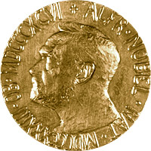
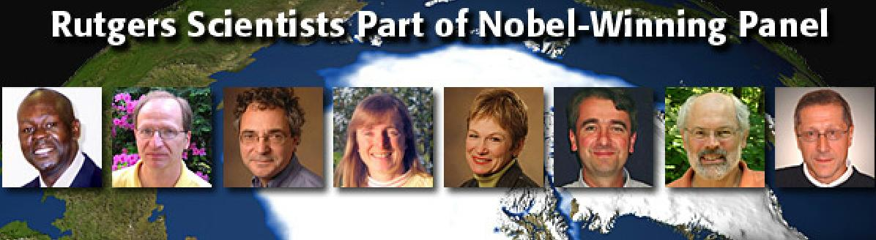
Intergovernmental Panel on Climate Change (IPCC)
Established in 1988 jointly by the World Meteorological Organization and the UN Environment Programme
  2500 scientists from more than 150 nations
Winner of 2007 Nobel Peace Prize
First Assessment Report (FAR), 1990
Second Assessment Report (SAR), 1996
Third Assessment Report (TAR), 2001
Fourth Assessment Report (AR4), 2007
Fifth Assessment Report (AR5), 2013

Slide 3
In this Summary for Policymakers, the following terms have been used to indicate the assessed likelihood, using expert judgment, of an outcome or a result:
Virtually certain > 99% probability of occurrence
Extremely likely > 95%
Very likely > 90%
Likely > 66%
More likely than not > 50%
Unlikely < 33%,
Very unlikely < 10%
Extremely unlikely < 5%

Slide 4
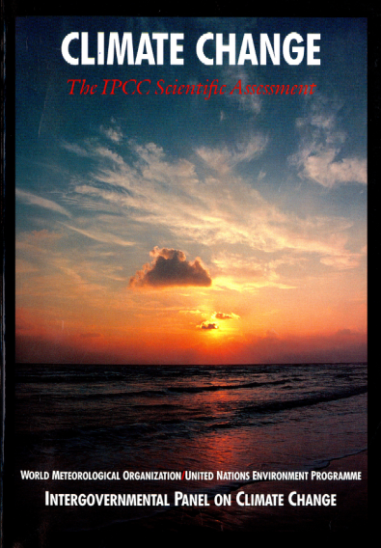
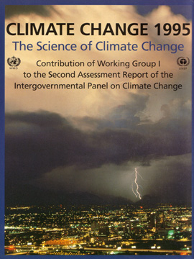
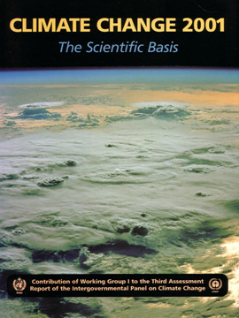
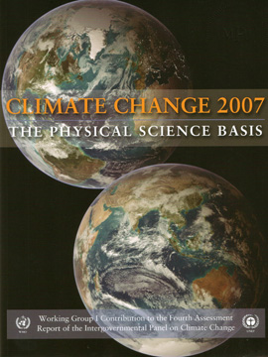
“The unequivocal detection of the enhanced greenhouse effect from observations is not likely for a decade or more.”
Climate Change – The IPCC Scientific Assessment (1990)
“The balance of evidence suggests
a discernible human influence on global climate.”
Climate Change 1995 – The Second IPCC Assessment
“Most of the observed warming over the last 50 years is likely to have been due to the increase in greenhouse gas concentrations.”
Climate Change 2001 – The Third IPCC Assessment
“Most of the observed increase in globally averaged temperatures since the mid-20th century is very likely due to the observed increase in anthropogenic greenhouse gas concentrations.”
Climate Change 2007 – The Fourth IPCC Assessment

Slide 5
“The unequivocal detection of the enhanced greenhouse effect from observations is not likely for a decade or more.”
Climate Change – The IPCC Scientific Assessment (1990)
“The balance of evidence suggests
a discernible human influence on global climate.”
Climate Change 1995 – The Second IPCC Assessment
“Most of the observed warming over the last 50 years is likely to have been due to the increase in greenhouse gas concentrations.”
Climate Change 2001 – The Third IPCC Assessment
“Most of the observed increase in globally averaged temperatures since the mid-20th century is very likely due to the observed increase in anthropogenic greenhouse gas concentrations.”
Climate Change 2007 – The Fourth IPCC Assessment

Slide 6
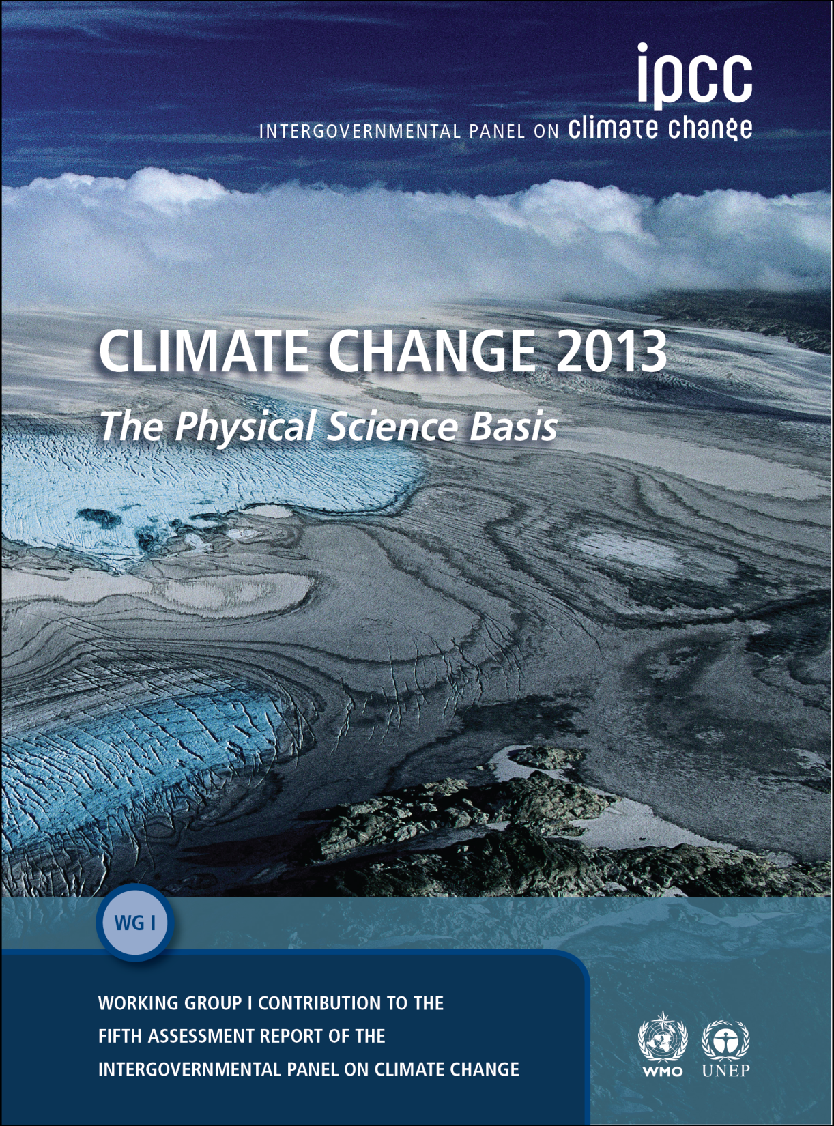
It is extremely likely that human influence has been the dominant cause of the observed warming since the mid-20th century.

Slide 7
In this Summary for Policymakers, the following terms have been used to indicate the assessed likelihood, using expert judgment, of an outcome or a result:
Virtually certain > 99% probability of occurrence
Extremely likely > 95%
Very likely > 90%
Likely > 66%
More likely than not > 50%
Unlikely < 33%,
Very unlikely < 10%
Extremely unlikely < 5%
What is new: It is now extremely likely that humans caused recent climate change.

Slide 8
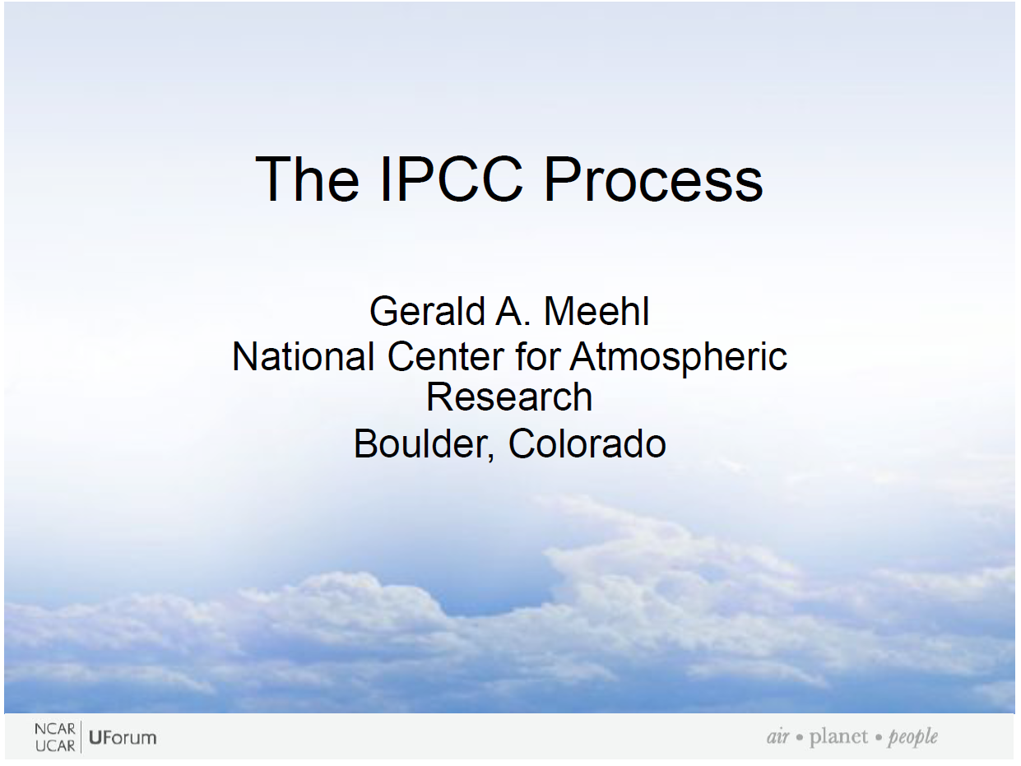

Slide 9
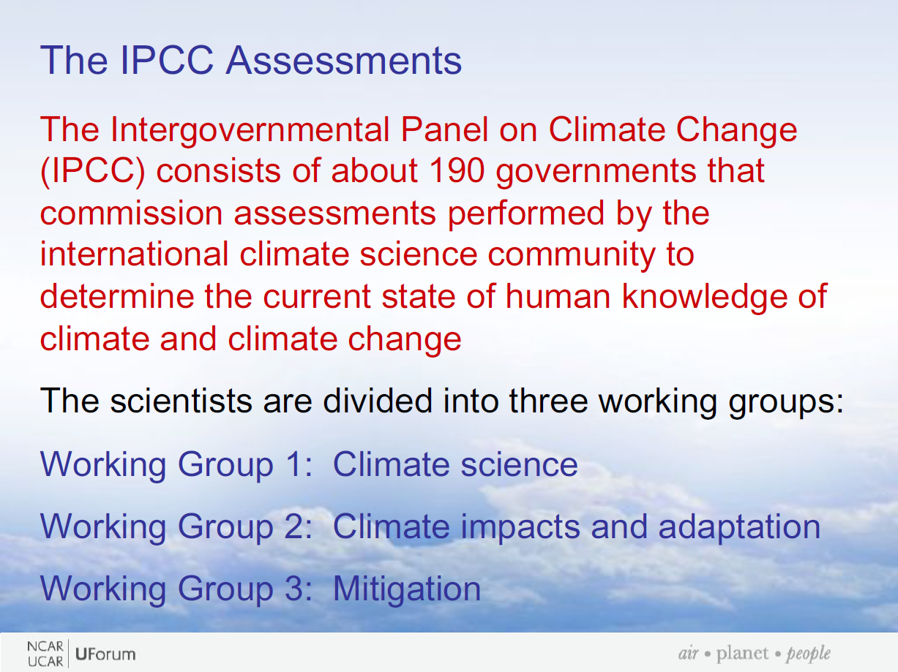

Slide 10
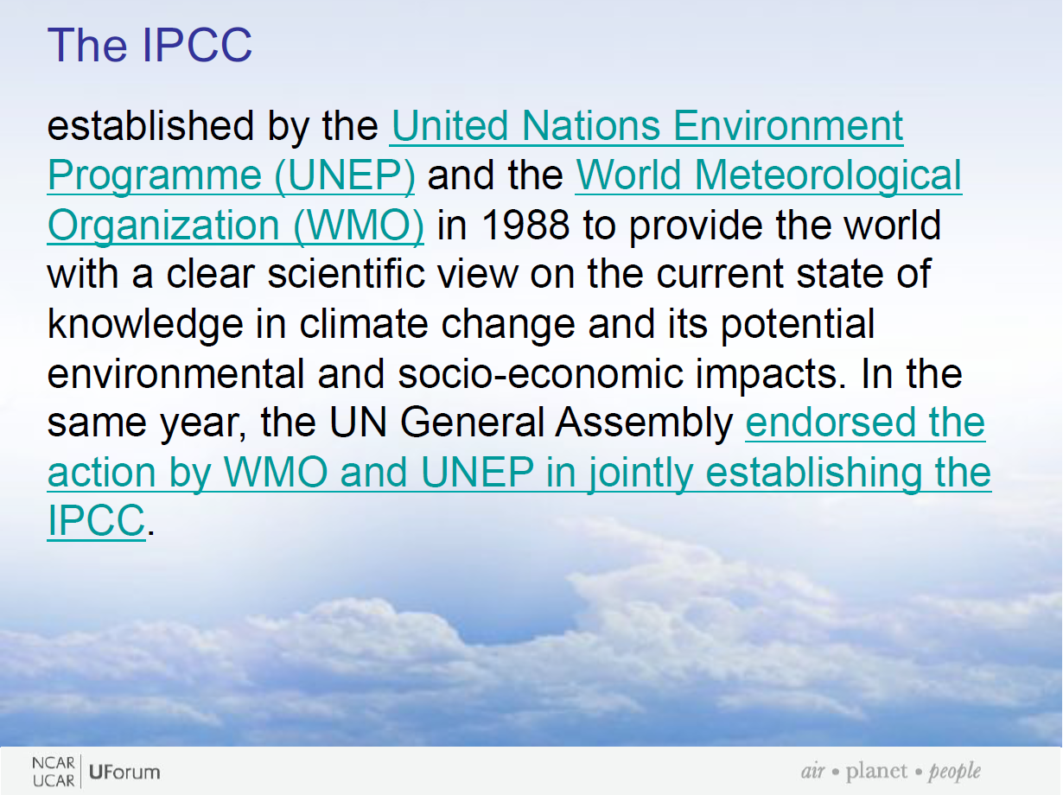

Slide 11
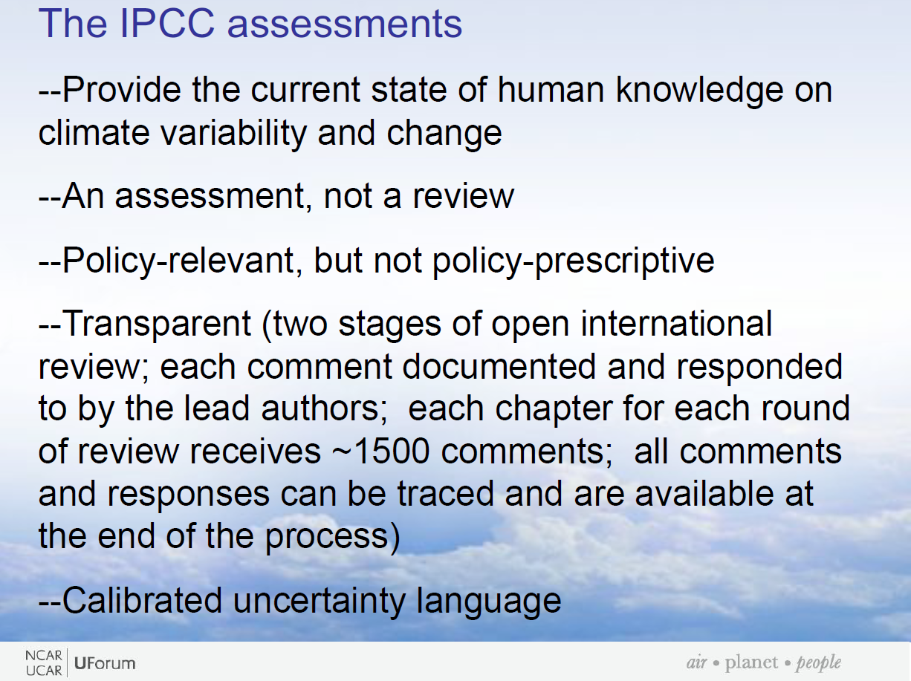

Slide 12
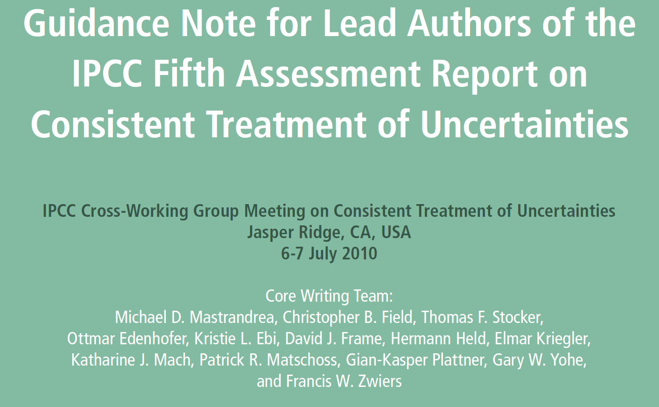

Slide 13
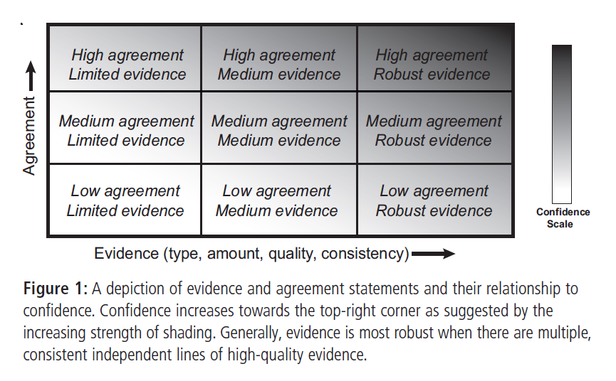

Slide 14
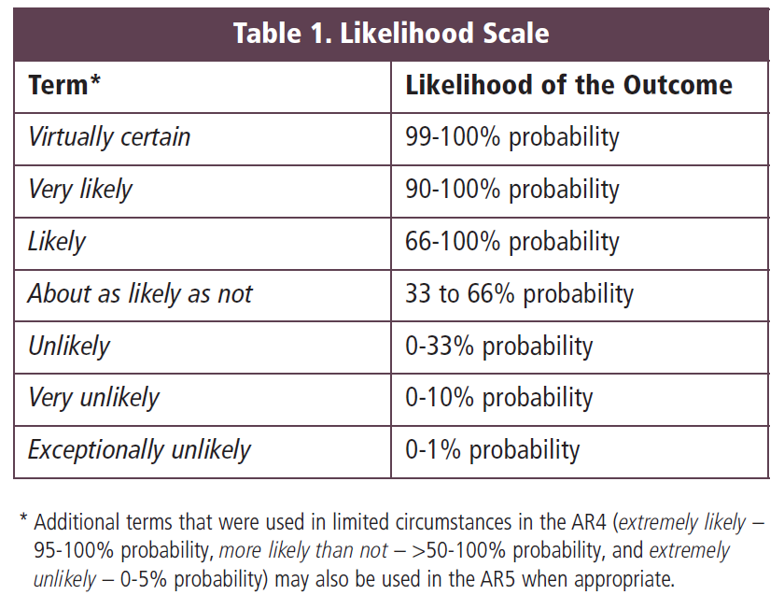

Slide 15
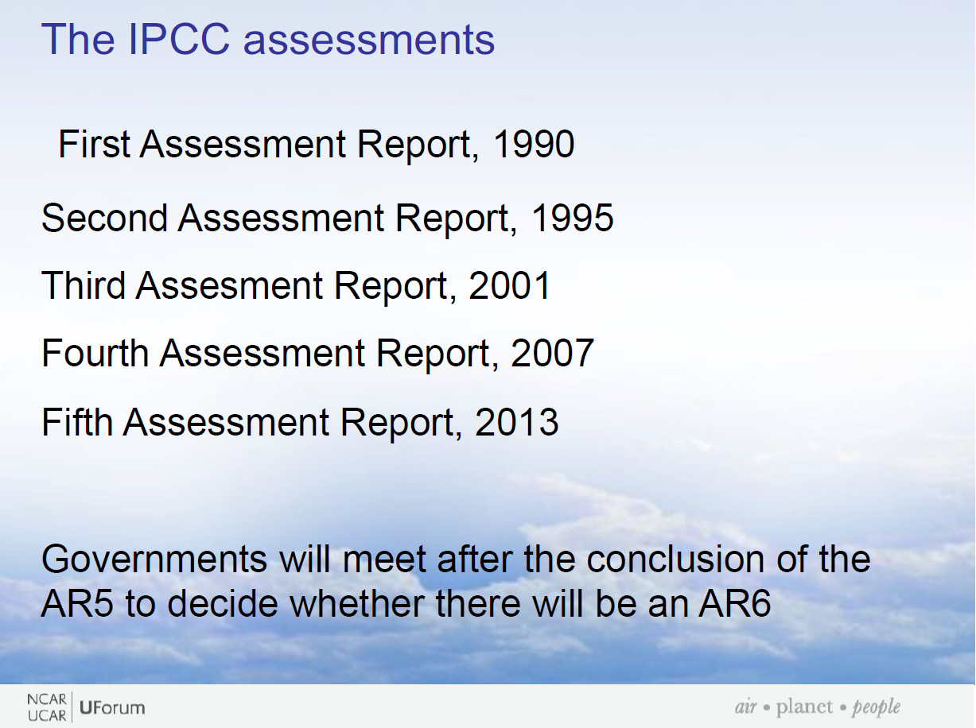
FAR
SAR
TAR
AR4
AR5

Slide 16
The Working Group Reports and Synthesis Report will be completed in 2013/2014. The Fifth Assessment Report will be considered by the Panel according to the following timetable:
IPCC Fifth Assessment Report Final Plenaries
Working Group I (Stockholm, Sweden) | 23-26 September 2013
Working Group II (Yokohama, Japan) | 25-29 March 2014
Working Group III (Berlin, Germany) | 7-11 April 2014
Synthesis Report (Copenhagen, Denmark) | 27-31 October 2014

Slide 17
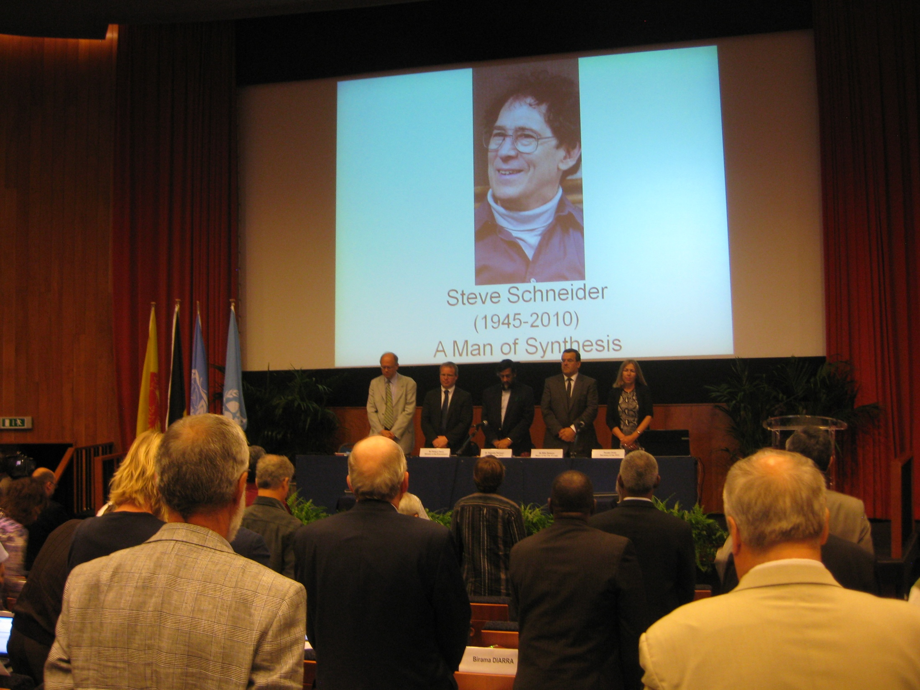
Scoping Meeting
for the IPCC AR5 Synthesis Report
25-27 August 2010, Liege, Belgium

Slide 18
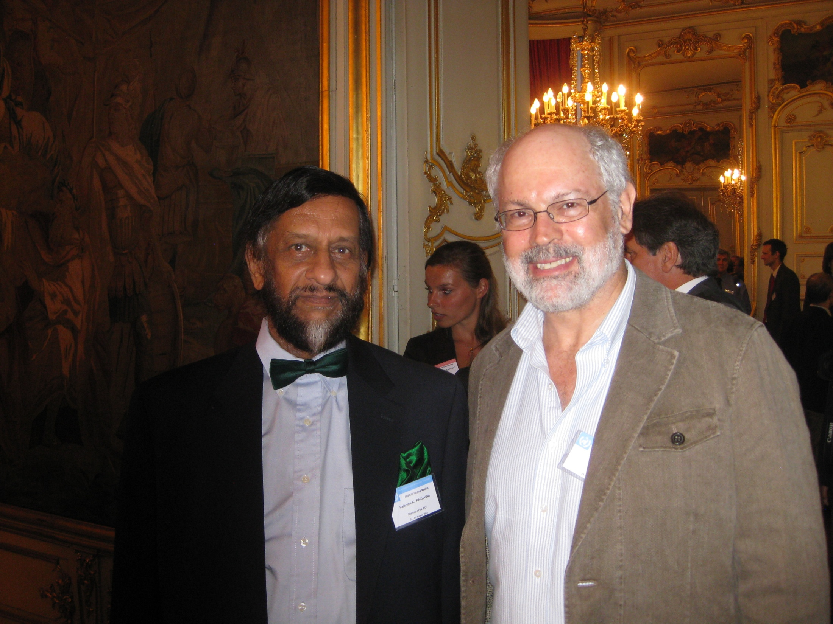

Slide 19
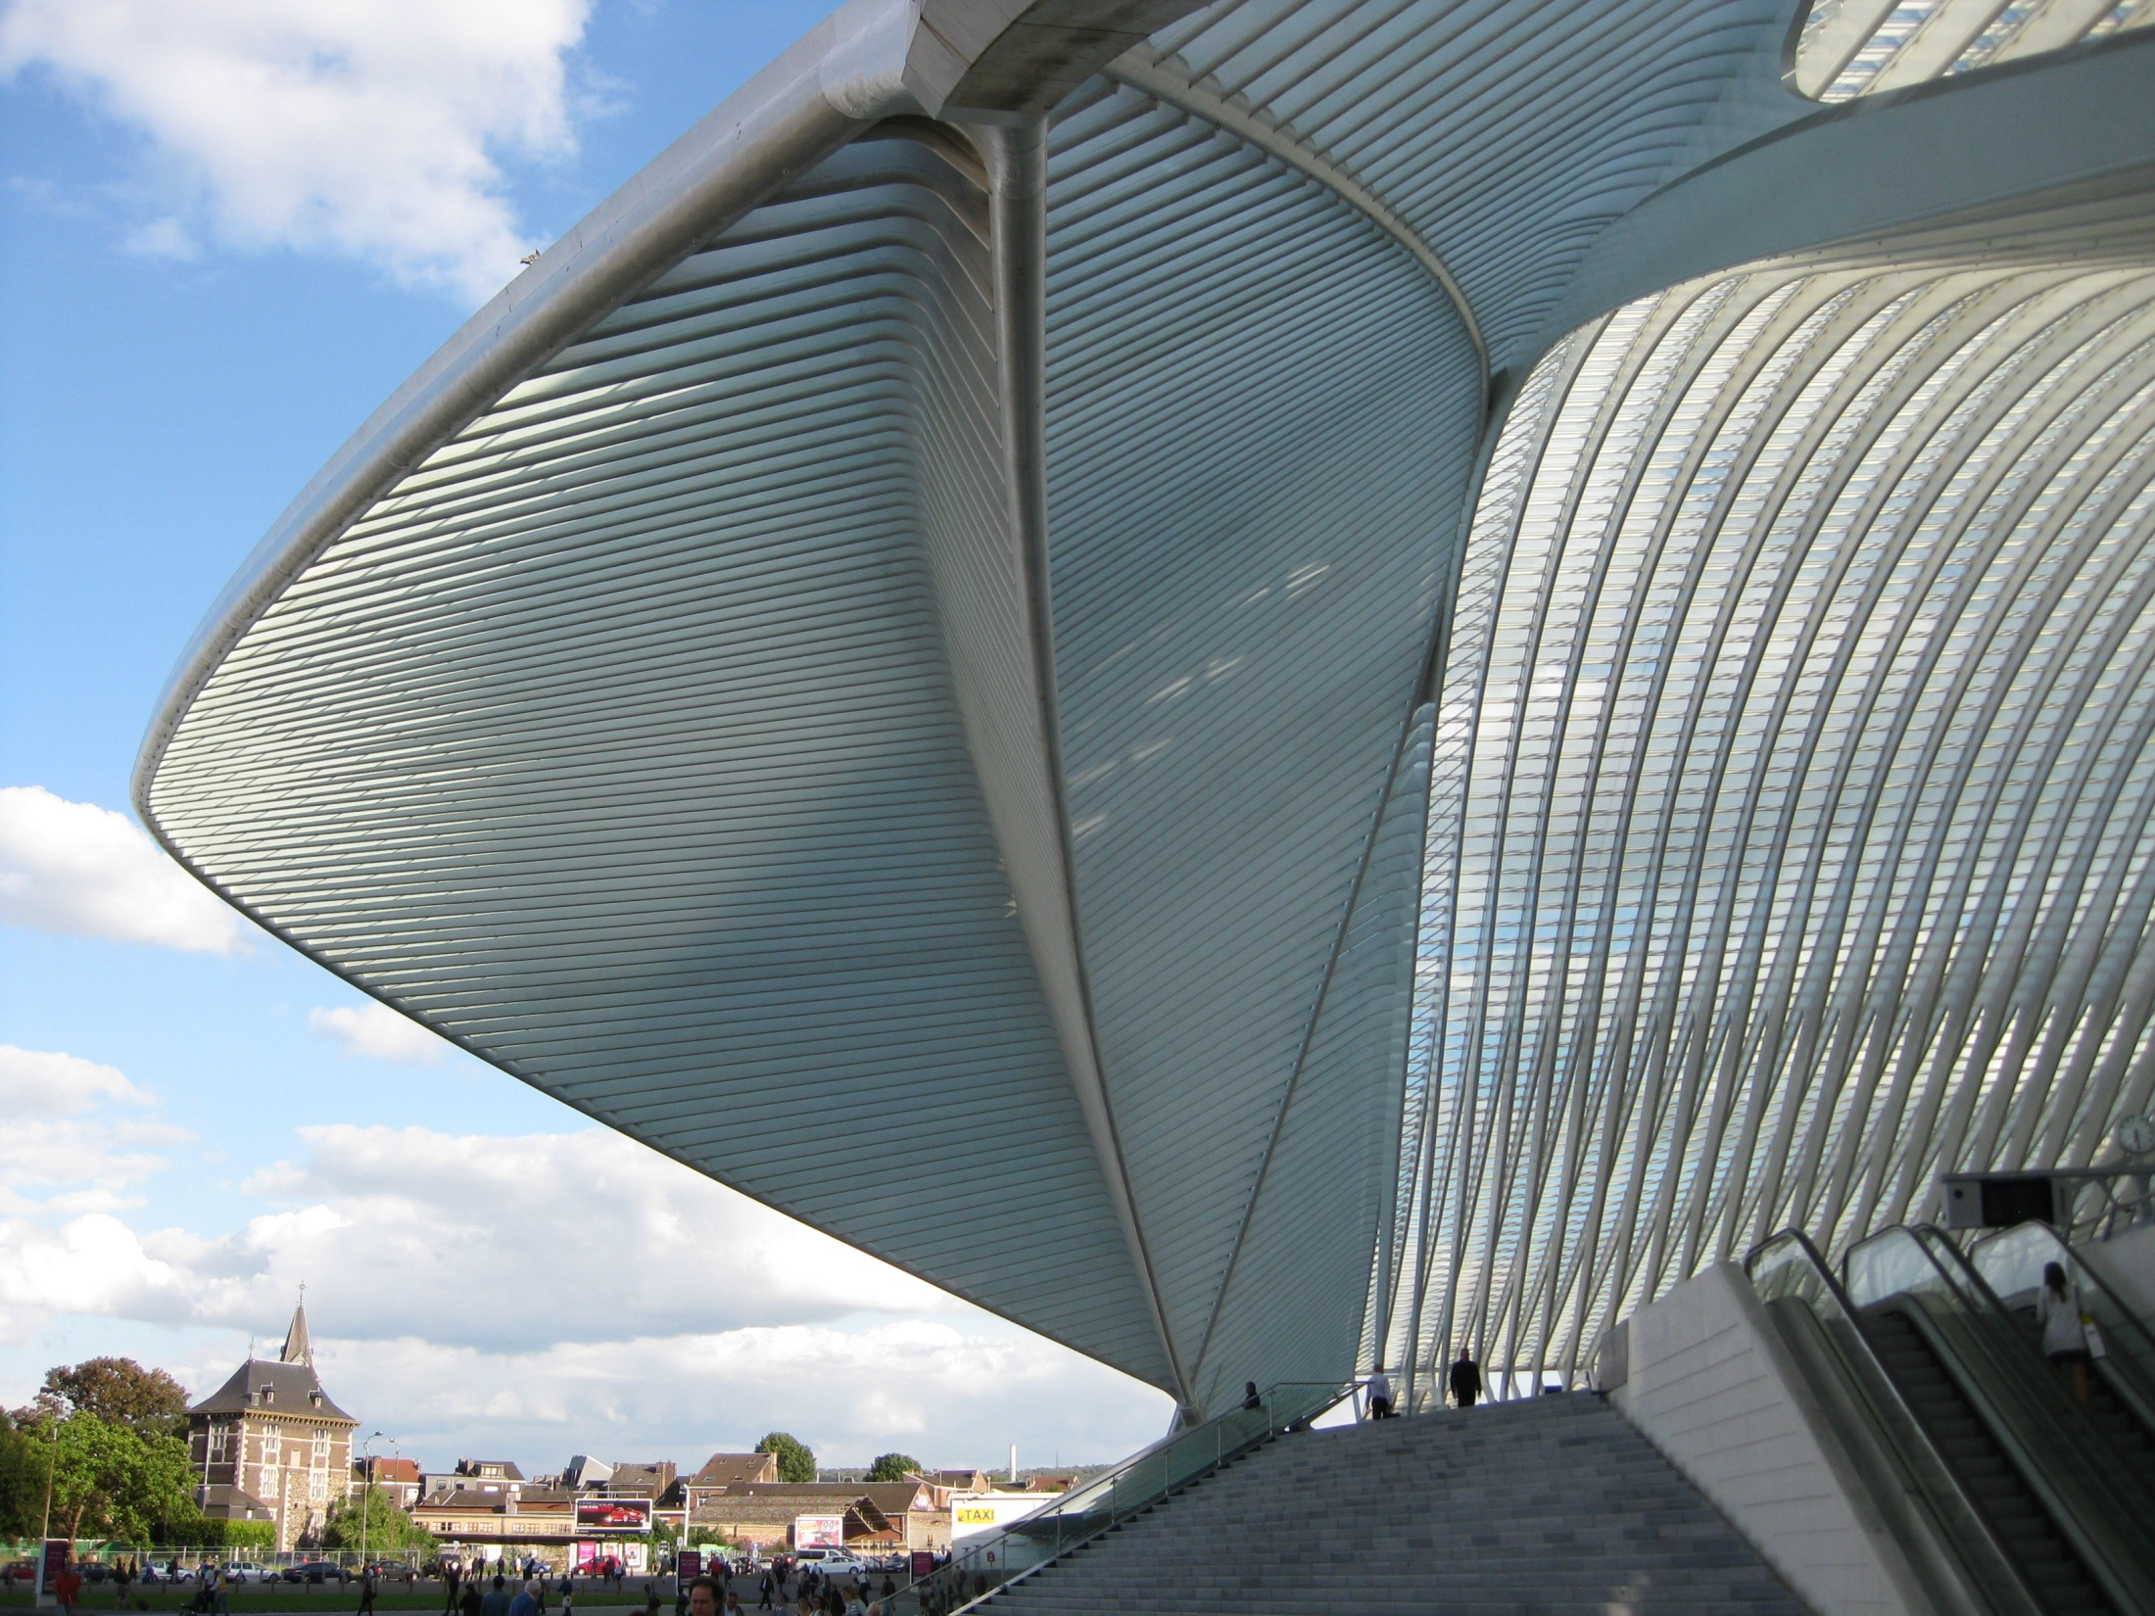

Slide 20
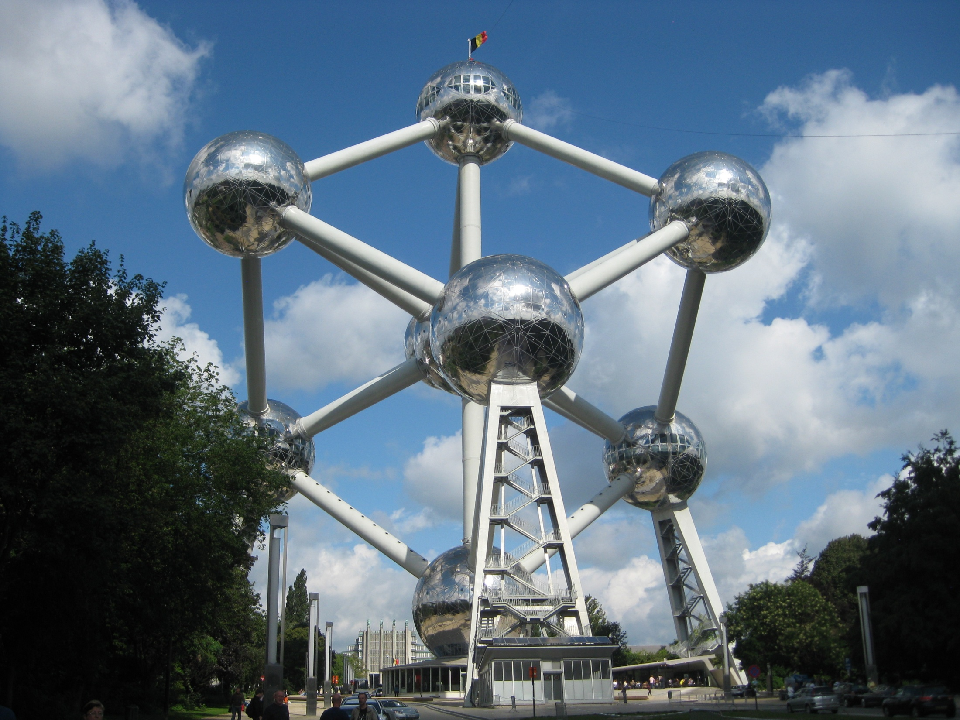

Slide 21
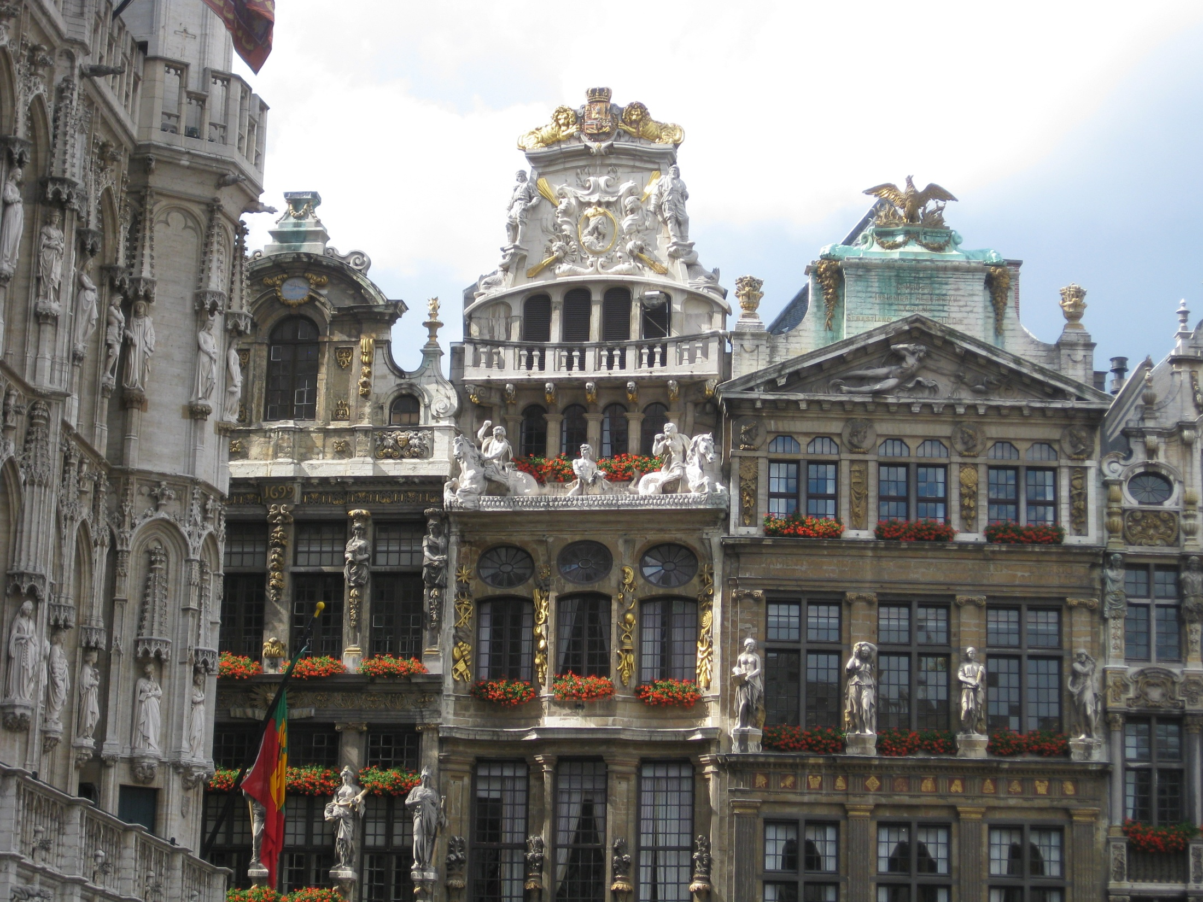

Slide 22
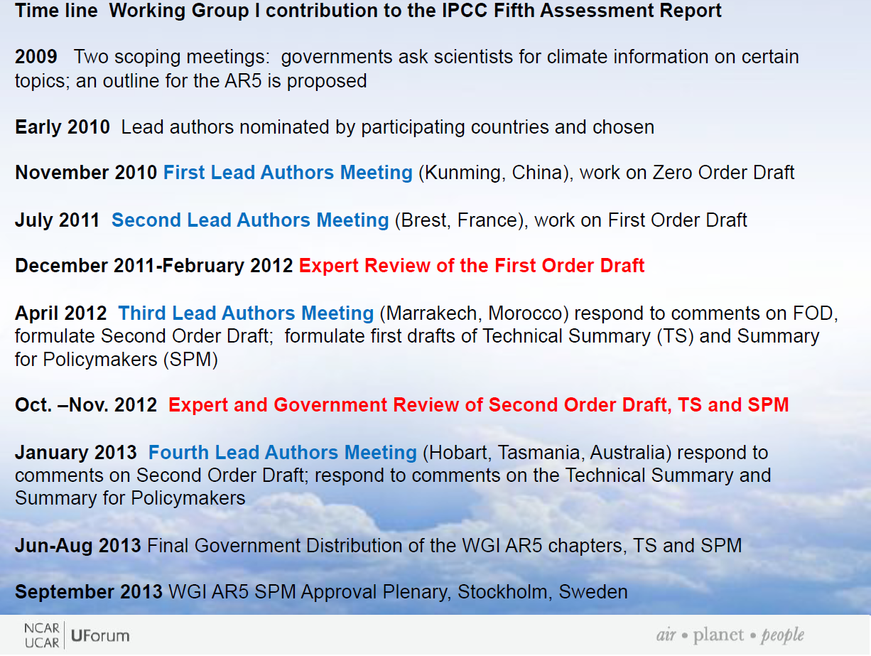

Slide 23
How do you become a Lead Author (LA)?
Nominated to your national IPCC bureau (USGCRP) (can be self-nominated)
National bureau chooses candidates to nominate to the international IPCC bureau
Lead authors chosen based on expertise and equitable representation among nations, continents, and gender.
Coordinating Lead Authors (CLAs) chosen based on same criteria, plus past experience and performance as LA.

Slide 24
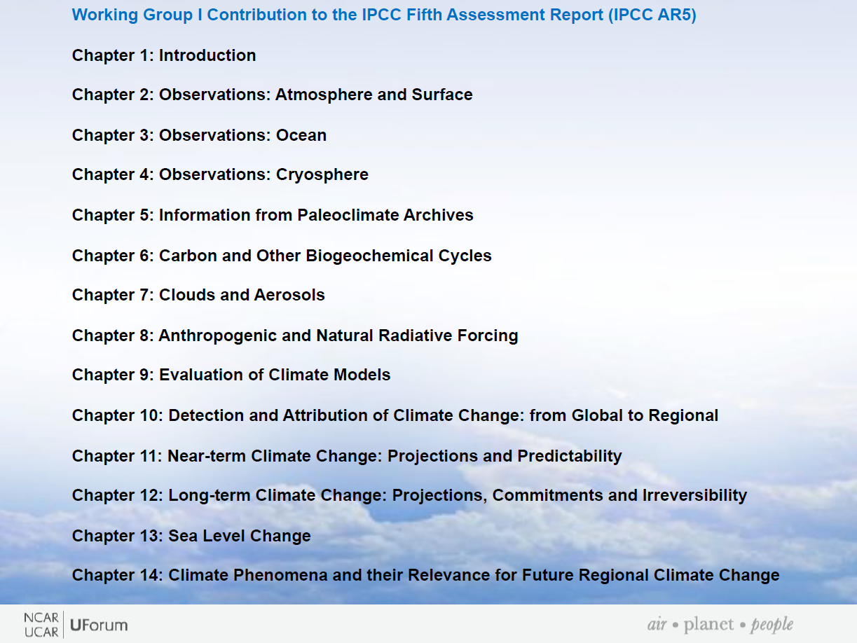

Slide 25
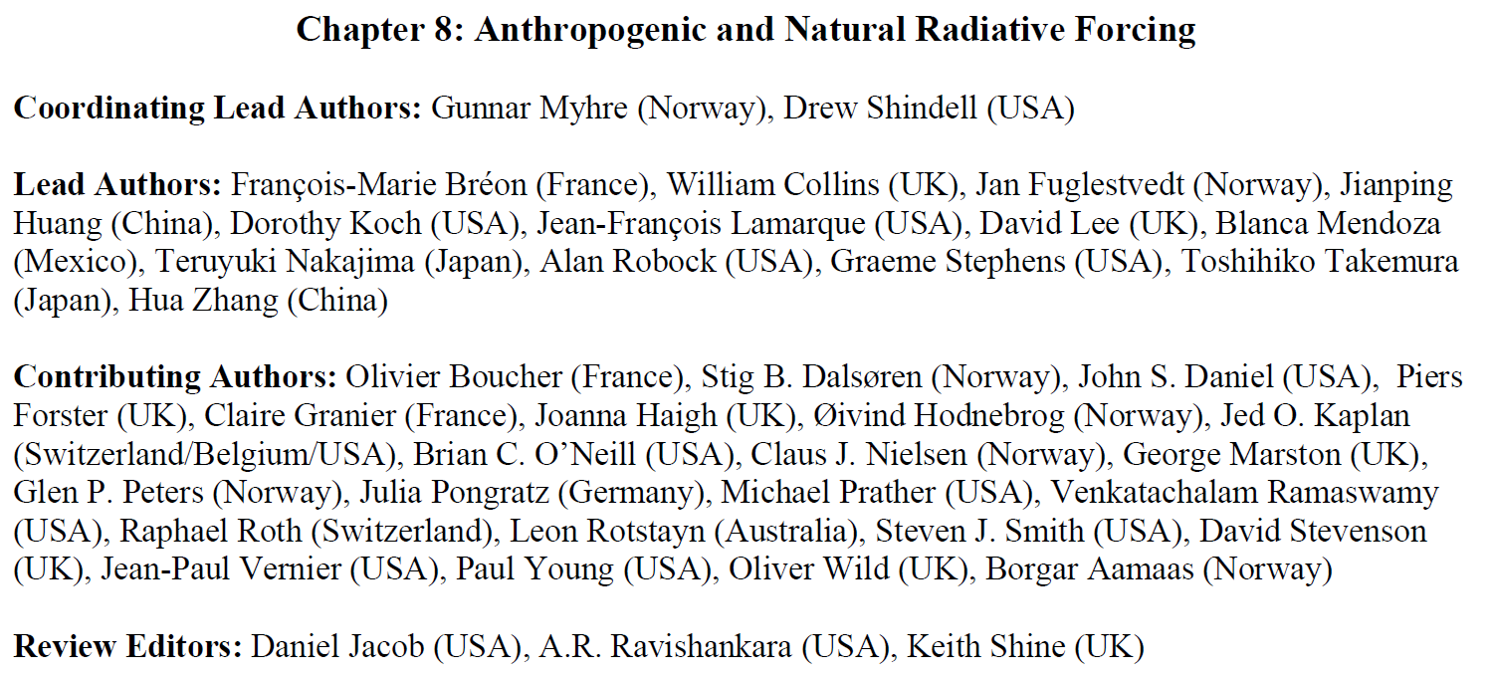

Slide 26
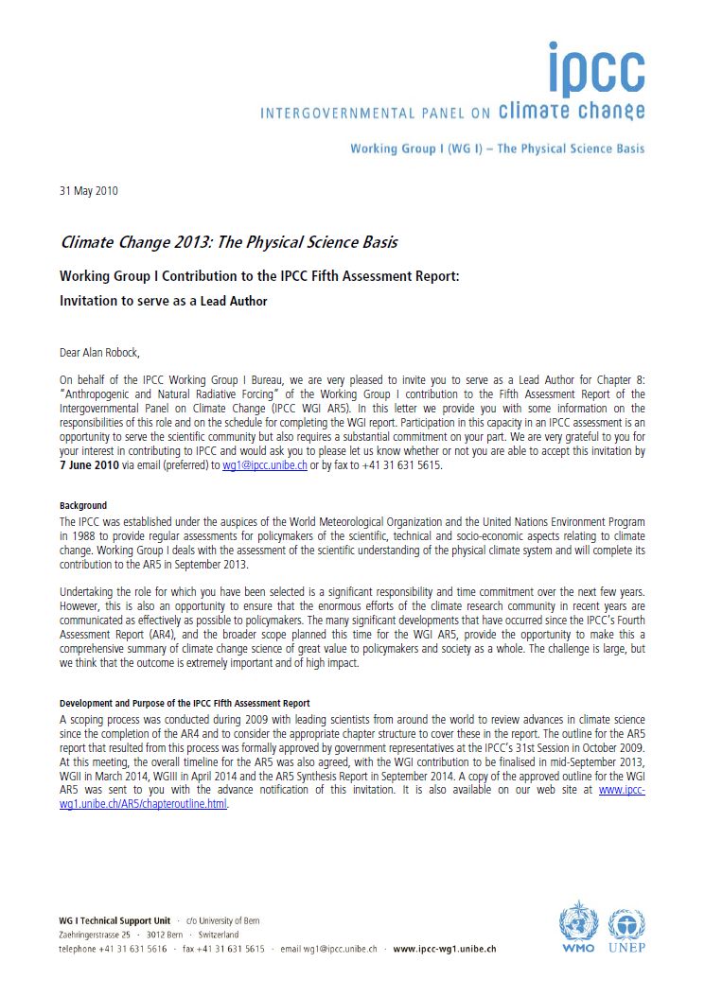
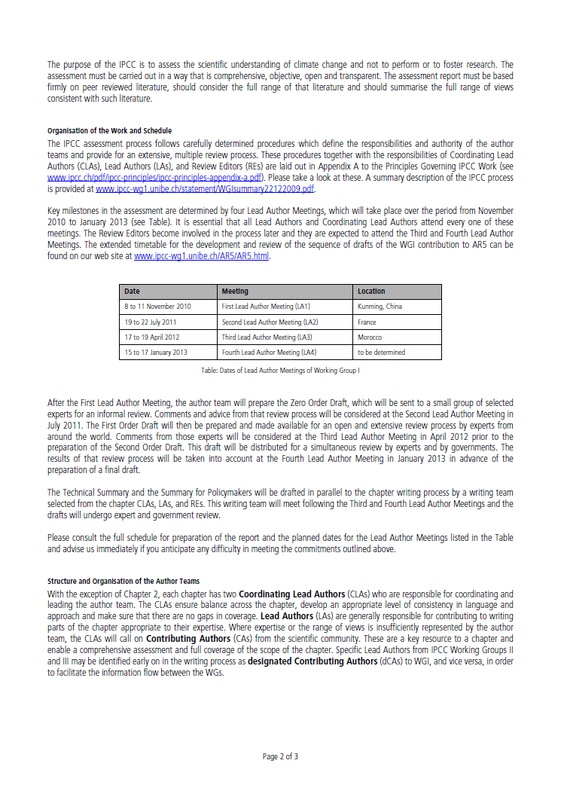

Slide 27
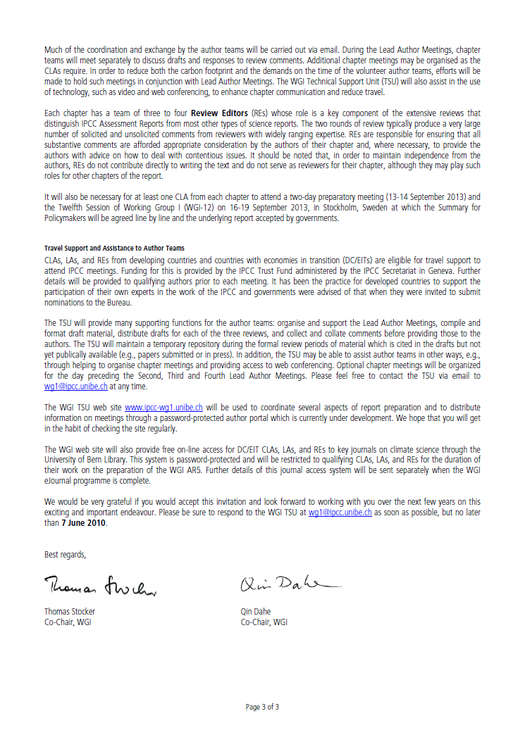

Slide 28
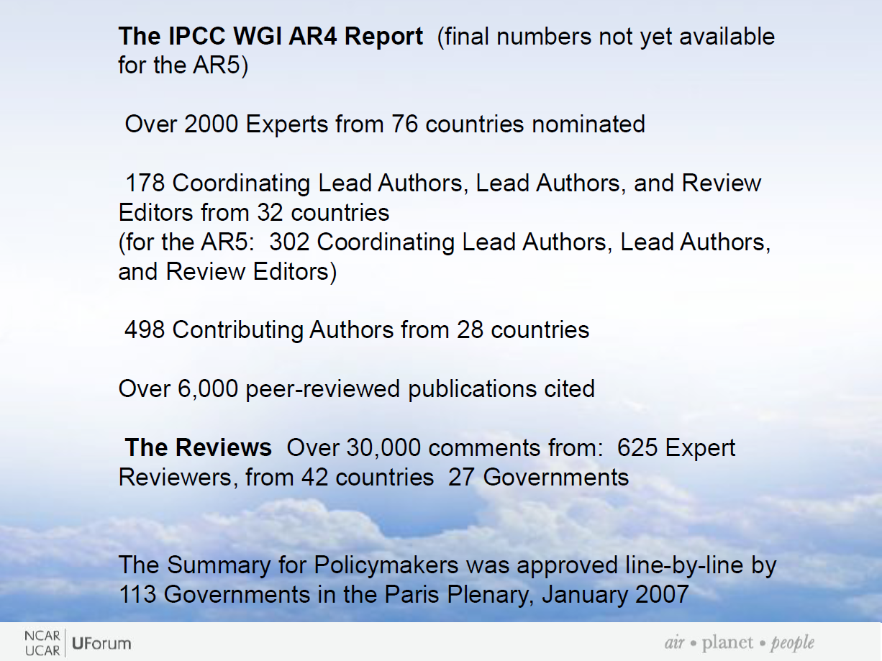

Slide 29
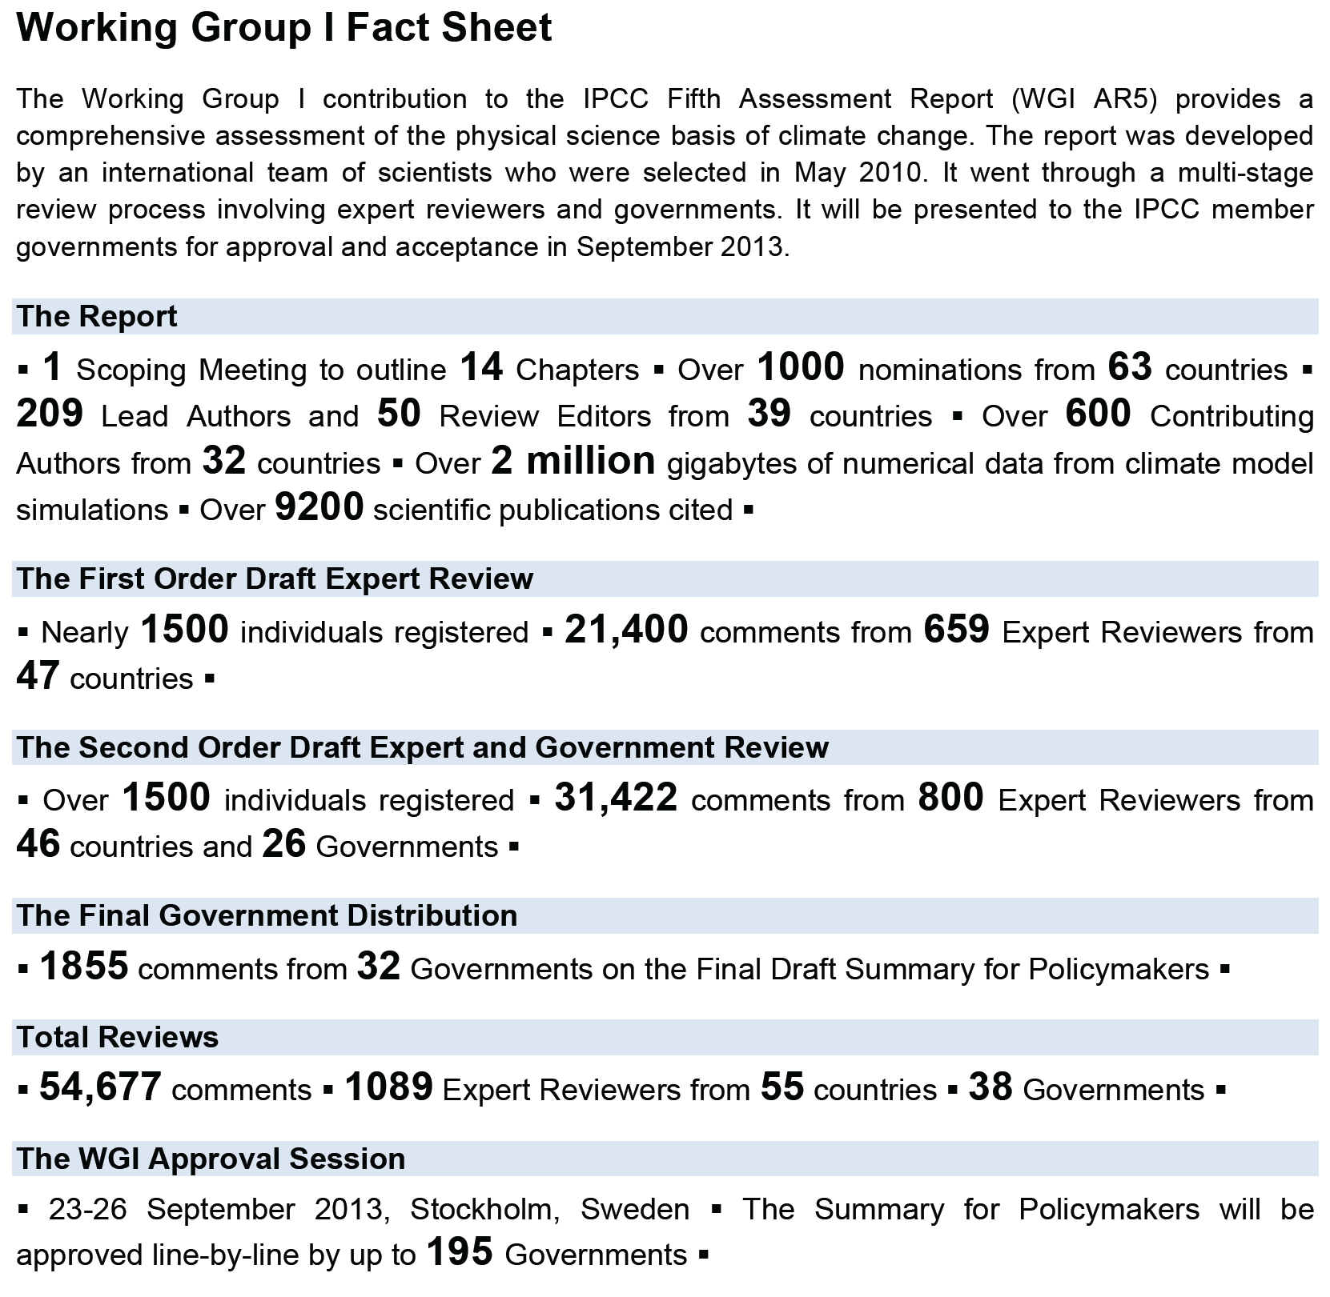

Slide 30
My IPCC participation
6 meetings:
Synthesis Report Scoping Meeting, Liege, Belgium
WG I LA Meeting, Kunming, China
WG I, II, and III Geoengineering Meeting, Lima, Peru
WG I LA Meeting, Brest, France
WG I LA Meeting, Marrakech, Morocco
WG I LA Meeting, Hobart, Australia
Lead Author, WG I, Chapter 8
Contributing Author, WG I, Chapter 5
Contributing Author, WG I, Chapter 7
Contributing Author, WG I, Chapter 11
Contributing Author, WG II, Chapter 19
Reviewer, many drafts of WG I, II, and III

Slide 31
My IPCC participation
6 meetings:
Synthesis Report Scoping Meeting, Liege, Belgium
1.26 tons CO₂
WG I LA Meeting, Kunming, China
2.68 tons CO₂
WG I, II, and III Geoengineering Meeting, Lima, Peru
1.24 tons CO₂
WG I LA Meeting, Brest, France
1.40 tons CO₂
WG I LA Meeting, Marrakech, Morocco
2.42 tons CO₂
WG I LA Meeting, Hobart, Australia
3.50 tons CO₂
Total: 12.50 tons CO₂
(My annual emissions from driving is 2.2 tons CO₂.)
http://www.travelnav.com/flight-emissions http://www.epa.gov/cleanenergy/energy-resources/calculator.html

Slide 32
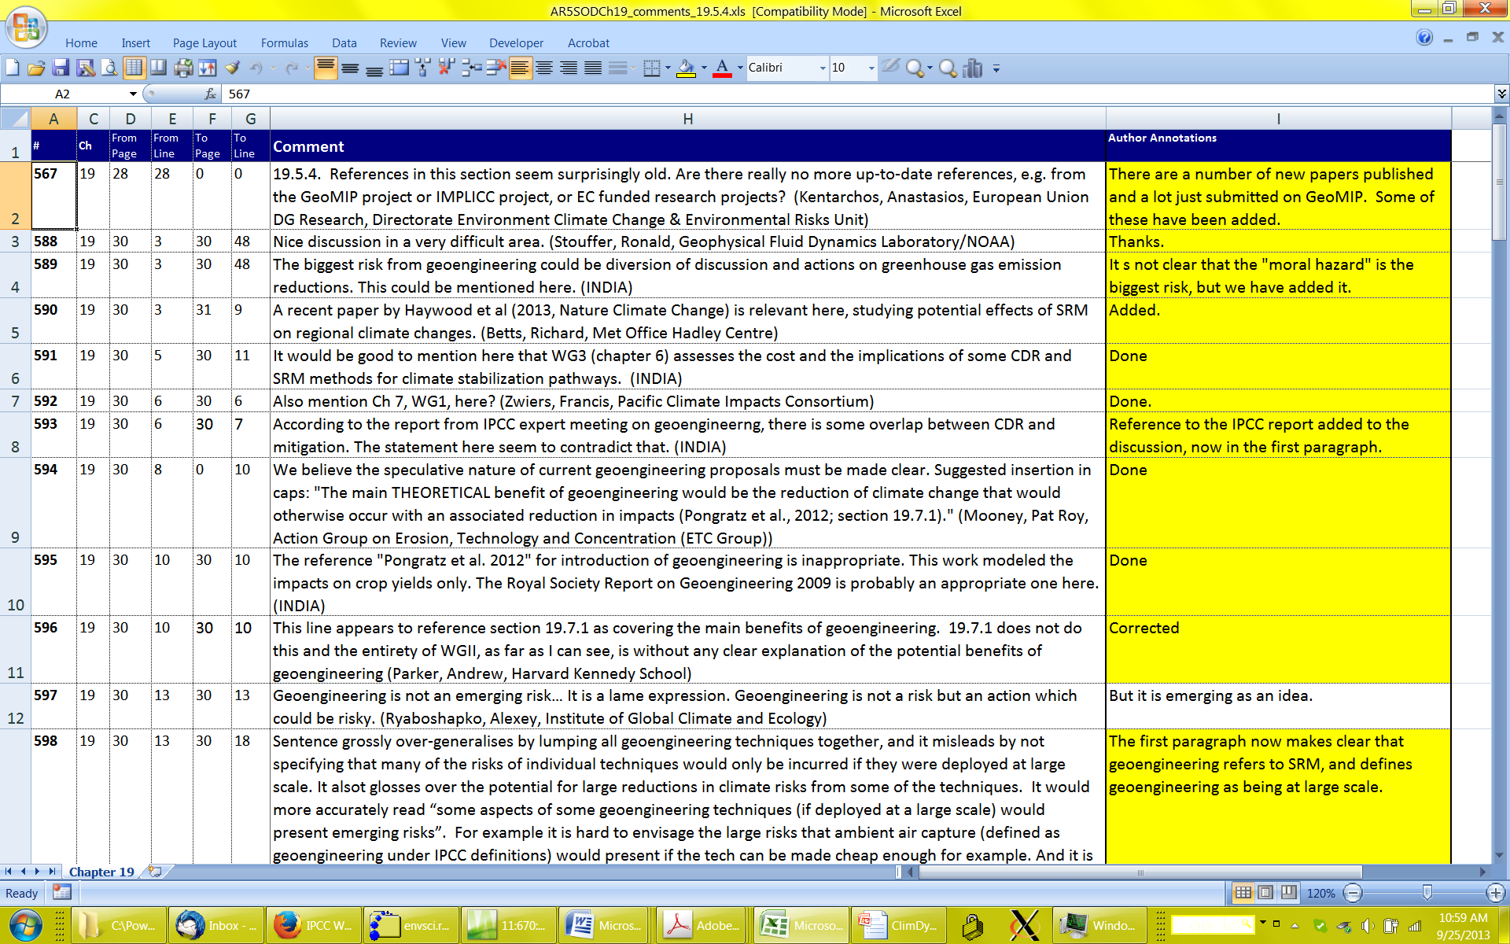
Sample of comments and responses to WG II, Chapter 19, Emerging Risks, section on geoengineering

Slide 33
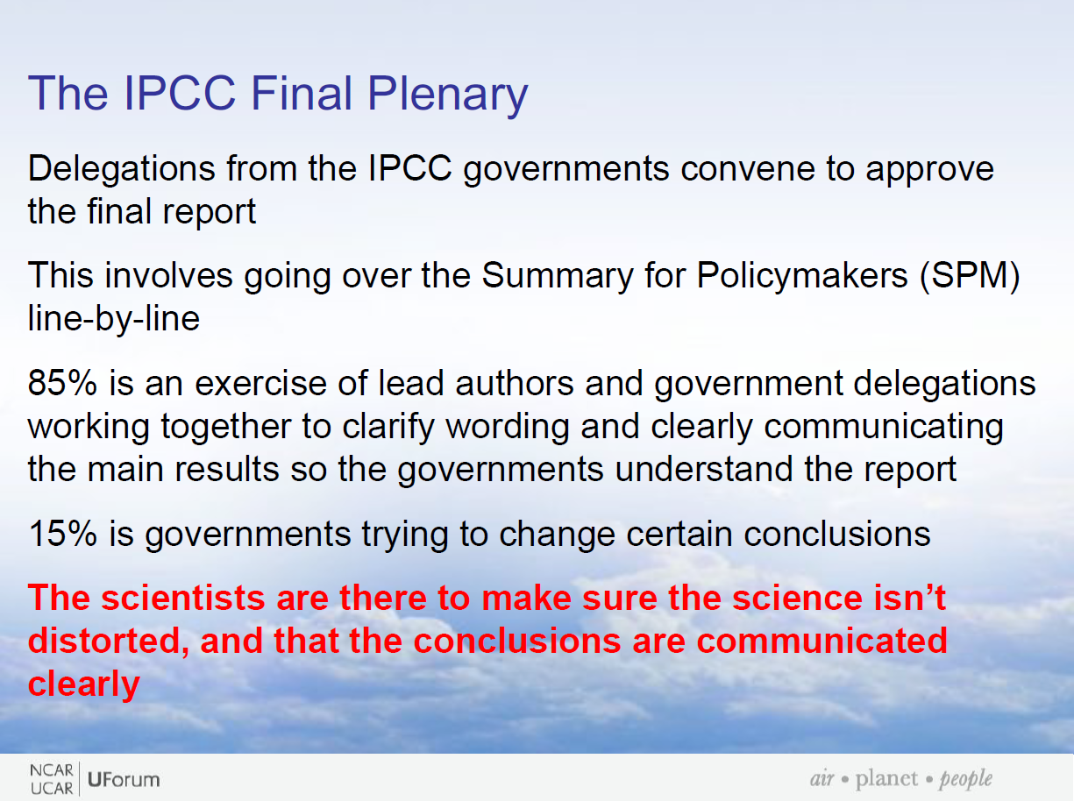

Slide 34
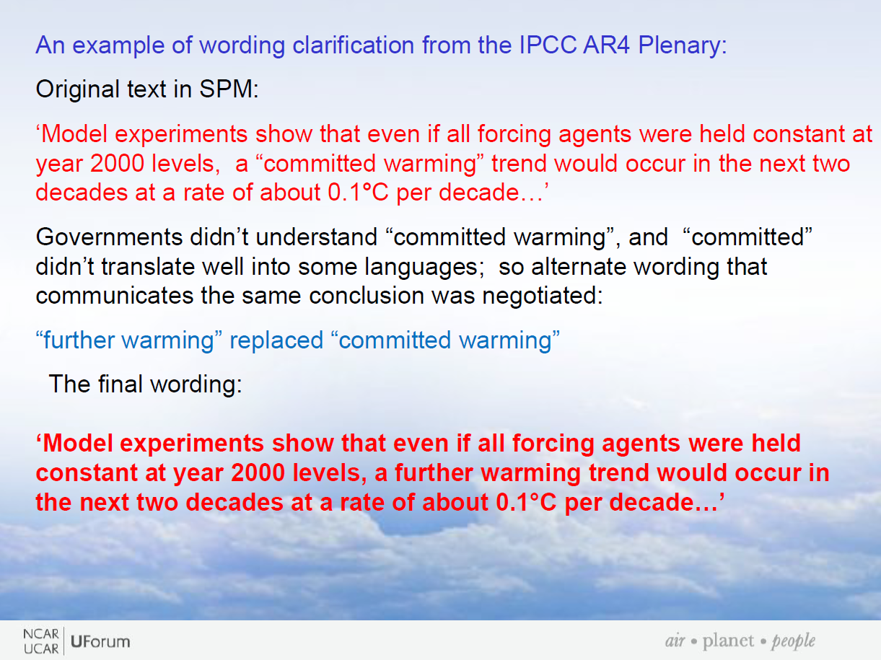

Slide 35
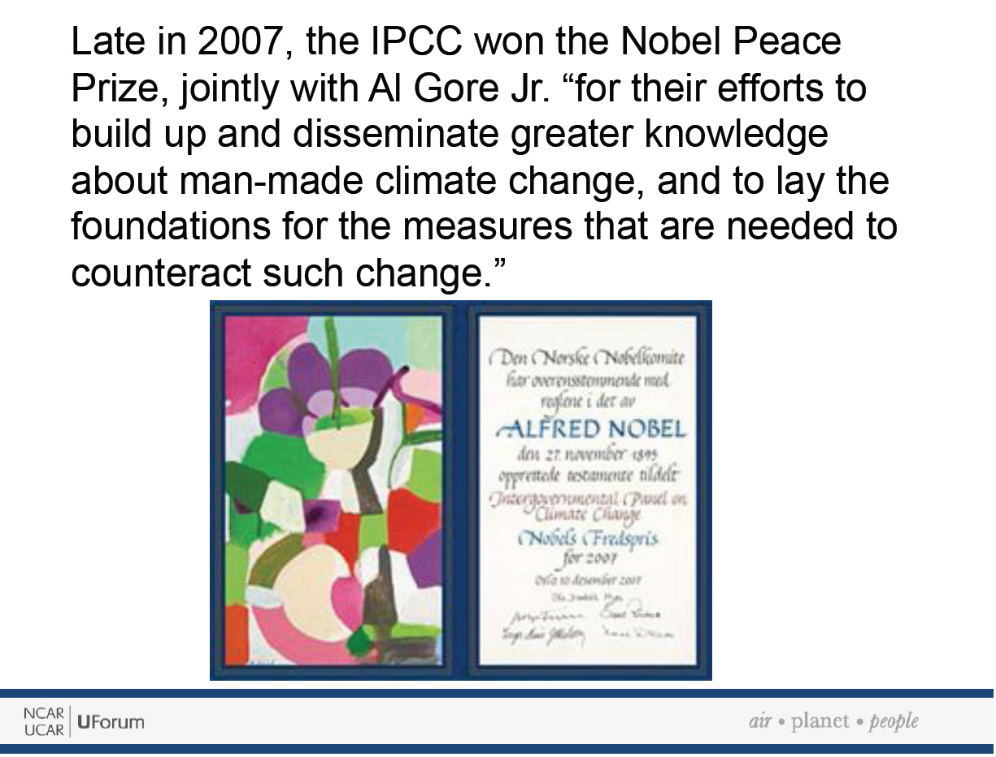

Slide 36
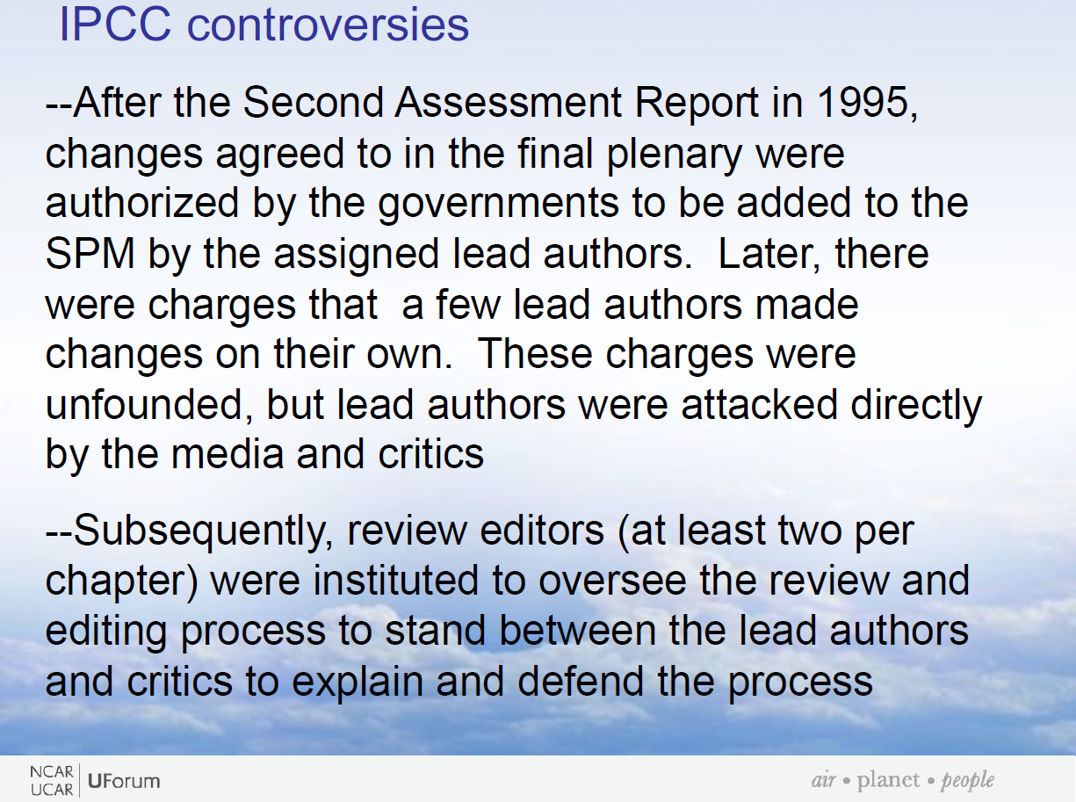

Slide 37
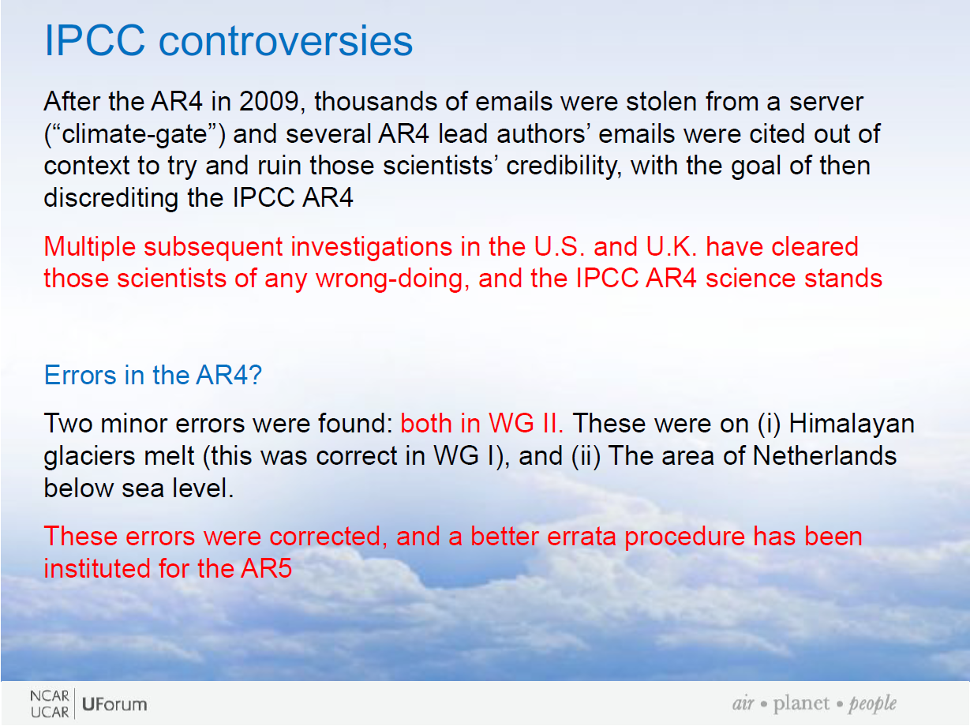

Slide 38
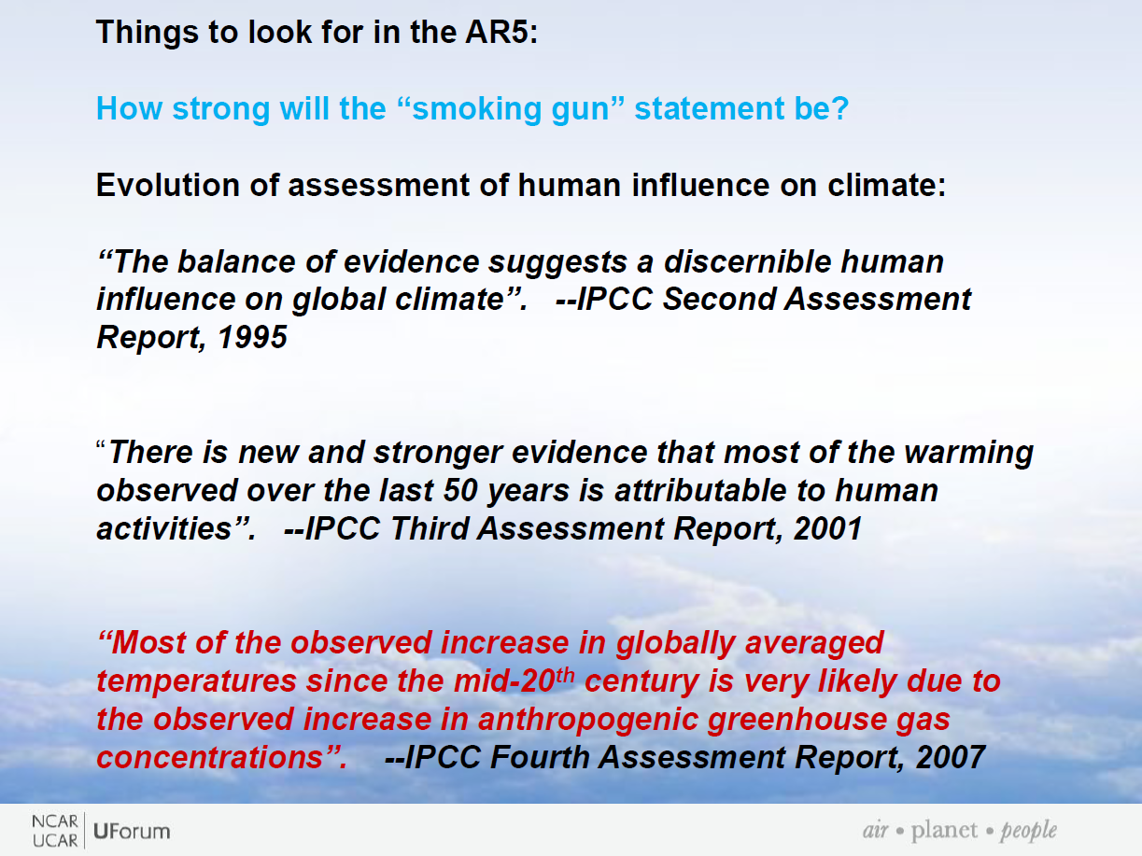

Slide 39
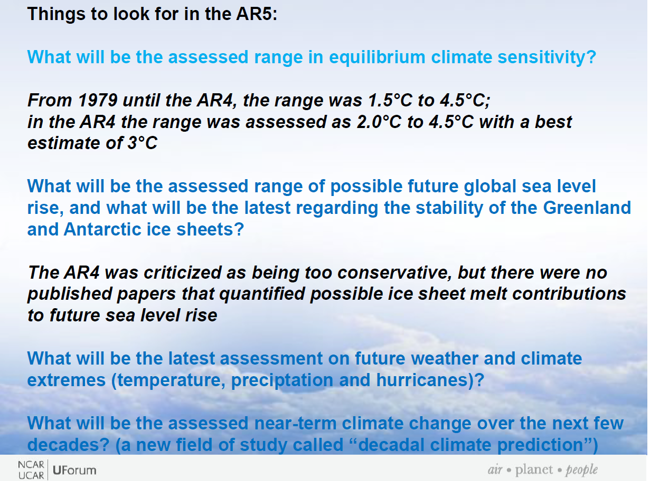

Slide 40
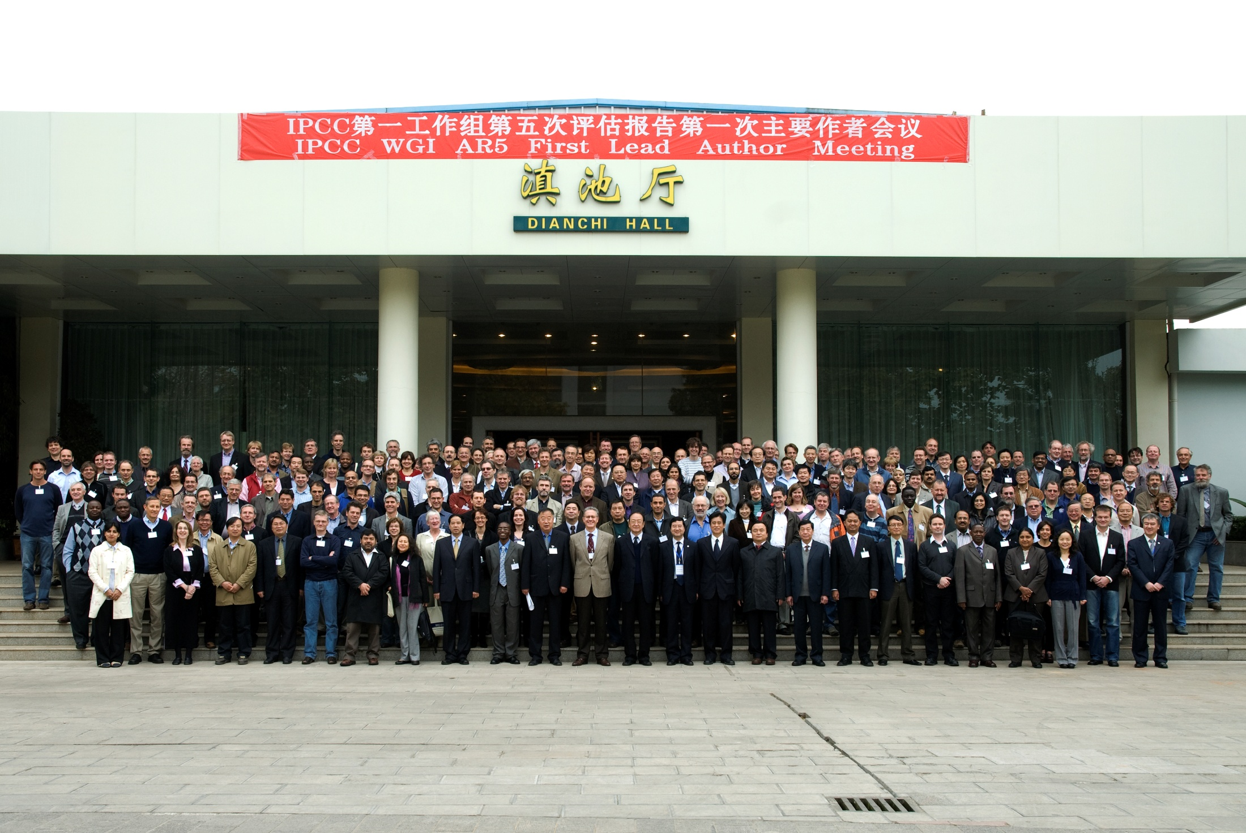

Slide 41
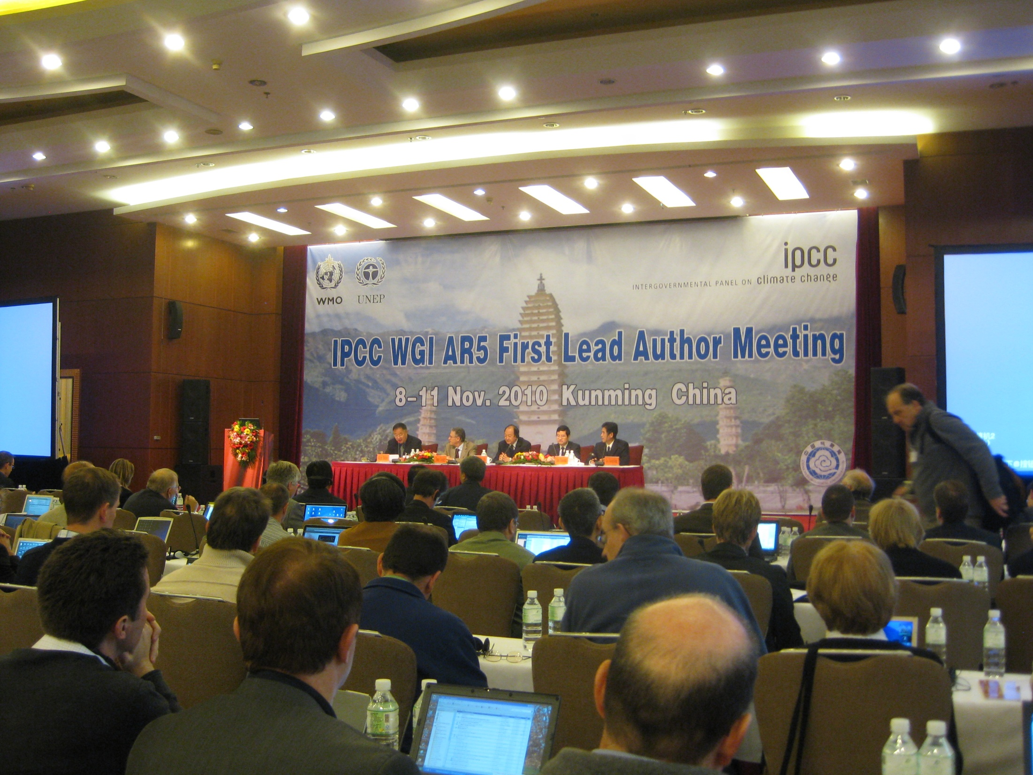

Slide 42
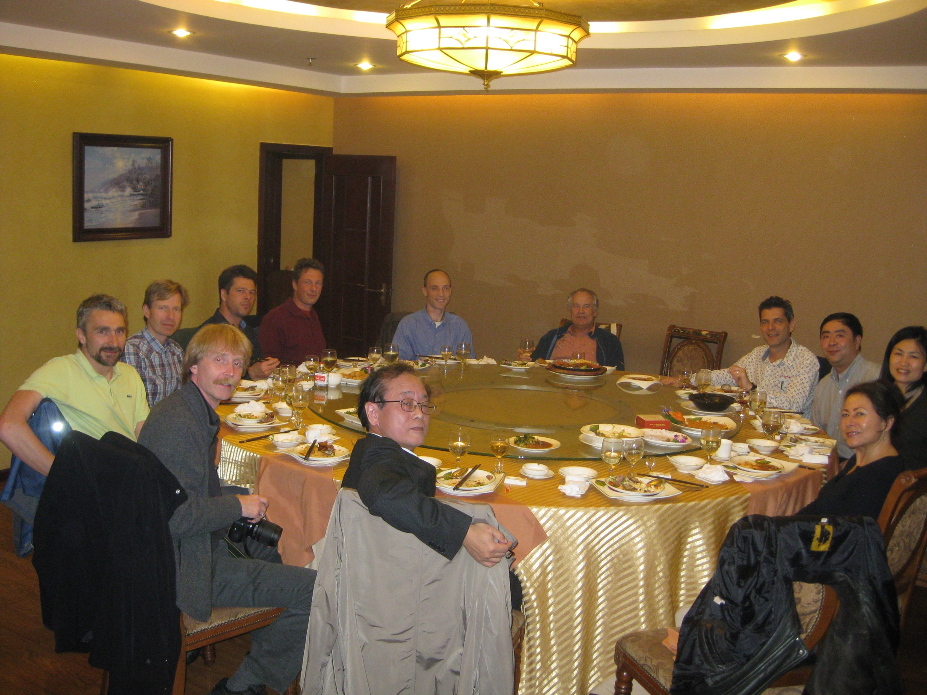

Slide 43
After the first Lead Author Meeting, we produced the Zero Order Draft, which was reviewed internally.
I was responsible for the section on Volcanic Radiative Forcing, and I included two paragraphs on how volcanic eruptions are useful as analogs to teach us about potential future anthropogenic stratospheric aerosol injections, from geoengineering and nuclear winter.

Slide 44
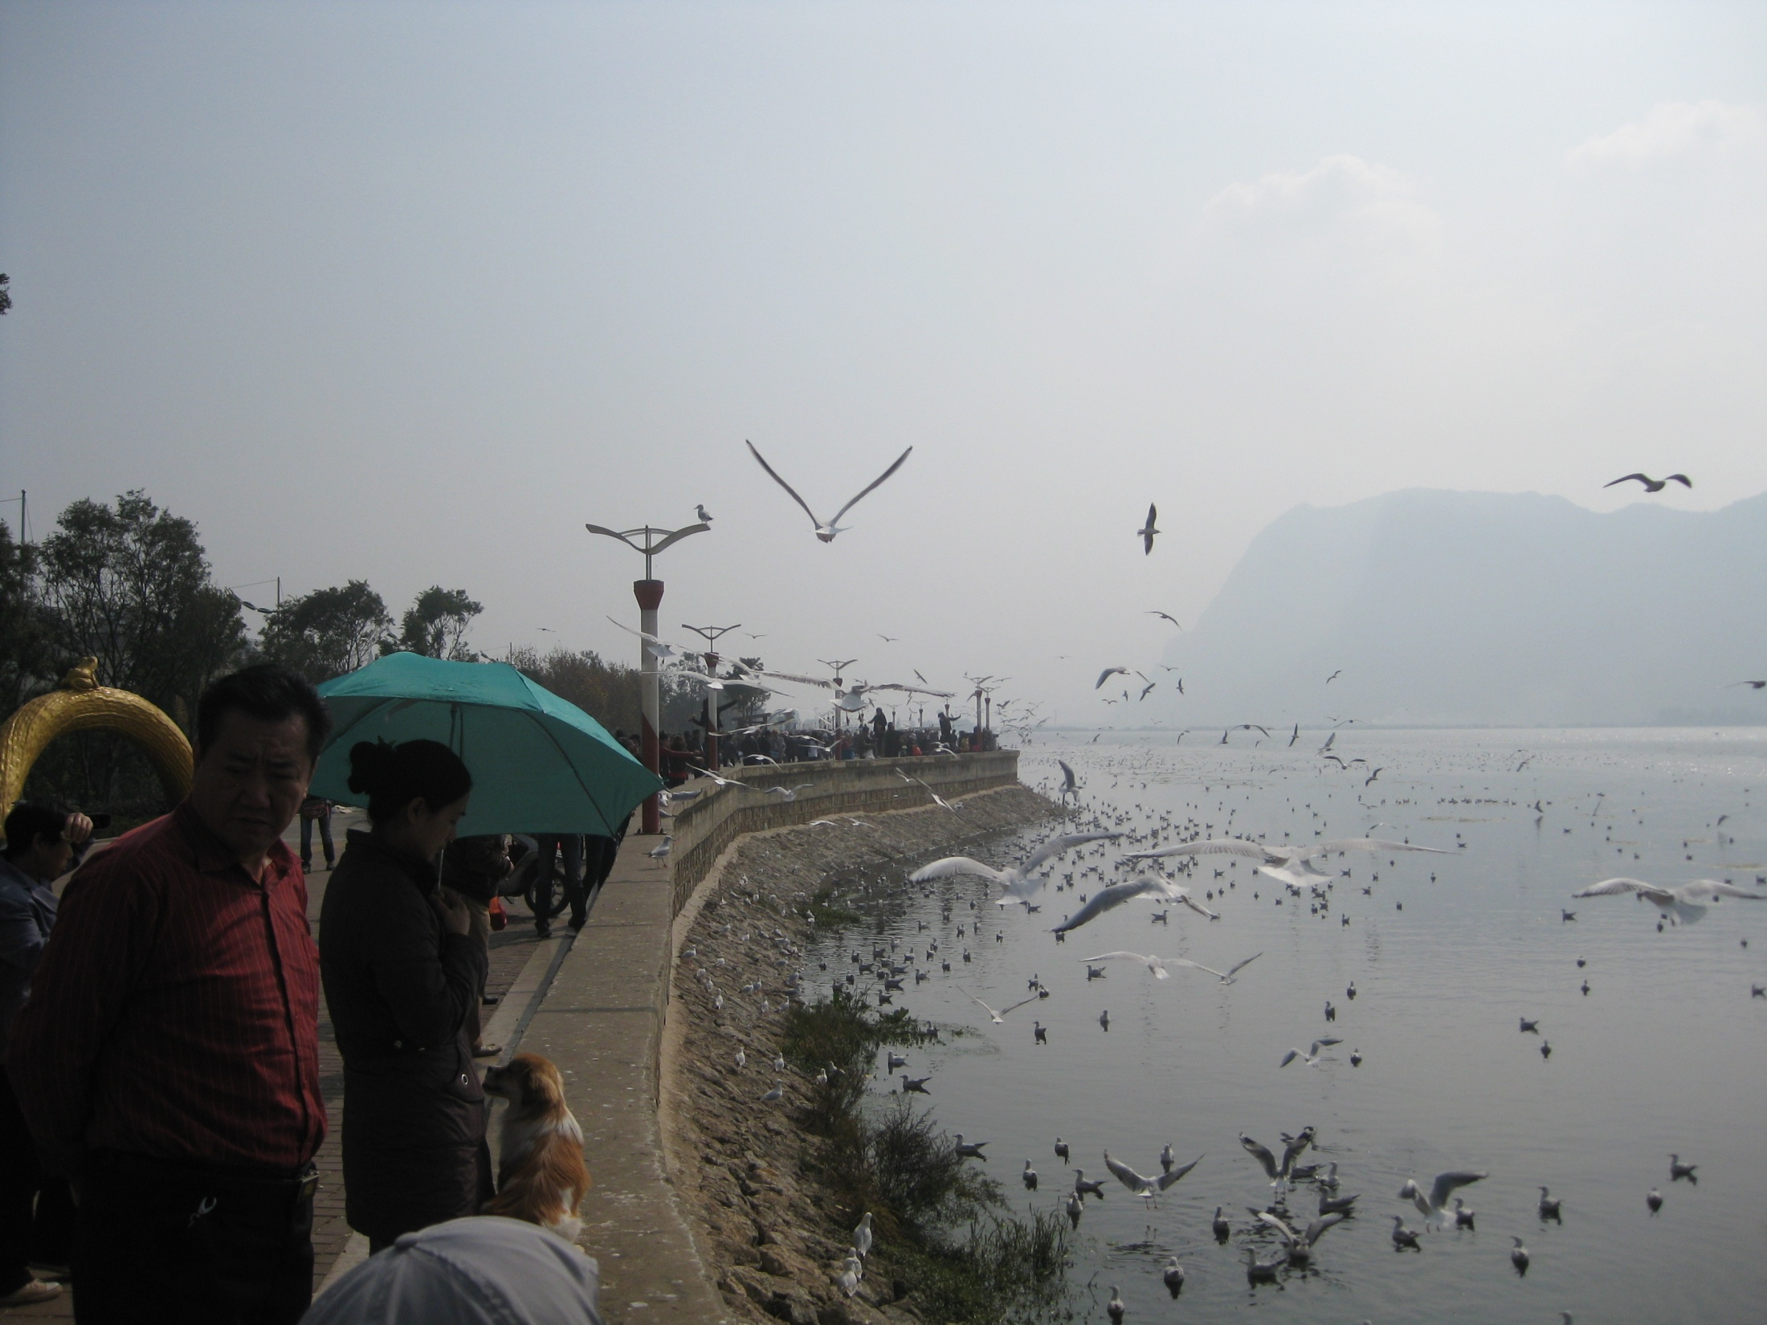

Slide 45


Slide 46
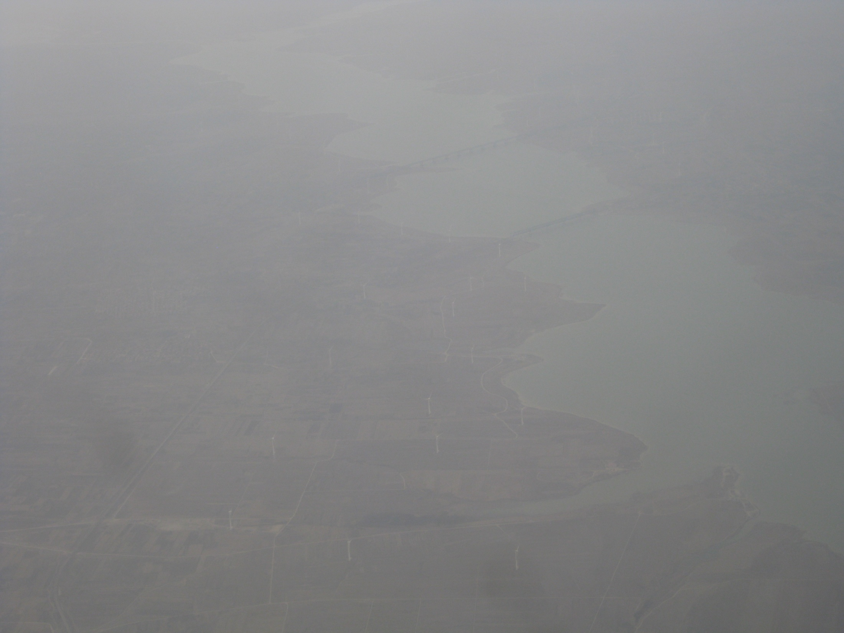

Slide 47
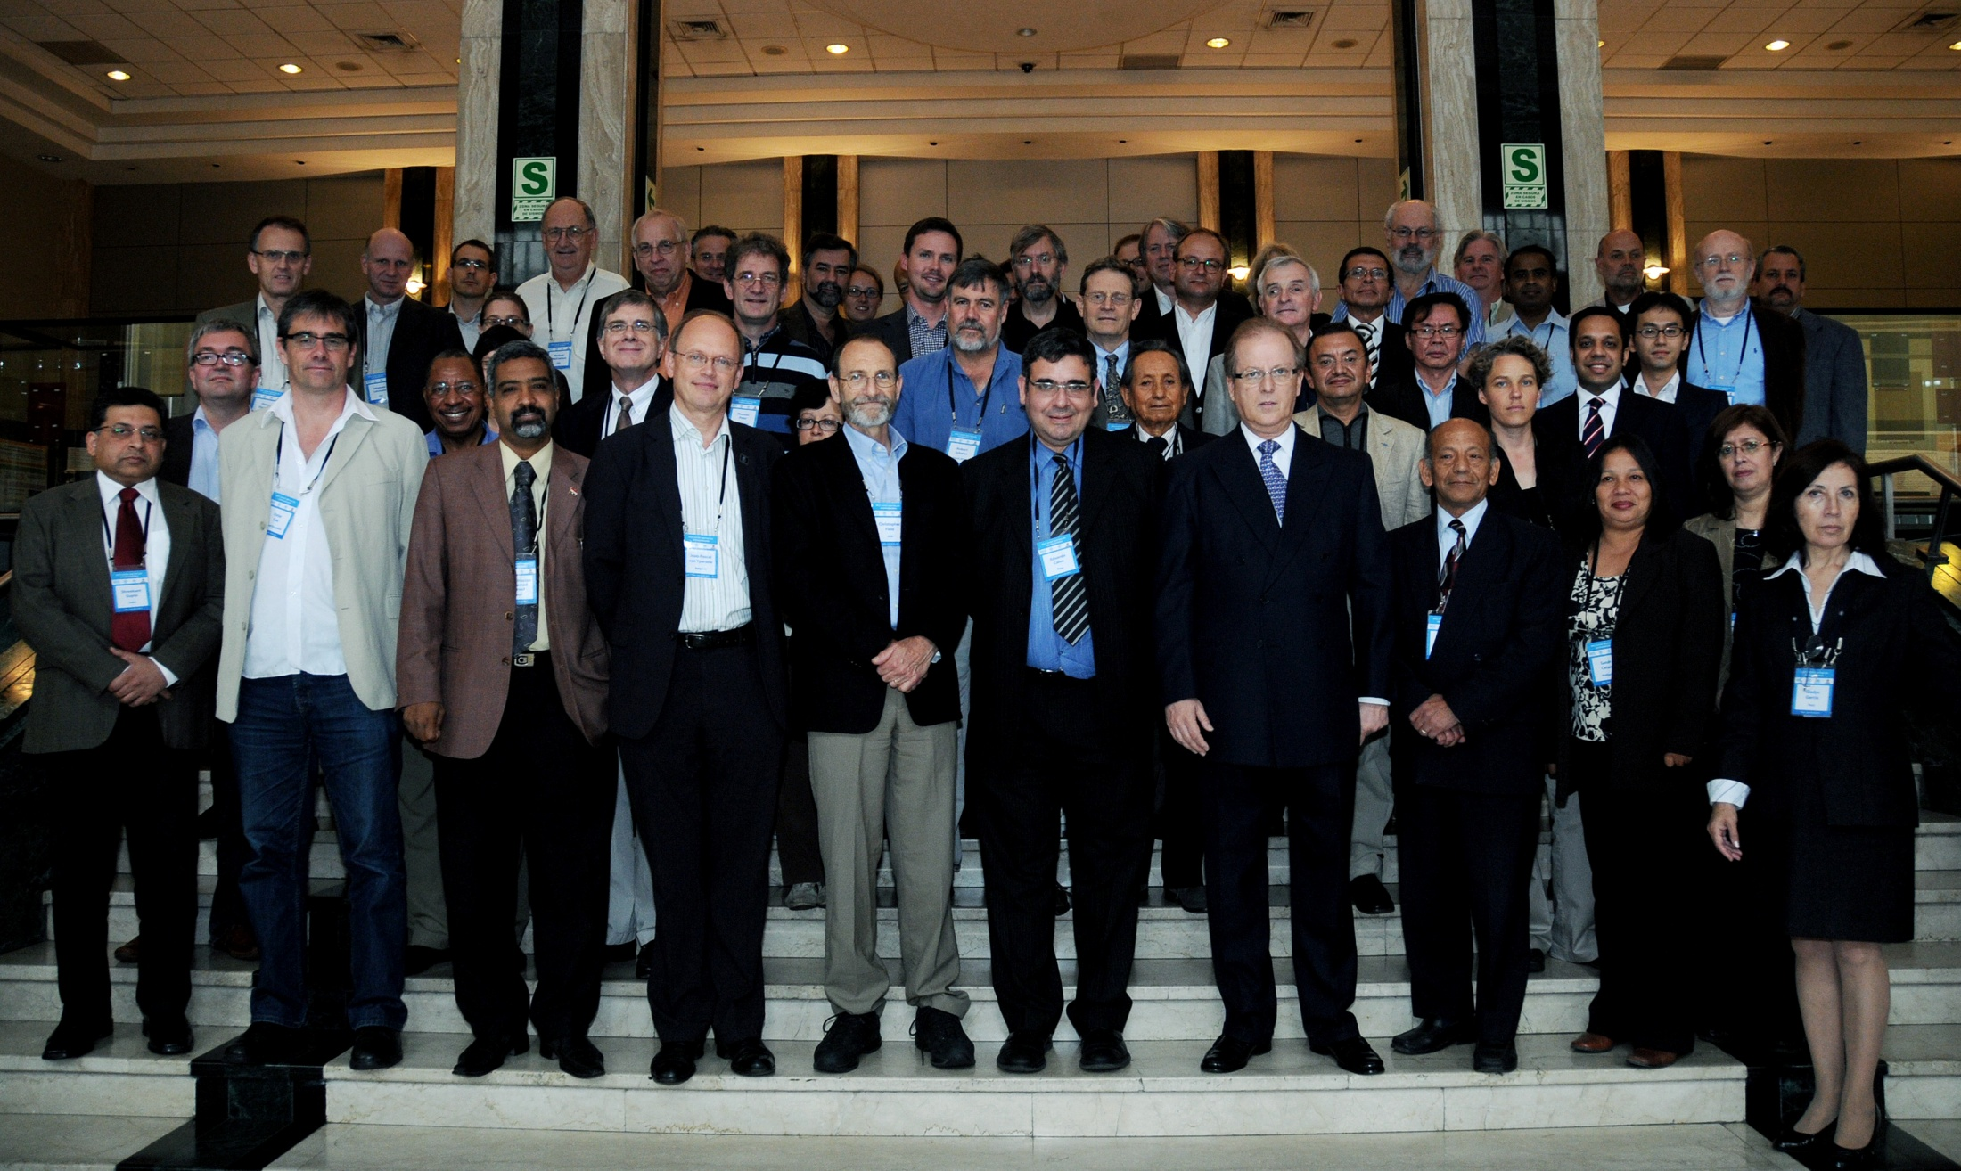
Joint IPCC Expert Meeting of WGI, WGII, and WGIII on Geoengineering
June 20-22, 2011, Lima, Peru

Slide 48
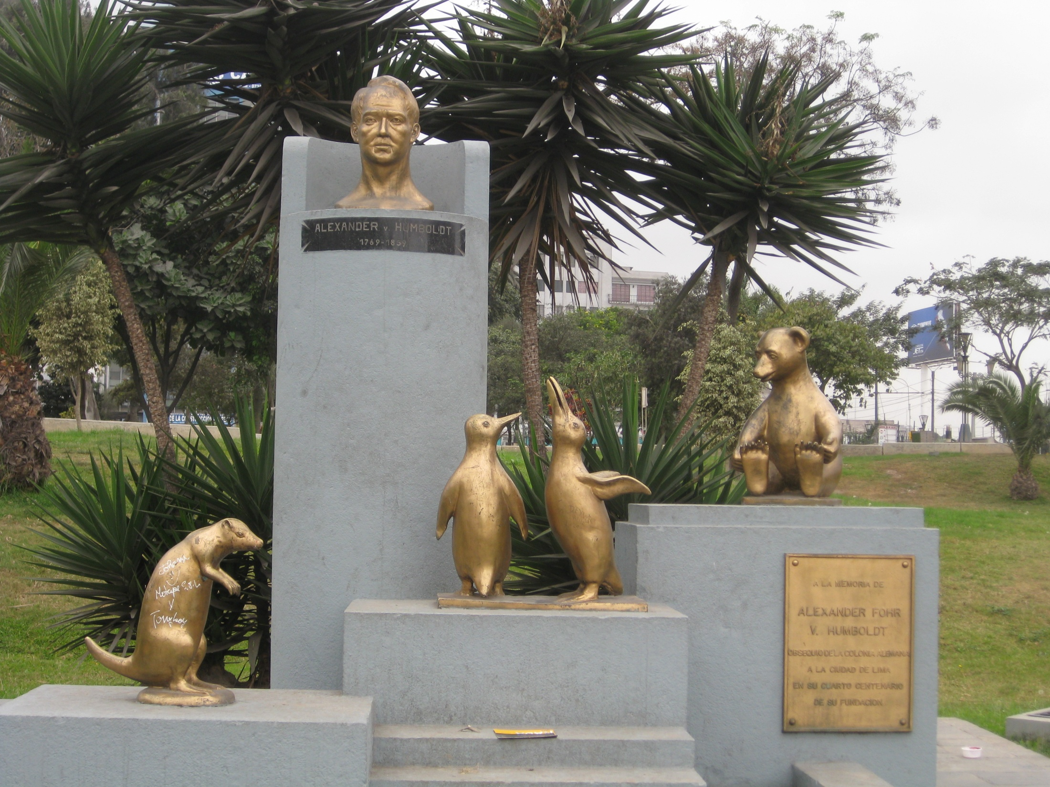

Slide 49
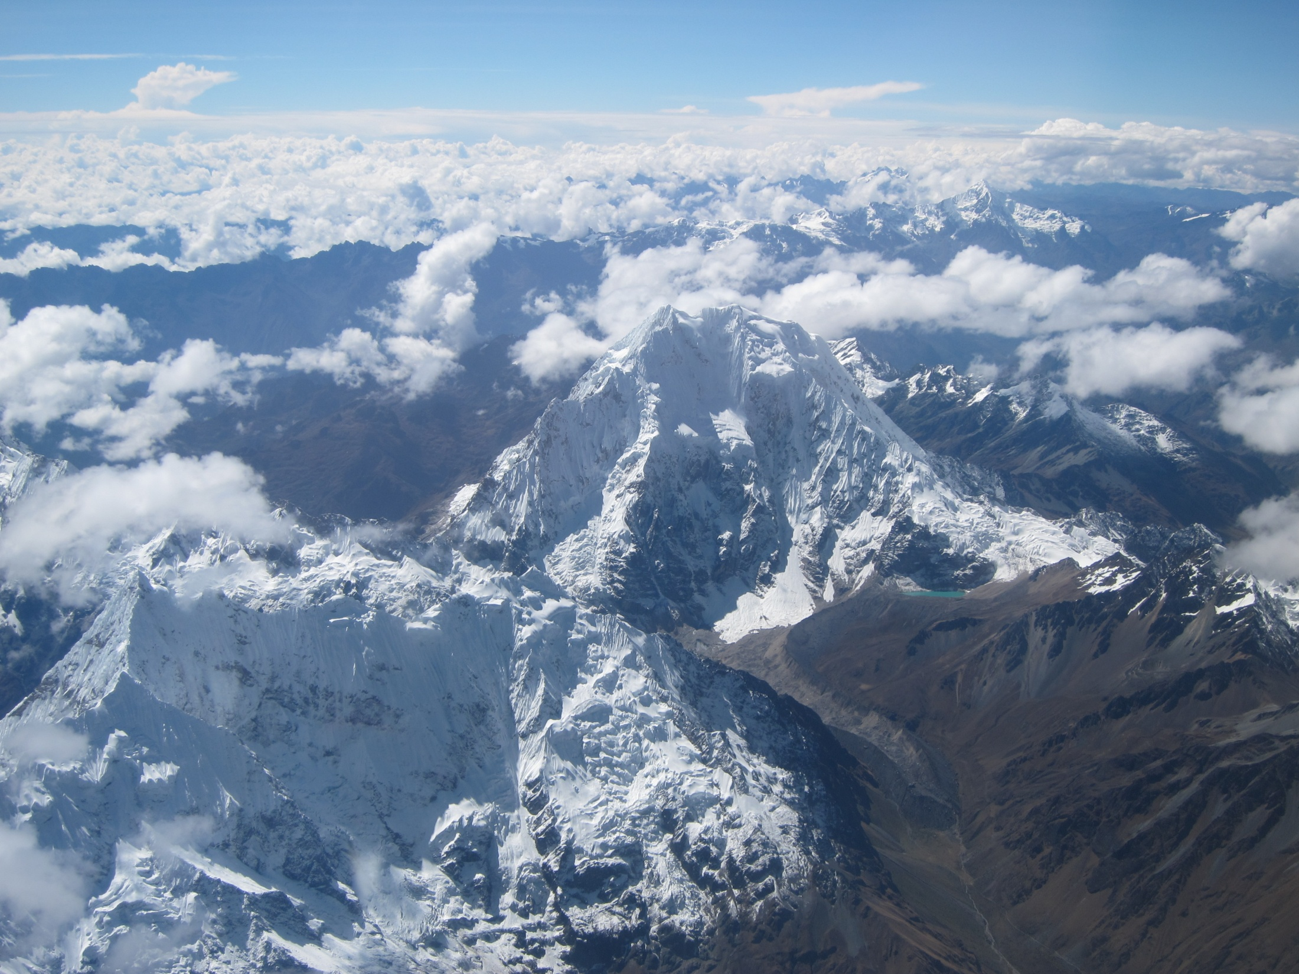

Slide 50
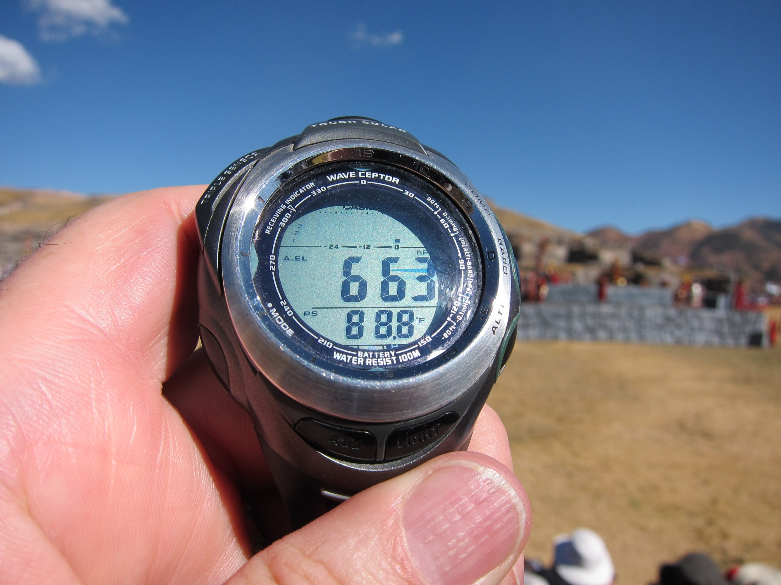

Slide 51
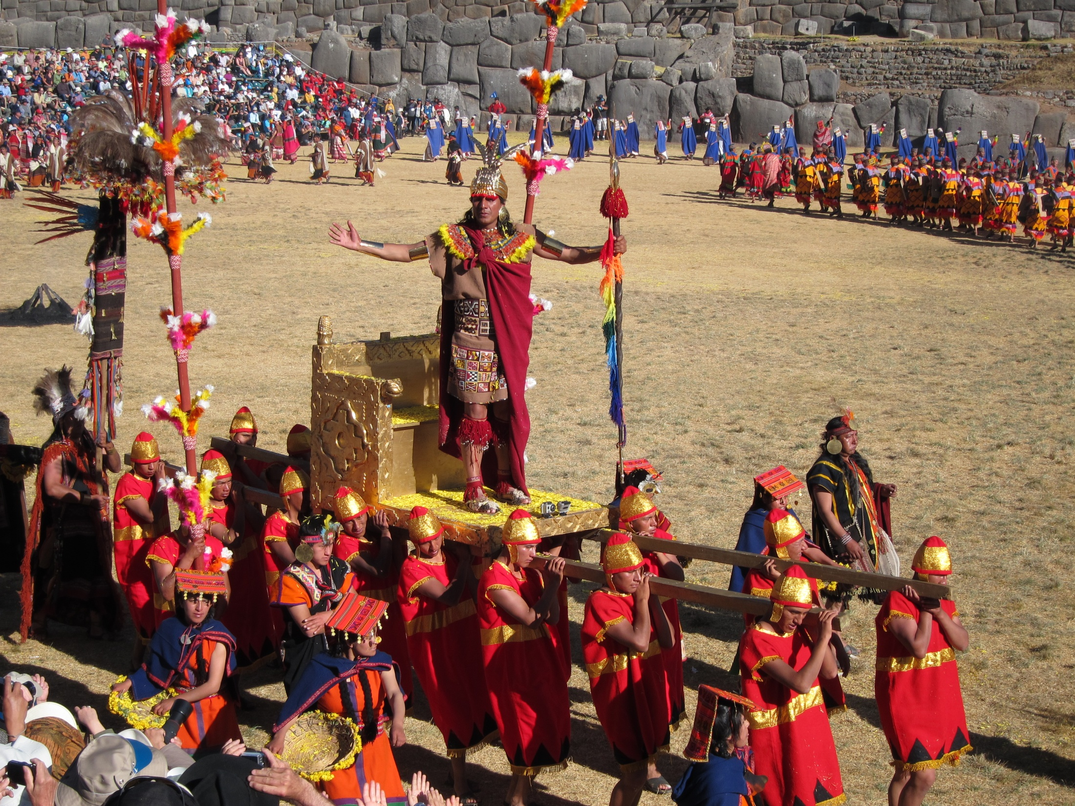

Slide 52
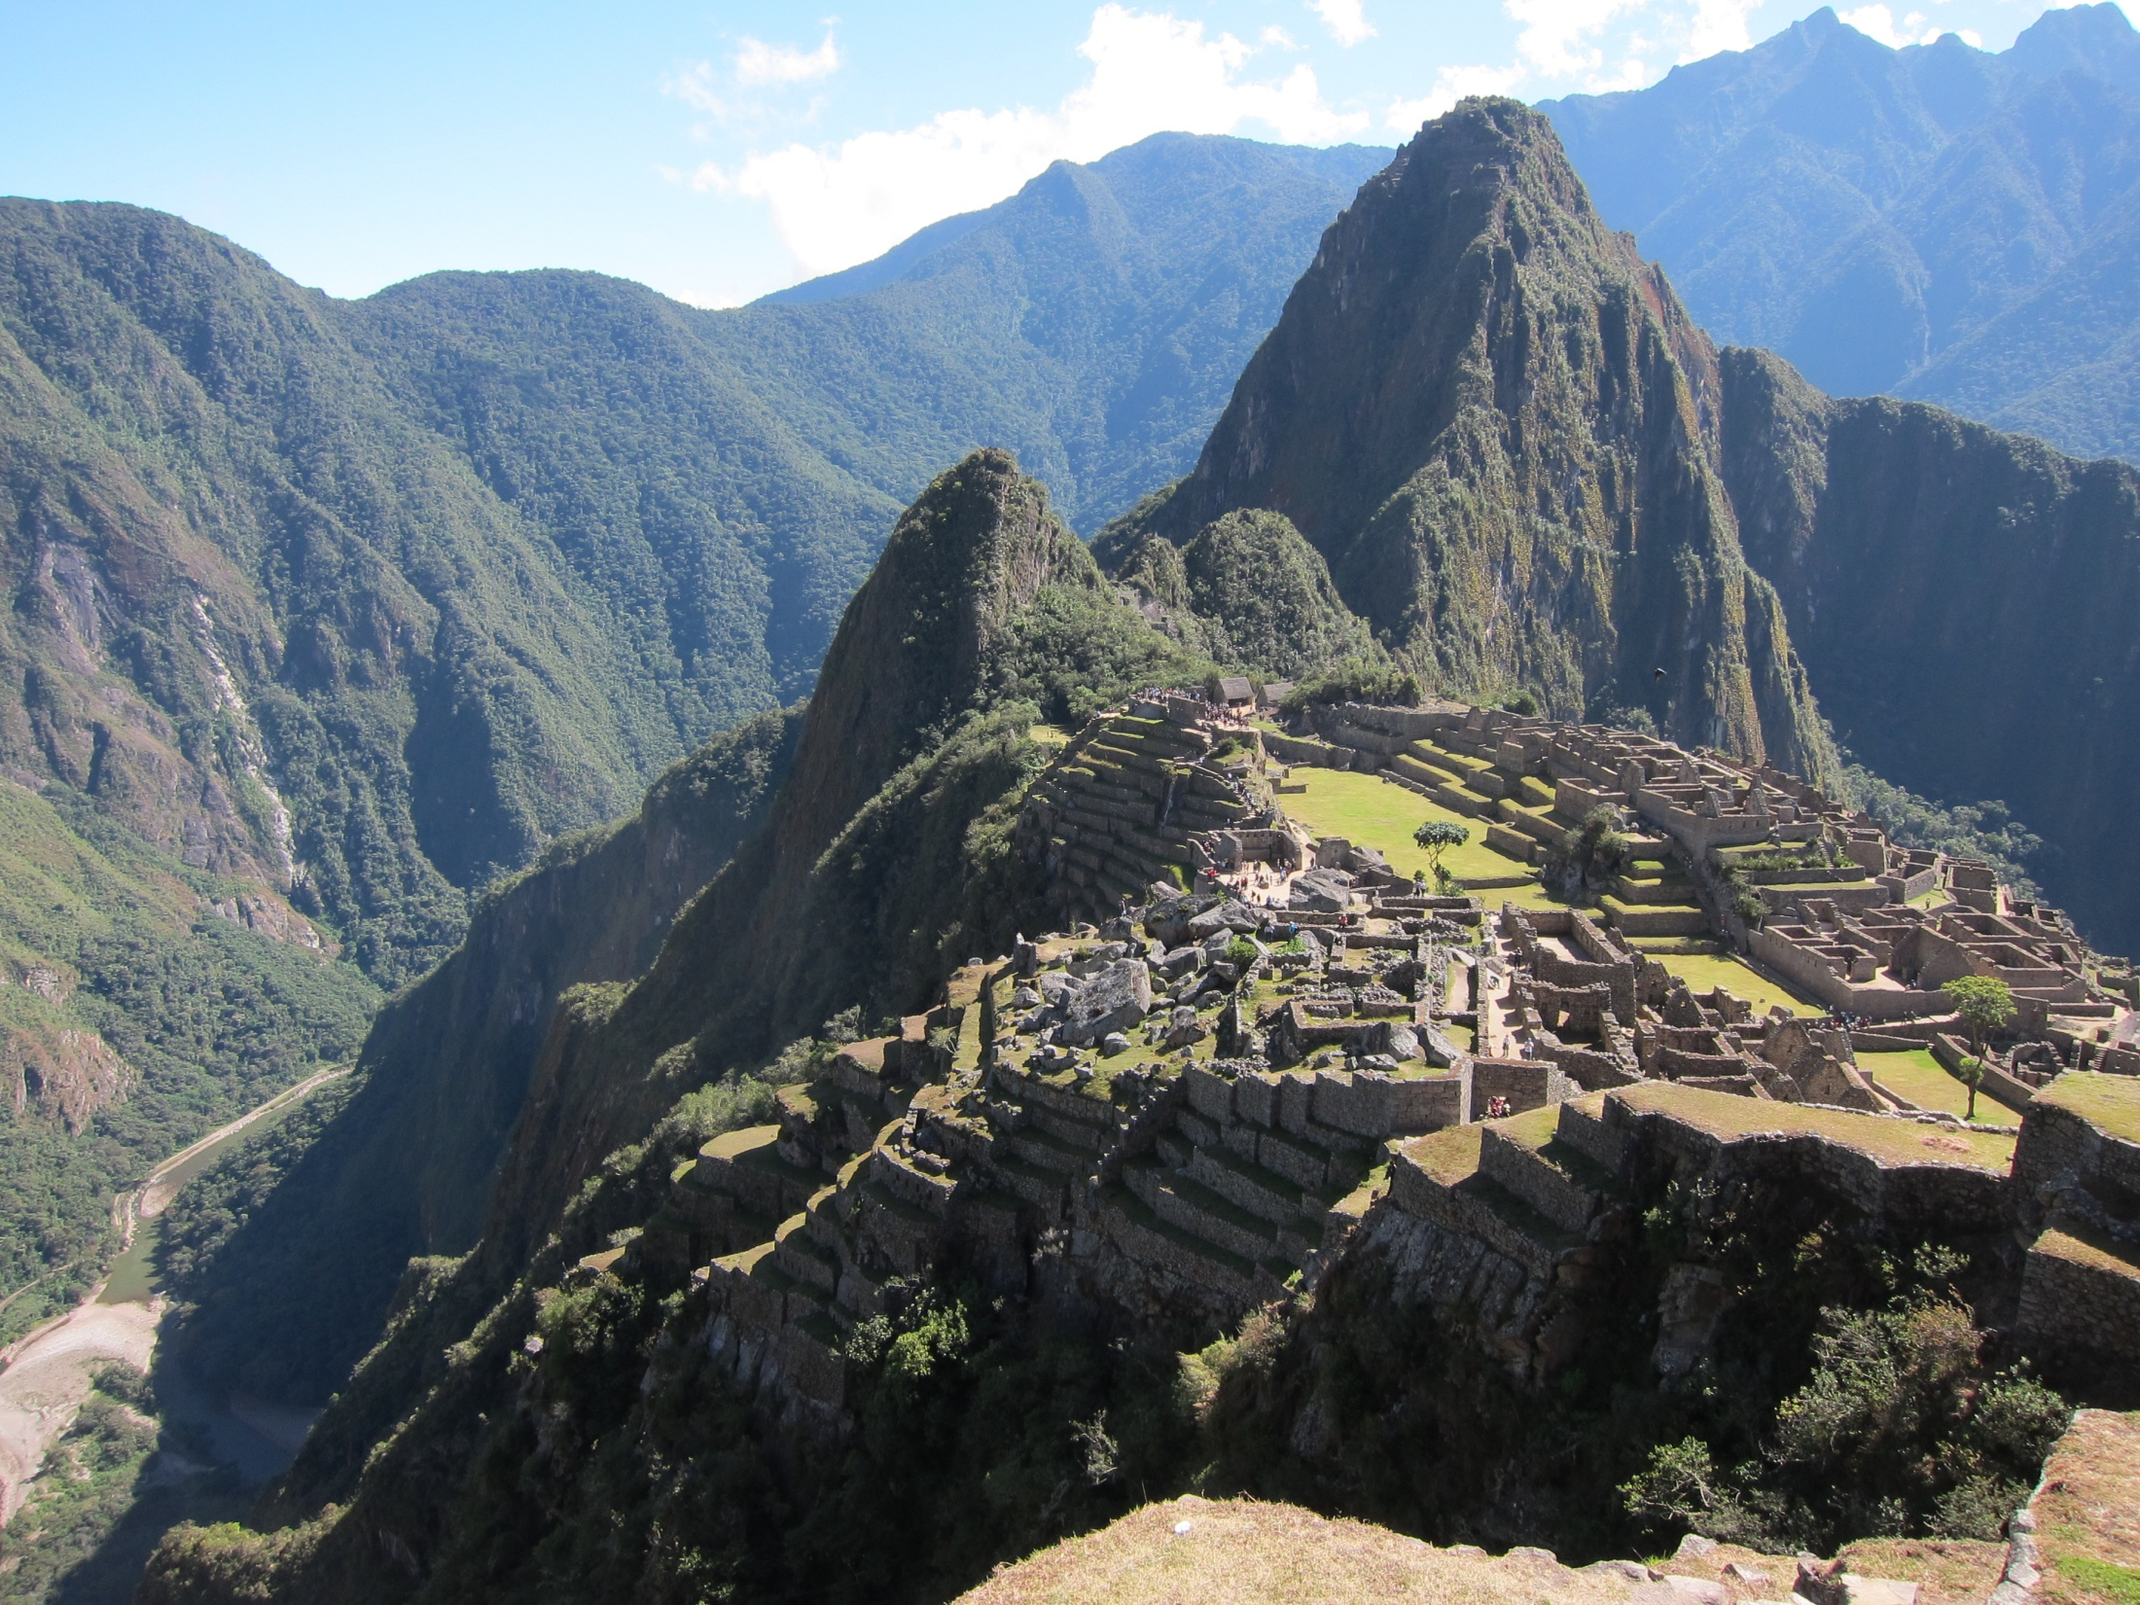

Slide 53
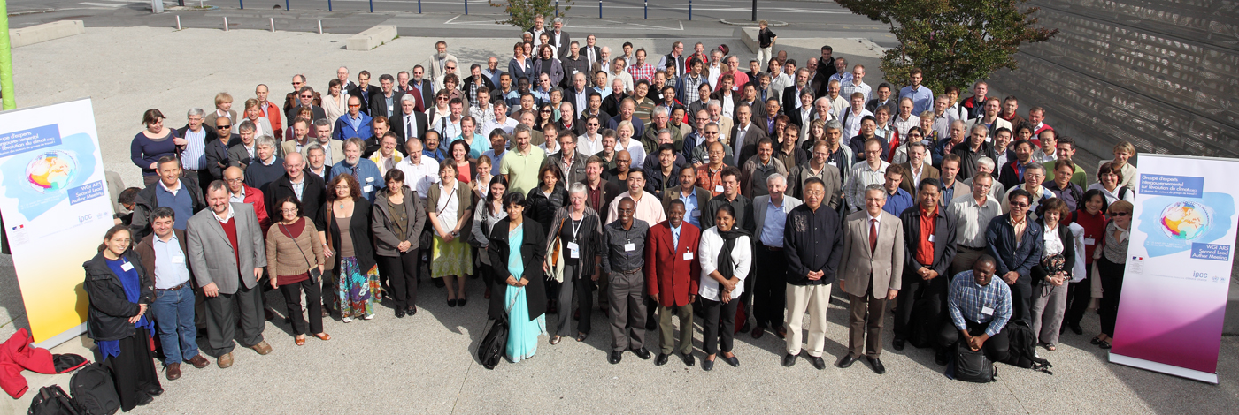
Second Lead Author Meeting, Brest, France
July 18-22, 2011

Slide 54
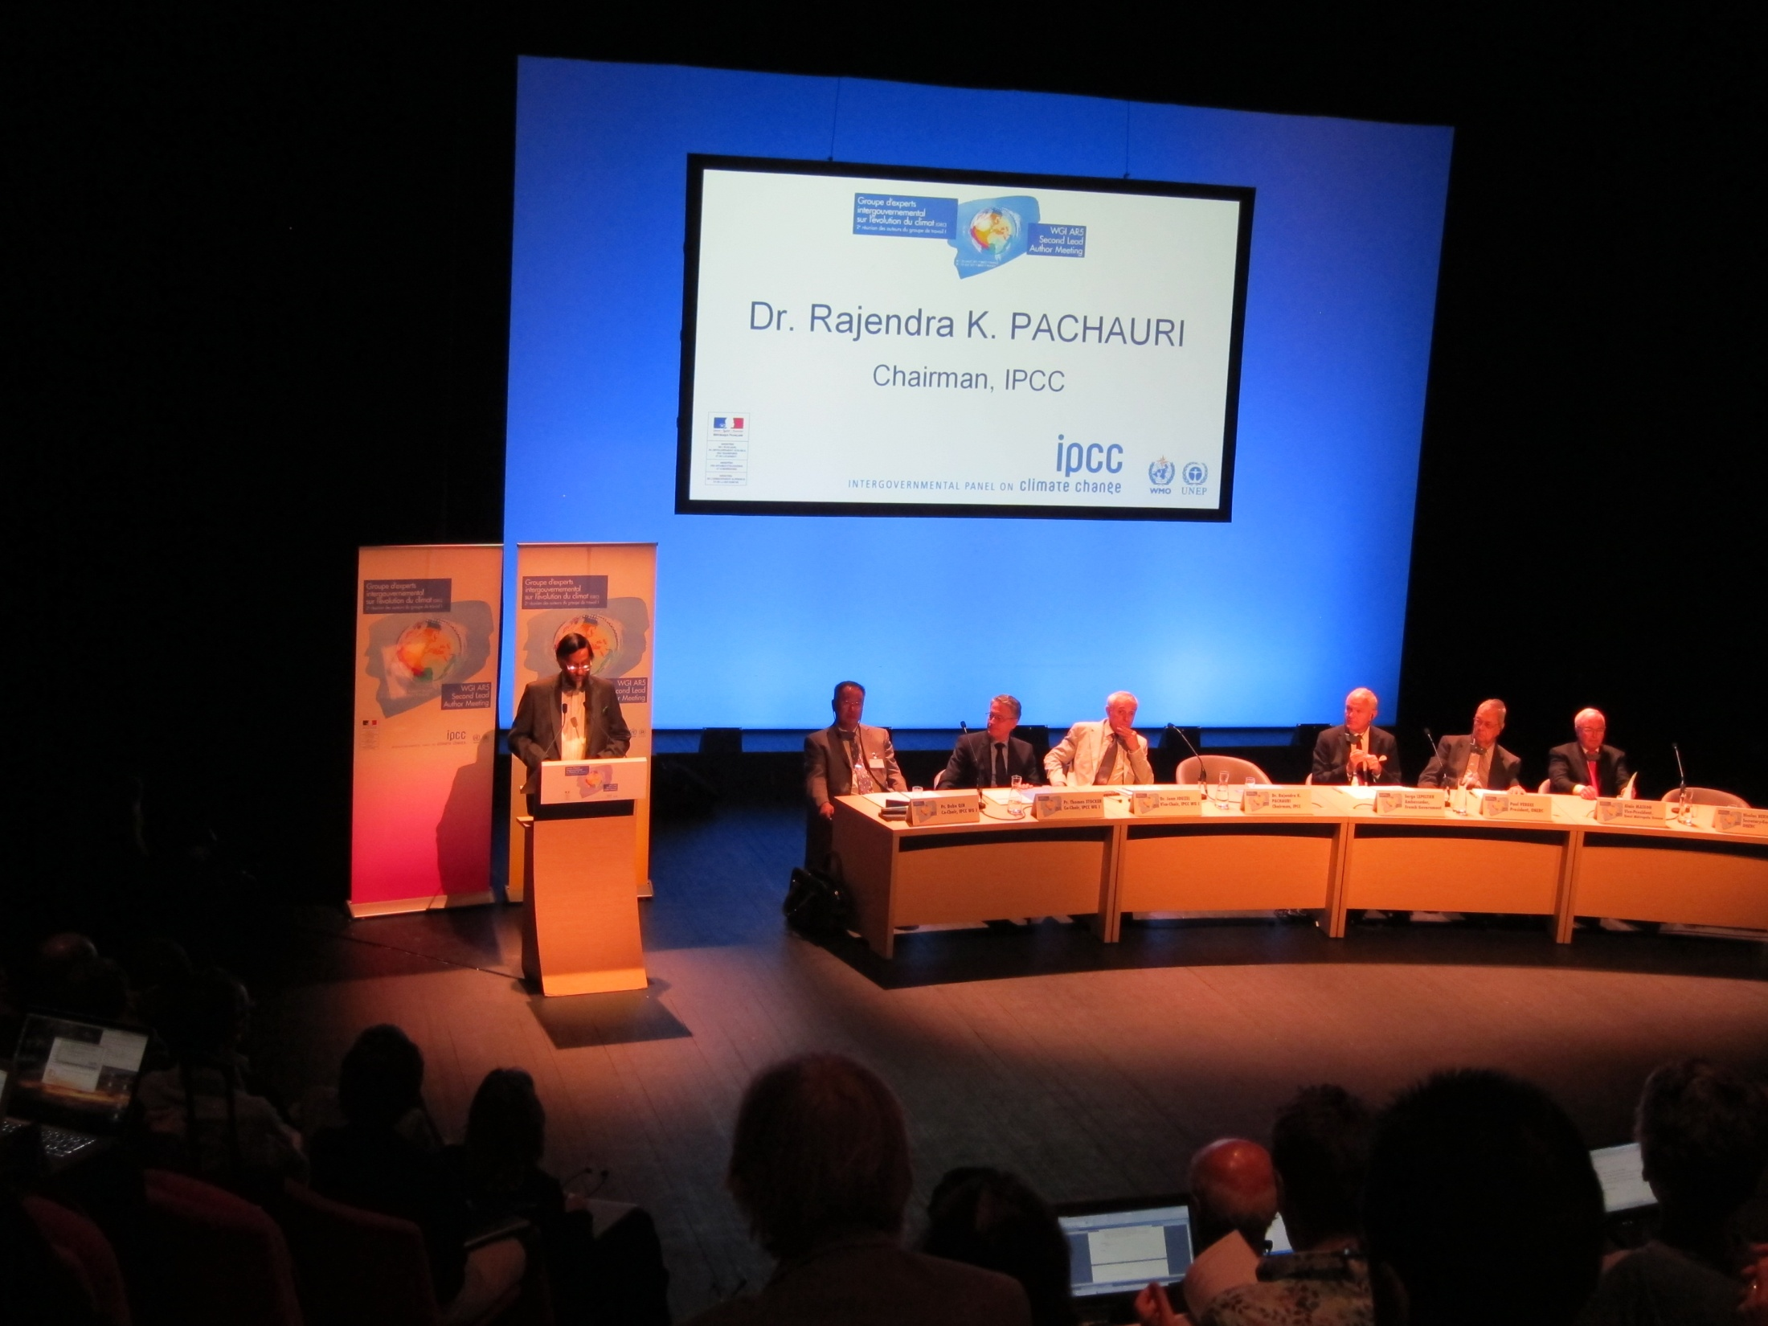

Slide 55
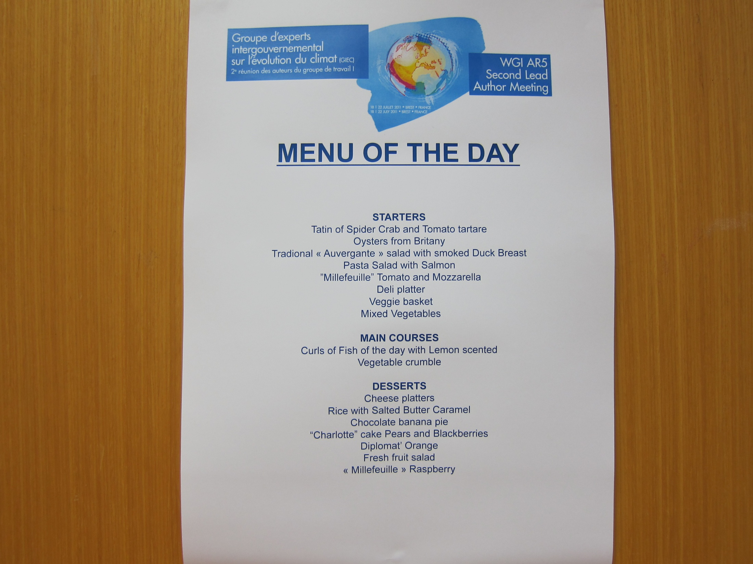

Slide 56


Slide 57
After the second Lead Author Meeting, we produced the First Order Draft, which was reviewed externally, by volunteer expert reviewers.

Slide 58

Review comments on First Order Draft of section of Chapter 8 about using volcanic eruptions as an analog for nuclear winter.

Slide 59
Review comments on First Order Draft of section of Chapter 8 about using volcanic eruptions as an analog for nuclear winter.

Slide 60

Third Lead Author Meeting
Marrakech, Morocco
April 16-20, 2012

Slide 61


Slide 62
Tom Stocker met with our chapter authors and asked that the nuclear winter section be deleted.
My arguments for keeping nuclear winter in the text:
This is the most important potential anthropogenic radiative forcing of climate.
You (Tom Stocker) told us to keep an eye out for articles in high-impact journals, such as Science, Nature, and PNAS, and each has had a recent article on this topic.
Your country (Switzerland) has funded this research.
The scoping document (see next slide) says we should cover emissions from fires and their effects.

Slide 63




Slide 64
Tom Stocker met with our chapter authors and asked that the nuclear winter section be deleted.
My arguments for keeping nuclear winter in the text:
This is the most important potential anthropogenic radiative forcing of climate.
You (Tom Stocker) told us to keep an eye out for articles in high-impact journals, such as Science, Nature, and PNAS, and each has had a recent article on this topic.
Your country (Switzerland) has funded this research.
The scoping document says we should cover emissions from fires and their effects.

Slide 65
Review comments on first order draft of section of Chapter 8 about using volcanic eruptions as an analog for nuclear winter with responses.

Slide 66


Slide 67


Slide 68


Slide 69


Slide 70
After the third Lead Author Meeting, we produced the Second Order Draft, which was reviewed externally, by volunteer expert reviewers and by governments.

Slide 71

Review comments on Second Order Draft of section of Chapter 8 about using volcanic eruptions as an analog for nuclear winter.

Slide 72

Fourth Lead Author Meeting
Hobart, Tasmania
January 13-19, 2013

Slide 73


Slide 74
Review comments on Second Order Draft of section of Chapter 8 about using volcanic eruptions as an analog for nuclear winter, with responses.

Slide 75


Slide 76


Slide 77

IPCC Working Group I, Fifth Assessment Report

Slide 78
IPCC is policy-relevant,
but not policy-prescriptive.
But personally,
I feel obligated to recommend policy responses.

Slide 79


Slide 80


Slide 81


Slide 82


Slide 83


Slide 84


