Slide 1
Ozone Hole Lecture
Most Slides from Prof. Annmarie Carlton
Climate Dynamics
11:670:461
Alan Robock
Department of Environmental Sciences
Rutgers University, New Brunswick, New Jersey USA
robock@envsci.rutgers.edu
http://envsci.rutgers.edu/~robock

Slide 2
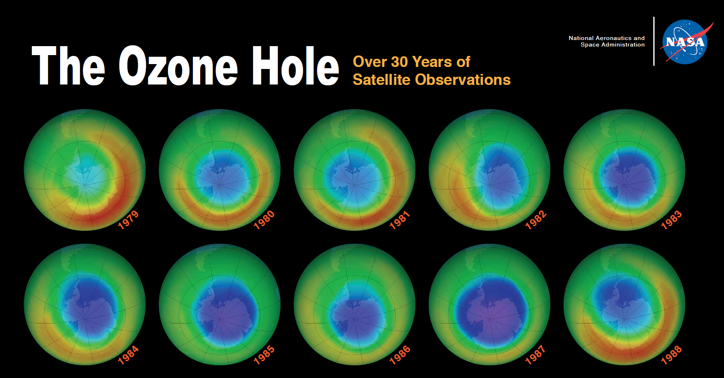
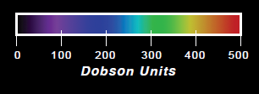
http://aura.gsfc.nasa.gov/ozoneholeposter/24x37_OZONEposter_front.pdf

Slide 3
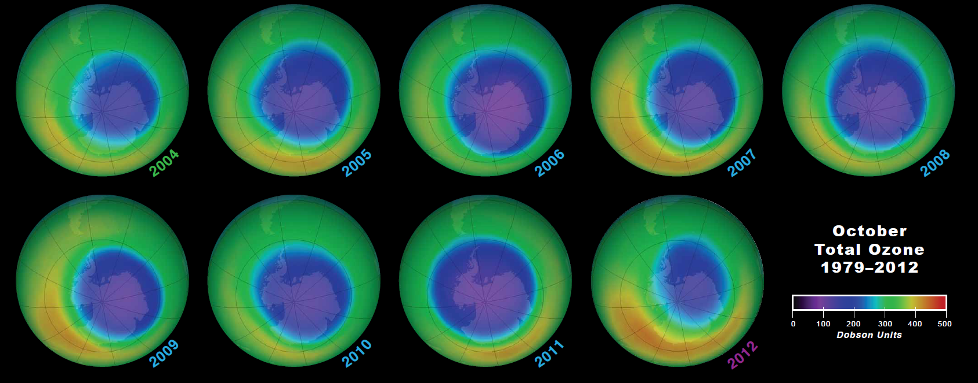
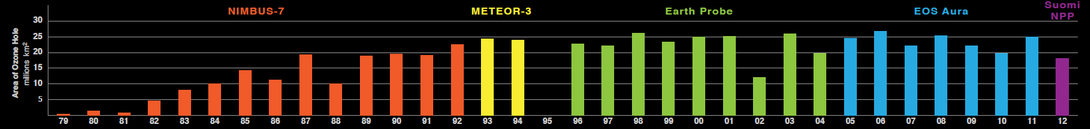
1 Dobson Unit (DU) = 0.01 mm O₃ STP = 2.69x10¹⁶ molecules cm⁻²
http://aura.gsfc.nasa.gov/ozoneholeposter/24x37_OZONEposter_front.pdf

Slide 4
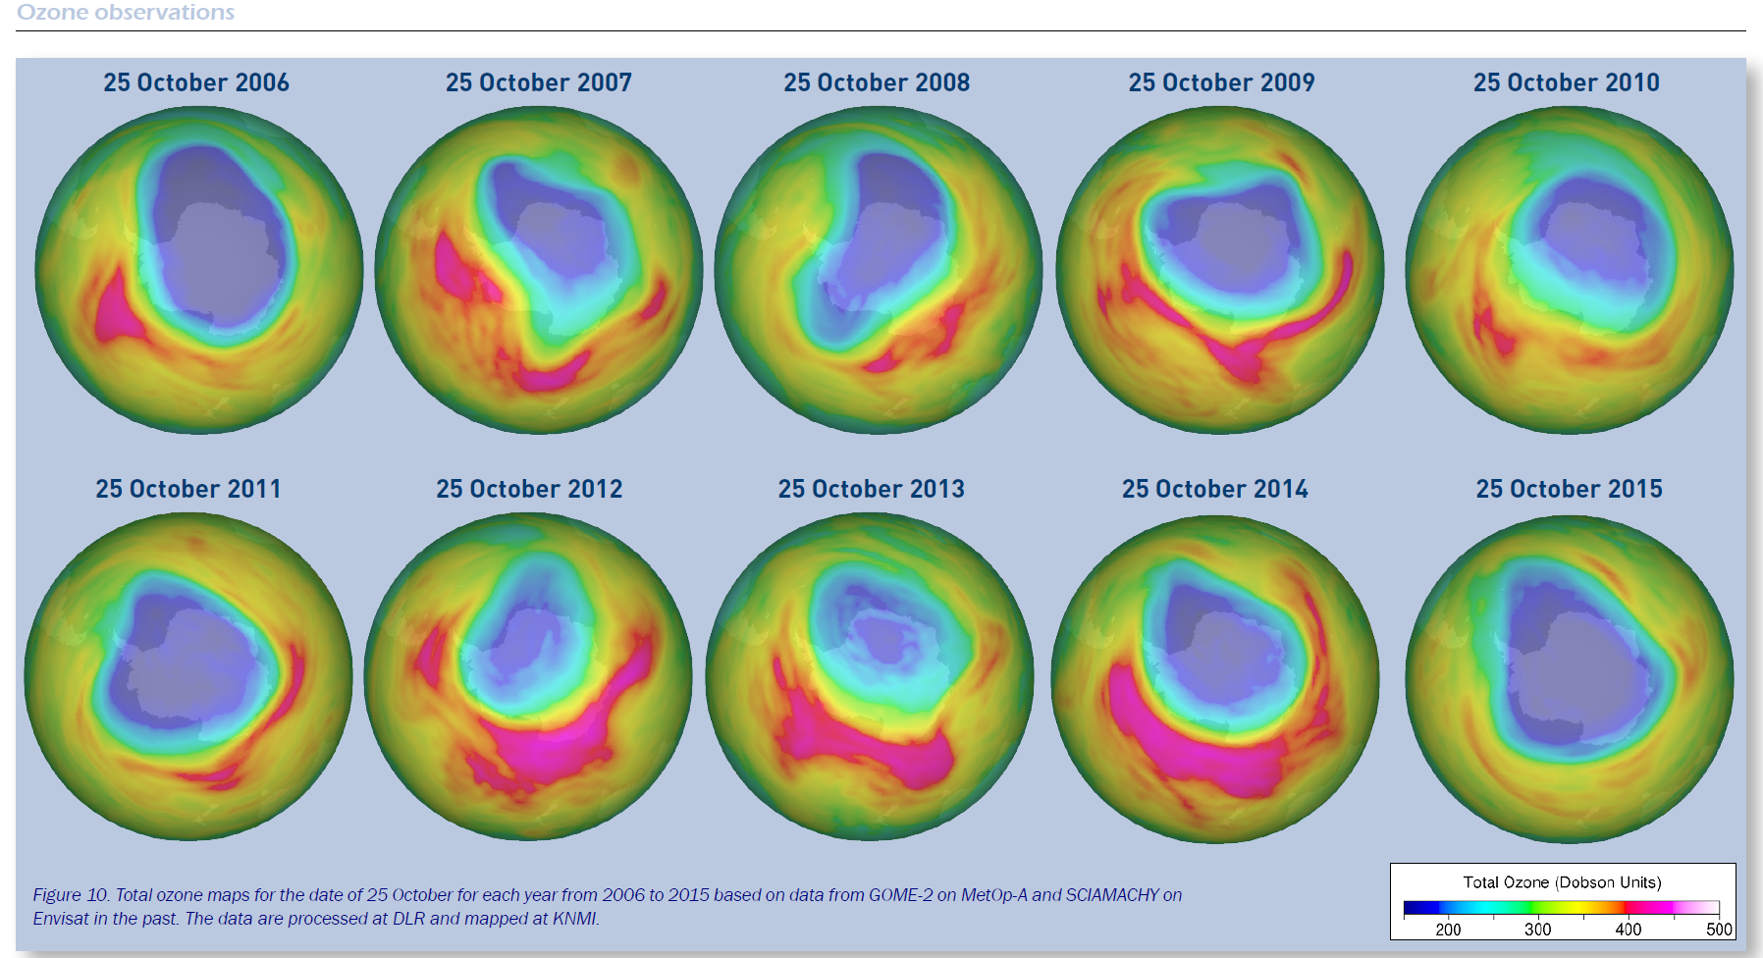
http://www.researchgate.net/profile/G_Braathen/publication/283301743_WMO_Antarctic_Ozone_Bulletin_no._4_2015/links/5631fa5508ae13bc6c35bab1.pdf

Slide 5
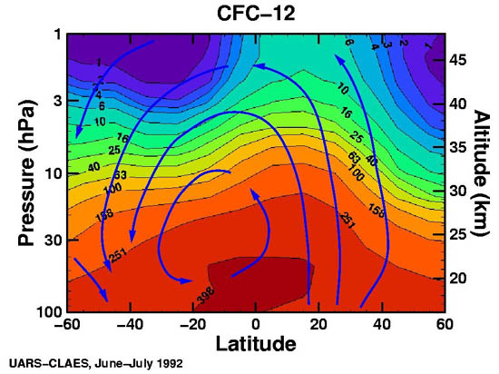
STRATOSPHERIC DISTRIBUTION OF CFC-12

Slide 6
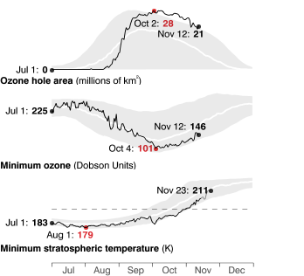
2015 (black line) compared to past record
The gray shading indicates the highest and lowest values measured since 1979. The red numbers are the maximum or minimum observed values.
http://ozonewatch.gsfc.nasa.gov/SH.html

Slide 7
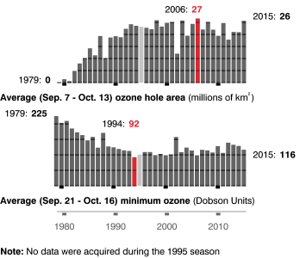
The area of the ozone hole is determined from a map of total column ozone. It is calculated from the area on the Earth that is enclosed by a line with a constant value of 220 Dobson Units. The value of 220 Dobson Units is chosen since total ozone values of less than 220 Dobson Units were not found in the historic observations over Antarctica prior to 1979. Also, from direct measurements over Antarctica, a column ozone level of less than 220 Dobson Units is a result of the ozone loss from chlorine and bromine compounds.
http://ozonewatch.gsfc.nasa.gov/SH.html

Slide 8
Freon – developed by General Motors and DuPont as refrigerants
Also used as aerosol propellants, for blowing foam and cleaning electronic circuit boards.
Freons are chloroflurocarbons (CFCs)
Main Freons are CCl₂F₂ (R-12 or CFC-12) and CCl₃F (R-11 or CFC-11)
Numbering code is rather obscure.
Start with methane (CH₄). Replace the H with Cl or F.
First number is 3 minus the number of Cl.
Second number is number of F.
Or add 90 to number to get number of C, H, F. (rest are Cl)
Example: R-12: 12 + 90 = 102, so 1 C, 0 H, 2 F (leaves 2 Cl)

Slide 9
Freon – developed by General Motors and DuPont as refrigerants
Also used as aerosol propellants, for blowing foam and cleaning electronic circuit boards.
Freons are chloroflurocarbons (CFCs)
Main Freons are CCl₂F₂ (R-12 or CFC-12) and CCl₃F (R-11 or CFC-11)
Numbering code is rather obscure.
Start with methane (CH₄). Replace the H with Cl or F.
First number is 3 minus the number of Cl.
Second number is number of F.
Or add 90 to number to get number of C, H, F. (rest are Cl)
Example: R-12: 12 + 90 = 102, so 1 C, 0 H, 2 F (leaves 2 Cl)
What is R-22?

Slide 10
Freon – developed by General Motors and DuPont as refrigerants
Also used as aerosol propellants, for blowing foam and cleaning electronic circuit boards.
Freons are chloroflurocarbons (CFCs)
Main Freons are CCl₂F₂ (R-12 or CFC-12) and CCl₃F (R-11 or CFC-11)
Numbering code is rather obscure.
Start with methane (CH₄). Replace the H with Cl or F.
First number is 3 minus the number of Cl.
Second number is number of F.
Or add 90 to number to get number of C, H, F. (rest are Cl)
Example: R-12: 12 + 90 = 102, so 1 C, 0 H, 2 F (leaves 2 Cl)
What is R-22? CHClF₂

Slide 11
ClO_{x}-CATALYZED OZONE LOSS
(ClO_{x} ≡ Cl + ClO)
Initiation: Cl radical generation from non-radical precursors (e.g., CFC-12)
CF₂Cl₂ + hν → CF₂Cl + Cl
Propagation:
Cl + O₃ → ClO + O₂
ClO + O → Cl + O₂
Net: O₃ + O → 2O₂
O₃ loss rate:
Termination: Recycling:
Cl + CH₄ → HCl + CH₃ HCl + OH → Cl + H₂O
ClO + NO₂ + M → ClNO₃ + M ClNO₃ + hv → Cl + NO₃
Cl_{y} ≡ ClO_{x} + reservoirs (HCl, ClNO₃)
http://www.atmos.washington.edu/2004Q4/211/09_OzoneDep.swf

Slide 12
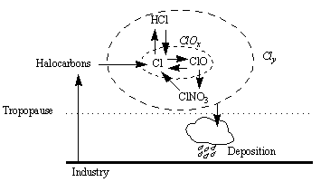
ATMOSPHERIC CYCLING OF ClO_{x} AND Cl_{y}
Molina and Rowland shared 1995 Nobel Prize for their work on the ClOx catalyzed destruction of ozone

Slide 13
SOURCE GAS CONTRIBUTIONS TO
STRATOSPHERIC CHLORINE (2004)

Slide 14
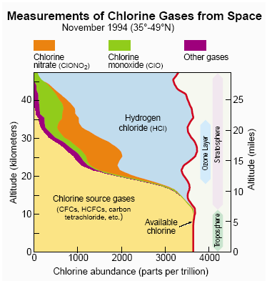
CHLORINE PARTITIONING IN STRATOSPHERE

Slide 15
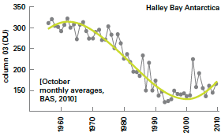
OZONE TREND AT HALLEY BAY, ANTARCTICA (OCTOBER)
Stabilization of chlorine?
Farman et al. paper
published in Nature
1 Dobson Unit (DU) = 0.01 mm O₃ STP = 2.69x10¹⁶ molecules cm⁻²

Slide 16
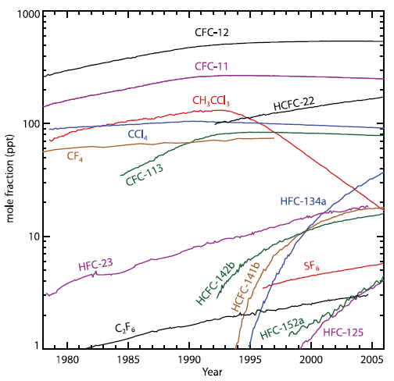
TRENDS IN ATMOSPHERIC CFCs AND HFCs (CFC REPLACEMENTS)
Montreal
Protocol
CFC production
is banned
[IPCC, 2007]

Slide 17

THE ANTARCTIC OZONE HOLE SEEN FROM SPACE
Southern hemisphere ozone column seen from TOMS

Slide 18
SPATIAL EXTENT OF THE OZONE HOLE
Isolated concentric region around Antarctic continent is called the polar vortex.
Strong westerly winds, little meridional transport

Slide 19


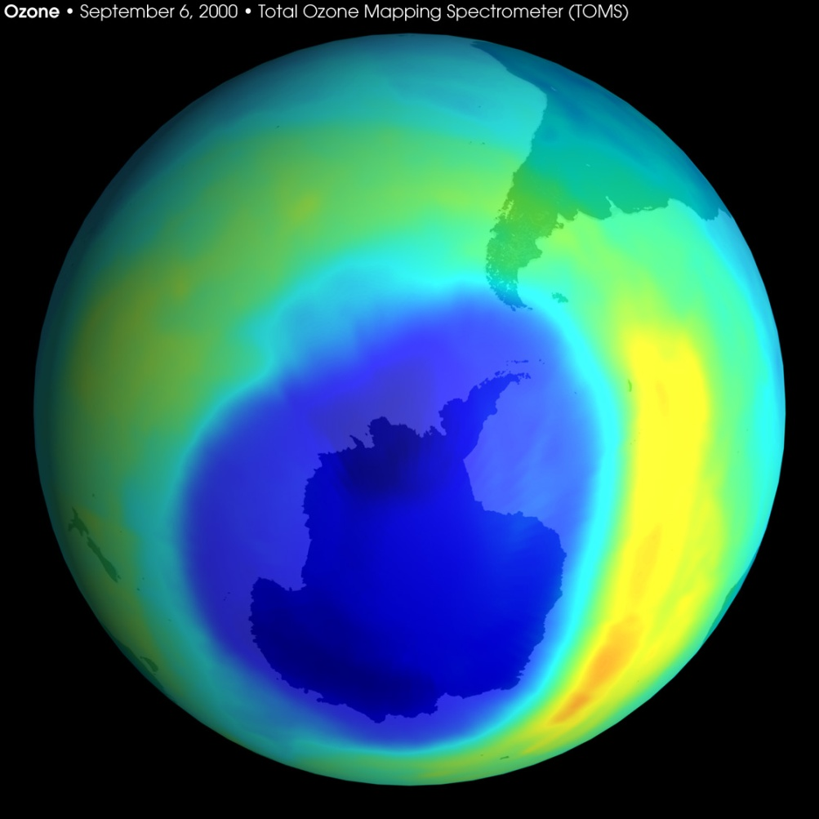

Ozone column (Dobson units)
Slide by Susan Solomon

Slide 20
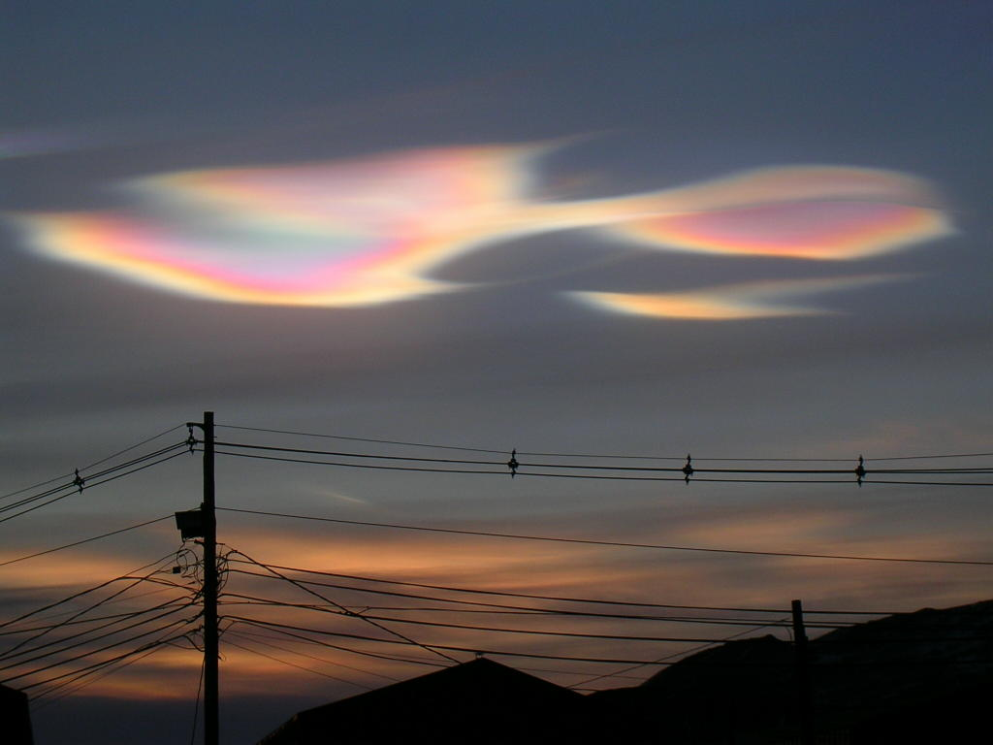
Polar stratospheric clouds, McMurdo, Antarctica, Aug. 29, 2004

Slide 21
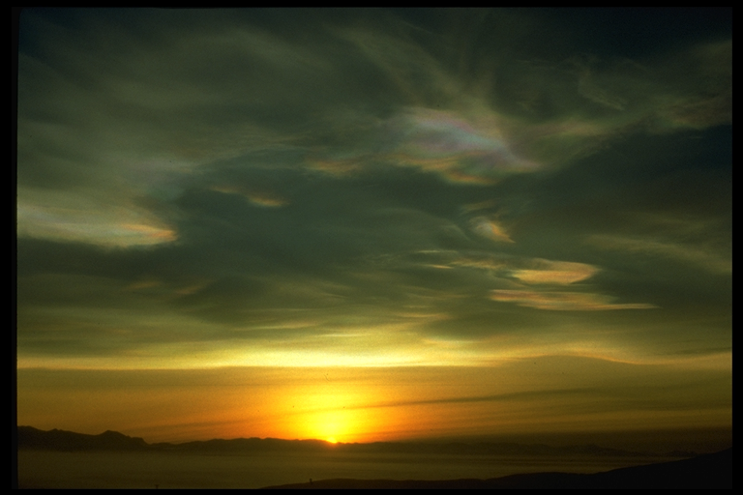
Gases destroy ozone here
40
Polar cloud surfaces lead to much
more ozone destruction, in the
heart of the layer
HCl
Altitude (km)
20
20
Cl
Cl₂
ClONO₂
ClO
Ozone
0
Slide by Susan Solomon
Amount of ozone
Activated
for ozone loss
Reservoirs

Slide 22
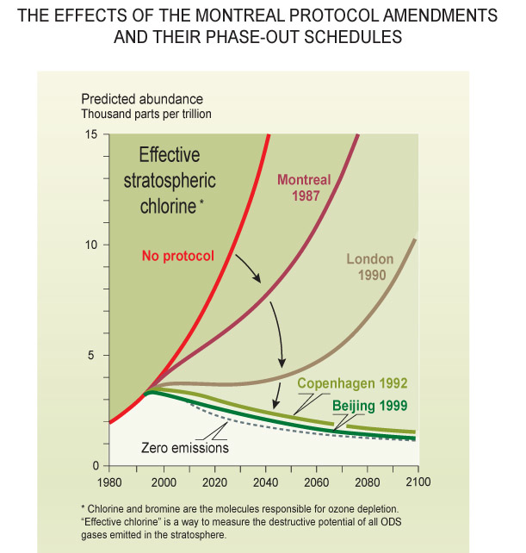
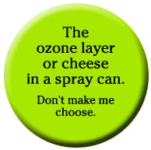
Amount of chlorine
Concern about ozone depletion led the nations of the world to agree to a Montreal Protocol to freeze and then phaseout the chemicals that caused ozone depletion.
Slide by Susan Solomon

Slide 23
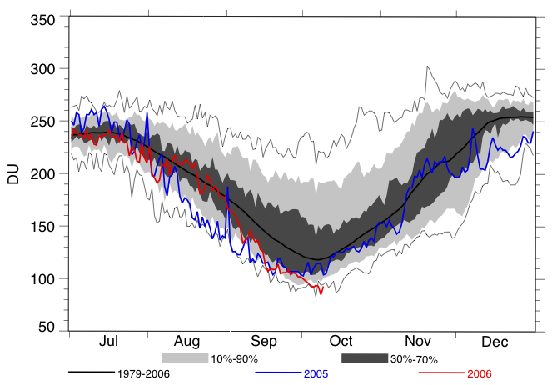
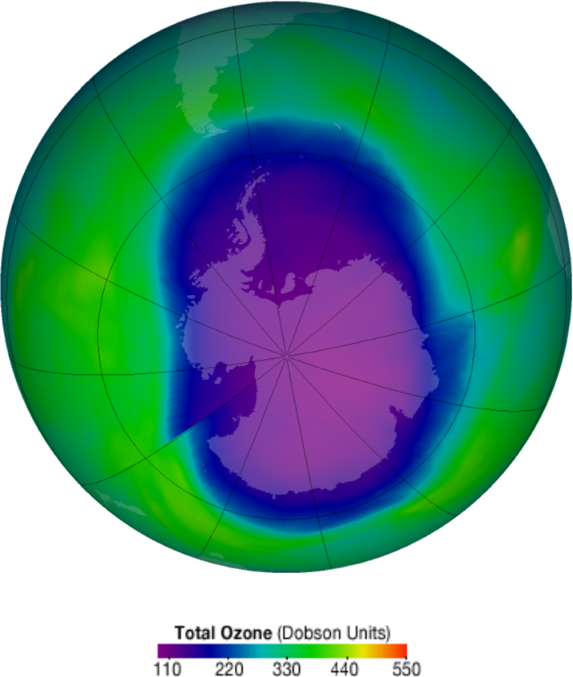
2006 ANTARCTIC OZONE HOLE: MOST SEVERE OBSERVED
Aura OMI – 8 Oct 2006
Ozone Hole Minimum
Minimum of 85 DU on 8 Oct 2006
The ozone hole is an austral spring phenomenon – it is not there year-round!

Slide 24
VERTICAL STRUCTURE OF THE OZONE HOLE: near-total depletion in lower stratosphere

Slide 25
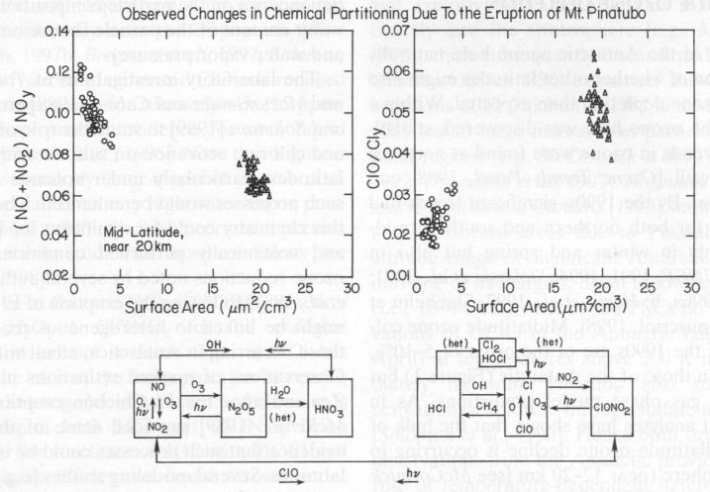
Volcanic aerosols produce more reactive chlorine
NO_{x}
ClO
Solomon (1999)
Notes:
Volcanic aerosols serve as surfaces for heterogeneous chemistry, which destroys ozone, liberating anthropogenic chlorine, in the same way that the Antarctic Ozone Hole is produced. But in this case, you do not need polar stratospheric clouds, and the destruction can take place at lower latitudes. Figure from Solomon (1999).
Solomon, S., Stratospheric ozone depletion: A review of concepts and history, Rev. Geophys., 37, 275-316, 1999.

Slide 26
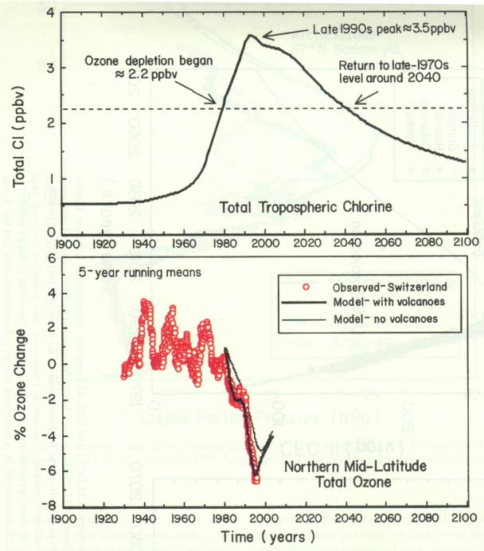
Tropospheric chlorine diffuses to stratosphere.
Volcanic aerosols make chlorine available to destroy ozone.
Solomon (1999)
Notes:
This volcanic effect on ozone can only take place when there is enough anthropogenic chlorine in the stratosphere, roughly from1980 to 2040.
The bottom panel shows how it is necessary to include the effects of volcanic eruptions to correctly model the recent ozone depletion.
Solomon, S., Stratospheric ozone depletion: A review of concepts and history, Rev. Geophys., 37, 275-316, 1999.

Slide 27
How is the Ozone Hole connected to global warming?
CFCs are strong greenhouse gases.
Cooling of stratosphere by increasing CO₂ prolongs time of ozone recovery.
Polar vortex stronger because of Ozone Hole. This affects the general circulation in the Southern Hemisphere, including the lack of trend in Antarctic sea ice.
The Ozone Hole lets in more UV radiation, but this DOES NOT PRODUCE GLOBAL WARMING.

Slide 28
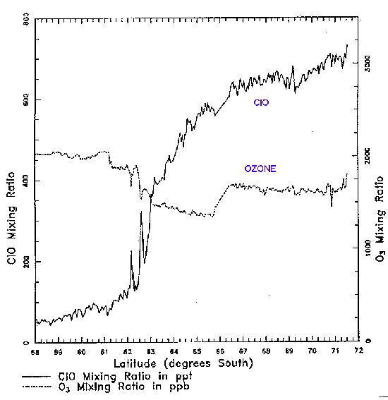
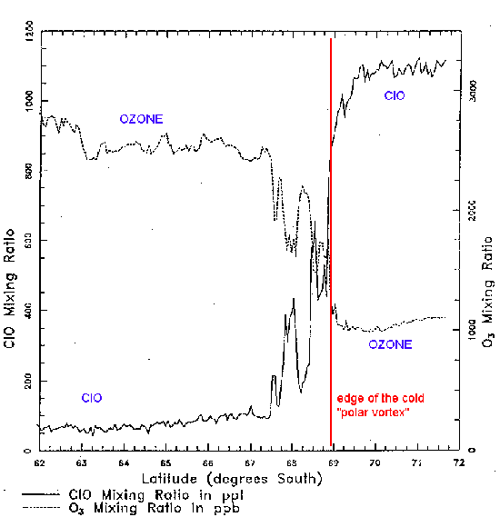
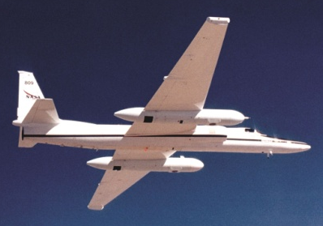
ASSOCIATION OF ANTARCTIC OZONE HOLE
WITH HIGH LEVELS OF ClO
Sept. 1987 ER-2 aircraft measurements at 20 km altitude S of Punta Arenas
O₃
ClO
O₃
Sep. 16
Edge of
Polar
vortex
Sep. 2, 1987
ClO
20 km altitude
Measurements by Jim Anderson’s group (Harvard)

Slide 29
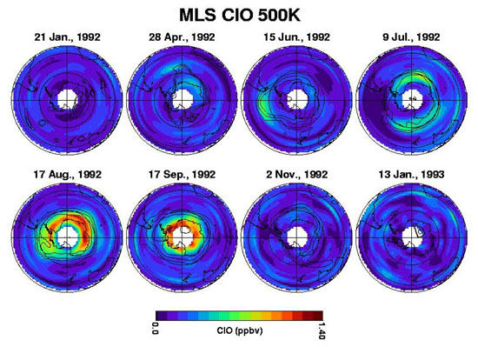
SATELLITE OBSERVATIONS OF ClO
IN THE SOUTHERN HEMISPHERE STRATOSPHERE

Slide 30
O₃ DEPLETION MECHANISM: ClO SELF-REACTION
ClO + ClO + M → ClOOCl + M
ClOOCl + hv → ClOO + Cl
ClOO + M → Cl + O₂
2 x [Cl + O₃ → ClO + O₂]
NET: 2O₃ → 3O₂
→ 70% of total ozone loss in Antarctic spring
An additional catalytic cycle in Antarctic spring involves Br radicals (BrO + ClO)
→ 30% of total ozone loss in Antarctic ozone hole
But why are [ClO] so high over Antarctica?
Polar stratospheric clouds: conversion of ClOx reservoirs to Cl₂
ClNO₃ + HCl –PSC→Cl₂ + HNO₃
Cl₂ + hv → 2Cl

Slide 31
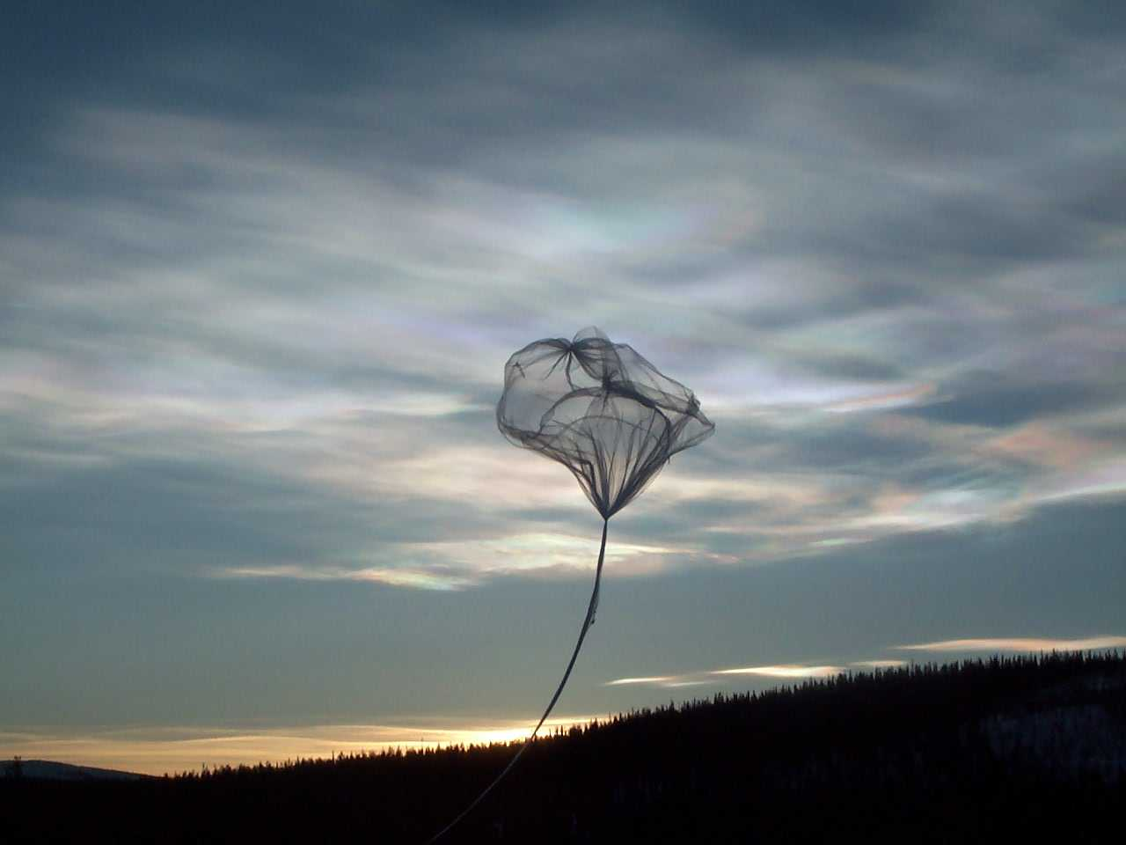
WHY THE HIGH ClO IN ANTARCTIC VORTEX?
Release of chlorine radicals from reactions of reservoir species in polar stratospheric clouds (PSCs)

Slide 32
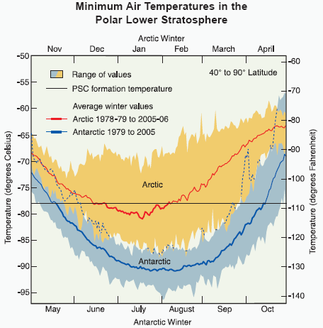
PSC FORMATION AT COLD TEMPERATURES
PSC formation
Frost point of water

Slide 33
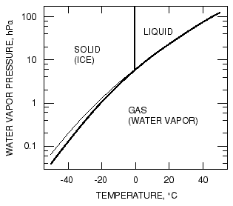
REMINDER: PHASE DIAGRAM FOR WATER
gas-liquid
metastable
equilibrium

Slide 34
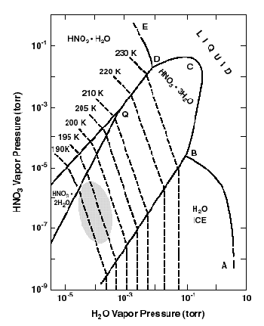
HOW DO PSCs START FORMING AT 195K?
HNO₃-H₂O PHASE DIAGRAM
Antarctic
vortex
conditions
PSCs are not water but nitric acid trihydrate (NAT) clouds

Slide 35
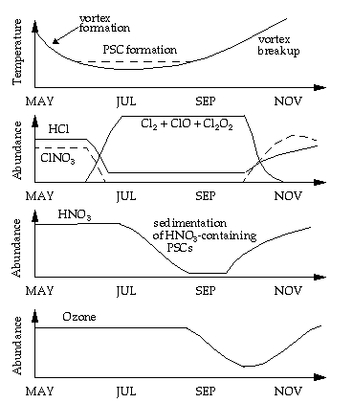
CHRONOLOGY OF ANTARCTIC OZONE HOLE

Slide 36
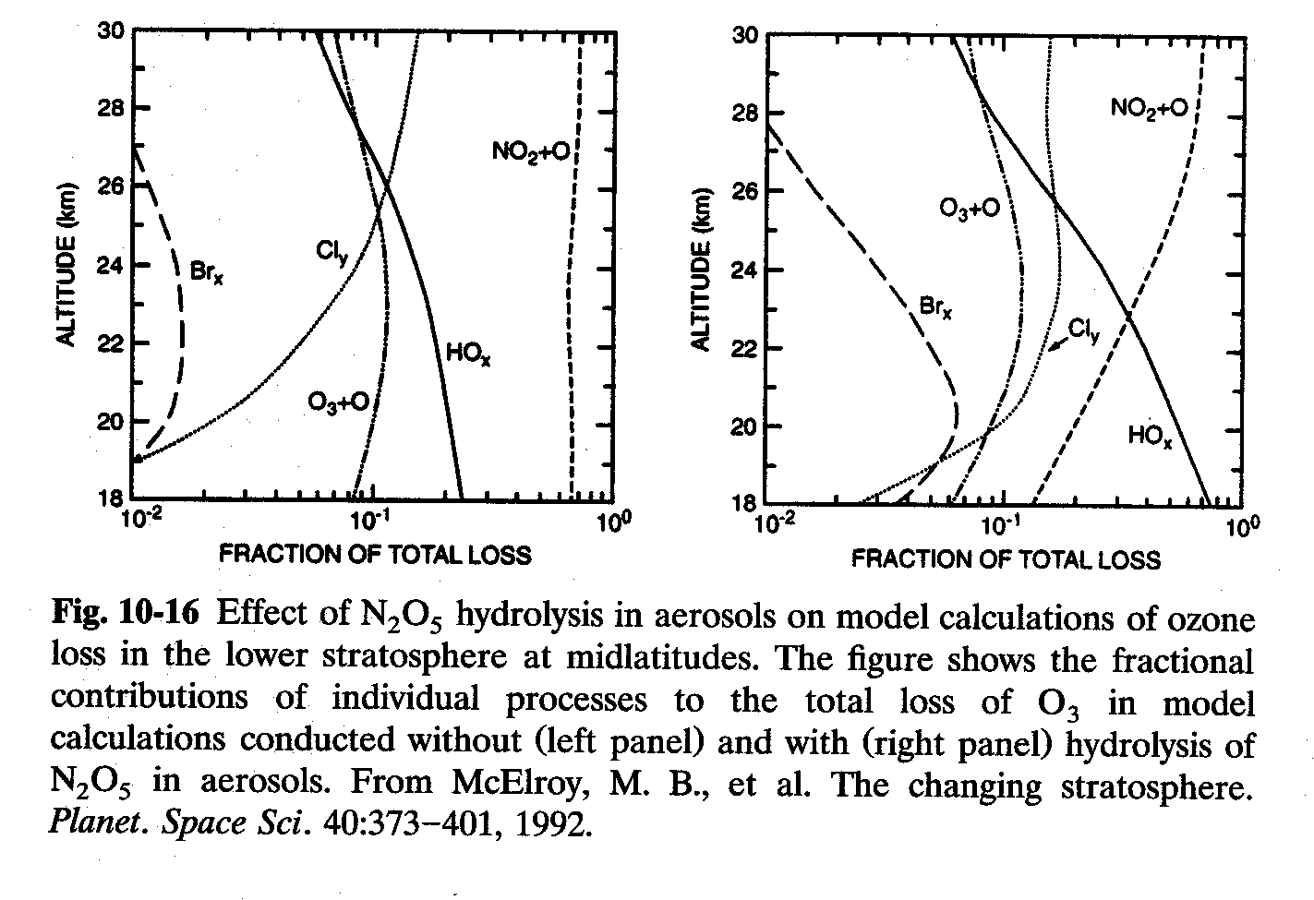
HYDROLYSIS OF N₂O₅ IN AEROSOLS
INCREASES THE SENSITIVITY OF OZONE TO CHLORINE
N₂O₅ + H₂O –aerosol→ 2HNO₃
N₂O₅ hydrolysis increases HO_{x}-catalyzed ozone loss. Why?

Slide 37
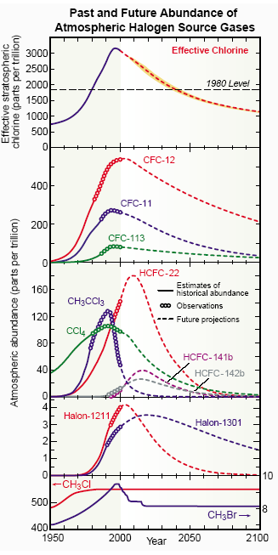
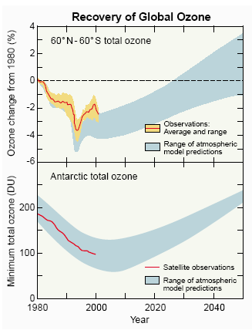

Slide 38
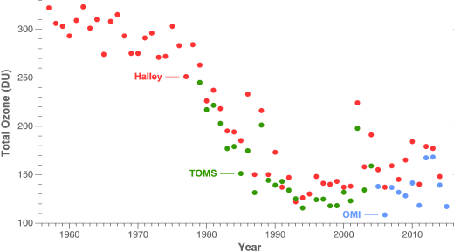
OBSERVED TREND IN OCTOBER OZONE IN ANTARCTICA
Recovery?
http://ozonewatch.gsfc.nasa.gov/facts/history.html

Slide 39
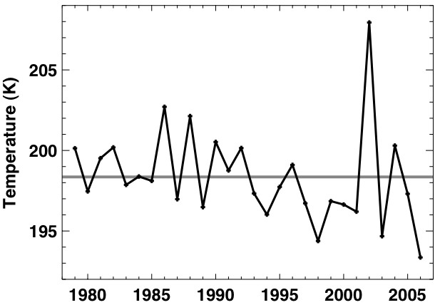
LONG-TERM COOLING OF THE STRATOSPHERE
Sep 21-30, 25 km, 65-75˚S
Increasing CO₂ is expected to cool the stratosphere

Slide 40
TRENDS IN POLAR OZONE
Could greenhouse-induced cooling of stratosphere produce an Arctic ozone hole over the next decade?
Race between chlorine decrease and climate change

Slide 41
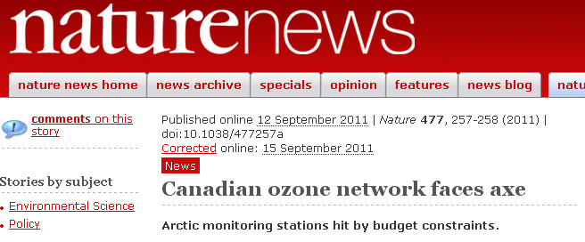
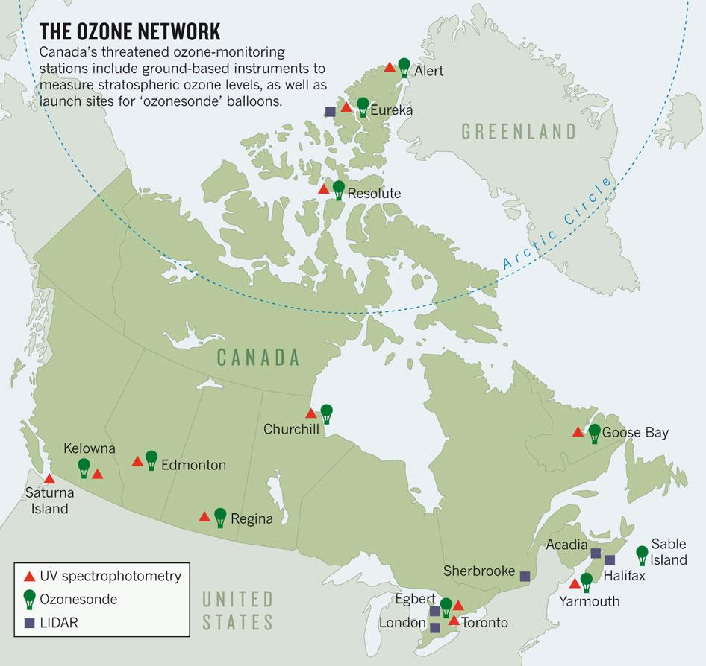
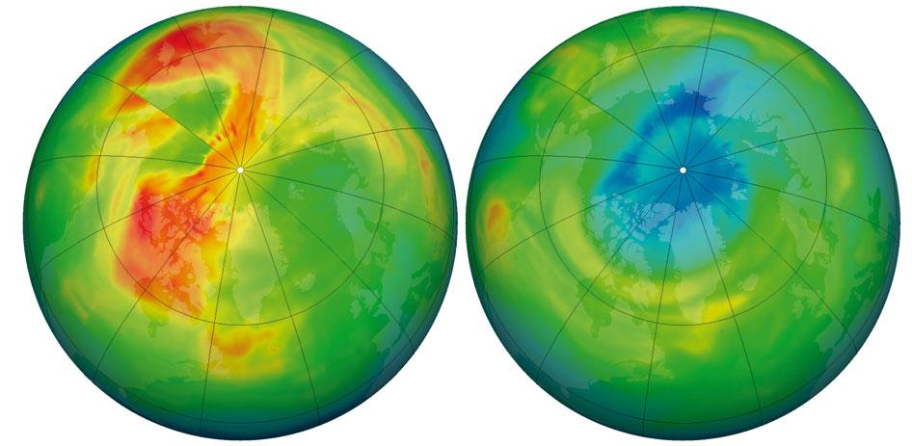
2010
(“regular” year)
2011
(lowest Arctic O₃ column)

Slide 42
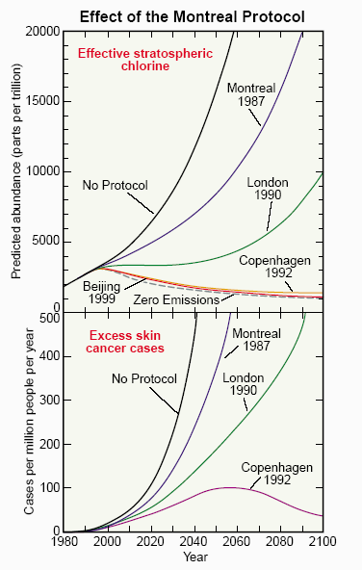
SKIN CANCER EPIDEMIOLOGY PREDICTIONS
"perhaps the single most successful international agreement to date has been the Montreal Protocol”
~ Kofi Annan (UN Secretary General 1997-2006)

