Slide 1
Volcanic Eruptions
and Climate
Alan Robock
Department of Environmental Sciences
Rutgers University, New Brunswick, New Jersey USA
robock@envsci.rutgers.edu
http://envsci.rutgers.edu/~robock
Notes:
This presentation discusses atmospheric emissions from volcanic eruptions and their effects on weather and climate.

Slide 2
http://www.agu.org/journals/rg/
Reviews of Geophysics distills and places in perspective previous scientific work in currently active subject areas of geophysics. Contributions evaluate overall progress in the field and cover all disciplines embraced by AGU.
Authorship is by invitation, but suggestions from readers and potential authors are welcome. If you are interested in writing an article please talk with me, or write to reviewsgeophysics@agu.org, with an abstract, outline, and analysis of recent similar review articles, to demonstrate the need for your proposed article.
Reviews of Geophysics has an impact factor of 14.8 in the 2014 Journal Citation Reports, highest in the geosciences.

Slide 3
Volcanic Eruptions and Climate
© Alan Robock, June 20, 2014
version 2.0
Feel free to use this presentation for non-commercial purposes, including teaching and research. At any time please email robock@envsci.rutgers.edu if you have any questions, comments, or corrections.
There are too many slides here for one class. Feel free to hide a number of them, so that the slide show could be used for one lecture at the advanced undergraduate/introductory graduate level, or to select a different set of slides for your own use.
There are also links to many volcanic topics at
http://climate.envsci.rutgers.edu/robock/robock_vol.html
Notes:
Volcanic Eruptions and Climate
© Alan Robock, March 30, 2007
version 1.5
Feel free to use this presentation for non-commercial purposes, including teaching and research. At any time please email robock@envsci.rutgers.edu if you have any questions, comments, or corrections.
There are too many slides here for one class. Feel free to hide a number of them, so that the slide show could be used for one lecture at the advanced undergraduate/introductory graduate level, or to select a different set of slides for your own use.
There are also links to many volcanic topics at
http://climate.envsci.rutgers.edu/robock/robock_vol.html

Slide 4
For the details, see list of publications
(with pdfs of all recent papers) at
http://climate.envsci.rutgers.edu/robock/robock_volpapers.html
Review article:
Robock, Alan, 2000: Volcanic eruptions and climate. Rev. Geophys., 38, 191-219.
Latest papers:
Bourassa, Adam E., Alan Robock, William J. Randel, Terry Deshler, Landon A. Rieger, Nicholas D. Lloyd, E. J. (Ted) Llewellyn, and Douglas A. Degenstein, 2012: Large volcanic aerosol load in the stratosphere linked to Asian monsoon transport. Science, 337, 78-81, doi:10.1126/science.1219371.
Driscoll, Simon, Alessio Bozzo, Lesley J. Gray, Alan Robock, and Georgiy Stenchikov, 2012: Coupled Model Intercomparison Project 5 (CMIP5) simulations of climate following volcanic eruptions. J. Geophys. Res., 117, D17105, doi:10.1029/ 2012JD017607.
Schmidt, Anja, Thorvaldur Thordarson, Luke Oman, Alan Robock, and Stephen Self, 2012: The 1783-1784 CE Laki eruption produced stratospheric injection and long-lived climate impacts. J. Geophys. Res. , 117, D23116, doi:10.1029/2012JD018414.
Robock, Alan, Michael R. Rampino, Thorvaldur Thordarson, and Stephen Self, 2012: Volcanism and the atmosphere: AGU Chapman Conference on Volcanism and the Earth’s Atmosphere; Selfoss, Iceland, 10-16 June 2012. Eos, 93, 511-512, doi:10.1029/ 2012ES004014.
Berdahl, Mira, and Alan Robock, 2013: Baffin Island snow extent sensitivity: Insights from a regional climate model. J. Geophys. Res., 118, 3506–3519, doi:10.1002/jgrd.50249.
Berdahl, Mira, and Alan Robock, 2013: Cryospheric response to volcanic eruptions in the Paleoclimate Model Intercomparison Project 3 last millennium simulations. J. Geophys. Res. Atmos., 118, 12,359-12,370, doi:10.1002/2013JD019914.
Robock, Alan, 2013: The latest on volcanic eruptions and climate, Eos, 94, 305-306, doi: 10.1002/2013EO350001.
Ding, Yanni, James A. Carton, Gennady A. Chepurin, Georgiy Stenchikov, Alan Robock, Lori T. Sentman, and John P. Krasting, 2014: Ocean response to volcanic eruptions in Coupled Model Intercomparison Project 5 (CMIP5) simulations. J. Geophys. Res. Oceans, 119, 5622-5637, doi:10.1002/2013JC009780.
Schmidt, Anja, and Alan Robock, 2015: Volcanism, the atmosphere, and climate through time, Chap. 13 of Volcanism and Global Environmental Change, Anja Schmidt, Кirsten E. Fristad, and Linda T. Elkins-Tanton, Eds., (Cambridge University Press, Cambridge, UK), 195-207.
Robock, Alan, 2015: Climatic impacts of volcanic eruptions, Chapter 53 in Encyclopedia of Volcanoes, Second Edition, Haraldur Sigurdsson (editor-in-chief), Bruce Houghton, Stephen R. McNutt, Hazel Rymer and John Styx (editors) (Elsevier, Amsterdam), 935-942.
Notes:
The review article (Robock, 2000) summarizes much of the material here, as of 2000. Newer, shorter review articles and the latest observational and climate modeling research can be downloaded from http://climate.envsci.rutgers.edu/robock/robock_volpapers.html .

Slide 5
This material is based upon work supported by the National Science Foundation under grants 0313592, 0351280, 0730452, 0908834, and 1157525, and by the NASA Office of Earth Science grant NNG05GB06G, and by the Chaire du Développement Durable de l'École Polytechnique, France.
Any opinions, findings, and conclusions or recommendations expressed in this material are those of the author and do not necessarily reflect the views of the National Science Foundation, the National Aeronautics and Space Administration, or the École Polytechnique.
Notes:
This material is based upon work supported by the National Science Foundation under grants 0313592 and 0351280, by the NASA Office of Earth Science grant NNG05GB06G, and by the Chaire du Développement Durable de l'École Polytechnique, France.
Any opinions, findings, and conclusions or recommendations expressed in this material are those of the author and do not necessarily reflect the views of the National Science Foundation, the National Aeronautics and Space Administration or the École Polytechnique.

Slide 6
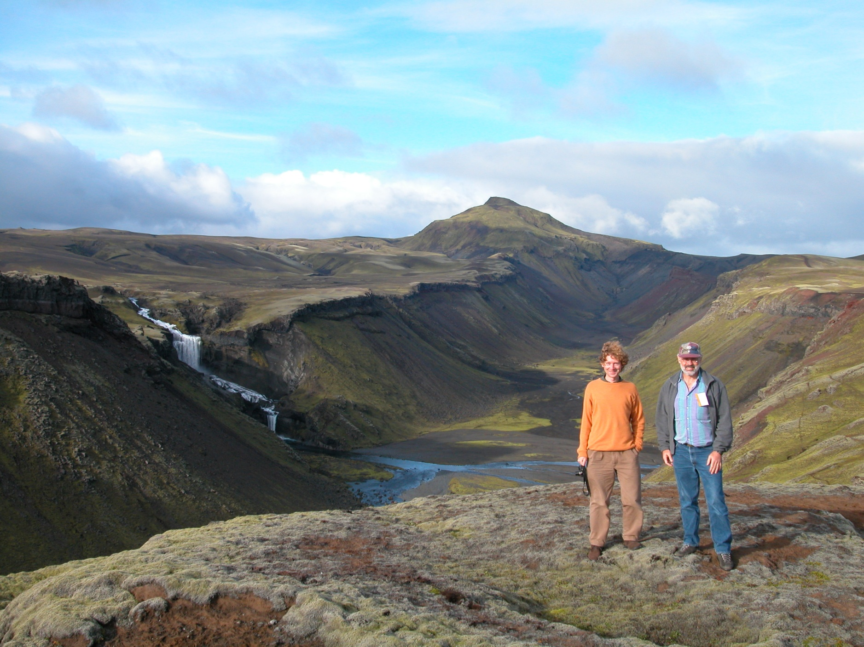
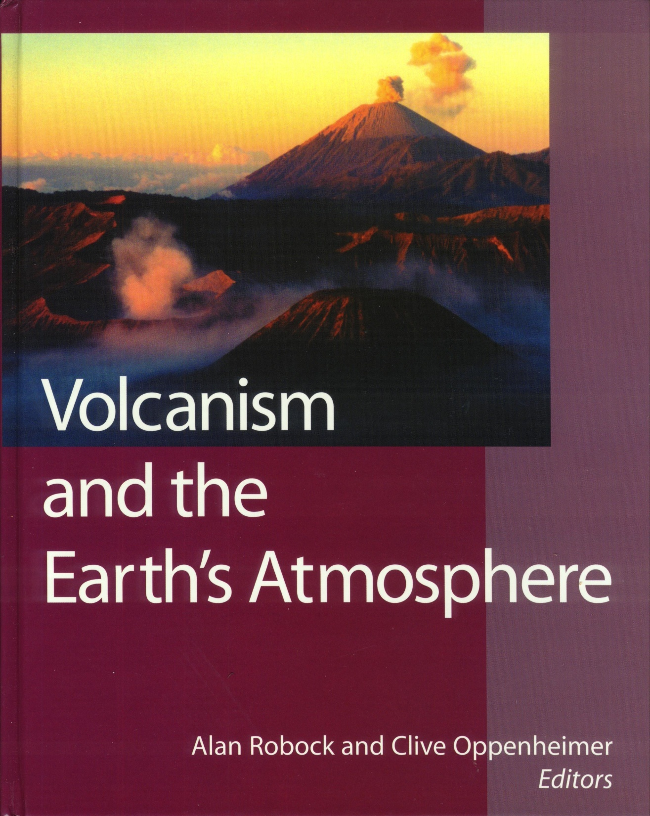
Notes:
Results from the AGU Chapman Conference on Volcanism and the Earth’s Atmosphere, held in Santorini, Greece, June, 2002, are in this book. Here is a photo of the Editors, in front of the Eldgja volcano, Iceland, which erupted in 934 AD. Photo © Peter Baxter 2002.
Robock, Alan, and Clive Oppenheimer, Eds., 2003: Volcanism and the Earth’s Atmosphere, Geophysical Monograph 139, American Geophysical Union, Washington, DC, 360 pp.

Slide 7

Based on Chapman Conference in Selfoss, Iceland in 2012, there were 14 articles published in
Special Section on
Volcanism and the Atmosphere
http://onlinelibrary.wiley.com/journal/10.1002/%28ISSN%292169-9356/specialsection/VOLCANISM1

Slide 8
Volcanic Eruptions and Climate
1. Introduction
    a. Why study volcanoes
    b. Volcanic emissions
    c. Summary of atmospheric effects
2. Past large eruptions, with examples of effects
3. Tropical eruptions: Summer cooling, winter warming
    a. Observations
    b. Climate model simulations
4. High latitude eruptions: Collapse of monsoons
5. Conclusions
Notes:
This presentation starts with an introduction that includes the reasons to study volcanic eruptions, what volcanic eruptions emit to the atmosphere, and a summary of atmospheric effects. Then, famous past eruptions are used to illustrate these effects. The 1991 Mt. Pinatubo eruption has been studied more than any other, and results from many observational and modeling studies are used to show how counterintuitive winter warming is produced by changes in atmospheric wind patterns produced by volcanic heating and cooling.

Slide 9
Collaborators
Ben Kravitz Chaochao Gao
Rutgers University Zhejiang University, Hangzhou, China
Georgiy L. Stenchikov Luke Oman
King Abdullah University, Saudi Arabia NASA, Greenbelt, Maryland
Kevin Hamilton Thorvaldur Thordarson
University of Hawaii, Honolulu Edinburgh University, Scotland
V. Ramaswamy, M. Daniel Schwartzkopf, and Richard Wetherald
NOAA Geophysical Fluid Dynamics Lab, Princeton, New Jersey
Hans-F. Graf Brian Soden
University of Cambridge, Cambridge, England University of Miami
Caspar Ammann S. Ramachandran
National Center for Atmospheric Research Physical Research Laboratory, Ahmedabad, India
Jianping Mao Melissa Free
Raytheon ITSS, Lanham, MD NOAA Air Resources Lab, Silver Spring, MD
Ingo Kirchner Juan Carlos Antuña
Max Plank Institute for Meteorology, Hamburg, Germany Camagüey Lidar Station, Cuba
Notes:
This work has been done in collaboration with many other scientists, including the ones listed here. Oman and Gao are current students, and Mao, Free, and Antuña are former students.

Slide 10
Why Study Volcanic Eruptions and Climate?
It helps us to improve climate models.
    Radiative and dynamic aspects of models used for other problems can be tested by these large, episodic events.
It allows us to make seasonal and interannual forecasts following large volcanic eruptions.
    Winter warming and summer cooling follow large tropical eruptions, like El Chichón (1982) and Pinatubo (1991). Summer Indian monsoon failure will follow large high latitude eruptions.
Notes:
Climate models represent the embodiment of our theoretical understanding of the climate system. They are used to predict the extent of global warming in the future due to anthropogenic emissions of greenhouse gases. One way to test whether these predictions are correct is to wait until global warming has occurred. Another method is to take advantage of natural climate change experiments, such as large volcanic eruptions, which provide a large impulse to the climate system, but are short-lived. Thus we can well characterize the forcing to the climate system and the response and use eruptions such as the 1991 Mt. Pinatubo eruption to test climate models. These tests cannot evaluate long-term aspects of climate change, such as changes to the conveyor belt (thermohaline circulation), but can test the sensitivity of the climate system to increasing greenhouse gases.
Now that we understand the rapid seasonal response to volcanic eruptions, we can use this understanding for seasonal forecasting following the next large eruption.

Slide 11
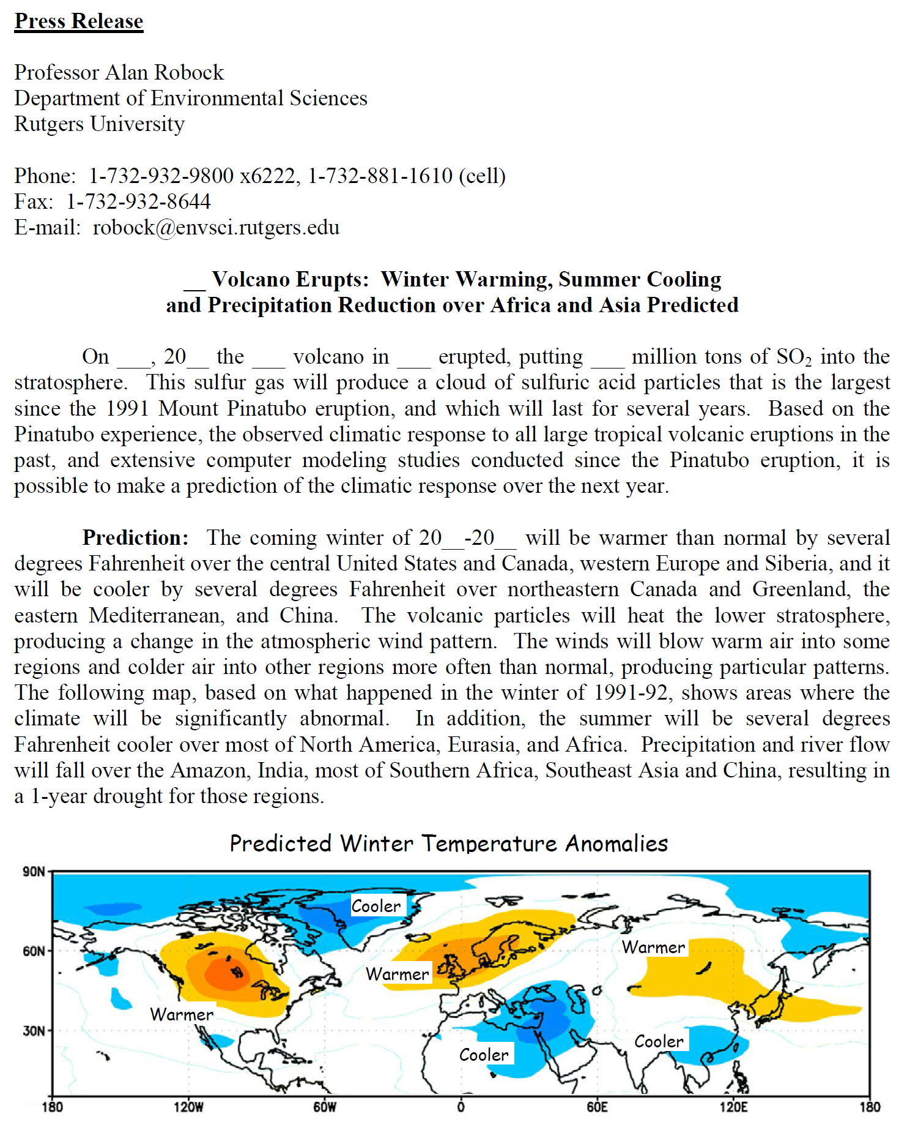
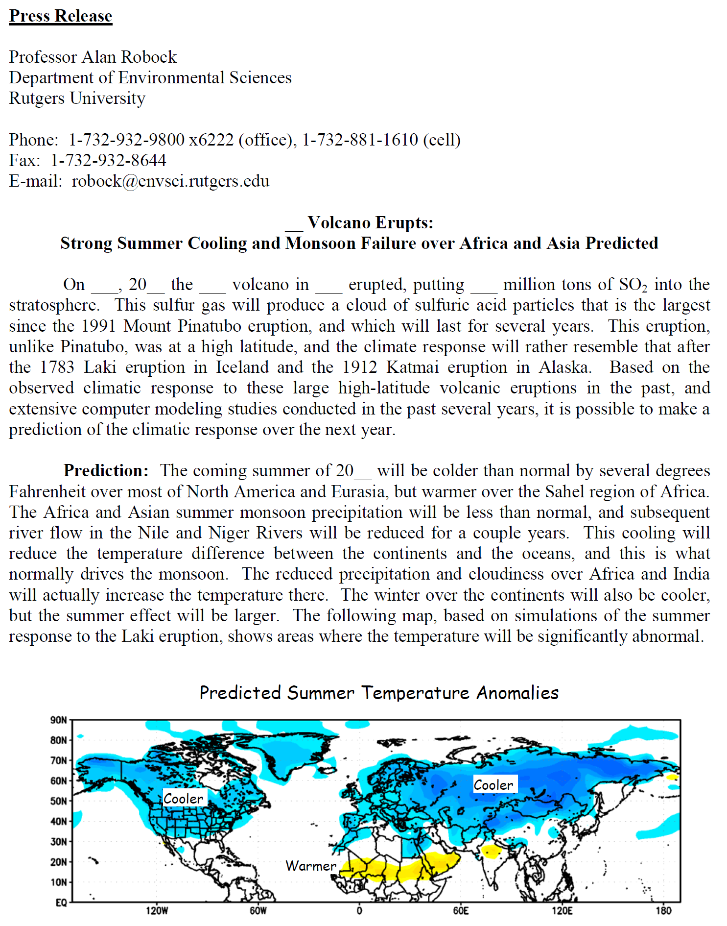

Slide 12
Why Study Volcanic Eruptions and Climate?
It provides an analog for some parts of the nuclear winter theory.
    Rapid global aerosol transport and surface cooling from large aerosol loading provide natural analogs that support the nuclear winter theory.
It provides an analog for suggestions to geoengineer the climate using stratospheric aerosols.
    Surface cooling, ozone depletion, and drought following large volcanic eruptions show that geoengineering is not an innocuous method to cool the planet.
Notes:
Nuclear winter, the climatic effects of large scale nuclear holocaust, in which the smoke from the fires would cause rapid surface cooling and darkness, is not an experiment we want to actually conduct. We can validate parts of the theory by observing that stratospheric aerosols get rapidly transported around the world after volcanic eruptions, and that these aerosol clouds produce surface cooling.
We can test climate models by using them to simulate past climate change. By correctly specifying natural causes of climate change, mainly solar variations and volcanic eruptions, and simulating the climate response, we can compare the climate change to what actually happened and see if the anthropogenic forcings can explain this difference. To do this, we need to accurately know the record of past volcanic eruptions.
Volcanic eruptions cause changes in the carbon cycle, through their effects on diffuse radiation. This helps to better understand interannual variations of CO₂. Rapid cooling following volcanic eruptions can, for example, produce more sea ice and allow polar bears to have more cubs. This positive effect on polar bears serves as a warning to them following the opposite effects which will happen with global warming.

Slide 13
Why Study Volcanic Eruptions and Climate?
It allows us to separate the natural causes of interdecadal climate change from anthropogenic effects.
    The anthropogenic cause of recent global warming is strengthened after accounting for volcanic effects.
The response to volcanic eruptions allows us to better understand the impacts of anthropogenic climate change on life.
    Biospheric responses and aspects of the carbon cycle have been clarified.
Notes:
Nuclear winter, the climatic effects of large scale nuclear holocaust, in which the smoke from the fires would cause rapid surface cooling and darkness, is not an experiment we want to actually conduct. We can validate parts of the theory by observing that stratospheric aerosols get rapidly transported around the world after volcanic eruptions, and that these aerosol clouds produce surface cooling.
We can test climate models by using them to simulate past climate change. By correctly specifying natural causes of climate change, mainly solar variations and volcanic eruptions, and simulating the climate response, we can compare the climate change to what actually happened and see if the anthropogenic forcings can explain this difference. To do this, we need to accurately know the record of past volcanic eruptions.
Volcanic eruptions cause changes in the carbon cycle, through their effects on diffuse radiation. This helps to better understand interannual variations of CO₂. Rapid cooling following volcanic eruptions can, for example, produce more sea ice and allow polar bears to have more cubs. This positive effect on polar bears serves as a warning to them following the opposite effects which will happen with global warming.

Slide 14
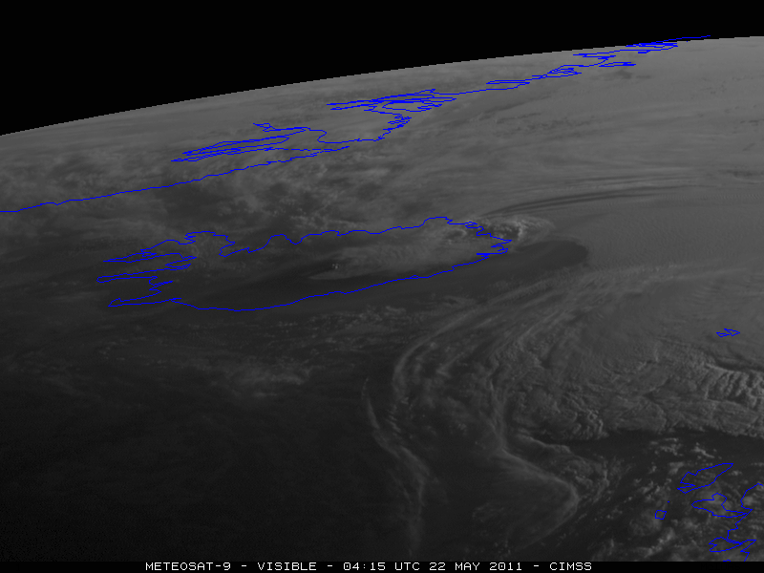
Eruption of Grímsvötn Volcano, Iceland

Slide 15
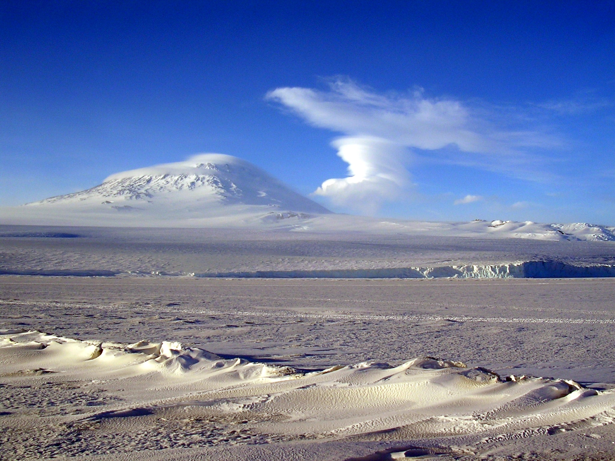
Mt. Erebus, Sept. 22, 2004

Slide 16
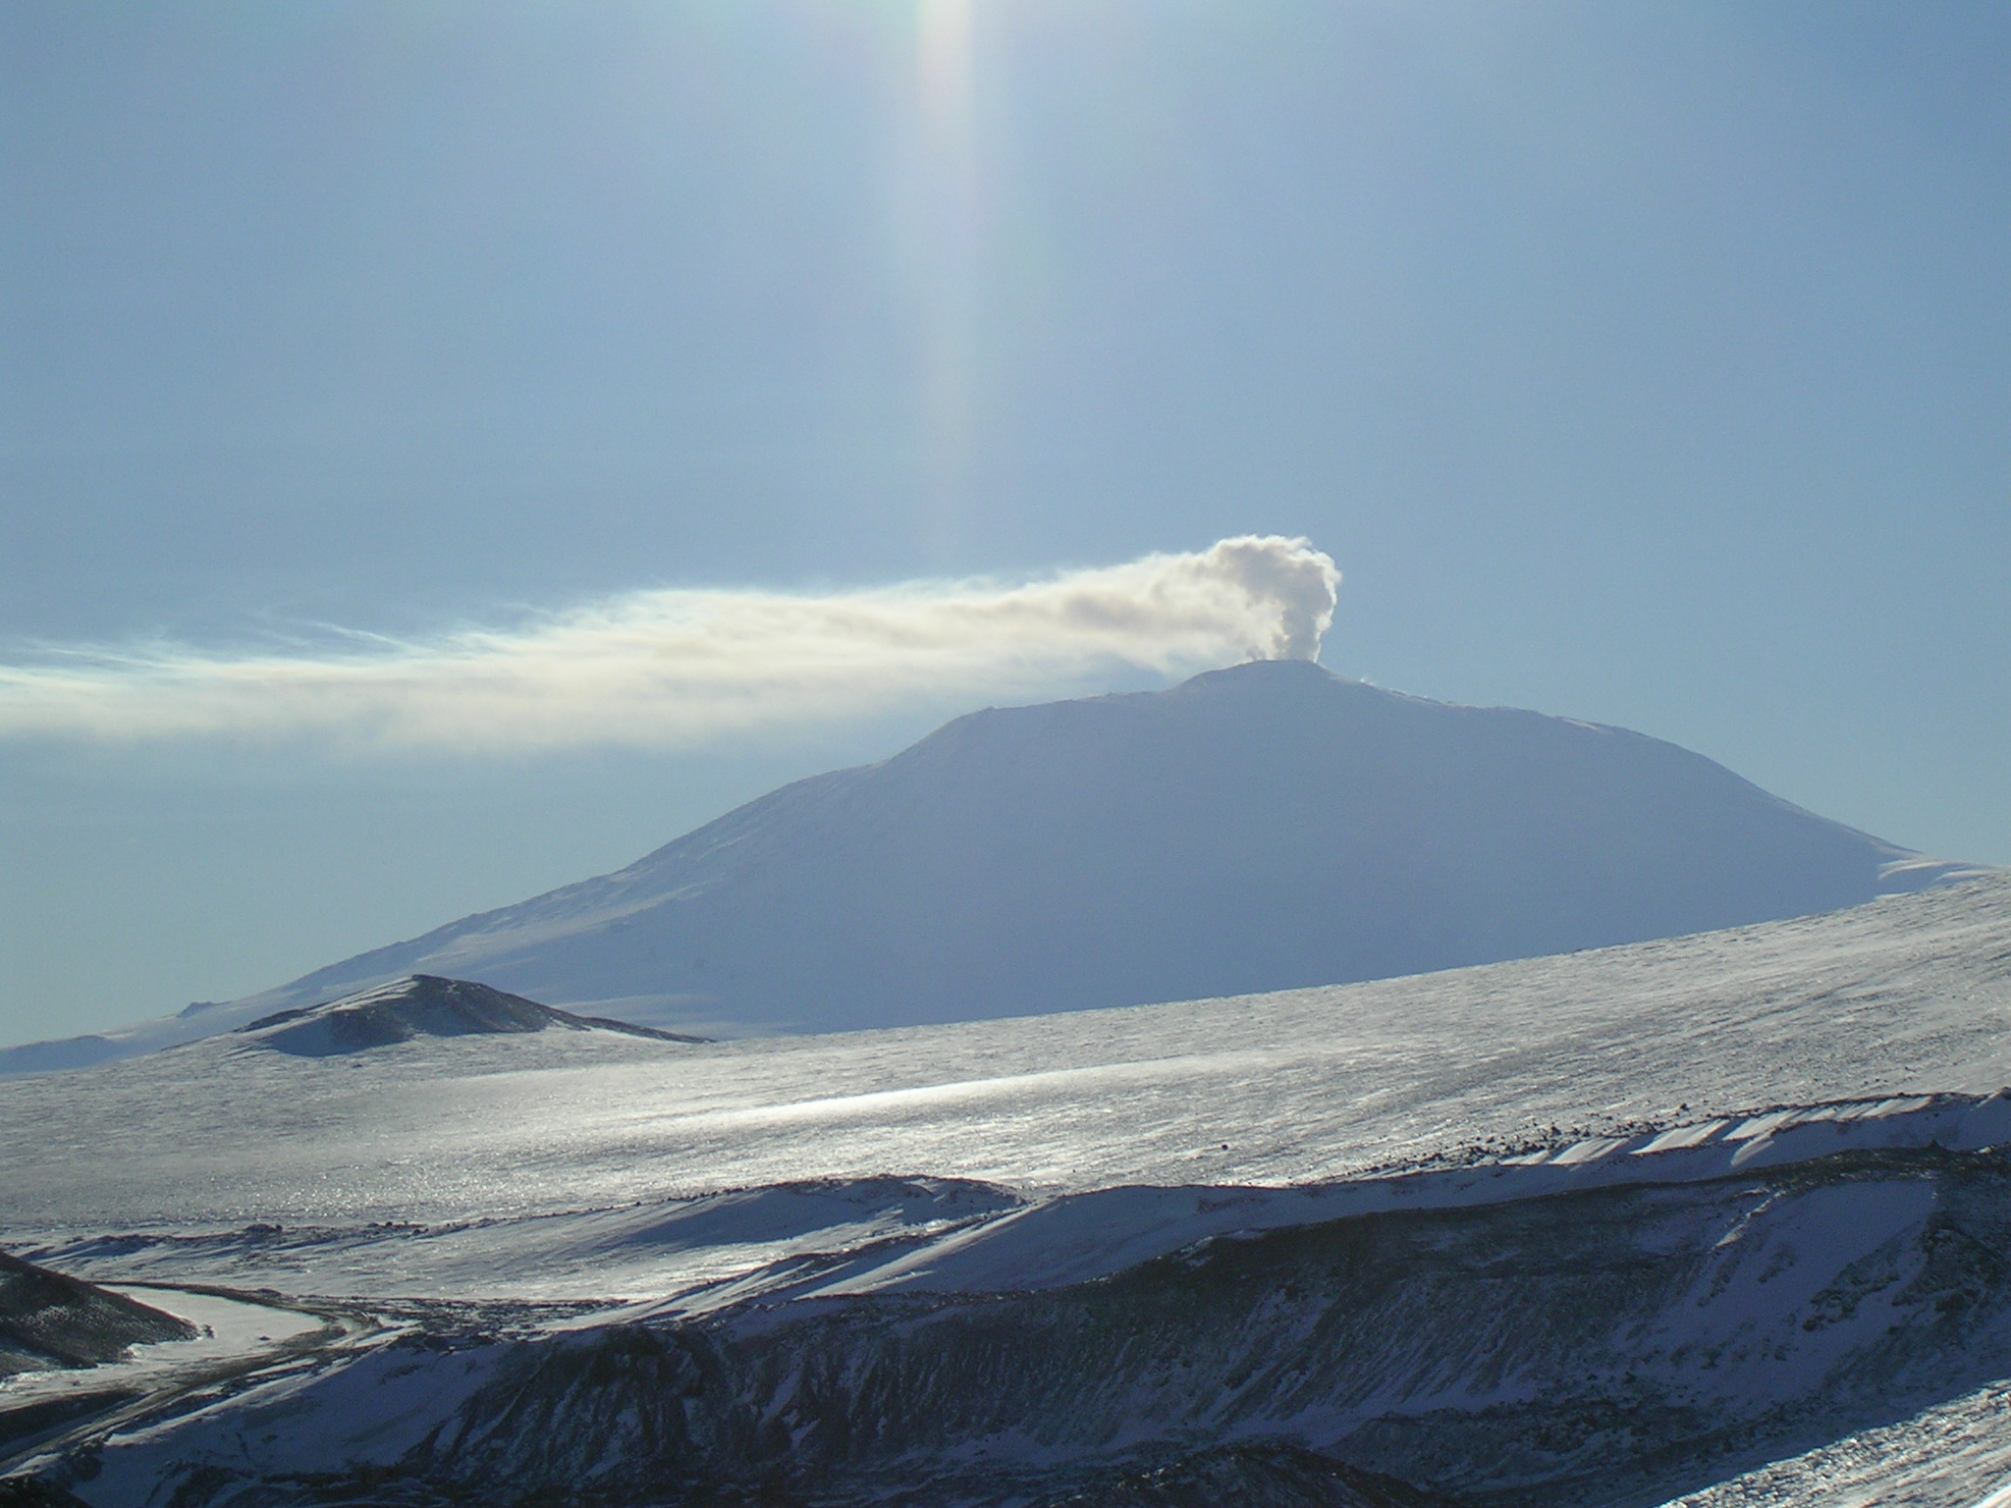
Mt. Erebus, Oct. 3, 2004
Notes:
Mt. Erebus on Ross Island, Antarctica – an example of a quiescent volcano with continuous emissions, in this case from a lava lake at the summit. Only if the rate of emissions from these volcanoes changes dramatically will there be a climate change. Nevertheless, their emissions need to be considered to understand the background atmospheric chemistry. Photo © Alan Robock, 2004.

Slide 17
More Reflected
Solar Flux
Less
Upward
IR Flux
Stratospheric aerosols
(Lifetime ≈ 1-3 years)
backscatter
H₂S
SO₂
absorption
(near IR)
Solar Heating
IR
Heating
emission
→ H₂SO₄
Heterogeneous → Less
O₃ depletion Solar Heating
NET HEATING
IR Cooling
CO₂
H₂O
absorption (IR)
emission
forward scatter
Explosive
Enhanced
Diffuse
Flux
Effects
on cirrus
clouds
Ash
Reduced
Direct
Flux
More
Downward
IR Flux
Tropospheric aerosols
(Lifetime ≈ 1-3 weeks)
Less Total
Solar Flux
SO₂ → H₂SO₄
Quiescent
NET COOLING
Indirect Effects on Clouds
Robock, Alan, 2000: Volcanic eruptions and climate. Rev. Geophys., 38, 191-219.
Notes:
This diagram shows the main components of non-explosive and explosive volcanic eruptions, and their effects on shortwave and longwave radiation.

Slide 18
Volcanoes produced the atmosphere and the oceans
Volcanic emissions
N₂
CO₂
H₂O
remains
photosynthesis
condensation
N₂
O₂
oceans
99% of atmosphere
Notes:
Over geologic time scales, emissions of carbon dioxide (CO₂) and water (H₂O) are responsible for the current oceans and atmosphere on the Earth. Life has converted these gases to oxygen (O₂), which along with nitrogen (N₂) make up the atmosphere. Take a deep breath. You are inhaling volcanic emissions.

Slide 19
EFFECTS OF LARGE EXPLOSIVE TROPICAL
VOLCANOES ON WEATHER AND CLIMATE
Notes:
But to cause climate to change, it is the large explosive eruptions that have the largest effect. On this and the next page are listed the major impacts of explosive eruptions on weather and climate.

Slide 20
EFFECTS OF LARGE EXPLOSIVE TROPICAL
VOLCANOES ON WEATHER AND CLIMATE
Notes:
These effects will be illustrated using the climate response to famous large volcanic eruptions.

Slide 21
EFFECTS OF EXPLOSIVE HIGH-LATITUDE VOLCANOES ON WEATHER AND CLIMATE
Notes:
These effects will be illustrated using the climate response to famous large volcanic eruptions.

Slide 22
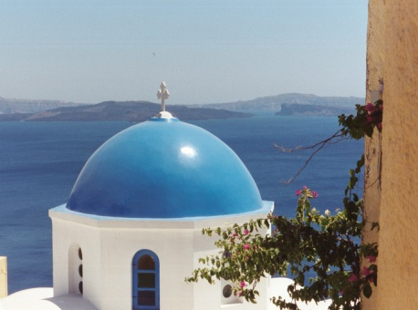
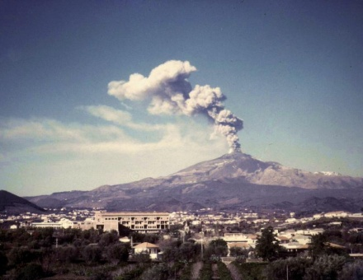
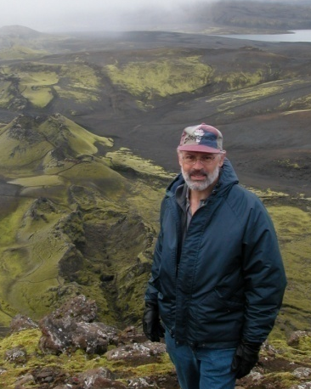
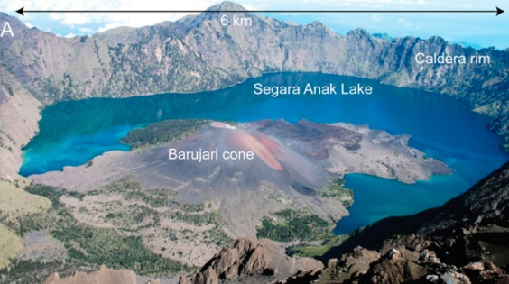
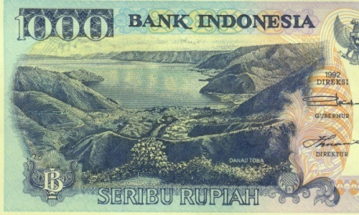
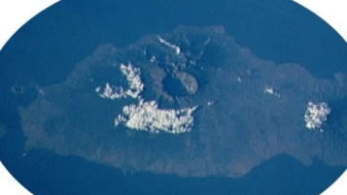
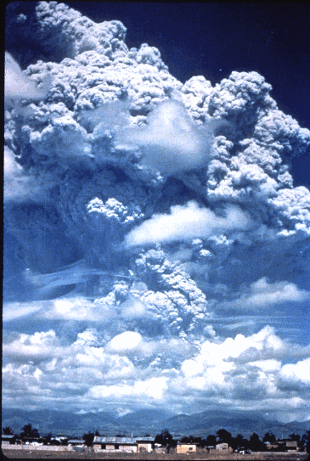
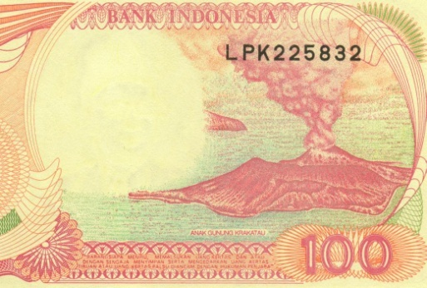
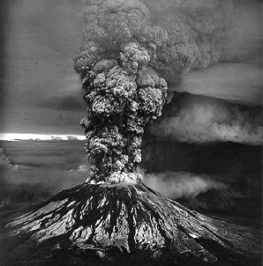
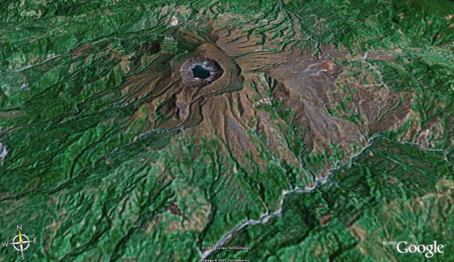
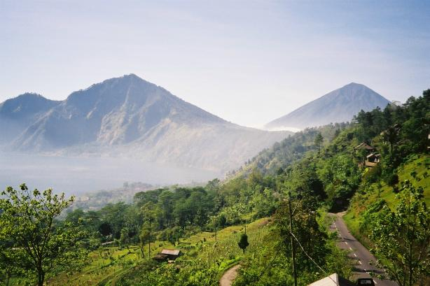
Santorini, 1628 BC
Etna, 44 BC
Samalas, 1257
Lakagígar, 1783
Famous Volcanic Eruptions
Toba, 74,000 BP
Tambora, 1815
Krakatau, 1883
Pinatubo, 1991
El Chichón, 1982
St. Helens, 1980
Agung, 1963
Notes:
These are some of the eruptions that will be used to illustrate the effects of volcanic eruptions on climate. Photos of Toba, Santorini, Laki, Krakatau, Agung, and El Chichón, © Alan Robock. Photo of Tambora from NASA, Space Shuttle image (no copyright). Photo of Pinatubo from USGS.. Photo of Etna from http://boris.vulcanoetna.com/ETNA_1972_73.html, © Boris Behnke. Photo of Mt. St. Helens by US Geological Survey scientist, Austin Post, on May 18, 1980.

Slide 23
Major volcanic eruptions
of the past 250 years
[Tg sulfate aerosol ]
Notes:
The major eruptions of the past 250 years are listed, along with three different scales that have been used to measure the size of the eruptions, the Volcanic Explosivity Index, the Dust Veil Index, and the Ice-core Volcanic Index. For more details, see:
Robock, Alan and Melissa P. Free, 1995: Ice cores as an index of global volcanism from 1850 to the present. J. Geophys. Res., 100, 11,549-11,567.

Slide 24
Major volcanic eruptions
of the past 250 years
[Tg sulfate aerosol ]
Notes:
The major eruptions of the past 250 years are listed, along with three different scales that have been used to measure the size of the eruptions, the Volcanic Explosivity Index, the Dust Veil Index, and the Ice-core Volcanic Index. For more details, see:
Robock, Alan and Melissa P. Free, 1995: Ice cores as an index of global volcanism from 1850 to the present. J. Geophys. Res., 100, 11,549-11,567.

Slide 25
Volcanic Forcing of Climate Change For the Past 1500 Years:
An Improved Ice-Core-Based Index for Climate Models
Chaochao Gao¹, Alan Robock¹, Caspar Ammann²
¹Rutgers University, New Brunswick, USA
²National Center for Atmospheric Research, Colorado, USA
Gao, Chaochao, Alan Robock, and Caspar Ammann, 2008: Volcanic forcing of climate over the past 1500 years: An improved ice-core-based index for climate models. J. Geophys. Res., 113, D23111, doi:10.1029/2008JD010239.
Notes:
Good morning, everyone. My name is Chaochao Gao, from Rutgers University, USA. Today I am going to talk about the reconstruction of global volcanic forcing index over the past 2000 years using multiple ice core records. It is a work done by Alan, Caspar and myself.

Slide 26
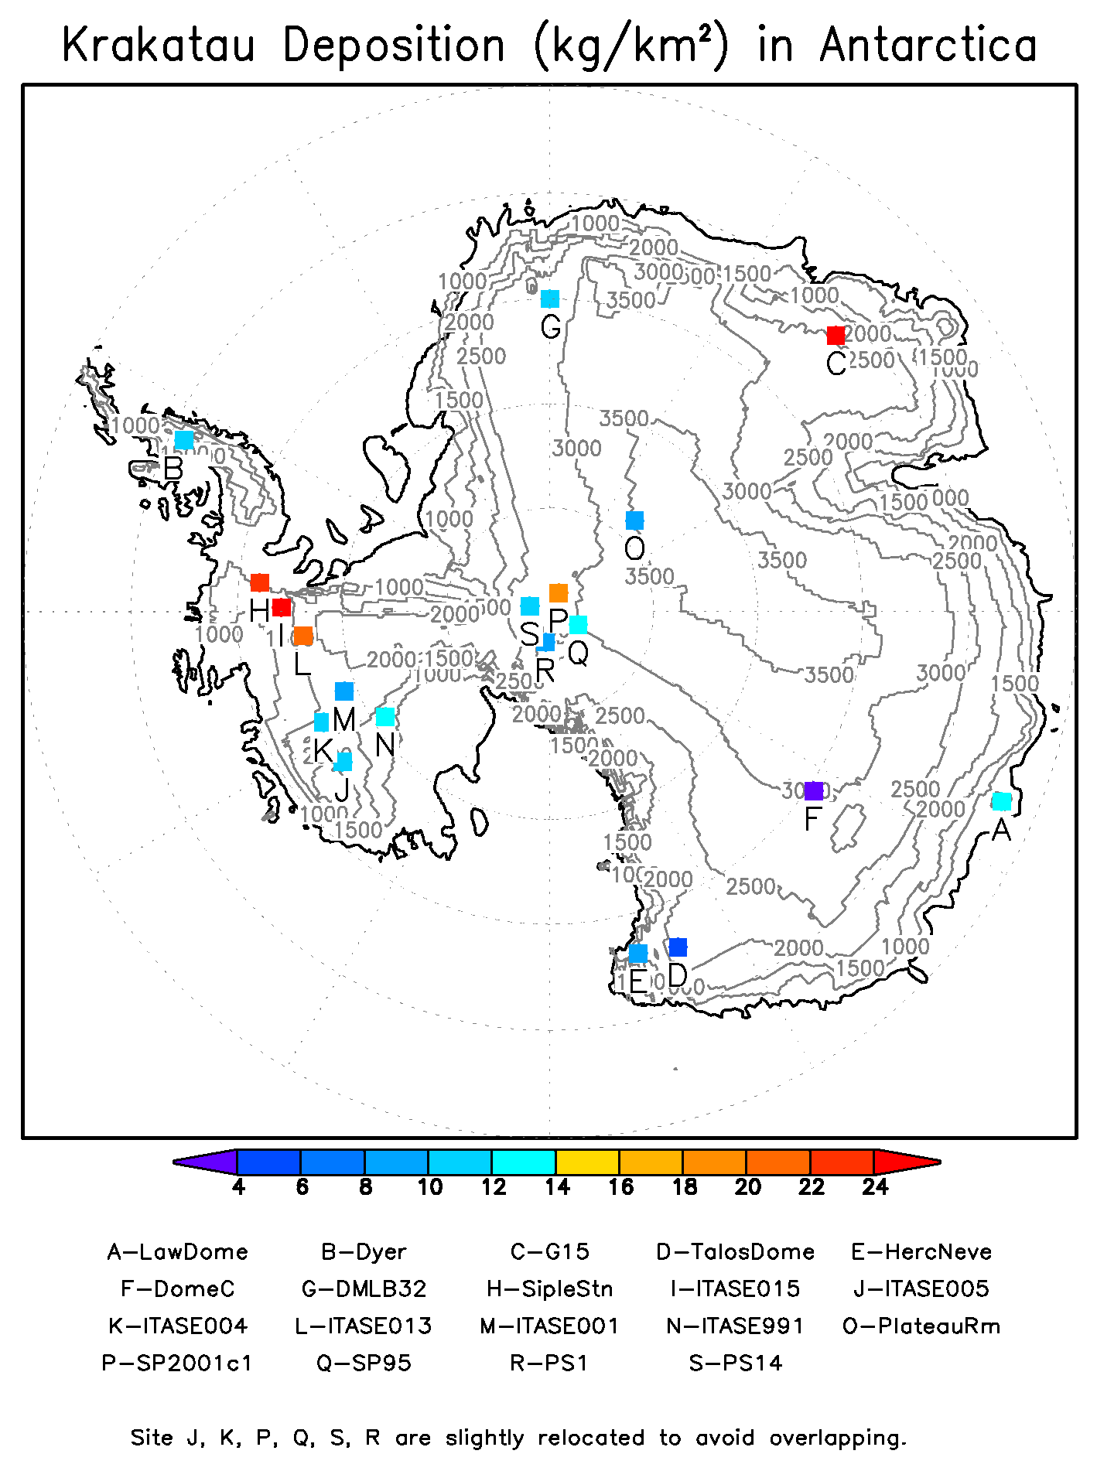
Volcanic sulfate in ice cores gives record of past climate forcing from volcanic eruptions
Gao, Chaochao, Alan Robock, and Caspar Ammann, 2008: Volcanic forcing of climate over the past 1500 years: An improved ice-core-based index for climate models. J. Geophys. Res., 113, D23111, doi:10.1029/2008JD010239.

Slide 27
The Need for a Long-term Volcanic Index
Currently available volcanic indices
  Too short, e.g., Sato [1993] 1850-1990
  Robock and Free [1995] 1850-1990
  Ammann [2003] 1890-2000
  Not directly related to radiative effects, e.g., VEI [Newhall and Self, 1982]
  Based on single or a few ice cores, e.g., Crête [Crowley, 2000]
More ice cores with longer records are needed to obtain a more reliable long-term volcanic index
Gao, Chaochao, Alan Robock, and Caspar Ammann, 2008: Volcanic forcing of climate over the past 1500 years: An improved ice-core-based index for climate models. J. Geophys. Res., 113, D23111, doi:10.1029/2008JD010239.
Notes:
The climate impact of volcanism has been long recognized. Nevertheless, the current available volcanic forcing indices are either too short or not directly related to climatic effects. Sulfate flux or electrical conductivity records in ice-cores were found in various studies to be a good indicator of past volcanism, but they also pointed out that more ice cores with longer records are necessary to obtain a reliable long-term volcanic index.

Slide 28
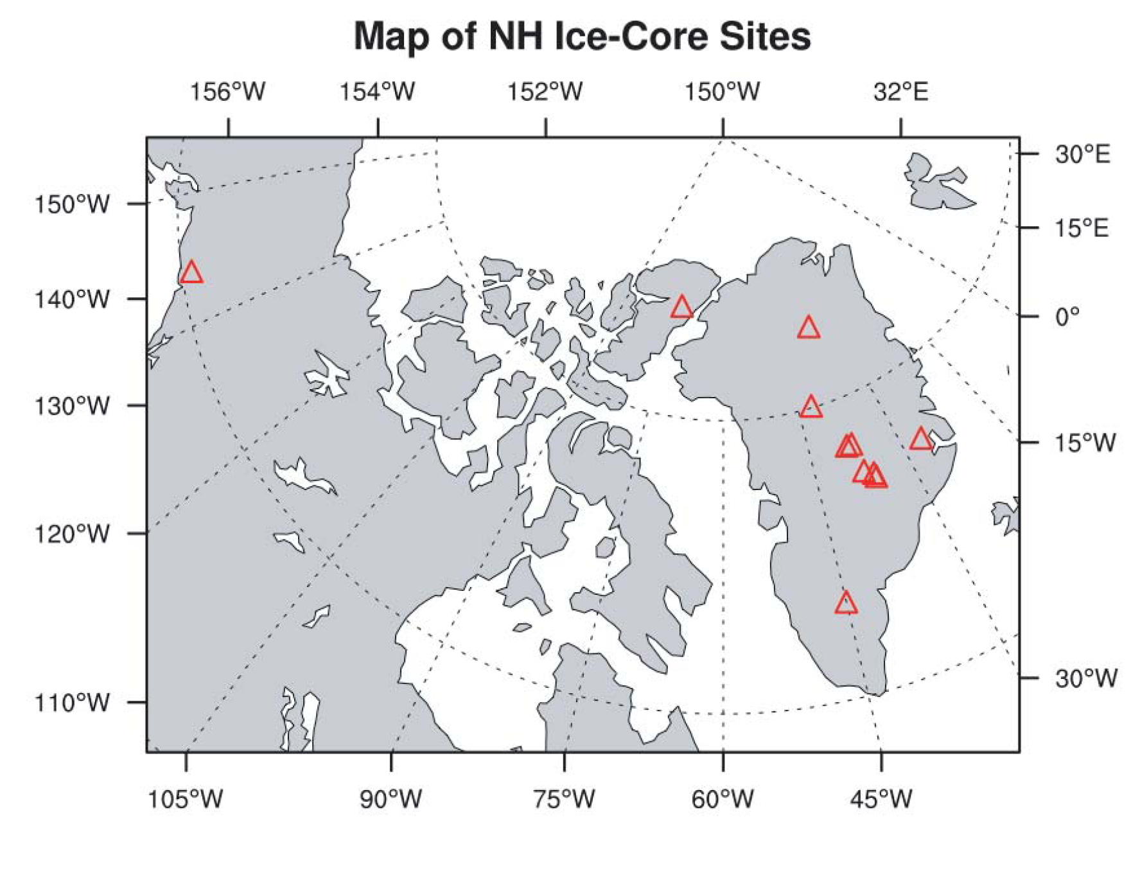

Slide 29
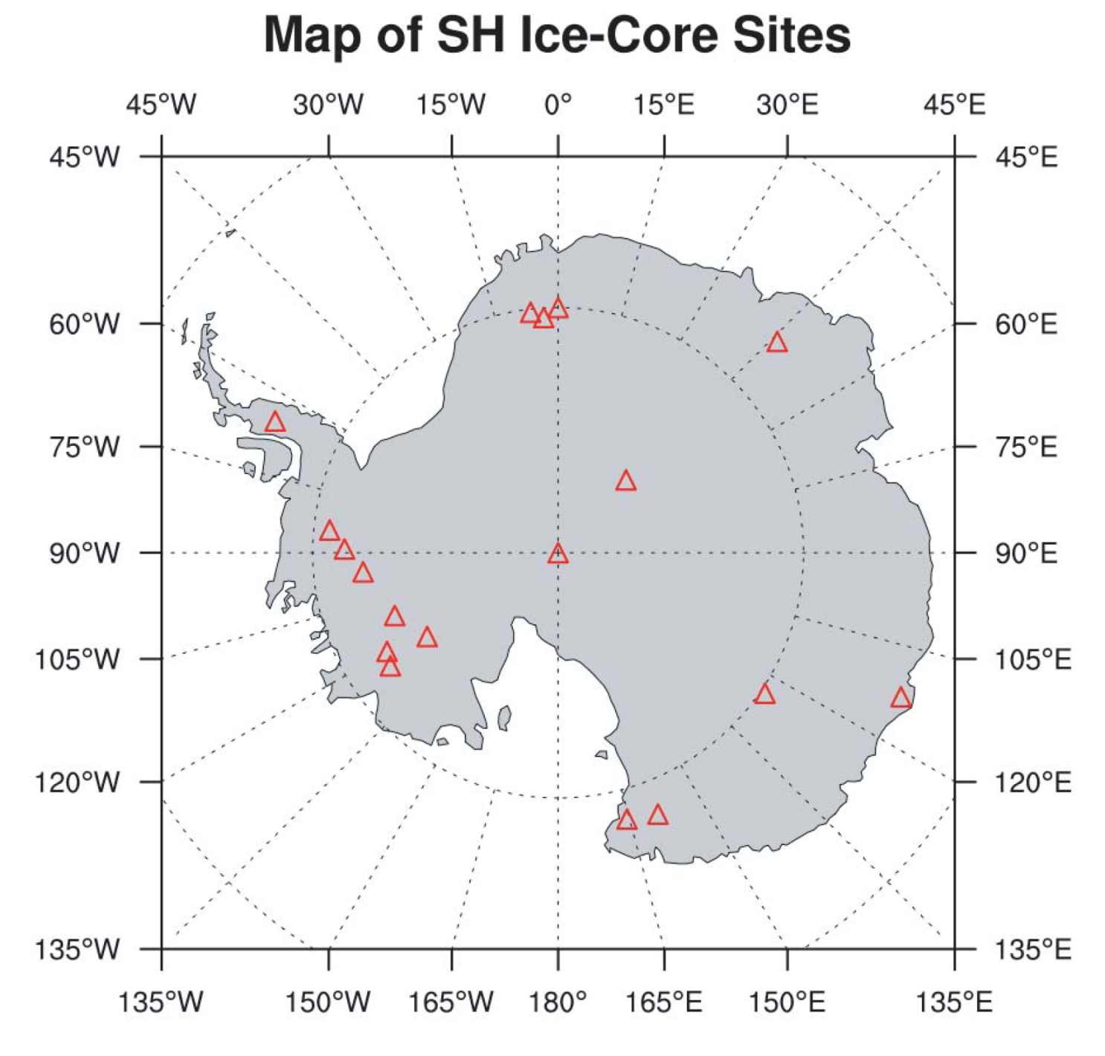

Slide 30
Construction of the Volcanic Index
1. Select the ice core records and calculate the annual means
  24 from Greenland, plus one from Mt. Logan
  19 from Antarctica
2. Extract the potential volcanic peaks
  High-pass loess filter to estimate the background
  Volcanic peaks: > 2×31-yr running MAD
Notes:
With this extensive ice core records, we constructed the volcanic forcing index. The first step is to extract the potential volcanic signals by applying a high-pass loess filter and examining peaks that exceed twice the 31-yr running median absolute deviation.

Slide 31
Extraction of Potential Volcanic Signals
Notes:
The blue line in the up panel shows the annual mean ice core time series. The green line is background trend estimated by the loess filter, and the red curve is the threshold we used to identify the potential volcanic signals. The resulting volcanic peaks are shown in the bottom panel here. This signal extraction method is very robust for time series with outliers like the volcanic peaks.

Slide 32
Construction of the Volcanic Index (cont.)
1. Select the ice core records and calculate the annual means
2. Extract the potential volcanic peaks
3. Select the peaks and adjust the timing of each eruption
4. Adjust for the spatial distribution and calculate the mean deposition
Notes:
After extracting the potential volcanic peaks we selected the ones that have signals in at least half of the available ice cores and adjust the timing of the signals so that the peak deposition can line in the same year. One thing I would like to point out is that we used all of the available ice core records to determine the timing of each eruption but only the sulfate records to calculate the volcanic deposition.
In the next step, After that we adjust the spatial variation of volcanic deposition and calculated the mean deposition of each eruption for Greenland and Antarctic ice cores respectively.

Slide 33
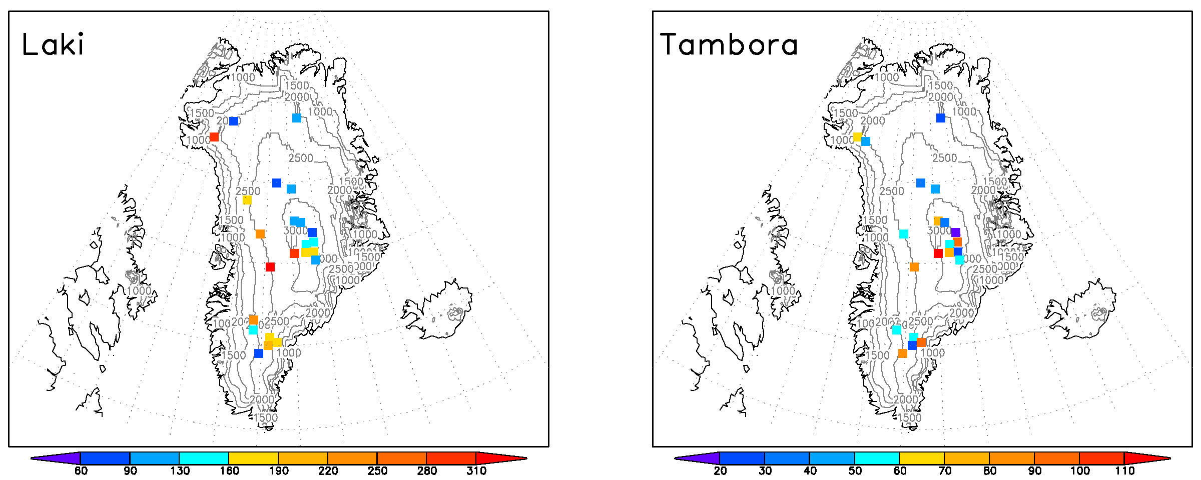
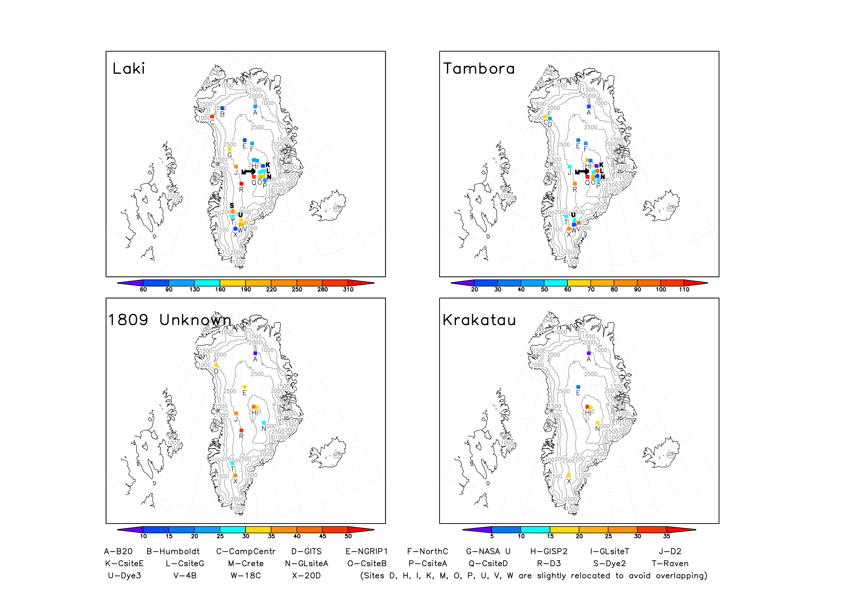
Spatial Distribution of Volcanic Deposition
in Greenland Ice Cores
B20
B20
NorthGRIP1
NorthGRIP1
GISP2
GISP2
(kg/km²)
Less than average deposition
Greater than average deposition
Gao, Chaochao, Alan Robock, and Caspar Ammann, 2008: Volcanic forcing of climate over the past 1500 years: An improved ice-core-based index for climate models. J. Geophys. Res., 113, D23111, doi:10.1029/2008JD010239.
Notes:
Basically, we found a similar spatial distribution of volcanic deposition in both regions among the largest eruptions during the past 1000 years, such as the Laki and Tambora eruption shown here. We also found that individual ice core has consistent relative magnitude compared to the Greenland and Antarctic means. So we multiplied the volcanic deposition in each ice core with the ratio of Greenland or Antarctic mean vs the individual ice core. This helps to minimize the change caused by the decrease of ice core body as we go back in time. For example, only the three cores, B20, NorthGRIP1, and GISP2 have records before 17th century. Both B20 and NorthGRIP1 show less than average deposition for the two events shown here. Without the spatial adjustment, the average deposition for the early period will be underestimated.

Slide 34
Construction of the Volcanic Index (cont.)
1. Select the ice core records and calculate the annual means
2. Extract the potential volcanic peaks
3. Select the peaks and adjust the timing of each eruption
4. Adjust for the spatial distribution and calculate the mean deposition
5. Calculate the stratospheric aerosol loading
Notes:
In the next step, we calculated the stratospheric aerosol loadings by multiplying the average deposition with a set of calibration factors

Slide 35
Conversion Factors
Method |  | For tropical eruptions based on NH ice cores |  |  | For tropical eruptions based on SH ice cores |  |  | For NH high latitude eruptions
 |  | 2:1 NH vs. SH | 1:1 NH vs. SH | 1:2 NH vs. SH | 2:1 SH vs. NH | 1:1 SH vs. NH | 1:2 SH vs. NH
Bomb test calculation (L_{B}) |  | 1.1 – 1.5 | 1.5 – 2.0 | 2.0 – 3.0 | N/A | N/A | N/A | 1.22
Pinatubo observations (L_{P}) |  | N/A | N/A | N/A | 1.5 – 2.0 | 2.0 – 2.7 | 2.7 – 3.6 | N/A
Climate model simulations (L_{GISS}) | Tambora | N/A | N/A | 1.36 | 0.94 | N/A | N/A | N/A
 | Pinatubo | 0.85 | N/A | N/A | N/A | N/A | 0.94 | N/A
 | Laki | N/A | N/A | N/A | N/A | N/A | N/A | 0.58
 | Katmai | N/A | N/A | N/A | N/A | N/A | N/A | 0.55
Notes:
We compared three techniques for estimating stratospheric aerosol loading from ice core data: radioactive deposition from nuclear bomb tests, satellite observations of Pinatubo aerosol loading, and climate model (GISS modelE) simulations of volcanic sulfate transport and deposition following the 1783 Laki, 1815 Tambora, 1912 Katmai, and 1991 Pinatubo eruptions.

Slide 36
Estimates of Stratospheric Aerosol Loading
Eruption | Ice Core Average Sulfate Deposition (kg/km²) |  | Calibration Factor (×10⁹ km²) |  | Hemispheric Aerosol Loading (Tg) |  | Global Loading (Tg) | Other Estimates (Tg)
 | NH | SH | NH | SH | NH | SH
1259 Unknown | 146 | 112 | 1 | 1 | 146 | 112 | 258 | N/A
1452 Kuwae | 45 | 93 | 1 | 1 | 45 | 93 | 138 | N/A
1783 Laki | 154 | 0 | 0.57 | N/A | 88 | 0 | 88 | 200
1809 Unknown | 29 | 27 | 1 | 1 | 29 | 27 | 56 | N/A
1815 Tambora | 58 | 57 | 1 | 1 | 58 | 57 | 115 | 93-118
1883 Krakatau | 13 | 12 | 1 | 1 | 13 | 12 | 25 | 30-50
1912 Katmai | 22 | 0 | 0.57 | N/A | 12.4 | 0 | 12.4 | 11
1963 Agung | 7 | 10 | 1 | 1 | 7 | 10 | 17 | 15-25
1991 Pinatubo | N/A | 15 | 1 | 1 | N/A | 15 | 30 | 20-40
Notes:
By applying the calibration factors obtained from above methods (Table 1) to the 44 ice core records we estimated the stratospheric sulfate aerosol loadings for the largest eruptions during the last millennium (Table 2). These results agree fairly well with estimates based on radiation, petrology and satellite observations

Slide 37
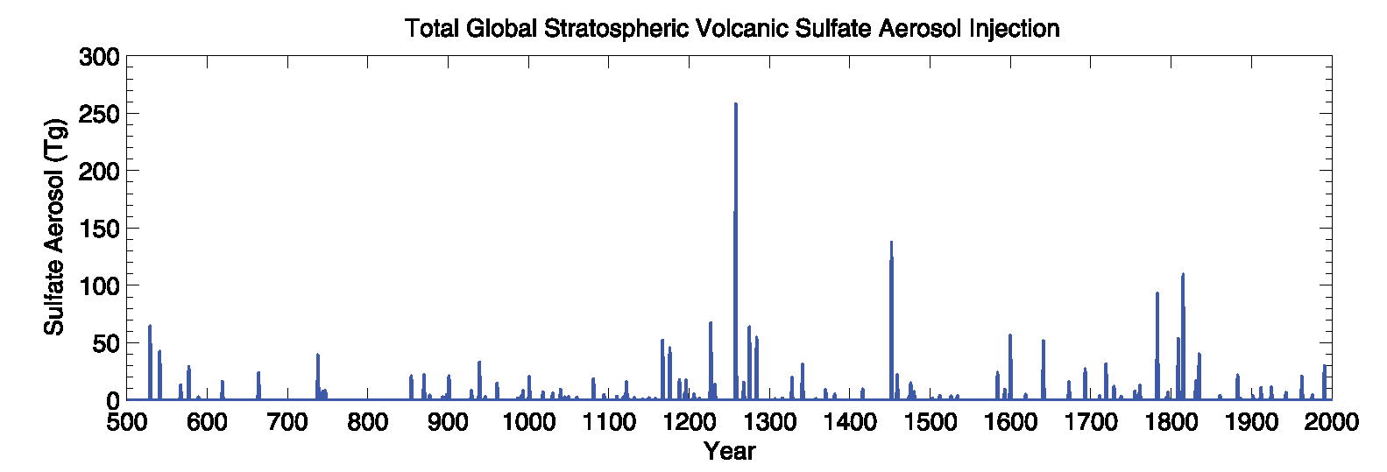
Gao, Chaochao, Alan Robock, and Caspar Ammann, 2008: Volcanic forcing of climate over the past 1500 years: An improved ice-core-based index for climate models. J. Geophys. Res., 113, D23111, doi:10.1029/2008JD010239.

Slide 38
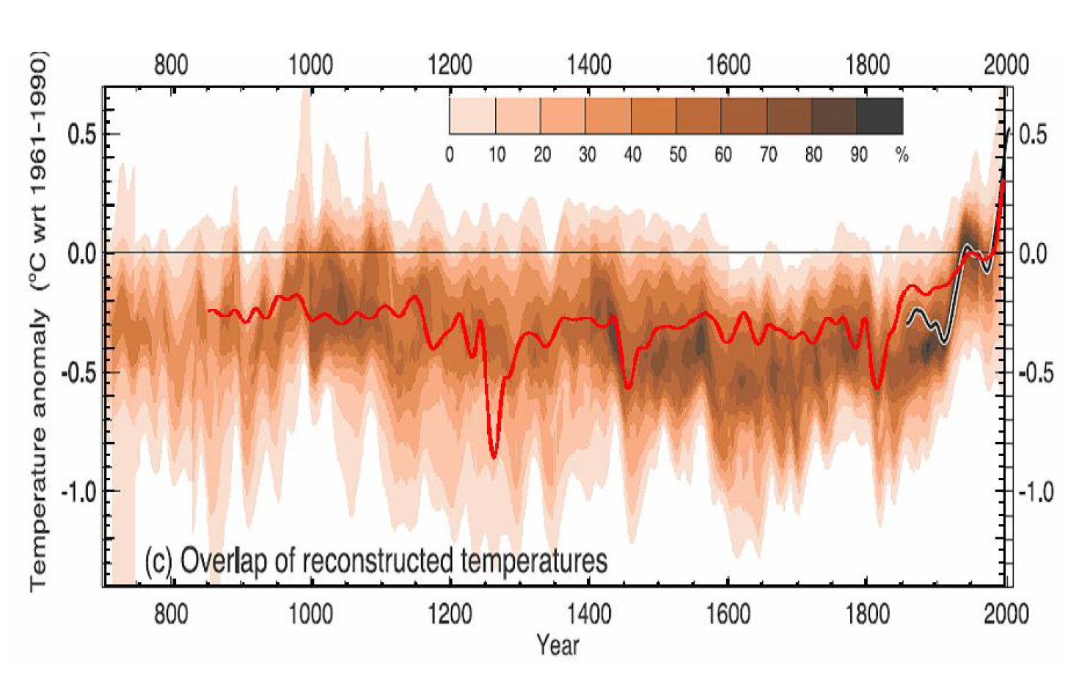
MAGICC simulation forced with IVI2, solar, and A1B with ΔT_{2xCO2} = 3K compared to climate reconstruction (Figure 6.10 of IPCC [2007])
Gao, Chaochao, Alan Robock, and Caspar Ammann, 2008: Volcanic forcing of climate over the past 1500 years: An improved ice-core-based index for climate models. J. Geophys. Res., 113, D23111, doi:10.1029/2008JD010239.

Slide 39
Construction of the Volcanic Index (cont.)
1. Select the ice core records and calculate the annual means
2. Extract the potential volcanic peaks
3. Select the peaks and adjust the timing of each eruption
4. Adjust for the spatial distribution and calculate the mean deposition
5. Calculate the hemispheric stratospheric aerosol loading
6. Construct the monthly and spatially dependent index
  Monthly and latitudinally: Stratospheric transport and decay parameterization, Grieser and Schönwiese [1999]
  Vertically: 11 lidar observation, Antuña et al. [2002]
Notes:
After obtaining the global stratospheric volcanic aerosol loading, we applied a stratospheric transport parameterization to calculate the spread of aerosol within the low and mid stratosphere plus a latitude-time dependent function to describe the production and sedimentation of aerosols5. Next figure shows an example of the resulting spatial and temporal distribution of the stratospheric volcanic aerosols three years after the 1809 Unknown and 1815 Tambora eruptions.

Slide 40
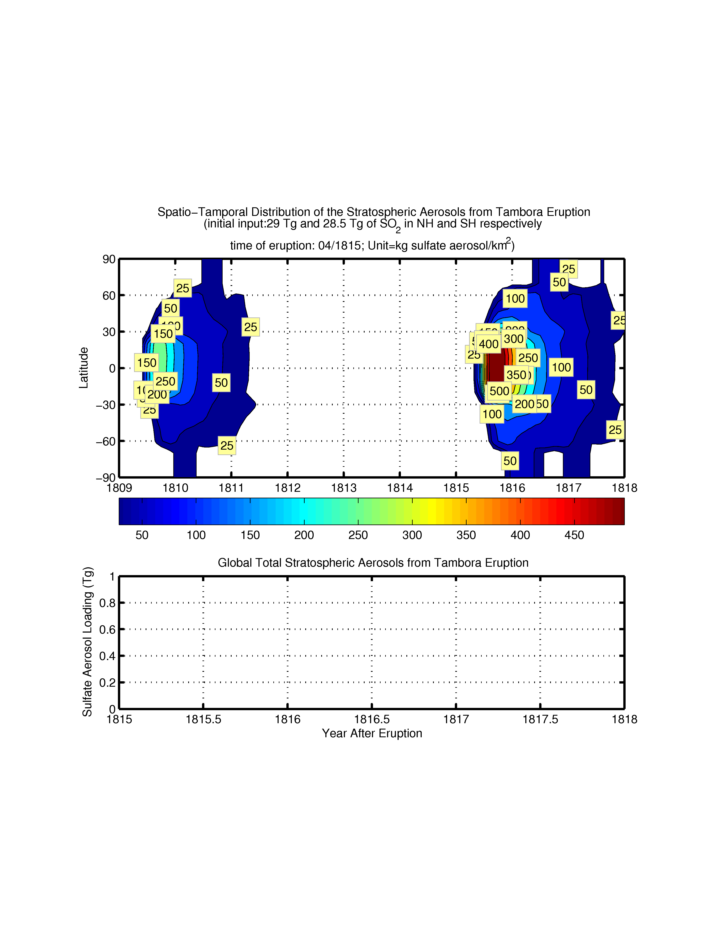
Spatial-temporal distribution of the stratospheric aerosols from 1809 Unknown and 1815 Tambora eruptions. Units: kg sulfate aerosol/km²
Figure 3. Spatial-temporal distribution of the stratospheric aerosols from the 1809 Unknown and 1815 Tambora eruptions. Units: kg sulfate aerosol/km²
Notes:
Next figure shows an example of the resulting spatial and temporal distribution of the stratospheric volcanic aerosols three years after the 1809 Unknown and 1815 Tambora eruptions, where we can see the spread and decay of volcanic aerosols in space and time.

Slide 41
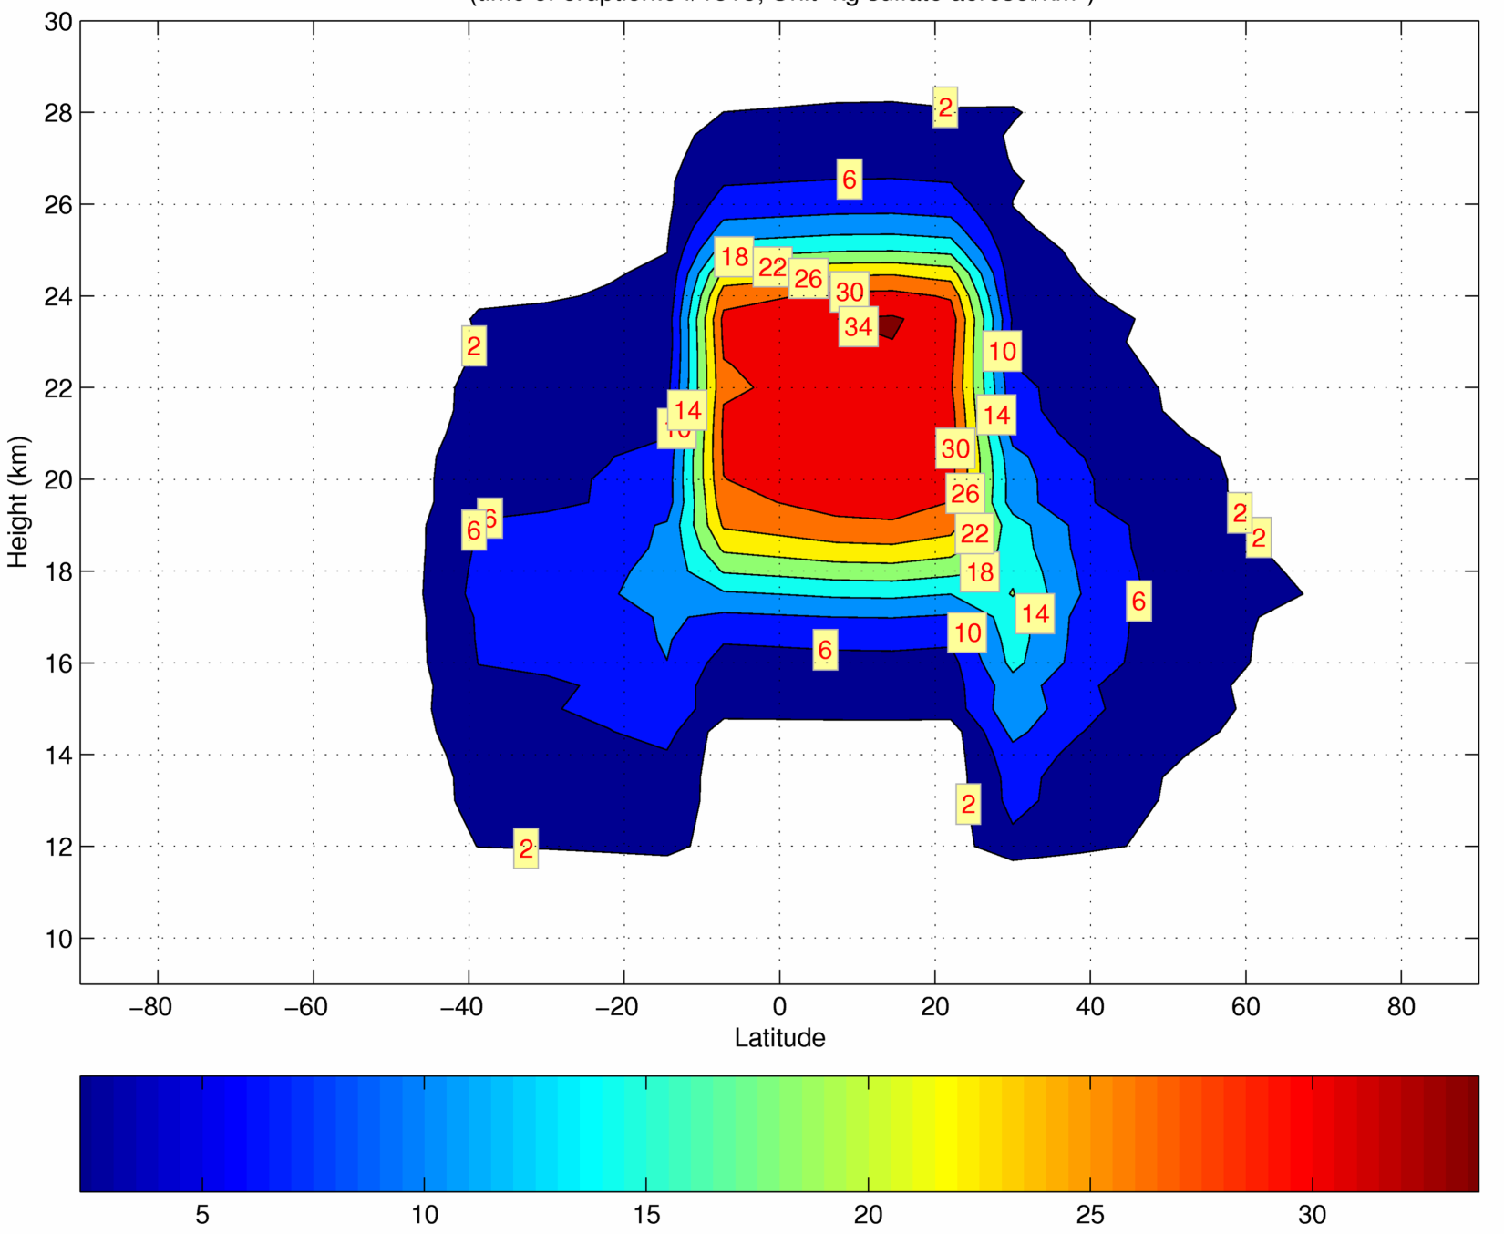
Vertical cross section of volcanic aerosols 6 months after the Tambora eruption. Units: kg sulfate aerosols/km² • 0.5 km
Notes:
For the dataset to be useable for GCMs, we interpolated the vertical distribution of volcanic aerosols based on information obtained from 11 lidar measurements of the backscattering coefficient after the 1991 Pinatubo eruption6, assuming that the aerosols from every eruption have the same vertical distribution as Pinatubo. Fig. 4 shows an example of the vertical distribution of volcanic aerosols 6 months after the Tambora eruption.

Slide 42
Conclusions
We reconstructed a volcanic forcing index (IVI2) that is the
  Longest: 501-2000 A.D.
  Most reliable: based on 44 bi-polar ice core records
  Most advanced:
    Updated signal extraction method
    Accounted for spatial variations
    IVI2 = f(t, ϕ, z) where
      t (time): 501-2000 A.D. at monthly resolution
      ϕ (latitude): 90ºS – 90ºN at 10º resolution
      z (altitude): 9 km to 30 km at 0.5 km resolution
The index can be used in GCMs to better characterize the natural causes of climate change.
Notes:
In conclusion, we used the most comprehensive set of ice core records plus an updated signal extraction method, ice-core-deposition to global stratospheric aerosol loading conversion factors, and a spatial-temporal transport parameterization program to reconstruct volcanic forcing index for the past 1500 years. The index is a function of month from 501 to 2000, latitude from 90 degree south to north at 10 degree band, and height from 9 to 30 km at 0.5 km resolution. It is the longest and the most advanced forcing time series of this type, and it will lead to improved prediction of anthropogenic impacts on climate.
.

Slide 43
You can download
the new IVI2 Ice Core Volcano index
and the JGR paper describing it at
http://climate.envsci.rutgers.edu/IVI2/
Gao, Chaochao, Alan Robock, and Caspar Ammann, 2008: Volcanic forcing of climate over the past 1500 years: An improved ice-core-based index for climate models. J. Geophys. Res., 113, D23111, doi:10.1029/2008JD010239.

Slide 44
Can Volcanic Eruptions Produce Ice Ages?
Robock, Alan, Caspar M. Ammann, Luke Oman, Drew Shindell, Samuel Levis, and Georgiy Stenchikov, 2009: Did the Toba volcanic eruption of ~74 ka B.P. produce widespread glaciation? J. Geophys. Res., 114, D10107, doi:10.1029/2008JD011652.
Notes:
This presentation discusses atmospheric emissions from volcanic eruptions and their effects on weather and climate.

Slide 45
Can Volcanic Eruptions Produce
Mass Extinctions?
Two possible mechanisms:
1. CO₂ warms climate, producing climate change, biological feedbacks, and poisoning of land species.
2. SO₂ forms stratospheric sulfate cloud, cooling climate long enough to kill not only existing species, but the seed bank.

Slide 46
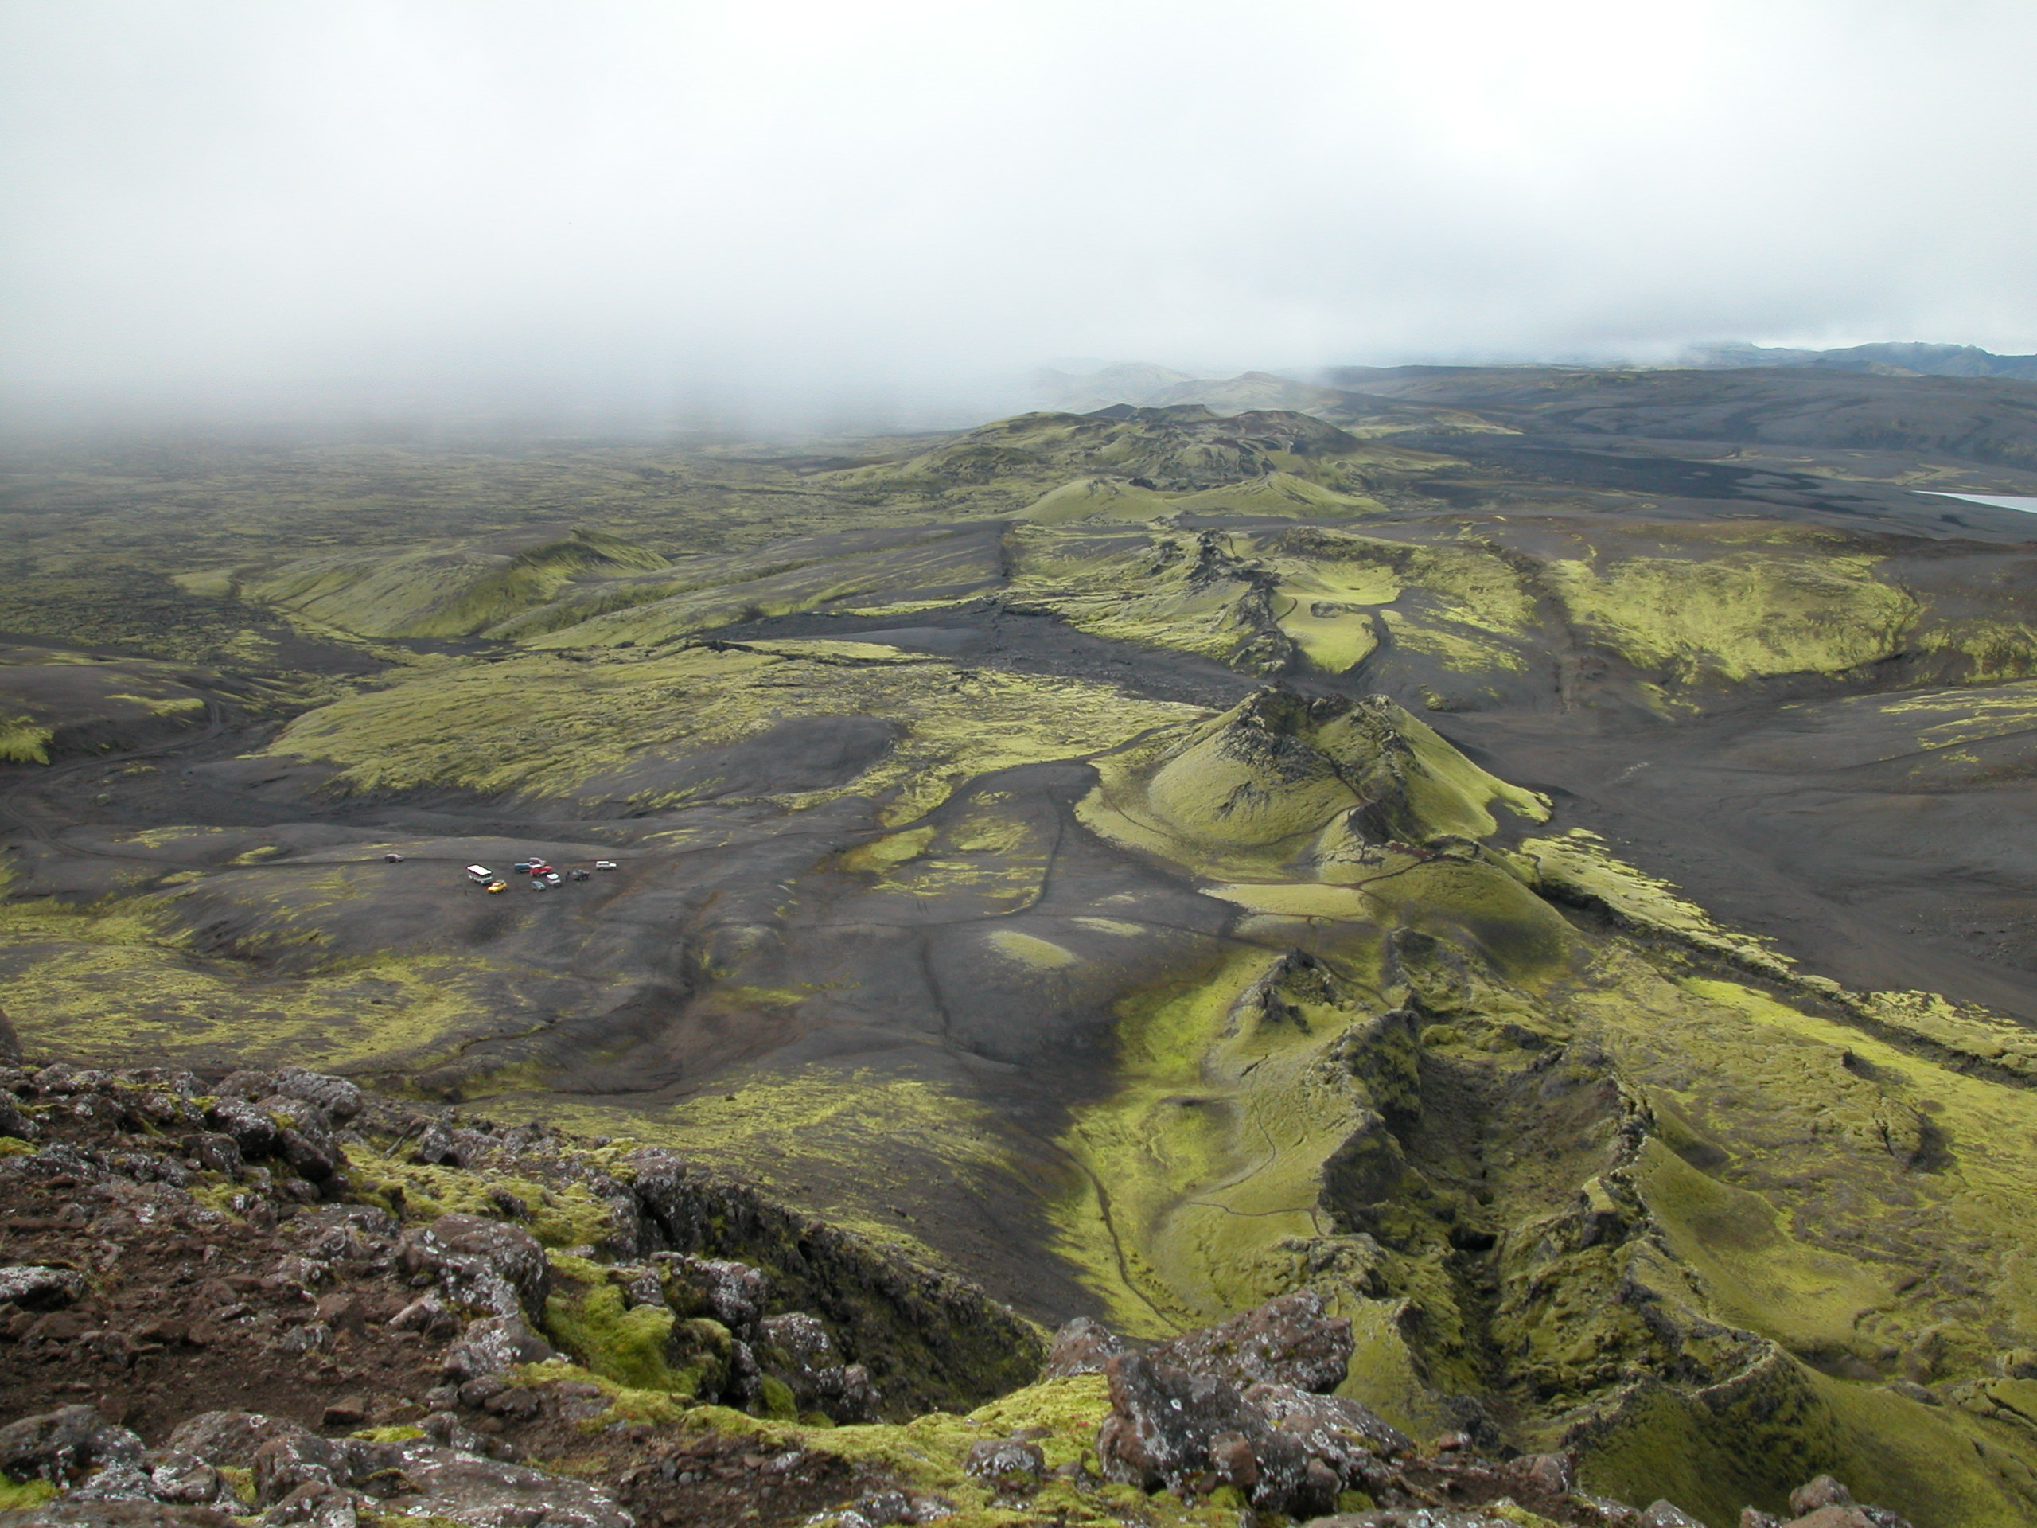
Laki, Iceland, erupted 1783-1784
Notes:
The Laki fissure looking toward the southeast from Laki mountain. Note bus and SUVs parked at left for scale. The road across the black lava deposits. The Laki mountain did not erupt. The 1783 eruption was of the Laki fissures (Lakagígar), as shown here and in the next slide and the total length of the vent system is 27 km (Thordarson and Self, 1993). In Iceland, it is referred to as Skaftáreldar, the Skaftá Fires, because the vents poured lava into the Skaftá River gorge, turning it into a river of fire. The nearby Grímsvötn volcano, beneath the Vatnajökull glacier, also erupted at the same time, but its activity was typified by a series of minor eruptions and was not responsible for the climate change. For simplicity and consistency with recent usage, I will refer to the eruption here as the Laki eruption. Photo © Alan Robock, 2002.
Thordarson, T., and S. Self, 1993. The Laki (Skaftár Fires) and Grímsvötn eruptions in 1783-1785. Bulletin of Volcanology, 55, 233-263.

Slide 47
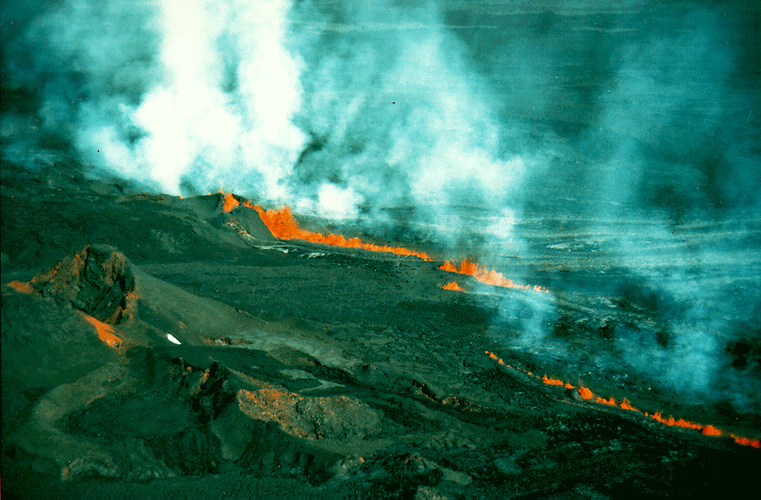
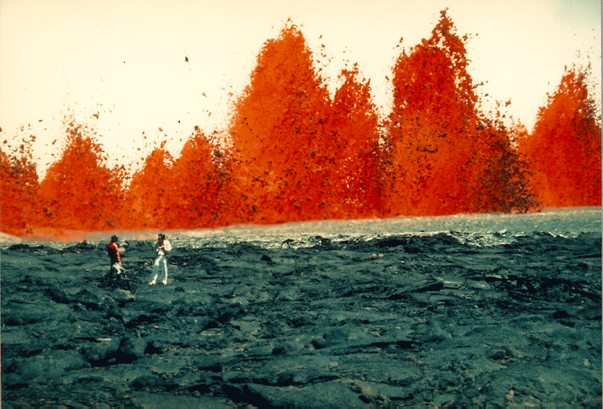
Fire fountains from Kilauea volcano in Hawaii
mac01.eps.pitt.edu/harbbook/c_iii/chapter_3b.htm

Slide 48
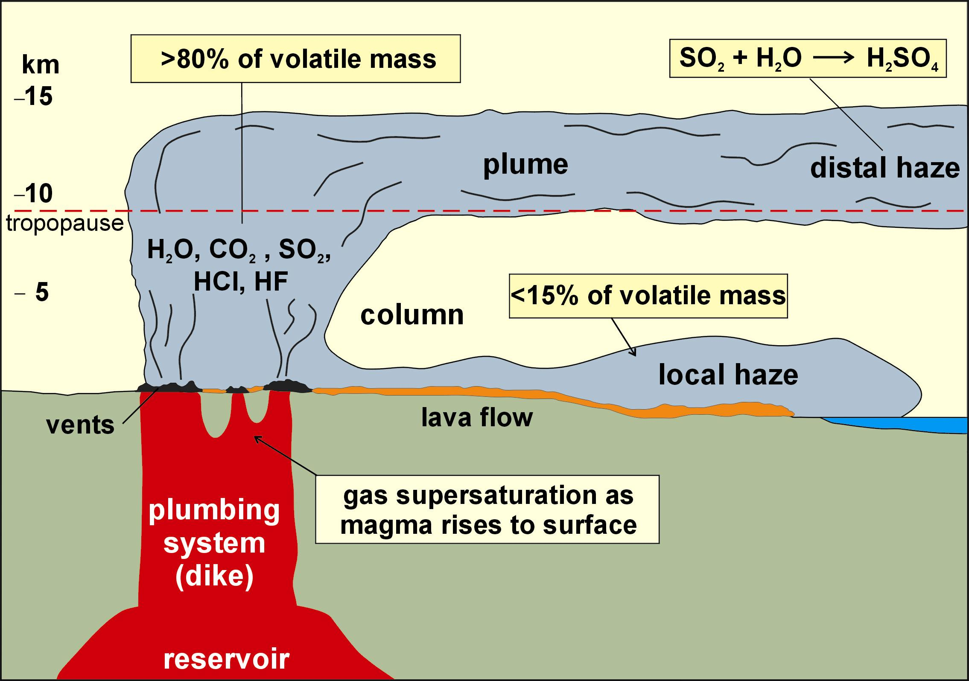
Laki eruption was both tropospheric and stratospheric.
Fig. 3 from Thordarson and Self (2003)
Notes:
The Laki eruption produced tropospheric haze from the fissure and had explosive episodes which put SO₂ and particles into the stratosphere.
Thordarson T., and S. Self , 2003: Atmospheric and environmental effects of the 1783–1784 Laki eruption: A review and reassessment, J. Geophys. Res., 108 (D1), 4011, doi:10.1029/2001JD002042.

Slide 49
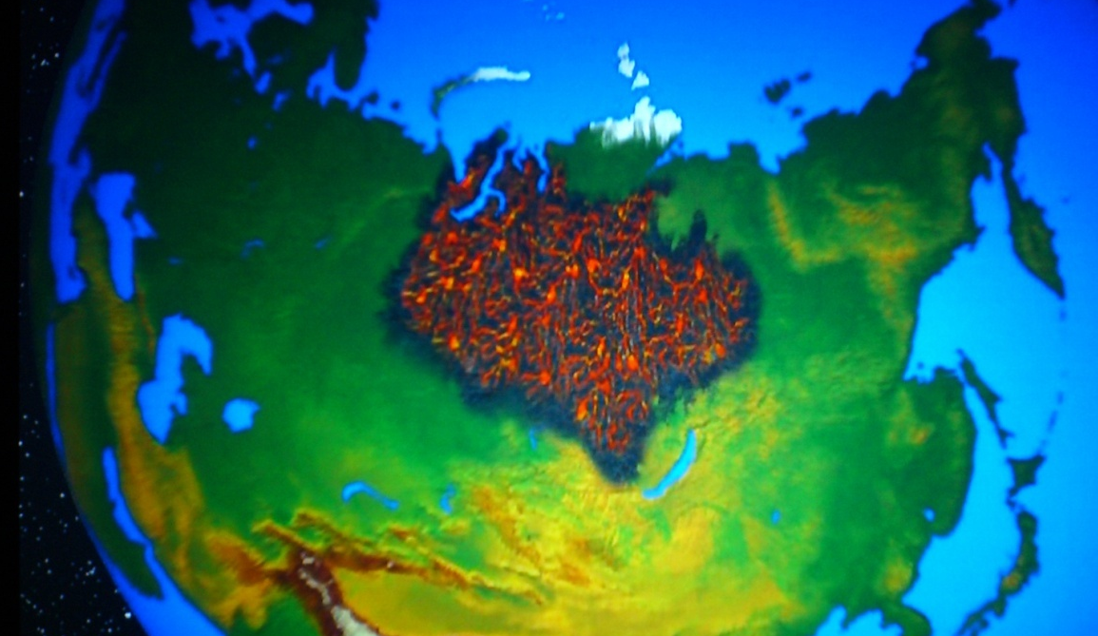
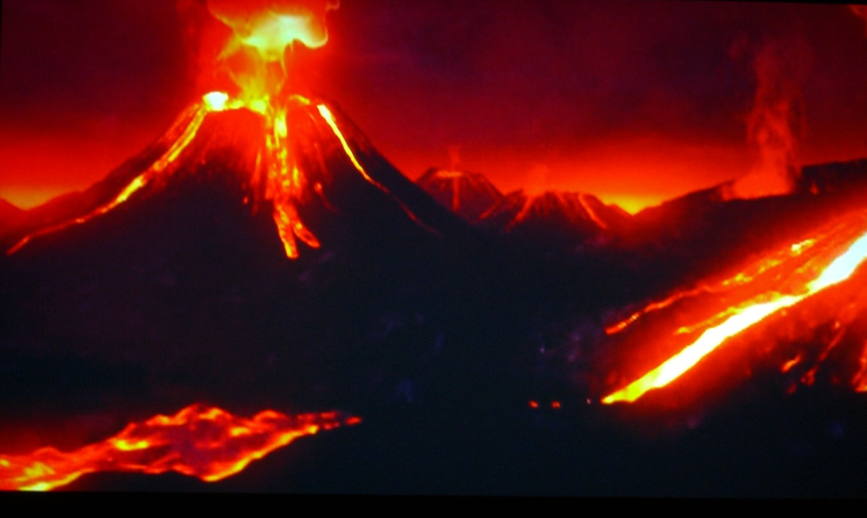
Poisoning Theory - Siberian Traps
volcanic eruptions produce CO₂
which warms climate
causes O₂ concentration to be reduced in warm oceans
lets bacteria thrive and produce H₂S
H₂S then bubbles into atmosphere killing life on land
Peter Ward (University of Washington), Lee Kump (Penn State), and Samuel Bowring (MIT)
from Nova ScienceNow, PBS

Slide 50
EFFECTS OF VOLCANIC COOLING
ON MASS EXTINCTION?
Stratospheric aerosol clouds block sunlight and cool the surface, also reducing precipitation.
No matter how large the eruption, the aerosol cloud falls out of the stratosphere in a few years.
While a massive eruption could produce a volcanic winter, continuous emissions would be needed to keep it cold and dark long enough to cause extinctions.

Slide 51
EFFECTS OF VOLCANIC COOLING
ON MASS EXTINCTION?
Vincent Courtillot, at the EGU meeting in April 2006, determined that the Deccan Traps in India emitted 50-500 Gt SO₂ per flow event, which lasted perhaps 50 yr. As the energy of the magma was so large, he suggests there is no doubt it would be lofted into the stratosphere. So that is 1000-10,000 Mt of SO₂ per year for 50 yr. We can compare this to:
Toba 74,000 BP 1000-6000 Mt SO₂ into the stratosphere once
Laki 1783 100 Mt SO₂ into the stratosphere over 8 months
Pinatubo 1991 20 Mt SO₂ into the stratosphere once over 1 day
The entire Deccan traps emitted 10,000 Gt over 6-8 million years, 90% in 100,000 years [Courtillot, pers. comm., 2006].

Slide 52
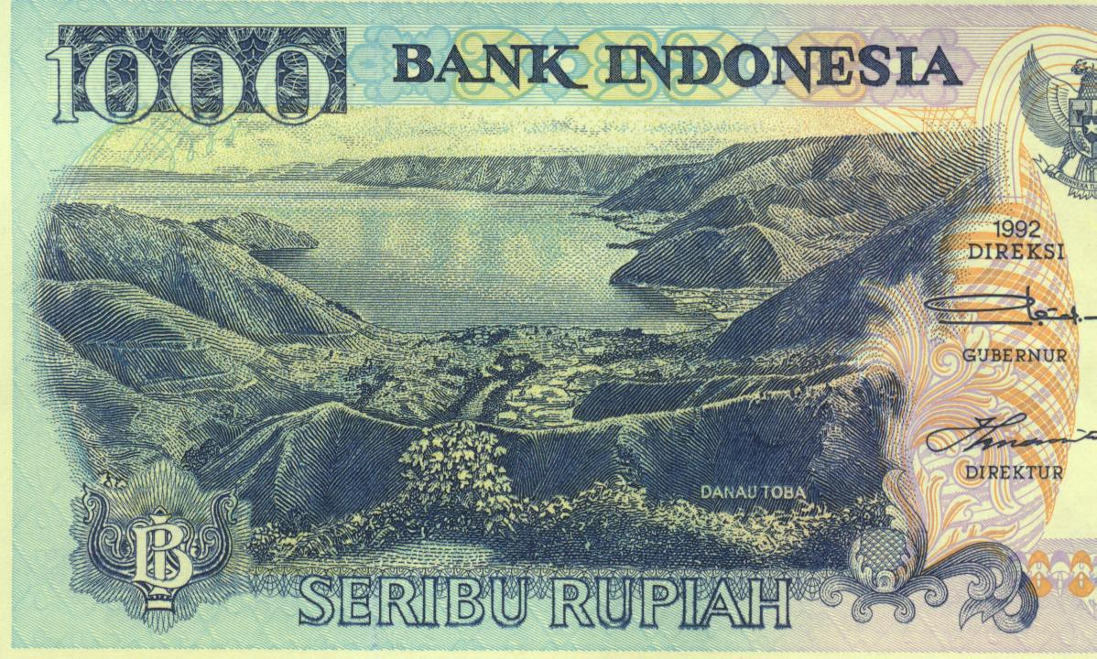
Toba, 74,000 BP
Cause of Ice Age?
Notes:
Some highly civilized countries, such as Indonesia, have volcanoes on their money. Here the 1000 rupiah note (worth US$0.11) has Danau Toba (Lake Toba), the 90-km long lake that formed in the hole left by the Toba eruption of 71,000 years ago, the largest known eruption on Earth. Danau Toba is the largest lake in southeast Asia and the largest volcanic lake in the world. It is more than 500 m deep at the deepest point. For more information on Danau Toba, visit http://www.worldlakes.org/lakedetails.asp?lakeid=8367

Slide 53
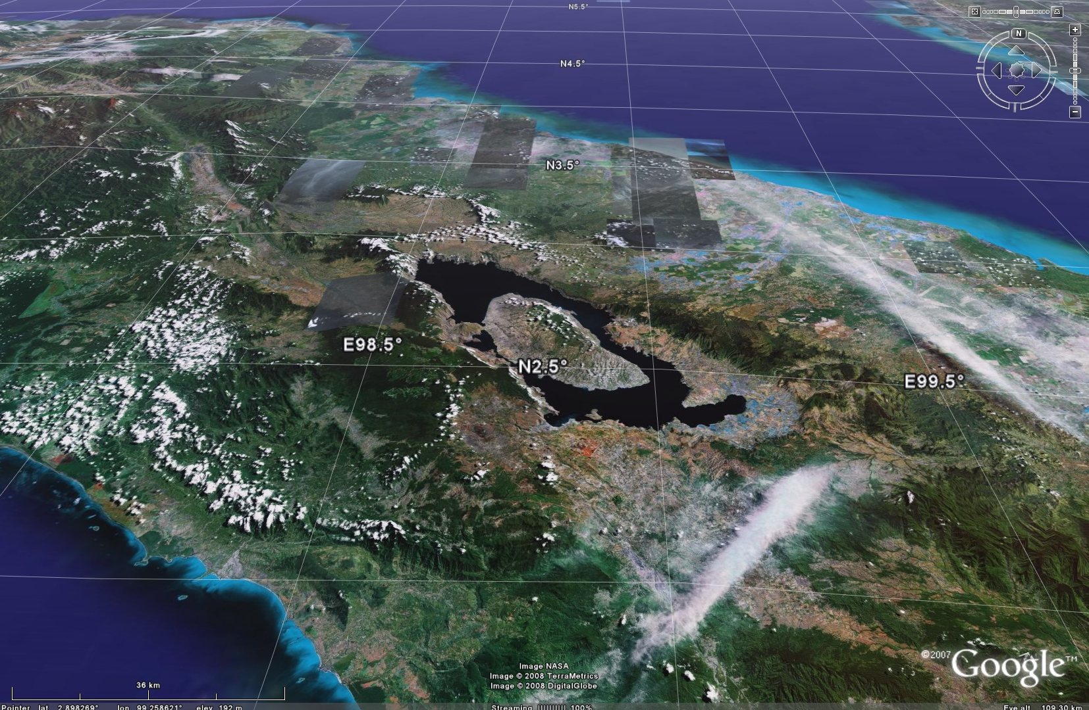

Slide 54
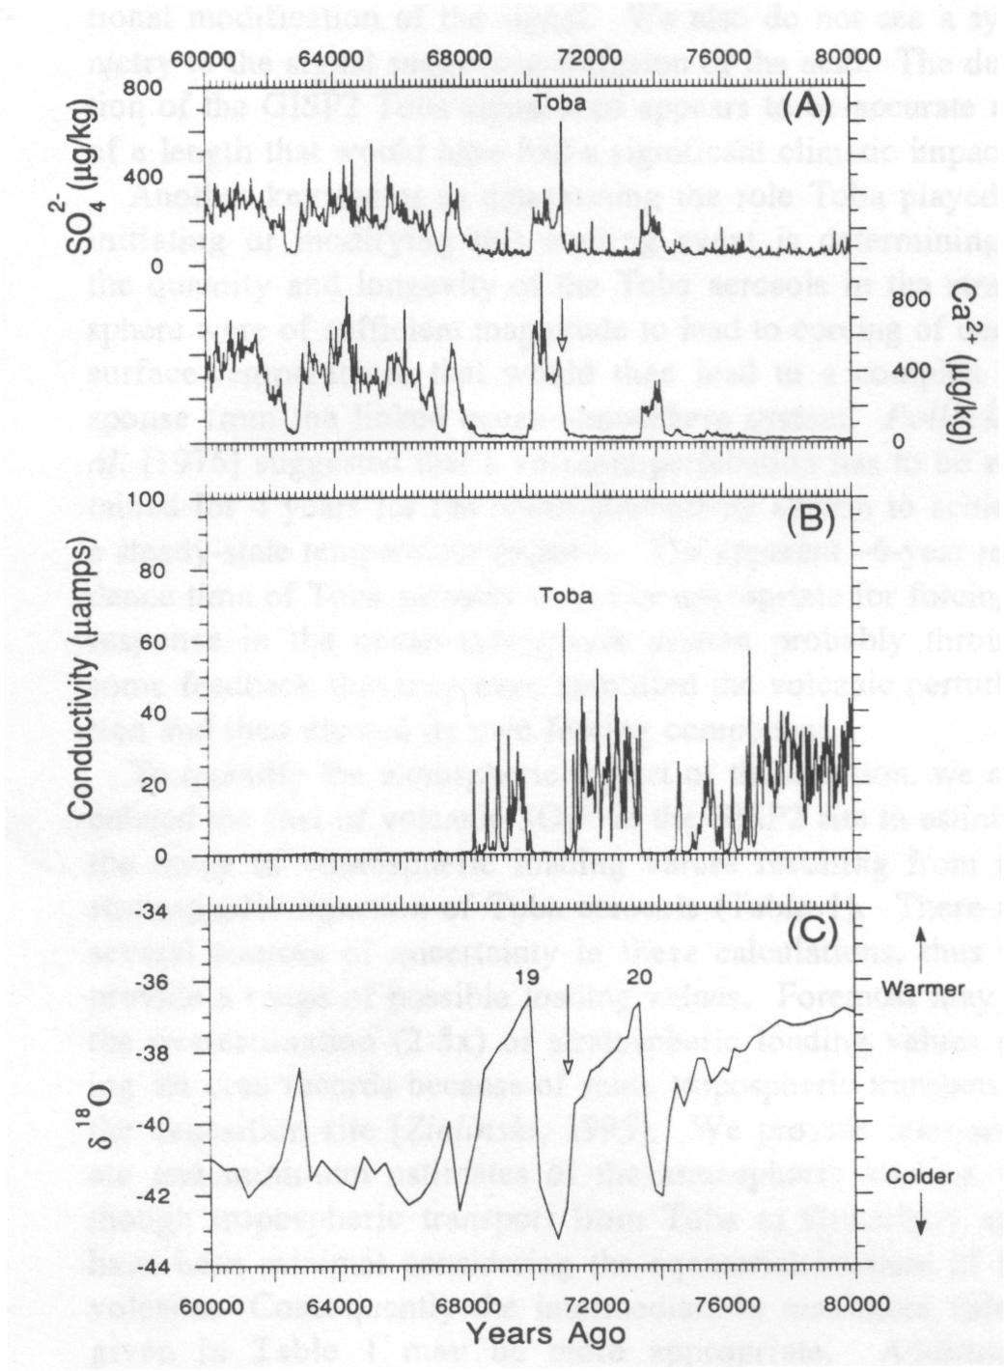
Toba, 74,000 BP
Cause of Ice Age?
Ice core data from Zielinski et al. (1996) show both aerosol signal and climate response.
time
Notes:
Figure from Zielinski et al. (1996). Time runs from right to left. The top panel shows an analysis of Greenland ice core sulfate concentration. The spike is the volcanic sulfate layer deposited from the Toba eruption. The middle panel shows conductivity, a measure of acidity in the core, and also shows the Toba peak. The bottom panel shows δ¹⁸O, the oxygen isotope ratio in the water in the ice, a measure of global temperature. Just after the eruption, a major cooling and ice advance occurred. Was this caused by the eruption? Researchers are still working on this problem. How could the volcanic aerosols have stayed in the atmosphere long enough for this large cooling to have taken place?
Zielinski, G. A., P. A. Mayewski, L. D. Meeker, S. Whitlow, M. S. Twickler, and K. Taylor, Potential atmospheric impact of the Toba mega-eruption ~71,000 years ago, Geophys. Res. Lett., 23, 837-840, 1996.

Slide 55
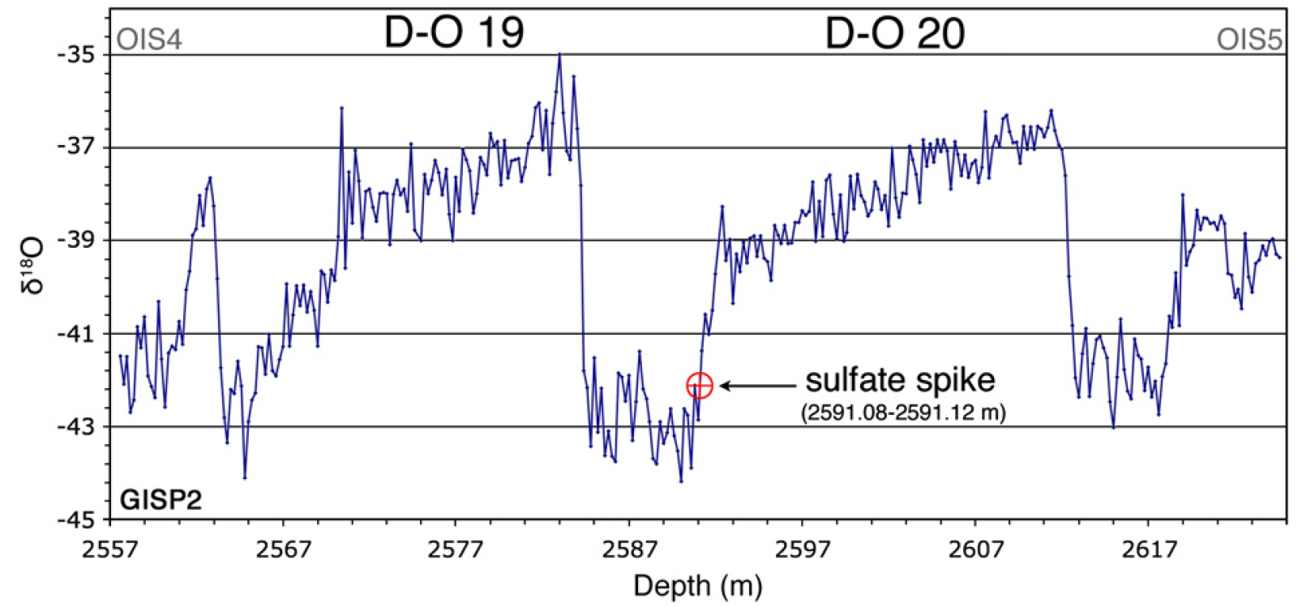
Recent analysis casts doubt on the timing:
Eruption occurred after the glaciation
time (ka BP)
73 74
Analysis of oxygen isotope data and sulfate from same core (Fig. 1 from Haslam and Petraglia [2010].)

Slide 56
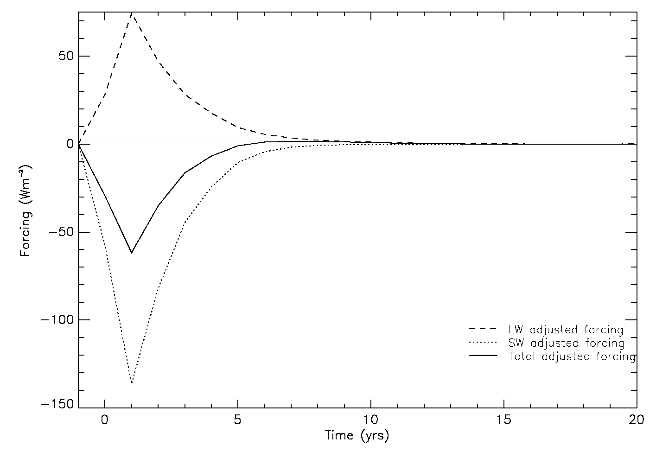
Tropopause-level radiative forcing
100x Pinatubo super-eruption, Gareth Jones et al. (2005)

Slide 57
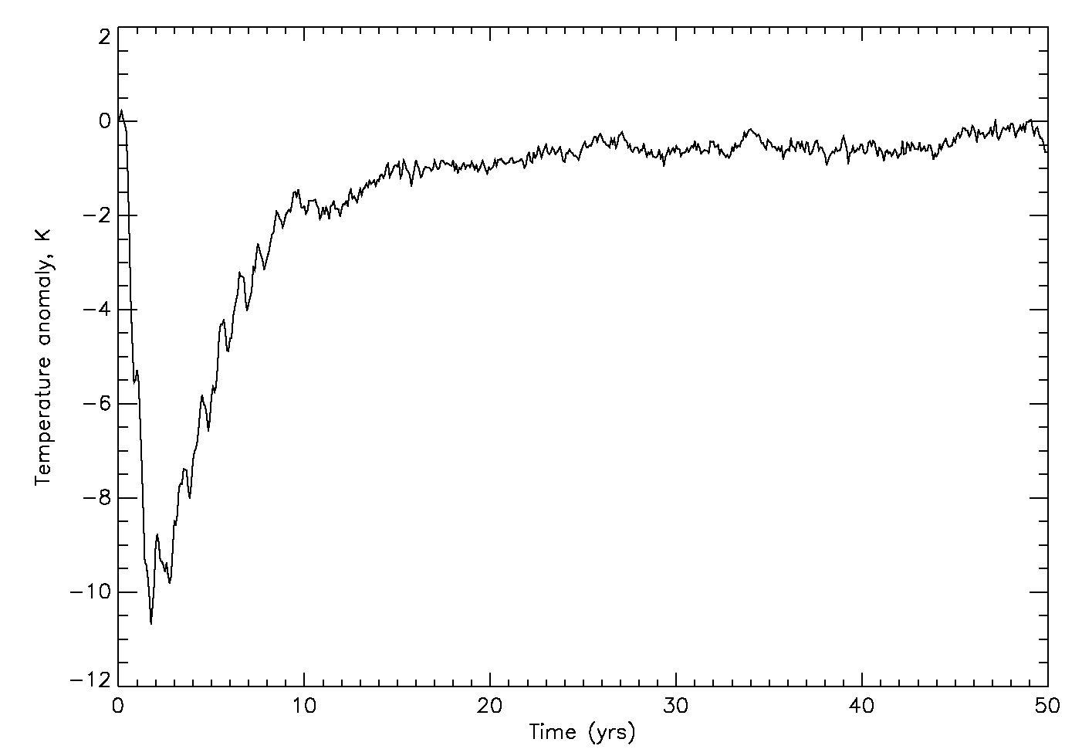
Surface temperature response
100x Pinatubo super-eruption, Gareth Jones et al. (2005)

Slide 58
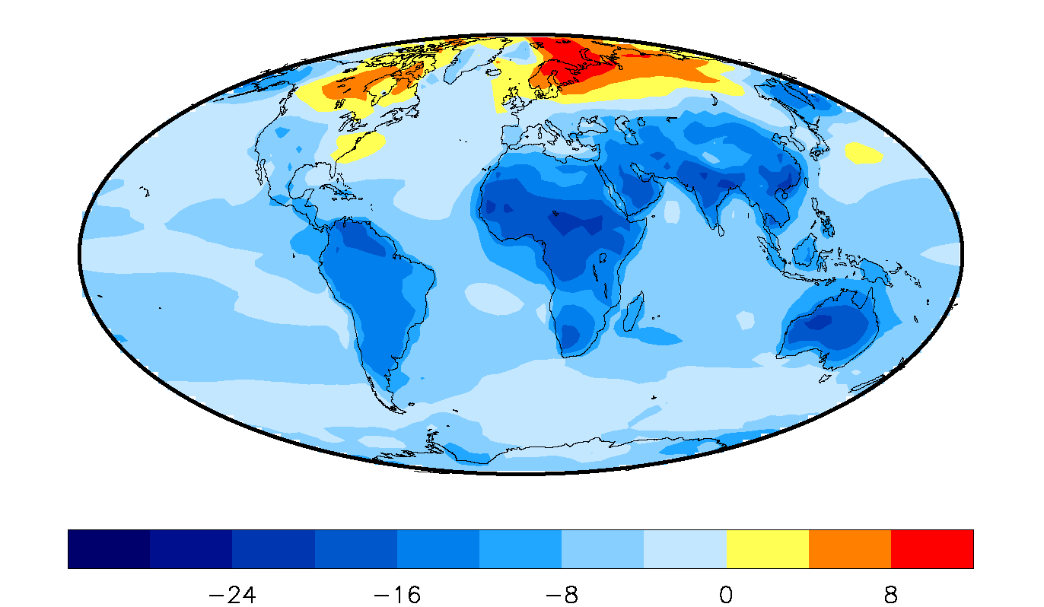
Surface temperature response (K)
for first NH winter (DJF) after eruption
100x Pinatubo super-eruption, Gareth Jones et al. (2005)

Slide 59
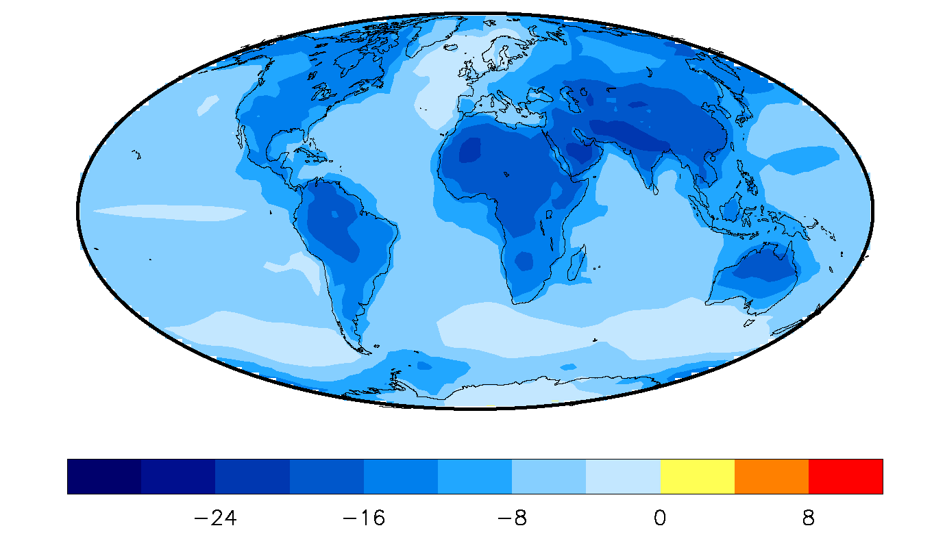
Annual average surface temperature response (K)
for year after eruption
100x Pinatubo super-eruption, Gareth Jones et al. (2005)

Slide 60
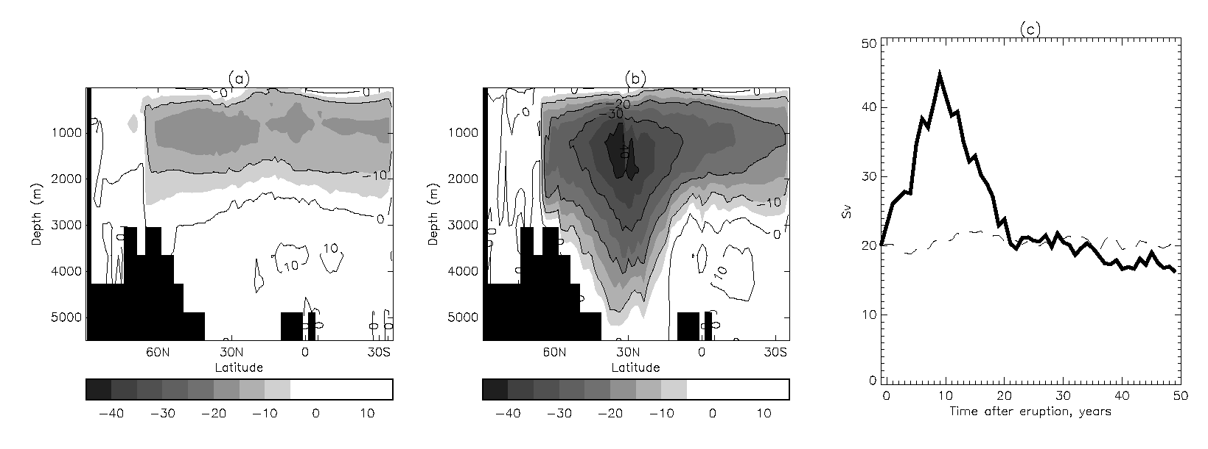
Change in thermohaline circulation - North Atlantic (Sv)
(a) before eruption, (b) year 9 after eruption
100x Pinatubo super-eruption, Gareth Jones et al. (2005)

Slide 61
Super-eruptions
Jones et al. (2005) showed large perturbations, but no long-term (ice-age-producing) response.
Are there additional mechanisms that could produce this?
  Persistence of SO₂ in stratosphere?
  Killing all the vegetation, increasing surface albedo?
  Painting the land white with ash?

Slide 62
Super-eruptions
We conducted three GCM experiments to investigate the first two of these mechanisms:
Persistence of SO₂ in stratosphere?
  NASA GISS ModelE, 300x Pinatubo
  NASA GISS ModelE with chemistry, 300x Pinatubo
Killing all the vegetation, increasing surface albedo?
  NCAR CLM3.0 with dynamic vegetation, 100x Pinatubo
Robock, Alan, Caspar M. Ammann, Luke Oman, Drew Shindell, Samuel Levis, and Georgiy Stenchikov, 2009: Did the Toba volcanic eruption of ~74 ka B.P. produce widespread glaciation? J. Geophys. Res., 114, D10107, doi:10.1029/2008JD011652.

Slide 63
NASA GISS ModelE, 300x Pinatubo

Slide 64
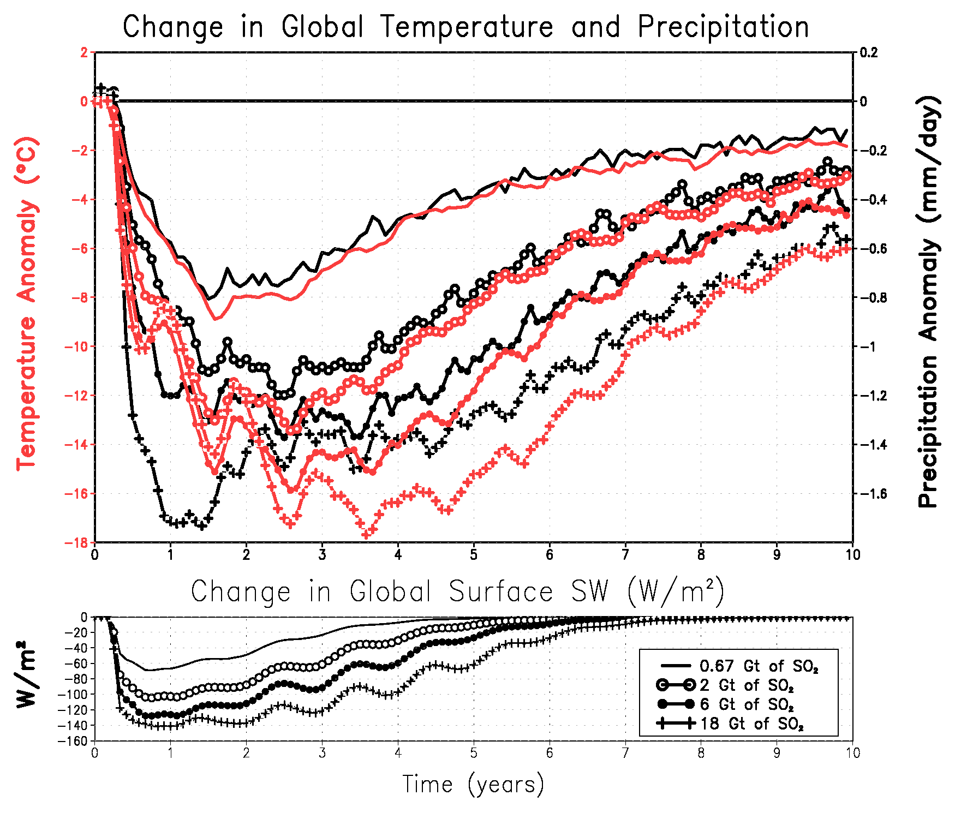
NASA GISS ModelE, 33x, 100x, 300x, 900x Pinatubo

Slide 65
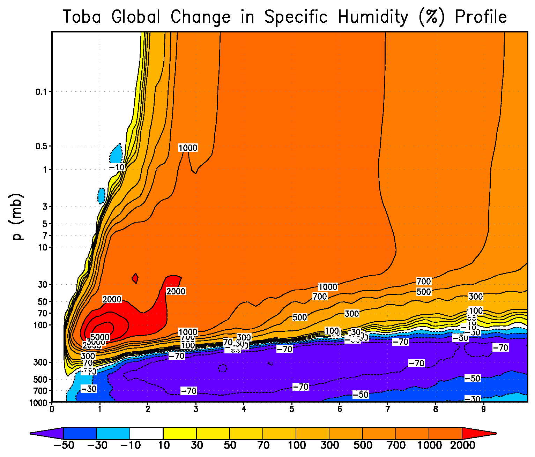
NASA GISS ModelE, 300x Pinatubo

Slide 66
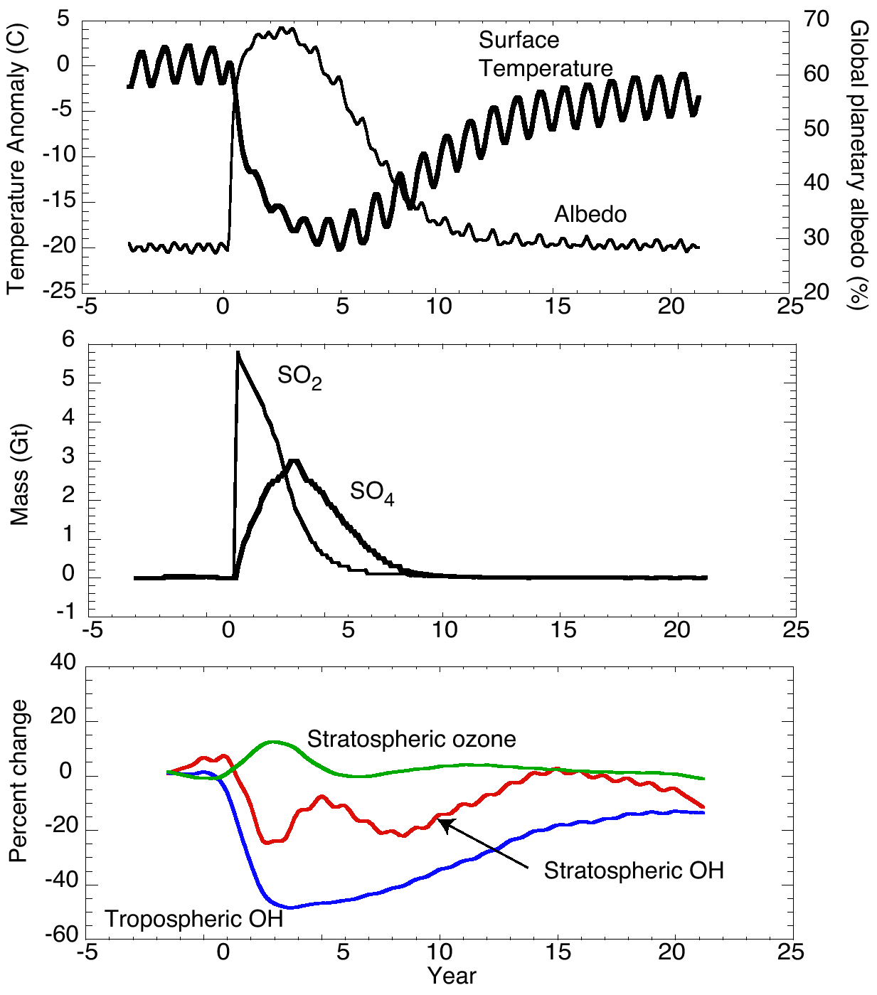
NASA GISS ModelE with stratospheric chemistry, 300x Pinatubo

Slide 67
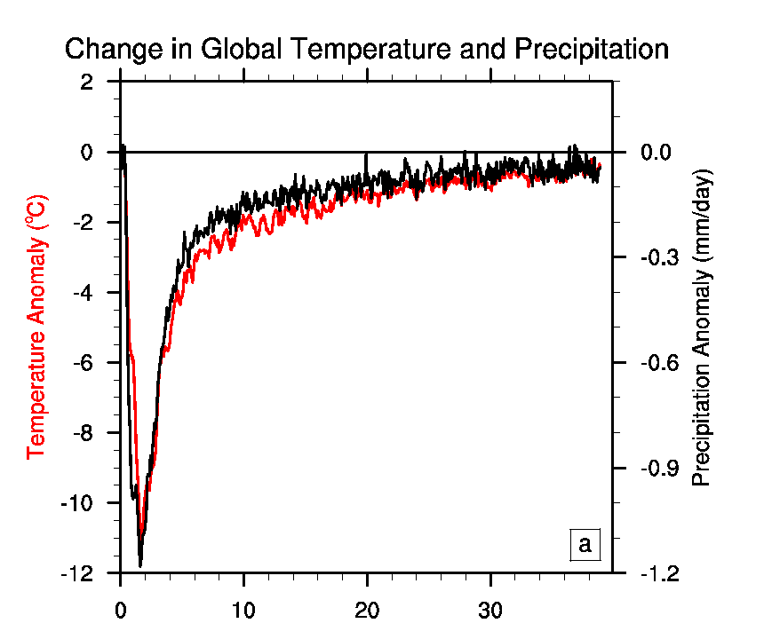
NCAR CLM3.0 with dynamic vegetation, 100x Pinatubo

Slide 68
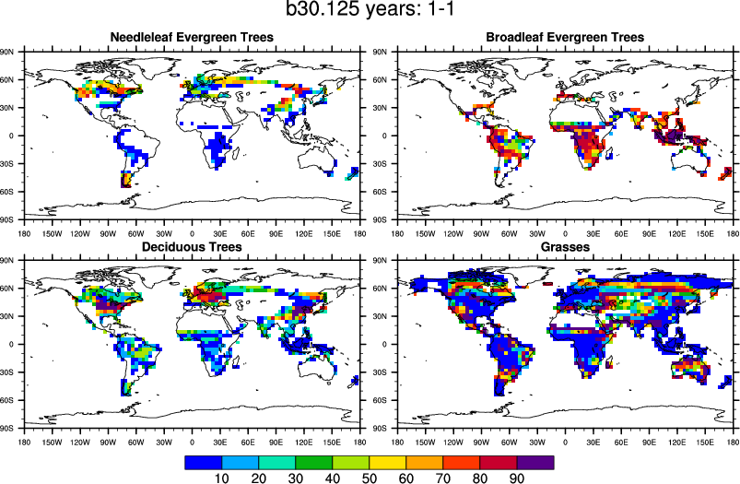
NCAR CLM3.0 with dynamic vegetation, 100x Pinatubo

Slide 69
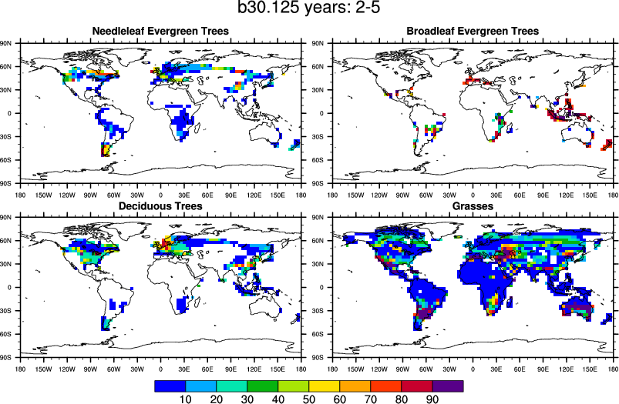
NCAR CLM3.0 with dynamic vegetation, 100x Pinatubo

Slide 70
Conclusions
We have not been able to show that a Toba-like eruption could produce an Ice Age, given the current distribution of solar radiation.
Robock, Alan, Caspar M. Ammann, Luke Oman, Drew Shindell, Samuel Levis, and Georgiy Stenchikov, 2009: Did the Toba volcanic eruption of ~74 ka B.P. produce widespread glaciation? J. Geophys. Res., 114, D10107, doi:10.1029/2008JD011652.

Slide 71
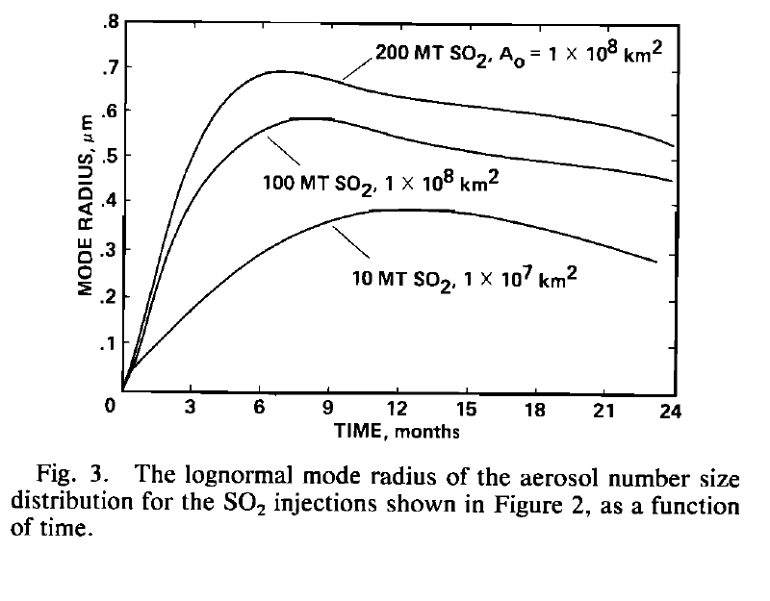
Do stratospheric aerosols grow with
large SO₂ injections?
“Successively larger SO₂ injections do not create proportionally larger optical depths because successively larger sulfate particles are formed.”
Areas refer to the initial area of the cloud over which oxidation is assumed to occur.
Pinto, J. R., R. P. Turco, and O. B. Toon, 1989: Self-limiting physical and chemical effects in volcanic eruption clouds. J. Geophys. Res., 94, 11,165–11,174, doi:10.1029/JD094iD08p11165.

Slide 72
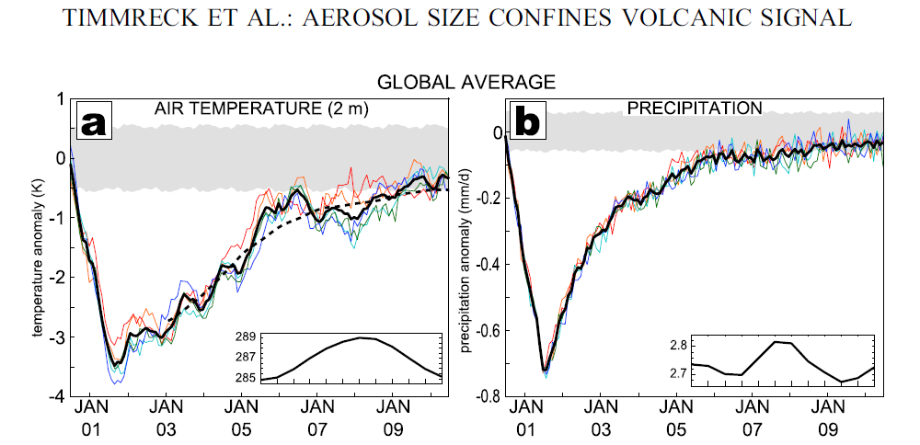
Do stratospheric aerosols grow with
large SO₂ injections?
Toba simulation
Timmreck, C., et al., 2010: Aerosol size confines climate response to volcanic super-eruptions. Geophys. Res. Lett., 37, L24705, doi:10.1029/2010GL045464.

Slide 73
Conclusions
Volcanic eruptions provide a strong, yet brief perturbation to the climate system.
The study of their effects on climate helps us to better understand this system and the impacts of climate change on us, and allows us to make better predictions of future weather and climate.
Notes:
Volcanic eruptions provide a strong, yet brief perturbation to the climate system.
The study of their effects on climate helps us to better understand this system and the impacts of climate change on us, and allows us to make better predictions of future weather and climate.

Slide 74

Global average surface air temperature
NCAR CESM 1.0 simulations of the 74ka BP Toba eruption with 21 Ka BP and 74ka BP boundary conditions. The two simulations are virtually identical.

Slide 75


Conclusions
Even during Ice Age conditions, a simulation of the impacts of a volcanic eruption with 100 times the 1991 Mt. Pinatubo stratospheric loading provided no evidence of ice-sheet initiation.
The simulation does provide support for a “volcanic winter” for several years producing extreme biological stress.
Temperature
Precipitation

Slide 76



Santorini, 1628 B.C.
Responsible for the legends of:
Atlantis (Minoans on Crete)
Biblical plagues
Parting of the Red Sea
Notes:
The island of Santorini (Thera) erupted in 1628 B.C. The picture on the top left, taken with a wide-angle lens, shows the remaining crescent of the island, with the submerged crater in the middle. A new island, also seen in lower right, has risen from the center. The town of Thera (Fira) is perched on the rim of the crater (top right). Due to a mistranslation of the numbers, Plato’s description of the civilization destroyed by the eruption was thought to place it so far from Athens that it could not have been in the Mediterranean, and so it was thought to have been in the Atlantic Ocean and was named Atlantis. Dividing the numbers by 10 puts the location at Crete, and the time exactly to the time of the Santorini eruption. So this eruption is thought to have produced the story of the legend of Atlantis, when actually it was partly responsible for the decline of the Minoan civilization on Crete. It also produced a tsunami and large atmospheric aerosol loading, which turned into the biblical stories of the parting of the Red Sea (actually the Red Marsh on the Mediterranean coast) and the plagues. While this eruption clearly had a large local effect, it is not clear if it was large enough to have caused global climate change.
Photos © Alan Robock.

Slide 77

Etna, 44 B.C.
“[in] 43 B.C. we are told [by Appian] that Cassius requested aid from Cleopatra; the queen, however, refused, claiming that Egypt was in the grip of famine and pestilence....Octavian and Antony were unable to obtain supplies from Egypt ‘since that country was exhausted by famine.’”
“The fullest description of the sun in this period is that provided by Plutarch (Life of Julius Caesar 69.3-4), who speaks of the rays of the sun being veiled, leaving the face of the sun pale and without radiance and thus furnishing so little heat that fruits never fully ripened, but shriveled instead...‘due to the coldness of the atmosphere.’”
(Forsyth, 1988)
(Forsyth, 1988)
Notes:
The first documented publication associating a volcanic eruption with climate impacts is by Plutarch in the Life of Julius Caesar. Here Forsyth (1988) describes the effects. While these are anecdotes, and do not prove that the eruption was strong enough to have caused famine, the effects are certainly possible.
Photo of Etna from http://boris.vulcanoetna.com/ETNA_1972_73.html, © Boris Behnke.
Forsyth, P. Y., In the wake of Etna, 44 B.C., Classical Antiquity, 7, 49-57, 1988.

Slide 78

Did volcanic eruptions at the end of the 13th Century produce the Little Ice Age?
Figure 5.7: Reconstructed Northern Hemisphere annual temperatures during the last 2000 years. Individual reconstructions grouped by colour according to their spatial representation (red: land-only all latitudes; orange: land-only extra-tropical latitudes; light blue: land and sea extra-tropical latitudes; dark blue: land and sea all latitudes), anomalies (ºC) from the 1881–1980 mean (horizontal dashed line), smoothed with a filter that reduces variations on timescales less than ~50 years. (IPCC AR5 WG I)

Slide 79

Did volcanic eruptions at the end of the 13th Century produce the Little Ice Age?
Figure 5.8: Comparisons of simulated and reconstructed NH temperature changes. (a) Changes over the last millennium. (IPCC AR5 WG I)

Slide 80

Miller, Gifford H., et al., 2012: Abrupt onset of the Little Ice Age triggered by volcanism and sustained by sea-ice/ocean feedbacks. Geophys. Res. Lett., 39, L02708, doi:10.1029/2011GL050168.

Slide 81


Miller, Gifford H., et al., 2012: Abrupt onset of the Little Ice Age triggered by volcanism and sustained by sea-ice/ocean feedbacks. Geophys. Res. Lett., 39, L02708, doi:10.1029/2011GL050168.

Slide 82


Volcanic forcing
Arctic sea ice
Atlantic northward heat transport
North Atlantic land summer temperature

Slide 83

Many climate models have the Arctic climate wrong, with too little sea ice.
Berdahl, Mira, and Alan Robock, 2013: Cryospheric response to volcanic eruptions in the Paleoclimate Model Intercomparison Project 3 last millennium simulations. J. Geophys. Res. Atmos., 118, 12,359-12,370, doi:10.1002/2013JD019914.

Slide 84

Notes:
The road to Laki from the main ring road around Iceland. It is 49 km, along a very rough road. Photo © Alan Robock, 2002.

Slide 85
Notes:
The Laki fissure looking toward the southeast from Laki mountain. Note bus and SUVs parked at left for scale. The road across the black lava deposits. The Laki mountain did not erupt. The 1783 eruption was of the Laki fissures (Lakagígar), as shown here and in the next slide and the total length of the vent system is 27 km (Thordarson and Self, 1993). In Iceland, it is referred to as Skaftáreldar, the Skaftá Fires, because the vents poured lava into the Skaftá River gorge, turning it into a river of fire. The nearby Grímsvötn volcano, beneath the Vatnajökull glacier, also erupted at the same time, but its activity was typified by a series of minor eruptions and was not responsible for the climate change. For simplicity and consistency with recent usage, I will refer to the eruption here as the Laki eruption. Photo © Alan Robock, 2002.
Thordarson, T., and S. Self, 1993. The Laki (Skaftár Fires) and Grímsvötn eruptions in 1783-1785. Bulletin of Volcanology, 55, 233-263.

Slide 86

Notes:
Looking northwest from Laki Mountain. The fissure disappears under the Vatnajökull glacier, in the direction of the Grímsvötn volcano. Photo © Alan Robock, 2002.

Slide 87

During several of the summer months of the year 1783, when the effect of the sun’s rays to heat the earth in these northern regions should have been greatest, there existed a constant fog over all Europe, and great part of North America. This fog was of a permanent nature; it was dry, and the rays of the sun seemed to have little effect towards dissipating it, as they easily do a moist fog, arising from water. They were indeed rendered so faint in passing through it, that when collected in the focus of a burning glass, they would scarce kindle brown paper. Of course, their summer effect in heating the earth was exceedingly diminished.
Hence the earth was early frozen,
Hence the first snows remained on it unmelted, and received continual additions.
Hence the air was more chilled, and the winds more severely cold.
Hence perhaps the winter of 1783-4, was more severe, than any that had happened for many years.
The cause of this universal fog is not yet ascertained. Whether it was adventitious to this earth, and merely a smoke, proceeding from the consumption by fire of some of those great burning balls or globes which we happen to meet within our rapid course round the sun, and which are sometimes seen to kindle and be destroyed in passing our atmosphere, and whose smoke might be attracted and retained by our earth; or whether it was the vast quantity of smoke, long continuing to issue during the summer from Hecla in Iceland, and that other volcano which arose out of the sea near that island, which smoke might be spread by various winds, over the northern part of the world, is yet uncertain.
Franklin (1784)
Notes:
Benjamin Franklin was the United States ambassador to France and living in Paris when Laki erupted. Here is an excerpt from his paper presented at the Manchester Academy of Sciences the next year. He conducted experiments to quantify the radiation (“the rays of the sun ... were indeed rendered so faint ... that when collected in the focus of a burning glass, they would scarce kindle brown paper.”), described the climatic response, and discussed the source of the fog and its transport around the Northern Hemisphere by the winds.
Franklin, B., Meteorological imaginations and conjectures, Manchester Literary and Philosophical Society Memoirs and Proceedings, 2, 122, 1784. [Reprinted in Weatherwise, 35, p. 262, 1982.]
Picture: Sitter: Benjamin Franklin,17 Jan 1706 - 17 Apr 1790, Artist: Pierre-Michel Alix, 1762 – 1817, Copy after: Charles Amedee Philippe Van Loo, 1719 - 1795?
Date of Work: c. 1790 Medium: Color aquatint Dimensions: 24.1cm x 20.3cm (9 1/2" x 8"), Image Owner: National Portrait Gallery, Smithsonian Institution
Acquisition Date: 1970-10, Credit Line: National Portrait Gallery, Smithsonian Institution, Ref. NPG.70.65

Slide 88

1783-84 Laki Eruption in Iceland
(8 June 1783 – 7 February 1784)
Second largest flood lava eruption in historical time
Iceland’s biggest
natural disaster
Lava = 14.7 km³
Tephra = 0.4 km³
WVZ, EVZ, NVZ are
Western, Eastern and
Northern Volcanic Zones
Fig. 1 from Thordarson and Self (2003)
Notes:
Orange areas are Iceland’s volcanic zones. White areas are permanent ice caps. Grímsvötn is underneath the ice.
Adapted from a sllide from Thorvaldur Thordarson. For more details see:
Thordarson, T., and S. Self, 1993: The Laki (Skaftár Fires) and Grímsvötn eruptions in 1783-1785. Bulletin of Volcanology, 55, 233-263.
Thordarson T., and S. Self , 2003: Atmospheric and environmental effects of the 1783–1784 Laki eruption: A review and reassessment, J. Geophys. Res., 108 (D1), 4011, doi:10.1029/2001JD002042.

Slide 89
Laki eruption was both tropospheric and stratospheric.
Fig. 3 from Thordarson and Self (2003)
Notes:
The Laki eruption produced tropospheric haze from the fissure and had explosive episodes which put SO₂ and particles into the stratosphere.
Thordarson T., and S. Self , 2003: Atmospheric and environmental effects of the 1783–1784 Laki eruption: A review and reassessment, J. Geophys. Res., 108 (D1), 4011, doi:10.1029/2001JD002042.

Slide 90

The Laki eruption lasted for 8 months, with continuous effusive emissions into the troposphere, as well as 10 El Chichón-size eruptions to a height of 10-13 km, into the lower stratosphere.
Fig. 2a from Thordarson and Self (2003)

Slide 91

Sulfur mass released
SO₂ total = 122 Mt
SO₂ at vent = 98 Mt
SO₂ by lava = 24 Mt
Fig. 2b from Thordarson and Self (2003)
Other volatiles
H₂O = 235 Mt
CO₂ = 349 Mt
HF = 15 Mt, HCl = 7 Mt
Notes:
This figure shows the 10 eruption episodes, 4-20 Mt SO₂ each, and the cumulative SO₂ released. We can compare this to 7 Mt for the 1982 El Chichón eruption and 20 Mt for the 1991 Pinatubo eruption.
Thordarson T., and S. Self , 2003: Atmospheric and environmental effects of the 1783–1784 Laki eruption: A review and reassessment, J. Geophys. Res., 108 (D1), 4011, doi:10.1029/2001JD002042.

Slide 92

Extent and date of first appearance of Laki haze at surface.
Fig. 4a from Thordarson and Self (2003)
Notes:
The Laki haze covered much of the polar regions of the Northern Hemisphere.
Thordarson T., and S. Self , 2003: Atmospheric and environmental effects of the 1783–1784 Laki eruption: A review and reassessment, J. Geophys. Res., 108 (D1), 4011, doi:10.1029/2001JD002042.

Slide 93
Laki effect?
Year 17__
Frequency distribution of cold summers, cold winters, and cold years in Europe and eastern United States during the period 1768 to 1798.
Fig. 11 from Thordarson and Self (2003)
Notes:
Were the cooling in the subsequent summers and winters an effect of a Laki stratospheric aerosol cloud?
Thordarson T., and S. Self , 2003: Atmospheric and environmental effects of the 1783–1784 Laki eruption: A review and reassessment, J. Geophys. Res., 108 (D1), 4011, doi:10.1029/2001JD002042.

Slide 94

Significant
at 90% level
Reconstruction from Luterbacher et al. (2004)
Anomalies based on 31 yr mean, 1770-1800
Notes:
July 1783 following the beginning of the Laki eruption was the warmest July in Europe until 2003.
Gridded data from Luterbacher et al. (2004), analyzed and plotted by Luke Oman.
Luterbacher, Jürg, Daniel Dietrich, Elena Xoplaki, Martin Grosjean, and Heinz Wanner, 2004: European seasonal and annual temperature variability, trends, and extremes since 1500, Science, 303, 1499-1503.

Slide 95

Significant
at 90% level
Reconstruction from Luterbacher et al. (2004)
Anomalies based on 31 yr mean, 1770-1800
Notes:
The summer following the beginning of the Laki eruption was much warmer than normal. Hatched areas are significantly different from average for the period 1770-1800, at the 5% level.
Gridded data from Luterbacher et al. (2004), analyzed and plotted by Luke Oman.
Luterbacher, Jürg, Daniel Dietrich, Elena Xoplaki, Martin Grosjean, and Heinz Wanner, 2004: European seasonal and annual temperature variability, trends, and extremes since 1500, Science, 303, 1499-1503.

Slide 96

Significant
at 90% level
Reconstruction from Luterbacher et al. (2004)
Anomalies based on 31 yr mean, 1770-1800
Notes:
The first winter following the beginning of the Laki eruption was much colder than normal, not only over Europe, but the entire Northern Hemisphere. Hatched areas are significantly different from average for the period 1770-1800, at the 5% level.
Gridded data from Luterbacher et al. (2004), analyzed and plotted by Luke Oman.
Luterbacher, Jürg, Daniel Dietrich, Elena Xoplaki, Martin Grosjean, and Heinz Wanner, 2004: European seasonal and annual temperature variability, trends, and extremes since 1500, Science, 303, 1499-1503.

Slide 97

Significant
at 90% level
Reconstruction from Luterbacher et al. (2004)
Anomalies based on 31 yr mean, 1770-1800
Notes:
The next summer was not particularly anomalous. Hatched areas are significantly different from average for the period 1770-1800, at the 5% level.
Gridded data from Luterbacher et al. (2004), analyzed and plotted by Luke Oman.
Luterbacher, Jürg, Daniel Dietrich, Elena Xoplaki, Martin Grosjean, and Heinz Wanner, 2004: European seasonal and annual temperature variability, trends, and extremes since 1500, Science, 303, 1499-1503.

Slide 98

Significant
at 90% level
Reconstruction from Luterbacher et al. (2004)
Anomalies based on 31 yr mean, 1770-1800
Notes:
The second winter was also cold, but not significantly so. Hatched areas are significantly different from average for the period 1770-1800, at the 5% level.
Gridded data from Luterbacher et al. (2004), analyzed and plotted by Luke Oman.
Luterbacher, Jürg, Daniel Dietrich, Elena Xoplaki, Martin Grosjean, and Heinz Wanner, 2004: European seasonal and annual temperature variability, trends, and extremes since 1500, Science, 303, 1499-1503.

Slide 99
Laki GCM Simulations
NASA Goddard Institute for Space Studies (GISS) ModelE GCM
4ºx5º horizontal resolution
Stratospheric version with 23 vertical levels
Gravity wave drag scheme
Fixed climatological SSTs
Dorothy Koch’s sulfur chemistry model, which includes gas-aerosol conversion, transport, and cloud microphysics
Notes:
We are beginning GCM simulations with GISS ModelE, described here.

Slide 100



Slide 101
And why was the winter of 1783-1784 so cold over Europe and North America?
If it was caused by the eruption, was it a negative mode of the Arctic Oscillation caused by radiative forcing from stratospheric aerosols?
[NO]
Notes:
For first results, see
Oman, Luke, Alan Robock, Georgiy Stenchikov, Gavin A. Schmidt, and Reto Ruedy, 2005: Climatic response to high latitude volcanic eruptions. J. Geophys. Res., in press.

Slide 102

Radiative forcing (W/m²)
was maximum in fall of 1783,
with strong latitudinal gradient,
but little forcing or latitudinal
gradient in winter of 1783-1784.

Slide 103


Slide 104
Schmidt et al. (2012, JGR, in press)

Slide 105
Schmidt et al. (2012, JGR, in press)

Slide 106
Why was the summer of 1783 so warm
over Europe?
If it was caused by the eruption, there are several possibilities:
1. Circulation anomalies induced by radiative forcing from volcanic gases and aerosols.
2. Somehow radiative anomalies from the sulfate aerosols caused warming.
3. SO₂ that had not converted to aerosols acted as a greenhouse gas.
Notes:
Each of these possibilities is under investigation.

Slide 107

Frequency of southerly weather type in July
for the British Isles. Data from Kington (1988).
Fig. 11 from Thordarson and Self (2003)
Notes:
Was this change in atmospheric circulation produced by the Laki eruption?
Kington, J. A., The Weather of the 1780’s Over Europe, 164 pp., Cambridge Univ. Press, New York, 1988.
Thordarson T., and S. Self , 2003: Atmospheric and environmental effects of the 1783–1784 Laki eruption: A review and reassessment, J. Geophys. Res., 108 (D1), 4011, doi:10.1029/2001JD002042.

Slide 108


Slide 109


Slide 110


Slide 111

Constantin-François de Chasseboeuf,
Comte de Volney
Travels through Syria and Egypt, in the years 1783, 1784, and 1785, Vol. I, Dublin, 258 pp. (1788), reports on the famine in Cairo and the annual flood (inundation) of the Nile River.
“The inundation of 1783 was not sufficient, great part of the lands therefore could not be sown for want of being watered, and another part was in the same predicament for want of seed. In 1784, the Nile again did not rise to the favorable height, and the dearth immediately became excessive. Soon after the end of November, the famine carried off, at Cairo, nearly as many as the plague; the streets, which before were full of beggars, now afforded not a single one: all had perished or deserted the city.”
By January 1785, 1/6 of the population of Egypt had either died or left the country in the previous two years.
http://www.academie-francaise.fr/images/immortels/portraits/volney.jpg

Slide 112
FAMINE IN INDIA AND CHINA IN 1783
The Chalisa Famine devastated India as the monsoon failed in the summer of 1783.
There was also the Great Tenmei Famine in Japan in 1783-1787, which was locally exacerbated by the Mount Asama eruption of 1783.

Slide 113
What about other high latitude eruptions?
There have been three major high latitude eruptions in the past 2000 years:
939 Eldgjá, Iceland - Tropospheric and stratospheric
1783-84 Lakagígar (Laki), Iceland - Same as Eldgjá
1912 Novarupta (Katmai), Alaska - Stratospheric only

Slide 114

Katmai village, buried by ash from the June 6, 1912 eruption
Katmai volcano in background covered by cloud
Simulations showed same reduction in African summer precipitation.

Slide 115




http://www.festivalsegou.org
Koulikoro
Aswan
Niger Basin
Malanville
Nile
Niger
http://www.isiimm.agropolis.org
Notes:
http://www.isiimm.agropolis.org/OSIRIS/map/nilebasin.jpg
http://www.festivalsegou.org/forumen.htm

Slide 116
cm
Kondrashov, D., Y. Feliks, M. Ghil (2005), Oscillatory modes of extended Nile River records (A.D. 622–1922), Geophys. Res. Lett., 32, L10702, doi:10.1029/2004GL022156.

Slide 117
cm
Laki, 1783-1784

Slide 118

High-latitude Eruptions
and the Nile River Level
The exact dating of Eldgjá is not known but it is thought to have occurred between 933 and 941 A.D.
Several points suggest 939:
Astronomical observations in Irish Annals (McCarthy and Breen, 1997)
GISP2 ice core has peak acidity in 938 ±4 years (Zielinski, 1995)
Winter of 939-940 was very severe over Europe and similar to 1783-1784 after Laki.

Slide 119
cm
Nile and Niger flows
Is the Eldgjá signal here?
cm

Slide 120
Tree ring temperature proxies
arbitrary units
Data from Osborn and Briffa, 10 February 2006, Science 311, 841 (2006)

Slide 121


Slide 122

Tambora in 1815, together with an eruption from an unknown volcano in 1809, produced
the “Year Without a Summer” (1816)
Notes:
This is a NASA Space Shuttle photograph of the Tambora crater, left from the 1815 eruption, the largest volcanic eruption of the past 500 years, on the Indonesian island of Sumbawa.

Slide 123









Haraldur Sigurdsson

Slide 124
Tambora in 1815, together with an eruption from an unknown volcano in 1809, produced
the “Year Without a Summer” (1816)
Mann et al. (2000)
Notes:
This reconstruction of past global surface air temperature, from Mann et al. (2000), shows the decadal-scale cooling following the 1815 Tambora eruption and an 1809 eruption of approximately half the size, which appears in every polar ice core record. It now appears that this cooling was even larger, as discussed below and by Robock (2005).
Robock, Alan, 2005: Cooling following large volcanic eruptions corrected for the effect of diffuse radiation on tree rings. Geophys. Res. Lett., 32, L06702, doi:10.1029/2004GL022116.

Slide 125



Tambora, 1815, produced the “Year Without a Summer” (1816)
Percy Bysshe Shelley
Mary Shelley
George Gordon,
Lord Byron
Notes:
The summer of 1816, Percy Bysshe Shelley, his wife Mary Wollstonecraft Shelley, and their friend Lord Byron went to Lake Geneva in Switzerland for their summer holiday. The weather was so cold and gloomy that they could not go boating and hiking like they planned. So to pass the time they decided to have a contest to see who could write the scariest ghost story. Mary Shelley won, and wrote Frankenstein [hit right arrow as you say Frankenstein]. It is an amazing book for many reasons, but in our context in the book [hit right arrow again] the monster is climbing over the ice at the beginning and also at the end, and she says in the foreword that the weather inspired these images. This story became well-known in the next century with the movie [hit right arrow again], which starred Boris Karloff as the monster [hit right arrow again]. It even produced a postage stamp [hit right arrow again]. So you see volcanic eruptions can produce literature and even postage.
Painting of Percy Shelley: by Joseph Severn, Keats-Shelley Museum, http://www.upei.ca/english/202/romantic/shelley.html
Painting of Mary Shelley: http://www.provost.cornell.edu/ shelley.htm http://165.29.91.7/classes/humanities/britlit/97-98/shelley/maryS.htm
Painting of Byron: George Gordon, 6th Lord Byron by Richard Westall, 1813 (National Portrait Gallery, London).
Frankenstein stamp: Boris Karloff as Frankenstein’s Monster, Watercolor on paper, Artist: Thomas Blackshear II, Art director: Derry Noyes, First day of issue: September 30, 1997
http://www.postalmuseum.si.edu/artofthestamp/SubPage%20table%20images/artwork/arts/Boris%20Karloff%20as%20Frankenstein's%20Monster/frankenstein.htm
http://www.animationcelection.com/frankbig.htm (Boris Karloff TM likeness, Karloff Enterprises TM/Sara Karloff. Frankenstein is a trademark and copyright of Universal City Studios,Inc. Licensed by Universal Studios Licensing, Inc. Stamp Designs © 1997 U.S. Postal Service, Chaney Enterprises Inc., Lugosi Enterprises TM/Blea G. Lugosi, Karloff Enterprises and Universal City Studios,Inc. All rights reserved.)
Frankenstein poster: http://www.musicman.com/usa/fran.html
Frankenstein black and white in center: http://hollywoodtreasures.com/

Slide 126



Notes:
Frankestein image from http://upload.wikimedia.org/wikipedia/commons/4/47/Unclestein%2C_experiment-in-the-making.jpg

Slide 127
Notes:
Frankestein image from http://upload.wikimedia.org/wikipedia/commons/4/47/Unclestein%2C_experiment-in-the-making.jpg

Slide 128





Tambora, 1815, produced the “Year Without a Summer” (1816)
Percy Bysshe Shelley
Mary Shelley
George Gordon,
Lord Byron
Notes:
The summer of 1816, Percy Bysshe Shelley, his wife Mary Wollstonecraft Shelley, and their friend Lord Byron went to Lake Geneva in Switzerland for their summer holiday. The weather was so cold and gloomy that they could not go boating and hiking like they planned. So to pass the time they decided to have a contest to see who could write the scariest ghost story. Mary Shelley won, and wrote Frankenstein [hit right arrow as you say Frankenstein]. It is an amazing book for many reasons, but in our context in the book [hit right arrow again] the monster is climbing over the ice at the beginning and also at the end, and she says in the foreword that the weather inspired these images. This story became well-known in the next century with the movie [hit right arrow again], which starred Boris Karloff as the monster [hit right arrow again]. It even produced a postage stamp [hit right arrow again]. So you see volcanic eruptions can produce literature and even postage.
Painting of Percy Shelley: by Joseph Severn, Keats-Shelley Museum, http://www.upei.ca/english/202/romantic/shelley.html
Painting of Mary Shelley: http://www.provost.cornell.edu/ shelley.htm http://165.29.91.7/classes/humanities/britlit/97-98/shelley/maryS.htm
Painting of Byron: George Gordon, 6th Lord Byron by Richard Westall, 1813 (National Portrait Gallery, London).
Frankenstein stamp: Boris Karloff as Frankenstein’s Monster, Watercolor on paper, Artist: Thomas Blackshear II, Art director: Derry Noyes, First day of issue: September 30, 1997
http://www.postalmuseum.si.edu/artofthestamp/SubPage%20table%20images/artwork/arts/Boris%20Karloff%20as%20Frankenstein's%20Monster/frankenstein.htm
http://www.animationcelection.com/frankbig.htm (Boris Karloff TM likeness, Karloff Enterprises TM/Sara Karloff. Frankenstein is a trademark and copyright of Universal City Studios,Inc. Licensed by Universal Studios Licensing, Inc. Stamp Designs © 1997 U.S. Postal Service, Chaney Enterprises Inc., Lugosi Enterprises TM/Blea G. Lugosi, Karloff Enterprises and Universal City Studios,Inc. All rights reserved.)
Frankenstein poster: http://www.musicman.com/usa/fran.html
Frankenstein black and white in center: http://hollywoodtreasures.com/

Slide 129

Tambora, 1815, produced the “Year Without a Summer” (1816)
“Darkness” by Byron
I had a dream, which was not all a dream.
The bright sun was extinguish'd, and the stars
Did wander darkling in the eternal space,
Rayless, and pathless, and the icy earth
Swung blind and blackening in the moonless air;
Morn came and went—and came, and brought no day,
And men forgot their passions in the dread
Of this their desolation; and all hearts
Were chill'd into a selfish prayer for light:
And they did live by watchfires—and the thrones,
The palaces of crowned kings—the huts,
The habitations of all things which dwell,
Were burnt for beacons; cities were consumed,
And men were gather'd round their blazing homes
To look once more into each other's face; . . .
Notes:
Byron did not write a novel that summer, but instead wrote a poem, inspired by the cold and gloomy weather. It was first discovered by American scientists in the context of the study of nuclear winter, in the 1980s. Russian scientists reminded them about it, having read the poem in a Russian translation by Turgenev. It goes like this: [read it] It would not really be that bad after a volcanic eruption, but it would following the cold and dark after a nuclear holocaust. But after all, we have to give him poetic license.
Sketch of Byron from http://englishhistory.net/byron/images/by1818.jpg

Slide 130
THE VAMPYRE; A TALE
by John William Polidori
written in 1816, published in 1819
But first on earth, as Vampyre sent,
Thy corpse shall from its tomb be rent;
Then ghastly haunt the native place,
And suck the blood of all thy race;
There from thy daughter, sister, wife,
At midnight drain the stream of life;
Yet loathe the banquet which perforce
Must feed thy livid living corpse,
Thy victims, ere they yet expire,
Shall know the demon for their sire.
The guardians hastened to protect Miss Aubrey; but when they arrived, it was too late. Lord Ruthven had disappeared, and Aubrey's sister had glutted the thirst of a VAMPYRE!

Slide 131

Krakatau, 1883
The Loudest Explosion Ever Heard
Notes:
The eruption of Krakatau in Indonesia on August 27, 1883, produced the loudest sound ever documented in history. The volcano is sometimes misspelled as “Krakatoa,” because of a mistake by British journalists at the time of the eruption. This 100 rupiah note shows Anak Gunung Krakatau, the child of Mt. Krakatau, which has grown in the Sunda Straits between Java and Sumatra as the island has started to rebuild itself since the 1883 eruption. The eruption also produced a massive tsunami that was felt around the world. The British Royal Society published a massive study of the eruption (Symons, 1888), and Simkin and Fiske (1983) updated it on the 100th anniversary of the eruption. For more information, you could also look at http://www.drgeorgepc.com/Vocano1883Krakatoa.html
Simkin, T., and R. S. Fiske, Krakatau 1883: The Volcanic Eruption and Its Effects, Smithsonian, Washington, D.C., 464 pp., 1983.
Symons, G. J., Editor, The Eruption of Krakatoa, and Subsequent Phenomena, Trübner, London, England, 494 pp., 1888.

Slide 132

Diurnal cycle effects at Batavia (Jakarta) after the
August 27, 1883 Krakatau eruption
pressure
temperature
Aug. 26
Aug. 27
Aug. 28
vapor pressure
Verbeek (1885)
relative humidity
Notes:
From a study by Verbeek (1885) quoted in Symons (1888), the records of surface air pressure, air temperature, vapor pressure and relative humidity are plotted at Batavia (now called Jakarta) for the day before the eruption, the day of the eruption, and the next day. The curves for Aug. 27 are colored red. The pressure curves show the normal tidal diurnal cycle of pressure in the tropics. On the day of the eruption, huge pressure waves can be seen in the barograph trace, which are manifestations of the sound waves from the explosion. The temperature record is expanded in the next slide.
Symons, G. J., Editor, The Eruption of Krakatoa, and Subsequent Phenomena, Trübner, London, England, 494 pp., 1888.

Slide 133
Diurnal cycle effects at Batavia (Jakarta) after the
August 27, 1883 Krakatau eruption
Aug. 26
Aug. 27
Aug. 28
Surface air temperature the day before, the day during and the day after the eruption cloud passes over
Verbeek (1885)
Notes:
As the aerosol cloud moved over Batavia, daytime temperatures were about 8°C colder than average. That next night the temperature was about 4°C colder, but temperatures returned to normal by the next afternoon, as the aerosol cloud moved off. This short surface temperature response was also observed to occur after Mount St. Helens in 1980 and Pinatubo in 1991, as shown later.
Symons, G. J., Editor, The Eruption of Krakatoa, and Subsequent Phenomena, Trübner, London, England, 494 pp., 1888.

Slide 134







Krakatau, 1883
The Loudest Explosion Ever Heard
Figures from Symons (1888)
Notes:
The pressure waves shown for Batavia occurred on barometers around the world as the atmospheric ripple propagated away from Krakatau, like ripples in a pond after a stone is thrown in. Here maps are shown with contours of constant time when the pressure wave passed. Symons (1888) was able to track the wave on more than three complete circuits of the globe during the next five days. Distortions from circular contours were caused by different temperature and topographic configurations of the atmosphere, which affected the propagation speed. Number on the curves are hours after midnight, Aug. 26-27, the night before the eruption, local time. The approximately 33-hour period for the wave to circle the Earth corresponds to a speed of about 330 m s⁻¹, and contributed to theoretical understanding of wave propagation in the atmosphere. For more information, see:
Taylor, G. I., 1929: Waves and tides in the atmosphere. Proc. Roy. Soc., A126, 169–183.
Hamilton, K., and R. Garcia, 1986: Theory and observations of the short period normal mode oscillations of the atmosphere. J. Geophys. Res., 91, 11,867–11,875.
Hamilton, Kevin, 2005: Explosive volcanic eruptions and the atmosphere, IPRC Climate, 4, no. 2, 7-9.
Symons, G. J., Editor, The Eruption of Krakatoa, and Subsequent Phenomena, Trübner, London, England, 494 pp., 1888.

Slide 135

Katmai village, buried by ash from the June 6, 1912 eruption
Katmai volcano in background covered by cloud
Notes:
On June 6, 1912, the Novarupta volcano in Alaska erupted, which Photo from Martin (1913).
Martin, George C., 1913: The Recent Eruption of Katmai Volcano in Alaska. National Geographic, Feb., 131-181.

Slide 136
GISS ModelE GCM
NASA Goddard Institute for Space Studies (GISS) ModelE GCM
4°x5° horizontal resolution
Stratospheric version with 23 vertical levels
Gravity wave drag scheme
Fixed climatological SSTs
40-year control run
20 ensemble members for each case
Notes:
We conducted GCM simulations to see how high latitude stratospheric eruptions would affect climate. The results are published by Oman et al. (2005).
Oman, Luke, Alan Robock, Georgiy Stenchikov, Gavin A. Schmidt, and Reto Ruedy, 2005: Climatic response to high latitude volcanic eruptions. J. Geophys. Res., 110 (D13), D13103, doi:10.1029/2004JD005487.

Slide 137

Optical Depth in the Visible
Ammann et al. (2003) data were used for Katmai eruption
3x Katmai simulations were done to see how strength impacts the climate response
Max optical depth:
Katmai - 0.3
3x Katmai - 0.9
Confined mostly north of 30°N
Notes:
This is the distribution in latitude and time of the optical depth of the specified aerosols. Fig.1 from Oman et al. (2005).
Oman, Luke, Alan Robock, Georgiy Stenchikov, Gavin A. Schmidt, and Reto Ruedy, 2005: Climatic response to high latitude volcanic eruptions. J. Geophys. Res., 110 (D13), D13103, doi:10.1029/2004JD005487.

Slide 138

Radiative Forcing
Strong seasonal effect is apparent for high latitude eruptions
Since aerosols were confined to NH doubling the global forcing here would give you NH-only forcing
For comparison Pinatubo had about
-2.5 W/m² Total
-4.0 W/m² SW
+1.5 W/m² LW
Notes:
This the change in the net radiation at the top of the atmosphere from the volcanic aerosols. Fig.3 from Oman et al. (2005).
Oman, Luke, Alan Robock, Georgiy Stenchikov, Gavin A. Schmidt, and Reto Ruedy, 2005: Climatic response to high latitude volcanic eruptions. J. Geophys. Res., 110 (D13), D13103, doi:10.1029/2004JD005487.

Slide 139

Zonal Temp. Anomalies
Katmai aerosols produce a maximum warming of 1°C
3x Katmai produces a maximum warming of ~3.5°C
Both show a strong seasonal effect in the heating
Comparing these to Pinatubo shows how tropical eruptions produce continuous heating with little seasonal effect
Strong cooling in boreal winter for Pinatubo is from positive AO response
(Hatching indicates 95% significance)
Notes:
While Pinatubo (seen later) produced stratospheric heating independent of season, the heating from Katmai had a large seasonal cycle, because of the seasonal heating from above and below. Fig. 5 from Oman et al. (2005).
Oman, Luke, Alan Robock, Georgiy Stenchikov, Gavin A. Schmidt, and Reto Ruedy, 2005: Climatic response to high latitude volcanic eruptions. J. Geophys. Res., 110 (D13), D13103, doi:10.1029/2004JD005487.

Slide 140

NH winter stratospheric circulation
These simulations do not show a strengthening of the polar vortex
Most cases show a slight weakening
Similar features present in first winter following Katmai and second winter after 3x Katmai – when both had similar optical depth perturbations
Notes:
Katmai did not produce a strong circulation response. Fig. 6 from Oman et al. (2005).
Oman, Luke, Alan Robock, Georgiy Stenchikov, Gavin A. Schmidt, and Reto Ruedy, 2005: Climatic response to high latitude volcanic eruptions. J. Geophys. Res., 110 (D13), D13103, doi:10.1029/2004JD005487.

Slide 141

NH Winter Sea Level Pressure Anomalies
Again we see a very similar response in these winters
Most winters seemed to have positive SLP anomalies over the polar regions and negative anomalies over the northern oceanic basins
This can be most clearly seen in the North Pacific Ocean – southward displacement of the Aleutian Low
Notes:
There was not a strong surface pressure response either. Fig. 9 from Oman et al. (2005).
Oman, Luke, Alan Robock, Georgiy Stenchikov, Gavin A. Schmidt, and Reto Ruedy, 2005: Climatic response to high latitude volcanic eruptions. J. Geophys. Res., 110 (D13), D13103, doi:10.1029/2004JD005487.

Slide 142

NH Winter Surface Air Temperature Anomalies
Significant cooling occurs over southeast Asia, some cooling over Alaska
Warming occurs over Eastern Canada toward Greenland
Notes:
There were not dramatic surface temperature changes in the winter. In particular, we did not find a strong winter cooling, as observed after Laki. Fig. 10 from Oman et al. (2005).
Oman, Luke, Alan Robock, Georgiy Stenchikov, Gavin A. Schmidt, and Reto Ruedy, 2005: Climatic response to high latitude volcanic eruptions. J. Geophys. Res., 110 (D13), D13103, doi:10.1029/2004JD005487.

Slide 143


NH Summer Surface Air Temperature Anomalies
Significant cooling over most NH land masses especially Asia
Warming over Northern India in 3x Katmai case from reduced monsoon circulation
Notes:
There was a strong continental cooling in the summer, except over India, which had warming. We traced this to a weakening of the summer monsoon. The Asian cooling reduced the continental-ocean temperature gradient. Fig. 7 from Oman et al. (2005).
Oman, Luke, Alan Robock, Georgiy Stenchikov, Gavin A. Schmidt, and Reto Ruedy, 2005: Climatic response to high latitude volcanic eruptions. J. Geophys. Res., 110 (D13), D13103, doi:10.1029/2004JD005487.

Slide 144

3x Katmai produced less cloud cover over the monsoon region and increased cloud cover over southern Europe
Consistent with a reduced Indian monsoon circulation
Notes:
The monsoon weakening also affects cloudiness, not only over India and Africa, but also over Europe. Fig. 8 from Oman et al. (2005).
Oman, Luke, Alan Robock, Georgiy Stenchikov, Gavin A. Schmidt, and Reto Ruedy, 2005: Climatic response to high latitude volcanic eruptions. J. Geophys. Res., 110 (D13), D13103, doi:10.1029/2004JD005487.

Slide 145
High Latitude Volcanic Eruptions with Stratospheric Injection, as Represented by Katmai
Radiative impact appears to be larger than dynamic
High latitude eruptions appear to weaken Indian monsoon
High latitude eruptions do not cause enhanced negative AO response
Similar response was seen in first winter following Katmai and second winter following 3x Katmai in 70 mb geopotential and surface pressure
A large number of ensemble simulations are needed
Future simulations could include a mixed layer ocean to see its impact
Notes:
Conclusions from
Oman, Luke, Alan Robock, Georgiy Stenchikov, Gavin A. Schmidt, and Reto Ruedy, 2005: Climatic response to high latitude volcanic eruptions. J. Geophys. Res., 110 (D13), D13103, doi:10.1029/2004JD005487.

Slide 146


Agung, 1963
Copies of photos from Agung Volcanic Observatory
Notes:
The Agung volcano on Bali, Indonesia, erupted in 1963, ending an unusual 50-year period with no major eruptions. The picture on the right shows results of a lahar (mudflow) caused by rain falling on loose volcanic deposits after the eruption.

Slide 147


Hansen et al. (1978)
RCM
Notes:
Hansen et al. (1978) used a radiative convective model (RCM) to calculate the vertical profile of the climate response to the Agung eruption. They correctly simulated stratospheric warming and surface cooling.
Hansen, J. E., W.-C. Wang, and A. A. Lacis, Mount Agung provides a test of a global climatic perturbation, Science, 199, 1065-1068, 1978.

Slide 148

Mt. St. Helens, May 18, 1980
Notes:
The May 18, 1980, Mount St. Helens eruption was the largest one in the United States since Katmai in 1912. The eruption, while a very violent explosion, was mainly the side of the mountain blowing away, so it loaded the troposphere with large aerosol particles, but put very little sulfur into the stratosphere, so had no global climatic effects.
Photo from USGS.

Slide 149

Cliff Mass and Alan Robock in the Mount St. Helens crater summer 1980 [photo by Chris Newhall]
Notes:
Robock and Mass (1982) studied the effects of this aerosol cloud on surface air temperatures.
Robock, A., and C. Mass, The Mount St. Helens volcanic eruption of 18 May 1980: Large short-term surface temperature effects, Science, 216, 628-630, 1982.

Slide 150


Mt. St. Helens, 1980
Spokane
Great Falls
Yakima
Boise
Robock and Mass (1982)
Notes:
Robock and Mass (1982) studied the effects of this aerosol cloud on surface air temperatures. The eruption was very convenient for such a study, as it occurred in the early morning into a high pressure system, so satellite observations could track the cloud during the day and so temperature effects could be attributed to the aerosols. This thermal infrared satellite image taken in the afternoon after the eruption, shows the cloud as a black boomerang extending east and south from the eruption. The cloud covered Yakima, Spokane, and Great Falls, but not Boise, which was used as a control. The figure shows surface air temperature plots for these cities from the day before the eruption until two days after. Arrows indicate the time of arrival of the aerosol cloud. The temperature in all the cities gradually increased due to warm advection as a high pressure area moved east. The temperature in Yakima was 15°C for 15 hours, independent of the time of day. In each of the cities, the diurnal cycle was suppressed while the air was filled with volcanic aerosols.
Satellite image courtesy of Michael Matson, NOAA.
Robock, A., and C. Mass, The Mount St. Helens volcanic eruption of 18 May 1980: Large short-term surface temperature effects, Science, 216, 628-630, 1982.

Slide 151


El Chichón, 1982
Matson (1984)
Notes:
On April 4, 1982, the last and largest of three El Chichón eruptions put a massive amount of ask particles and sulfate aerosols into the stratosphere. These visible and infrared images show a mid-tropospheric cloud moving to the East, but the main stratospheric cloud moved westward.
Satellite images courtesy of Michael Matson, NOAA.

Slide 152



El Chichón, 1982
(Robock and Matson, 1983)
Notes:
Robock and Matson (1983) used satellite imagery to track the cloud as it circled the Earth in three weeks. After one week it has crossed most of the Pacific. The little dots in the Pacific are the Hawaiian Islands and the Mauna Loa observatory was able to obtain excellent observations of the cloud as it passed overhead and remained centered on the latitude of Hawaii for more than a year.
This figure was copied by Rampino and Self in a Scientific American article, and copies of it are often attributed to them, but Robock and Matson (1983) did the work, and they just copied it. While they do give credit to the source in the front of that issue of the magazine, M. T. Coffey and W. G. Mankin blatantly plagiarized this figure without attribution in their 2003 Encyclopedia of Atmospheric Sciences article.
Robock, A., and M. Matson, Circumglobal transport of the El Chichón volcanic dust cloud, Science, 221, 195-197, 1983.

Slide 153

El Chichón, 1982
Sunset
Madison,
Wisconsin
July, 1982
Photograph by Alan Robock
Notes:
This red sunset picture, taken a year after the El Chichón eruption in Madison, Wisconsin, latitude 43°N, is typical of red sunsets following volcanic eruptions.
Photograph © Alan Robock.

Slide 154

SAGE II, III
SME
OSIRIS
Robock (1983)
Notes:
This figure shows the many ways that volcanic aerosol clouds can be measured, using El Chichón as an example. It can also be used to illustrate how red sunsets are produced following volcanic eruptions. The light from the sun is scattered by the molecules of the atmosphere (Rayleigh scattering), producing the blue sky and removing the shorter wavelengths, blue and yellow from the light, leaving red. The red light reflects off the bottom of the stratospheric cloud, producing the red color about one hour after the actual sunset. Reports of these sunsets can be used as an indication of past volcanic eruptions. By the way, there would of course also be volcanic sunrises, which would be produced the same way.
Robock, A., The dust cloud of the century, Nature, 301, 373-374, 1983.

Slide 155
El Chichón, 1982
Sunset
Madison,
Wisconsin
July, 1982
Photograph by Alan Robock
Notes:
This red sunset picture, taken a year after the El Chichón eruption in Madison, Wisconsin, latitude 43°N, is typical of red sunsets following volcanic eruptions.
Photograph © Alan Robock.

Slide 156

Krakatau, 1883
Watercolor by William Ascroft
Figure from Symons (1888)
Notes:
This is one of about 530 watercolors done by William Ascroft in London in the years following the Krakatau eruption. It is one of six published in the frontpiece of Symons (1888), and is one of the most beautiful illustrations of a volcanic red sunset.
Symons, G. J., Editor, The Eruption of Krakatoa, and Subsequent Phenomena, Trübner, London, England, 494 pp., 1888.
Ascroft, William, 1888: Catalogue of sky sketches from September 1883 to September 1886, Eyre and Spottiswoode, London, England, 18 pp.

Slide 157


Slide 158

“Despair”
Edvard Munch
Painted in 1892 based on Munch’s memory of the brilliant sunsets following the 1883 Krakatau eruption.
http://commons.wikimedia.org/wiki/File:Fortvivlan.jpg
Notes:
Edvard Munch was also struck by the fabulous Krakatau sunsets, and in 1893 painted his famous “The Scream” with a volcanic sunset in the sky. This is a great painting for other reasons, but is one of the best renditions of a volcanic sunset.

Slide 159

“Anxiety”
Edvard Munch
Painted in 1894 based on Munch’s memory of the brilliant sunsets following the 1883 Krakatau eruption.
http://imgkid.com/edvard-munch-anxiety.shtml
Notes:
Edvard Munch was also struck by the fabulous Krakatau sunsets, and in 1893 painted his famous “The Scream” with a volcanic sunset in the sky. This is a great painting for other reasons, but is one of the best renditions of a volcanic sunset.

Slide 160

“The Scream”
Edvard Munch
Painted in 1893 based on Munch’s memory of the brilliant sunsets following the 1883 Krakatau eruption.
http://www.ibiblio.org/wm/paint/auth/munch/munch.scream.jpg
Notes:
Edvard Munch was also struck by the fabulous Krakatau sunsets, and in 1893 painted his famous “The Scream” with a volcanic sunset in the sky. This is a great painting for other reasons, but is one of the best renditions of a volcanic sunset.

Slide 161

“The Scream”
Edvard Munch
Painted in 1910 based on Munch’s memory of the brilliant sunsets following the 1883 Krakatau eruption.
http://en.wikipedia.org/wiki/The_Scream#/media/File:Edvard_Munch_-_The_Scream_-_Google_Art_Project.jpg
Notes:
Edvard Munch was also struck by the fabulous Krakatau sunsets, and in 1893 painted his famous “The Scream” with a volcanic sunset in the sky. This is a great painting for other reasons, but is one of the best renditions of a volcanic sunset.
"Edvard Munch - The Scream - Google Art Project" by Edvard Munch - Google Art Project: pic. Licensed under Public Domain via Wikimedia Commons - http://commons.wikimedia.org/wiki/File:Edvard_Munch_-_The_Scream_-_Google_Art_Project.jpg#/media/File:Edvard_Munch_-_The_Scream_-_Google_Art_Project.jpg

Slide 162

“The Scream”
Edvard Munch
Painted in 1893 based on Munch’s memory of the brilliant sunsets following the 1883 Krakatau eruption.
Notes:
Edvard Munch was also struck by the fabulous Krakatau sunsets, and in 1893 painted his famous “The Scream” with a volcanic sunset in the sky. This is a great painting for other reasons, but is one of the best renditions of a volcanic sunset.

Slide 163
SAGE II, III
SME
Robock (1983)
Notes:
Another way volcanic aerosols can be observed is by sending balloons into the clouds to directly measure the chemistry and size distributions of the particles.
Figure from Robock, A., The dust cloud of the century, Nature, 301, 373-374, 1983.

Slide 164

Notes:
This picture, taken by Alan Robock in McMurdo, Antarctica on September 10, 2004, shows Roberto Morbidini holding the balloon and Jennifer Mercer and Linnea Avallone preparing the connection to the parachute, mast, and GPS transmitter for the launch of a custom-made aerosol detector, built by Terry Deshler’s group from the University of Wyoming.
Photograph © Alan Robock.

Slide 165

Notes:
This is the inside of the aerosol detector.
Photograph © Alan Robock.

Slide 166

Notes:
The air is pumped in through the black tube at the top. A light source from the left causes scattering, which is picked up by the detectors in the grey tubes on the right.
Photograph © Alan Robock.

Slide 167

Notes:
The light source is a 1967 VW taillight bulb, the only source known to produce a completely flat light source.
Photograph © Alan Robock.

Slide 168
SAGE II, III
SME
Robock (1983)
Notes:
Another way to measure stratospheric aerosols is with lidar, light detection and ranging.
Figure from Robock, A., The dust cloud of the century, Nature, 301, 373-374, 1983.

Slide 169

Notes:
Here are Francesco Cairo and Roberto Morbidini, who operated the lidar at McMurdo. The laser is the black box under the silver tube. The large dark grey tube labeled Celestron is the telescope which receives the back-scattered lidar signal.
Photograph © Alan Robock.

Slide 170


Notes:
The left picture is the lidar beam going up through the window in the roof of the building. The picture on the right is the lidar beam in the atmosphere. This was a bad day for detection of stratospheric clouds, as there was snow in the air which scattered the beam, making it visible.
Photographs © Alan Robock.

Slide 171
Pinatubo
June 12, 1991
Three days before major eruption of
June 15, 1991
Notes:
The largest eruption of the 20th century in terms of stratospheric loading was the June 15, 1991, Mt. Pinatubo eruption in the Philippines. This is a photograph of a smaller precursory eruption three days earlier. The actual eruption was at night during a typhoon, so there are no such pictures of the large eruption.
Photo from USGS.

Slide 172

  These two photos show the Earth’s limb at sunset before and after the Mt. Pinatubo eruption. The first view (STS41D-32-14) shows a relatively clear atmosphere, taken August 30, 1984. Astronauts were looking at the profiles of high thunderstorms topping out at the tropopause at sunset; different atmospheric layers absorbed the last rays of light from the sun as the spacecraft moved eastward.
  The same type of photograph (STS043-22-23) was taken August 8, 1991, less than two months after the Pinatubo eruption. Two dark layers of aerosols make distinct boundaries in the atmosphere. The estimated altitude of aerosol layers in this view is 20 to 25 km.
Notes:
From http://earthobservatory.nasa.gov/Study/AstronautPinatubo/astronaut_pinatubo2.html

Slide 173

Casadevall et al. (1996)
Bataan
Notes:
Location of Mount Pinatubo. Clark Air Base of the United States was destroyed by the eruption and never re-opened. Effects of the eruption at Clark, Subic Bay, and Cubi Point will also be shown. This is Fig. 2 from Casadevall et al. (1996).
Casadevall, Thomas J., Perla J. Delos Reyes, and David J. Schneider, 1996: The 1991 Pinatubo eruptions and their effects on aircraft operations, in Fire and Mud: Eruptions and Lahars of Mount Pinatubo, Philippines, edited by C. G. Newhall and R. S. Punongbayan, University of Washington Press, 1,120 pp.

Slide 174

After Pinatubo, Clark Air Force Base 25 km from volcano
Photo by R. P. Hoblitt, June 15, 1991
Notes:
This is not snow, but volcanic ash, which fell out of the atmosphere quickly and had not climatic effect.

Slide 175

After Pinatubo, Cubi Point Naval Air Station, 40 km from volcano
U.S. Navy photograph by R. L. Rieger
Notes:
This World Airways DC-10 was not evacuated in time. The white and black coatings are volcanic ash. There was so much weight on the stabilizer that it tipped the plane backwards.

Slide 176

After Pinatubo, Subic Bay Naval Base 35 km from volcano
Photo by Tom Grzelak
Notes:
This shows roofs that collapsed in Subic Bay from the weight of wet ash on them. More people died from roof collapses (as the typhoon made the ash wet and heavy) following the eruption than from the effects of the blast itself.

Slide 177

Cubi Point Naval Air Station, June 15, 1991
40 km from volcano
30°C
25°C
Oswalt et al. (1996)
Notes:
Reduction of daytime temperature and increase of nighttime temperature on the day of the Pinatubo eruption. Because the temperature anomalies appeared before the eruption and it was cloudy, these effects are probably caused by water clouds rather than the volcanic aerosols. Fig. 6 from Oswalt et al. (1996).
Oswalt, J. Scott, William Nichols, John F. O'Hara1, 1996: Meteorological Observations of the 1991 Mount Pinatubo Eruption, , in Fire and Mud: Eruptions and Lahars of Mount Pinatubo, Philippines, edited by C. G. Newhall and R. S. Punongbayan, University of Washington Press, 1,120 pp.

Slide 178

Volcano Fatalities
The 1783 Laki eruption killed 75% of all the livestock and 24% of all the people on Iceland.
In addition, famine in Africa, India, China, and Japan killed 6,000,000 people, almost 1% of global population, making this the most deadly eruption in history.
The 1815 Tambora eruption killed 35% of the people on Sumbawa (48,000 in 2 years, 10,000 immediately and 38,000 from hunger and disease) and 44,000 on Lombok 160 km to the east.
The most deadly eruptions of the 20th century were the 1902 Pelée eruption on Martinique, which killed 29,000 and the 1985 Nevado del Ruiz eruption, which killed >23,000 from mud flows (lahars) from the melted ice cap on the top of the volcano.
In addition, the 1816 typhus epidemic in Ireland spread to England and Scotland, killing 65,000. Bad harvests in India produced a cholera epidemic, which spread to Asia and Europe, the great cholera pandemic of the century, killing >100,000.
Simkin et al. (2001)
Notes:
Simkin et al. (2001) did a study of fatalities from volcanic eruptions. According to them, the most deadly eruption in history was the 1815 Tambora eruption. In the 20th century, Pelee and Nevado del Ruiz were the most deadly.
Simkin Tom, Lee Siebert, and Russell Blong, 2001, Disasters: Volcano fatalities-lessons from the historical record, Science, 291, 255.
-----------------------
But they did not consider all the indirect effects. Famine after the 1783 Laki eruption killed millions. The 1816 typhus epidemic cholera epidemic in Ireland and the great cholera pandemic starting in India were caused by the climate response to the Tambora eruption.
INDIA AND JAPAN: John Grattan, Sabina Michnowicz, and Roland Rabartin, “The Long Shadow: Understanding the Influence of the Laki Fissure Eruption on Human Mortality in Europe,” Living Under the Shadow: Cultural Impacts of Volcanic Eruptions, ed. John Grattan and Robin Torrence (Walnut Creek, CA: Left Coast Press, 2010), 156; TENMEI: Clive Oppenheimer, Eruptions That Shook the World (Cambridge: Cambridge University Press, 2011), 293; RICE CROPS COLLAPSE AND DEATH TOLL: “The Summer of Acid Rain,” The Economist, December 19, 2007; COLD WINTER: Rudolf Brázdil et al., “European Floods During the Winter 1783/1784: Scenarios of an Extreme Event During the ‘Little Ice Age,’” Theoretical and Applied Climatology 100 (2010): 179–185; SIX MILLION PEOPLE: Nathan Myhrvold, “Earth in the Balance, Humankind on the Edge,” Bloomberg, June 22, 2011; Mike Mangan, “French Lessons in Dangerous QE Seduction,” Business Spectator, April 15, 2013.

Slide 179

Armero, Colombia, destroyed by lahar on November 13, 1985 after the Nevado del Ruiz eruption.
More than 23,000 people were killed.
Notes:
The Nevado del Ruiz eruption melted snow and ice on the summit, which several hours later resulted in a lahar covering the city of Armero. If a warning system had been in place, all the people could have been saved.
USGS photo by R. J. Janda, 1985, from http://vulcan.wr.usgs.gov/Volcanoes/Colombia/Ruiz/description_eruption_lahar_1985.html

Slide 180
Using the Pinatubo eruption
to test climate feedback mechanisms
The timing and amplitude of future global warming depend on the sensitivity of the climate system.
The impacts of global warming depend on the response of various natural and human systems to climate changes.
Pinatubo was a short, but large, perturbation to the climate system. While we cannot use it to test long-term processes, such as changes in the thermohaline circulation, we can take advantage of it to examine some short time-scale feedback processes and impacts.
Notes:
How Pinatubo can be used to test climate feedback mechanisms.

Slide 181
Using the Pinatubo eruption
to test climate feedback mechanisms
Carbon cycle feedbacks
Impact of climate change on polar bears
Water vapor feedback
Arctic Oscillation response to climate change
Notes:
Examples here.

Slide 182
Radiative Effects
Notes:
First we will use observations to see how volcanic eruptions affected the vertical flux of radiation.

Slide 183


Diffuse Radiation from Pinatubo Makes a White Sky
Photographs by Alan Robock
Notes:
The left photo is the shadow-band sun photometer at the Mauna Loa Observatory. I placed my camera under the shadow looking up and took this picture of the sky. It is milky white and not blue, due to the forward scattering of diffuse radiation.
Photographs © Alan Robock.
Left: photograph of radiation instruments at the Mauna Loa Observatory on the Island of Hawaii, United States, looking north toward Hualalai, on March 27, 1992. Fig. 2 from Robock (2000).
Right: Fig. 5 from Robock (2000).
Robock, Alan, 2000: Volcanic eruptions and climate. Rev. Geophys., 38, 191-219.

Slide 184

Notes:
Broadband spectrally-integrated atmospheric transmission factor, measured with the pyrheliometer shown in previous slide. The calculations eliminate instrument calibration and solar constant variation dependence and show mainly the effects of aerosols. Effects of the 1963 Agung, 1982 El Chichón, and 1991 Pinatubo eruptions can clearly be seen, and small effects of the 1974 Fuego eruption can also be seen. The El Chichón effect appears larger than Pinatubo because the El Chichón cloud went right over Hawaii and the observations are from the center of the cloud, while they were only able to measure the edge of the thicker Pinatubo cloud.
Years on abscissa indicate January of that year. Data courtesy of E. Dutton. Fig. 3 from Robock (2000).
Robock, Alan, 2000: Volcanic eruptions and climate. Rev. Geophys., 38, 191-219.

Slide 185

- 175 W m⁻²
- 34 %
+ 140 W m⁻²
Robock (2000), Dutton and Bodhaine (2001)
Notes:
Direct and diffuse broadband radiation measurements from the Mauna Loa observatory, measured with a tracking pyrheliometer and shade disk pyranometer on mornings with clear skies at solar zenith angle of 60°, equivalent to 2 relative airmasses [Dutton and Christy, 1992]. The reduction of direct radiation and enhancement of diffuse radiation after the 1982 El Chichón and 1991 Pinatubo eruptions are clearly seen.
The blue sky produces the background diffuse radiation, about 40 W m⁻². After El Chichón, while the direct radiation was reduced by 175 W m⁻², the diffuse radiation increased by 140 W m⁻², compensating for a lot of the loss.
Years on abscissa indicate January of that year. Data courtesy of E. Dutton. Fig. 3 from Robock (2000).
Robock, Alan, 2000: Volcanic eruptions and climate. Rev. Geophys., 38, 191-219.

Slide 186



Nevada Solar One
64 MW
Solar steam generators requiring direct solar
Seville, Spain
Solar Tower
11 MW
http://www.electronichealing.co.uk/articles/solar_power_tower_spain.htm http://judykitsune.wordpress.com/2007/09/12/solar-seville/
Notes:
Broadband spectrally-integrated atmospheric transmission factor, measured with the pyrheliometer shown in previous slide. The calculations eliminate instrument calibration and solar constant variation dependence and show mainly the effects of aerosols. Effects of the 1963 Agung, 1982 El Chichón, and 1991 Pinatubo eruptions can clearly be seen, and small effects of the 1974 Fuego eruption can also be seen. The El Chichón effect appears larger than Pinatubo because the El Chichón cloud went right over Hawaii and the observations are from the center of the cloud, while they were only able to measure the edge of the thicker Pinatubo cloud.
Years on abscissa indicate January of that year. Data courtesy of E. Dutton. Fig. 3 from Robock (2000).
Robock, Alan, 2000: Volcanic eruptions and climate. Rev. Geophys., 38, 191-219.

Slide 187
- 34 %
Output of solar electric generating systems (SEGS) solar thermal power plants in California (9 with a combined capacity of 354 peak MW). (Murphy, 2009, ES&T)

Slide 188


Jonathan Kingston for the New York Times, http://www.kingstonimages.com/

Slide 189


Slide 190


Slide 191

Principal investigator: Thomas Conway, NOAA CMDL
http://www.cmdl.noaa.gov/ccgg
Notes:
The year-to-year changes in CO₂ concentrations are certainly not uniform.
Fig. from http://www.cmdl.noaa.gov/ccgg/iadv/
http://www.cmdl.noaa.gov/albums/ccgg_figures/co2_gr_001.sized.jpg (actually postscript image from ftp://ftp.cmdl.noaa.gov/ccg/figures/co2gr.ps)

Slide 192


Slide 193
Possible causes of interannual CO₂ variations
- Changes in emissions
- Land use changes
- Unusual atmospheric temperatures or precipitation (e.g., drought)
- El Niño and La Niña episodes
- Volcanic eruptions through effects on diffuse radiation
Notes:
These ideas from Hoffman (2004), and discussed in detail by Robock (2005).
Hofmann, D. J. (2004), Volcanic eruption influences on the rate of increase in major atmospheric greenhouse gases over the past 25 years, presentation at the IAVCEI General Assembly, Pucón, Chile, November 18, 2004.
Robock, Alan, 2005: Cooling following large volcanic eruptions corrected for the effect of diffuse radiation on tree rings. Geophys. Res. Lett., 32, L06702, doi:10.1029/2004GL022116.

Slide 194
Mercado et al., Nature, 2009
El Chichón
Pinatubo
Additional carbon sequestration after volcanic eruptions because of the effects of diffuse radiation, but certainly will impact natural and farmed vegetation.

Slide 195
El Chichón
Fuego
Agung
Pinatubo

Slide 196

Agung
El Chichón
Pinatubo
Notes:
The global average change from year to year show peaks associated with El Niños, indicated by arrows at bottom, but also minima following each volcanic eruption of the period.
Fig. 3 from Robock (2005). This actual image is from Figure 3.3 from the IPCC Third Assessment Report: http://www.grida.no/climate/ipcc_tar/wg1/fig3-3.htm
Robock, Alan, 2005: Cooling following large volcanic eruptions corrected for the effect of diffuse radiation on tree rings. Geophys. Res. Lett., 32, L06702, doi:10.1029/2004GL022116.

Slide 197
This brings up the question of how well tree rings represent the climate response to volcanic eruptions.
Both the width of tree rings and the density of the latewood have been used, from trees that are stressed by temperature (growing just at the northern or vertical edge of their possible life zone), as an indication of summer temperature. Following large volcanic eruptions, these responses have been used to measure the cooling response from these eruptions. Because trees also enhance their growth because of the changed distribution of diffuse vs. direct radiation, and the tree ring-temperature relationships were derived during normal radiation, tree-ring-based temperature reconstructions may underestimate the cooling from large volcanic eruptions.
Notes:
Robock, Alan, 2005: Cooling following large volcanic eruptions corrected for the effect of diffuse radiation on tree rings. Geophys. Res. Lett., 32, L06702, doi:10.1029/2004GL022116.

Slide 198

Science and Engineering Visualization Challenge
Sept. 12, 2003 Science
FIRST PLACE
Mongolian Frost Rings
Dee Breger
Magnification: 35×
Sample courtesy of G. Jacoby
Krakatau?
535 A.D.
536 A.D.
537 A.D.
538 A.D.
Notes:
This spectacular image of a frost ring earned an award from Science magazine. When a tree is damaged by frost during the growing season it is not only narrower, but also exhibits pockets produced by the expansion of ice crystals. This very cold event in Mongolia is evidence for a very cold summer and is coincident with a major sulfate layer in Greenland ice. Identification of the specific eruption that produced this has not yet been made. Was it a Krakatau eruption?
How is tree ring growth affected by diffuse radiation from volcanic eruptions?

Slide 199
Diffuse Radiation Effect
The increased diffuse radiation allows plants to photosynthesize more of the time, increasing the CO₂ sink (Cohan et al., 2002; Gu et al., 2002, 2003; Farquhar and Roderick, 2003).
In fact, Gu et al. (2003) actually measured this effect in trees following the 1991 Pinatubo eruption.
Notes:
Robock, Alan, 2005: Cooling following large volcanic eruptions corrected for the effect of diffuse radiation on tree rings. Geophys. Res. Lett., 32, L06702, doi:10.1029/2004GL022116.

Slide 200
Major volcanic eruptions
of the past 250 years
Notes:
The major eruptions of the past 250 years are listed, along with three different scales that have been used to measure the size of the eruptions, the Volcanic Explosivity Index, the Dust Veil Index, and the Ice-core Volcanic Index. For more details, see:
Robock, Alan and Melissa P. Free, 1995: Ice cores as an index of global volcanism from 1850 to the present. J. Geophys. Res., 100, 11,549-11,567.

Slide 201
Unknown
Krakatau
Tambora
Reconstruction from Mann et al. (1998)
Notes:
The cooling from proxy data that did not include tree rings (black curve) is much more than using proxy data with only tree ring data (blue curve) following the largest volcanic eruptions, so perhaps proxy data using tree rings do not measure the true cooling following volcanic eruptions.
Mann, M. E., R. S. Bradley, and M. K. Hughes (1998), Global-scale temperature patterns and climate forcing over the past six centuries, Nature, 392, 779-787.
Robock, Alan, 2005: Cooling following large volcanic eruptions corrected for the effect of diffuse radiation on tree rings. Geophys. Res. Lett., 32, L06702, doi:10.1029/2004GL022116.

Slide 202
Conclusions
The effect of enhanced diffuse radiation and less direct radiation after volcanic eruptions on tree growth may bias interpretation of tree rings response following eruptions as being solely records of temperature.
When proxy records of Northern Hemisphere climate change are corrected for the diffuse effect, there is no impact on climate change for time scales longer than 20 years. However, it appears that there was a hemispheric cooling of about 0.6ºC for a decade following the unknown volcanic eruption of 1809 and Tambora in 1815, and a cooling of 0.3ºC for several years following the Krakatau eruption of 1883.
Notes:
Robock, Alan, 2005: Cooling following large volcanic eruptions corrected for the effect of diffuse radiation on tree rings. Geophys. Res. Lett., 32, L06702, doi:10.1029/2004GL022116.

Slide 203
Aerosol Distribution

Slide 204

[Run pin.avi using Quicktime]
Stowe et al. (1997)

Slide 205
Stowe et al. (1997)

Slide 206
Summer Cooling

Slide 207

Notes:
These are the temperature anomalies after the 1991 Pinatubo eruption. Everything in blue shades is colder than normal. It is particularly cool over the continents. The temperature over the middle of North America was as much as 3°C (5°F) colder than normal.

Slide 208

The Pinatubo Bears
In the summer of 1992 the ice on Hudson Bay melted almost a month later than normal.
“That had a dramatic effect on the bears,” Ian Stirling says. “They were bigger, they were heavier, they had more cubs, the cubs survived better. And the cubs that were born in that year, we call them the Pinatubo bears, because so many of them survived from that particular year class.”
Notes:
That summer, there were many more polar bears born. Right now there are a lot of 13-year old bears walking around Canada, many more than there are 12-year old or 14-year old bears. While the cooling due to Pinatubo helped the bears, this serves as a warning to bears with future global warming, and illustrates how the large, brief climate response to volcanic eruptions can be used to investigate the impacts of climate change.
Stirling, I., The importance of polynyas, ice edges, and leads to marine mammals and birds, J. Marine Systems, 10, 9-21, 1997.
Photo from http://www.polarbearsalive.org/pb13.php, © Dan Guravich.

Slide 209

Mitchell (1961)
Superposed epoch analysis of effects of volcanic eruptions on climate.
Notes:
Murray Mitchell was one of the first to illustrate how volcanic eruptions can cause cooling. But he did not discuss El Niño and La Niña and their similar effects. With 5-yr (pentad) averaging, however, they would not be important.
Mitchell, J. M., Jr., Recent secular changes of the global temperature, Ann. N. Y. Acad. Sci., 95, 235-250, 1961.

Slide 210

Tree ring analysis shows summer cooling over most of U.S. and warming on West Coast after large low latitude eruptions
Average temperature anomaly (K)
Dots are stations with 95% significance
Lough and Fritts (1987)
Notes:
Lough and Fritts (1987) used tree rings to show the summer temperature response to tropical eruptions.
Lough, J. M., and H. C. Fritts, An assessment of the possible effects of volcanic eruptions on North American climate using tree-ring data, 1602 to 1900 A.D, Climatic Change, 10, 219-239, 1987.

Slide 211


Angell (1988)
removed the effects of ENSO from global temperature observations.
Notes:
El Niños and La Niñas are responsible for interannual variations of surface air temperature. Angell (1988) was the first to show that if the ENSO signal is filtered out, a clear volcanic signal can be seen.
Angell, J. K., Impact of El Niño on the delineation of tropospheric cooling due to volcanic eruptions, J. Geophys. Res., 93, 3697-3704, 1988.

Slide 212

Superposed epoch analysis of six largest eruptions of past 120 years
Significant cooling follows sun for two years
Robock and Mao (1995)
Year of eruption
Notes:
Robock and Mao (1995) removed the ENSO signal, and averaged the temperature change for the six largest recent eruptions, showing the anomaly from the preceding 5-year period. The cooling follows the sun for two years after the eruptions, but is displaced north of the Equator because there is more land in the Northern Hemisphere, so the cooling is larger there. The volcanic aerosol clouds were fairly evenly distributed in latitude.
Robock, A. and J. Mao, The volcanic signal in surface temperature observations, J. Climate, 8, 1086-1103, 1995.

Slide 213

Tropospheric aerosols mask warming
(global dimming)
Greenhouse gases dominate
Recovery from volcanic eruptions dominates
http://data.giss.nasa.gov/gistemp/graphs_v3/Fig.A2.pdf

Slide 214




“The unequivocal detection of the enhanced greenhouse effect from observations is not likely for a decade or more.”
Climate Change – The IPCC Scientific Assessment (1990)
“The balance of evidence suggests
a discernible human influence on global climate.”
Climate Change 1995 – The Second IPCC Assessment
“Most of the observed warming over the last 50 years is likely to have been due to the increase in greenhouse gas concentrations.”
Climate Change 2001 – The Third IPCC Assessment
“Most of the observed increase in globally averaged temperatures since the mid-20th century is very likely due to the observed increase in anthropogenic greenhouse gas concentrations.”
Climate Change 2007 – The Fourth IPCC Assessment

Slide 215
“The unequivocal detection of the enhanced greenhouse effect from observations is not likely for a decade or more.”
Climate Change – The IPCC Scientific Assessment (1990)
“The balance of evidence suggests
a discernible human influence on global climate.”
Climate Change 1995 – The Second IPCC Assessment
“Most of the observed warming over the last 50 years is likely to have been due to the increase in greenhouse gas concentrations.”
Climate Change 2001 – The Third IPCC Assessment
“Most of the observed increase in globally averaged temperatures since the mid-20th century is very likely due to the observed increase in anthropogenic greenhouse gas concentrations.”
Climate Change 2007 – The Fourth IPCC Assessment

Slide 216

It is extremely likely that human influence has been the dominant cause of the observed warming since the mid-20th century.

Slide 217
NASA GISS climate model

Slide 218

Volcanic forcing needed to explain climate change of past 150 years: Energy-balance climate model simulations
Volcanic and Solar Forcing
Volcanic, Solar, and Anthropogenic Forcing
Instrumental observations
xxxxx Proxy observations
Climate sensitivity
3ºC for doubled CO₂
1.5ºC for doubled CO₂
Third Assessment Report of the IPCC (2001)
Fig. 12-6 (from Free and Robock, 1999)
Notes:
Volcanic forcing is an important natural cause of climate change, but cannot explain the warming of the past century. Only anthropogenic forcing, mainly from increasing CO₂, can explain this.
Free, Melissa, and Alan Robock, 1999: Global warming in the context of the Little Ice Age. J. Geophys. Res., 104, 19,057-19,070.
Houghton, J. T., Y. Ding, D. J. Griggs, M. Noguer, P. J. van der Linden, X. Dai, K. Maskell, and C. A. Johnson, Eds., Climate Change 2001: The Scientific Basis, Contribution of Working Group I to the Third Assessment Report of the Intergovernmental Panel on Climate Change , Cambridge Univ. Press, Cambridge, UK, 881 pp., 2001.

Slide 219

Third Assessment Report of the IPCC (2001):
General circulation model results
Fig. 12-7
Notes:
The same results were found with GCM simulations from the Hadley Centre. Here natural forcings do not explain the recent warming.
Houghton, J. T., Y. Ding, D. J. Griggs, M. Noguer, P. J. van der Linden, X. Dai, K. Maskell, and C. A. Johnson, Eds., Climate Change 2001: The Scientific Basis, Contribution of Working Group I to the Third Assessment Report of the Intergovernmental Panel on Climate Change , Cambridge Univ. Press, Cambridge, UK, 881 pp., 2001.

Slide 220
Third Assessment Report of the IPCC (2001):
General circulation model results
Fig. 12-7
Notes:
Anthropogenic forcing does not explain the warming of the first have of the last century.
Houghton, J. T., Y. Ding, D. J. Griggs, M. Noguer, P. J. van der Linden, X. Dai, K. Maskell, and C. A. Johnson, Eds., Climate Change 2001: The Scientific Basis, Contribution of Working Group I to the Third Assessment Report of the Intergovernmental Panel on Climate Change , Cambridge Univ. Press, Cambridge, UK, 881 pp., 2001.

Slide 221
Third Assessment Report of the IPCC (2001):
General circulation model results
Pinatubo
Fig. 12-7
Notes:
Combined anthropogenic and natural forcings do explain the recent climate change.
Houghton, J. T., Y. Ding, D. J. Griggs, M. Noguer, P. J. van der Linden, X. Dai, K. Maskell, and C. A. Johnson, Eds., Climate Change 2001: The Scientific Basis, Contribution of Working Group I to the Third Assessment Report of the Intergovernmental Panel on Climate Change , Cambridge Univ. Press, Cambridge, UK, 881 pp., 2001.

Slide 222
IPCC AR4 Simulations (from 13 different climate models from around the world)

Slide 223
IPCC AR4 Simulations (from 13 different climate models from around the world)

Slide 224


IPCC AR5 WGI, Fig. TS.9

Slide 225
IPCC AR5 WGI, Fig. TS.9

Slide 226
What about the last decade?
IPCC AR5 WGI, Fig. TS.9

Slide 227
http://data.giss.nasa.gov/gistemp/graphs_v3/Fig.A2.pdf

Slide 228

There have been more La Niñas recently, but the upward trend has not disappeared.
http://www.giss.nasa.gov/research/news/20150116/graph_gis_2014_lrg.pdf

Slide 229


Slide 230
What other climate forcings may have also been important during the last decade?
La Niña dominated
Extended solar minimum
Increased tropospheric pollution from China and India not important (sulfate cooling balanced by soot warming)
Random ocean-atmosphere interactions, resulting in more energy stored temporarily in deeper ocean
Missed warming in Arctic due to lack of surface observations (Cowtan and Way, PNAS, 2014)
Series of small volcanic eruptions

Slide 231

The corrected data (bold lines) are shown in the graph compared to the uncorrected ones (thin lines). The temperatures of the last three years have become a little warmer, the year 1998 a little cooler
http://www.realclimate.org/index.php/archives/2013/11/global-warming-since-1997-underestimated-by-half/

Slide 232

The interpolated HadCRUT4 data (annual average) from 1970. Source: Kevin Cowtan, University of York. 2013 was thus even warmer than the record El Niño year 1998.
http://www.realclimate.org/index.php/archives/2014/01/global-temperature-2013

Slide 233

Nabro Eruption, June 13, 2011
Largest stratospheric sulfate loading since Pinatubo

Slide 234
The weekly zonal mean stratospheric aerosol optical depth at 750 nm for all measurements during the OSIRIS mission.
Bourassa, Adam E., Alan Robock, William J. Randel, Terry Deshler, Landon A. Rieger, Nicholas D. Lloyd, E. J. (Ted) Llewellyn, and Douglas A. Degenstein, 2012: Large volcanic aerosol load in the stratosphere linked to Asian monsoon transport. Science, 337, 78-81, doi:10.1126/science.1219371.

Slide 235
Altitude profiles of the zonal average aerosol extinction ratio shown every 12 days from June through September, 2011. The altitude of the 380K level of potential temperature is shown by the dashed line.
Bourassa, Adam E., Alan Robock, William J. Randel, Terry Deshler, Landon A. Rieger, Nicholas D. Lloyd, E. J. (Ted) Llewellyn, and Douglas A. Degenstein, 2012: Large volcanic aerosol load in the stratosphere linked to Asian monsoon transport. Science, 337, 78-81, doi:10.1126/science.1219371.

Slide 236

Maps of the mean stratospheric aerosol optical depth at 750 nm for a series of selected days following the Nabro eruption. Each row of two maps, which are centered on Asia and North America, is a 5 day average. Date is day 3 of 5-day period.
Bourassa, Adam E., Alan Robock, William J. Randel, Terry Deshler, Landon A. Rieger, Nicholas D. Lloyd, E. J. (Ted) Llewellyn, and Douglas A. Degenstein, 2012: Large volcanic aerosol load in the stratosphere linked to Asian monsoon transport. Science, 337, 78-81, doi:10.1126/science.1219371.

Slide 237
The time series of Northern Hemisphere stratospheric aerosol optical depth during days following the volcanic eruptions that caused the four largest stratospheric perturbations as measured by OSIRIS since launch in 2001. Soufrière Hills (16.72ºN, 62.18ºW) erupted on May 20, 2006, Kasatochi (52.1ºN, 175.3ºW) erupted on August 8, 2008, and Sarychev (48.1ºN, 153.2ºE) began erupting on June 12, 2009.
Bourassa, Adam E., Alan Robock, William J. Randel, Terry Deshler, Landon A. Rieger, Nicholas D. Lloyd, E. J. (Ted) Llewellyn, and Douglas A. Degenstein, 2012: Large volcanic aerosol load in the stratosphere linked to Asian monsoon transport. Science, 337, 78-81, doi:10.1126/science.1219371.

Slide 238
a) GOME 2 total column SO₂ measurements from June 16, three days after the Nabro eruption. After initially traveling northwest, the eruption plume was transported eastward to the region of the monsoon anticyclone. (b) A segment of a CALIPSO orbit track from the same day; the pink segment corresponds to the orbit track of the measurements in (c) and (d). (c) CALIPSO backscatter measurements. (d) CALIPSO vertical feature mask. The bulk of the Nabro aerosol indicated in orange appears south of 20º N latitude and between 10 and 13 km altitude. A small stratospheric layer also appears at approximately 19 km.
Bourassa, Adam E., Alan Robock, William J. Randel, Terry Deshler, Landon A. Rieger, Nicholas D. Lloyd, E. J. (Ted) Llewellyn, and Douglas A. Degenstein, 2012: Large volcanic aerosol load in the stratosphere linked to Asian monsoon transport. Submitted to Science.

Slide 239
a) Profiles, above Laramie, Wyoming, of the increases in aerosol concentration for July 2011 and November 2011, compared to June 2011, for aerosol with radius > 0.15, 0.25, 0.5 and 4.0 µm. In June 2011 there were no 4.0 µm particles so the 4.0 µm curve also represents the concentration on November 4. b) Bimodal lognormal size distributions at 17 ± 0.25 km from the three profiles. Parameters of the size distributions are shown in the legend. In July the layer is fairly narrow around 420 K, 17 km, with the effects limited to the concentration of particles < 0.5 µm. By November the layer has broadened, extending to 20 km, with significant concentrations of particles > 0.5 um and up to 4.0 µm. The large particles in November are assumed to be ash or dust, since purely sulfuric acid aerosol would not be expected to grow to such large sizes in 140 days. These large particles further support the importance of the Asian monsoon as a pathway to the stratosphere, lifting both gases and particles. Such concentrations of large particles would not have been missed in the very early observations of Nabro if the eruption had directly penetrated into the stratosphere.
Bourassa, Adam E., Alan Robock, William J. Randel, Terry Deshler, Landon A. Rieger, Nicholas D. Lloyd, E. J. (Ted) Llewellyn, and Douglas A. Degenstein, 2012: Large volcanic aerosol load in the stratosphere linked to Asian monsoon transport. Submitted to Science.

Slide 240

Volcano
El Niño
La Niña
Drawn by Makiko Sato (NASA GISS)
using CRU TS 2.0 data
Notes:
Volcanic eruptions produce a reduction in global precipitation, especially in the Tropics, but it is probably not statistically significant. This figure is from
http://www.giss.nasa.gov/data/precipcru/graphs/, specifically http://www.giss.nasa.gov/data/precipcru/graphs/Fig.E.ps

Slide 241
Katmai village, buried by ash from the June 6, 1912 eruption
Katmai volcano in background covered by cloud
Simulations showed same reduction in African summer precipitation.
Notes:
On June 6, 1912, the Novarupta volcano in Alaska erupted, which Photo from Martin (1913).
Martin, George C., 1913: The Recent Eruption of Katmai Volcano in Alaska. National Geographic, Feb., 131-181.

Slide 242
http://www.festivalsegou.org
Koulikoro
Aswan
Niger Basin
Malanville
Nile
Niger
http://www.isiimm.agropolis.org
Notes:
http://www.isiimm.agropolis.org/OSIRIS/map/nilebasin.jpg
http://www.festivalsegou.org/forumen.htm

Slide 243
http://www.festivalsegou.org
Koulikoro
Aswan
Niger Basin
Nile
Niger
http://www.isiimm.agropolis.org
Notes:
http://www.isiimm.agropolis.org/OSIRIS/map/nilebasin.jpg
http://www.festivalsegou.org/forumen.htm

Slide 244
Trenberth and Dai (2007)
Effects of Mount Pinatubo volcanic eruption on the hydrological cycle as an analog of geoengineering
Geophys. Res. Lett.

Slide 245

Trenberth and Dai (2007)
Effects of Mount Pinatubo volcanic eruption on the hydrological cycle as an analog of geoengineering
Geophys. Res. Lett.

Slide 246
Water Vapor Feedback Experiments
Notes:
The water vapor feedback is the strongest positive feedback in the climate system. The 1991 Pinatubo eruption can be used to test this feedback in climate models.

Slide 247

GFDL R30 GCM Experiments
Soden, Brian J., Richard T. Wetherald, Georgiy L. Stenchikov, and Alan Robock, 2002: Global cooling following the eruption of Mt. Pinatubo: A test of climate feedback by water vapor. Science, 296, 727-730.
Notes:
Experiments with the GFDL R30 Manabe climate model allowed us to look at the climate response to the Pinatubo eruption, with and without the water vapor feedback – the strongest positive feedback in the climate system. Without the feedback the model did not produce enough cooling. As this model has a sensitivity of +3°C for a doubling of CO₂, this gives us confidence that the model sensitivity is correct.
Soden, Brian J., Richard T. Wetherald, Georgiy L. Stenchikov, and Alan Robock, 2002: Global cooling following the eruption of Mt. Pinatubo: A test of climate feedback by water vapor. Science, 296, 727-730. (April 26, 2002)

Slide 248

GFDL R30 GCM Experiments
Constant relative humidity
Constant specific humidity
Global Mean
Notes:
Experiments with the GFDL R30 Manabe climate model allowed us to look at the climate response to the Pinatubo eruption, with and without the water vapor feedback – the strongest positive feedback in the climate system. Without the feedback (constant specific humidity) the model produced a too large a change in relative humidity. So both the temperature and humidity observations from satellites can be well simulated, and give us more confidence in this climate model.
T_{b} 6.7 μm (brightness temperature at l = 6.7 μm): Under clear skies, the 6.7-μm channel is primarily sensitive to changes in relative humidity averaged over a deep layer of the upper troposphere (roughly 200 to 500 mb). Thus, if the water vapor mass in the upper troposphere decreases by conserving relative humidity as the atmosphere cools, only a small perturbation to T_{b} 6.7 μm would be expected.
Soden, Brian J., Richard T. Wetherald, Georgiy L. Stenchikov, and Alan Robock, 2002: Global cooling following the eruption of Mt. Pinatubo: A test of climate feedback by water vapor. Science, 296, 727-730. (April 26, 2002)

Slide 249
Winter Warming
Notes:
After large tropical eruptions, Northern Hemisphere continents experience a counter-intuitive winter warming.

Slide 250

Notes:
Observations show a large decrease in stratospheric temperatures for the past 20 years (caused by O₃ depletion and CO₂ increase), interrupted by episodic warmings from the 1982 El Chichón and 1991 Pinatubo eruptions. Fig. 11a from Robock (2000).
Robock, Alan, 2000: Volcanic eruptions and climate. Rev. Geophys., 38, 191-219.

Slide 251

Notes:
The winter following the Pinatubo eruption did not show cooler temperatures, as one might expect, but showed warmer temperatures over North America, Europe and eastern Asia. Was this by chance, or caused by the volcanic eruption? Fig. 12 from Robock (2000).
Robock, Alan, 2000: Volcanic eruptions and climate. Rev. Geophys., 38, 191-219.

Slide 252

Genin et al. (1995) found coral death in the Red Sea in the winter following the Pinatubo eruption.
Cooling induced mixing, bringing nutrients which produced an algae bloom, which smothered the coral.
a. Dec. 15, 1994 (normal)
b. April 6, 1992 (after
Pinatubo)
Notes:
While it was warm over Europe and North America, it was cold over the Middle East. It snowed in Jerusalem that winter, a rare occurrence.
Normally the coral at the bottom of the Red Sea look like the top panel (a). But after Pinatubo, as the Red Sea is not very stably stratified, cooling at the surface produced convection and mixed nutrients down into the water column. This produced an algae bloom which later fell to the bottom and smothered the coral (b). Genin et al. (1995) showed that this happened after every large tropical volcanic eruption.
So the wave pattern of warm temperatures in some places and cold ones in others after large tropical eruptions seems robust.
Genin, A., B. Lazar, and S. Brenner, Vertical mixing and coral death in the Red Sea following the eruption of Mount Pinatubo, Nature, 377, 507-510, 1995.

Slide 253
Notes:
Here is the Pinatubo pattern again. How long did it last? Did it happen after previous eruptions?

Slide 254

Notes:
The next winter showed a similar pattern, so this pattern lasted two winters after Pinatubo.

Slide 255

Notes:
This is the pattern after the previous large tropical eruption, El Chichón in 1982. It is also similar, but there is also a large tropical warming, produced by the large El Niño that year. Most scientists at the time attributed the warming over North America to the El Niño, but it is a response to the combination of the El Niño and the volcanic eruption.

Slide 256
Tree ring analysis shows winter warming over most of U.S. after large low latitude eruptions
Average temperature anomaly (K)
Dots are stations with 95% significance
Lough and Fritts (1987)
Notes:
Previously Lough and Fritts (1987) found this pattern over the United States using tree rings.
Lough, J. M., and H. C. Fritts, An assessment of the possible effects of volcanic eruptions on North American climate using tree-ring data, 1602 to 1900 A.D, Climatic Change, 10, 219-239, 1987.

Slide 257


Winter Warming for largest eruptions of the past 120 years
Observed surface air temperature anomalies
Robock and Mao (1992)
Notes:
Robock and Mao (1992) using surface temperature data showed the pattern after every large eruption since Krakatau. The average pattern looks much like the one after Pinatubo.
Robock, A., and J. Mao, Winter warming from large volcanic eruptions, Geophys. Res. Lett., 12, 2405-2408, 1992.

Slide 258

The Arctic Oscillation
Thompson and Wallace (1998)
Stronger polar vortex
Winter warming
Positive mode is the same as the response to volcanic aerosols.
Notes:
Thompson and Wallace (1998) showed that the Arctic Oscillation (AO, also know and the Northern Annular Mode or the North Atlantic Oscillation) is a dominant mode of atmospheric variability in the winter. The positive mode corresponds to the pattern after the 1991 Pinatubo eruption. We showed with climate model simulations that the stratospheric polar vortex (to right) is stronger (driven by the radiative forcing from the stratospheric aerosols). The winter warming is caused by stronger winds bringing in warmer air from off the ocean. Thus the changes in wind patterns are more important than changes in radiation in the winter, as there is little radiation to block, which is why it is winter in the first place.
Thompson, D. W. J., and J. M. Wallace, The Arctic Oscillation signature in the wintertime geopotential height and temperature fields, Geophys. Res. Lett., 25, 1297-1300, 1998.

Slide 259

Aerosol
cloud
50 mb after heating
50 mb before heating
Tropopause
Jet stream axis
Height →
Aerosol heating increases Equator-Pole
temperature gradient, increasing height gradient, and makes jet stream (polar vortex) stronger.
North Pole
Tropics
Stronger vortex amplifies
“Arctic Oscillation” circulation
pattern, producing winter warming.

Slide 260
“stratospheric gradient” mechanism
Ways Volcanic Eruptions Force Positive AO Mode in Winter
“tropospheric gradient” mechanism
“wave feedback” mechanism
“QBO phase” effect
QBO
Aerosol heating
O₃ cooling
Increased height gradient
z
Dynamic
cooling
Stronger
polar vortex
Decreased EP flux
Weaker temperature gradient
Surface warming
Surface cooling
North Pole
60°N
30°N
Equator
Notes:
This diagram shows three different ways that volcanic eruptions can produce a positive AO and winter warming. Heating of the tropical lower stratosphere produces and enhanced height gradient, as does polar cooling from ozone depletion caused by the eruption. Surface temperature effects also strengthen the polar vortex by changing the wave driving. For more details, see Stenchikov et al. (2002, 2004).
Stenchikov, Georgiy, Alan Robock, V. Ramaswamy, M. Daniel Schwarzkopf, Kevin Hamilton, and S. Ramachandran, 2002: Arctic Oscillation response to the 1991 Mount Pinatubo eruption: Effects of volcanic aerosols and ozone depletion. J. Geophys. Res., 107 (D24), 4803, doi:10.1029/2002JD002090.
Stenchikov, Georgiy, Kevin Hamilton, Alan Robock, V. Ramaswamy, and M. Daniel Schwarzkopf, 2004: Arctic Oscillation response to the 1991 Pinatubo eruption in the SKYHI GCM with a realistic Quasi-Biennial Oscillation. J. Geophys. Res., 109, D03112, doi: 10.1029/2003JD003699.

Slide 261

Volcanic aerosols produce more reactive chlorine
NO_{x}
ClO
Solomon (1999)
Notes:
Volcanic aerosols serve as surfaces for heterogeneous chemistry, which destroys ozone, liberating anthropogenic chlorine, in the same way that the Antarctic Ozone Hole is produced. But in this case, you do not need polar stratospheric clouds, and the destruction can take place at lower latitudes. Figure from Solomon (1999).
Solomon, S., Stratospheric ozone depletion: A review of concepts and history, Rev. Geophys., 37, 275-316, 1999.

Slide 262

Tropospheric chlorine diffuses to stratosphere.
Volcanic aerosols make chlorine available to destroy ozone.
Solomon (1999)
Notes:
This volcanic effect on ozone can only take place when there is enough anthropogenic chlorine in the stratosphere, roughly from1980 to 2040.
The bottom panel shows how it is necessary to include the effects of volcanic eruptions to correctly model the recent ozone depletion.
Solomon, S., Stratospheric ozone depletion: A review of concepts and history, Rev. Geophys., 37, 275-316, 1999.

Slide 263

Geoengineering Run
SH
Rasch et al.
(2008)
Ozone concentration for coldest winters with and without geoengineering
WACCM3 model runs by Tilmes et al. (2008)
with 2 Tg S/yr
NH

Slide 264

El Chichón
Pinatubo
Notes:
This shows the stratospheric temperature again, but broken up into four equal-area latitude bands. After both El Chichón and Pinatubo it can be seen that the tropics warm more than the northern latitudes, producing a larger pole-equator temperature gradient. Fig. 11b from Robock (2000).
Robock, Alan, 2000: Volcanic eruptions and climate. Rev. Geophys., 38, 191-219.

Slide 265

Winter 91/92
NCEP Observations
Geopotential height anomaly (m)
with respect to 1985-1990 mean
at 50 mb and 500 mb
Winter 92/93
Hatching shows 90%
significance
Notes:
These are the observed stratospheric and mid-tropospheric circulation anomalies for the two winters following Pinatubo. Fig. 5 from Stenchikov et al. (2004).
Stenchikov, Georgiy, Kevin Hamilton, Alan Robock, V. Ramaswamy, and M. Daniel Schwarzkopf, 2004: Arctic Oscillation response to the 1991 Pinatubo eruption in the SKYHI GCM with a realistic Quasi-Biennial Oscillation. J. Geophys. Res., 109, D03112, doi: 10.1029/2003JD003699.

Slide 266

SKYHI simulations
of geopotential height
anomaly (m) at 50 hpa
and 500 hPa caused by
aerosols and QBO (AQ)
Winter of 91/92
Hatching shows
90% significance
Winter of 92/93
Notes:
These are the simulated anomalies, including the effects of the quasi-biennial oscillation (QBO). Fig. 6 from Stenchikov et al. (2004).
Stenchikov, Georgiy, Kevin Hamilton, Alan Robock, V. Ramaswamy, and M. Daniel Schwarzkopf, 2004: Arctic Oscillation response to the 1991 Pinatubo eruption in the SKYHI GCM with a realistic Quasi-Biennial Oscillation. J. Geophys. Res., 109, D03112, doi: 10.1029/2003JD003699.

Slide 267

NCEP observations of
surface air temperature
anomalies (K) with respect to 1985-1990 mean
Winter 91/92
Hatching shows 95%
significance
Winter 92/93
Notes:
These are the observed surface air temperature anomalies following Pinatubo.

Slide 268

SKYHI simulations
of surface temperature
anomaly (K) caused by
aerosols and QBO
Winter of 91/92
Anomalies with respect to mean climatology,
QA – QC
Hatching shows
95% significance
Winter of 92/93
Notes:
These are the simulated surface air temperature anomalies following Pinatubo, including the QBO. Fig. 7 from Stenchikov et al. (2004).
Stenchikov, Georgiy, Kevin Hamilton, Alan Robock, V. Ramaswamy, and M. Daniel Schwarzkopf, 2004: Arctic Oscillation response to the 1991 Pinatubo eruption in the SKYHI GCM with a realistic Quasi-Biennial Oscillation. J. Geophys. Res., 109, D03112, doi: 10.1029/2003JD003699.

Slide 269

Stratospheric geoengineering
How could we actually get
the sulfate aerosols
into the stratosphere?
Artillery?
Aircraft?
Balloons?
Tower?
Starting from a mountain top would make stratospheric injection easier, say from the Andes in the tropics, or from Greenland in the Arctic.
Robock, Alan, Allison B. Marquardt, Ben Kravitz, and Georgiy Stenchikov, 2009: The benefits, risks, and costs of stratospheric geoengineering. Geophys. Res. Lett., 36, L19703, doi:10.1029/2009GL039209.
Drawing by Brian West

Slide 270
Stratospheric Geoengineering
Benefits | Risks
1. Reduce surface air temperatures, which could reduce or reverse negative impacts of global warming, including floods, droughts, stronger storms, sea ice melting, land-based ice sheet melting, and sea level rise | 1. Drought in Africa and Asia
 | 2. Perturb ecology with more diffuse radiation
 | 3. Ozone depletion
 | 4. Continued ocean acidification
 | 5. Impacts on tropospheric chemistry
 | 6. Whiter skies
2. Increase plant productivity | 7. Less solar electricity generation
3. Increase terrestrial CO₂ sink | 8. Degrade passive solar heating
4. Beautiful red and yellow sunsets | 9. Rapid warming if stopped
5. Unexpected benefits | 10. Cannot stop effects quickly
 | 11. Human error
 | 12. Unexpected consequences
 | 13. Commercial control
 | 14. Military use of technology
 | 15. Societal disruption, conflict between countries
 | 16. Conflicts with current treaties
 | 17. Whose hand on the thermostat?
 | 18. Effects on airplanes flying in stratosphere
 | 19. Effects on electrical properties of atmosphere
 | 20. Environmental impact of implementation
 | 21. Degrade terrestrial optical astronomy
 | 22. Affect stargazing
 | 23. Affect satellite remote sensing
 | 24. More sunburn
 | 25. Moral hazard – the prospect of it working would reduce drive for mitigation
 | 26. Moral authority – do we have the right to do this?
Each of these needs to be quantified so that society can make informed decisions.
Robock, Alan, 2008: 20 reasons why geoengineering may be a bad idea. Bull. Atomic Scientists, 64, No. 2, 14-18, 59, doi:10.2968/064002006.
Robock, Alan, Allison B. Marquardt, Ben Kravitz, and Georgiy Stenchikov, 2009: The benefits, risks, and costs of stratospheric geoengineering. Geophys. Res. Lett., 36, L19703, doi:10.1029/2009GL039209.
Robock, Alan, 2014: Stratospheric aerosol geoengineering. Issues Env. Sci. Tech. (Special issue “Geoengineering of the Climate System”), 38, 162-185.
Notes:
270

Slide 271
Stratospheric Geoengineering
Benefits | Risks
1. Reduce surface air temperatures, which could reduce or reverse negative impacts of global warming, including floods, droughts, stronger storms, sea ice melting, land-based ice sheet melting, and sea level rise | 1. Drought in Africa and Asia
 | 2. Perturb ecology with more diffuse radiation
 | 3. Ozone depletion
 | 4. Continued ocean acidification
 | 5. Impacts on tropospheric chemistry
 | 6. Whiter skies
2. Increase plant productivity | 7. Less solar electricity generation
3. Increase terrestrial CO₂ sink | 8. Degrade passive solar heating
4. Beautiful red and yellow sunsets | 9. Rapid warming if stopped
5. Unexpected benefits | 10. Cannot stop effects quickly
 | 11. Human error
 | 12. Unexpected consequences
 | 13. Commercial control
 | 14. Military use of technology
 | 15. Societal disruption, conflict between countries
 | 16. Conflicts with current treaties
 | 17. Whose hand on the thermostat?
 | 18. Effects on airplanes flying in stratosphere
 | 19. Effects on electrical properties of atmosphere
 | 20. Environmental impact of implementation
 | 21. Degrade terrestrial optical astronomy
 | 22. Affect stargazing
 | 23. Affect satellite remote sensing
 | 24. More sunburn
 | 25. Moral hazard – the prospect of it working would reduce drive for mitigation
 | 26. Moral authority – do we have the right to do this?
Being addressed by GeoMIP
Robock, Alan, 2008: 20 reasons why geoengineering may be a bad idea. Bull. Atomic Scientists, 64, No. 2, 14-18, 59, doi:10.2968/064002006.
Robock, Alan, Allison B. Marquardt, Ben Kravitz, and Georgiy Stenchikov, 2009: The benefits, risks, and costs of stratospheric geoengineering. Geophys. Res. Lett., 36, L19703, doi:10.1029/2009GL039209.
Robock, Alan, 2014: Stratospheric aerosol geoengineering. Issues Env. Sci. Tech. (Special issue “Geoengineering of the Climate System”), 38, 162-185.
Notes:
271

Slide 272
Stratospheric Geoengineering
Benefits | Risks
1. Reduce surface air temperatures, which could reduce or reverse negative impacts of global warming, including floods, droughts, stronger storms, sea ice melting, land-based ice sheet melting, and sea level rise | 1. Drought in Africa and Asia
 | 2. Perturb ecology with more diffuse radiation
 | 3. Ozone depletion
 | 4. Continued ocean acidification
 | 5. Impacts on tropospheric chemistry
 | 6. Whiter skies
2. Increase plant productivity | 7. Less solar electricity generation
3. Increase terrestrial CO₂ sink | 8. Degrade passive solar heating
4. Beautiful red and yellow sunsets | 9. Rapid warming if stopped
5. Unexpected benefits | 10. Cannot stop effects quickly
 | 11. Human error
 | 12. Unexpected consequences
 | 13. Commercial control
 | 14. Military use of technology
 | 15. Societal disruption, conflict between countries
 | 16. Conflicts with current treaties
 | 17. Whose hand on the thermostat?
 | 18. Effects on airplanes flying in stratosphere
 | 19. Effects on electrical properties of atmosphere
 | 20. Environmental impact of implementation
 | 21. Degrade terrestrial optical astronomy
 | 22. Affect stargazing
 | 23. Affect satellite remote sensing
 | 24. More sunburn
 | 25. Moral hazard – the prospect of it working would reduce drive for mitigation
 | 26. Moral authority – do we have the right to do this?
Volcanic analog
Robock, Alan, Douglas G. MacMartin, Riley Duren, and Matthew W. Christensen, 2013: Studying geoengineering with natural and anthropogenic analogs. Climatic Change, 121, 445-458, doi:10.1007/s10584-013-0777-5.
Robock, Alan, 2008: 20 reasons why geoengineering may be a bad idea. Bull. Atomic Scientists, 64, No. 2, 14-18, 59, doi:10.2968/064002006.
Robock, Alan, Allison B. Marquardt, Ben Kravitz, and Georgiy Stenchikov, 2009: The benefits, risks, and costs of stratospheric geoengineering. Geophys. Res. Lett., 36, L19703, doi:10.1029/2009GL039209.
Robock, Alan, 2014: Stratospheric aerosol geoengineering. Issues Env. Sci. Tech. (Special issue “Geoengineering of the Climate System”), 38, 162-185.
Notes:
272

Slide 273
Stratospheric Geoengineering
Benefits | Risks
1. Reduce surface air temperatures, which could reduce or reverse negative impacts of global warming, including floods, droughts, stronger storms, sea ice melting, land-based ice sheet melting, and sea level rise | 1. Drought in Africa and Asia
 | 2. Perturb ecology with more diffuse radiation
 | 3. Ozone depletion
 | 4. Continued ocean acidification
 | 5. Impacts on tropospheric chemistry
 | 6. Whiter skies
2. Increase plant productivity | 7. Less solar electricity generation
3. Increase terrestrial CO₂ sink | 8. Degrade passive solar heating
4. Beautiful red and yellow sunsets | 9. Rapid warming if stopped
5. Unexpected benefits | 10. Cannot stop effects quickly
 | 11. Human error
 | 12. Unexpected consequences
 | 13. Commercial control
 | 14. Military use of technology
 | 15. Societal disruption, conflict between countries
 | 16. Conflicts with current treaties
 | 17. Whose hand on the thermostat?
 | 18. Effects on airplanes flying in stratosphere
 | 19. Effects on electrical properties of atmosphere
 | 20. Environmental impact of implementation
 | 21. Degrade terrestrial optical astronomy
 | 22. Affect stargazing
 | 23. Affect satellite remote sensing
 | 24. More sunburn
 | 25. Moral hazard – the prospect of it working would reduce drive for mitigation
 | 26. Moral authority – do we have the right to do this?
Not testable with GeoMIP or the volcanic analog
Robock, Alan, Douglas G. MacMartin, Riley Duren, and Matthew W. Christensen, 2013: Studying geoengineering with natural and anthropogenic analogs. Climatic Change, 121, 445-458, doi:10.1007/s10584-013-0777-5.
Robock, Alan, 2008: 20 reasons why geoengineering may be a bad idea. Bull. Atomic Scientists, 64, No. 2, 14-18, 59, doi:10.2968/064002006.
Robock, Alan, Allison B. Marquardt, Ben Kravitz, and Georgiy Stenchikov, 2009: The benefits, risks, and costs of stratospheric geoengineering. Geophys. Res. Lett., 36, L19703, doi:10.1029/2009GL039209.
Robock, Alan, 2014: Stratospheric aerosol geoengineering. Issues Env. Sci. Tech. (Special issue “Geoengineering of the Climate System”), 38, 162-185.
Notes:
273

Slide 274



Slide 275
Are We Ready for the Next Big Volcanic Eruption?
Scientific questions to address:
What will be the size distribution of sulfate aerosol particles created by geoengineering?
How will the aerosols be transported throughout the stratosphere?
How do temperatures change in the stratosphere as a result of the aerosol interactions with shortwave (particularly near IR) and longwave radiation?
Are there large stratospheric water vapor changes associated with stratospheric aerosols? Is there an initial injection of water from the eruption?
Is there ozone depletion from heterogeneous reactions on the stratospheric aerosols?
As the aerosols leave the stratosphere, and as the aerosols affect the upper troposphere temperature and circulation, are there interactions with cirrus and other clouds?
How will tropospheric chemistry be affected by stratospheric geoengineering?

Slide 276
Do stratospheric aerosols grow with
large SO₂ injections?
“Successively larger SO₂ injections do not create proportionally larger optical depths because successively larger sulfate particles are formed.”
Areas refer to the initial area of the cloud over which oxidation is assumed to occur.
Pinto, J. R., R. P. Turco, and O. B. Toon, 1989: Self-limiting physical and chemical effects in volcanic eruption clouds. J. Geophys. Res., 94, 11,165–11,174, doi:10.1029/JD094iD08p11165.

Slide 277

(Pinatubo)
“It combines both particle density, calculated from SAGE II extinctions, and effective radii, calculated for different altitudes from ISAMS [Improved Stratospheric And Mesospheric Sounder on UARS] measurements.”
Stenchikov, Georgiy L., Ingo Kirchner, Alan Robock, Hans-F. Graf, Juan Carlos Antuña, R. G. Grainger, Alyn Lambert, and Larry Thomason, 1998: Radiative forcing from the 1991 Mount Pinatubo volcanic eruption. J. Geophys. Res., 103, 13,837-13,857.

Slide 278

Heckendorn et al. (2009) showed particles would grow, requiring much larger injections for the same forcing.

Slide 279
Are We Ready for the Next Big Volcanic Eruption or to Monitor SRM Outdoor Experiments or Implementation?
Desired observation platforms or outdoor experiments:
Balloons
Airships (blimps in the stratosphere)
Aircraft and drones (up to 20 km currently)
Lidar (ground-based and on satellites)
Satellite radiometers, both nadir and limb pointing
Spraying a small amount of SO₂ into the volcanic aerosol cloud to see if you get more or larger particles?

Slide 280

An artist’s rendering of a stratospheric airship in flight.
Credit Keck Institute for Space Studies/Eagre Interactive
http://www.nytimes.com/2014/08/26/science/airships-that-carry-science-into-the-stratosphere.html

Slide 281

Come to our session at the AGU Fall Meeting:

Slide 282
Stratospheric Geoengineering
Benefits | Risks
1. Reduce surface air temperatures, which could reduce or reverse negative impacts of global warming, including floods, droughts, stronger storms, sea ice melting, land-based ice sheet melting, and sea level rise | 1. Drought in Africa and Asia
 | 2. Perturb ecology with more diffuse radiation
 | 3. Ozone depletion
 | 4. Continued ocean acidification
 | 5. Impacts on tropospheric chemistry
 | 6. Whiter skies
2. Increase plant productivity | 7. Less solar electricity generation
3. Increase terrestrial CO₂ sink | 8. Degrade passive solar heating
4. Beautiful red and yellow sunsets | 9. Rapid warming if stopped
5. Unexpected benefits | 10. Cannot stop effects quickly
 | 11. Human error
 | 12. Unexpected consequences
 | 13. Commercial control
 | 14. Military use of technology
 | 15. Societal disruption, conflict between countries
 | 16. Conflicts with current treaties
 | 17. Whose hand on the thermostat?
 | 18. Effects on airplanes flying in stratosphere
 | 19. Effects on electrical properties of atmosphere
 | 20. Environmental impact of implementation
 | 21. Degrade terrestrial optical astronomy
 | 22. Affect stargazing
 | 23. Affect satellite remote sensing
 | 24. More sunburn
 | 25. Moral hazard – the prospect of it working would reduce drive for mitigation
 | 26. Moral authority – do we have the right to do this?
Each of these needs to be quantified so that society can make informed decisions.
Robock, Alan, 2008: 20 reasons why geoengineering may be a bad idea. Bull. Atomic Scientists, 64, No. 2, 14-18, 59, doi:10.2968/064002006.
Robock, Alan, Allison B. Marquardt, Ben Kravitz, and Georgiy Stenchikov, 2009: The benefits, risks, and costs of stratospheric geoengineering. Geophys. Res. Lett., 36, L19703, doi:10.1029/2009GL039209.
Robock, Alan, 2014: Stratospheric aerosol geoengineering, Chapter 5 of special issue “Geoengineering of the Climate System,” Issues Env. Sci. Tech., 38, in press.
Notes:
282

Slide 283
Volcanic eruptions warn us
that stratospheric geoengineering could:
- Cool the surface, reducing ice melt and sea level rise, produce pretty sunsets, and increase the CO₂ sink, but
Reduce summer monsoon precipitation,
Destroy ozone, allowing more harmful UV at the surface,
Produce rapid warming when stopped,
Make the sky white,
Reduce solar power,
Perturb the ecology with more diffuse radiation,
Damage airplanes flying in the stratosphere,
Degrade astronomical observations,
Affect remote sensing, and
Affect stargazing

Slide 284

IPCC Working Group I, Fifth Assessment Report

Slide 285
My new NSF project
How much seasonal, annual, and decadal predictability is possible following a large volcanic eruption? How large does an eruption have to be to produce a detectable response, and how does this depend on the location and time of year of the eruption? Are the amplitudes of global cooling patterns, winter warming, and summer monsoon precipitation reductions linear with respect to stratospheric aerosol loading? Are there thresholds for a detectable volcanic signal?

Slide 286
My new NSF project
Do volcanic eruptions change the probability of El Niño or La Niña in the years following the eruption? Recent eruptions, such as 1982 El Chichón and 1991 Pinatubo occurred at the same time as the initiation of an El Niño. Did the forcing from the eruption modify the progression of the El Niño event? Do eruptions change the tropical Pacific climate during the next year or two, and how much predictability would this provide? Does the volcanic influence depend on the oceanic state at the time of the eruption? Does the volcanic influence depend on the halogen content in the atmosphere and therefore changes in the stratospheric composition?

Slide 287
My new NSF project
Are there decadal scale oceanic responses that can provide long-term predictability? Different recent studies give conflicting results with respect to the Atlantic Ocean response to large eruptions. Does the initial cooling cause a circulation response that then triggers feedbacks that can prolong the response for a long time, such as has been suggested in some but not all simulations of the initiation of the Little Ice Age following a series of large eruptions at the end of the 13th Century? Would smaller eruptions do the same thing? How do changes of energy flows in the system affect these processes?

Slide 288
My new NSF project
What are the observational needs for future volcanic eruptions, which will provide information to improve forecasts and observe responses following volcanic eruptions? Can we currently observe all we need to determine an eruption’s decadal impact? Is the total SO₂ enough, or do we need more precise measurements of altitude or the short-lived small tephra particles, and subsequent sulfate aerosol clouds? If there is an influence on cirrus clouds as the sulfate leaves the stratosphere, do we have good enough observations of them, or of potential indirect effects on other tropospheric clouds? Do we have enough measurements to evaluate changes in the chemical composition of the atmosphere?

Slide 289

London Sunset After Krakatau
4:40 p.m., Nov. 26, 1883
Watercolor by William Ascroft
Figure from Symons (1888)
Notes:
The satellite carries SAGE II, which has measured stratospheric aerosols for more than 20 years.
Symons, G. J., Editor, The Eruption of Krakatoa, and Subsequent Phenomena, Trübner, London, England, 494 pp., 1888.
Ascroft, William, 1888: Catalogue of sky sketches from September 1883 to September 1886, Eyre and Spottiswoode, London, England, 18 pp.

Slide 290
Important Future Research Questions
What exactly goes into the atmosphere during an explosive eruption? The impacts of volcanic eruptions on weather, climate, and atmospheric chemistry depend on what material eruptions put into the atmosphere. Climatically significant inputs include sulfur species (especially SO₂), halogens, H₂O, and fine silicate particles. What are the magmatic controls on how much sulfur is emitted from eruptions? When eruptions take place in wet environments, how much of the water in the plume is primary magmatic water, as compared to entrained water from the atmosphere, lakes, or the ocean? What are the detailed chemical and microphysical transformations that occur in the eruption column and downwind plume, and how do they affect the composition of the stratospheric injection?
Robock, Alan, 2002: Blowin' in the wind: Research priorities for climate effects of volcanic eruptions. EOS, 83, 472.
Notes:
Robock, Alan, 2002: Blowin’ in the wind: Research priorities for climate effects of volcanic eruptions. EOS, 83, 472. [Report of AGU Chapman Conference on Volcanism and the Earth’s Atmosphere, Santorini, Greece, June, 2002]

Slide 291
Important Future Research Questions
How do quiescent emissions change over time? What is their current source strength? Explosive eruptions are not the only volcanic source to the atmosphere. While quiescent emissions have regional rather than global impacts, they are important in the context of anthropogenic tropospheric aerosols [Graf et al., 1997]. If the source strength changes significantly over time, this can produce large regional climate changes. More monitoring of the chemistry and magnitude of continuing quiescent emissions will be essential if we are to understand issues such as the impact of anthropogenic aerosols.
Robock, Alan, 2002: Blowin' in the wind: Research priorities for climate effects of volcanic eruptions. EOS, 83, 472.
Notes:
Robock, Alan, 2002: Blowin’ in the wind: Research priorities for climate effects of volcanic eruptions. EOS, 83, 472. [Report of AGU Chapman Conference on Volcanism and the Earth’s Atmosphere, Santorini, Greece, June, 2002]

Slide 292
Important Future Research Questions
How can we better quantify the record of climatically significant volcanism? To measure the natural climatic forcing from volcanic eruptions for the past, so that we may place anthropogenic climate change in context, we need a better record of the frequency and magnitude of past eruptions. Unlike many other attempts to reconstruct past climate and its forcing, the evidence from past volcanic eruptions is preserved in ice cores, waiting for us to analyze it. A major advance to allow better interpretation of the location of eruptions that produce ice core signatures would be better atmospheric models of transport and deposition that could trace sulfate aerosols from the vent to the ice.
Robock, Alan, 2002: Blowin' in the wind: Research priorities for climate effects of volcanic eruptions. EOS, 83, 472.
Notes:
Robock, Alan, 2002: Blowin’ in the wind: Research priorities for climate effects of volcanic eruptions. EOS, 83, 472. [Report of AGU Chapman Conference on Volcanism and the Earth’s Atmosphere, Santorini, Greece, June, 2002]

Slide 293
Important Future Research Questions
How can we better quantify the record of climatically significant volcanism? (continued) More study is also needed of possible volcanic components of distal sediments on land and in lakes and deep oceans. Volcanic geology and stratigraphy remain important areas of study, and continued refinement of petrologic methods will enhance interpretation of in situ deposits. Archeology and biostratigraphy of deposits associated with eruptions are relatively untapped approaches that can help to date and interpret the local environmental impact of past eruptions.
Robock, Alan, 2002: Blowin' in the wind: Research priorities for climate effects of volcanic eruptions. EOS, 83, 472.
Notes:
Robock, Alan, 2002: Blowin’ in the wind: Research priorities for climate effects of volcanic eruptions. EOS, 83, 472. [Report of AGU Chapman Conference on Volcanism and the Earth’s Atmosphere, Santorini, Greece, June, 2002]

Slide 294
Important Future Research Questions
Can we design an improved system for measuring and monitoring the atmospheric gases and aerosols resulting from future eruptions? In spite of current technology, without better planning and an investment in equipment, there may be significant gaps in observations of the next major volcanic eruption. Near vent observations, unless the eruption is forecast in advance as were Mount St. Helens in 1980 and Mount Pinatubo in 1991, will depend on work with local observers. As many volcanoes are in developing countries, a program to train, work with, and support local observers will significantly enhance our ability to monitor small and medium eruptions.
Robock, Alan, 2002: Blowin' in the wind: Research priorities for climate effects of volcanic eruptions. EOS, 83, 472.
Notes:
Robock, Alan, 2002: Blowin’ in the wind: Research priorities for climate effects of volcanic eruptions. EOS, 83, 472. [Report of AGU Chapman Conference on Volcanism and the Earth’s Atmosphere, Santorini, Greece, June, 2002]

Slide 295
Important Future Research Questions
Can we design an improved system for measuring and monitoring the atmospheric gases and aerosols resulting from future eruptions? (continued) Given the lack of a global satellite monitoring system, to be ready for the next major eruption we should have a fleet of stratospheric balloons, lidar-equipped airplanes, and stratospheric airplanes equipped for in situ observations ready to be deployed within weeks of the eruption.
Robock, Alan, 2002: Blowin' in the wind: Research priorities for climate effects of volcanic eruptions. EOS, 83, 472.
Notes:
Robock, Alan, 2002: Blowin’ in the wind: Research priorities for climate effects of volcanic eruptions. EOS, 83, 472. [Report of AGU Chapman Conference on Volcanism and the Earth’s Atmosphere, Santorini, Greece, June, 2002]

Slide 296
Important Future Research Questions
Can we design an improved system for measuring and monitoring the atmospheric gases and aerosols resulting from future eruptions? (continued) While there are many lidar observatories in the Northern Hemisphere mid-latitudes, and several in the Southern Hemisphere mid-latitudes, there are no lidars in the tropics designed for measuring stratospheric aerosols. It would be relatively cheap and quick to fill in this gap. New satellite missions are beginning to help.
Because of the diversity of observations available for eruptions, a data assimilation system using atmospheric models must be developed; it is the only way to produce a stratospheric aerosol data set that can be used for atmospheric chemistry and climate calculations.
Robock, Alan, 2002: Blowin' in the wind: Research priorities for climate effects of volcanic eruptions. EOS, 83, 472.
Notes:
Robock, Alan, 2002: Blowin’ in the wind: Research priorities for climate effects of volcanic eruptions. EOS, 83, 472. [Report of AGU Chapman Conference on Volcanism and the Earth’s Atmosphere, Santorini, Greece, June, 2002]

Slide 297
Important Future Research Questions
How can we better model the climatic impact of eruptions, including microphysics, chemistry, transport, radiation, and dynamical responses? A few general circulation models have simulated the general climatic response to the 1991 Pinatubo eruption using a specified distribution of aerosols [Stenchikov et al., 1998]. Remaining problems include adequately accounting for the effects of the Quasi-Biennial Oscillation, microphysical evolution and transport of the aerosols, effects on ozone, the amount and impacts of water vapor injection into the stratosphere, and the regional response.
Robock, Alan, 2002: Blowin' in the wind: Research priorities for climate effects of volcanic eruptions. EOS, 83, 472.
Notes:
Robock, Alan, 2002: Blowin’ in the wind: Research priorities for climate effects of volcanic eruptions. EOS, 83, 472. [Report of AGU Chapman Conference on Volcanism and the Earth’s Atmosphere, Santorini, Greece, June, 2002]

Slide 298
Important Future Research Questions
How can we better model the climatic impact of eruptions, including microphysics, chemistry, transport, radiation, and dynamical responses? (continued) Data assimilation experiments and model intercomparison programs, like the Pinatubo Model Intercomparison Project (PINMIP) now being carried out under the General Circulation Model-Reality Intercomparison Project for SPARC (GRIPS), will help to improve the models. The ultimate goal would be to couple conduit models of magma, plume models discussed above, and microphysical and transport models in the stratosphere to climate models to predict the impact of the next large eruption as soon as it occurs. An important ancillary activity is to better characterize the climatic response to past volcanism. Tree ring analysis would be an important source of information.
Robock, Alan, 2002: Blowin' in the wind: Research priorities for climate effects of volcanic eruptions. EOS, 83, 472.
Notes:
Robock, Alan, 2002: Blowin’ in the wind: Research priorities for climate effects of volcanic eruptions. EOS, 83, 472. [Report of AGU Chapman Conference on Volcanism and the Earth’s Atmosphere, Santorini, Greece, June, 2002]

Slide 299
Important Future Research Questions
How do high-latitude eruptions affect climate? Most research on the impacts of volcanic eruptions on climate has focused on tropical explosive eruptions, such as the recent 1963 Agung, 1982 El Chichón and 1991 Pinatubo eruptions. But there have been larger high-latitude eruptions in the historic past that have also had profound influences, the most notable recent one being the 1783 Laki fissure eruption in Iceland. The eruption affected air quality and climate for most of the Northern Hemisphere. If it occurred today, it could halt air traffic there for 6 months [Thordarson and Self, 2002]. Questions that still need answers include whether high-latitude eruptions can affect the climate in the other hemisphere, and what the effects would be of eruptions from high latitude Southern Hemisphere volcanoes.
Robock, Alan, 2002: Blowin' in the wind: Research priorities for climate effects of volcanic eruptions. EOS, 83, 472.
Notes:
Robock, Alan, 2002: Blowin’ in the wind: Research priorities for climate effects of volcanic eruptions. EOS, 83, 472. [Report of AGU Chapman Conference on Volcanism and the Earth’s Atmosphere, Santorini, Greece, June, 2002]

Slide 300
Important Future Research Questions
How important are indirect effects of volcanic emissions on clouds? The indirect effect of tropospheric sulfate emissions on clouds is an area of intensive research. Can volcanic examples be used to improve current models? Do the aerosols from the stratosphere seed cirrus clouds and affect their optical properties and lifetimes?
Robock, Alan, 2002: Blowin' in the wind: Research priorities for climate effects of volcanic eruptions. EOS, 83, 472.
Notes:
Robock, Alan, 2002: Blowin’ in the wind: Research priorities for climate effects of volcanic eruptions. EOS, 83, 472. [Report of AGU Chapman Conference on Volcanism and the Earth’s Atmosphere, Santorini, Greece, June, 2002]

Slide 301
Important Future Research Questions
Where are the important potential sites for future eruptions? For monitoring, emergency response, warning aircraft, and real-time prediction of climatic response, it would be helpful to know which volcanoes would be most likely to erupt. This will involve production of improved risk maps and catalogs of hazards. It will again require working with and supporting local observers.
Robock, Alan, 2002: Blowin' in the wind: Research priorities for climate effects of volcanic eruptions. EOS, 83, 472.
Notes:
Robock, Alan, 2002: Blowin’ in the wind: Research priorities for climate effects of volcanic eruptions. EOS, 83, 472. [Report of AGU Chapman Conference on Volcanism and the Earth’s Atmosphere, Santorini, Greece, June, 2002]

