Slide 1
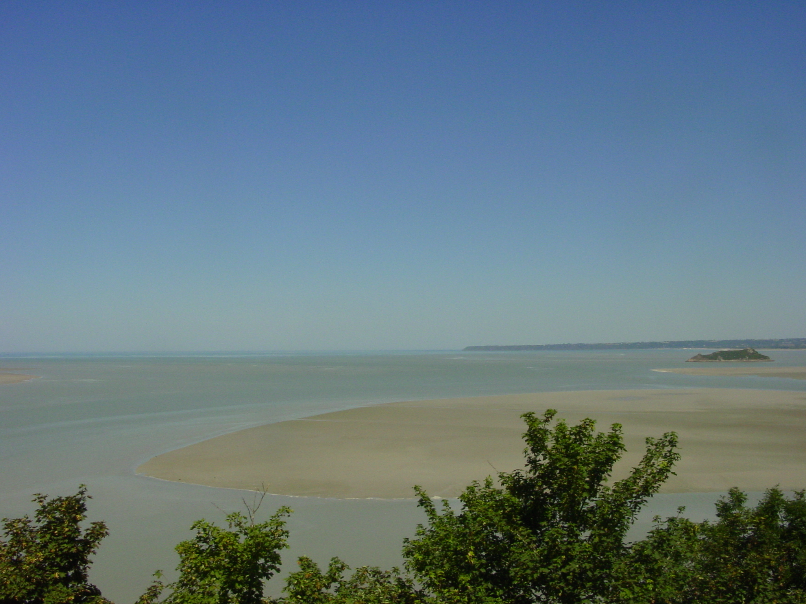
Chapter 1
Description of the climate system and of its components
Climate system dynamics and modelling Hugues Goosse

Slide 2
Outline
Presentation of the main components of the climate system
Description of some processes that will be useful in the next chapters.
Chapter 1 Page 2

Slide 3
Definition of climate
Climate is traditionally defined as a description in terms of the mean and variability of relevant atmospheric variables such as temperature, precipitation and wind.
Now the entire climate system is included in the definition
Chapter 1 Page 3

Slide 4
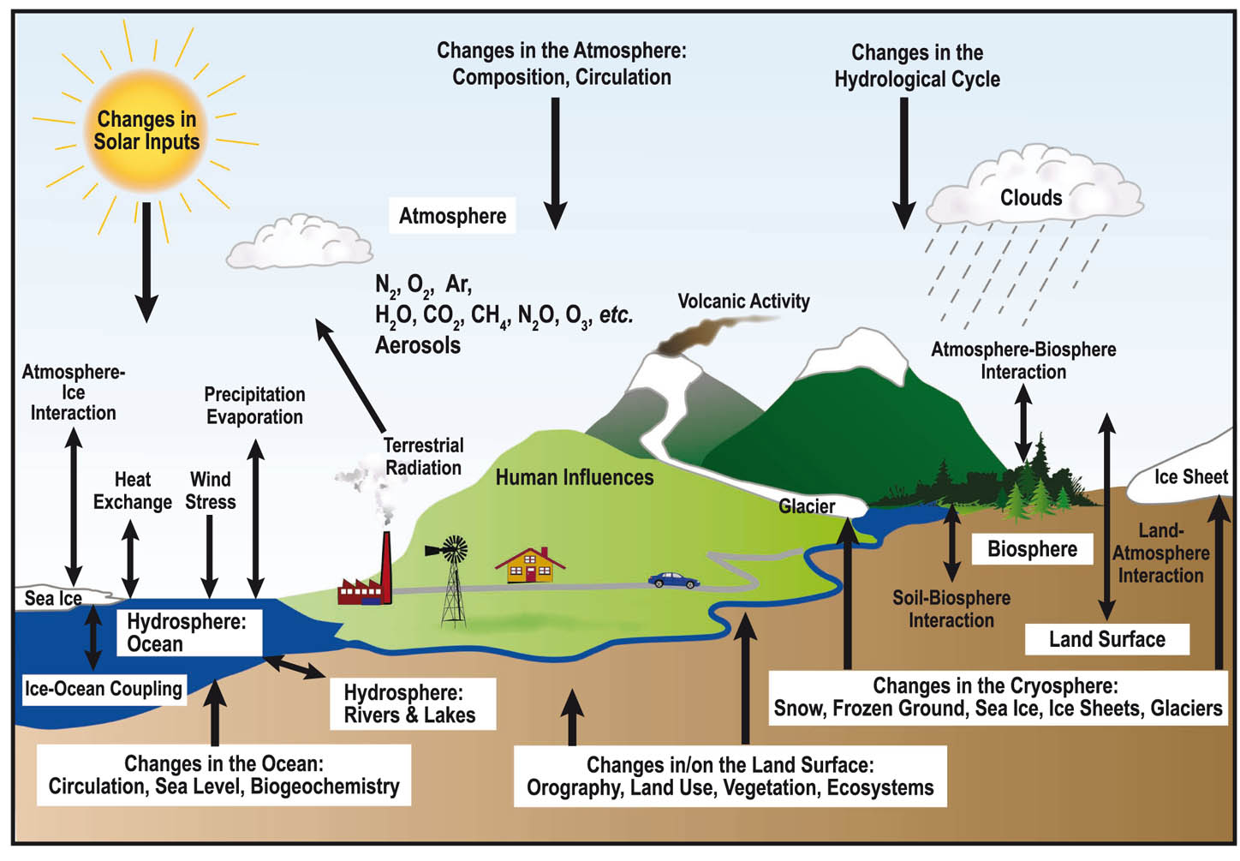
Definition of climate
Climate is now more and more defined in a wider sense as the description of the whole climate system.
Figure: IPCC(2007)
Chapter 1 Page 4

Slide 5
Definition of climate
30 years is the classical period for performing the statistics used to defined climate but this period is indicative.
Problem: with global warming, we will always be warmer than “normal” (= mean)
Example: definition of El Niño
For paleoclimate, longer time periods are also used.
Chapter 1 Page 5

Slide 7
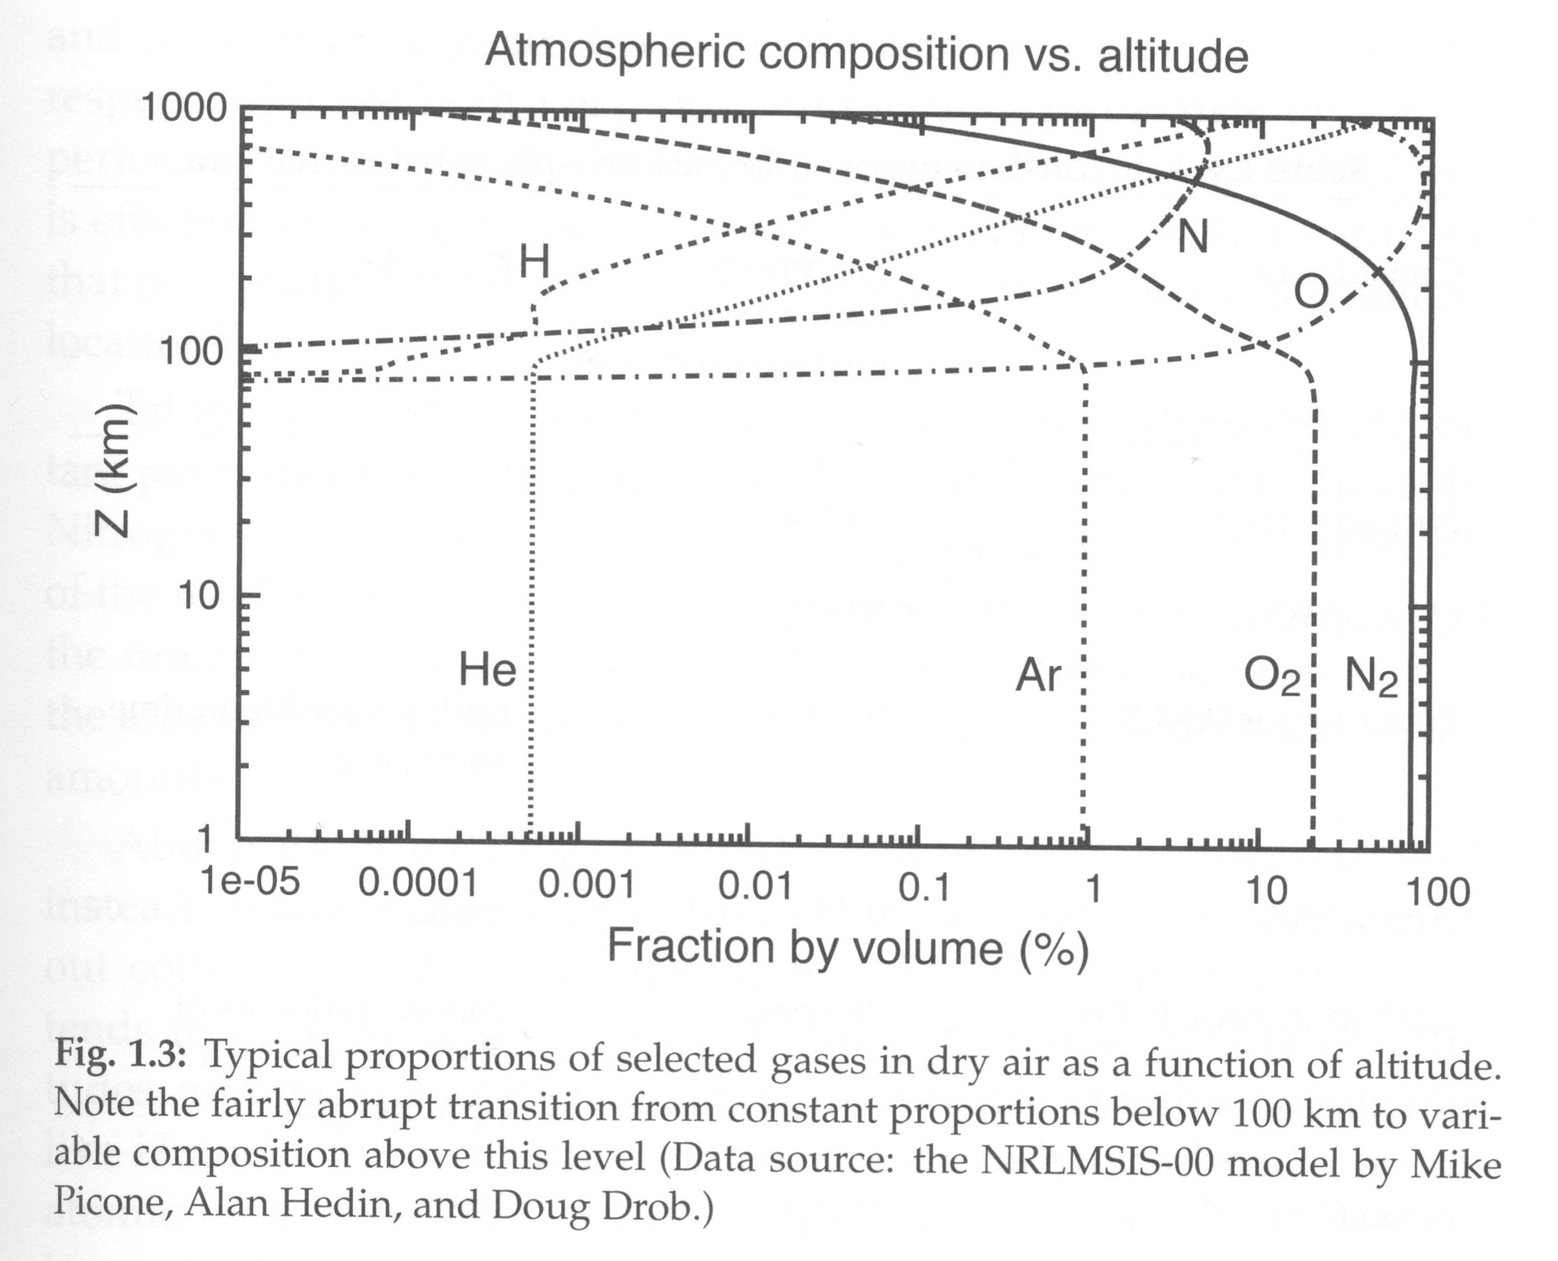

Slide 8


Slide 9
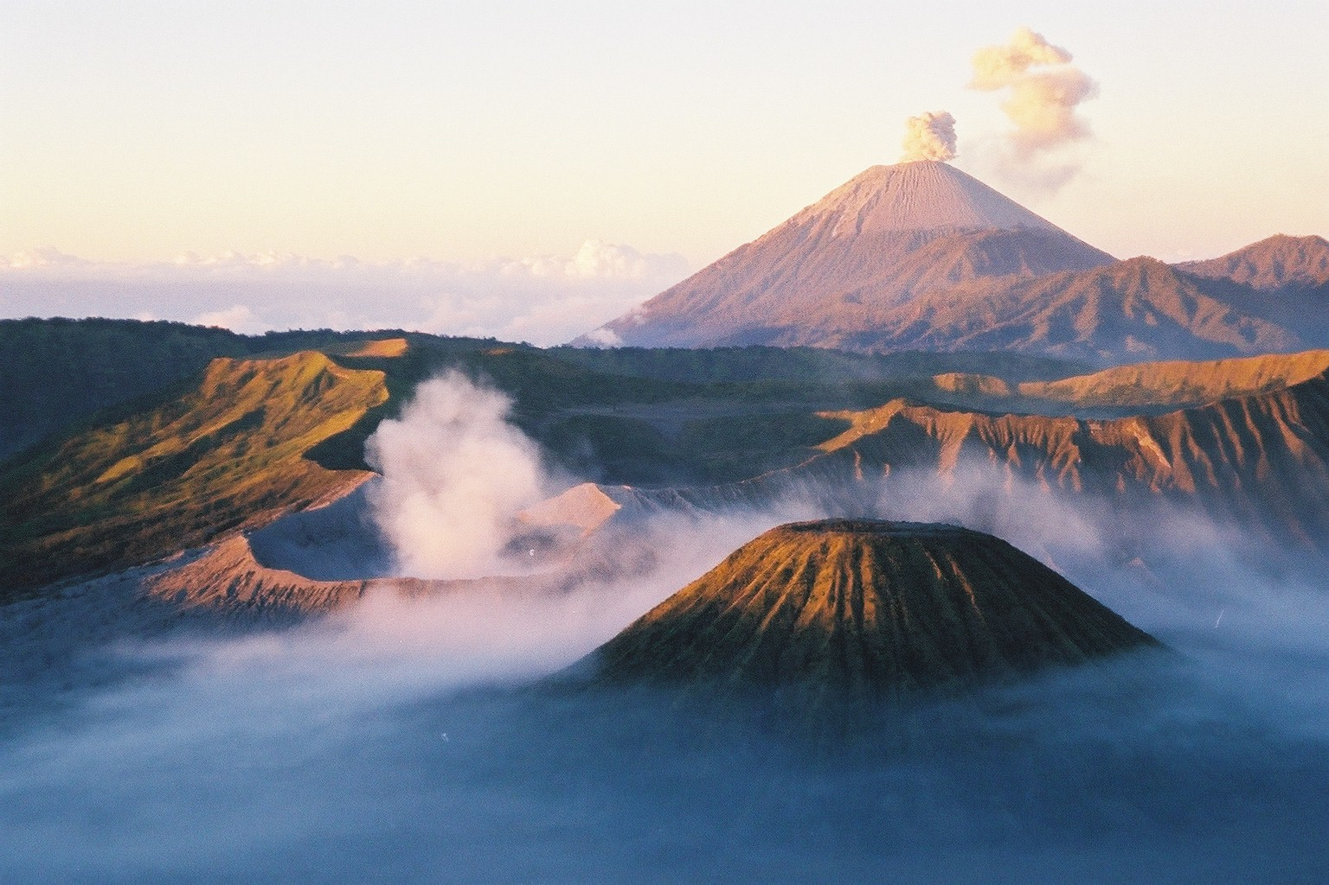
Gunung Bromo (left, steaming), Gunung Batok (closest), and Gunung Semuru (on horizon, erupting), eastern Java, Indonesia. Photo was taken at sunrise on July 24, 2000, during a field trip after the IAVCEI General Assembly in Bali. Bromo was continuously emitting water, sulfur gases, and other material, which filled the larger, older crater, trapped by the crater walls and an atmospheric inversion.

Slide 10
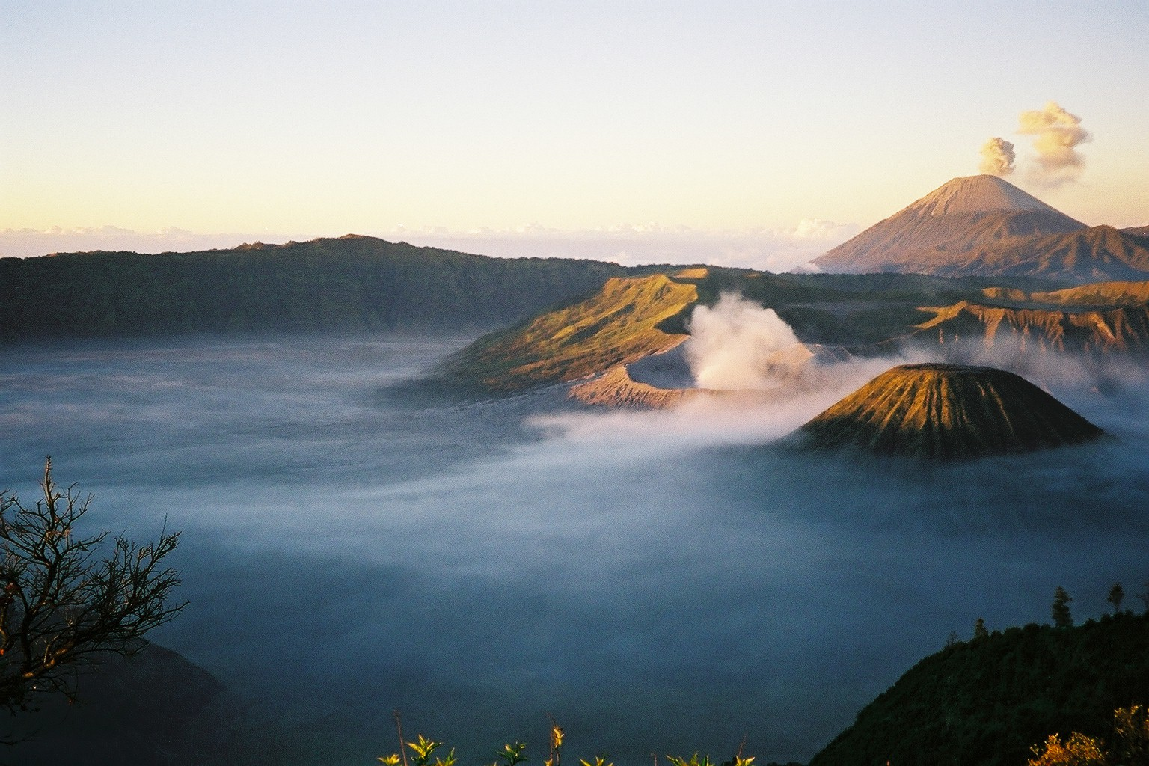

Slide 11


Slide 12


Slide 13
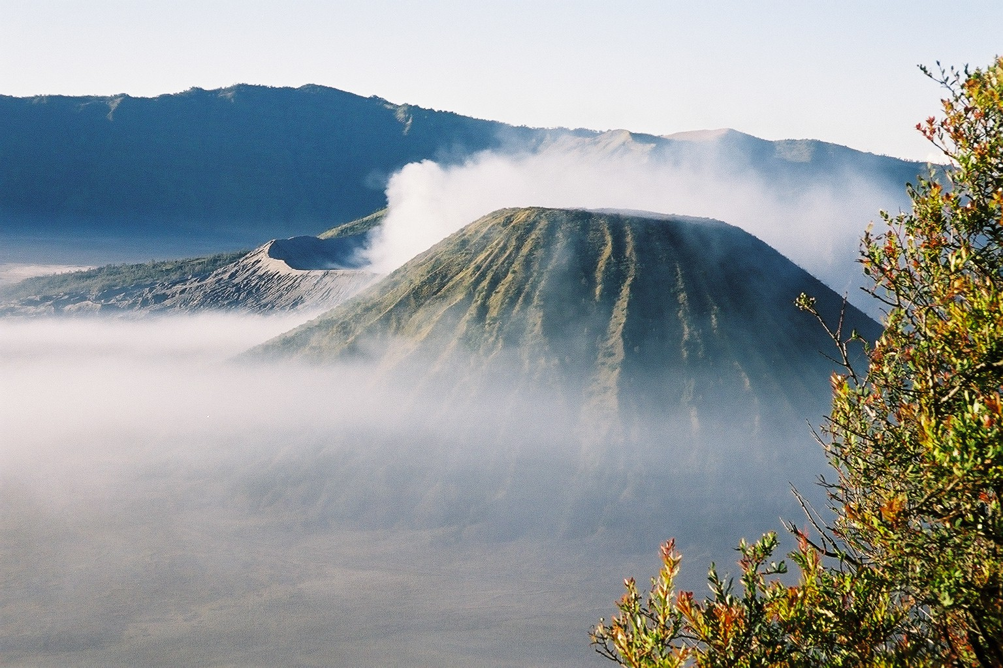

Slide 14


Slide 15
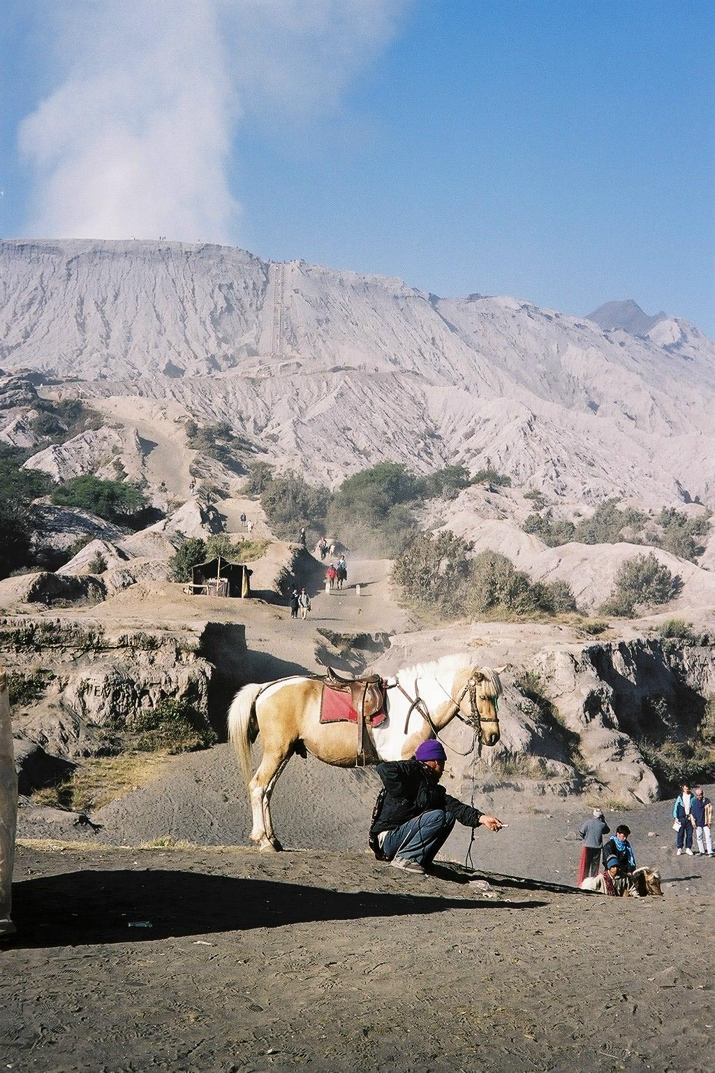

Slide 16


Slide 17
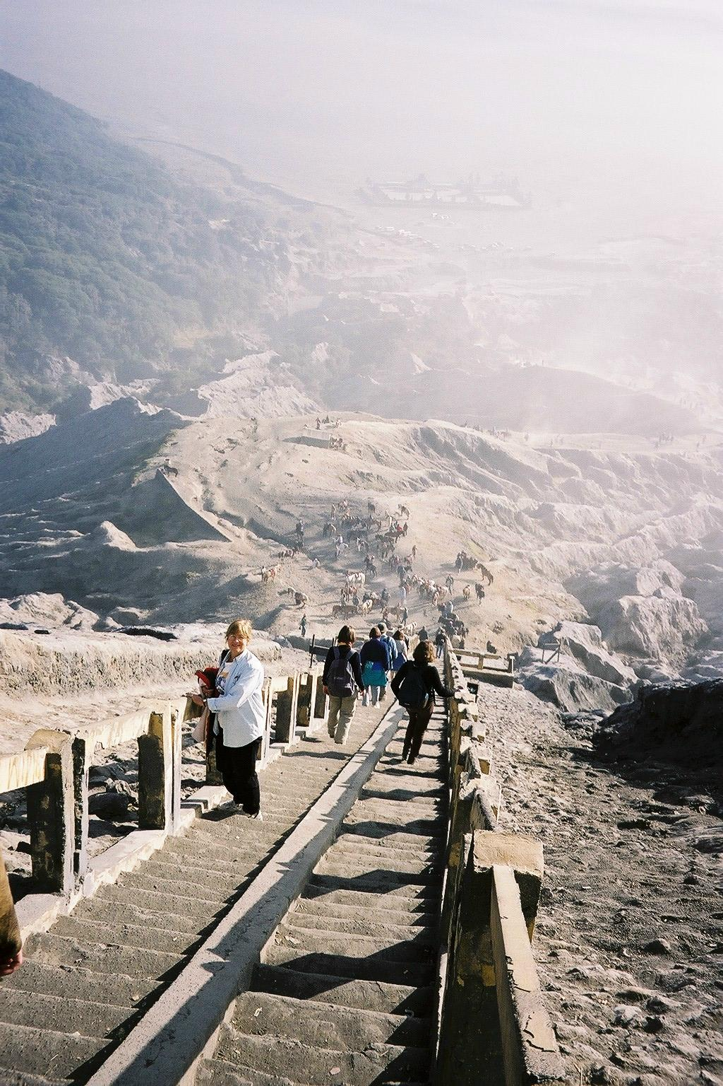

Slide 18
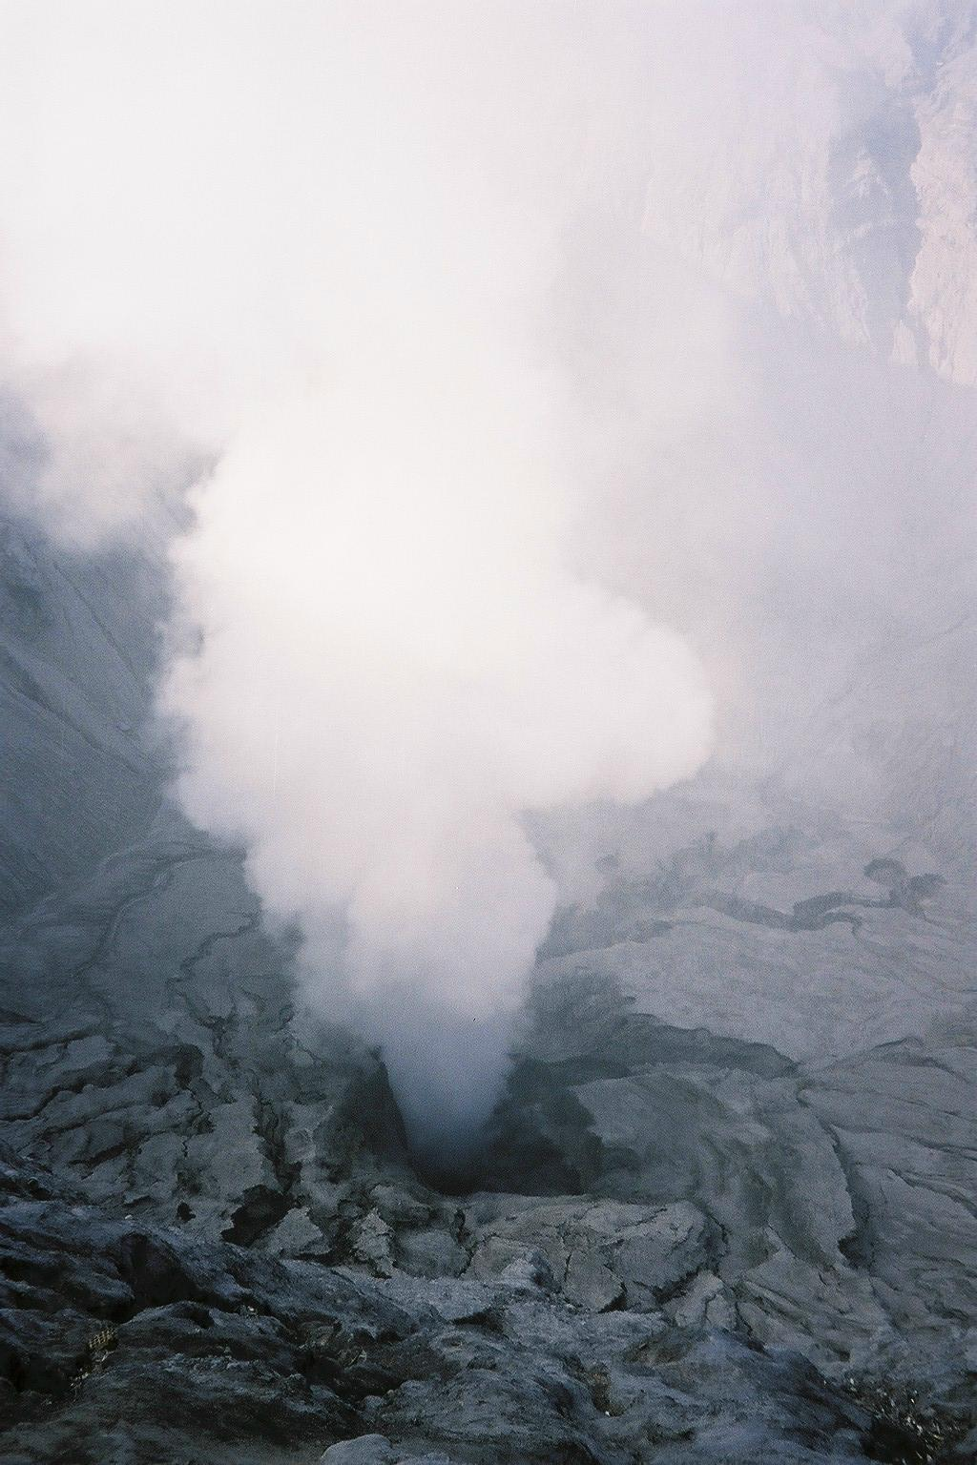

Slide 19
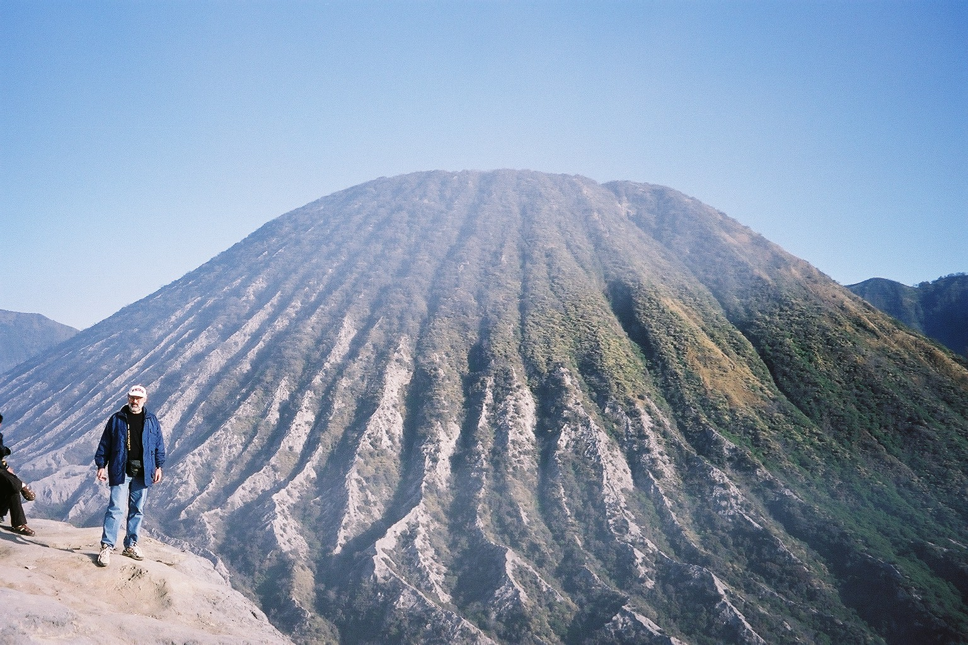

Slide 20


Slide 21


Slide 22
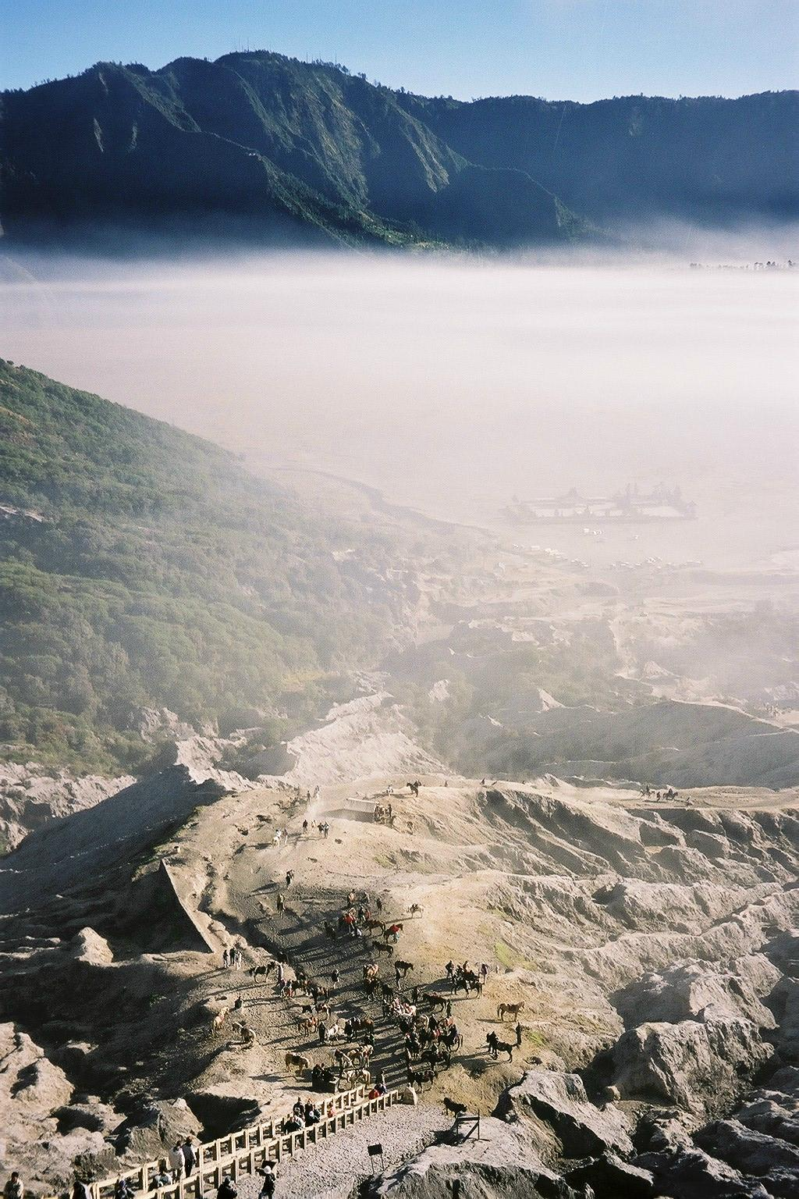

Slide 23
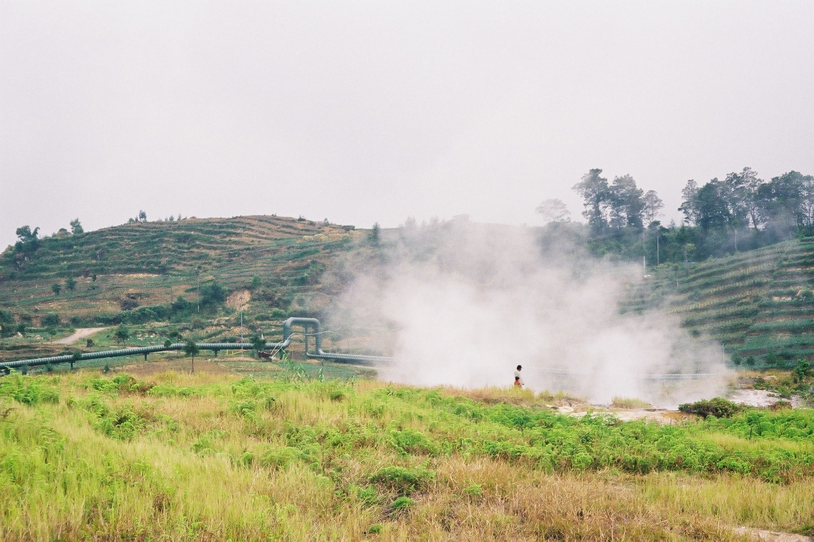

Slide 24
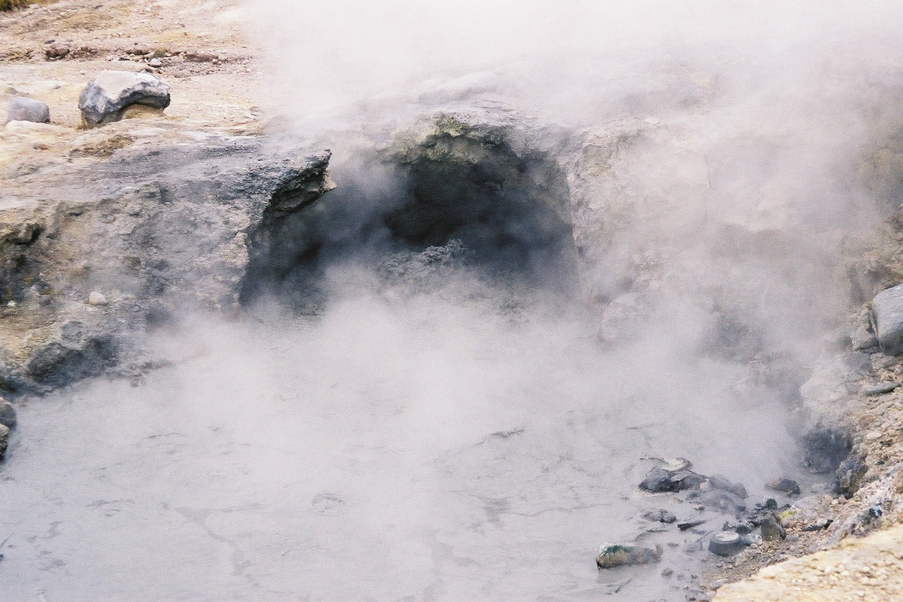

Slide 25
Global Emission of Sulfur Gases [Tg S yr⁻¹]
Northern Southern Global
Source Global Hemisphere Hemisphere (Andreae, 1990)
Fuel combustion and 77.6 69.8 7.8 80±10
industrial activities
Biomass burning 2.3 1.3 1.0 >2.5
Volcanoes 9.6 7.6 2.0 9.6-13
Marine biosphere 11.9 5.3 6.6 35-57
Terrestrial biosphere 0.9 0.5 0.3 4.8-13
Total 102.2 84.5 17.7 128-148
From Spiro et al. (1992), © American Geophysical Union and Andreae (1990), reprinted with permission from Elsevier Publishers.

Slide 26
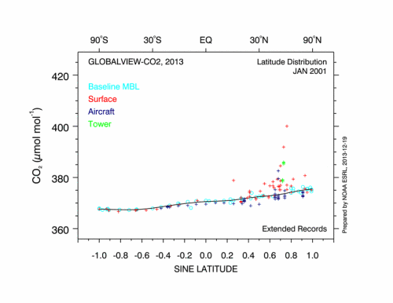

Slide 27
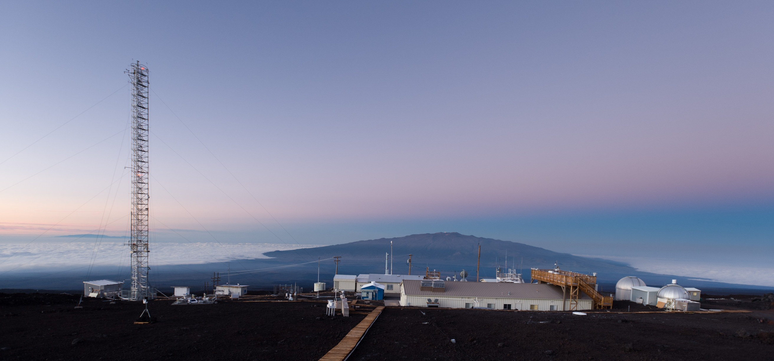
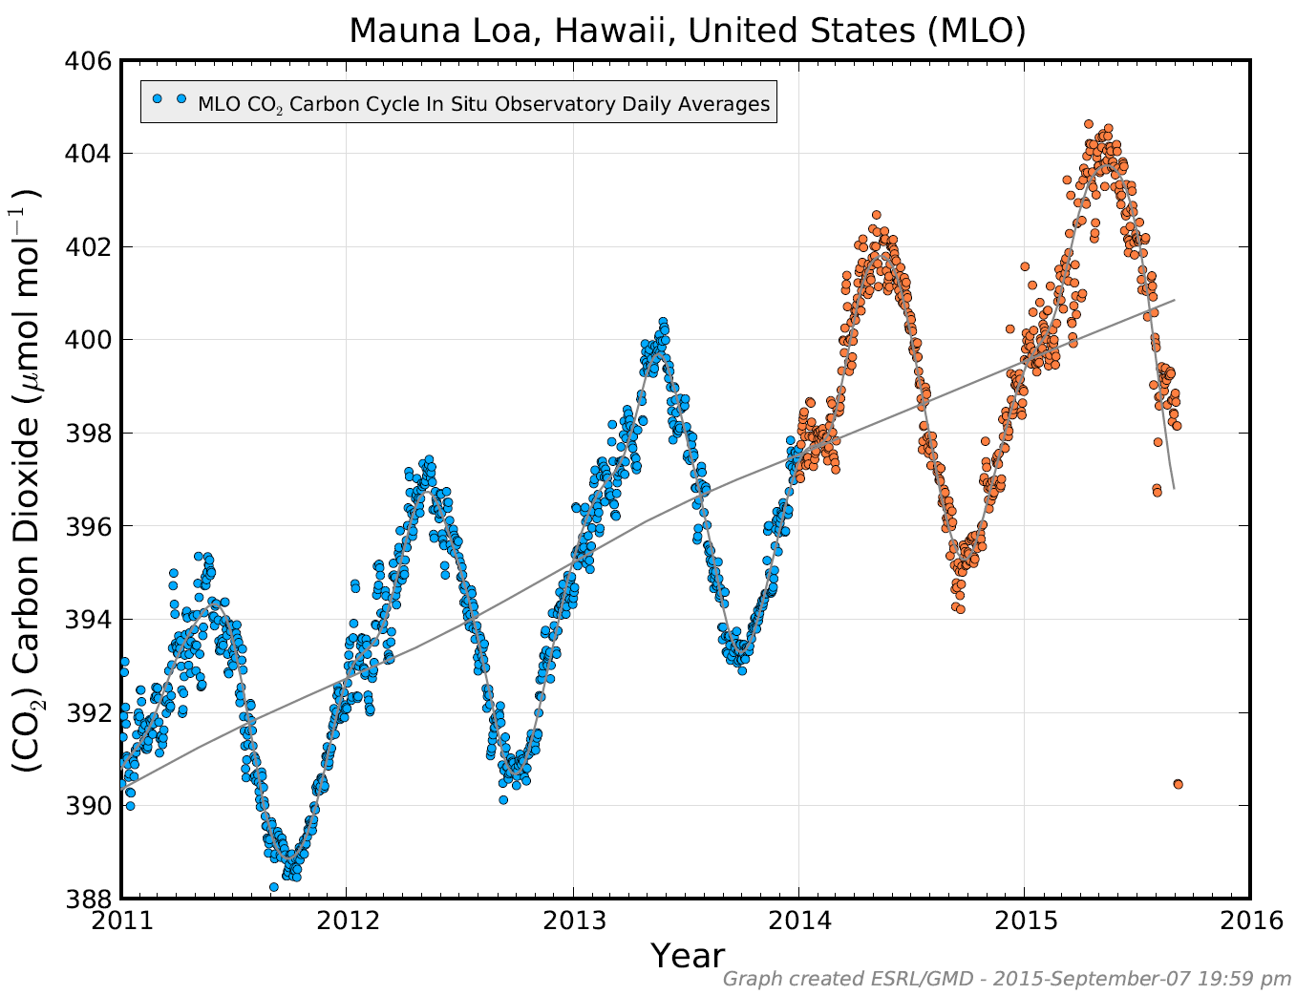
Jonathan Kingston for the New York Times, http://www.kingstonimages.com/

Slide 28
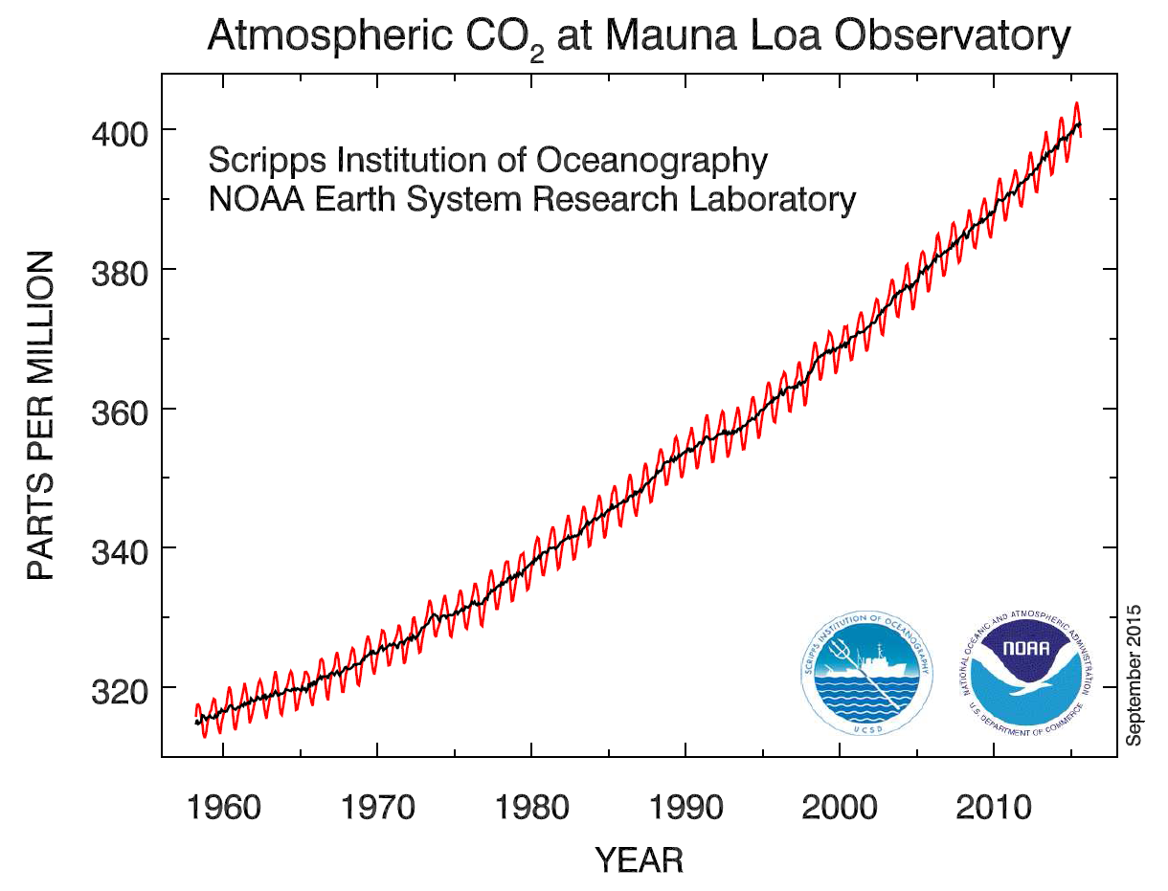

Slide 29
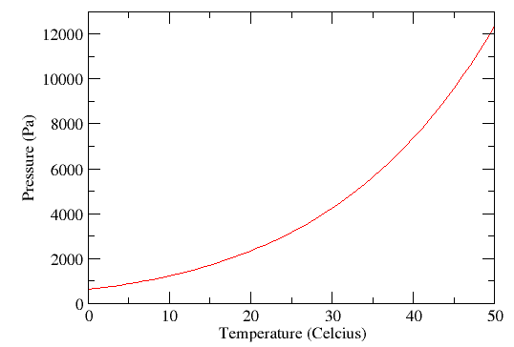
The atmosphere
Composition and temperature
In most cases, dry air can be considered as a perfect gas.
The amount of water vapour in the air at saturation is strongly dependent on temperature.
Saturation vapour pressure over water surface as a function of the temperature.
(Celsius)
Chapter 1 Page 29

Slide 30
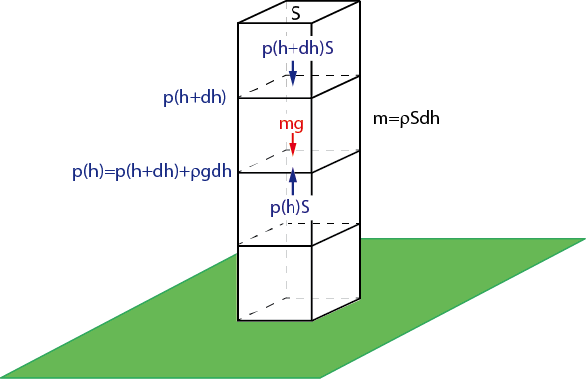
The atmosphere
Vertical profile
The atmosphere is generally close to hydrostatic equilibrium.
Balance of gravity and pressure forces on a small element of surface S and height dh. The increase in pressure between h+dh and h is equal to the weight of the element divided by its surface.
Chapter 1 Page 30

Slide 31
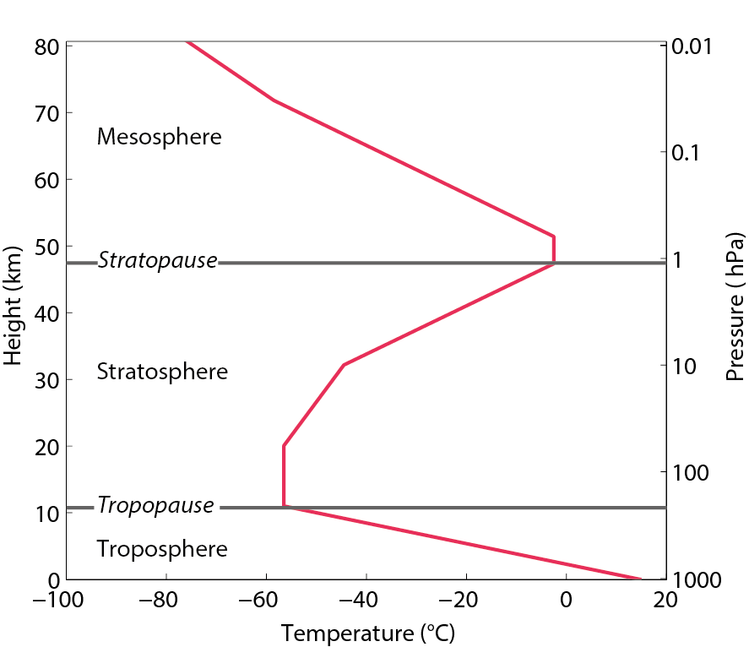
The atmosphere
Vertical profile
In the troposphere, the temperature decreases with height.
Typical temperature profile in the atmosphere as a function of the height (or of the pressure).
The global mean value of the lapse rate Γ in the troposphere is about 6.5 K km⁻¹.
Chapter 1 Page 31

Slide 32
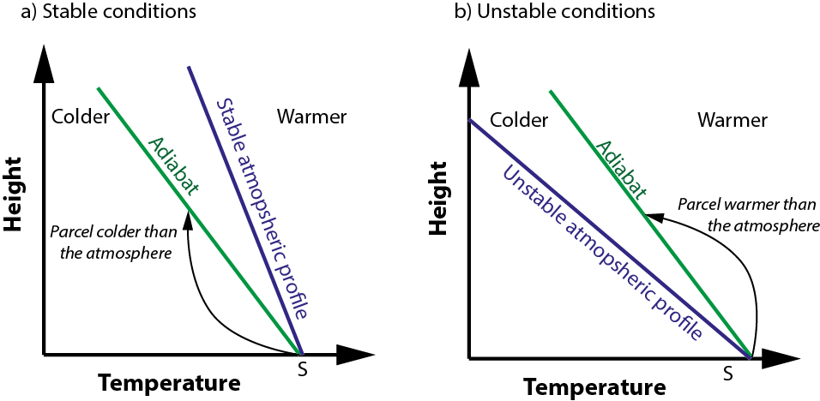
The atmosphere
The lapse rate determines the vertical stability of the atmosphere.
Chapter 1 Page 32

Slide 33
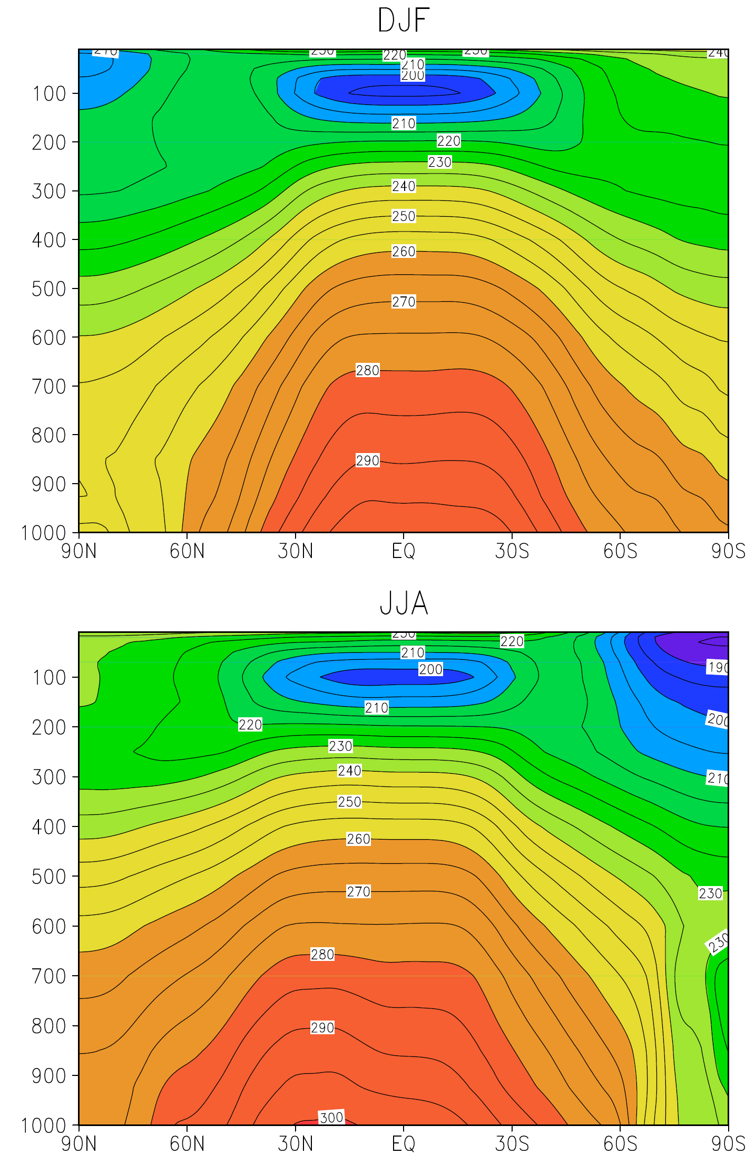
Fig. 2.9 (Cook, 2013)
p (mb)
Seasonal, zonal mean
air temperature (K)

Slide 34
Fig. 2.9 (Cook, 2013)
p (mb)
Seasonal, zonal mean
air temperature (K)

Slide 35
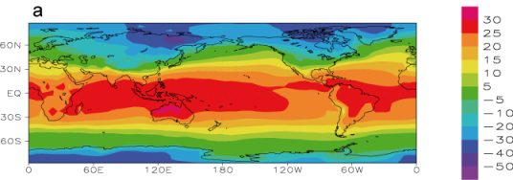
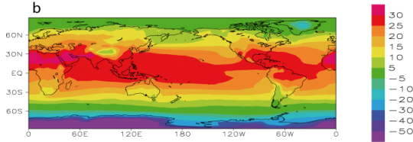
Global mean surface air temperature (°C)
Fig. 1.4 (Goosse, 2015)
DJF
JJA

Slide 36
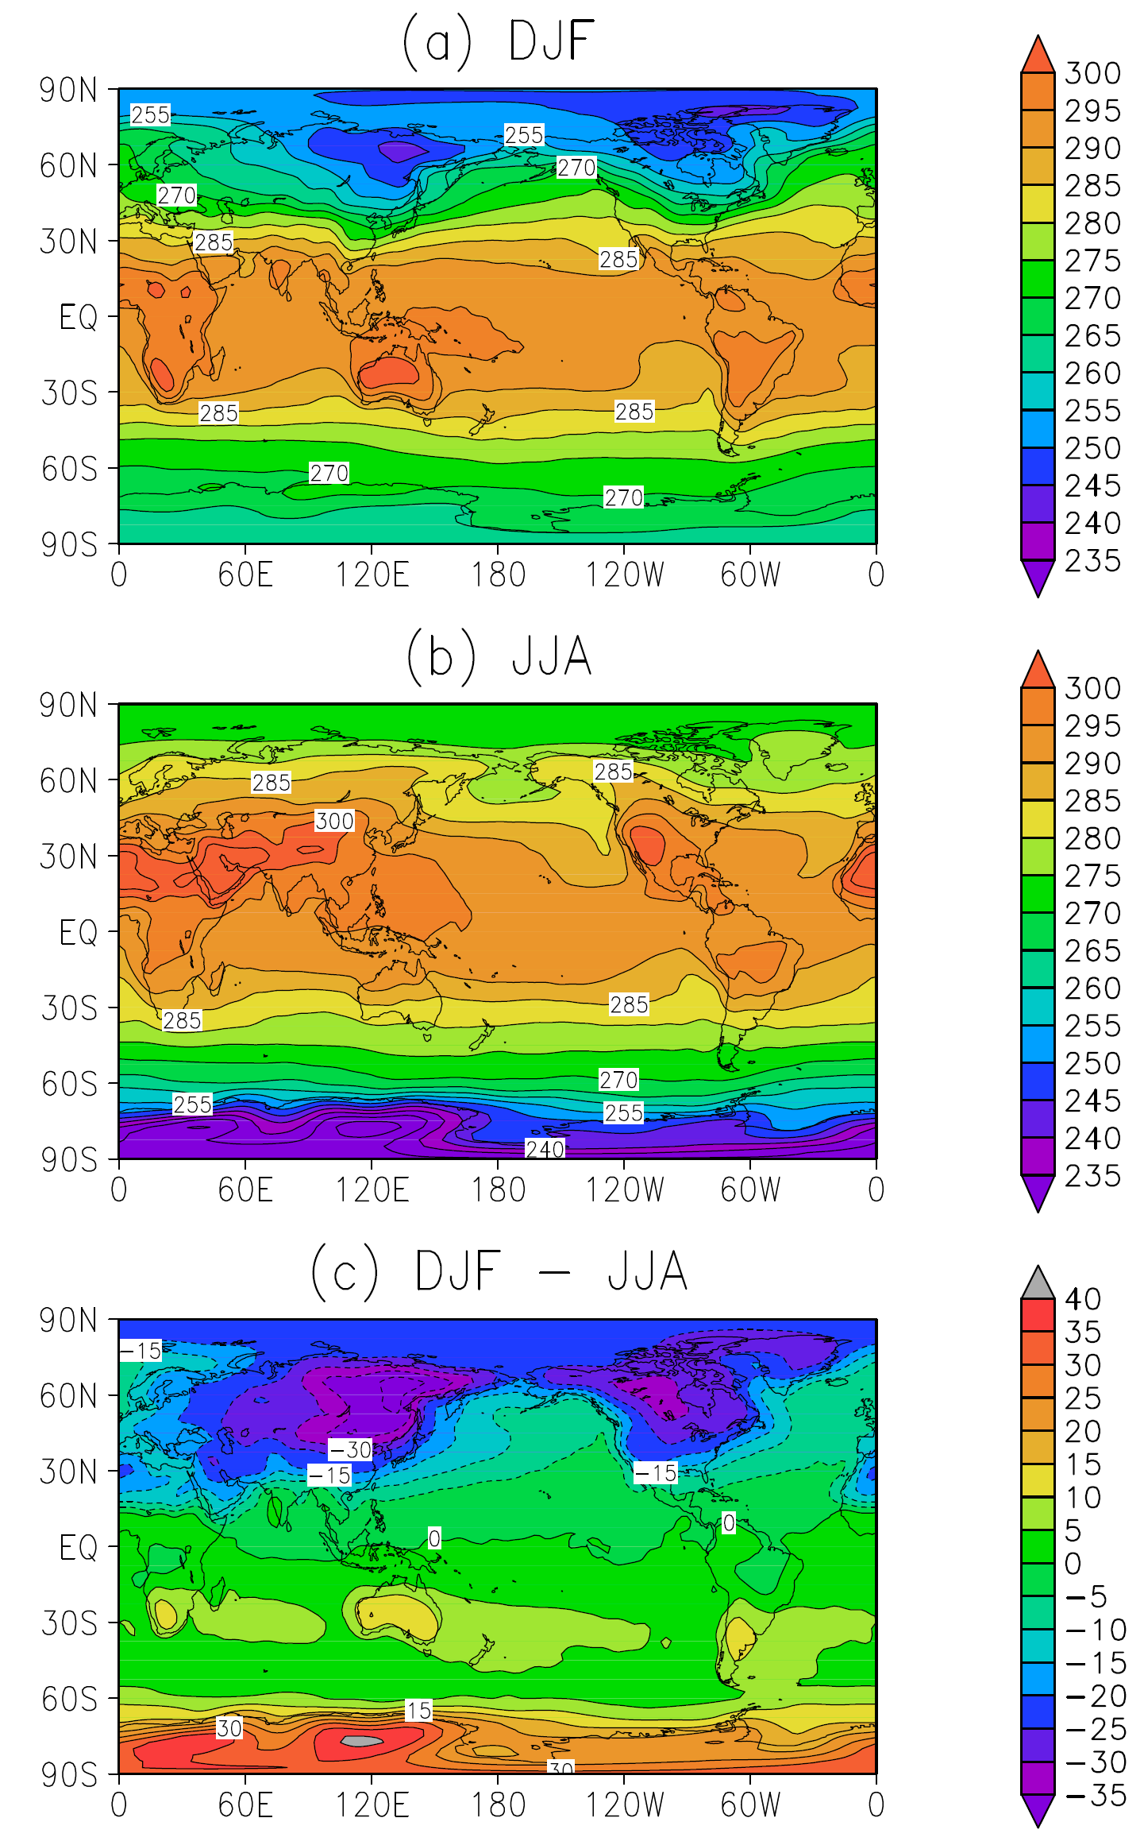
Seasonal
900 mb air temperature (K)
Fig. 2.7 (Cook, 2013)

Slide 37

The atmosphere
General circulation of the atmosphere
Importance of “convective” motion at various scales
Schematic representation of convection in a fluid heated from below and cooled from above.
Chapter 1 Page 37

Slide 38
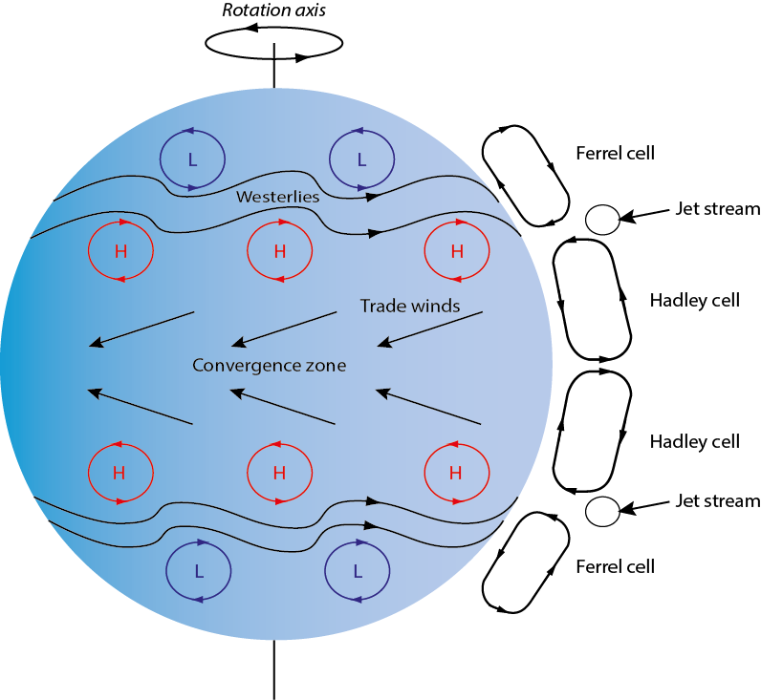
The atmosphere
General circulation of the atmosphere
Schematic representation of the annual mean general atmospheric circulation.
Chapter 1 Page 38

Slide 39
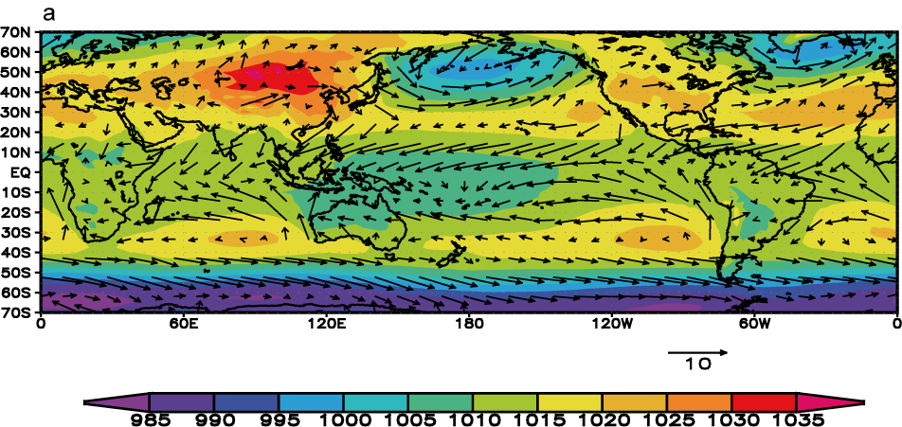
The atmosphere
General circulation of the atmosphere
10m winds (arrows, in m/s) and sea level pressure (colours, in hPa) averaged over December, January, and February.
Chapter 1 Page 39

Slide 40

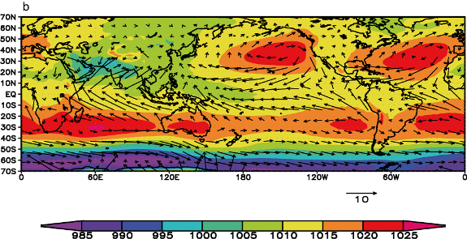
DJF
10 m winds (arrows, in m/s) and sea level pressure (colors, in hPa) averaged over (a) December, January, and February and (b) June, July, and August
JJA

Slide 41
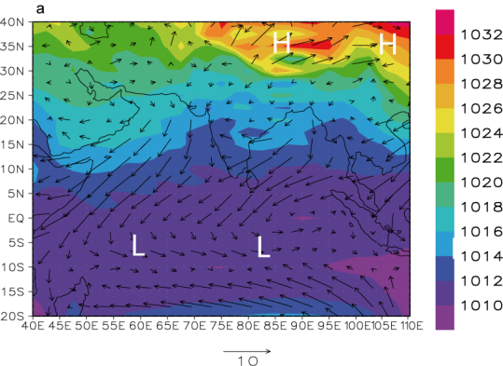
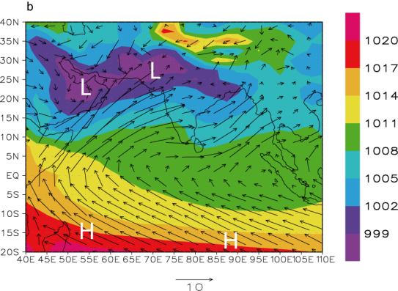
January
Indian Monsoon
10 m winds (arrows, in m/s) and sea level pressure (colors, in hPa) averaged over (a) January, and (b) July
July

Slide 42
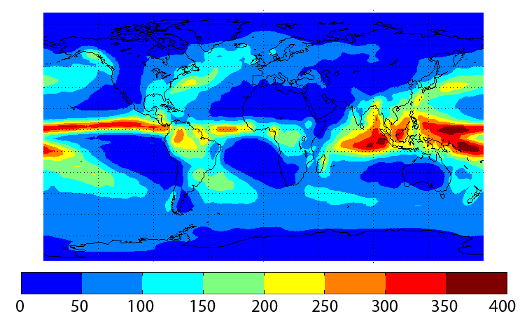
The atmosphere
Precipitation
Annual mean precipitation in cm per year
Chapter 1 Page 42

Slide 43
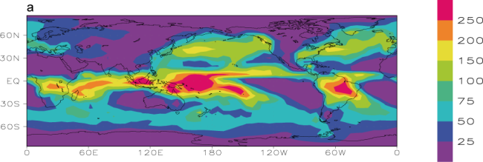
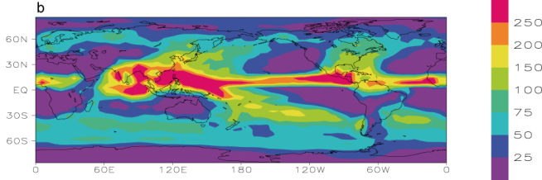
Seasonal mean total precipitation (cm)
DJF
JJA

Slide 44
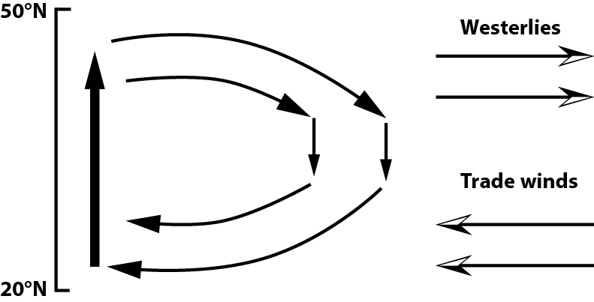
The ocean
Oceanic circulation at surface: role of the wind
Coast
Oceanic gyre
Western
boundary
current
Schematic representation of the wind-driven circulation at mid-latitudes
Chapter 1 Page 44

Slide 45
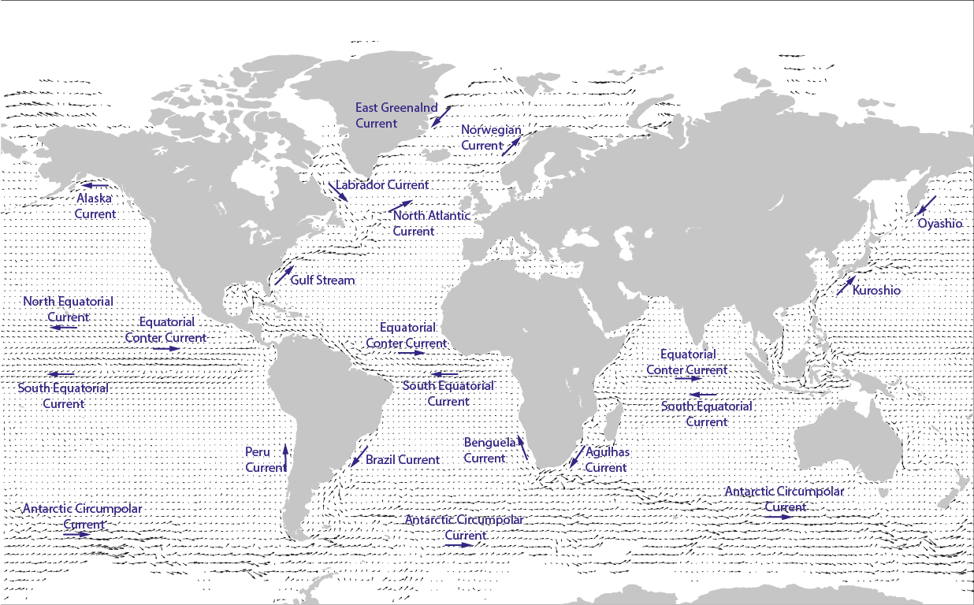
The ocean
Oceanic circulation at surface: role of the wind
Surface currents derived from satellite-tracked surface drifting buoy observations
Chapter 1 Page 45

Slide 46
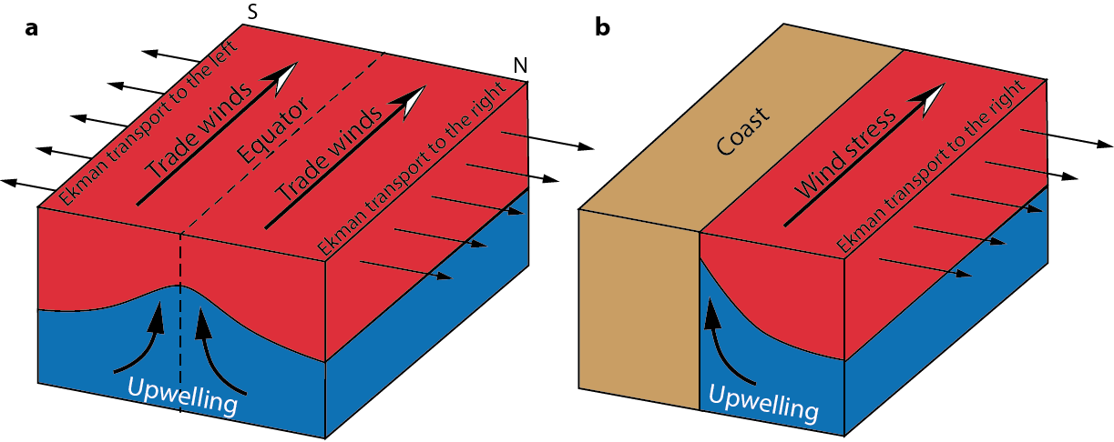
The ocean
Role of the wind in upwelling
Coastal upwelling in the Northern Hemisphere
Equatorial upwelling
Chapter 1 Page 46

Slide 47
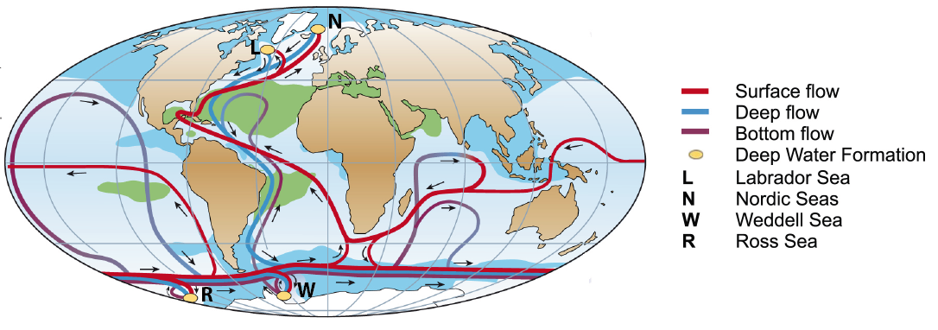
The ocean
The global thermohaline circulation
Figure based on Rahmstorf (2002) and Kuhlbrodt et al. (2007).
Chapter 1 Page 47

Slide 48
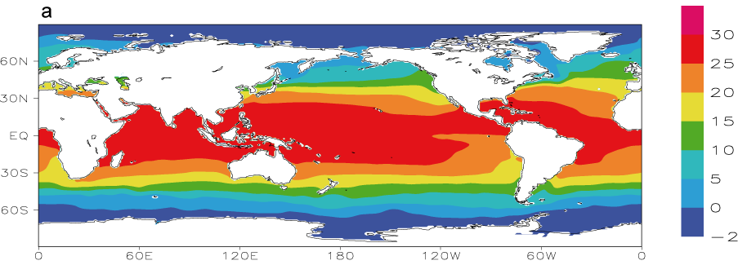
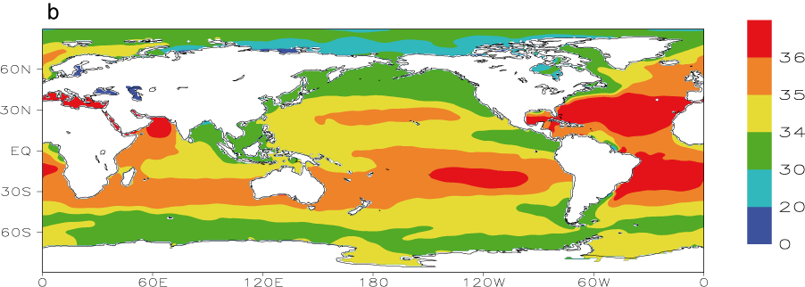
The ocean
Temperature and salinity
Annual mean sea surface temperature (°C)
Annual mean sea surface salinity (psu)
Chapter 1 Page 48

Slide 49
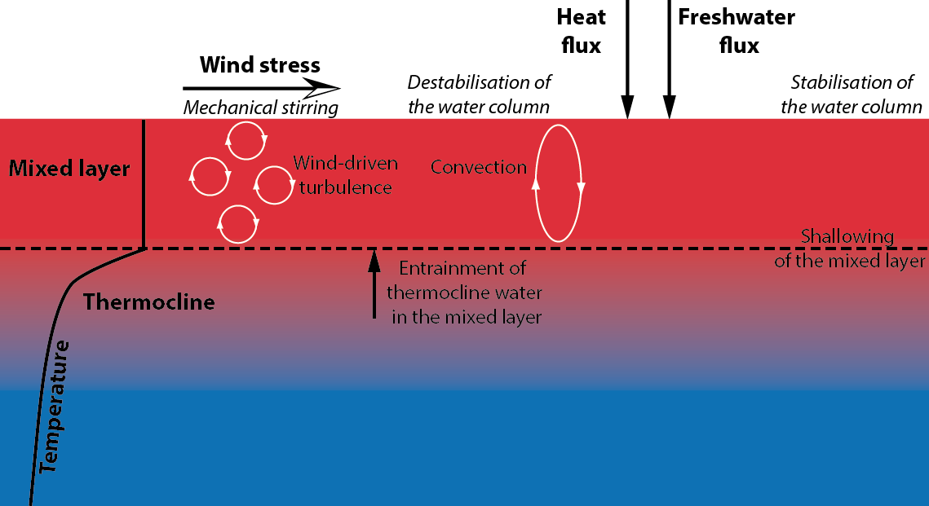
The ocean
Dynamics of the surface layer
Schematic illustration of the processes governing the time development of the mixed layer depth
Chapter 1 Page 49

Slide 50
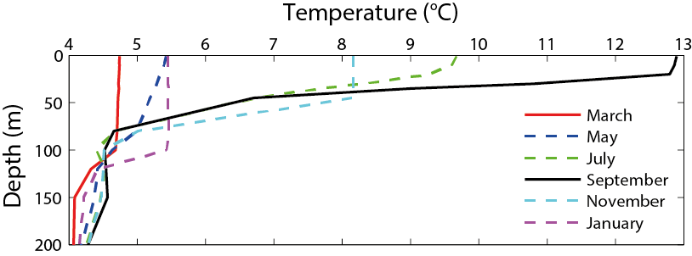
The ocean
Dynamics of the surface layer
Monthly mean temperature profiles at a mid-latitude site in the Northern Hemisphere (50° N, 145° W).
Chapter 1 Page 50

Slide 51
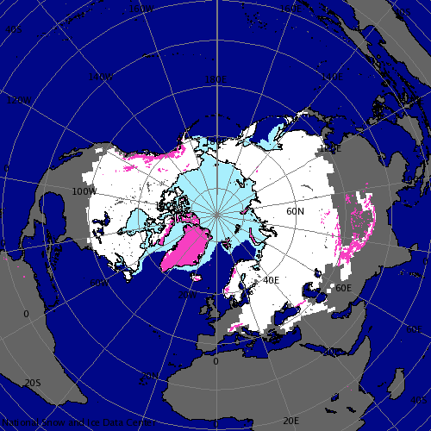

The cryosphere
The cryosphere includes sea ice, lake ice, ice sheets, ice caps, glaciers, permafrost.
The distribution of sea ice, snow and land ice in January in the Northern Hemisphere. Source: Atlas of the Cryosphere, National Snow and Ice Data Center (NSIDC), http://nsidc.org/data/atlas/
Chapter 1 Page 51

Slide 52
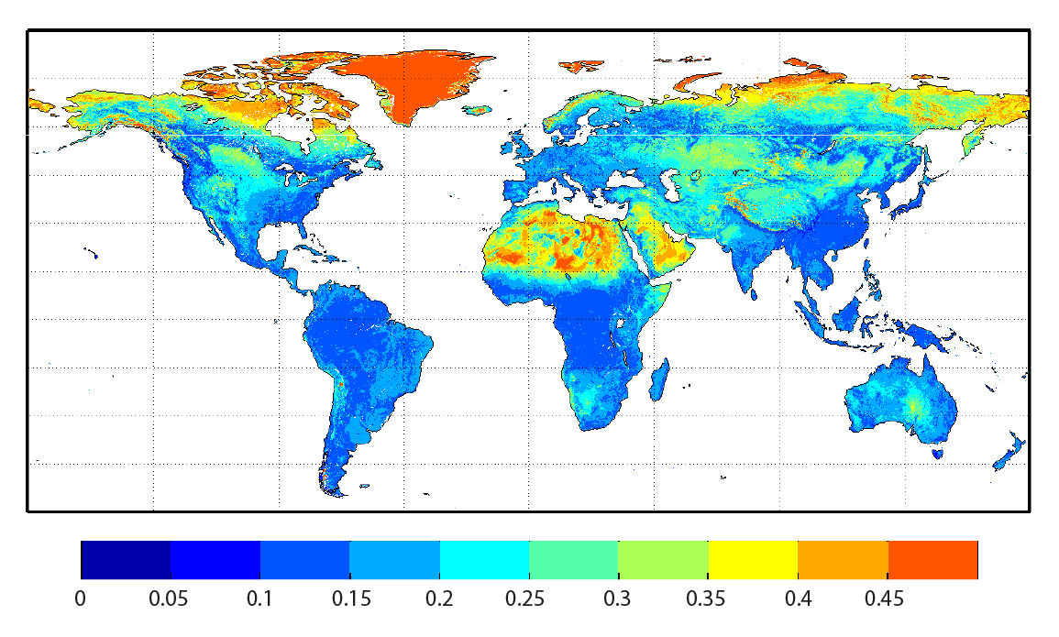
The land surface and the terrestrial biosphere
The topography, the surface type, the distance to the coast strongly influence the climate.
Land surface albedo from Moderate Resolution Imaging Spectroradiometer (MODIS) satellite data.
Chapter 1 Page 52

