Slide 1
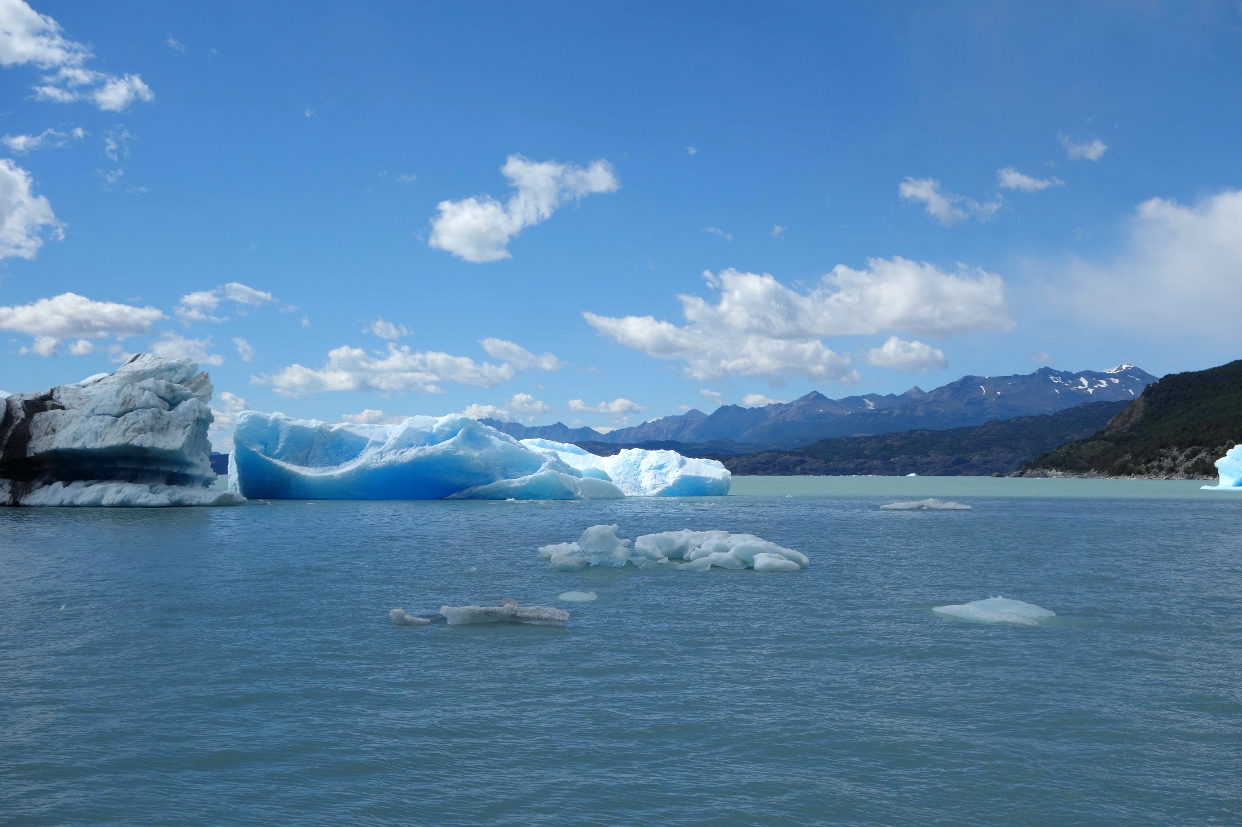
Chapter 2
Energy balance, hydrological
and carbon cycles
Climate system dynamics and modelling Hugues Goosse

Slide 2
Outline
Description of the global energy budget and of the exchanges of energy between the components of the climate system.
Spatial distribution for radiative fluxes and heat transport.
Description of the global water balance, local water balance and water transport.
Presentation of the carbon cycle, focusing on carbon dioxide and methane as they are major greenhouse gases.
Chapter 2 Page 2

Slide 3
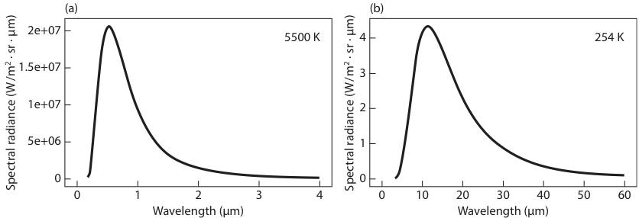
Fig. 4.3

Slide 4
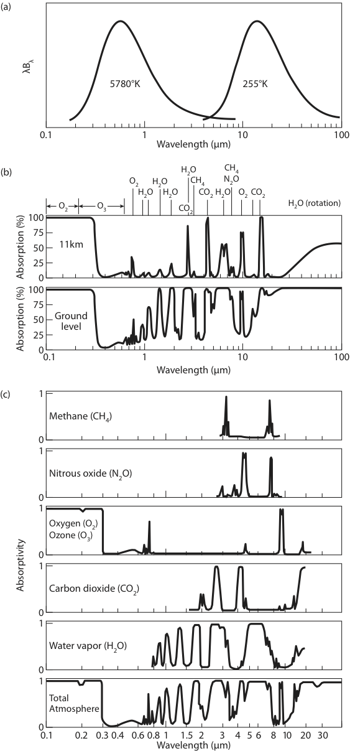

Slide 6
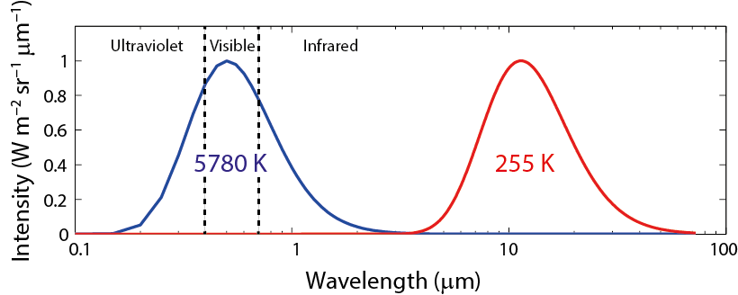
The heat balance at the top of the atmosphere
At the top of the atmosphere, the energy received from
the Sun (shortwave radiation) is balanced by the energy emitted by the Earth (longwave radiation).
The total solar irradiance (TSI) is equal to 1360 W/m².
SUN
EARTH
Normalized blackbody spectra for temperatures representative of the Sun (blue, temperature of 5780 K) and the Earth (red, temperature of 255 K).
Chapter 2 Page 6

Slide 7
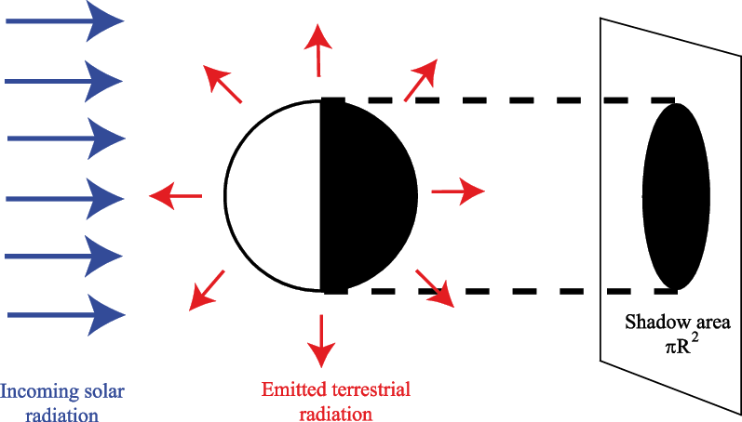
The heat balance at the top of the atmosphere
On average, the total amount of incoming solar energy per unit of time outside the Earth’s atmosphere is the TSI times the surface that intercepts the solar rays.
Schematic view of the energy absorbed and emitted by the Earth.
R, the Earth’s radius, is equal to 6371 km.
Chapter 2 Page 7

Slide 8
The heat balance at the top of the atmosphere
The fraction of the incoming solar radiation that is reflected is called the albedo of the Earth or planetary albedo (α_{p}).
For present-day conditions it has a value of about 0.3.
The total amount of energy that is emitted by a 1 m² surface per unit of time by the Earth at the top of the atmosphere (A↑) can be computed following Stefan-Boltzmann’s law:
where T_{e} is the effective emission temperature of the Earth and σ is the Stefan Boltzmann constant
(σ = 5.67 10⁻⁸ W m⁻² K⁻⁴).
Chapter 2 Page 8

Slide 9
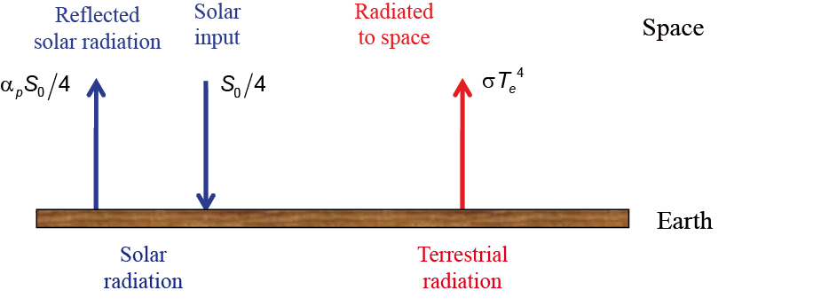
The heat balance at the top of the atmosphere
Heat balance of the Earth
Absorbed solar radiation = emitted terrestrial radiation
This corresponds to T_{e}=255 K (=-18°C).
Chapter 2 Page 9

Slide 10
Greenhouse Effect
A = π r²
A = 4π r²
r
α
Sun
T_{s}
S₀ = 1361 W m⁻²
Emission = σT_{e}⁴
α = planetary albedo (0.30)
Earth

Slide 11

Greenhouse
Effect
Global Energy Balance
Incoming Energy = Outgoing Energy
πr² S₀ (1-α) = 4πr² σT_{e}⁴
r = radius of Earth
S₀ = solar constant (1361 W/m²)
α = planetary albedo (0.30)
σ = Stefan-Boltzmann constant
(5.67 x 10⁸ W m⁻² K⁻⁴)
T_{e} = effective temperature of Earth
T_{s} = observed global average surface temperature
Greenhouse Effect
T_{s} = 288 K
T_{e} = 255 K
33 K (33C° = 59F°)

Slide 12
S₀ = “solar constant” = 1361 W/m²
Greenhouse Effect
Greenhouse Effect
α = planetary albedo = 0.30
T_{e} = effective temperature
T_{s} = surface temperature
σT_{e}⁴
σT_{e}⁴
Greenhouse gases
Sensible and latent heat
σT_{s}⁴
εσT_{e}⁴
T_{s} = T_{e} = 255K = -18°C
T_{s} = 288K = 15°C (Observed)

Slide 13
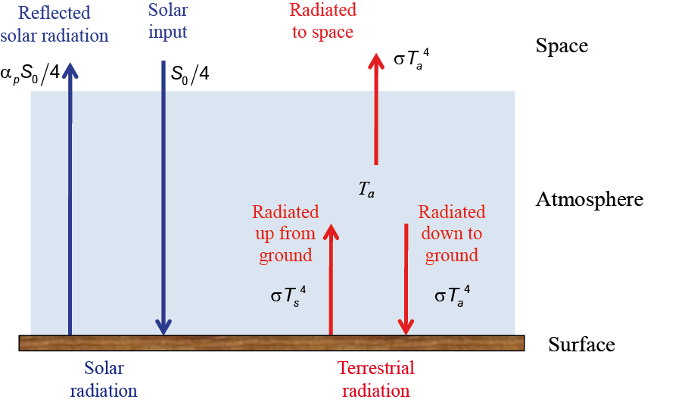
The heat balance at the top of the atmosphere
Greenhouse effect
The atmosphere is nearly transparent to visible light.
The atmosphere is almost opaque across most of the infrared part of the electromagnetic spectrum because of some minor constituents (water vapour, carbon dioxide, methane and ozone).
Heat balance of the Earth with an atmosphere represented by a single layer totally transparent to solar radiation and opaque to infrared radiations.
Chapter 2 Page 13

Slide 14
The heat balance at the top of the atmosphere
Greenhouse effect
Representing the atmosphere by a single homogenous layer of temperature T_{a}, totally transparent to the solar radiation and totally opaque to the infrared radiations emitted by the Earth’s surface, the heat balance at the top of the atmosphere is:
The heat balance at the surface is:
This leads to:
This corresponds to a surface temperature of 303K (30°C).
Chapter 2 Page 14

Slide 15
The heat balance at the top of the atmosphere
Greenhouse effect
A more precise estimate of the radiative balance of the Earth, requires to take into account
the multiple absorption by the various atmospheric layers and emission at a lower intensity as the temperature decreases with height.
the strong absorption only in some specific ranges of frequencies which are characteristic of each component.
Furthermore, the contribution of non-radiative exchanges have to be included to close the surface energy balance.
Chapter 2 Page 15

Slide 16
Present-day insolation at the top of the atmosphere
The irradiance at the top of the atmosphere is a function of the Earth-Sun distance.
Total energy emitted by the Sun at a distance r_{m}=
Total energy emitted by the Sun at a distance r
Earth
S_{r}
r
S₀
r_{m}
Sun
Chapter 2 Page 16

Slide 17
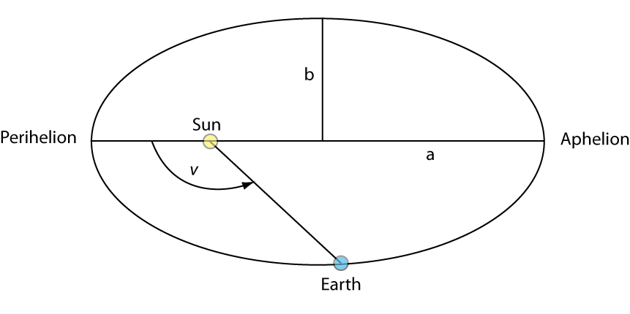
Present-day insolation at the top of the atmosphere
The Sun-Earth distance can be computed as a function of the position of the Earth on its elliptic orbit :
v is the true anomaly, a, half of the major axis, and ecc the eccentricity.
Schematic representation of the Earth’s orbit around the Sun. The eccentricity has been strongly amplified for the clarity of the drawing.
Chapter 2 Page 17

Slide 18
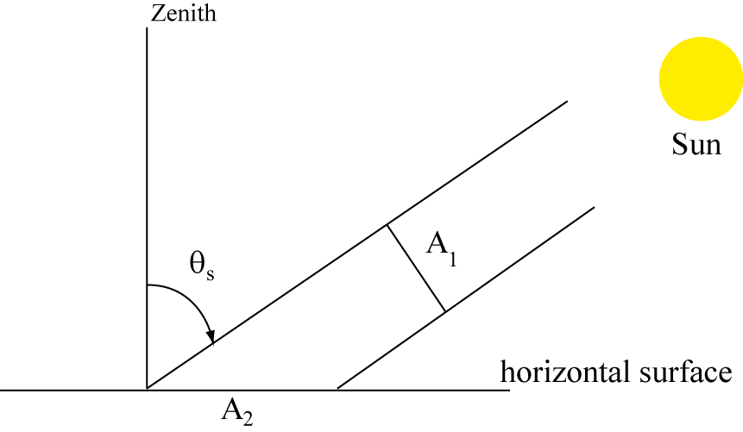
Present-day insolation at the top of the atmosphere
The insolation on a unit horizontal surface at the top of the atmosphere (S_{h}) is proportional to the angle between the solar rays and the vertical.
energy crossing A₁
=energy reaching A₂
S_{r}
A₁
S_{h}
θ_{s} is the solar zenith distance
Chapter 2 Page 18

Slide 19
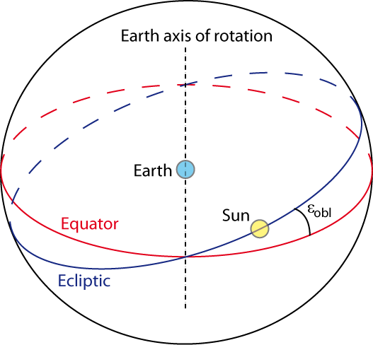
Present-day insolation at the top of the atmosphere
The solar zenith distance depends on the obliquity.
The obliquity, ε_{obl} , is the angle between the ecliptic plane and the celestial equatorial plane.
The obliquity is at the origin of the seasons.
Representation of the ecliptic and the obliquity ε_{obl} in a geocentric system.
Presently
ε_{obl} =23°27’
Chapter 2 Page 19

Slide 20
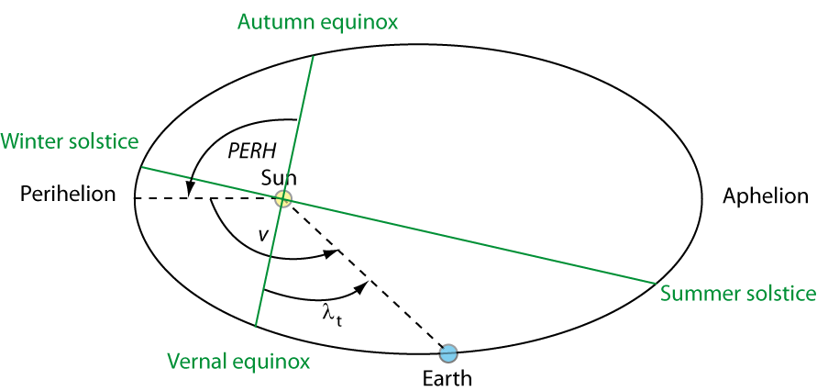
Present-day insolation at the top of the atmosphere
The solar zenith distance depends on the position (true longitude λ_{t}) relative to the vernal equinox.
The vernal equinox corresponds to the intersection of the ecliptic plane with the celestial equator when the Sun “apparently” moves from the austral to the boreal hemisphere.
Representation of the true longitudes and the seasons in the ecliptic plane.
Chapter 2 Page 20

Slide 21
Present-day insolation at the top of the atmosphere
The solar zenith distance depends on the latitude (φ ) and on the hour of the day (HA, the hour angle).
δ is the solar declination. It is related to the true longitude or alternatively to the day of the year.
Those formulas can be used to compute the instantaneous insolation, the time of sunrise, of sunset as well as the daily mean insolation.
Chapter 2 Page 21

Slide 22
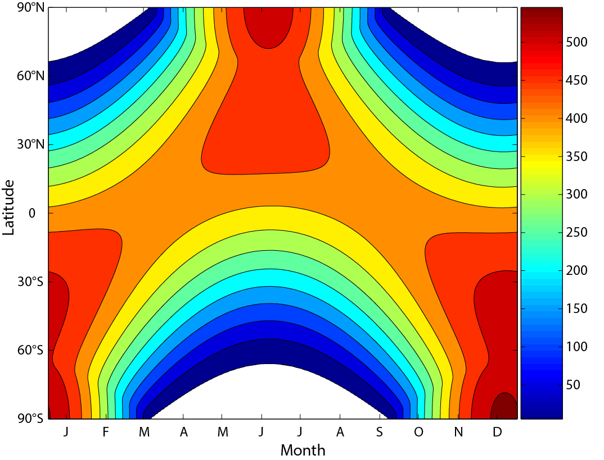
Present-day insolation at the top of the atmosphere
Daily mean insolation on an horizontal surface (W m⁻²).
Polar night
Chapter 2 Page 22

Slide 23
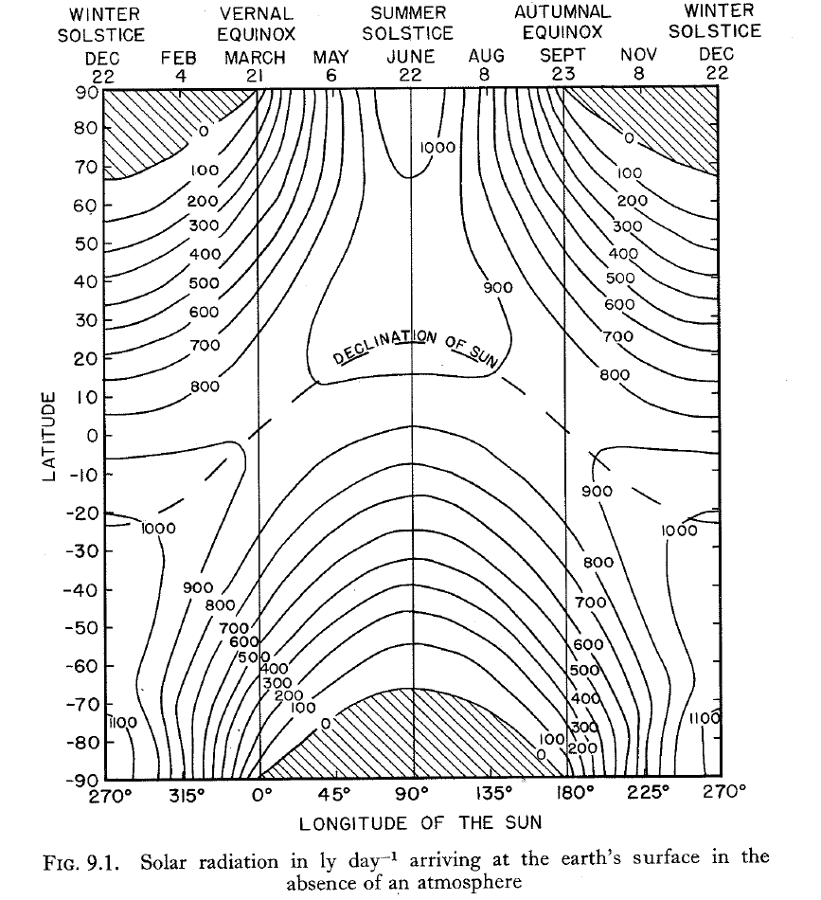

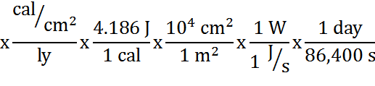

1 W/m²
= 2.064 ly/day
Hess, Seymour, 1959: Introduction to Theoretical Meteorology

Slide 24
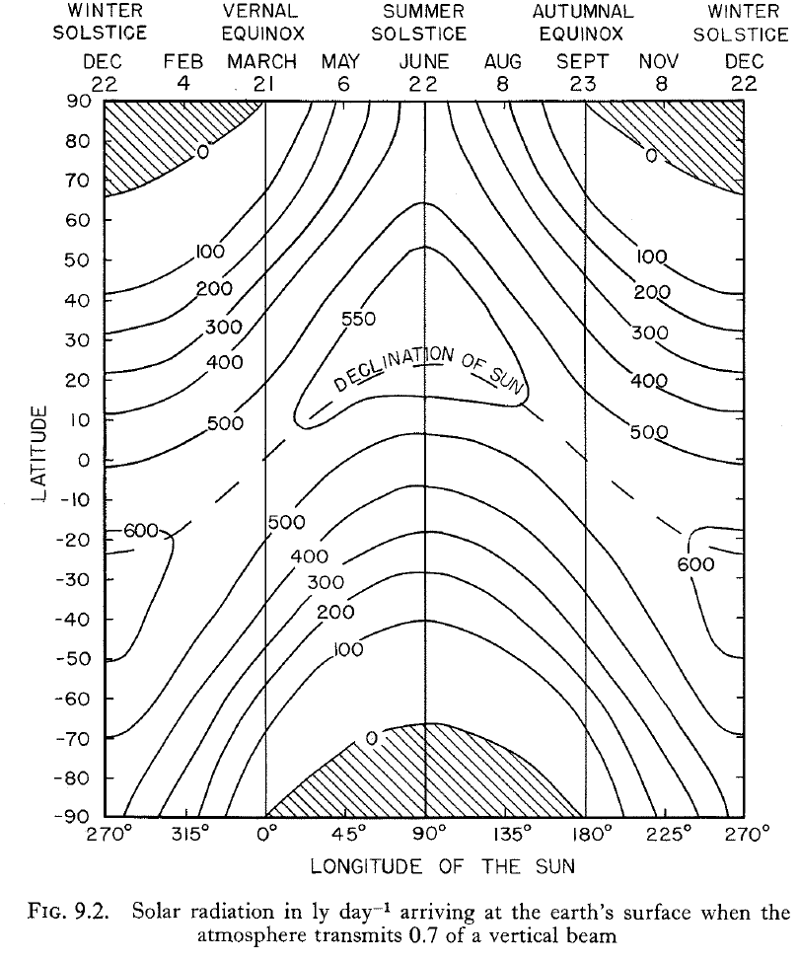
1 W/m²
= 2.064 ly/day
Hess, Seymour, 1959: Introduction to Theoretical Meteorology

Slide 25
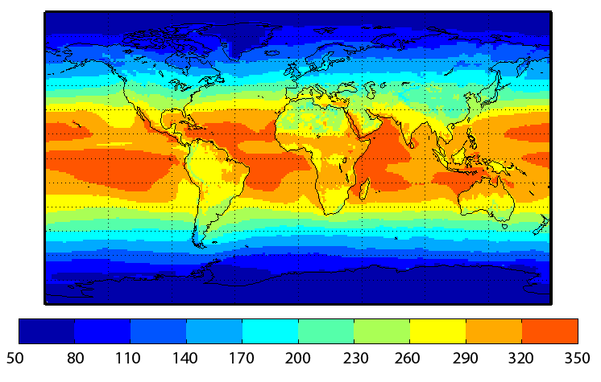
Radiative balance at the top of the atmosphere
Geographical distribution
Annual mean net solar flux at the top of the atmosphere (Wm⁻²)
It is a function of the insolation and of the albedo.
Chapter 2 Page 25

Slide 26
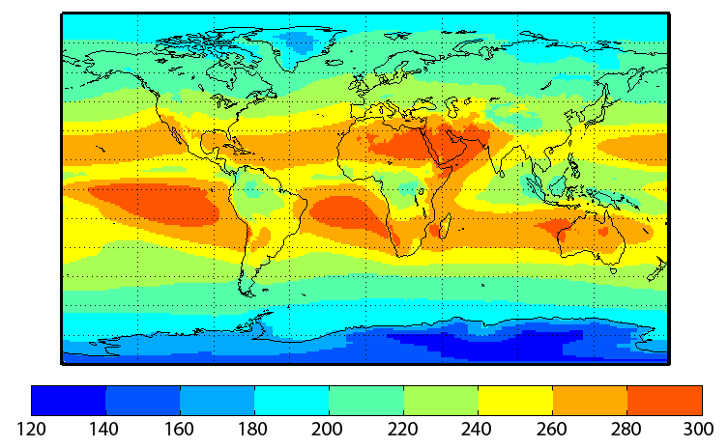
Radiative balance at the top of the atmosphere
Geographical distribution
Net annual mean outgoing longwave flux
at the top of the atmosphere (Wm⁻²)
It is a function of the temperature and of the properties of the atmosphere.

Slide 27
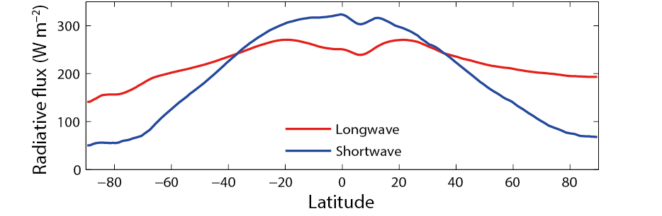
Radiative balance at the top of the atmosphere
Zonal mean of the absorbed solar radiation and the outgoing longwave radiation at the top of the atmosphere in annual mean (in W/m²).
net excess in the radiative flux
net deficit in the radiative flux
Chapter 2 Page 27

Slide 28
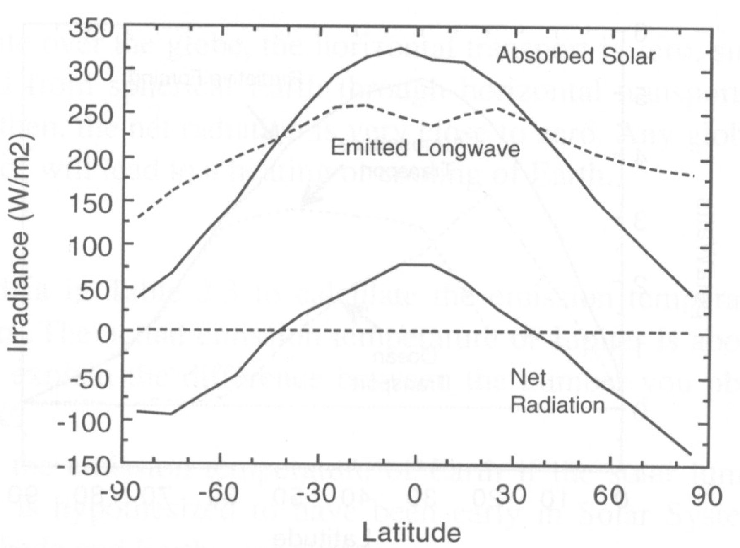
Fig. 2.12. Hartmann, Dennis, 1994: Global Physical Climatology

Slide 29
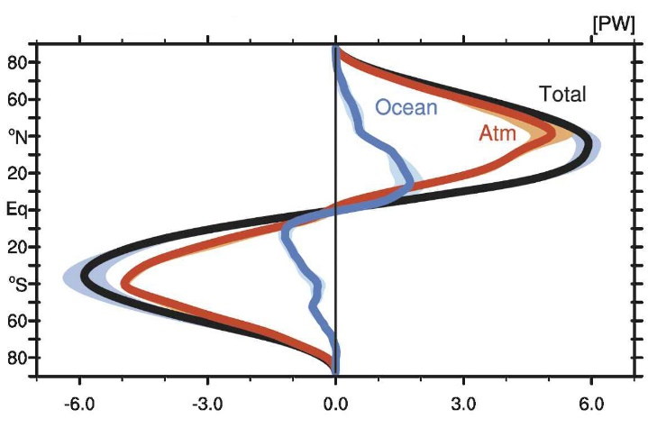
Heat storage and transport
On annual mean, the net heat flux at the top of the atmosphere is balanced by the meridional heat transport.
The heat transport in PW (10¹⁵ W) needed to balance the net radiative imbalance at the top of the atmosphere (in black) and the repartition of this transport in oceanic (blue) and atmospheric (red) contributions. A positive value of the transport on the x axis corresponds to a northward transport. Figure from Fasullo and Trenberth (2008).
Chapter 2 Page 29

Slide 30
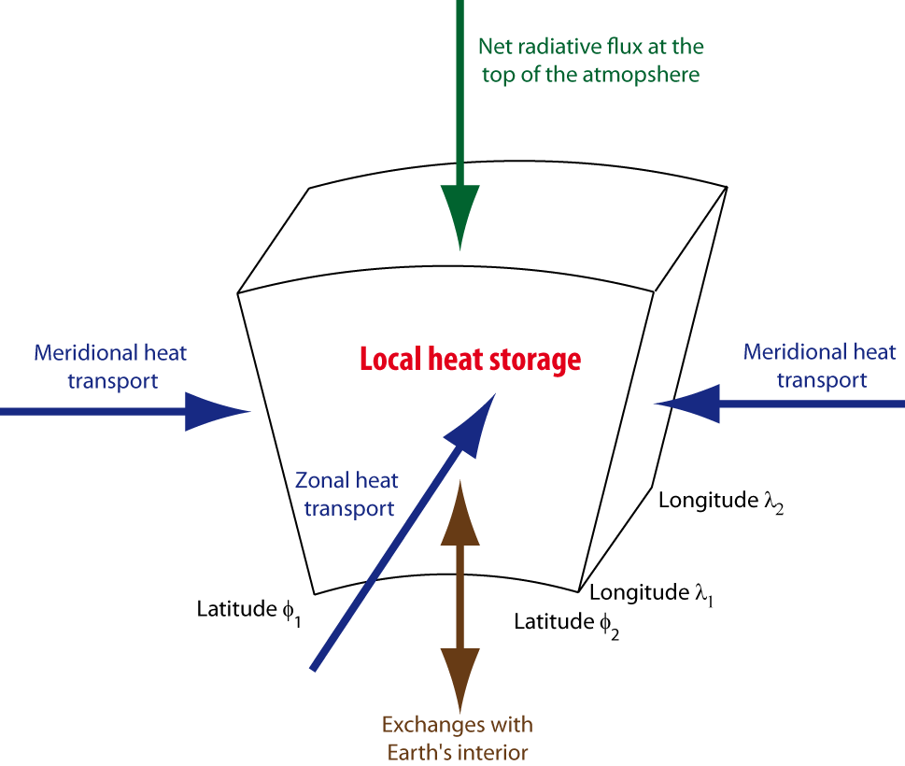
Heat storage and transport
The net radiative heat flux at the top of the atmosphere is mainly balanced by the horizontal heat transport and by changes in the heat storage.
Chapter 2 Page 30

Slide 31
Sensible heat content of a unit mass is c_{p}T, c_{p} = 1004 J/(K kg) [J/kg]
For entire atmosphere, heat capacity (C) is about 10⁷ J K⁻¹ m⁻² (2.30)
For oceans, C = depth x 4.2 x 10⁶ J K⁻¹ m⁻¹ (2.31)
So the entire atmosphere has the heat capacity of about 2 m of water, however about the top 70 m of ocean interacts with the climate system on short time scales.
The heat capacity of land is about equal to 10 cm of water.
Surface energy balance at one point:
(1-α) F_{solar} + F_{IR↓} + F_{IR↑} + F_{SH} + F_{LH} + F_{cond} (2.37)

Slide 32
F_{SH} = wρc_{p}T [W m^{–2}]
F_{LH} = wρLq [W m^{–2}]
where L (latent heat) = 2.5 x 10⁶ J/(kg H₂O).
But the atmosphere is turbulent, and eddies do most of the convection.
c_{h} and c_{L} are drag coefficients, and are about 0.001 over water and 0.003 over land. They are usually assumed to be the same for sensible and latent heat flux. But they depend on atmospheric stability. They are higher for more unstable conditions.
Bowen ratio is the ratio of these 2 fluxes:
B_{o} = F_{SH} /F_{LH}

Slide 33
Heat storage and transport
The heat storage strongly modulates the daily and seasonal cycles.
Amplitude of the seasonal cycle in surface temperature in the Northern Hemisphere measured as the difference between July and January monthly mean temperatures. Data from HadCRUT2 (Rayner et al., 2003).
Chapter 2 Page 33

Slide 34
Heat storage and transport
The horizontal heat transport is also responsible for some temperature differences at the regional scale.
Difference between the annual mean surface temperature and the zonal mean temperature. This difference has been computed as the annual mean temperature measured at one particular point minus the mean temperature obtained at the same latitude but averaged over all possible longitudes.
Data from HadCRUT2 (Rayner et al., 2003).
Chapter 2 Page 34

Slide 35
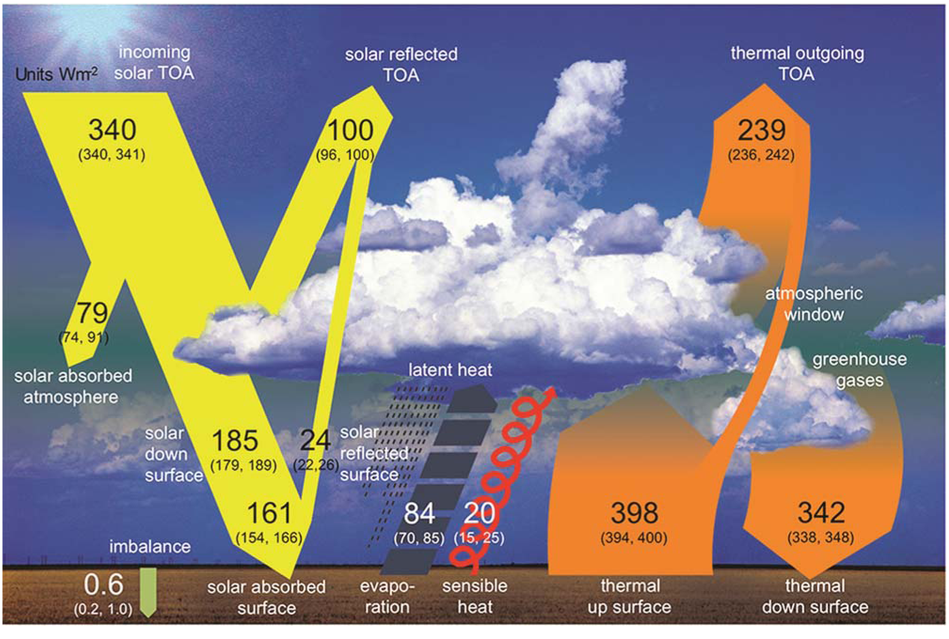
Heat balance at the surface
The numbers represent estimates of each individual energy flux whose uncertainty is given in the parentheses using smaller fonts. Figure from Hartmann et al. (2014) which is adapted from Wild et al. (2013).
Chapter 2 Page 35

Slide 36
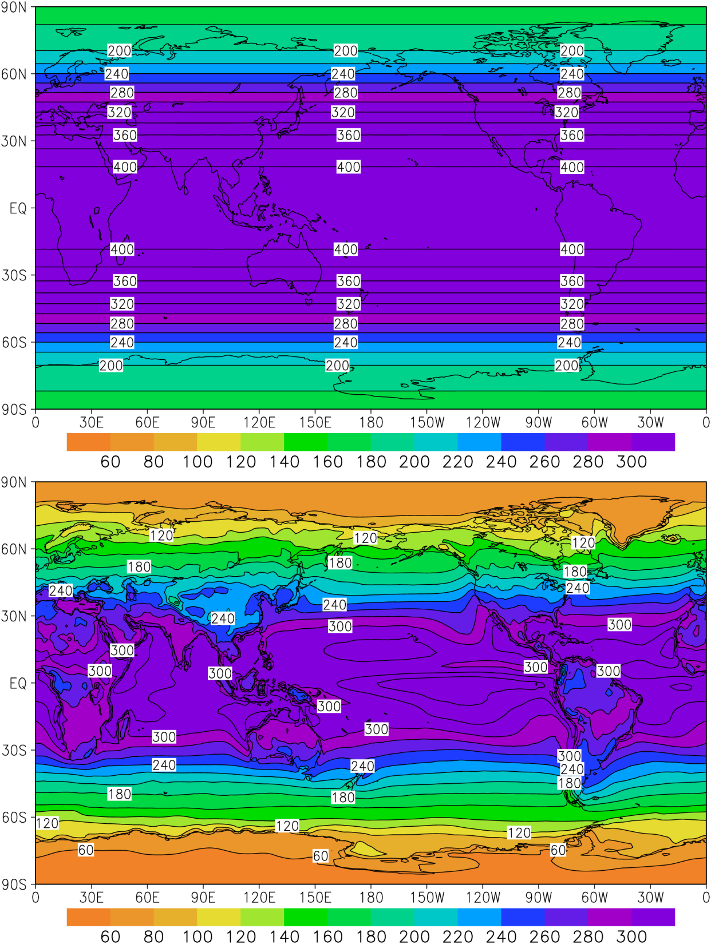
Annual average incident solar radiation (W/m²)
Annual average absorbed solar radiation
at top of atmosphere (W/m²)
Fig. 5.5

Slide 37
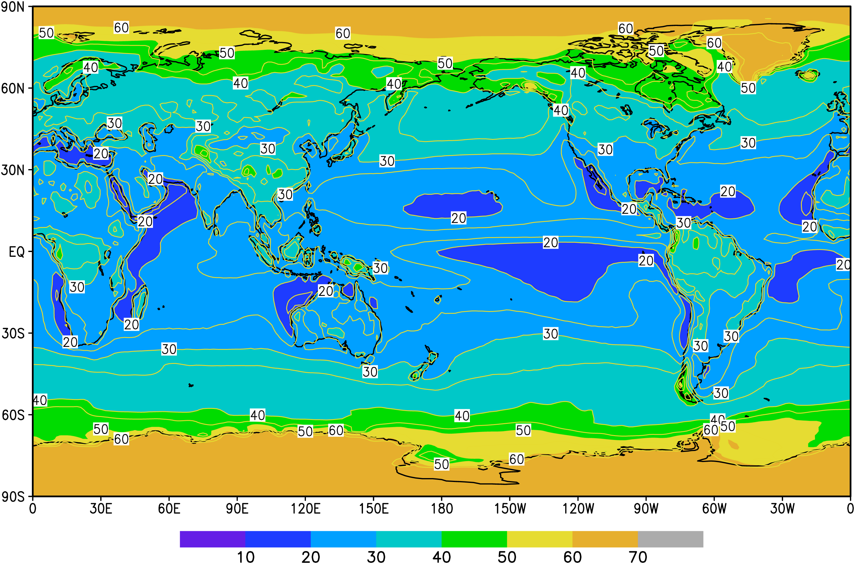
Fig. 5.6
Planetary albedo (%)

Slide 38
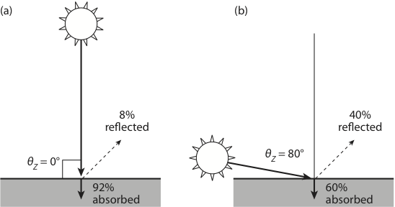
Dependence of water albedo on solar zenith angle, θ_{Z}
Fig. 5.7

Slide 39
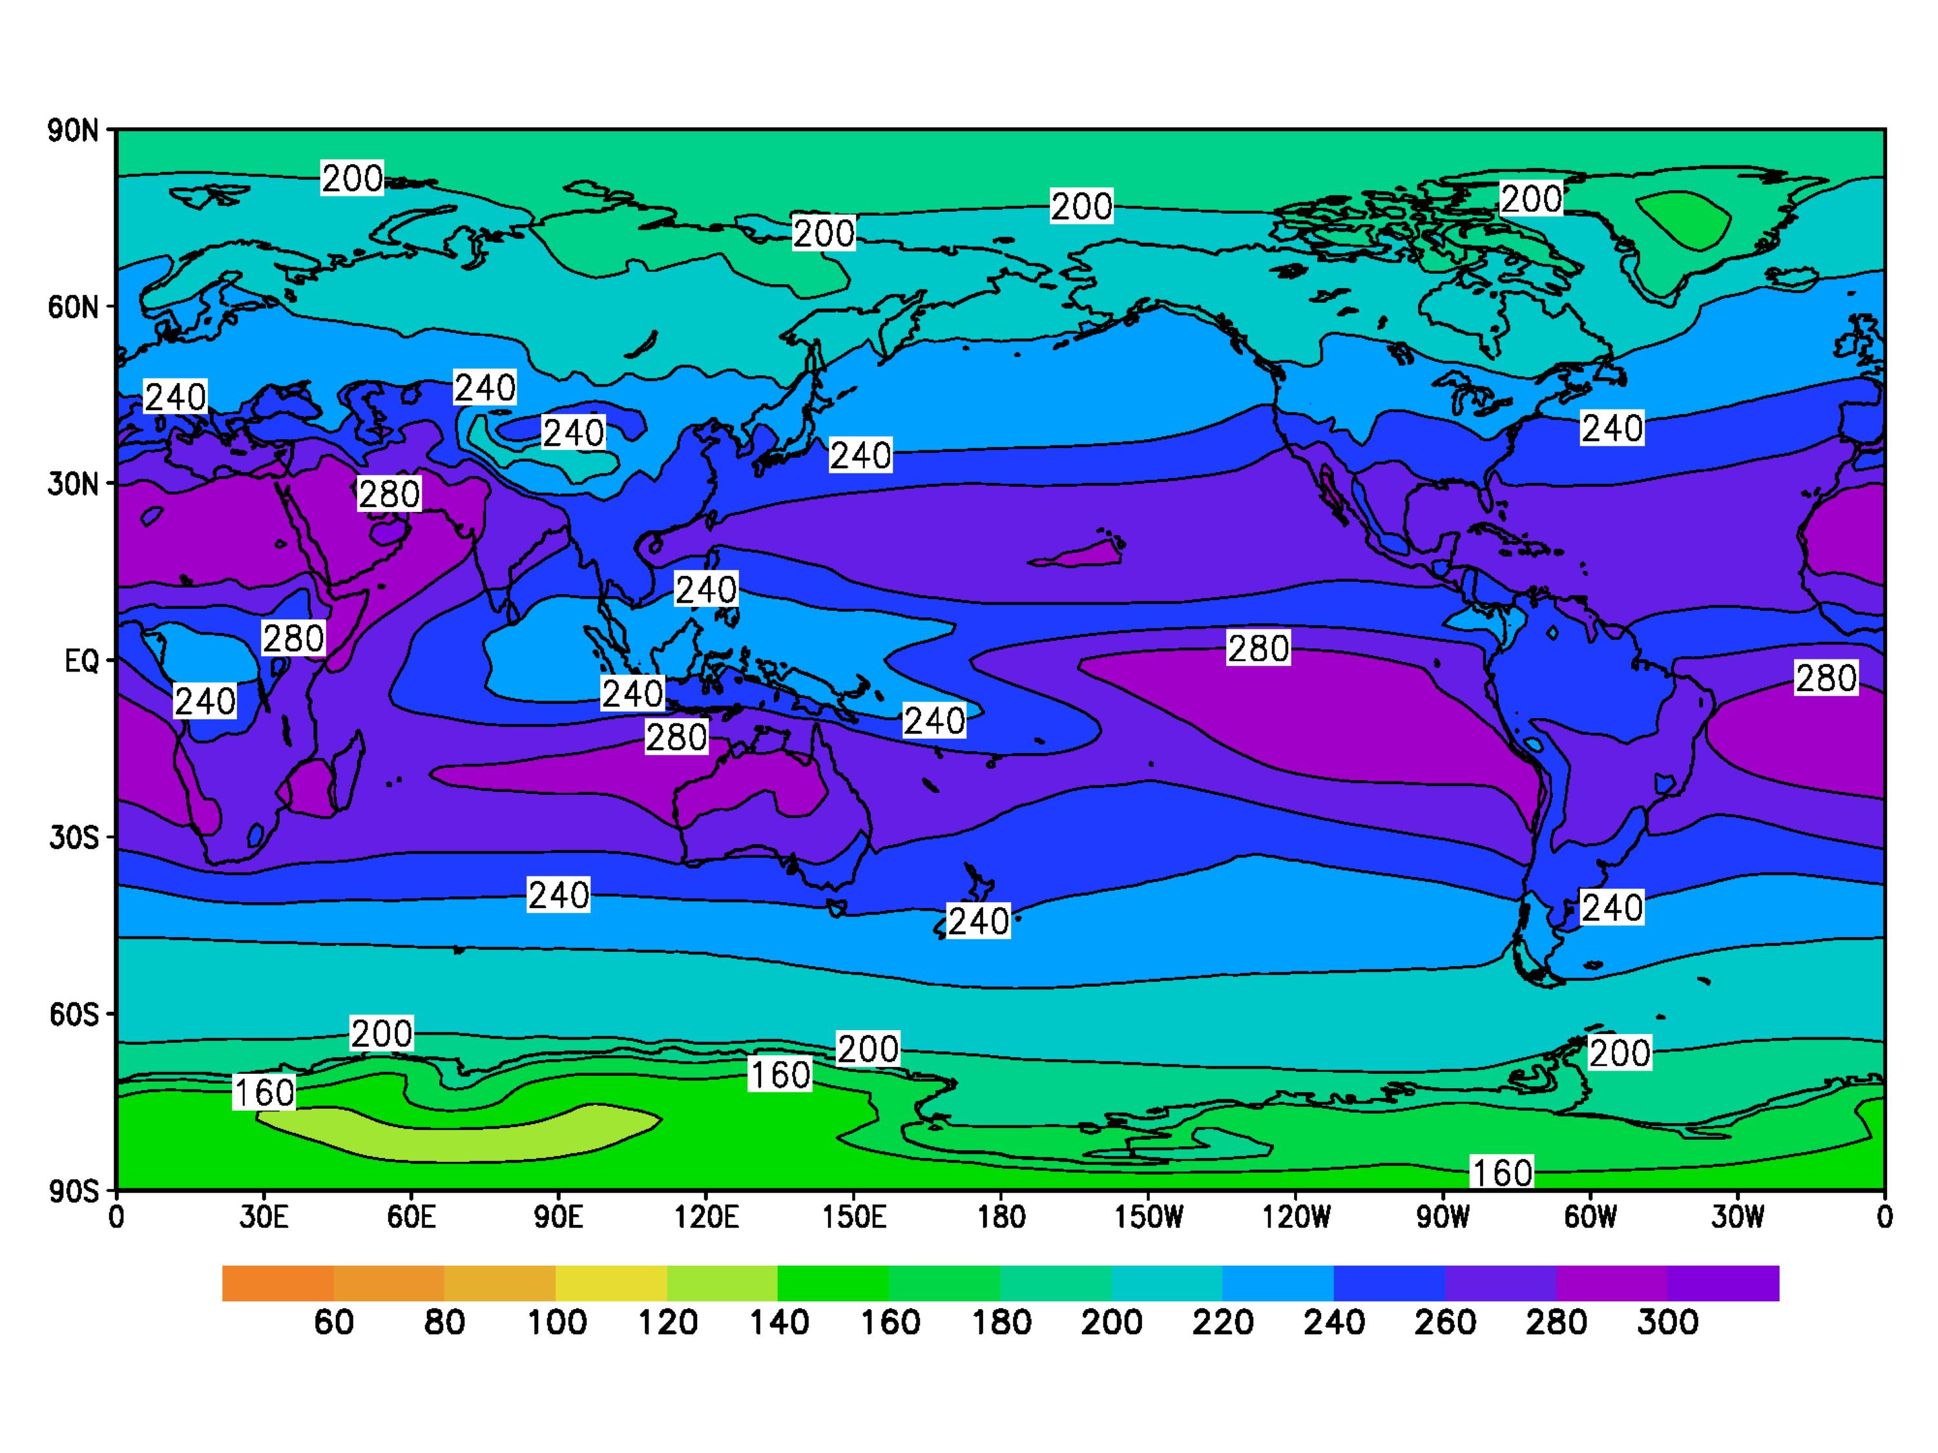
Annual mean outgoing longwave radiation (W/m²)
Fig. 5.8

Slide 40
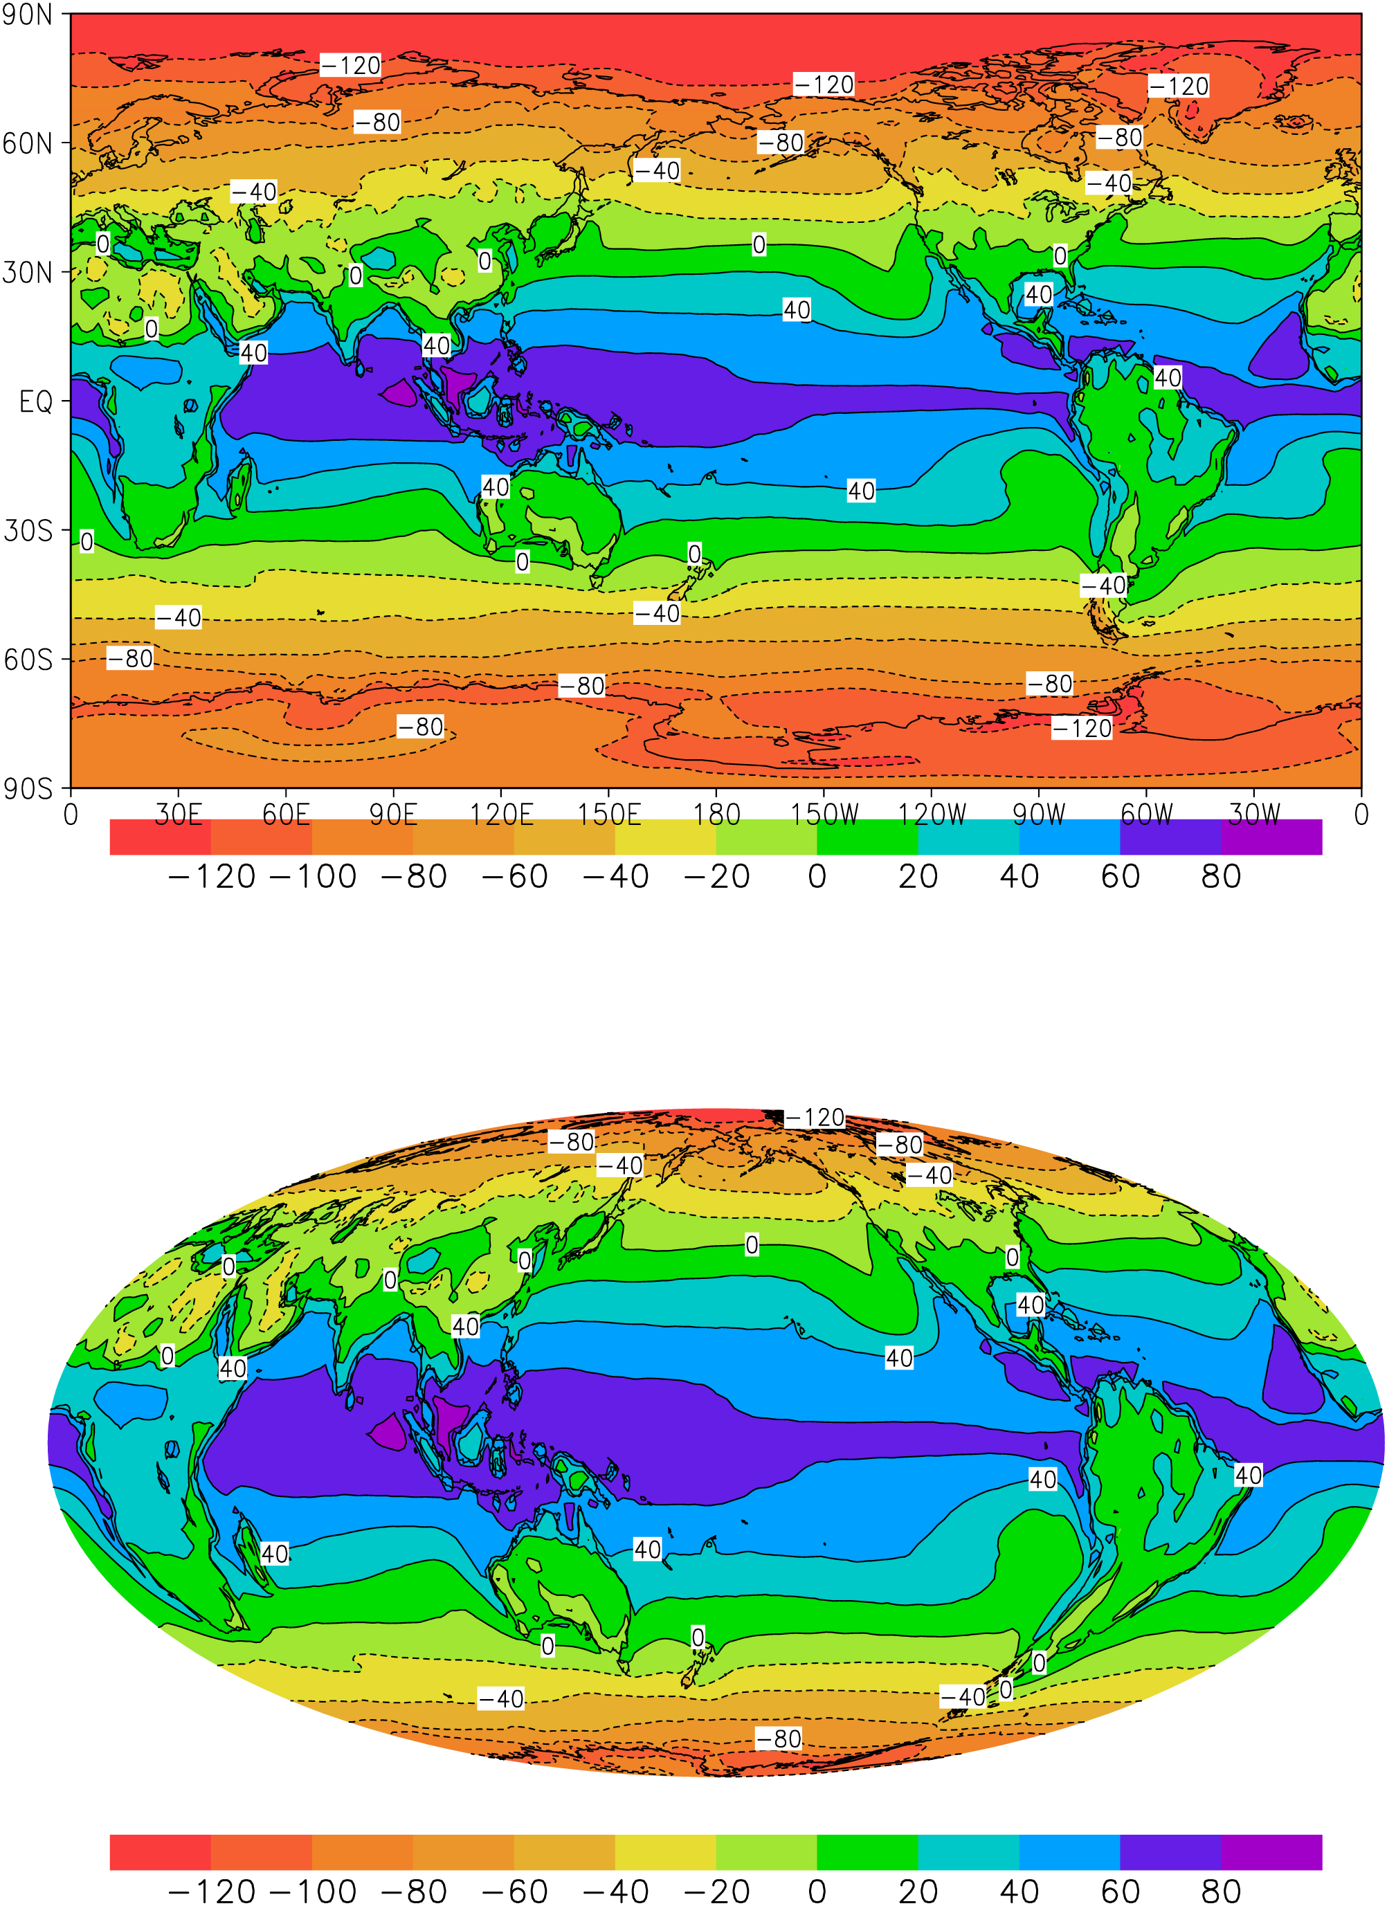
Net radiation at top of atmosphere (W/m²)
Fig. 5.9

Slide 41
Net radiation at top of atmosphere (W/m²)
Fig. 5.9

Slide 42
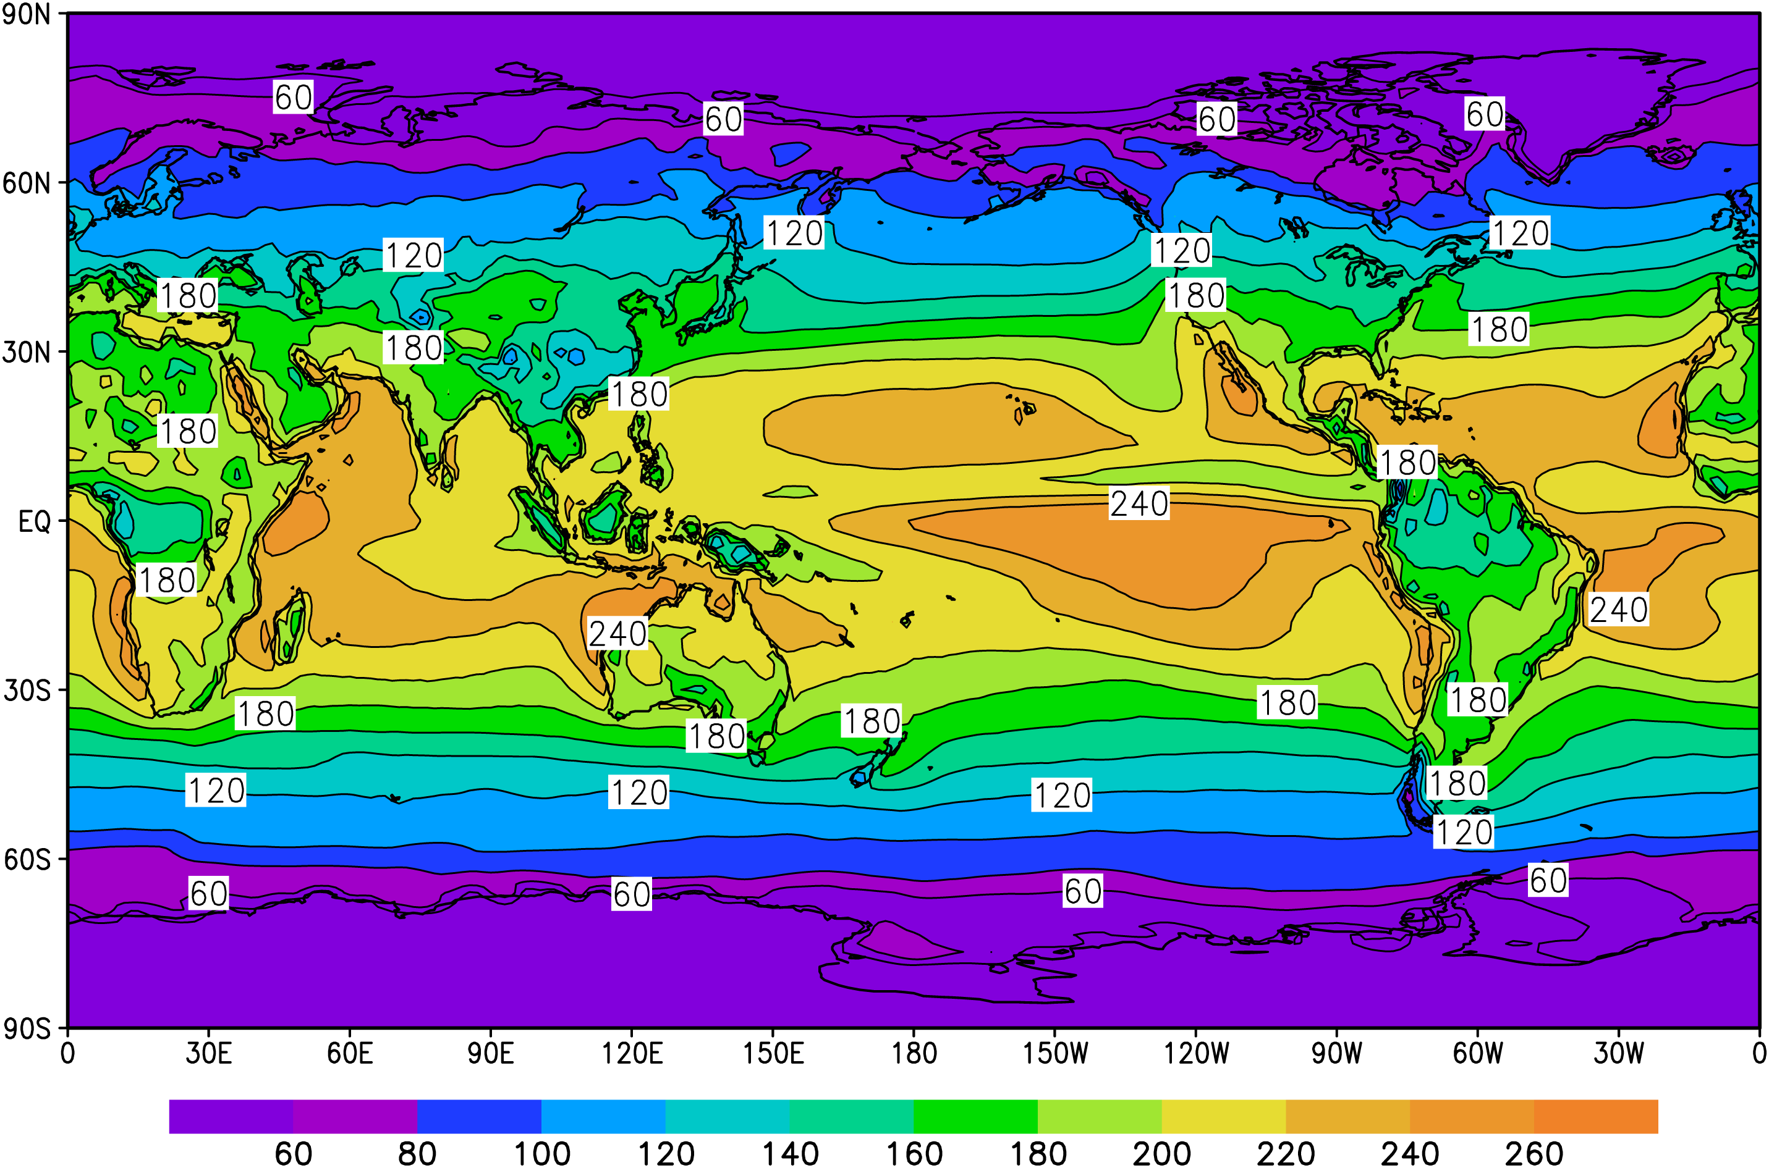
Solar radiation absorbed at surface, S_{ABS} (W/m²)
Fig. 5.10

Slide 43
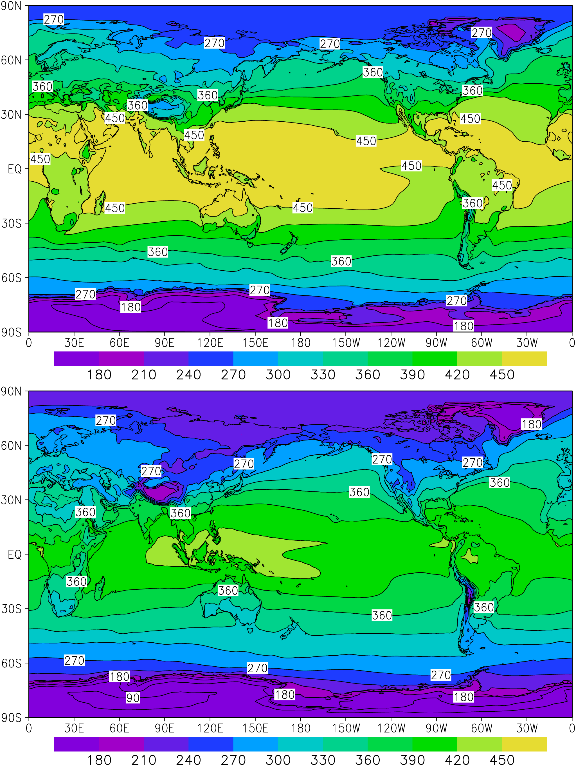
Outgoing longwave radiation at surface, εσT⁴ (W/m²)
Fig. 5.11a

Slide 44
Downward back radiation at surface, F_{BACK} (W/m²)
Fig. 5.11b

Slide 45
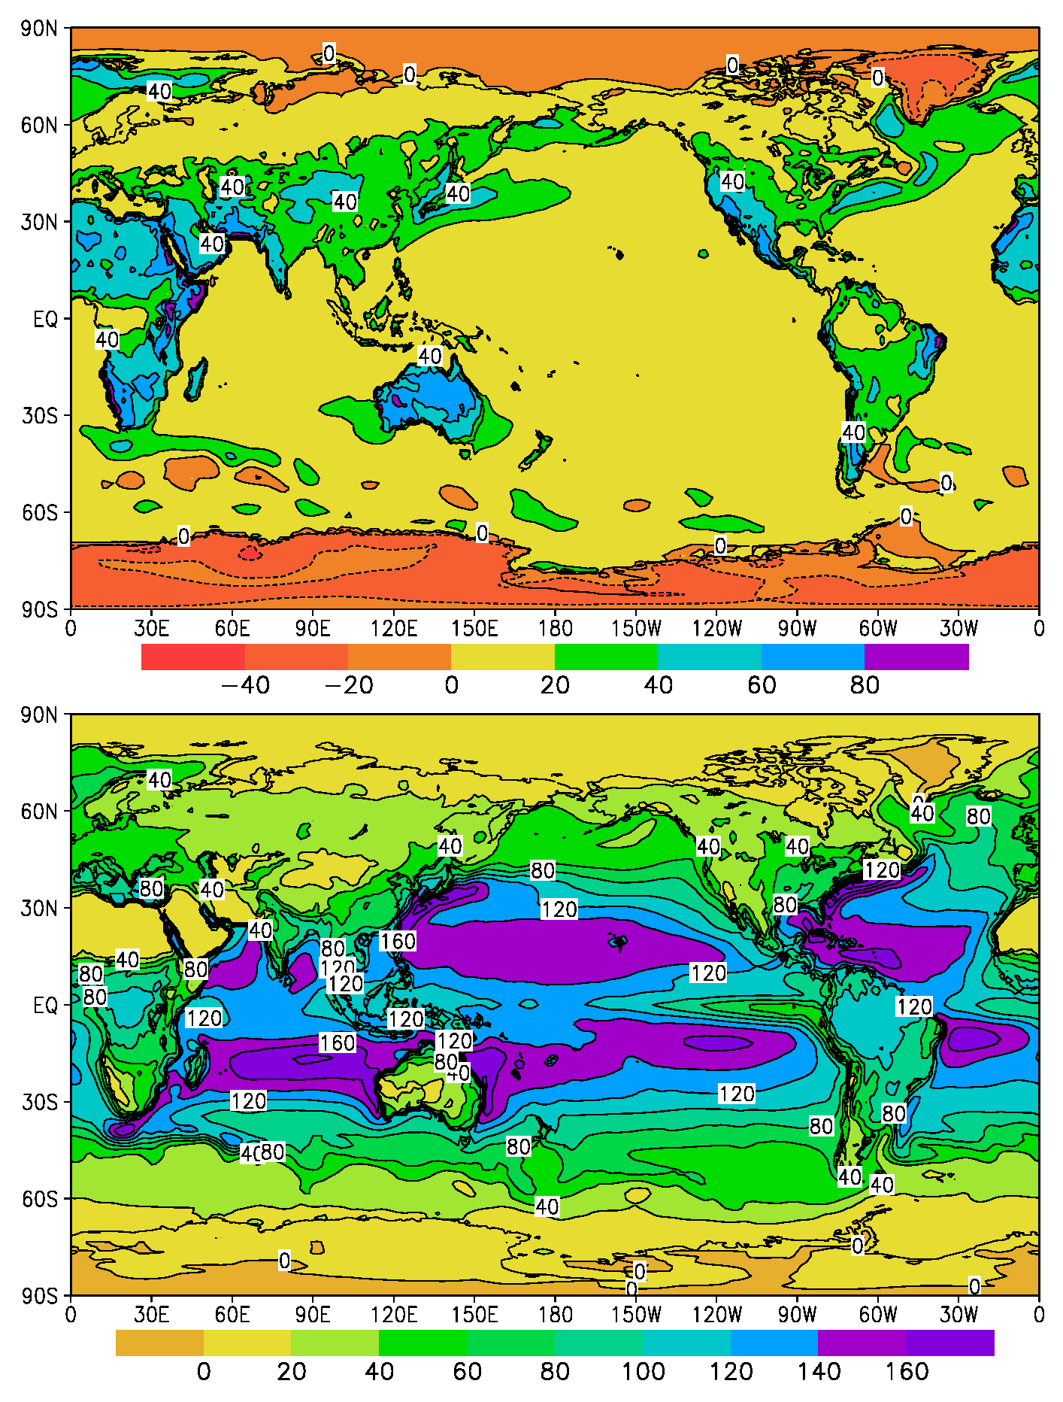
Sensible heat flux at surface, H_{S} (W/m²)
Fig. 5.12a

Slide 46
Latent heat flux at surface, H_{L} (W/m²)
Fig. 5.12b

Slide 47
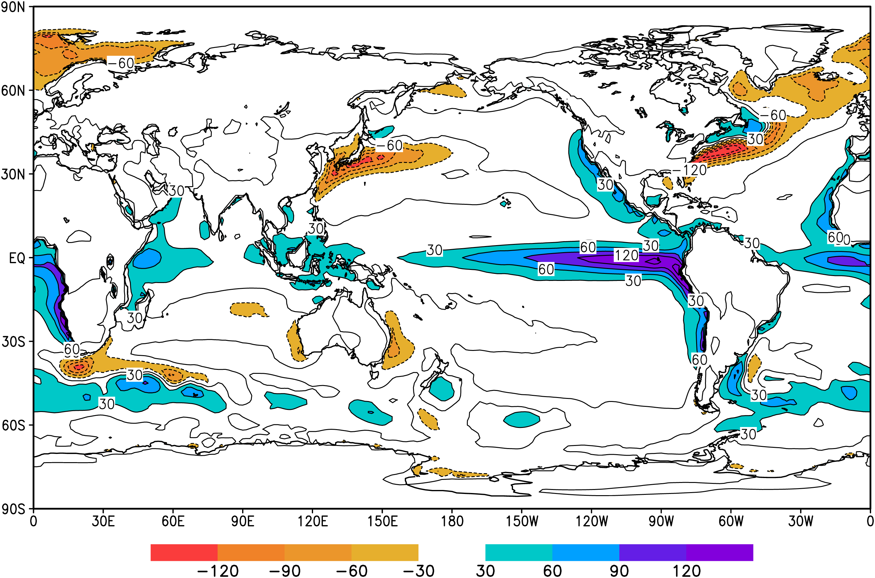
Horizontal and vertical heat fluxes at surface, F_{H} + F_{V} (W/m²)
Fig. 5.13

Slide 48
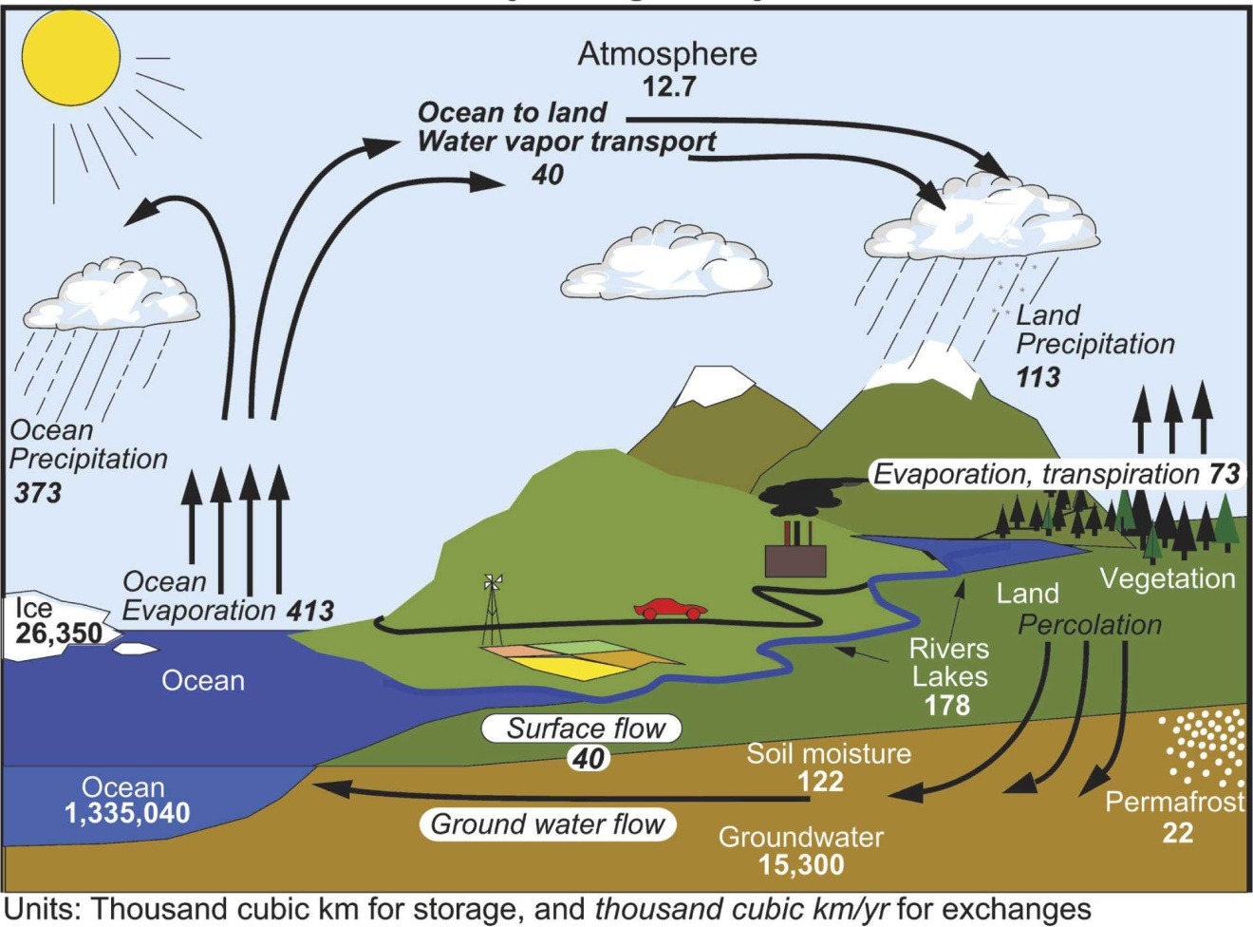
Global water balance
Long-term mean global hydrological cycle
Estimates of the main water reservoirs in plain font (e.g., soil moisture) are given in 10³ km³ and estimates of the flows between the reservoirs in italics (e.g. Surface flow) are given in 10³ km³/year. Figure from Trenberth et al. (2007)

Slide 49
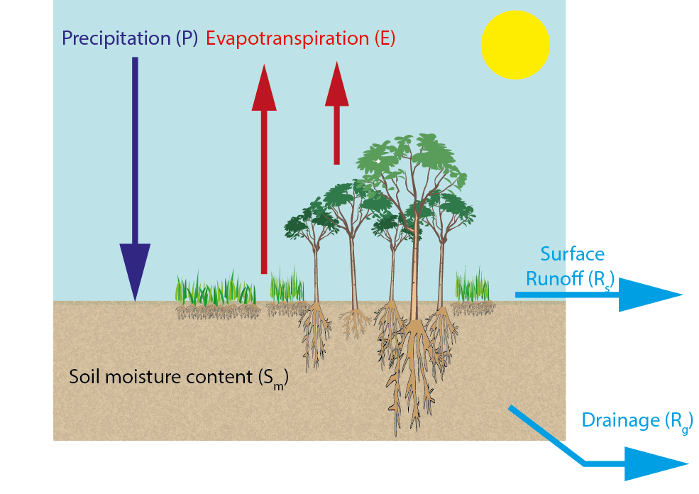
Global water balance
Soil water balance
+ D
P = precipitation rate (rain, snow, hail, sleet)
D = dew and frost rate (not in book – small term in general, but sometimes important)
Figure Modified from Seneviratne et al. (2010).
Chapter 2 Page 49

Slide 50
Standard bucket
gives summer desiccation
Mitchell and Warrilow (1987) midlatitude soil moisture seasonal cycles
for current and 2xCO₂
No infiltration for frozen soil gives no summer desiccation

Slide 51
water depth (cm)
50 Total Capacity
35 Field Capacity
15 Wilting Level
0
GRAVITY
AVAILABLE
UNAVAILABLE
1 m
SOIL

Slide 52
1. Soil moisture affects the surface energy balance and surface temperature by affecting:
    latent heat flux, and hence sensible heat flux
    surface albedo
2. Soil moisture affects evaporation and precipitation. Month to month variations of soil moisture are as large as the other terms in the hydrologic balance, namely precipitation, evaporation, and runoff. Perhaps half of all precipitation is recycled water from the land.
3. Hence accurate soil moisture observations are needed for better weather forecasts.
Why study soil moisture?

Slide 53
Why study soil moisture?
4. Soil moisture affects runoff, and hence the thermohaline circulation of the ocean.
5. Soil moisture is the source of water for agricultural and natural vegetation.
6. Drought is a soil moisture deficiency.
7. Flooding is a soil moisture excess.
8. Soil moisture is the most important component of memory for the climate system over the land, and hence correct observation and modeling of soil moisture will lead to improved seasonal forecasts.

Slide 54
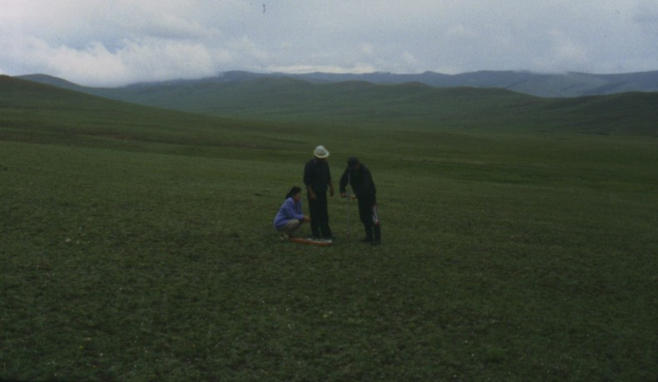
Soil moisture observations in Mongolia, 1999

Slide 55
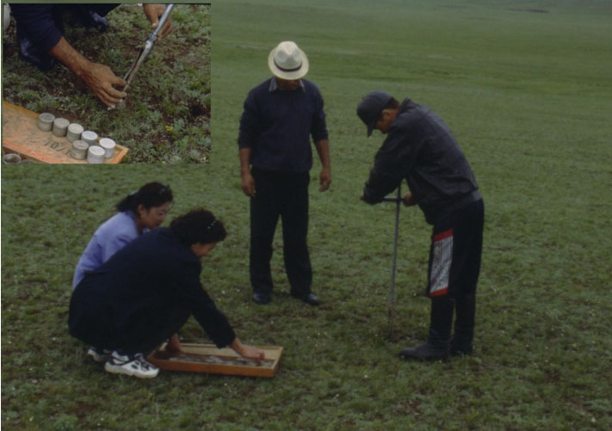

Slide 56
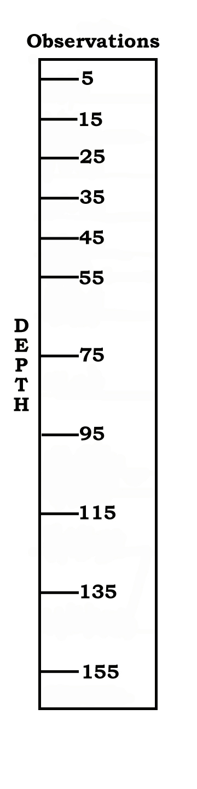
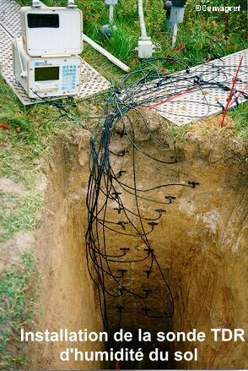
Boissy-le-Châtel
Hydrological station in the Orgeval catchment of the Seine Basin at 48.8°N, 3.1°E.
Twice daily soil moisture reading at 11 levels, from November 1996 - present
Uses TDR probe to measure soil moisture, which is calibrated with gravimetric readings.
(cm)

Slide 57
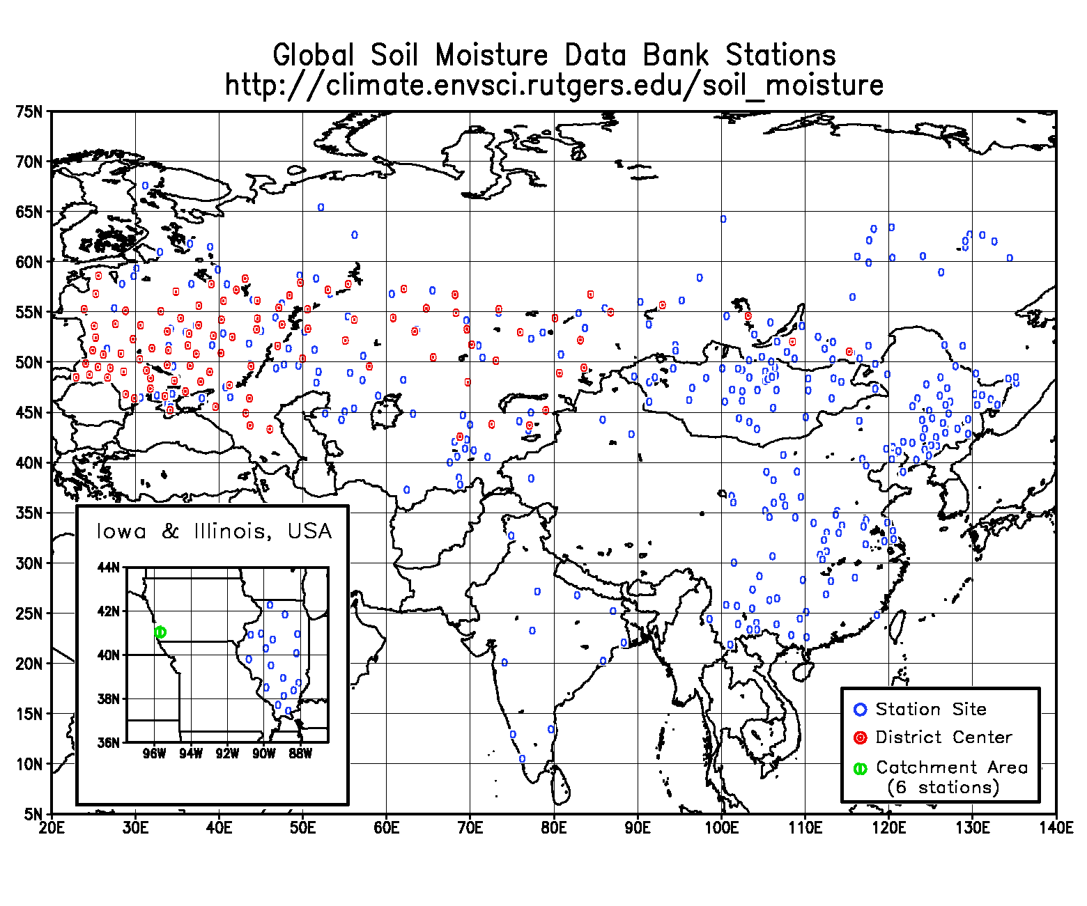
Ukraine: Now updated through 2004
Russia: Now being updated through 2003
Mongolia: Now updated through 2003
China: Now updated through 1999
India: Now updated through 1999
Data have been transitioned to the International Soil Moisture Network, http://ismn.geo.tuwien.ac.at/ismn/

Slide 58
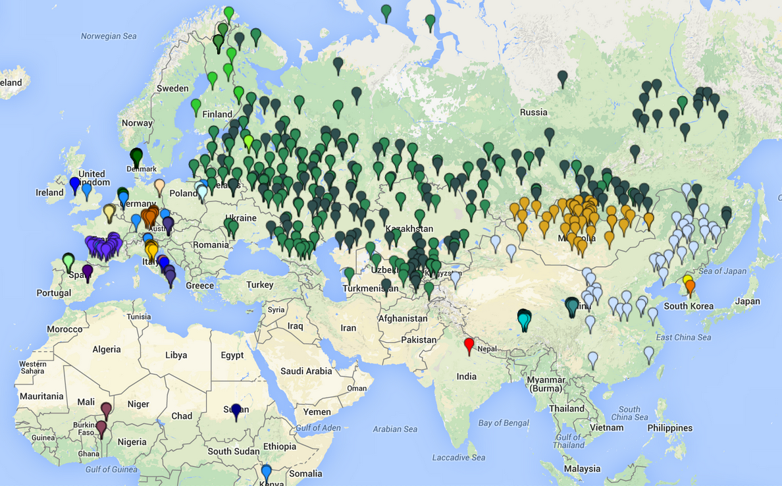
Eurasian soil moisture data available at the International Soil Moisture Network, http://ismn.geo.tuwien.ac.at/ismn/

Slide 59
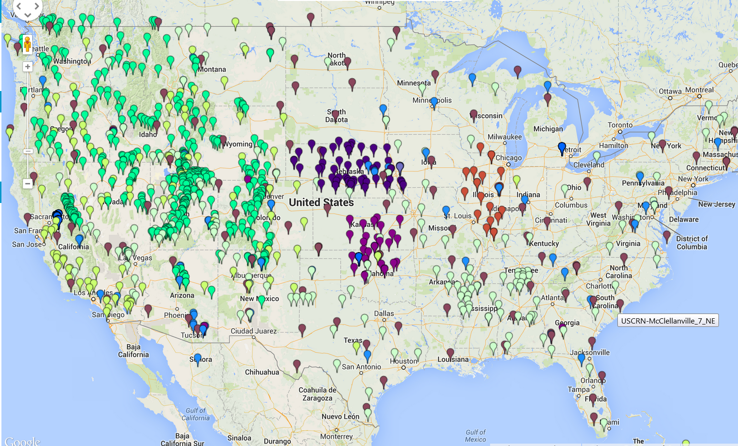
U.S. soil moisture data available at the International Soil Moisture Network, http://ismn.geo.tuwien.ac.at/ismn/

Slide 60
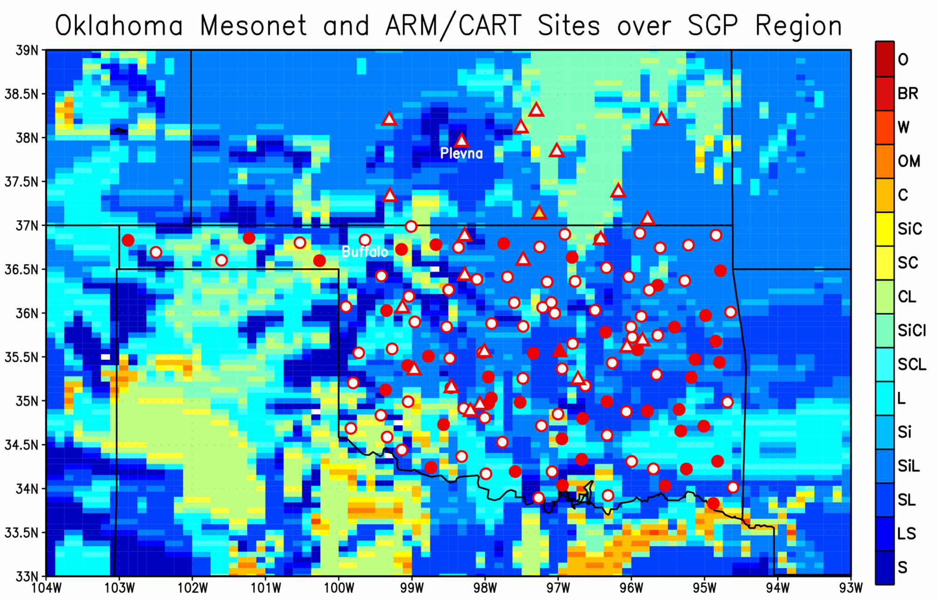
ARM/CART
Mesonet
Mesonet with soil moisture and soil temperature observations
In addition, the Oklahoma Mesonet has more than 100 stations. All now include soil moisture observations.

Slide 61
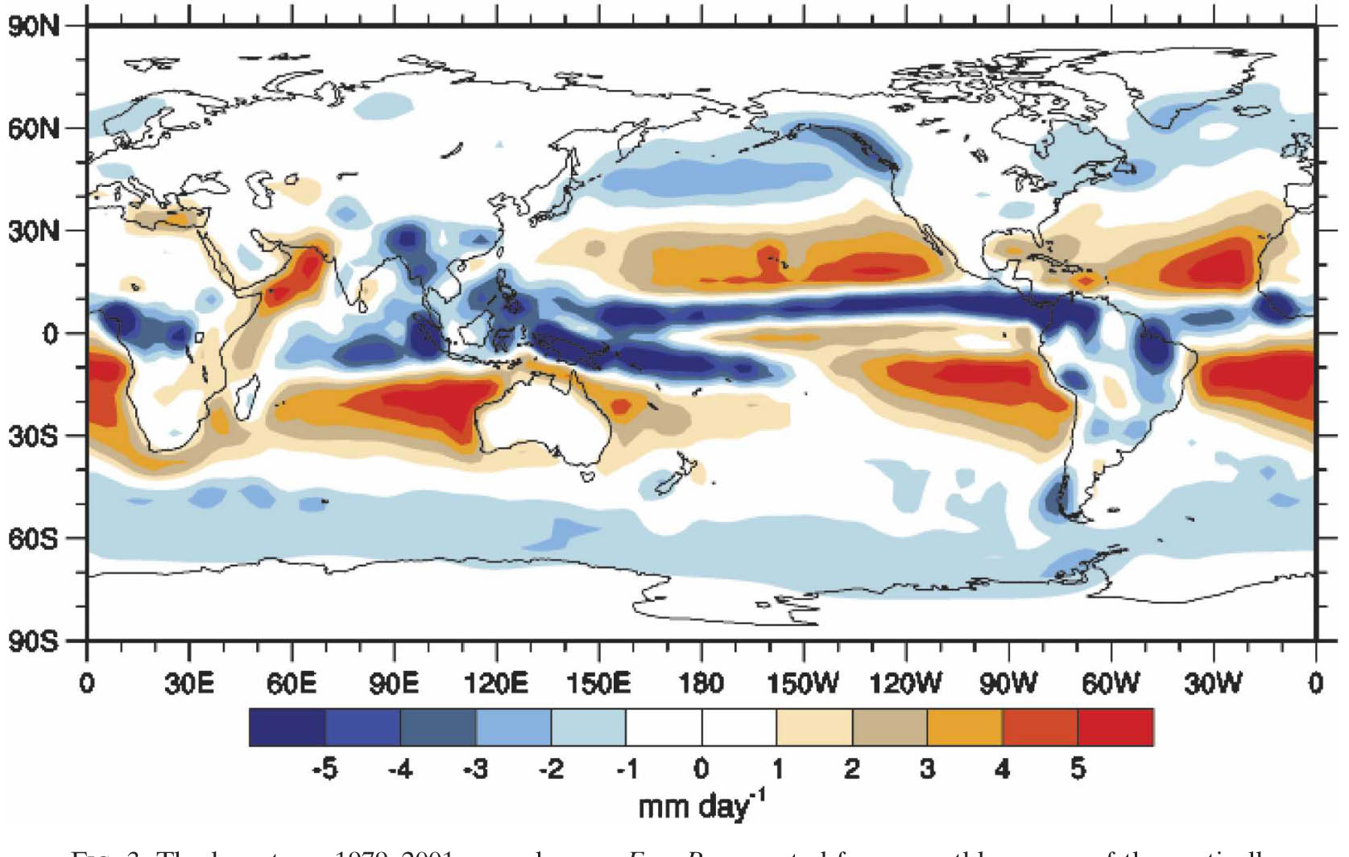
Global water balance
Water balance at the ocean surface
Long term annual mean evaporation minus precipitation (E-P) budget based on ERA-40 reanalyses. Figure from Trenberth et al. (2007).
Chapter 2 Page 61

Slide 62
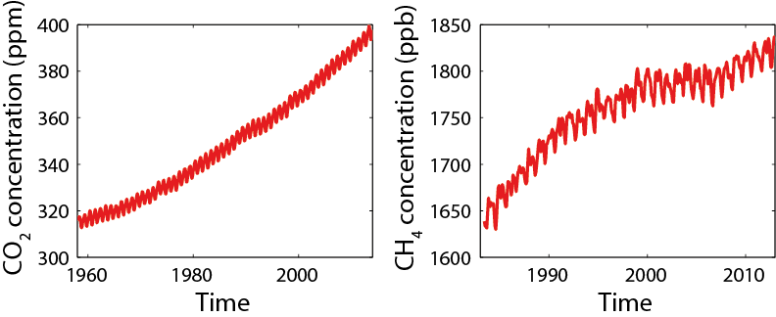
The carbon cycle
CO₂ and CH₄ are two important greenhouse gases.
CO₂ and CH₄ concentration at Mauna Loa observatory.
Sources: Dr. Pieter Tans, NOAA/ESRL (www.esrl.noaa.gov/gmd/ccgg/trends/) and Dr. Ralph Keeling, Scripps Institution of Oceanography (scrippsco2.ucsd.edu/), the NOAA Annual Greenhouse Gas Index (AGGI) (http://www.esrl.noaa.gov/gmd/aggi/), Dlugokencky et al. (2013).

Slide 63
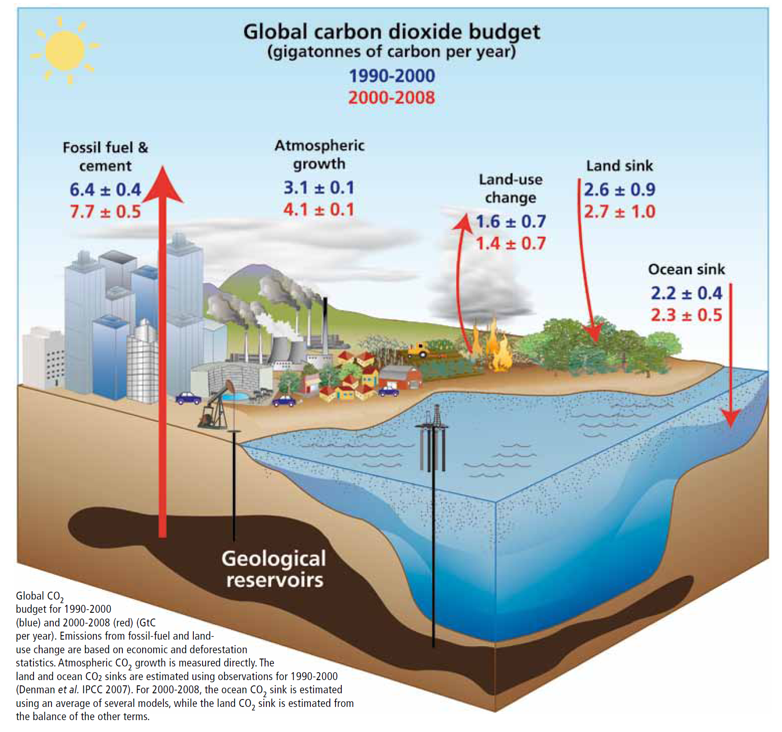
Closing the global
budget for CO₂
Corinne Le Quéré
Global Change, Issue 74, Winter 2009, 28-31.
http://www.igbp.net/documents/NL74-global_CO2_budget.pdf

Slide 64
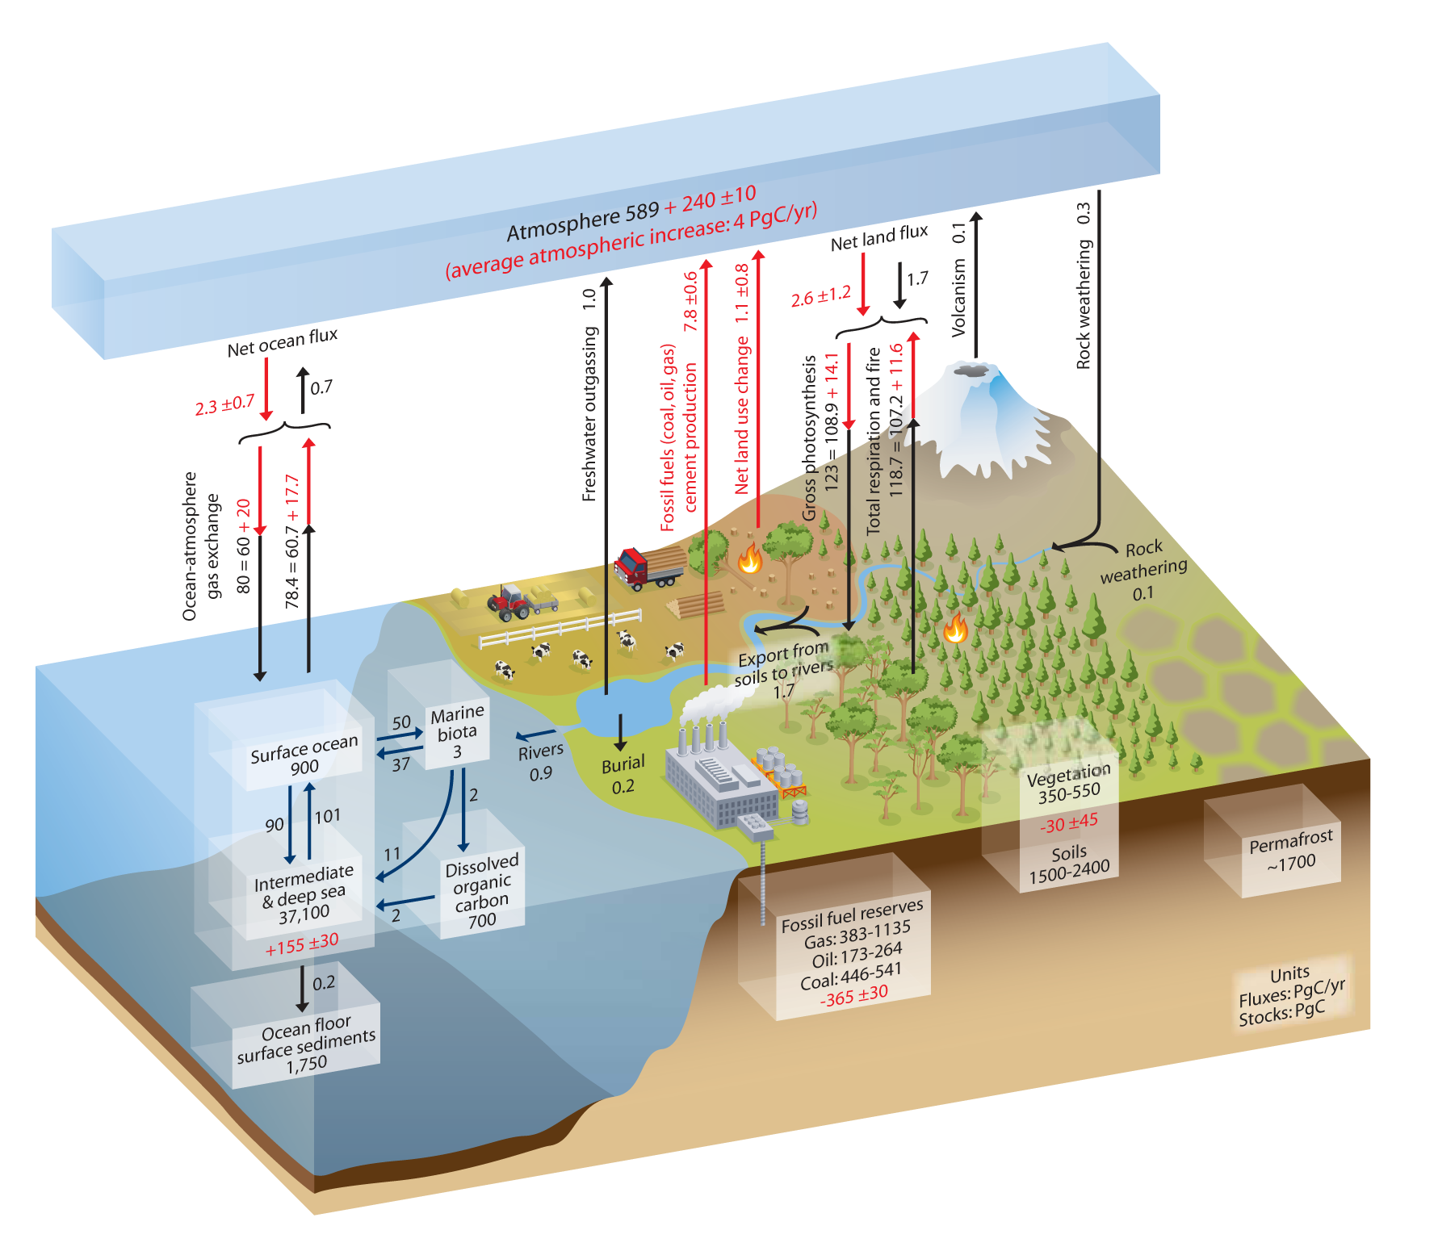
The carbon cycle
Overview
The annual fluxes are in PgC yr^{–1} , the carbon stocks in the reservoirs are given in PgC. Pre-industrial ‘natural’ fluxes are in black and ‘anthropogenic’ fluxes averaged over the 2000–2009 in red. Figure from Ciais et al. (2014).

Slide 65
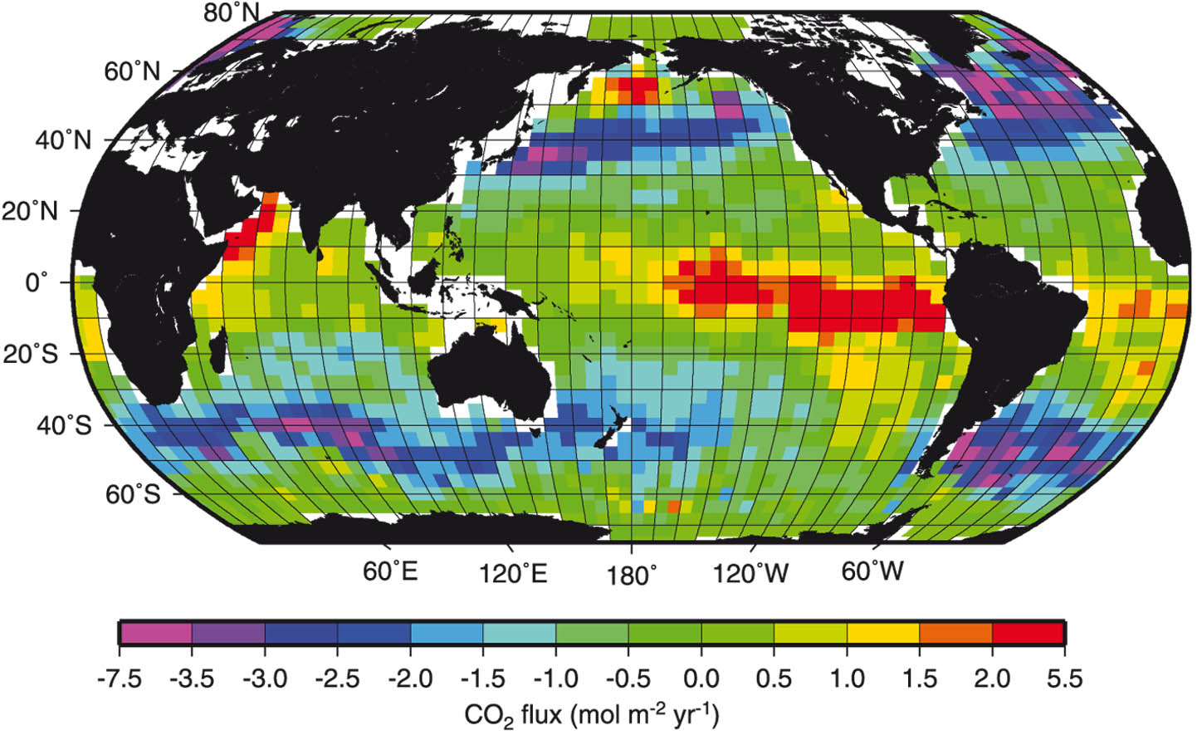
The oceanic carbon cycle
  The CO₂ flux from the ocean to the atmosphere is proportional to the difference of partial pressure ( p^{CO2} ) between the two media:
  Subscripts A and W refer to the air and the water, respectively. k^{CO2} is a transfer coefficient.
Estimates of sea-to-air flux of CO₂ (Denman et al. (2007), based on the work of T. Takahashi ).
Chapter 2 Page 65

Slide 66
The oceanic carbon cycle
  The inorganic carbon cycle: balance between carbonic acid (H₂CO₃), bicarbonate ( ) and carbonate ions ( )
  The sum of the concentration of these three forms of carbon is referred to as the Dissolved Inorganic Carbon (DIC):
Chapter 2 Page 66

Slide 67
The oceanic carbon cycle
  K_{H}, the solubility of CO₂ , relates the amount of the carbonic acid to the pCO₂ at equilibrium.
  K_{H} is a strong function of the temperature.
  At equilibrium, 90% of the dissolved inorganic carbon is in the form of bicarbonate, around 10% in carbonate form while carbonic acid represent only 0.5% of the DIC:
  Important for carbon storage in the ocean.
Chapter 2 Page 67

Slide 68
The oceanic carbon cycle
  The alkalinity Alk is defined as the excess of bases over acid in water:
  where is the concentration of the borate ion.
  The total alkalinity is dominated by the influence of bicarbonate and carbonate ions.
  Conversely, changes in total alkalinity have a strong influence on the equilibrium of the reactions between the different carbon species.
Chapter 2 Page 68

Slide 69
The oceanic carbon cycle
  Biological pumps: the soft tissue pump
  During photosynthesis, phytoplankton uses solar radiation to form organic matter from CO₂ and water:
  The organic matter can be dissociated to form inorganic carbon by respiration and remineralisation of dead phytoplankton and detritus.
  A fraction of the organic matter is exported downward out of the surface layer.
Chapter 2 Page 69

Slide 70
The oceanic carbon cycle
  Biological pumps: the carbonate pump
  Calcium carbonate, is produced by different species :
  This production influences both the DIC and the Alk and thus has a large influence on the carbon cycle.
  The dissolution of calcite and aragonite occurs mainly at depths, following the falling of particles and dead organism.
Chapter 2 Page 70

Slide 71
The oceanic carbon cycle
  The solubility pump
  The “solubility pump” is associated with the sinking at high latitude of cold surface water to great depth.
  This cold water characterized by a relatively high solubility of CO₂ and thus high DIC.
Chapter 2 Page 71

Slide 72
The oceanic carbon cycle
  Because of those three pumps, DIC is about 15% higher at depth than at surface, inducing lower atmospheric CO₂ concentration compared to an homogenous ocean.
  When deep water upwells to the surface, CO₂ will have the tendency to escape from the ocean because of the high DIC. But this is partly compensated by biological activity.
Chapter 2 Page 72

Slide 73
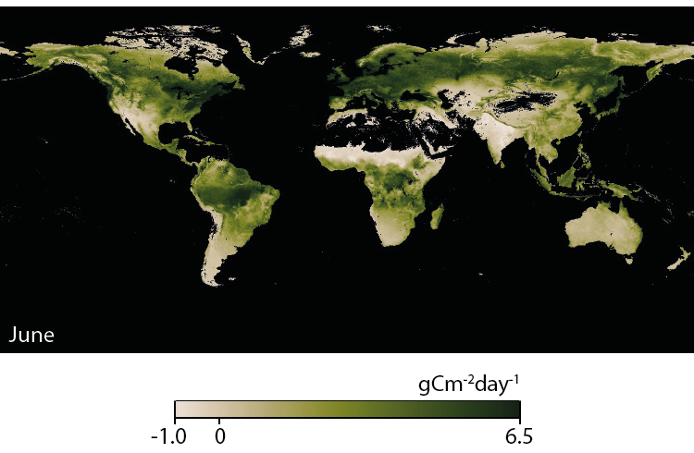
The terrestrial carbon cycle
  The photosynthesis by land plants has a strong seasonal cycle.
Net productivity over land in June 2014 based on Terra/MODIS satellite data.
Source: NASA Earth Observations.
Chapter 2 Page 73

Slide 74
Geological reservoirs
  A fraction of the of CaCO₃ produced in the ocean is buried in the sediments to produce limestone, mainly in shallow seas.
  During the subduction, limestone is transformed into calcium-silicate rocks (metamorphism) by the reaction:
  The CO₂ that is realised by this reaction can return to the atmosphere, in particular through volcanic eruptions.
Chapter 2 Page 74

Slide 75
Geological reservoirs
  If the calcium-silicate rocks are uplifted to the continental surface, they are affected by physical and chemical weathering.
  The products of this reaction are transported by rivers to the oceans where they could compensate for the net export of CaCO₃ by sedimentation.
  The weathering tends thus to reduce atmospheric CO₂ by taking up carbonic acid to make CaCO₃ and increasing ocean alkalinity.
Chapter 2 Page 75

Slide 76
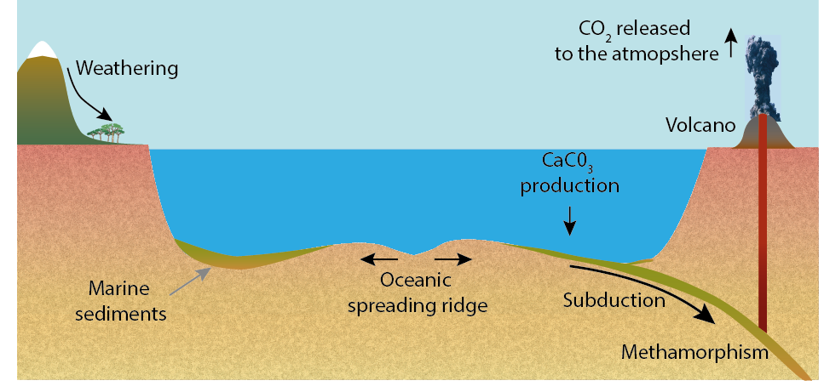
Geological reservoirs
  Those equations describes the ‘long term inorganic carbon cycle” .
  Sedimentation
  Metamorphism
  Weathering

Slide 77
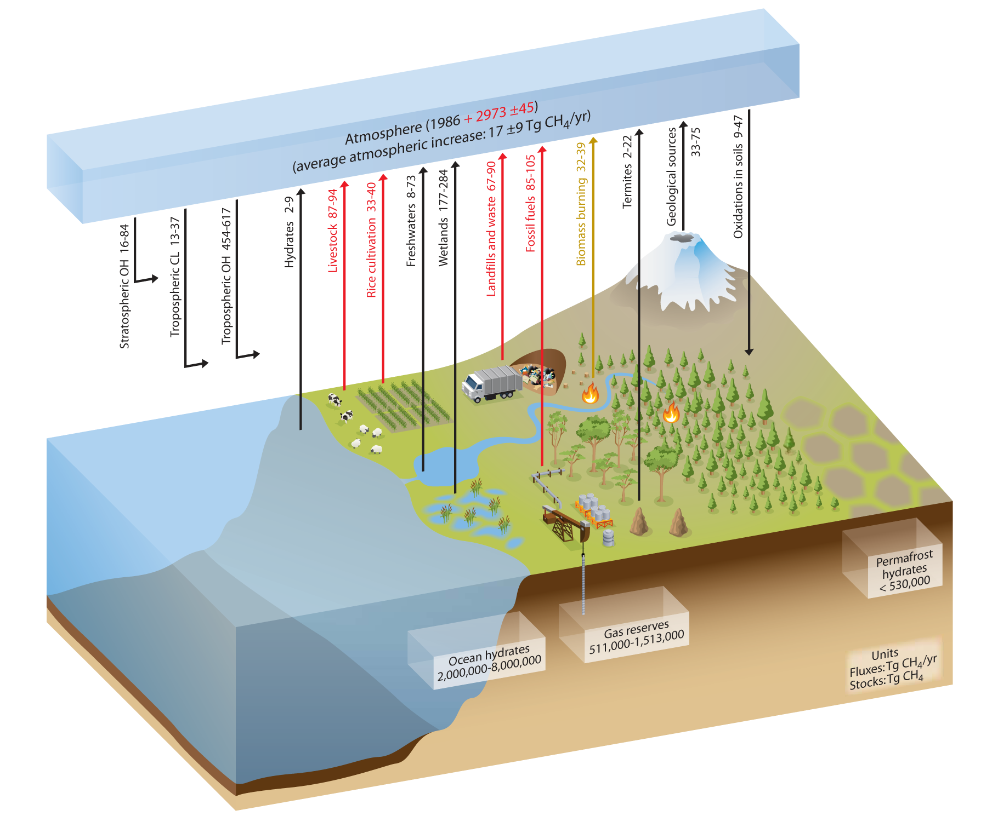
Methane cycle
  Overview
The annual fluxes are in Tg(CH₄) yr^{–1} for the period 2000–2009 and CH₄ reservoirs are in Tg(CH₄). Black arrows denote the natural fluxes red arrows the anthropogenic fluxes, and the light brown arrow denotes a combined natural + anthropogenic flux. Figure from Ciais et al. (2014).

Slide 78
Methane cycle
  The observed atmospheric methane concentration results from the balance between sources and sinks due to methane oxidation.
  This reaction requires the presence of highly reactive constituents such as the hydroxyl radical (OH) .
Chapter 2 Page 78

