Slide 1
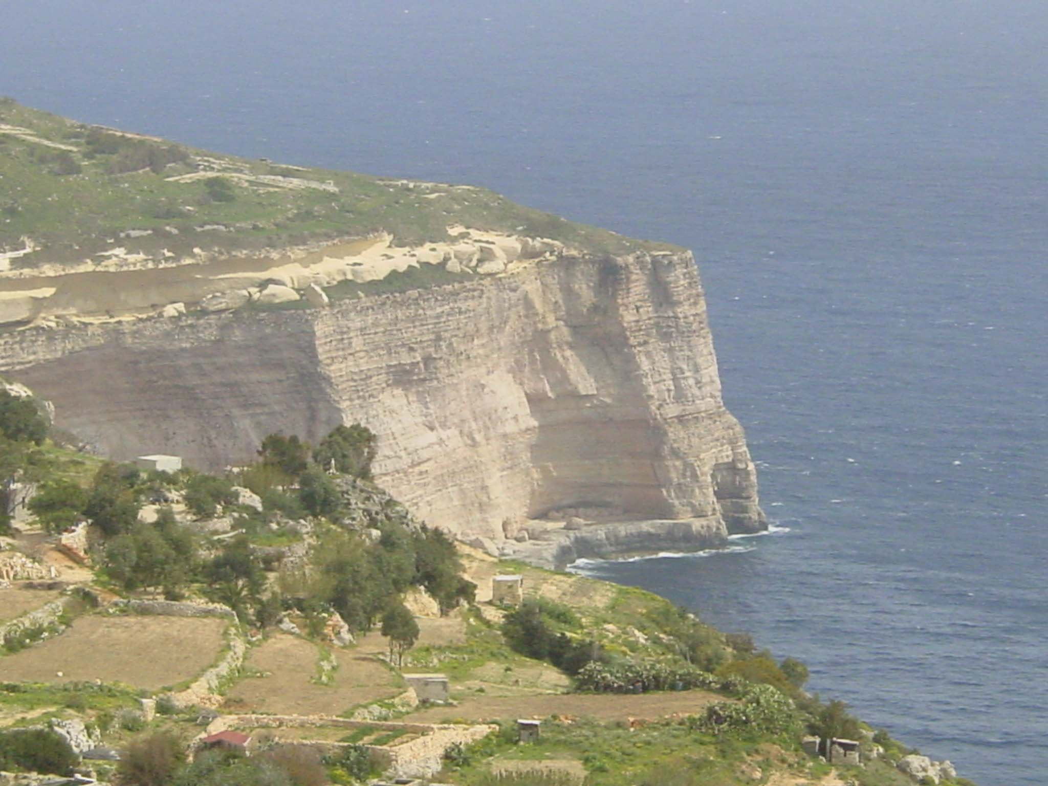
Chapter 4
Response of the climate system to a perturbation
Climate system dynamics and modelling Hugues Goosse

Slide 2
Outline
Notion of forcing and feedback.
Description of the standard physical feedbacks.
Analysis of the interactions implying jointly the energy balance, the hydrological and the biogeochemical cycles.
Chapter 4 Page 2

Slide 3
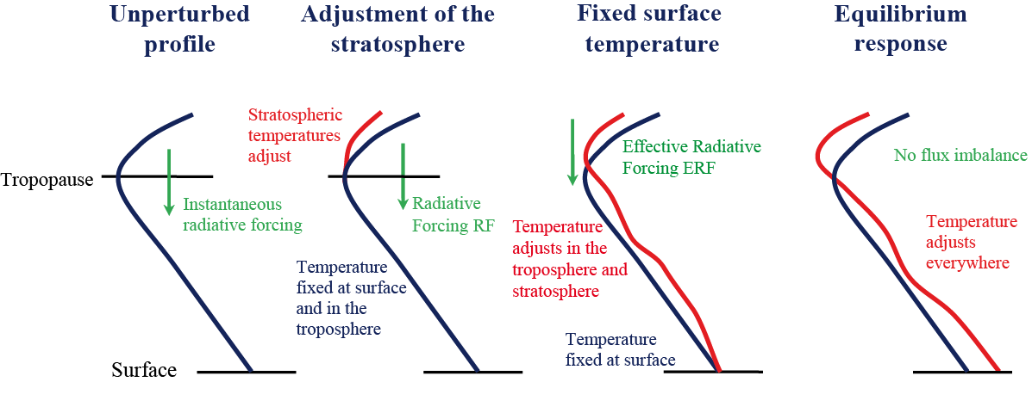
Notion of radiative forcing
To compare the effect on the climate of different perturbations, it is convenient to estimate their effect on the Earth’s radiative budget.
Usually fixed SST
Chapter 4 Page 3

Slide 4
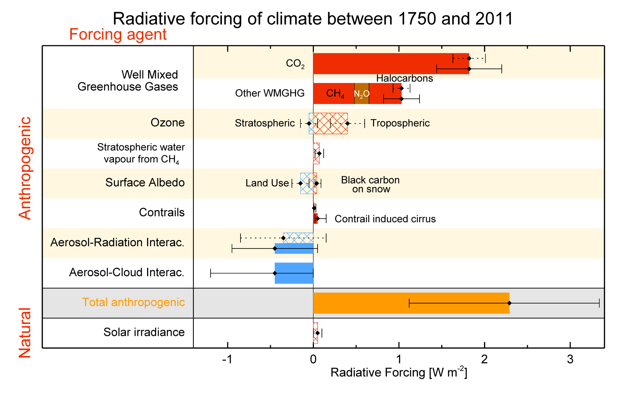
Major Radiative forcing agents
Greenhouse gases
Radiative forcing (RF, hatched) and effective radiative forcing (ERF, solid) between 1750 and 2011 for individual forcing agents and the total anthropogenic forcing. Figure from Myhre et al. (2013).
Chapter 4 Page 4

Slide 5
Major Radiative forcing agents
Greenhouse gases
Relatively good approximations of the radiative forcing ΔQ can be obtained from simple formulas:
[CO₂] and [CO₂]_{r} are the CO₂ concentrations in ppm for the period being investigated and for a reference period, respectively. The units for the other concentrations are ppb.
Chapter 4 Page 5

Slide 6
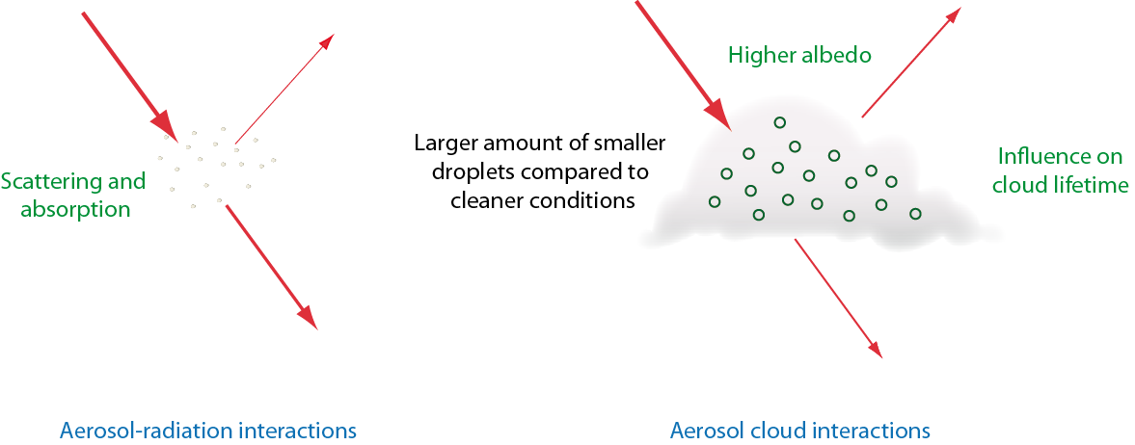
Major Radiative forcing agents
Aerosols
Atmospheric aerosols are relatively small solid or liquid particles that are suspended in the atmosphere.
Schematic representation of some aerosol-radiation interactions and aerosol-cloud interactions, focusing on the influence on solar radiation..
Chapter 4 Page 6

Slide 7
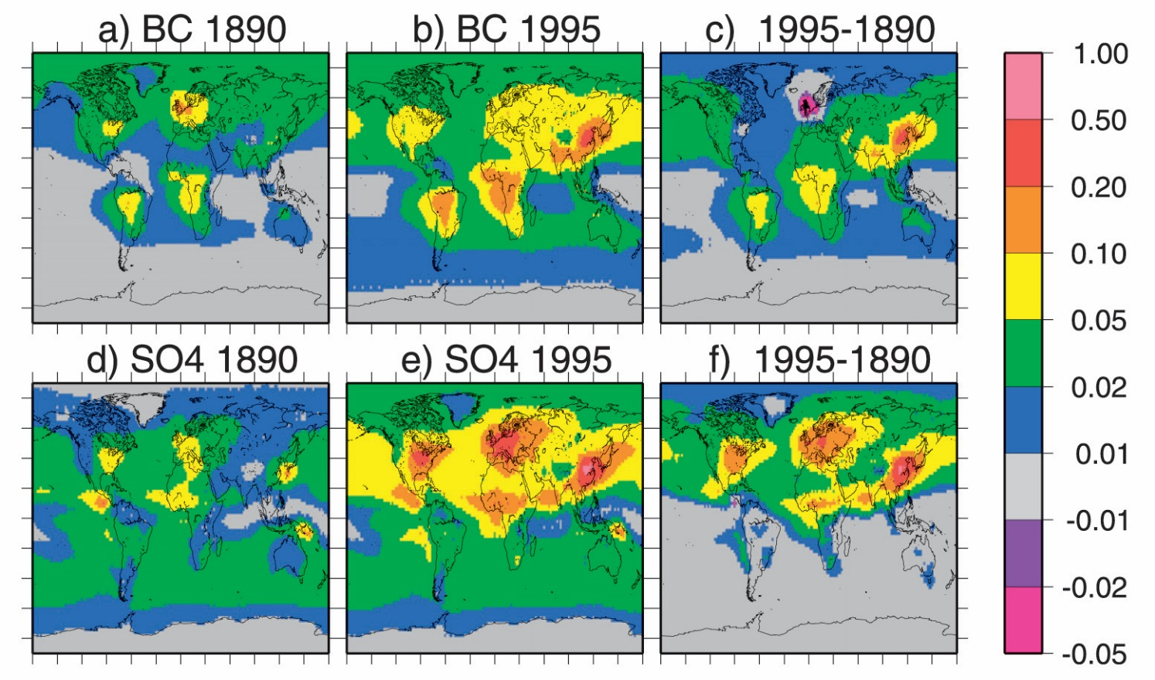
Major Radiative forcing agents
Aerosols
Anthropogenic aerosols are mainly concentrated downwind of industrial areas.
Aerosol optical depths (i.e. a measure of atmospheric transparency) for black carbon (BC, x10) (a) in 1890, (b) in 1995, and (c) the change between 1890 and 1995; (d)–(f) the same measures for sulphates. Reproduced from Koch et al. (2008).
Chapter 4 Page 7

Slide 8
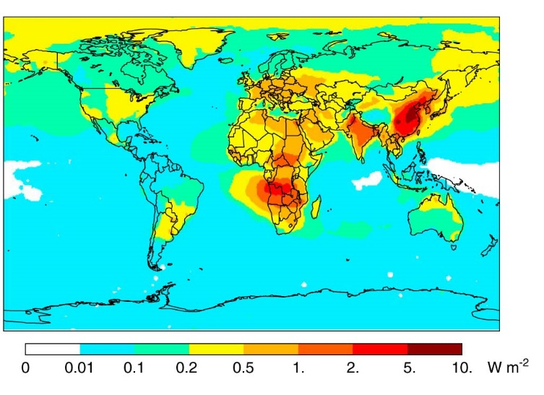
Major Radiative forcing agents
Aerosols
The net aerosols forcing is negative but some aerosols induce a positive forcing.
Estimate of annual mean forcing due to of black carbon in 2009 (Wang et al. 2014).
Chapter 4 Page 8

Slide 9
Major Radiative forcing agents
Land use and land cover changes
Direct impact on emissions of CO₂ and CH₄ and aerosols.
Modification of the characteristics of the Earth’s surface.
The fraction of land occupied by crops in 1700 and 1992. Figure from Pongratz et al. (2008).
Chapter 4 Page 9

Slide 10
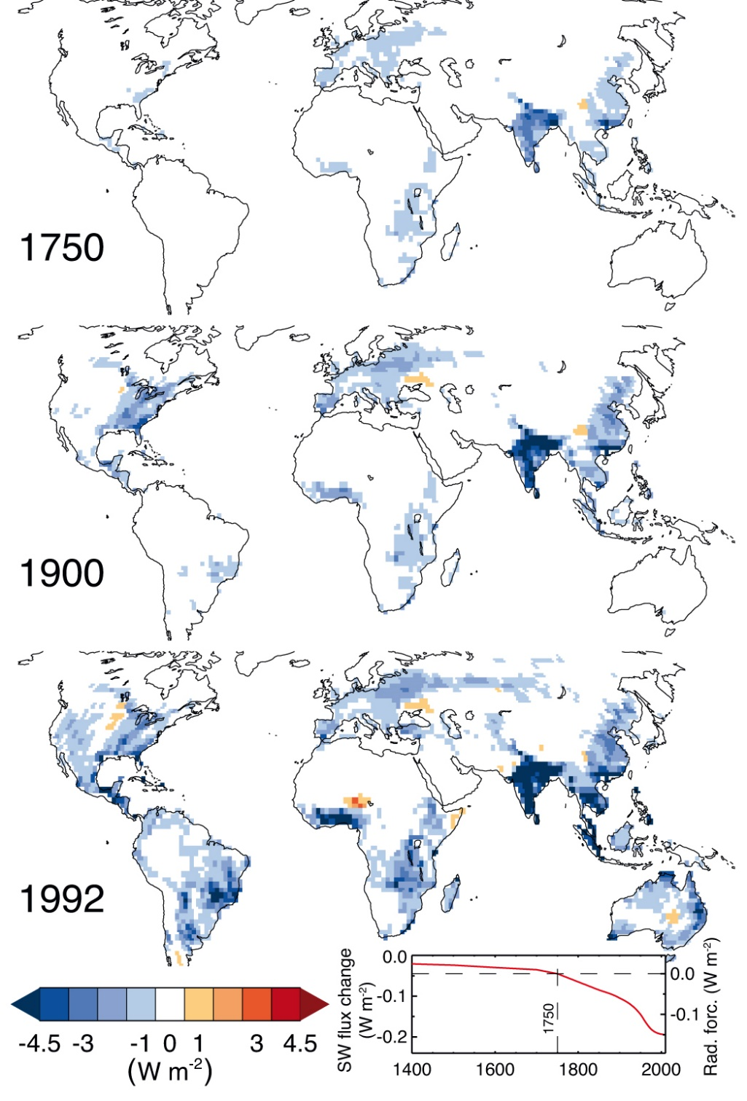
Major Radiative forcing agents
Land use and land cover changes: radiative forcing
Change in top of the atmosphere shortwave (SW) flux (W m^{–2}) following the change in albedo as a result of anthropogenic land use change.
Figure from Myhre et al. (2013), based on simulations by Pongratz et al. (2009).
Chapter 4 Page 10

Slide 11
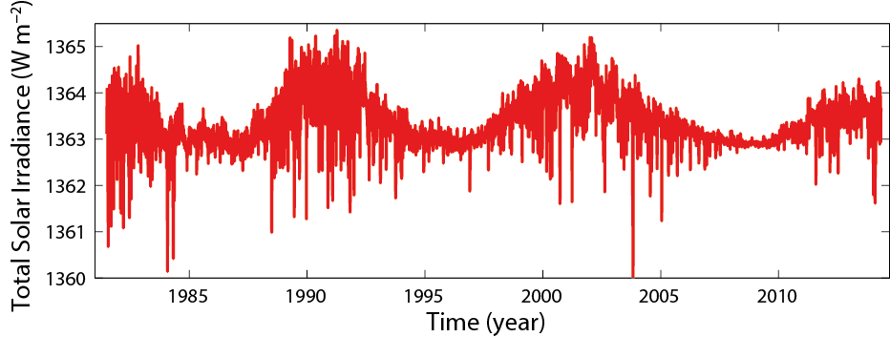
Major Radiative forcing agents
Solar and volcanic forcings
Changes in total solar irradiance
Changes in total solar irradiance estimated from a composite of measurements performed with different satellites (RMIB TSI composite, Mekaoui and Dewitte, 2008 and updates).
Chapter 4 Page 11

Slide 12
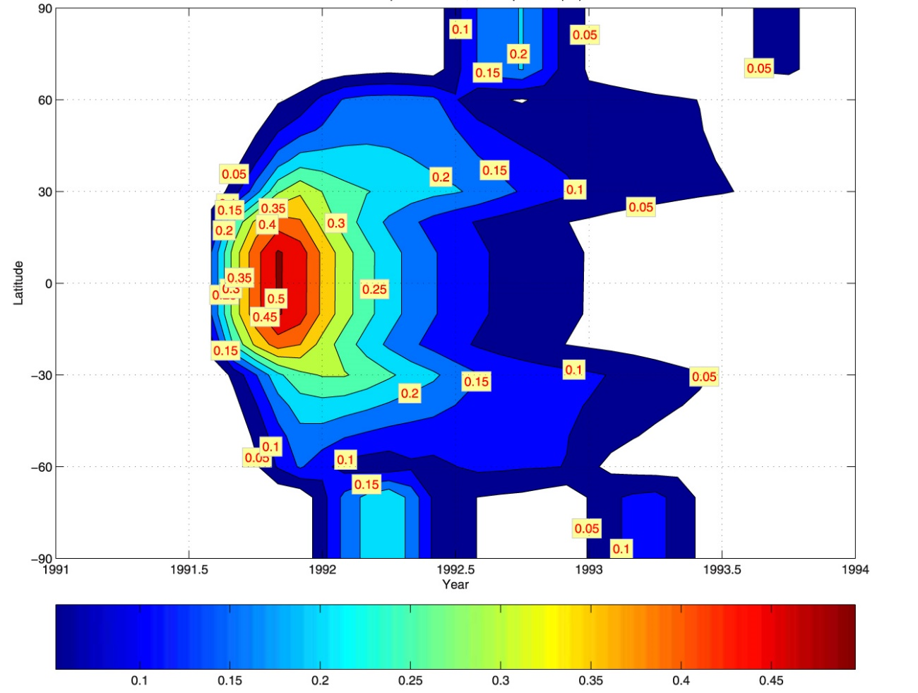
Major Radiative forcing agents
Solar and volcanic forcings
Explosive volcanic eruptions can transport aerosols directly to the stratosphere where they remain for a few years.
Estimate of the volcanic aerosol optical depth after the 1991 Pinatubo eruption as a function of latitude and time. Figure from Gao et al. (2008).
Chapter 4 Page 12

Slide 13
Definition of feedback
The imbalance in the radiative budget can be expressed as a function of the changes in global mean surface temperature, ΔT_{s}.
Imbalance in the radiative budget
Radiative forcing
Climate feedback parameter (expressed in W m⁻² K⁻¹).
Chapter 4 Page 13

Slide 14
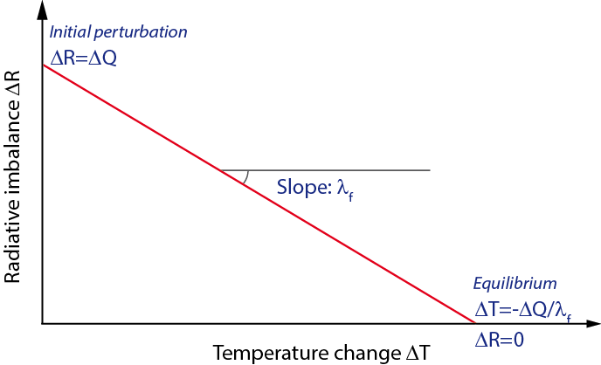
Definition of feedback
To reach an equilibrium, λ_{f} must be negative.
Schematic representation illustrating the role of the climate feedback parameter λ_{f}
Chapter 4 Page 14

Slide 15
Definition of feedback
The equilibrium climate sensitivity is defined as the global mean surface temperature change after the climate system has stabilized in a new equilibrium state in response to a doubling of the CO₂ concentration in the atmosphere.
The equilibrium climate sensitivity is measured in °C and its value is likely to be in the range 1.5-4.5°C.
Chapter 4 Page 15

Slide 16
Direct physical feedbacks
λ_{f} could be represented by the sum of different feedback parameters.
Blackbody response
surface albedo feedback
Lapse rate feedback
Cloud feedback
Water vapour feedback
Chapter 4 Page 16

Slide 17
Direct physical feedbacks
λ₀ can be evaluated relatively easily using integrated balance at the top of the atmosphere:
This leads to:
≈
If this feedback was the only one active:
Chapter 4 Page 17

Slide 18
Direct physical feedbacks
If all the feedbacks are active:
A negative value of a feedback parameter reduce the equilibrium temperature change compared to the blackbody response.
Chapter 4 Page 18

Slide 19
Transient response of the climate system
The equilibrium response is achieved when all the components of the system have adjusted to the new forcing (ocean heat uptake).
Transient response:
Thermal inertia of the system
Chapter 4 Page 19

Slide 20
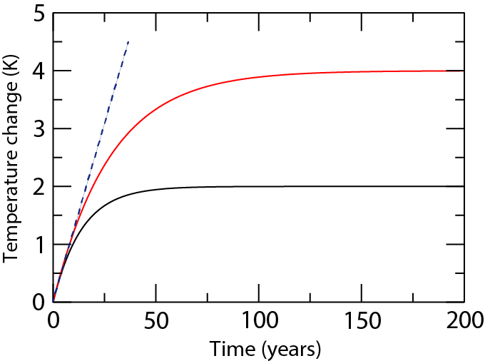
Transient response of the climate system
λ_{f} = -0.925 W m⁻² K⁻¹
λ_{f} = -1.85 W m⁻² K⁻¹
Initial slope = ΔQ/C_{s}.
Transient temperature changes obtained using a forcing ΔQ of 3.7 W m⁻² and C_{s} equal to 8.36 10⁸ J K⁻¹ m⁻²
Chapter 4 Page 20

Slide 21
Transient response of the climate system
In some cases, the ocean heat uptake is roughly proportional to ΔT_{s}.
The heat balance becomes:
Ocean heat uptake efficiency (W m⁻² K⁻¹).
In this framework, the heat uptake can be interpreted as equivalent to a negative feedback :
Chapter 4 Page 21

Slide 22
Water vapour feedback
The increase in the amount of water vapour in the atmosphere due to a warming leads to a strong positive feedback.
Simplified signal flow graph illustrating the water vapour feedback. A positive sign on an arrow means that the sign of the change remains the same when moving from the variable at the origin of the arrow (on the left in the top row) to the one pointed by the arrow (on the right in the top row) while a negative sign implies that an increase (decrease) in one variable induces a decrease (increase) in next one. The positive sign in a circle indicates that the overall feedback is positive.
Chapter 4 Page 22

Slide 23
Lapse rate feedback
The vertical variations of the temperature change have a climatic effect that vary between regions.
Unperturbed profile
No lapse rate feedback
Negative lapse rate feedback
Positive lapse rate feedback
Radiative forcing ΔQ
Radiative forcing ΔQ
Radiative forcing ΔQ
Tropopause
Larger temperature changes in the upper troposphere
Uniform temperature changes over the vertical
Larger temperature changes at surface
Surface
Chapter 4 Page 23

Slide 24
Cryospheric feedbacks
The presence of ice or snow at the surface strongly modifies the albedo: snow-and-ice albedo feedback.
Other cryospheric feedbacks are also important, related to the insulation effect of sea ice or to the formation of ice sheets.
Chapter 4 Page 24

Slide 25
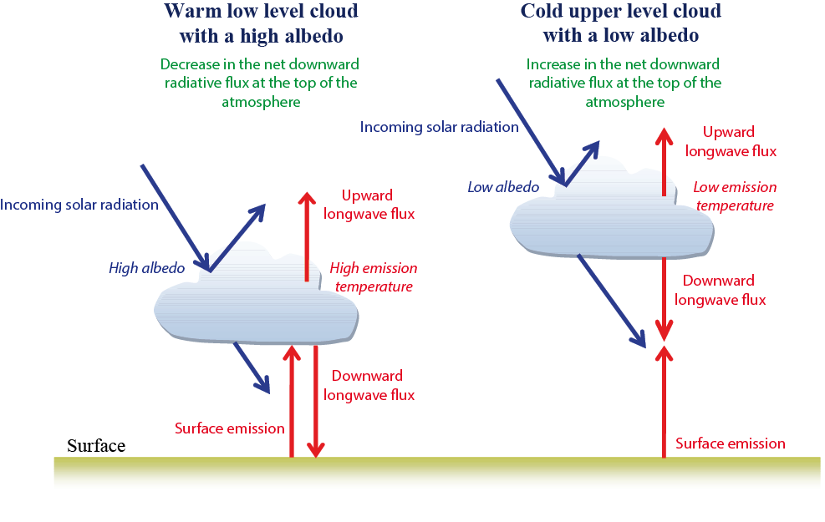
Cloud feedbacks
Clouds strongly affects the Earth energy budget.
The magnitude of cloud feedbacks is uncertain.

Slide 26
Soil-moisture climate feedbacks
Changes in soil moisture content affect the surface heat fluxes.
Changes in soil moisture content can also affect precipitation.
Chapter 4 Page 26

Slide 27
Advective feedback in the ocean
A perturbation of the freshwater budget of the North Atlantic can be amplified by ocean circulation changes.
Chapter 4 Page 27

Slide 28
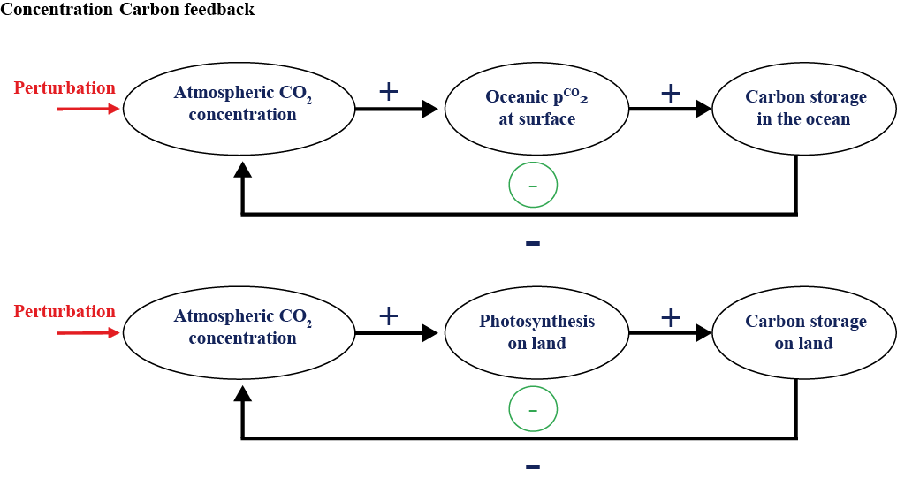
Biogeochemical and biogeophysical feedbacks
Some biogeochemical feedbacks are present even in the absence of any climate change.
Chapter 4 Page 28

Slide 29
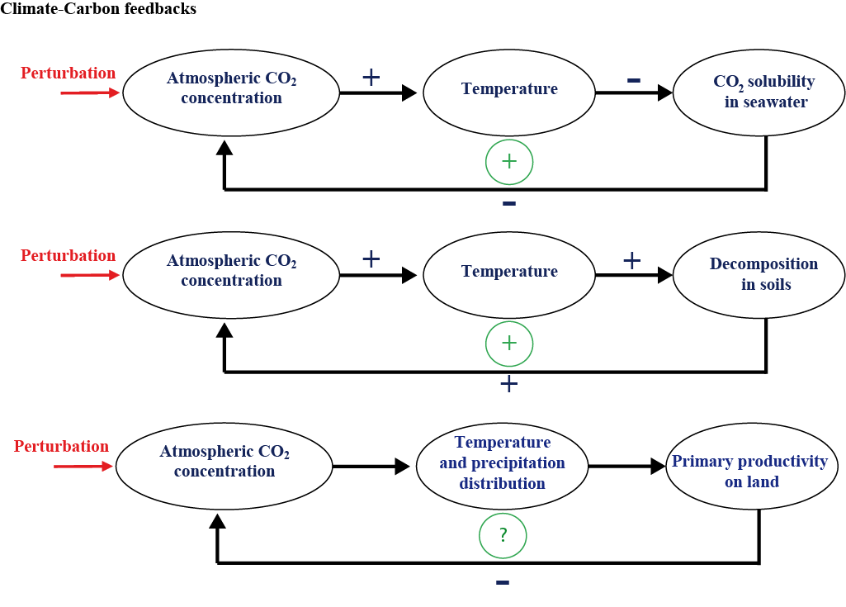
Biogeochemical and biogeophysical feedbacks
Some biogeochemical feedbacks are related to climate changes.

Slide 30
Biogeochemical and biogeophysical feedbacks
Concentration-carbon feedback and the climate-carbon feedback parameters
C_{E} = ΔC + ΔC_{O} + ΔC_{L}
Carbon emission
Change in carbon storage over land
Change in atmospheric carbon content
Change in oceanic carbon content
Chapter 4 Page 30

Slide 31
Biogeochemical and biogeophysical feedbacks
Concentration-carbon feedback and the climate-carbon feedback parameters.
C_{E} = ΔC + βΔC + γΔT
Carbon emission
Climate-carbon feedback
Change in atmospheric carbon content
Concentration-carbon feedback
Chapter 4 Page 31

Slide 32
Biogeochemical and biogeophysical feedbacks
Feedbacks involving permafrost and methane.
Chapter 4 Page 32

Slide 33
Biogeochemical and biogeophysical feedbacks
Interactions between climate and the terrestrial biosphere.
The albedo of a snow covered forest is much lower than the one of snow over grass.
Chapter 4 Page 33

Slide 34
Biogeochemical and biogeophysical feedbacks
Interactions between climate and the terrestrial biosphere.
Tundra-Taïga feedback.
Chapter 4 Page 34

Slide 35
Biogeochemical and biogeophysical feedbacks
Some feedbacks act on long timescales.
The carbonate compensation.
A stabilising feedback between the oceanic carbon cycle and the underlying sediment allows a balance between the source of calcium carbonate due to weathering and the sink due to sedimentation.
Chapter 4 Page 35

Slide 36
Biogeochemical and biogeophysical feedbacks
The carbonate compensation.
The saturation of calcium carbonate is mainly influenced by the carbonate concentration.
Carbonate concentration decreases with depths and solubility increases with pressure.
The upper ocean is supersaturated while the deep ocean is undersaturated. The depth at which those two regions are separated is called the saturation horizon.
Chapter 4 Page 36

Slide 37
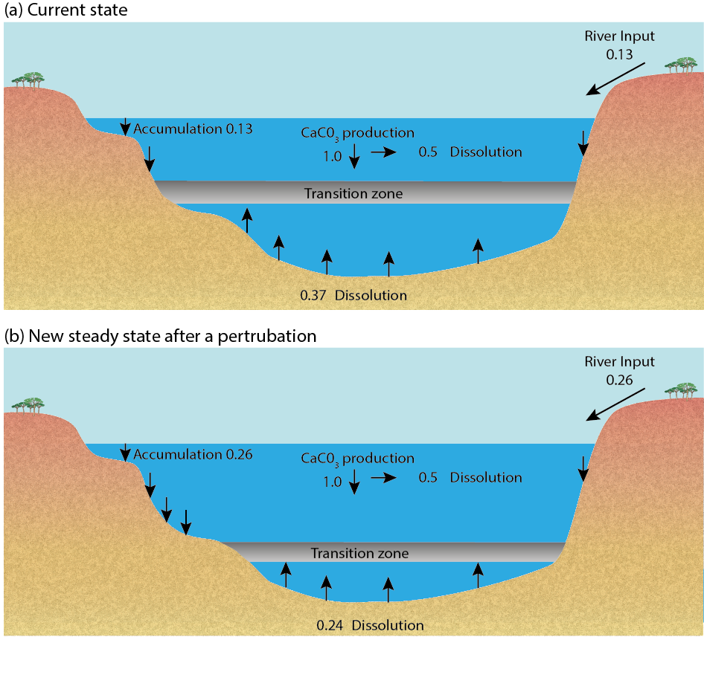
Biogeochemical and biogeophysical feedbacks
The carbonate compensation.
If the river input of calcium carbonate is doubled, the saturation horizon deepens, leading to less dissolution and more accumulation in the sediments in order to reach a new balance.
Figure based on Sarmiento and Gruber (2006).
Chapter 4 Page 37

Slide 38
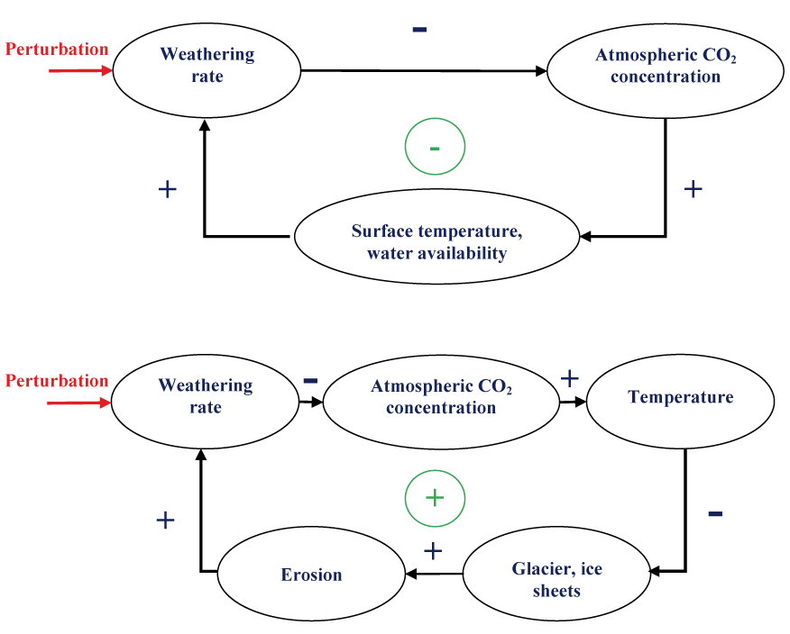
Biogeochemical and biogeophysical feedbacks
Interaction between plate tectonics, climate and the carbon cycle.
A negative feedback
A positive feedback
Chapter 4 Page 38

Slide 39
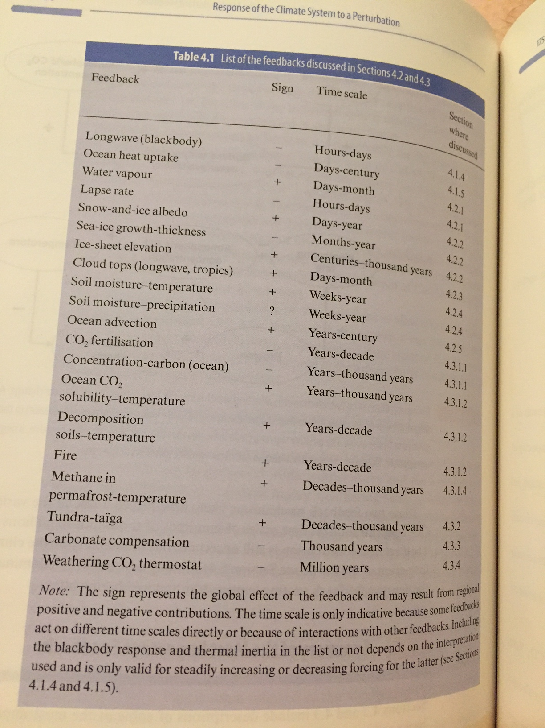

Slide 40
Additionnal reference:
Wang, Q., D. J. Jacob, J. R. Spackman, A. E. Perring, J. P. Schwarz, N. Moteki, E. A. Marais, C. Ge, J. Wang, and S. R. H. Barrett (2014), Global budget and radiative forcing of black carbon aerosol: Constraints from pole-to-pole (HIPPO) observations across the Pacific, J. Geophys. Res. Atmos., 119, 195–206, doi:10.1002/2013JD020824.

