Slide 1
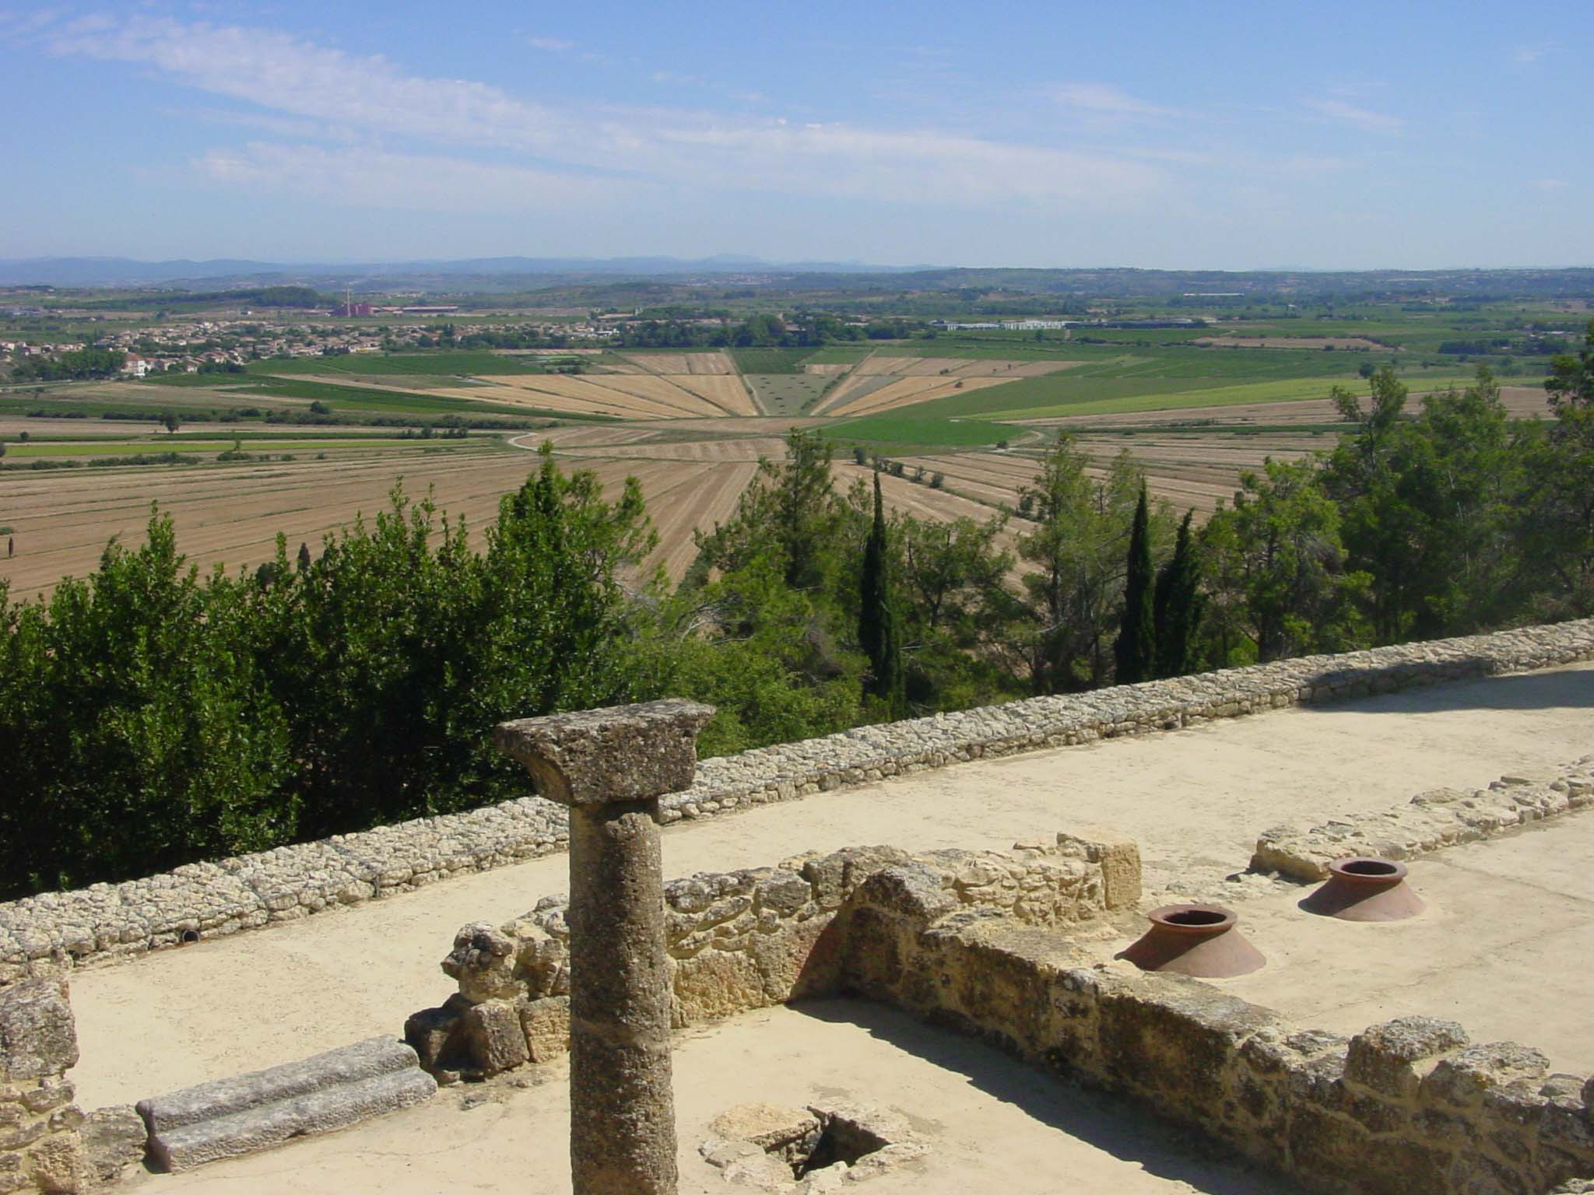
Chapter 5
Brief history of climate: causes and mechanisms
Climate system dynamics and modelling Hugues Goosse

Slide 2
Outline
Investigation of the role of the external forcing and of the internal dynamics.
Analysis of key periods to illustrate dominant processes.
Chapter 5 Page 2

Slide 3
Forced and internal variability
  Forced variability: driven by changes in external forcing
  Internal variability: caused by interactions between various elements of the system
Chapter 5 Page 3

Slide 4
Forced and internal variability
  Forced variability: possible to find the ultimate cause of the observed changes
  Internal variability: only the chain of events can be identified, the proximate cause.
Chapter 5 Page 4

Slide 5
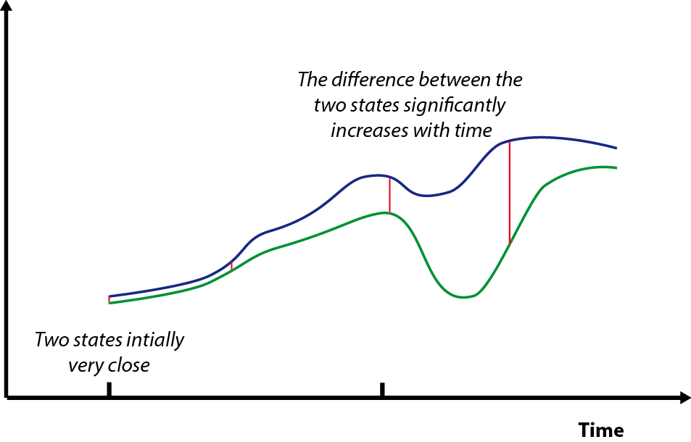
Forced and internal variability
  The climate system is sensitive to small perturbations.
Chapter 5 Page 5

Slide 6
Forced and internal variability
  The climate system is sensitive to small perturbations.
  Consequences:
  The skill of weather forecasts is limited in time.
  Two simulations include different realisations of internal variability.
  An agreement between simulations and observations on the timing of unforced events is not expected on the long term.
Chapter 5 Page 6

Slide 7
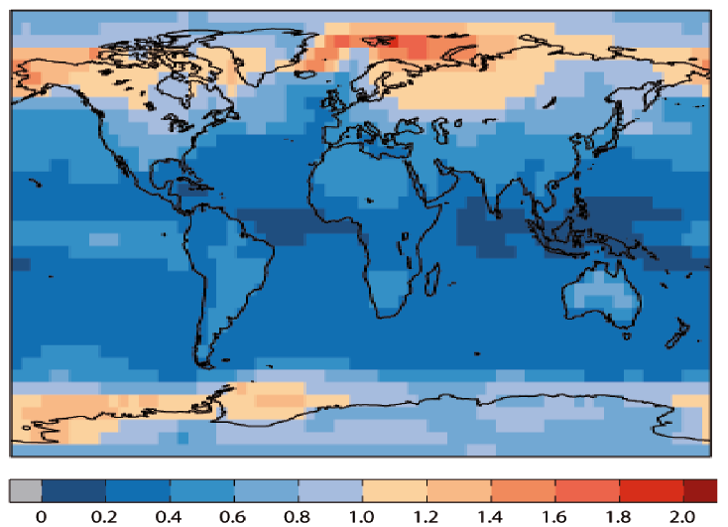
Forced and internal variability
  The magnitude of internal variability is a strong function of the spatial and temporal scale investigated.
Median of the standard deviation of the annual mean surface air temperature from control simulations performed in the framework of CMIP5. Figure from E. Hawkins updated from Hawkins and Sutton (2012).
Chapter 5 Page 7

Slide 8
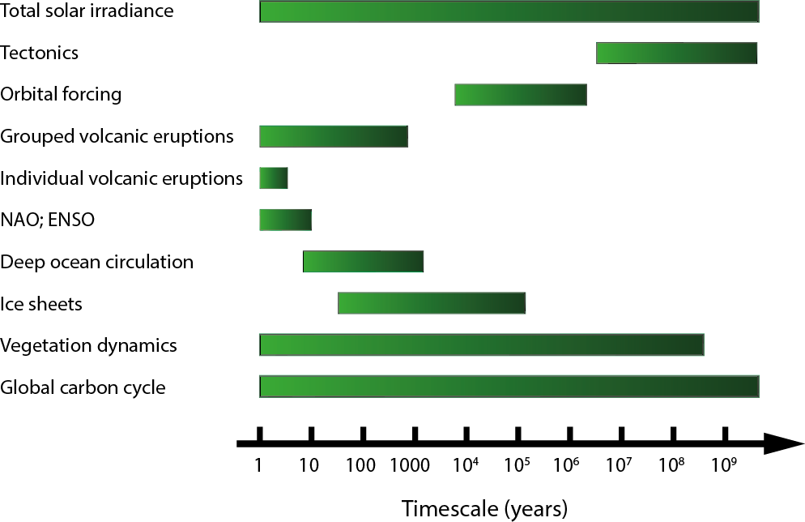
Timescales of climate variations
  The timescale of climate variations is set up by both the forcing and internal dynamics.
Schematic representation of the dominant timescales of selected external forcing and processes related to internal dynamics which affect climate.
Chapter 5 Page 8

Slide 9
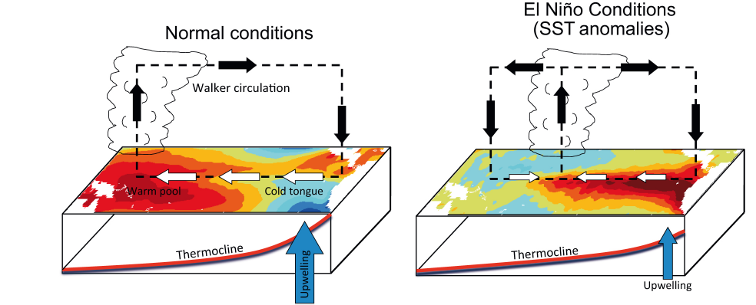
El Niño-Southern Oscillation
  In normal conditions, the thermocline is much deeper in the West Pacific than in the East Pacific.
Figure from Christensen et al. (2013)
  In El Niño conditions, the intensity of the upwelling is reduced in the East Pacific and the SST warms in the East Pacific.
Chapter 5 Page 9

Slide 10
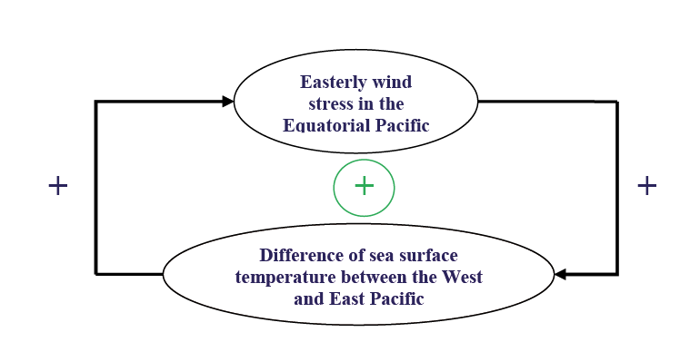
El Niño-Southern Oscillation
  The Walker circulation is associated with a positive feedback, called the Bjerknes feedback.
Chapter 5 Page 10

Slide 11
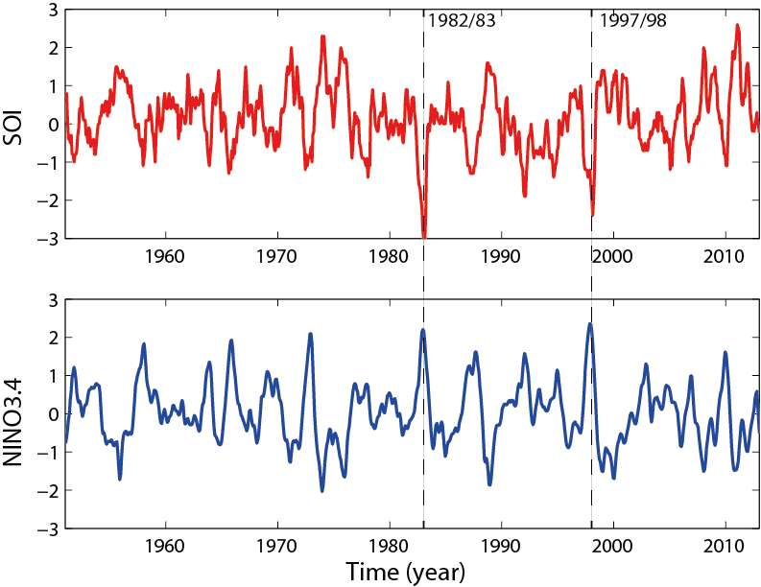
El Niño-Southern Oscillation
  The atmospheric circulation and sea surface temperature exhibit irregular oscillations: El Niño Southern Oscillation (ENSO).
Time series of the temperature in the eastern equatorial Pacific (averaged over the area 5°N-5°S-170°W-120°W, the so-called Niño3.4 index) and the SOI index (normalized difference between SLP in Tahiti and Darwin). Source: http://www.cpc.ncep.noaa.gov/data/indices/
.
Chapter 5 Page 11

Slide 12
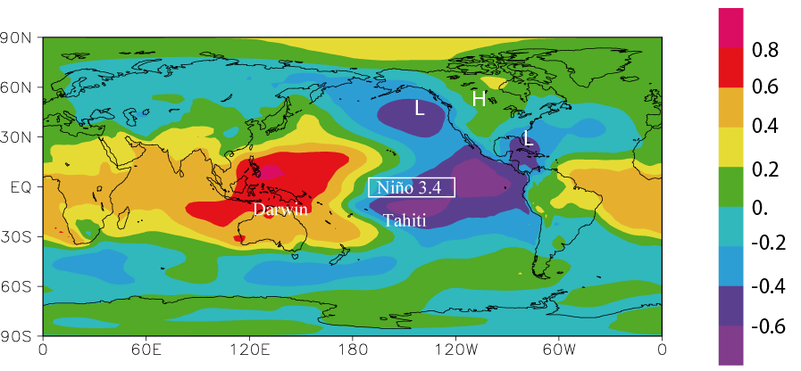
El Niño-Southern Oscillation
  ENSO is also associated with nearly global scale perturbations .
.
Correlation between the sea surface temperature in the eastern tropical Pacific (Niño3.4 index) and sea-level pressure in January.
Chapter 5 Page 12

Slide 13
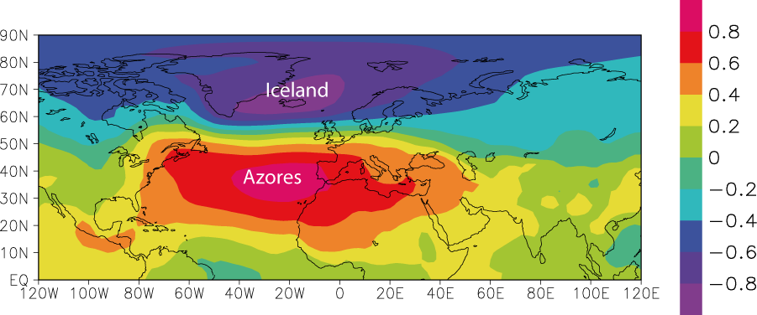
The North Atlantic Oscillation
  The mid-latitude westerlies in the North Atlantic present irregular changes in their intensity and in the location of their maximum.
Correlation between the winter NAO index and the winter SLP (average over December, January, February).
Chapter 5 Page 13

Slide 14
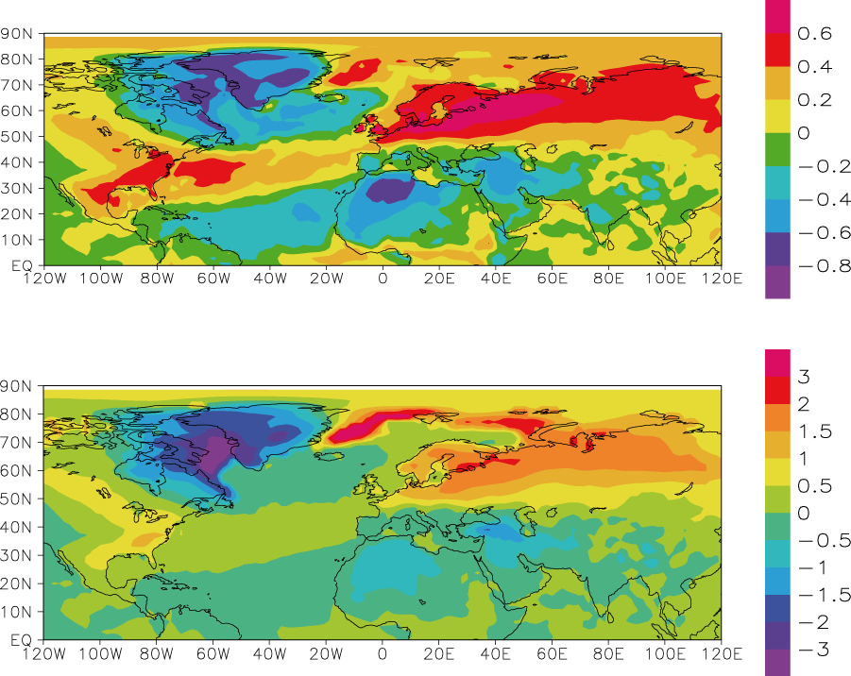
The North Atlantic Oscillation
  The NAO is associated with changes in many atmospheric and oceanic variables.
  Correlation NAO index-winter temperatures
Correlation (top) and regression in °C (bottom) between the winter NAO index and the winter surface air temperature (average over December, January, February).
  Regression NAO index-winter temperatures
Chapter 5 Page 14

Slide 15
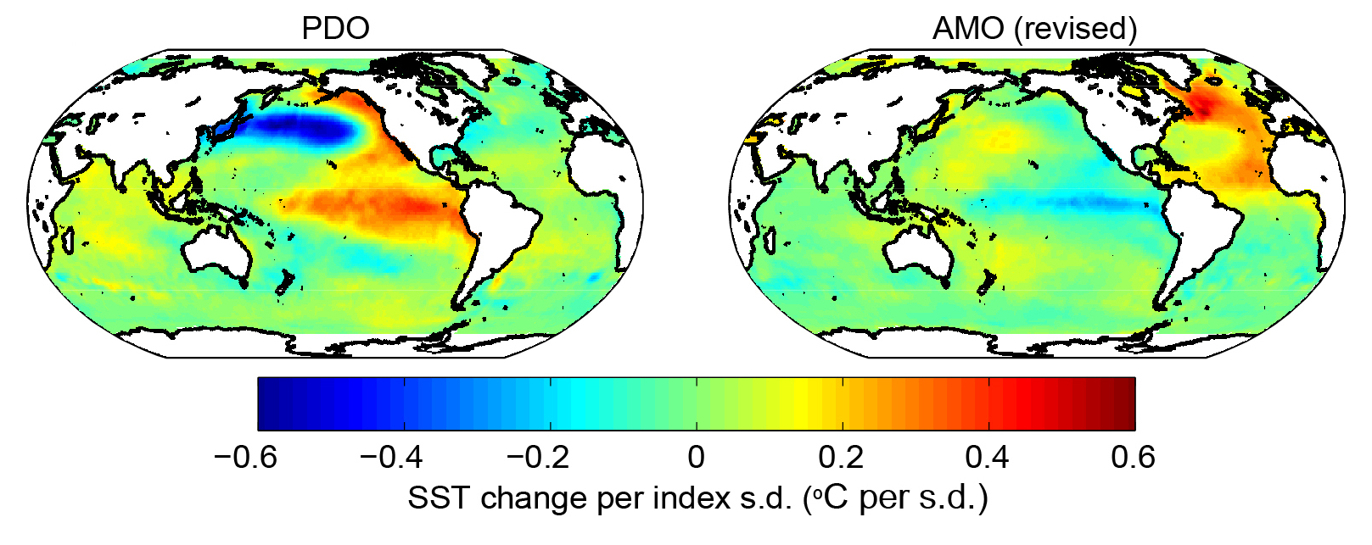
The Atlantic multidecadal oscillation and the Pacific decadal oscillation
  The sea surface temperature is characterized by pronounced decadal and multidecadal variations.
Regression between PDO and AMO indices with annual sea surface temperature. Figure from Hartmann et al. (2014).
Chapter 5 Page 15

Slide 16
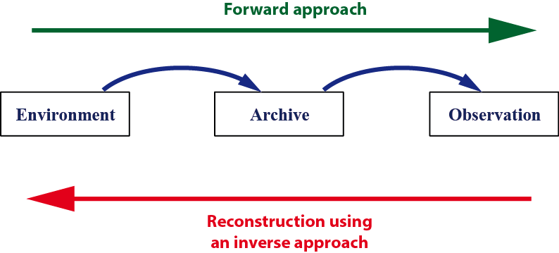
Reconstructing past climates
  Past climate variations can be reconstructed using the signal recorded in natural archives by various sensors.
Schematic illustration of the forward and inverse approaches.
Chapter 5 Page 16

Slide 17
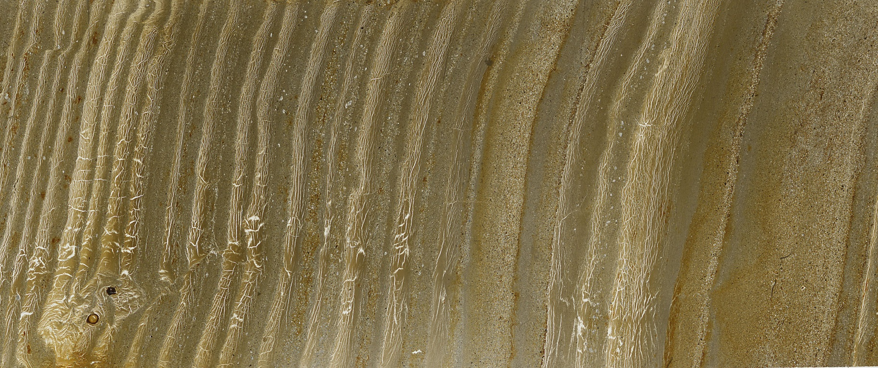
Reconstructing past climates
  Dating methods
  Annual layer counting.
5 cm-long section from the lake sediment of Cape Bounty, East Lake, Nunavut, Canada. Picture from François Lapointe.
Chapter 5 Page 17

Slide 18
Reconstructing past climates
  Dating methods
  Radiometric dating: based on the decay of radioactive isotopes.
decay constant of the radioactive isotope
  The decay follows a standard law:
concentration of radioisotopes at time t
initial concentration at time t=0
Chapter 5 Page 18

Slide 19
Reconstructions based on isotopes
  Oxygen isotopes
  The abundance of isotopes is measured using the delta value.
x
  δ¹⁸O is the ratio of ¹⁸O and ¹⁶O isotopes in the sample, compared to a standard.
Chapter 5 Page 19

Slide 20
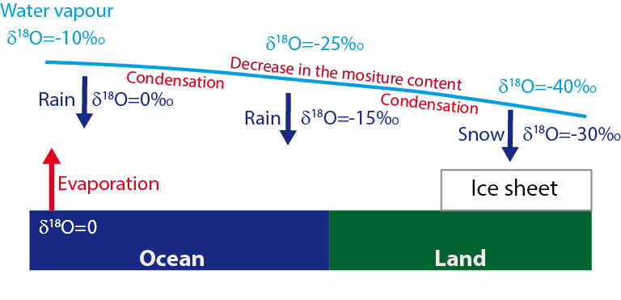
Reconstructions based on isotopes
  Oxygen isotopes
  Isotopic fractionation takes place during evaporation and condensation
Chapter 5 Page 20

Slide 21
Reconstructions based on isotopes
  Carbon isotopes
  During photosynthesis, ¹²C is taken preferentially to ¹³C because it is lighter.
x
  Organic matter has a low (negative) δ¹³C.
Chapter 5 Page 21

Slide 22
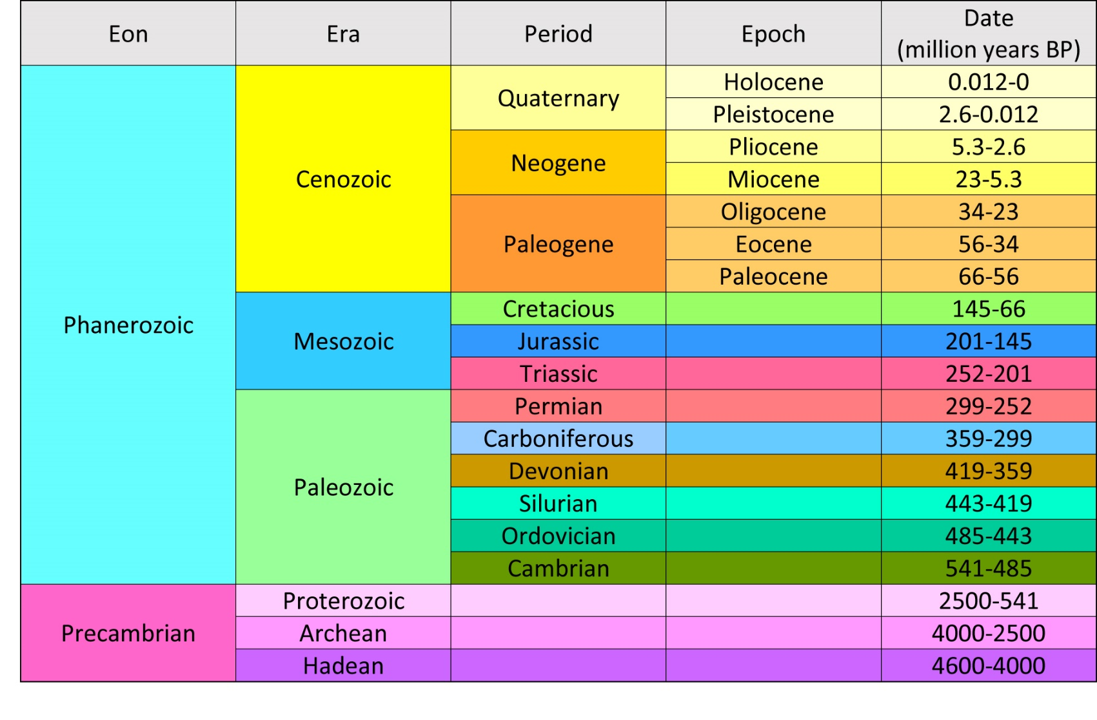
The Climate since the Earth’s formation
  The uncertainties on Earth’ climate are larger as we go back in time.
A simplified geological time scale.

Slide 23
Precambrian climate
  4 billion years ago, the solar irradiance was about 25-30% lower than at present but the Earth was not totally ice covered: the “faint young Sun paradox”.
  Main hypothesis: a much stronger greenhouse effect caused by a much higher CO₂ (250 times the present-day value?) and CH₄ concentration.
Chapter 5 Page 23

Slide 24
Precambrian climate
  Atmospheric composition has been modified with time.
  Photosynthesis induced a large increase in the atmospheric oxygen concentration 2.2. to 2.4 billion years ago.
  Did this caused a glaciation?
Chapter 5 Page 24

Slide 25
Precambrian climate
  Large glaciations took place around 550 to 750 million years ago.
  Formation of a Snowball Earth around 635 million years ago?
  If this is really occurred, why does not Earth not stay permanently in this state ?
Chapter 5 Page 25

Slide 26
Phanerozoic climate
  The carbon cycle and climate appear strongly linked on timescales of millions of years.
  Changes in atmospheric CO₂ concentration can be represented by:
Outgassing of CO₂ due to metamorphism and volcanic eruptions
Silicate weathering and calcium carbonate sedimentation in the ocean
Long-term burial of organic matter
Chapter 5 Page 26

Slide 27
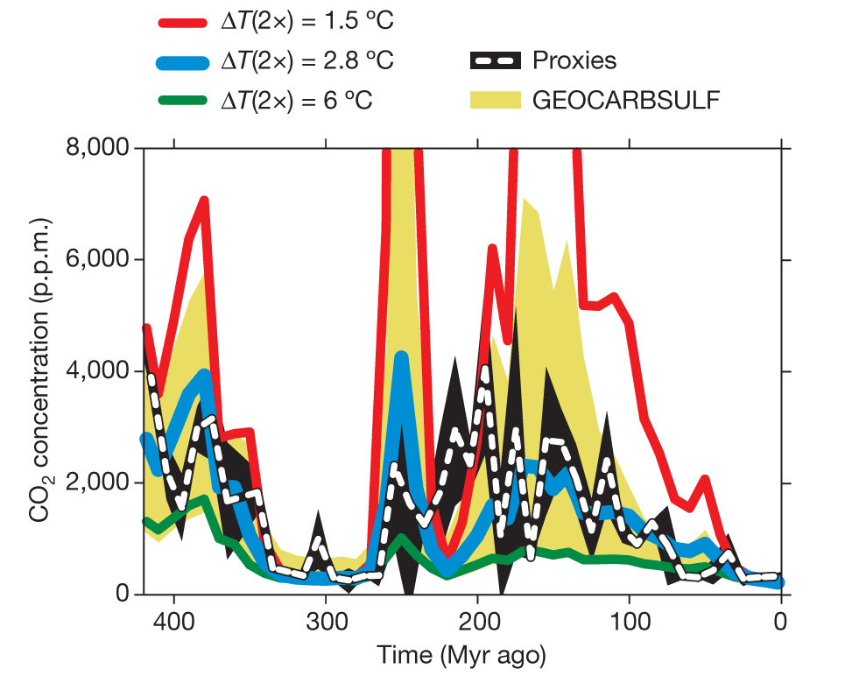
Phanerozoic climate
  Models based on this balance are able to reproduce the long-term changes in the carbon cycle.
Large influence of climate sensitivity
Comparison of the CO₂ concentration calculated by GEOCARBSULF model for varying climate sensitivities (noted ΔT(2x) on the figure) to an independent CO₂ record based on different proxies. Figure from Royer et al. (2007).
Chapter 5 Page 27

Slide 28
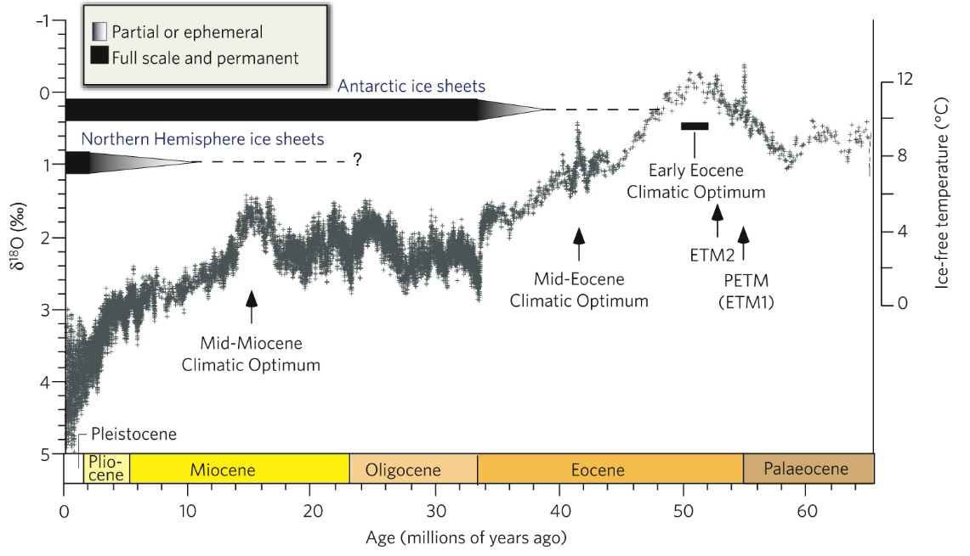
Cenozoic climate
  The temperature over the last 65 million years has gradually decreased . This is associated with a cooling that is often referred to as a transition from a greenhouse climate to an icehouse.
← Time
The global climate over the past 65 million years based on deep-sea oxygen-isotope measurements. Figure from Zachos et al. (2008).
Chapter 5 Page 28

Slide 29
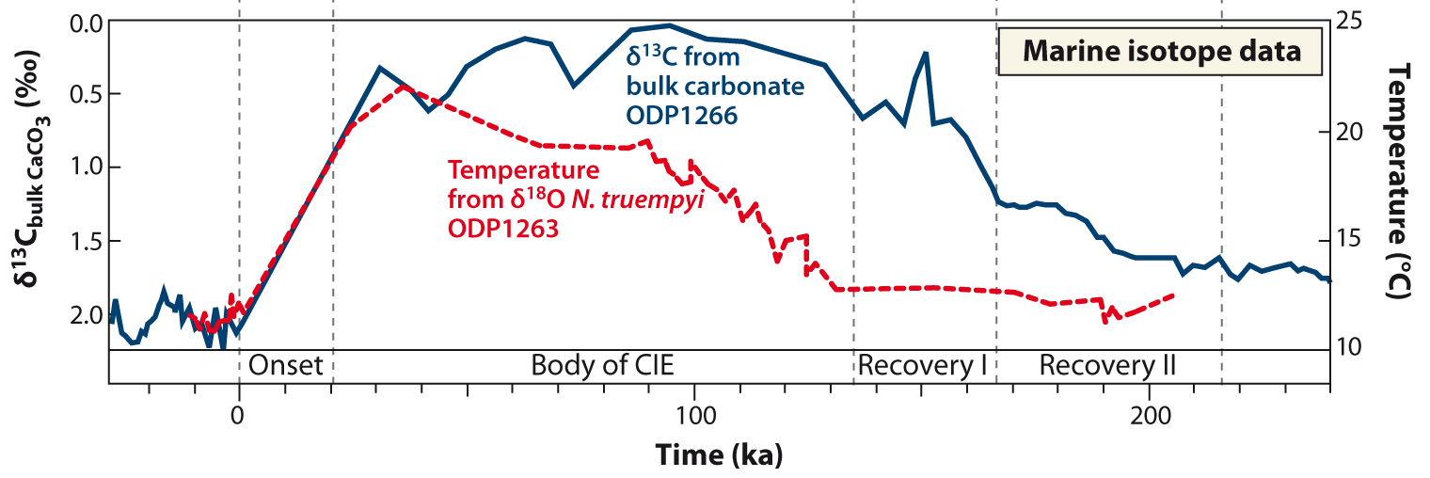
Cenozoic climate
  During the Paleocene Eocene Thermal Maximum
  (PETM, 55 million years ago) global temperature increased by more than 5°C in about 10 000 years.
Carbonate carbon isotope and oxygen isotope ratio in two cores in the South Atlantic. The time on the x axis starts at the onset of the PETM about 55 million years ago. Figure from McInerney and Wing (2011).
Chapter 5 Page 29

Slide 30
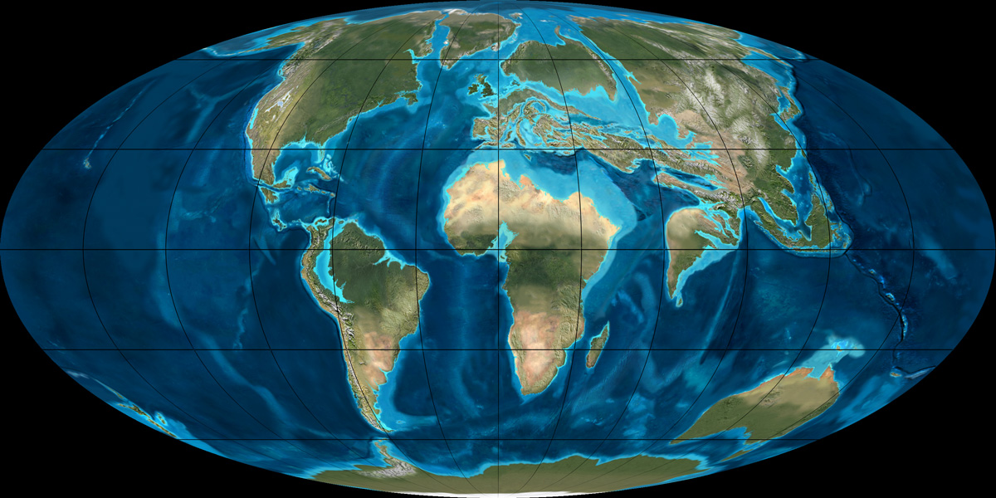
Cenozoic climate
  50 million years ago, the location of the continents was quite close to that of the present-day one but changes in boundary conditions still had an influence on climate.
Land configuration about 60 million years ago. Map from Ron Blakey
Chapter 5 Page 30

Slide 31
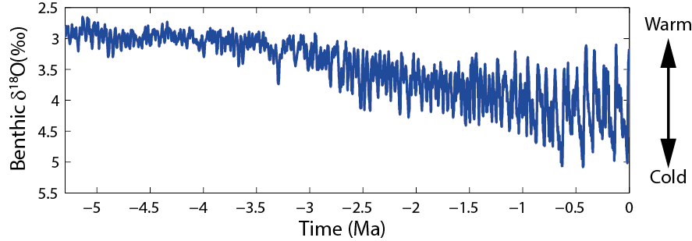
Cenozoic climate
  Large climate fluctuations have occurred over the last 5 million years.
Benthic δ¹⁸O, which measures global ice volume and deep ocean temperature. Data from Lisiecki and Raymo (2005).
Chapter 5 Page 31

Slide 32
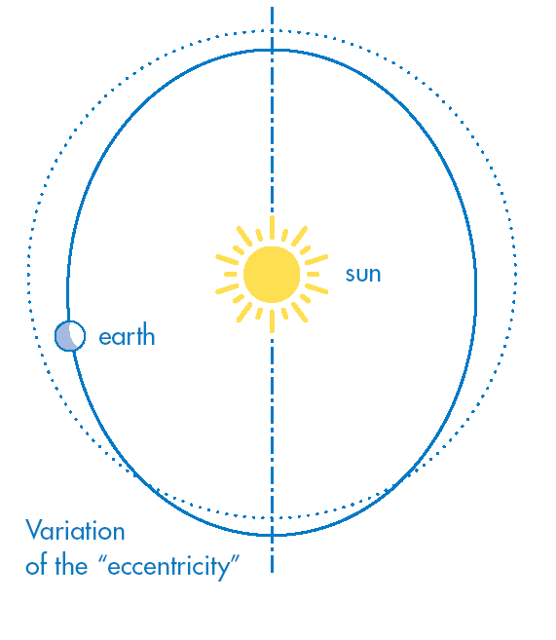
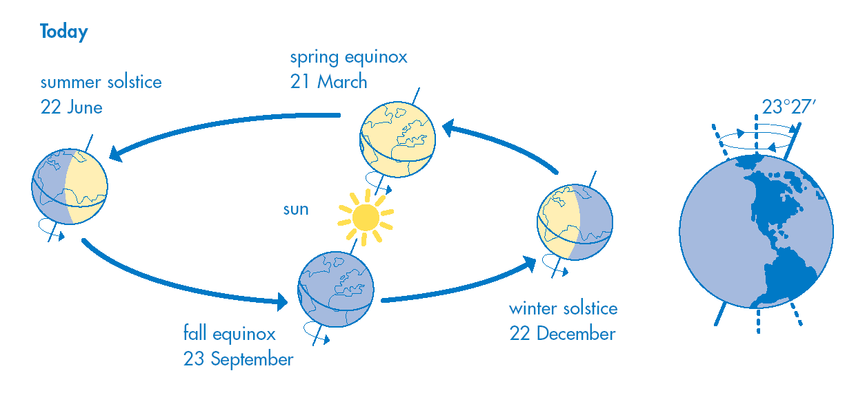
The last million years: glacial interglacial cycles
  The characteristics of the Earth’s orbit are determined by three astronomical parameters.
  eccentricity (ecc) obliquity (ε_{obl}),
Chapter 5 Page 32

Slide 33
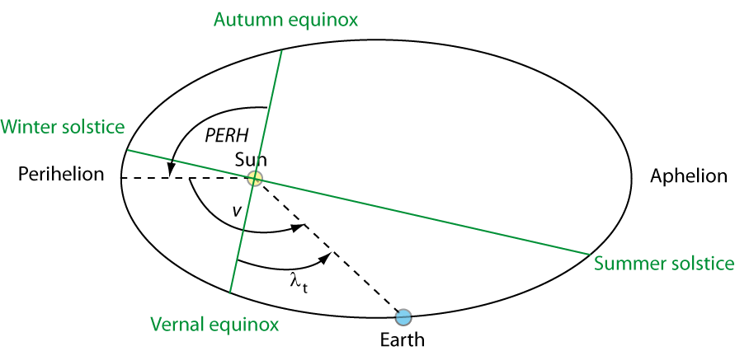
The last million years: glacial interglacial cycles
  The climatic precession is ecc sin (PERH) = ecc sin (ω)
Chapter 5 Page 33

Slide 34
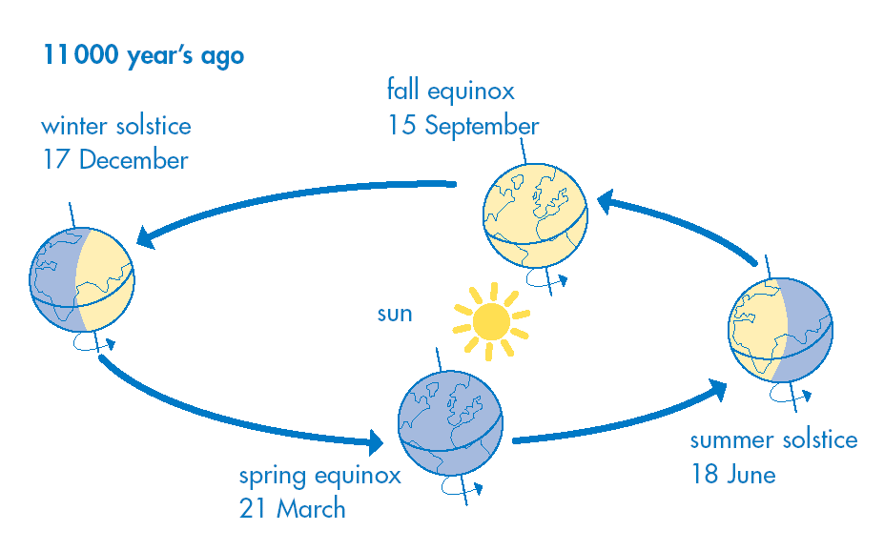
The last million years: glacial interglacial cycles
  Because of the climatic precession, the Earth was closest to the sun during the boreal summer 11 ka ago and the closest to the sun during boreal winter now.
Chapter 5 Page 34

Slide 35
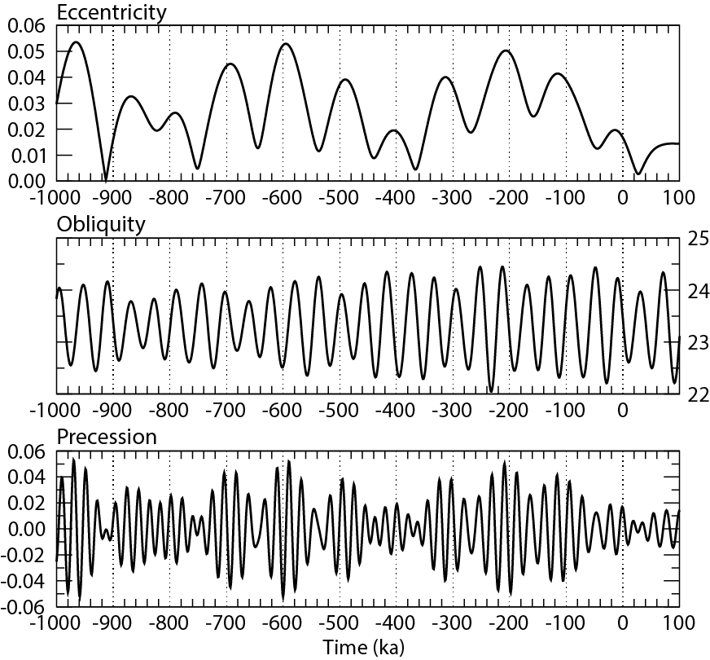
The last million years: glacial interglacial cycles
  The astronomical parameters are varying through time.
Long-term variations in eccentricity, climatic precession and obliquity (in degrees). zero corresponds to 1950 AD. Computed from Berger (1978). Figure from Marie-France Loutre.
Chapter 5 Page 35

Slide 36
The last million years: glacial interglacial cycles
  Eccentricity. The annual mean energy received by the Earth is inversely proportional to:
The differences in the annual mean radiations received by the Earth are small: maximum variation of 0.15%, i.e., 0.5 W m⁻² .
Chapter 5 Page 36

Slide 37
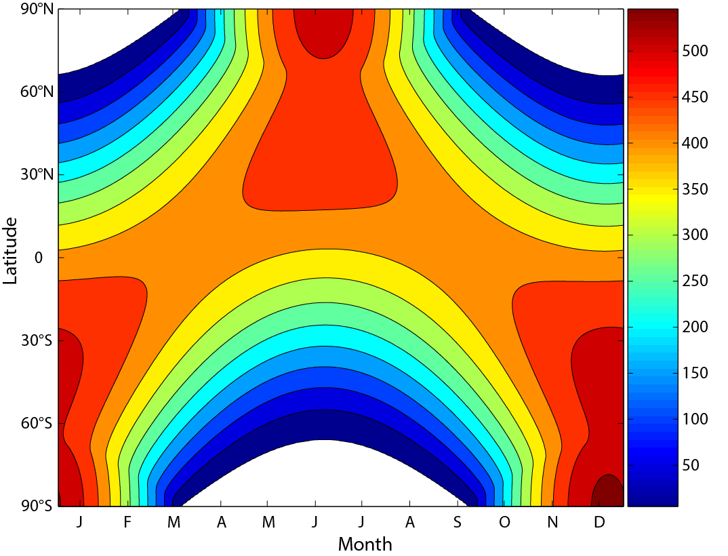
Present-day insolation at the top of the atmosphere
Daily mean insolation on an horizontal surface (W m⁻²).
Polar night
Chapter 2 Page 37

Slide 38
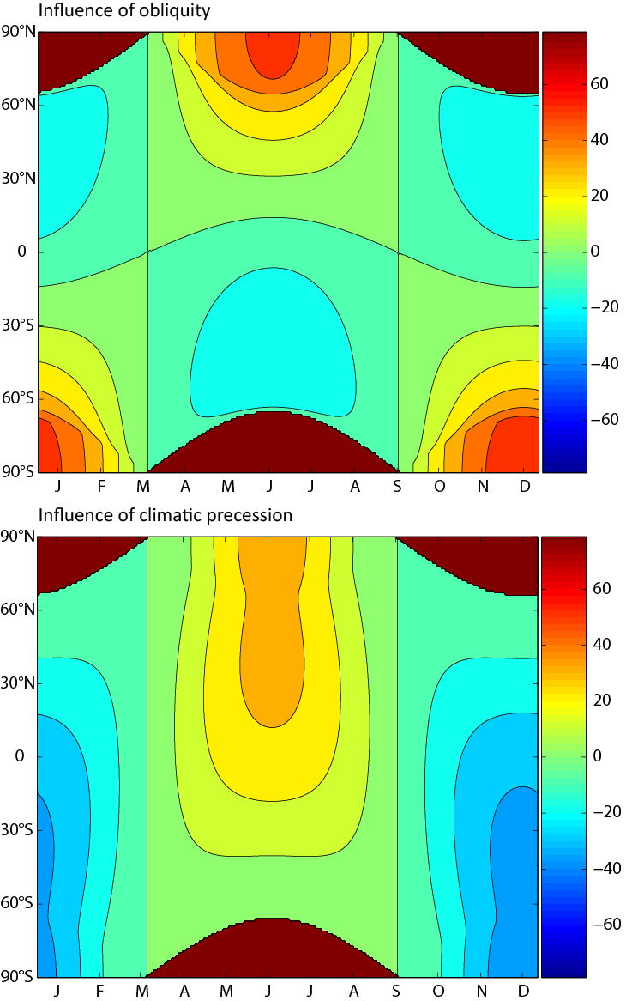
The last million years: glacial interglacial cycles
  The obliquity has a large impact on the seasonal distribution of insolation in polar regions.
Changes in insolation in W m⁻² caused by an increase in the obliquity from 22.0° to 24.5° with ecc=0.016724, PERH=102.04, i.e. the present-day values. Figure from Marie-France Loutre
Chapter 5 Page 38

Slide 39
The last million years: glacial interglacial cycles
  The climatic precession has a large impact on the seasonal cycle of insolation.
Changes in insolation in W m⁻² caused by a decrease of the climatic precession from its maximum value (boreal winter at perihelion) to its minimum value (boreal summer at perihelion) with ecc=0.016724, ε_{obl}=23.446°, i.e. the present-day values. Figure from Marie-France Loutre
Chapter 5 Page 39

Slide 40
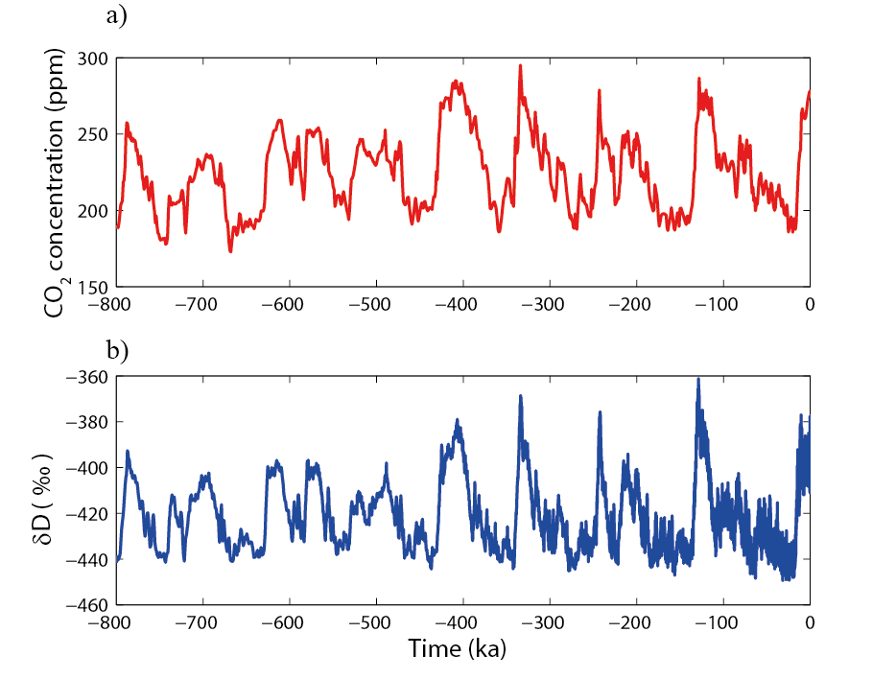
The last million years: glacial interglacial cycles
  The last 800 kyr are characterized by the alternation between long glacial periods and relatively brief interglacials.
CO₂ concentration
Variations in the atmospheric concentrations of CO₂ (in ppm, and in deuterium in Antarctica Dome C (EDC) ice core (δD in ‰, Jouzel et al., 2007).
Deuterium
Warm
Cold
Chapter 5 Page 40

Slide 41
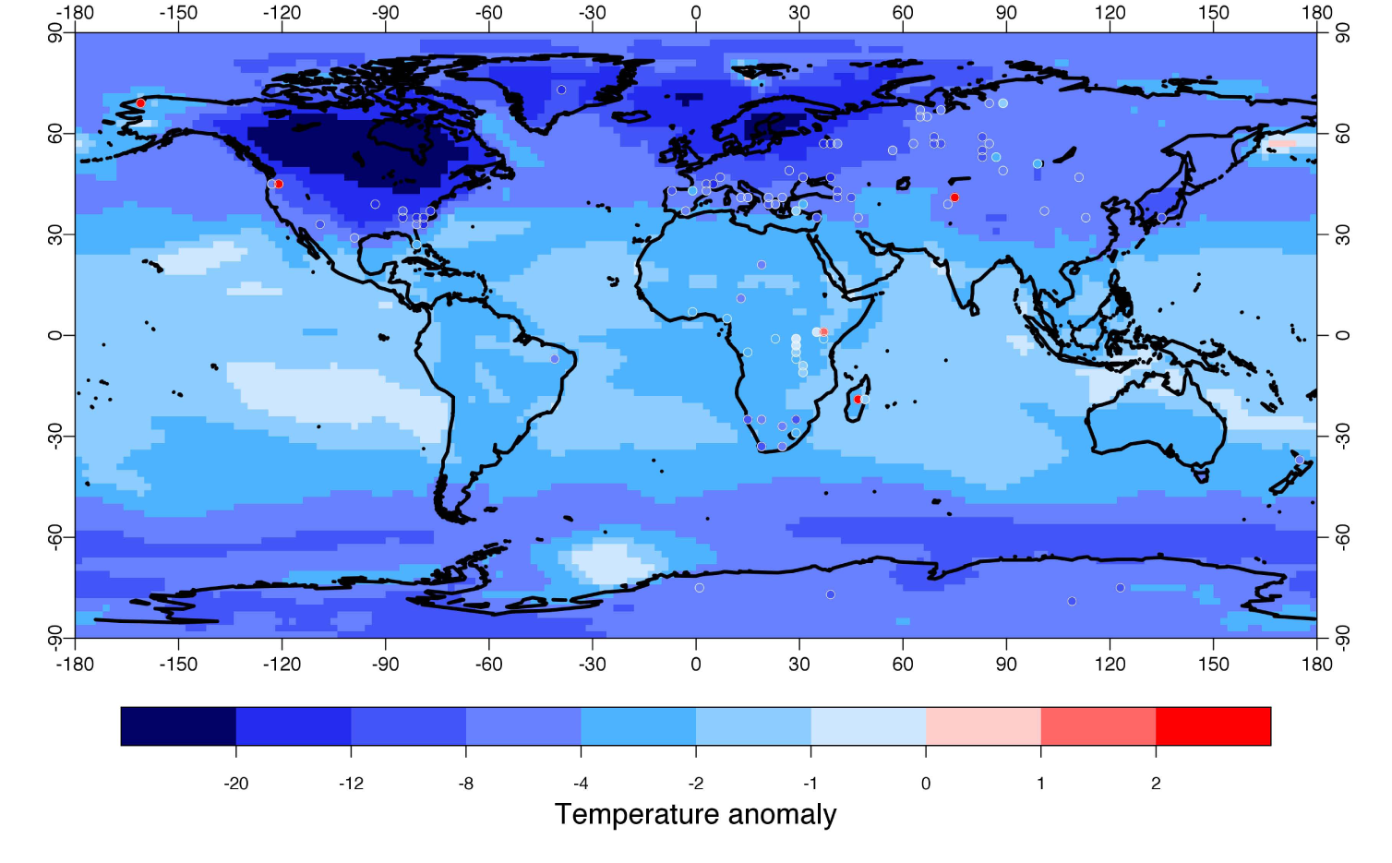
The last million years: glacial interglacial cycles
  The latest glacial period culminates about 21 ka ago: the Last Glacial Maximum (LGM).
Reconstruction of the difference in surface air temperature (K) between the Last Glacial Maximum and preindustrial conditions. Figure from Annan and Hargreaves (2013).
Chapter 5 Page 41

Slide 42
The last million years: glacial interglacial cycles
  The astronomical theory of paleoclimate assumes that glacial interglacial-cycles are driven by the changes in the astronomical parameters.
  The summer insolation at high northern latitudes appears to be of critical importance.
Chapter 5 Page 42

Slide 43
The last million years: glacial interglacial cycles
  The astronomical theory of paleoclimate.
  The dominant frequencies of the astronomical parameters are also found in many proxy records of past climate changes.
  Models driven by past changes in orbital parameters and by the observed evolution of greenhouse gases reproduced quite well the estimated past ice volume variations .
  However, the link between climate change and insolation is far from being simple and linear.
Chapter 5 Page 43

Slide 44
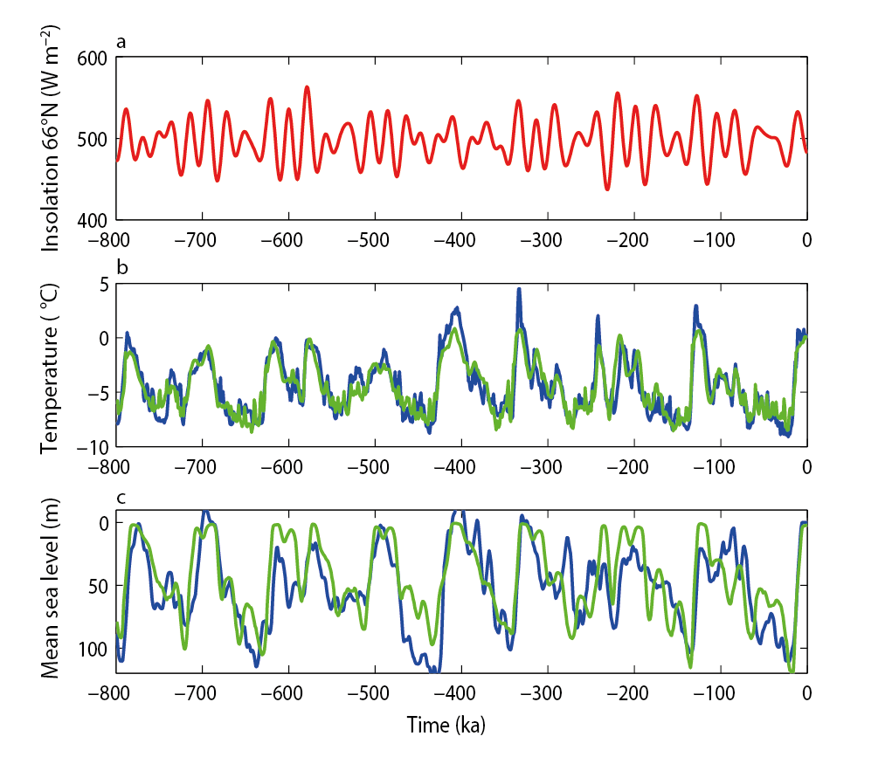
The last million years: glacial interglacial cycles
  The astronomical theory of paleoclimate.
Insolation at 66°N at the June solstice (in W m⁻², red) according to Berger (1978), anomaly of Antarctic temperature reconstructed from the deuterium record (blue) and in the simulation of Ganopolski and Calov (2011) (green), Sea level reconstructed by Elderfield et al. (2012) (blue) and deduced from the change in continental ice volume simulated in Ganopolski and Calov (2011) (green).
June insolation at 66°N
Antarctic temperature
Sea level
Observation
Model
Chapter 5 Page 44

Slide 45
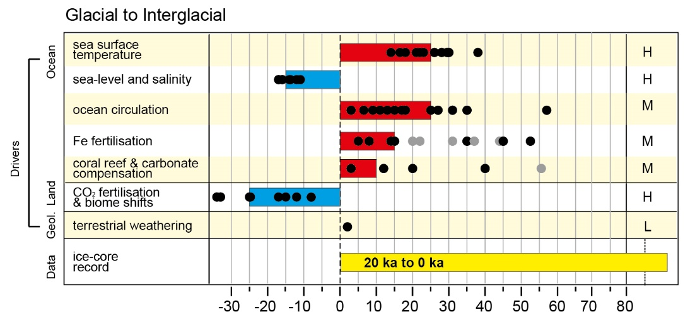
The last million years: glacial interglacial cycles
  The glacial-interglacial variations in the atmospheric CO₂ concentration reach 90 ppm.
  This corresponds to a radiative forcing of 2 W m⁻².
Mechanisms contributing to the glacial to interglacial difference in CO₂.
CO₂ changes (ppm)
Figure from Ciais et al. (2013).
Chapter 5 Page 45

Slide 46
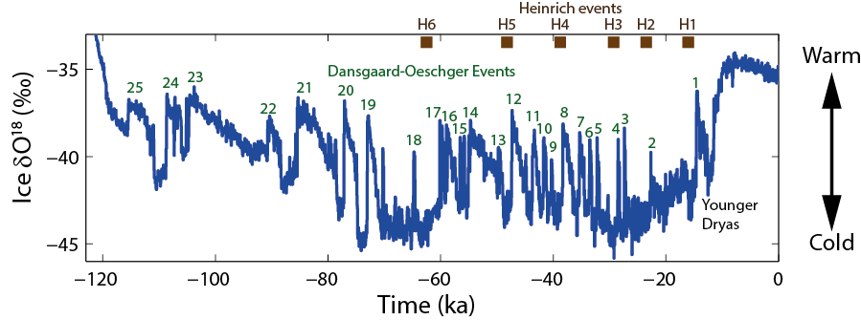
Millennial-scale variability during glacial periods
  Dansgaard-Oeschger events are abrupt events characterized by warming in Greenland of several degrees in a few decades.
Time series of δ¹⁸O measurements obtained in the framework of the North Greenland Ice Core Project (NGRIP, North Greenland Ice Core Project Members, 2004).
  Dansgaard-Oeschger events have a global impact.
Chapter 5 Page 46

Slide 47
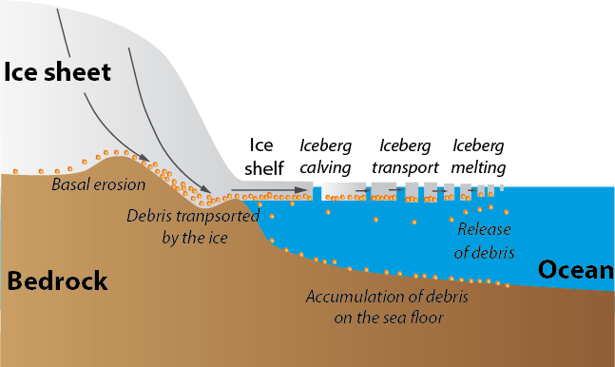
Millennial-scale variability during glacial periods
  Heinrich events correspond to a massive iceberg discharge that let thick layers of debris in the sediments of the North Atlantic.
Schematic representation of the massive iceberg release leading to the sediments deposits characteristics of Heinrich events.
Chapter 5 Page 47

Slide 48
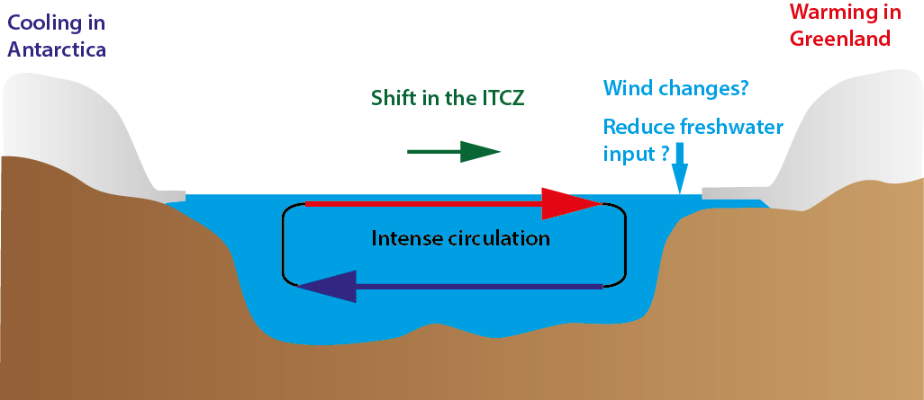
Millennial-scale variability during glacial periods
  The millennial-scale variability is likely related to the ice sheet dynamics and the oceanic circulation.
Schematic representation of the processes potentially occurring during Dansgaard-Oeschger events.
Chapter 5 Page 48

Slide 49
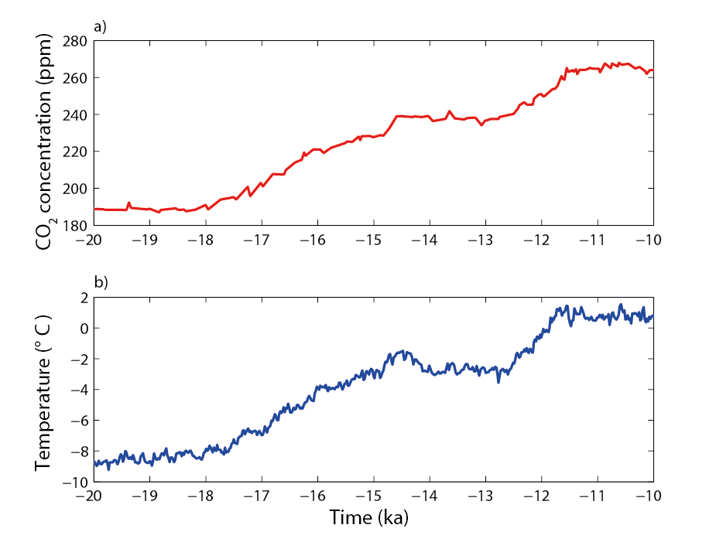
The last deglaciation
  The increase in CO₂ concentration appears synchronous with the temperature rise in Antarctica.
CO₂ concentration
Antarctic temperature
Times series of CO₂ concentration measured in the EDC ice core and Antarctic temperature estimated from a composite of five Antarctic ice cores records during the deglaciation. Data from Parrenin et al. (2013).
Chapter 5 Page 49

Slide 50
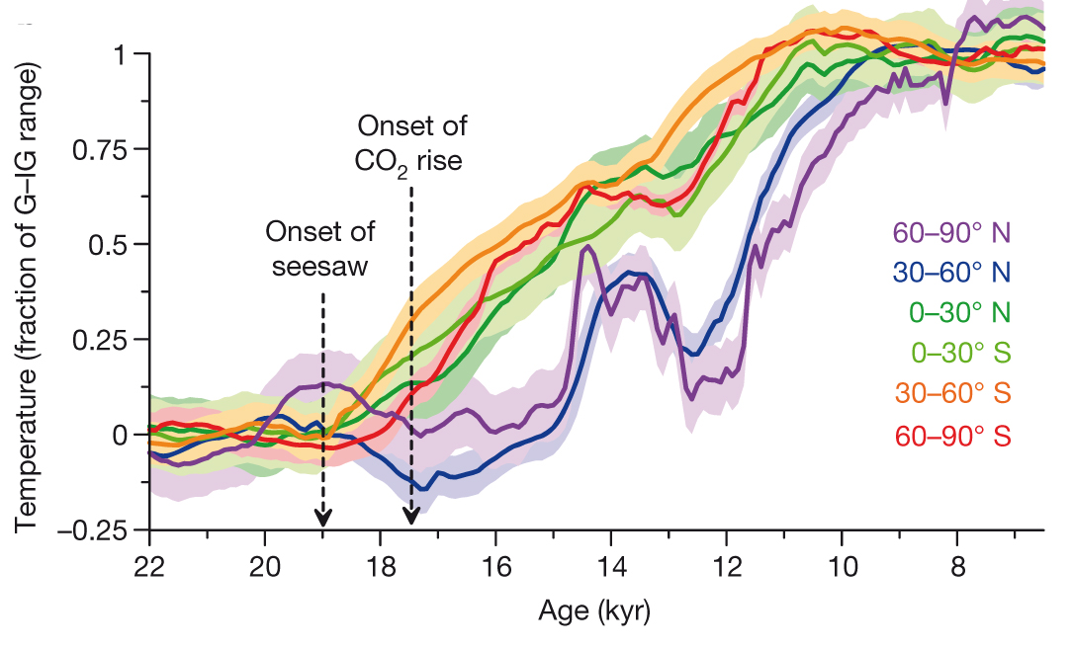
The last deglaciation
  The deglaciation is also characterized by millennial-scale variability.
Younger Dryas
Time series of temperature averaged over different latitudes bands reconstructed from a compilation of various proxies. Figure from Shakun et al. (2012).
Chapter 5 Page 50

Slide 51
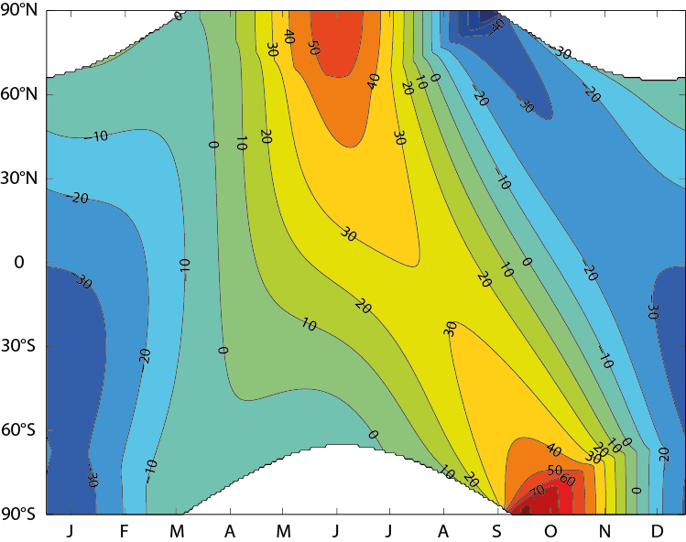
The current interglacial –The Holocene
  The maximum of summer insolation at high latitudes over the Holocene was reached at the beginning of the interglacial.
Deviations from present-day values at 10ka BP of the daily insolation for calendar months (in Wm⁻²). Data from Berger (1978). Figure from Marie-France Loutre.
Chapter 5 Page 51

Slide 52
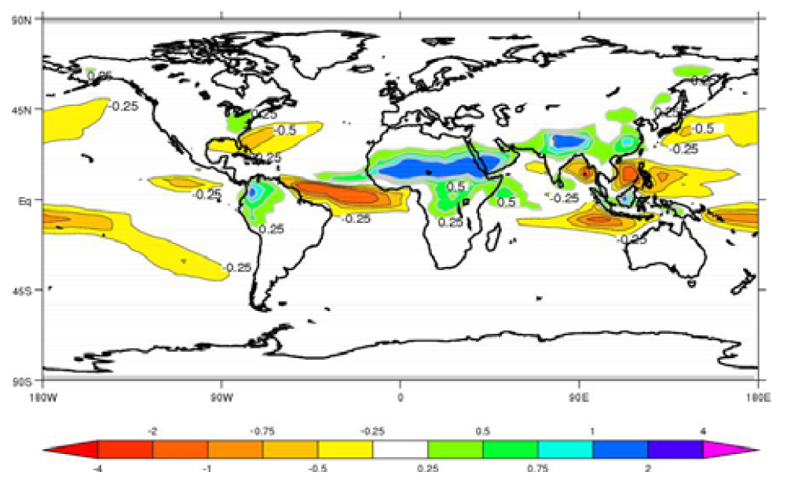
The current interglacial –The Holocene
  The Holocene Thermal Optimum is found between 9 and 6 ka BP in the Northern Hemisphere.
  Northern Hemisphere summer monsoon was stronger in the early and mid-Holocene.
Difference of precipitation (mm/d) between Mid-Holocene (6000 yr BP) and preindustrial conditions for the ensemble mean of PMIP2 simulations. Figure from Braconnot et al. (2007).
Chapter 5 Page 52

Slide 53
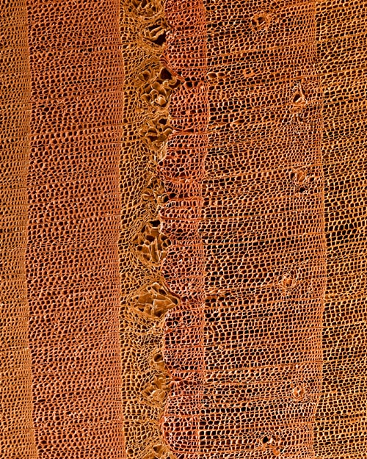
Science and Engineering Visualization Challenge
Sept. 12, 2003 Science
FIRST PLACE
Mongolian Frost Rings
Dee Breger
Magnification: 35×
Sample courtesy of G. Jacoby
Krakatau?
535 A.D.
536 A.D.
537 A.D.
538 A.D.
Notes:
This spectacular image of a frost ring earned an award from Science magazine. When a tree is damaged by frost during the growing season it is not only narrower, but also exhibits pockets produced by the expansion of ice crystals. This very cold event in Mongolia is evidence for a very cold summer and is coincident with a major sulfate layer in Greenland ice. Identification of the specific eruption that produced this has not yet been made. Was it a Krakatau eruption?
How is tree ring growth affected by diffuse radiation from volcanic eruptions?

Slide 54
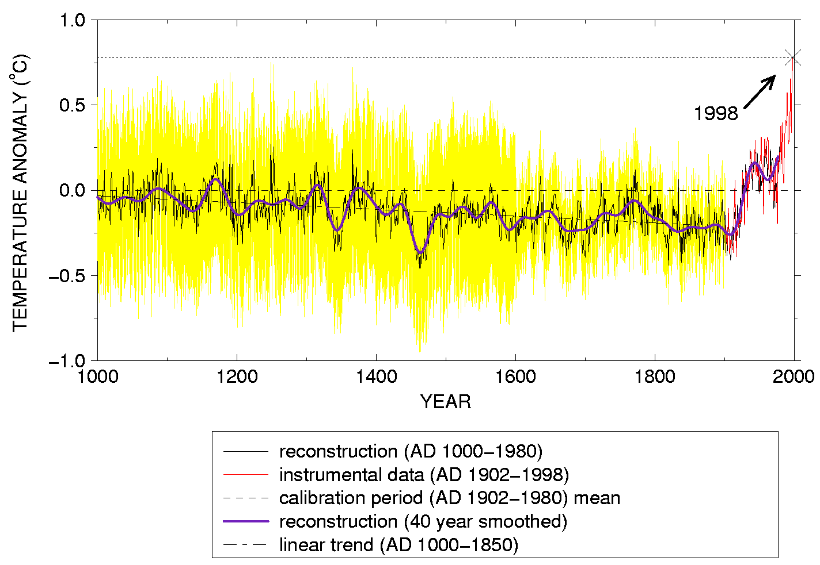
Mann et al.
(1999)

Slide 55
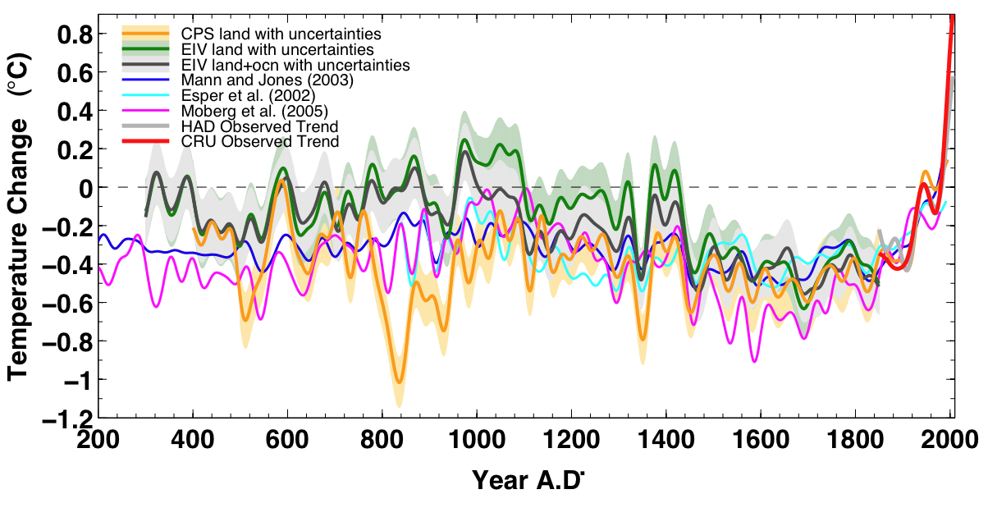

Figure 19: Northern Hemisphere reconstructed temperature change since 200 AD

Slide 56
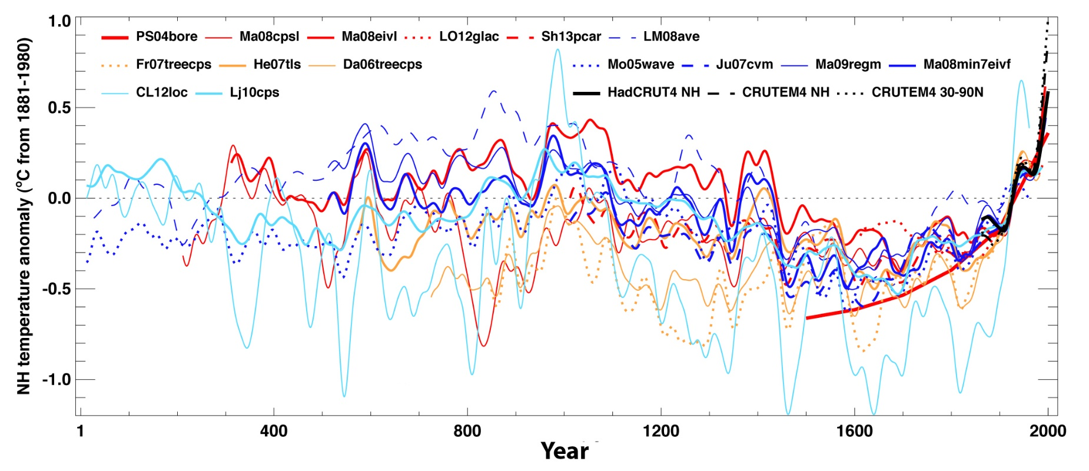
The past 2000 years
  The global mean temperature shows relatively mild conditions between 950 and 1250 AD and cold conditions between 1450 and 1850 AD.
Reconstructions of Northern Hemisphere temperatures during the last 2000 years. Figure from Masson-Delmotte et al. (2013).
  The last 30 years were likely the warmest 30-year period of the last 1400 years in the Northern Hemisphere
Chapter 5 Page 56

Slide 57
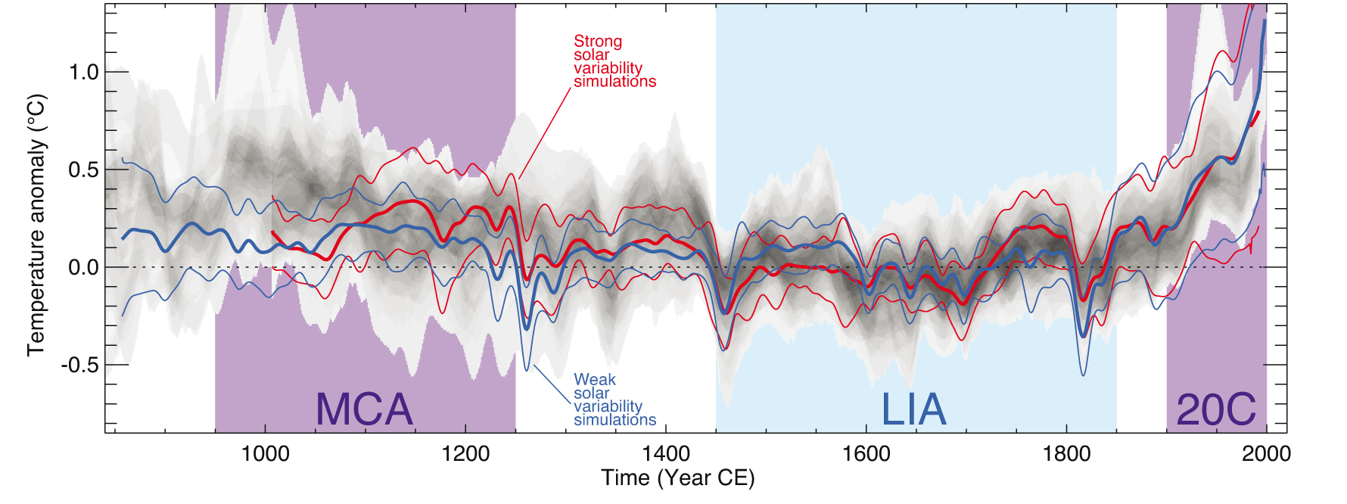
The past 2000 years
  When driven by natural and anthropogenic forcings, model are able to reproduce the observed changes.
Range of the reconstructions
Medieval Climate Anomaly
Little Ice Age
20th century
Comparison of simulated and reconstructed changes over past millennium in the Northern Hemisphere. Figure from Masson-Delmotte et al. (2013).
Chapter 5 Page 57

Slide 58
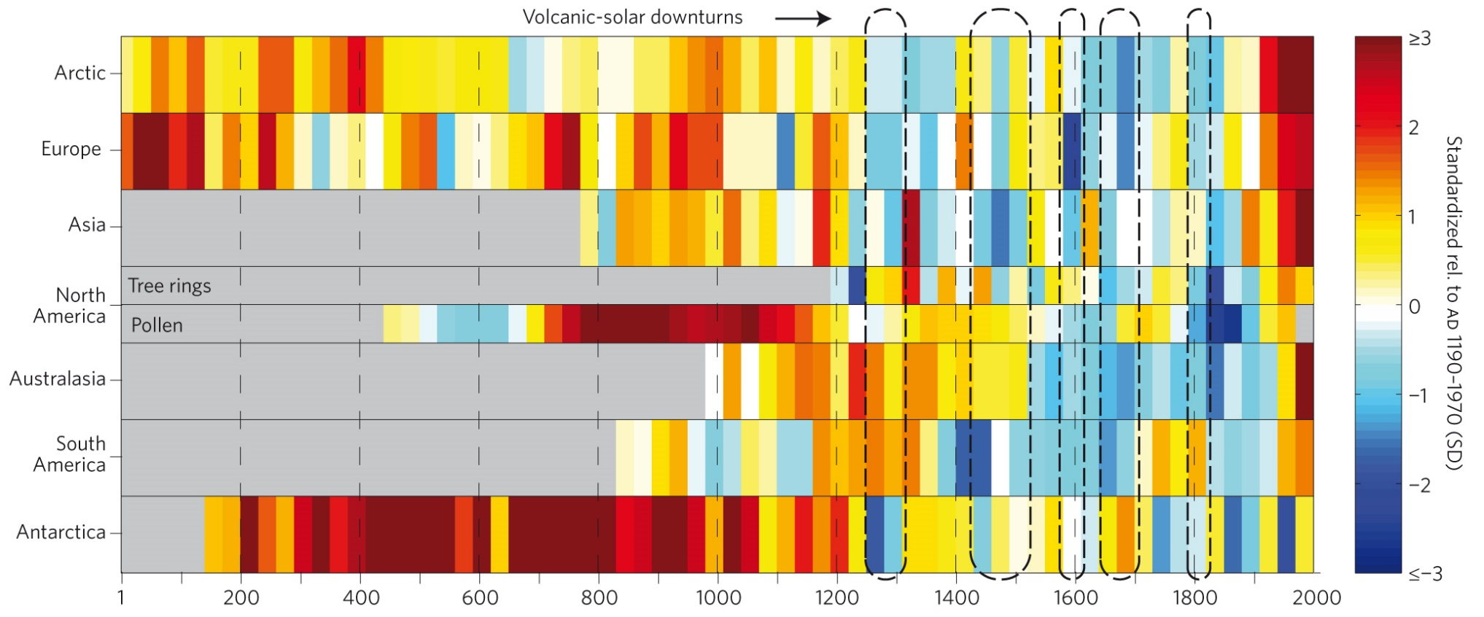
The past 2000 years
  Some characteristics are common, but the warm and cold periods are not synchronous between the different regions.
Temperature reconstructions for seven continental-scale regions. Figure from PAGES2K (2013).
Chapter 5 Page 58

Slide 59
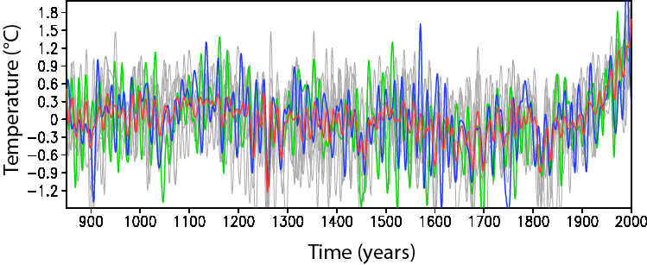
The past 2000 years
  Internal variability is responsible for some of the warm and cold periods in the different regions.
Two simulations are in blue and red.
Eight simulations are in grey.
Surface temperature anomaly (°C) in the Arctic over the last millennium in an ensemble of 10 simulations using the same model driven by the same natural and anthropogenic forcings. A decadal smoothing has been applied to the series. Data from Crespin et al. (2013).
Chapter 5 Page 59

Slide 60
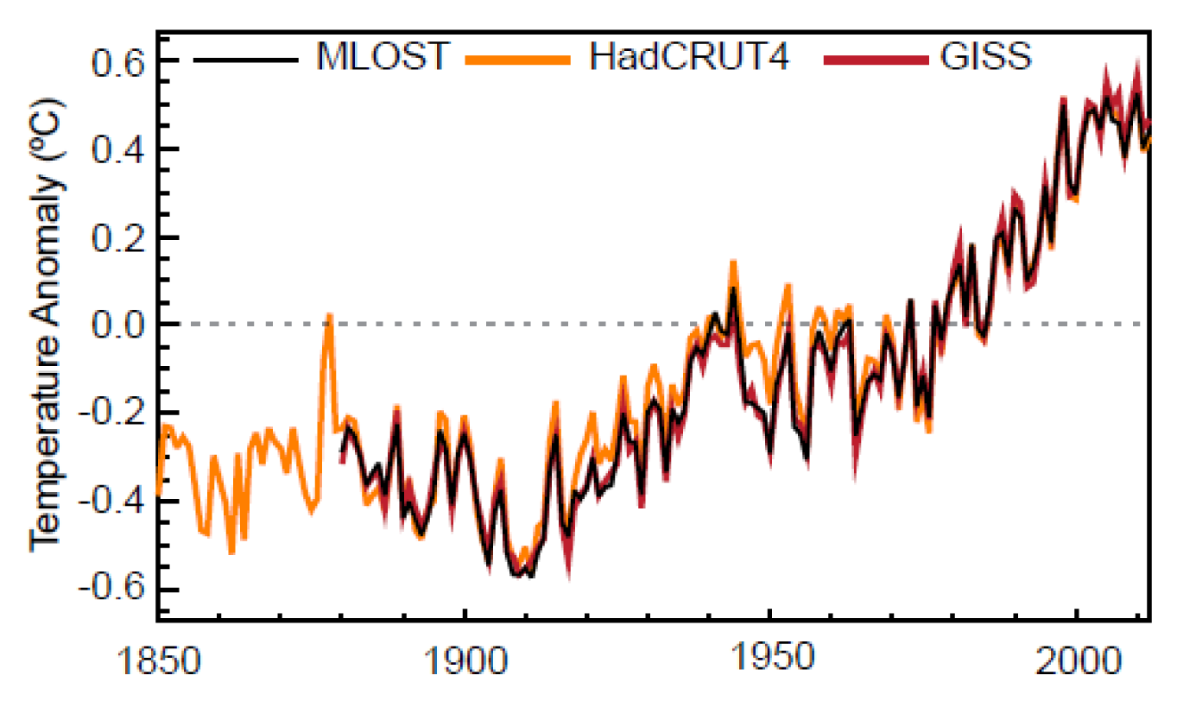
The last century
  The linear trend of global mean temperature over the years 1901-2012 gives an increase of 0.89°C over that period.
Global mean annual surface temperature (°C) from 1850 to 2012 relative to the 1961 to 1990 mean, from 3 different datasets. Figure from Hartmann et al. (2014).
Chapter 5 Page 60

Slide 61
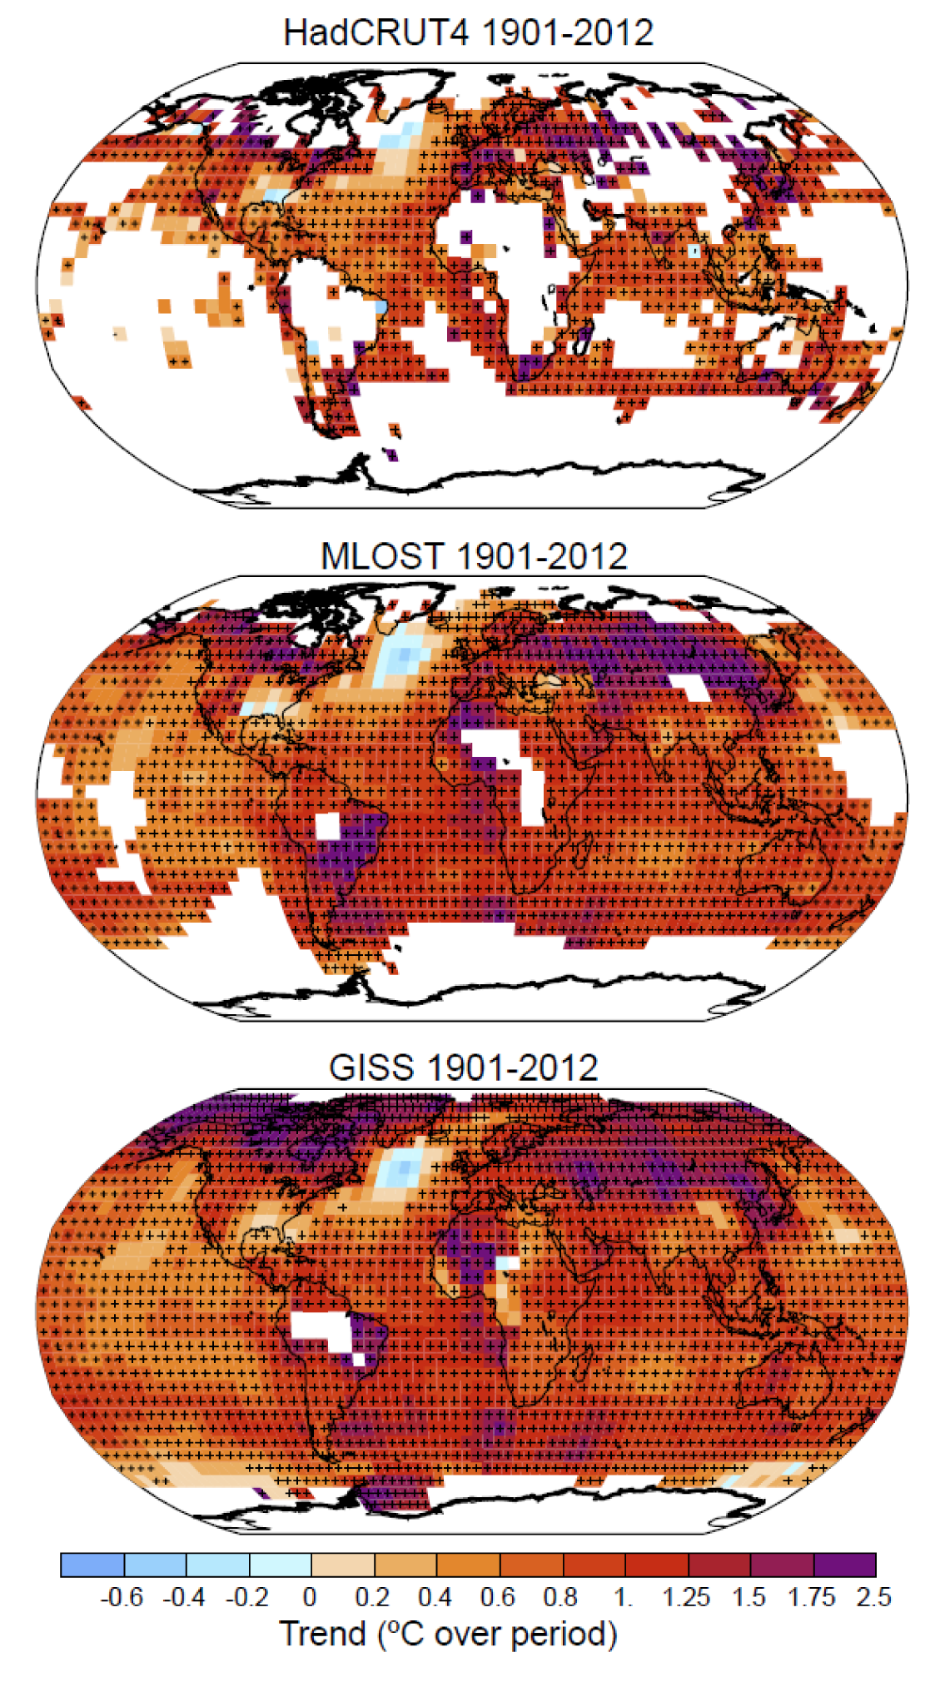
The last century
  Warming is seen in nearly all the regions with generally a slower warming over ocean than over land.
Linear trend of annual temperatures between 1901 and 2012 in HadCRUT4 and GISS datasets (°C over the period). Figure from Hartmann et al. (2014).
Chapter 5 Page 61

Slide 62
Detection and attribution of recent climate changes
  The anthropogenic origin of the rise in atmospheric CO₂ concentration since the 19th century is unequivocal.
  The part of the recent temperature changes compatible with the natural variability can be estimated using various techniques.
Chapter 5 Page 62

Slide 63
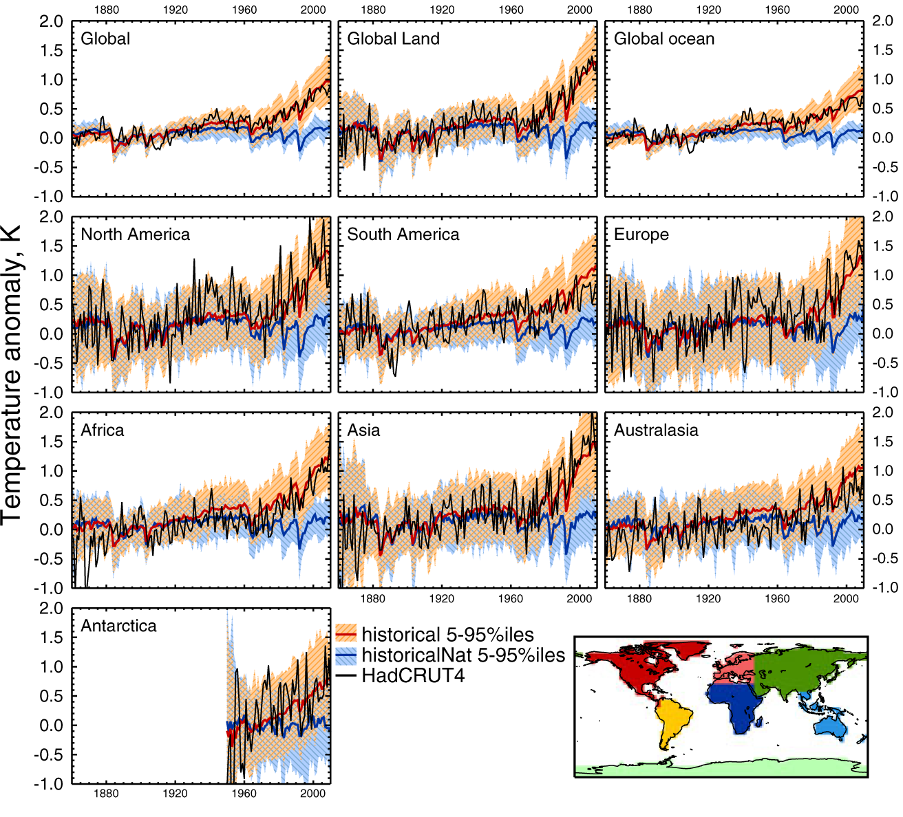
Detection and attribution of recent climate changes
  Simulations using various combinations of forcings can be compared to observations.
Models with natural and anthropogenic forcings
Observations
Models with natural forcings only
Figure from Jones et al. (2013)
Chapter 5 Page 63

Slide 64
Detection and attribution of recent climate changes
  Observations are not compatible with the hypothesis stating that the changes in climate observed recently are in the range of natural variability on decadal to centennial timescales.
  Observations are compatible with the hypothesis that anthropogenic forcing is needed to explain the recent temperature changes.
Chapter 5 Page 64

Slide 65
Detection and attribution of recent climate changes
  Detection and attribution methods represent the observed changes as the sum of the response to different forcings and
  internal variability.
Spatial dimensions
Number of forcings studied
“Fingerprint”
Time
Observations
Internal variability
Response to forcing i.
Scaling coefficient
Chapter 5 Page 65

Slide 66
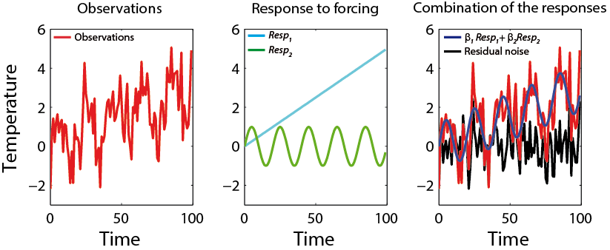
Detection and attribution of recent climate changes
  Example: simple, idealised situation, considering
  an observed time series T(t)
Simple illustration of the detection and attribution method. The observed time series
T(t) = β₁ Resp₁(t) + β₂ Resp₂(t)+u(t). In the chosen example, the coefficient of the linear combination are β₁=0.6 and β₂=1.2.
Chapter 5 Page 66

Slide 67
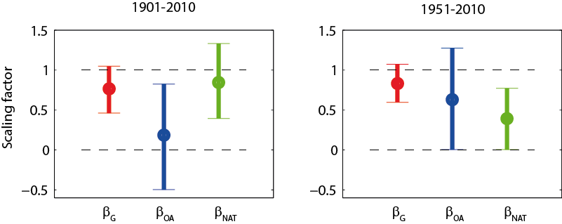
Detection and attribution of recent climate changes
  The contribution of the increase in greenhouse gas concentrations in the atmosphere in the recent warming can be clearly detected.
Greenhouse gases
Other anthropogenic forcings
Natural forcings
Scaling coefficient in a detection and attribution study. Data from Jones et al. (2013).
Chapter 5 Page 67

