Slide 1
How not to make a good PowerPoint

Slide 2
No introduction
No table of contents

Slide 3
Have a poor contrast between text and the background

Slide 4
Use as many different animations as you can.
Use as many different animations as you can.

Slide 5
Fill the page with lots of text that you read, in a font that is very small.
Fill the page with lots of text that you read, in a font that is very small.
Fill the page with lots of text that you read, in a font that is very small.
Fill the page with lots of text that you read, in a font that is very small.
Fill the page with lots of text that you read, in a font that is very small.
Fill the page with lots of text that you read, in a font that is very small.
Fill the page with lots of text that you read, in a font that is very small.
Fill the page with lots of text that you read, in a font that is very small.
Fill the page with lots of text that you read, in a font that is very small.
Fill the page with lots of text that you read, in a font that is very small.
Fill the page with lots of text that you read, in a font that is very small.
Fill the page with lots of text that you read, in a font that is very small.

Slide 6
Use lots of different fonts and colors.
Use lots of different fonts and colors.
Use lots of different fonts and colors.
Use lots of different fonts and colors.
Use lots of different fonts and colors.
Use lots of different fonts and colors.
Use lots of different fonts and colors.
Use lots of different fonts and colors.

Slide 7
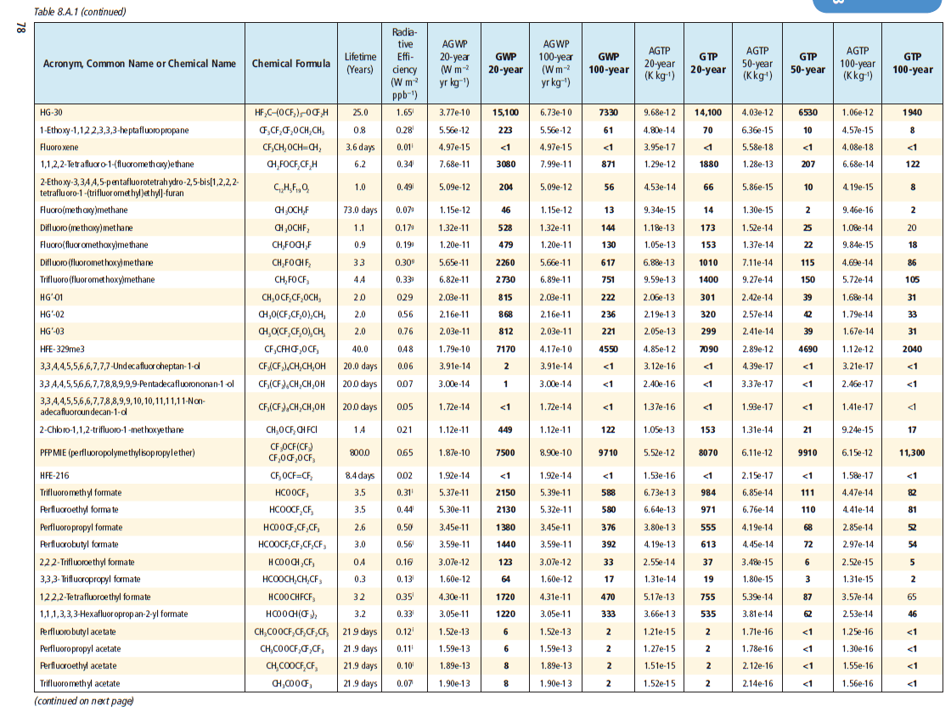
Use lots of tables that are hard to see and that you do not have time to explain.

Slide 8
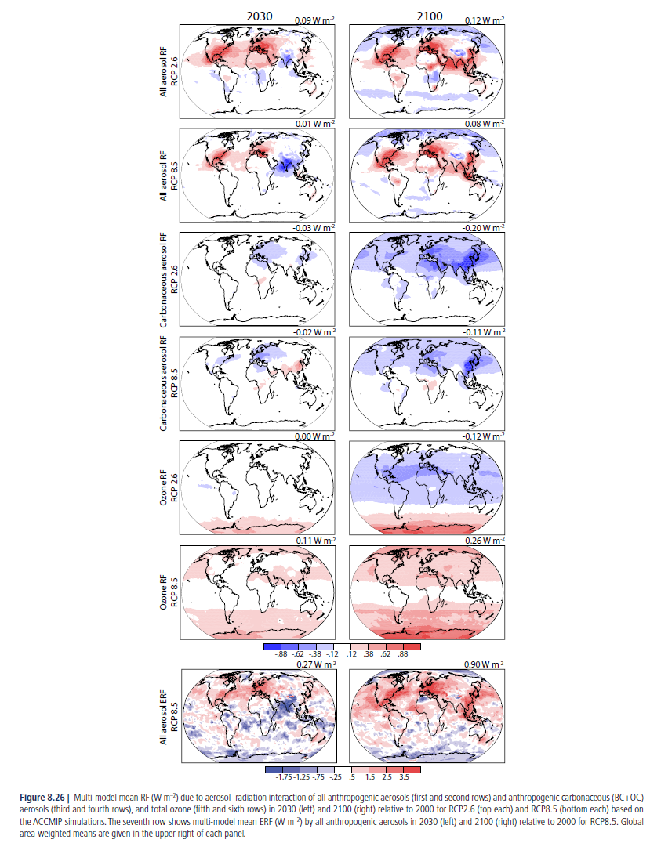
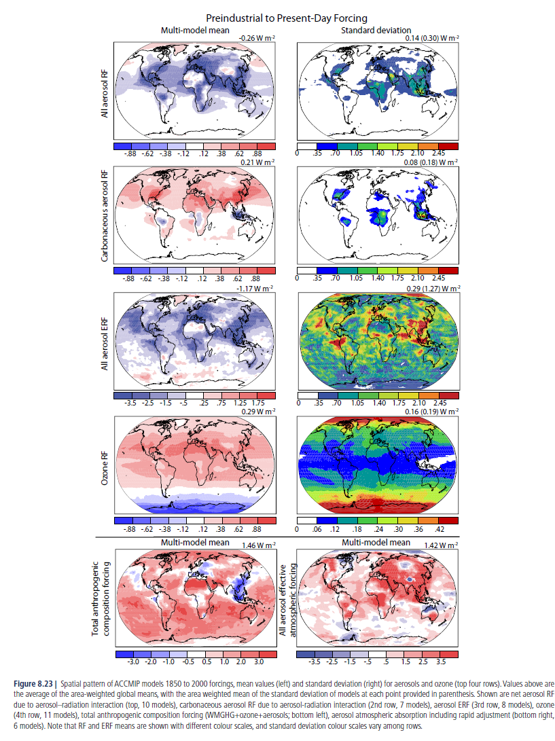
Use lots of tiny figures that are hard to see and that you do not have time to explain.

Slide 9
No conclusions

