Slide 1



Areas of uncertainty in climate model inputs:
We will never be able to predict everything that will happen in a nuclear war, but we might identify the range of plausible outcomes
Brian Toon
Department of Atmospheric and Oceanic Sciences
Laboratory for Atmospheric and Space Physics,
University of Colorado, Boulder
http://climate.envsci.rutgers.edu/nuclear/

Slide 2
Major uncertainties in input to climate models
Weapons, targets and what happens when a bomb explodes
Fuel loads & composition
Fire spread in cities
Fraction of fuel burned
Smoke composition
Smoke rise

Slide 3
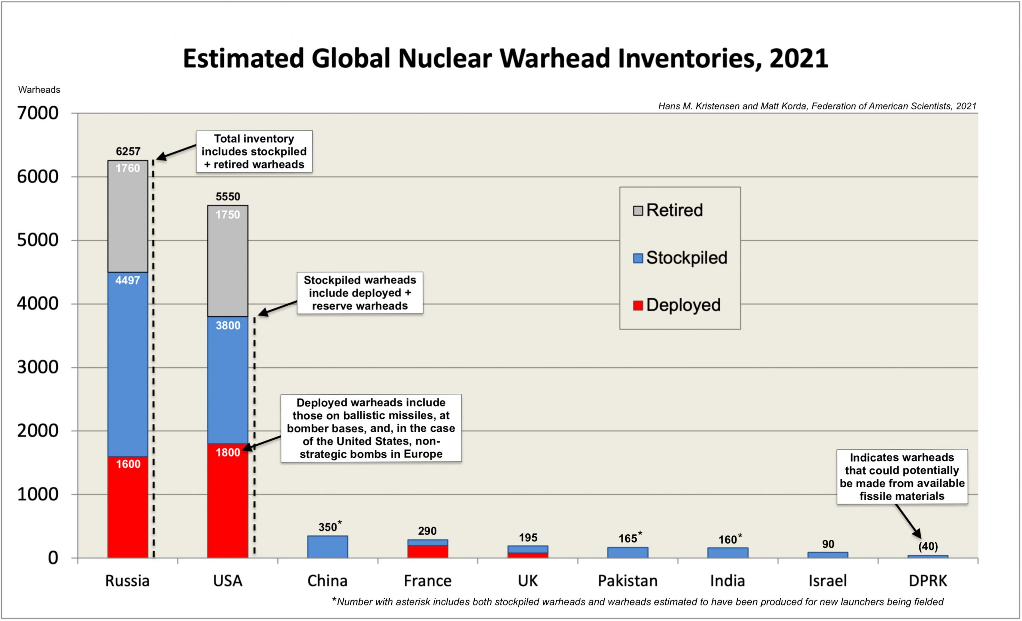
About 8,000 Strategic Weapons are restricted by treaty, ~1200 weapons are not
R.S. Norris, H.M. Kristensen, (2006).
Notes:
R.S. Norris, H.M. Kristensen, Bull. Atom. Scientists, 62 (4), 64 (2006).

Slide 4
U. S. and Russia have about 1600 deployed weapons each, 225kt average yield
Delivery system | Number of warheads | Number deployed | Average yield in kt (range)
U.S. ICBMs | 800 | 400 | 325 (300-335)
U.S. SLBMs | 1920 | 900 | 165 (90 kt-1486 weapons-445kt 384 weapons)
U.S. bomber | 850 | 300 | (<5-1200)
U.S. total strategic | 3570 | 1600 | Total deployed yield ~336 Mt; average yield ~210 kt
U.S. tactical | 230 | 150 | (<170)
Russia ICBMs | 1136 | 810 | 454 (100-800)
Russia SLBMs | 720 | 560 | 97 (50-100)
Russia bombers | 580 | 200 | unknown
Russia total strategic | 2436 | 1570 | Total deployed yield ~415 Mt; average yield ~264 kt
Russia tactical | 1870 |  | unknown
United Kingdom SLBM | 195 | 120 | 100
France SLBM Aircraft | 290 | 280 | 50 @ < 300 kt 240 @ 100 kt

Slide 5
Potential military targets
Type of target | U.S. and allies² | NATO³ | Russia and allies⁴
Navy and Marine Units | 214 | 49 | 54
Airforce Units | 137 | 137 | 202
Army Units | 134 | 111 | 111
ICBM silos or launchers⁵ | 450 | 0 | 306
Government centers | 51 |  | 85
EMP | 1
Commercial airports | 10 | 142 | 100
Oil refineries⁶ | 146 | 106 | 21
Oil storage locations | 12
Fossil fuel power plants⁷ | 120 | 54 | 133
Nuclear power plants | 32 | 36 | 9
Hydroelectric power plants | 9 | 3 | 66
Military supporting industry | 56 |  | 99
Commercial harbors on the ocean | 60
Railyards | 70 |  | 25
National laboratories | 45 |  | 44⁸
Total (Sept. 13, 2022) | 1547 + 23 | 638 | 1255 + 47

Slide 6
U.S. Counter Force Targets (~1200)
“Assured Destruction”
Fire ignition area
Toon et al .in prep

Slide 7
U.S. Counter Force Military Targets (~1200)
“Assured Destruction”
Fire ignition area
Toon et al .in prep

Slide 8
Military Targets in San Diego
100 kt weapons
Assured Destruction, 5 and 20 psi
Fire Ignition area, 10 cal/cm²
Toon et al .in prep

Slide 9
Countervalue and Counterforce targets are different

Slide 10
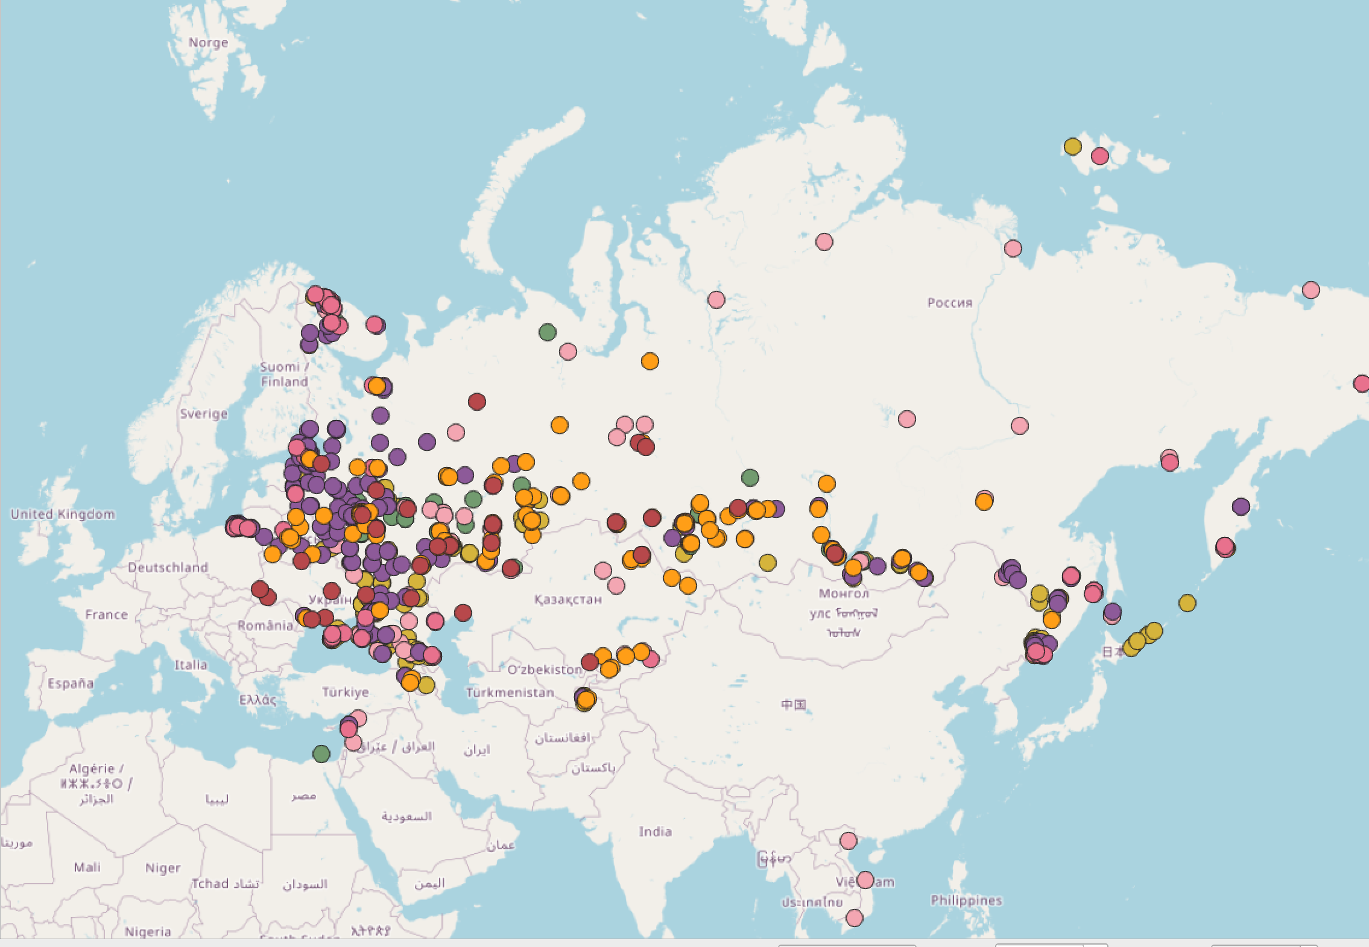
Russian Counter Force Targets (~971)
Toon et al .in prep
“Assured Destruction”
Fire ignition area

Slide 11
European Counter Force Targets (~640)
Toon et al .in prep
“Assured Destruction”
Fire ignition area

Slide 12
Fatalities at Hiroshima, 15 kt airburst

Slide 13
Fatalities, 1 Mt airburst

Slide 14
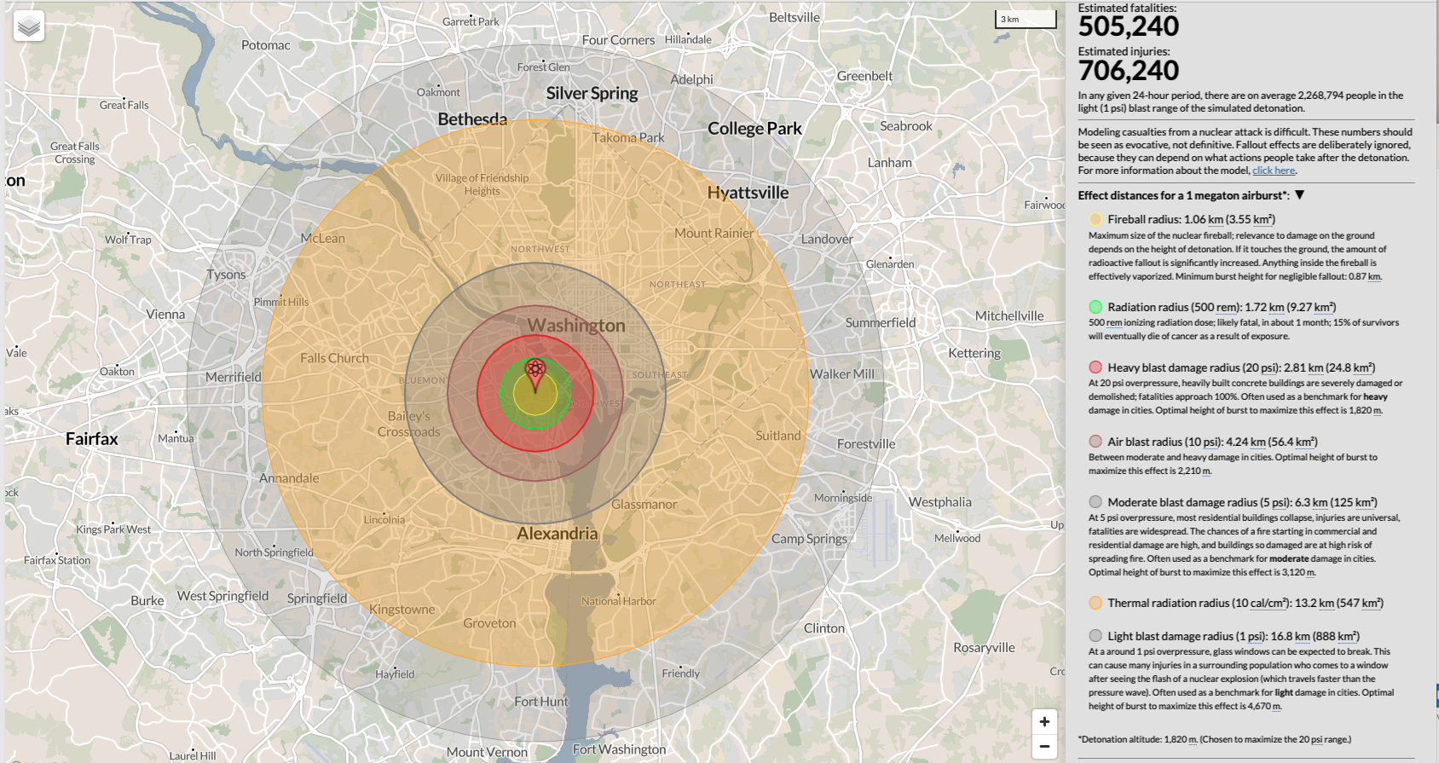
Nukemap by Alex Wellerstein
Will fires over this area create a mesoscale convective complex? Is O2 depleted?
Is rubble restricted to 10-20% of fire area?
See Nuclear War: a Scenario by Annie Jacobsen

Slide 15
Area impacted versus yield

Slide 16
Fuel loading scales with population
Toon et al, 1997
Notes:
Top down and bottom up studies show that over large areas the fuel loading scales with population. www.atmos-chem-phys.net/7/1973/2007/
We are trying a new approach for the U.S. in which we resolve every building with Zillow or satellite data to determine the fuel loads

Slide 17
Las Vegas, NV
Satellite based fuel loads have potential to improve fuel loads
Indianapolis
1999
2020
Cincinnati
> 0
>10⁷
Balch et al. 2023
Combustible mass [t]

Slide 18
U. S. Structural mass, tonnes/person
Fuel type/Fuel load | Turco et al., 1990 Total mass | Frantz et al, 2023 Structure mass
Wood, lumber, paper | 8.8 | 11.6
Plastics & polymers | 0.44 | 2.4
Asphalt | 0.33 | 0.32
Vegetation | 0.55 | NA
Petroleum | 0.88 | NA
Total | 11 | 14.3
Can we do this for other countries? Can we now say how the fuel is distributed?
Notes:
Turco is NATO, Warsaw pact average
Frantz ia U.S. at 10 m

Slide 19
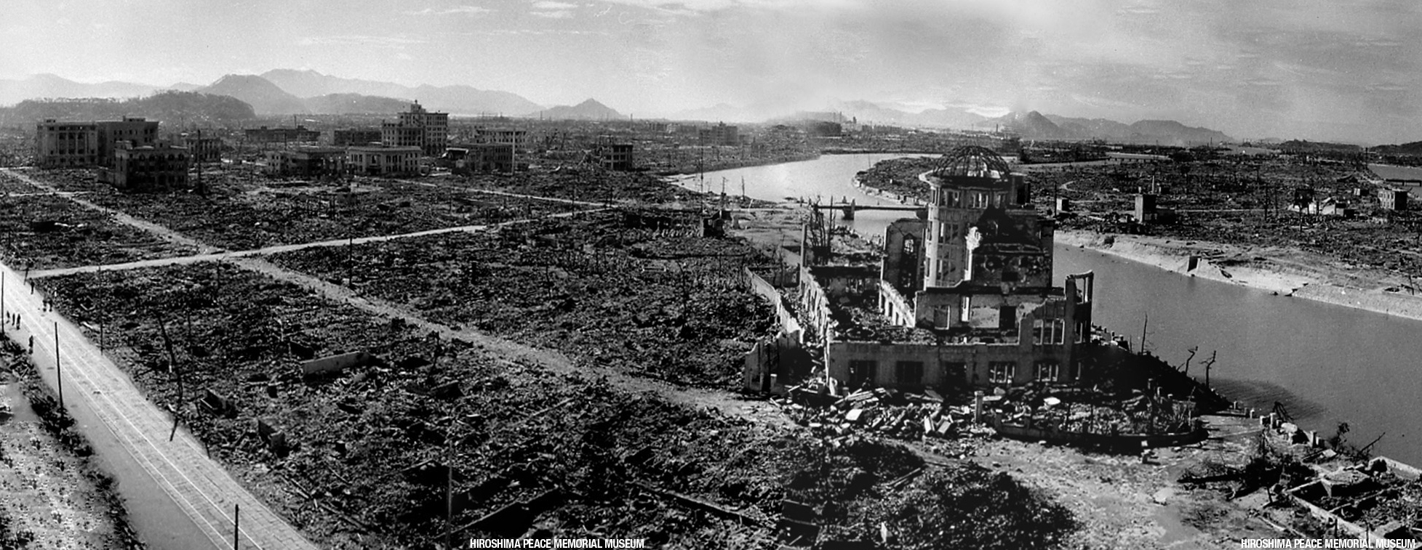
Firestorm at Hiroshima consumed almost all fuel and released ~1000 the energy of the bomb

Slide 20
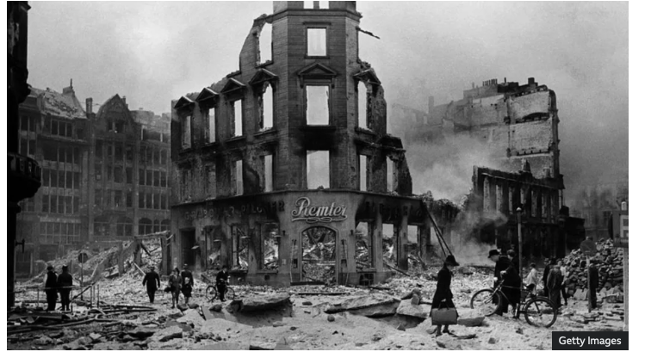
Firestorm at Hamburg consumed almost all fuel

Slide 21
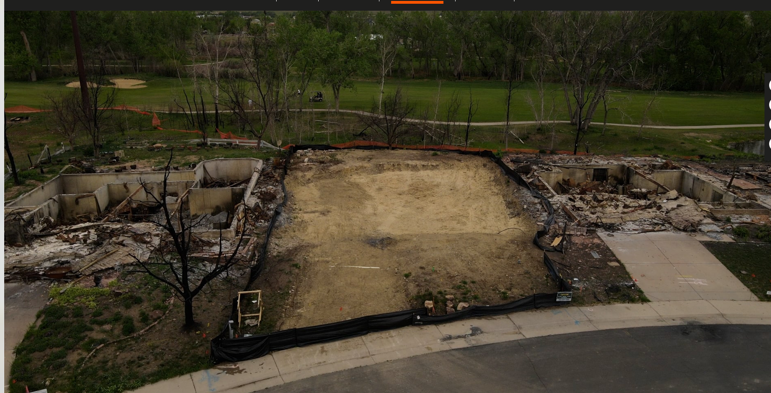
Marshall CO conflagration consumed house fuel, but not vegetation, skipped some houses

Slide 22
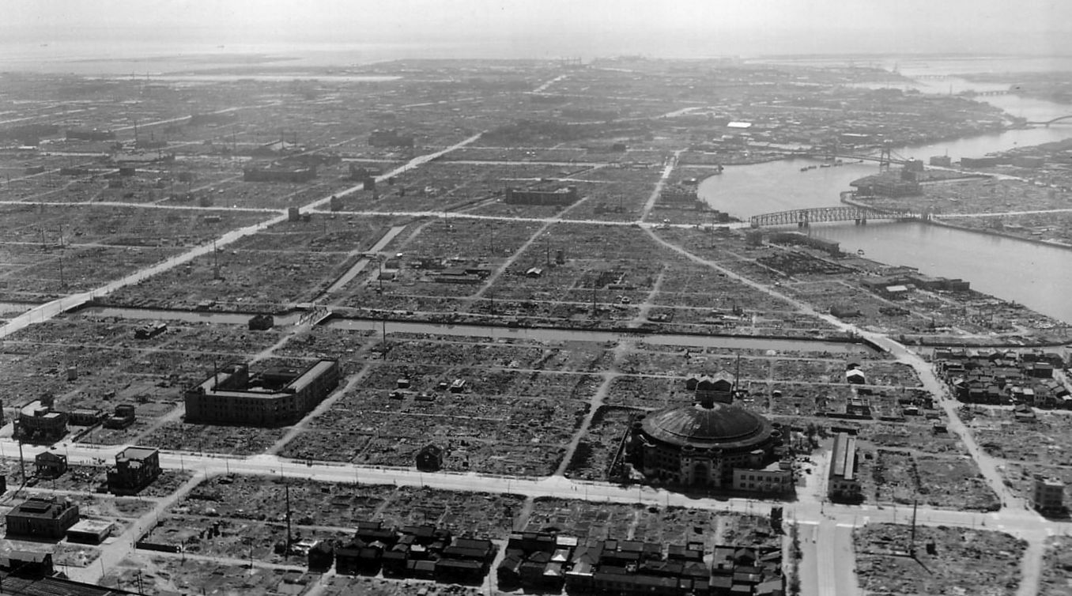
Tokyo conflagration consumed house fuel, but not all vegetation
After the bombing of Tokyo, only buildings of brick and stone remained. National Archives

Slide 23
Smoke/BC emission factors for fuels, more data needed for wood
.
Flammable material | Quantity burned in 1990 scenario (Tg) | BC (soot) emission factor g/g fuel burned Turco et al. [1990] | BC emission in 1990 scenario (Tg) | Average BC emission factor found by Toon et al (range) | BC fraction of total smoke g/g found by Toon et al. (range) | BC (Total) [total range] smoke emission in 1990 scenario Tg
A Wood and lumber | 4000 (2000-6000) | 0.01 (0.002-0.02) | 40 (4-120) | 0.01 (0.0005-0.019 | 0.70 (0.56-0.86) | 40 (57) [71-47]
B. Petroleum | 600 (250-1100) | 0.06 (0.03-0.10) | 36 (7.5-110) | 0.06 (0.0163-0.105) | 0.82 (0.76-0.9) | 36 (44) [47-40]
C. Plastic and polymers | 200 (100-300) | 0.08 (0.05-0.10) | 16 (5-30) | 0.08 (0.0265-0.2218) | 0.68 (0.25-0.97) | 16 (24) [64-27]
D. Asphalt roofing | 125 (60-200) | 0.10 (0.06-0.13) | 12.5 (3.6-26) | 0.08 (0.0623-0.1003) | 0.665 (0.61-0.72) | 10 (15) [16-14]
E.Vegetation | 150 (150-750) | 0.003 (0.001-0.005) | 0.45 (0.15-3.8) | 0.0005 (0.0001-0.00055) | 0.03 (0.005-0.08) | 0.075 (2.5) [15-.4]
Total | 5075 (2560-8350) |  | 105 (20-290) |  |  | 102 (142) [213-128] {1.39-2.09-1.25}
Turco et al. 1990; Toon et al. in prep
Notes:
"Climate and smoke: An appraisal of nuclear winter" (R. P. Turco, O.B. Toon, T. P. Ackerman, J. Pollack, and C. Sagan) Science, 247, 166-176 (1990).
Note new data are consistent with older 1980s studies. However new lab data are needed especially for wood and lumber with high temperatures and low oxygen.

Slide 24
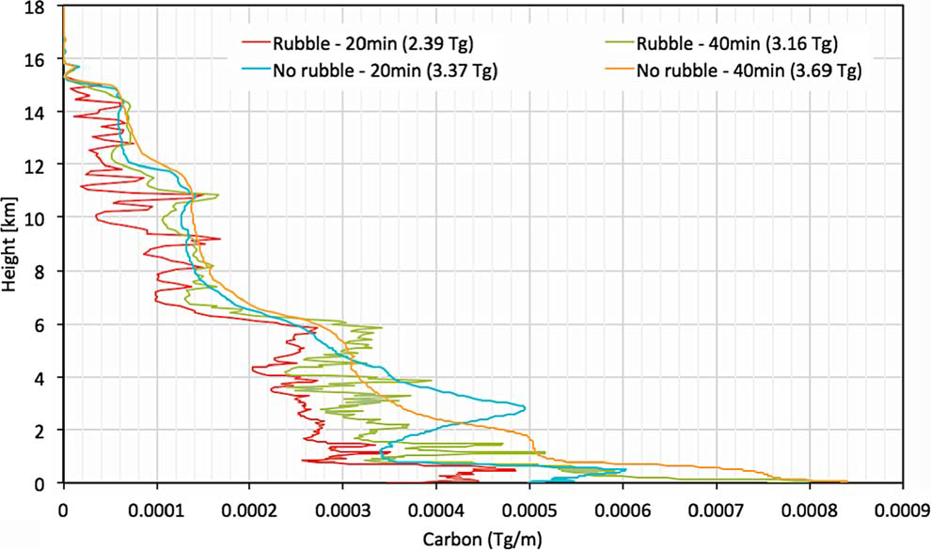
Reisner et al 2018 JGR question smoke rise
<-trop
…while our thorough simulations of the firestorm produce about 3.7 x 10⁹ kg of black
carbon, we find that the vast majority of the black carbon never reaches an altitude above weather systems…. Our analysis demonstrates that the probability of significant global cooling from a limited exchange scenario as envisioned in previous studies is highly unlikely, a conclusion supported by examination of natural analogs,
such as large forest fires and volcanic eruptions.

Slide 25
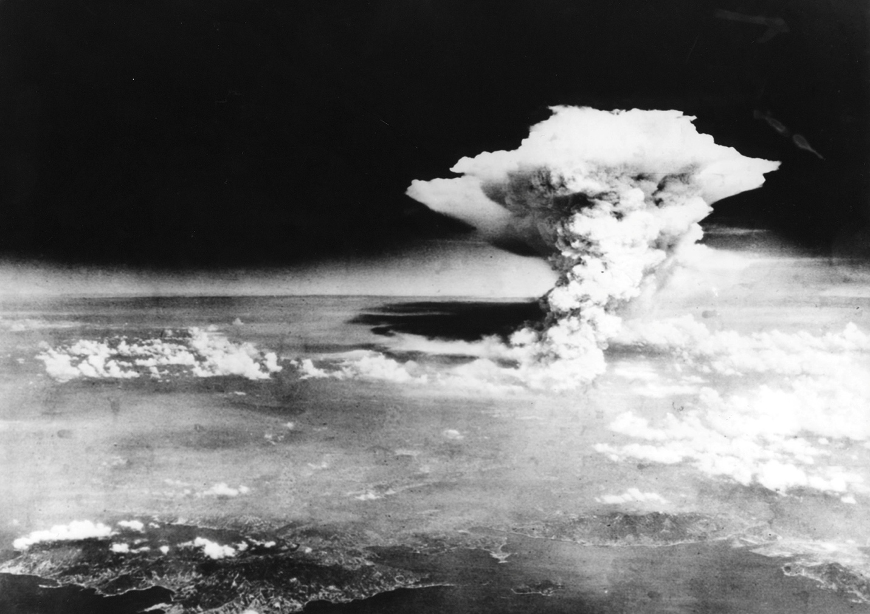
Smoke from fires in Hiroshima after the atomic blast reached 16 km
http://www.atomicarchive.com
Notes:
Pyrocumulus in Hiroshima about three hours after the explosion. 1000 time as much energy released in fires as from bomb

Slide 26

Black radioactive rain fell on Hiroshima. How much smoke is removed this way?

Slide 27
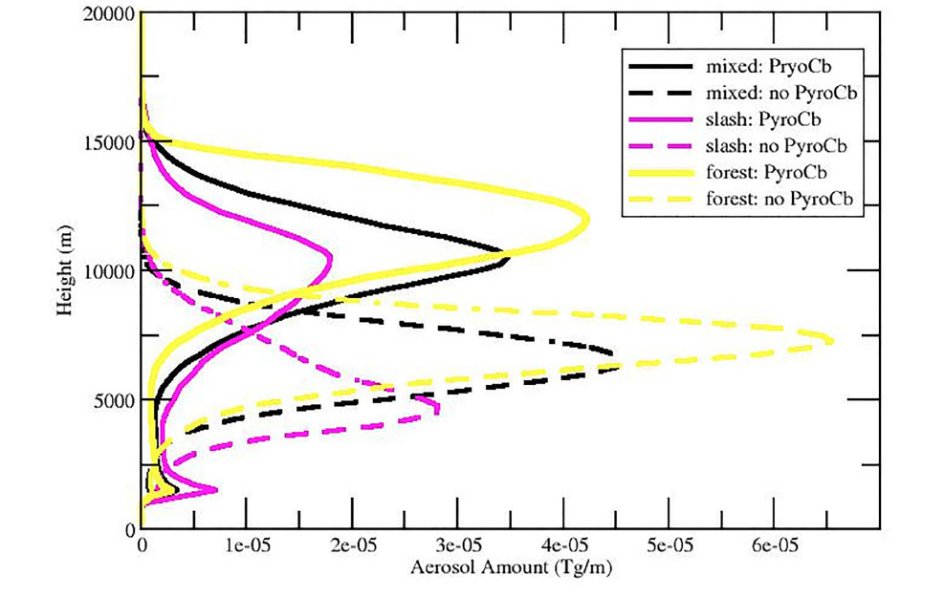
Reisner et al 2018 is wrong for many reasons including neglect of latent heat
Redfern et al 2021 10.1029/2020JD034332. Wagman et al. 2020 10.1029/2020jd033056. Badlan et al 2021doi.org/10.1071/WF20040
Tarnish & Romps 2022 10.1029/2022JD036667 Reisner et al. 2023 10.1029/2022JD037238
<-Trop
Reisner, et al
2023

Slide 28
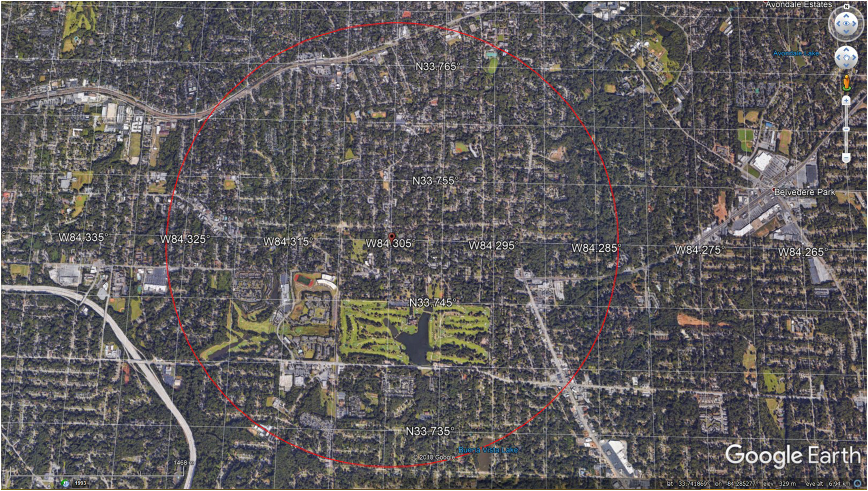
Reisner et al 2018 paper wrong for many reasons
WWII criteria for fire storm
Fuel loading >8 lbs/ft² (39 kg/m²)
Fire density >50% of structures on fire simultaneously
Surface Wind <8 mph (3.58 m s⁻¹)
Fire storm area >0.5 square miles (1.3 × 10⁶ m²).

Slide 29
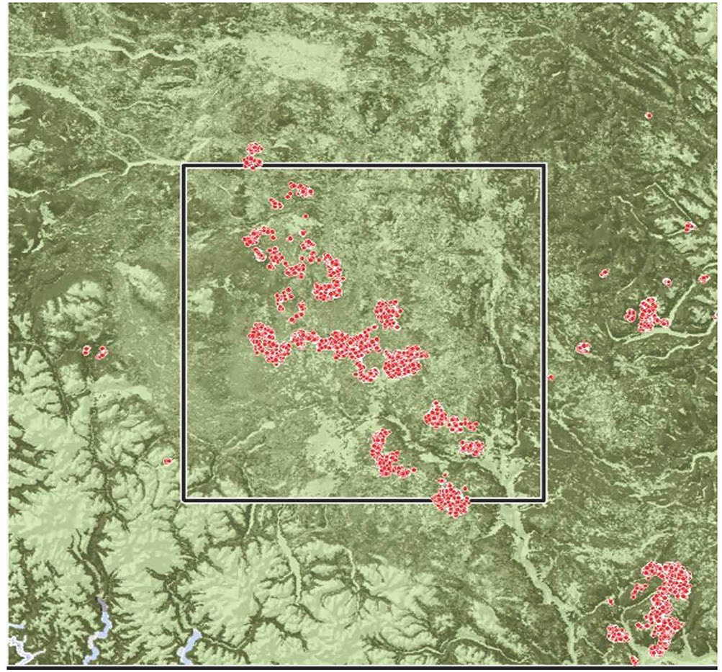
Reisner paper is wrong for many reasons
WWII criteria for fire storm
Fuel loading >8 lbs/ft² (39 kg/m²)
Fire density >50% of structures on fire simultaneously
Surface Wind <8 mph (3.58 m s⁻¹)
Fire storm area >0.5 square miles (1.3 × 10⁶ m²).
400 km->

Slide 30
Summary-areas of uncertainty
Largest source of uncertainty is scenario
  No bombs no problem
  543 nuclear weapons with 440 Mt of yield , about half the yield in current arsenals, exploding on deserts and islands does little to climate.
  100 explosions of 15 kt weapons in densely populated cities may perturb the climate, and possibly kill many through starvation, but it isn’t a nuclear winter.

Slide 31
Summary - Areas of uncertainty in climate model inputs
Fuel loads & composition -need to develop satellite data for high resolution maps and extend outside U.S.
Fire spread in cities –poorly understood, no current models, need to include O₂ loss, will large area fires develop multiple firestorms, how much fuel will rubble bury
Fraction of fuel burned -need studies of what burns in conflagrations, can we model fire spread in cities
Smoke composition -need data on BC fraction and emission factors especially for lumber
Smoke rise - need to better understand frequency of high wind cases, which may retard rise. Need to understand conditions for smoke to get into the stratosphere. Does winter matter to self lofting? Need to quantify soot removal.
Targets – need to understand differences in smoke amount for military targets versus urban targets

