Slide 1

The G4-Specified Stratospheric Aerosol Experiment
Alan Robock¹, Lili Xia¹, and Simone Tilmes²
¹Dept. Environmental Sci., Rutgers University, New Brunswick, NJ
²National Center for Atmospheric Research, Boulder, Colorado
robock@envsci.rutgers.edu
http://envsci.rutgers.edu/~robock

Slide 2
Scientific motivation:
- Pitari et al. (2014) compared the results of the G3 and G4 experiments and concluded that it was very difficult to identify the impact of aerosol geoengineering on chemistry and dynamics because every model developed a very different aerosol distribution.
- To understand the impact of geoengineering in a multi-model comparison project, a prescribed aerosol distribution is useful. Chemistry-Climate Model Initiative (CCMI) models are well suited for this activity. Ideally, we still need more modeling groups to perform this experiment.
Pitari, Giovanni, Valentina Aquila, Ben Kravitz, Alan Robock, Shingo Watanabe, Natalia De Luca, Glauco Di Genova, Eva Mancini, and Simone Tilmes, 2014: Stratospheric ozone response in experiments G3 and G4 of the Geoengineering Model Intercomparison Project (GeoMIP). J. Geophys. Res. Atmos., 119, 2629-2653, doi:10.1002/ 2013JD020566.

Slide 3
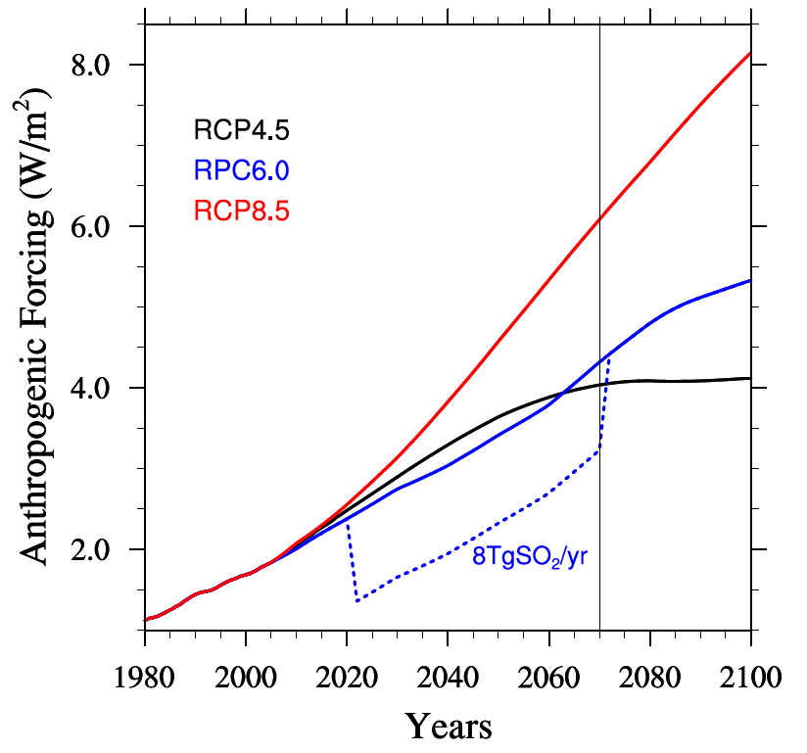
GeoMIP Chemistry Climate Model Initiative (CCMI)
G4SSA (specified stratospheric aerosols) experiment
Tilmes, S., M. J. Mills, U. Niemeier, H. Schmidt, A. Robock, B. Kravitz, J.-F. Lamarque, G. Pitari, and J. M. English, 2015: A new Geoengineering Model Intercomparison Project (GeoMIP) experiment designed for climate and chemistry models. Geosci. Model Dev., 8, 43-49, doi:10.5194/gmd-8-43-2015.

Slide 4
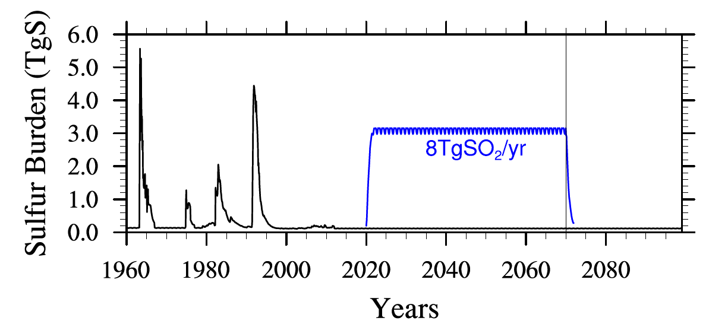
GeoMIP CCMI G4SSA experiment
Tilmes, S., M. J. Mills, U. Niemeier, H. Schmidt, A. Robock, B. Kravitz, J.-F. Lamarque, G. Pitari, and J. M. English, 2015: A new Geoengineering Model Intercomparison Project (GeoMIP) experiment designed for climate and chemistry models. Geosci. Model Dev., 8, 43-49, doi:10.5194/gmd-8-43-2015.

Slide 5
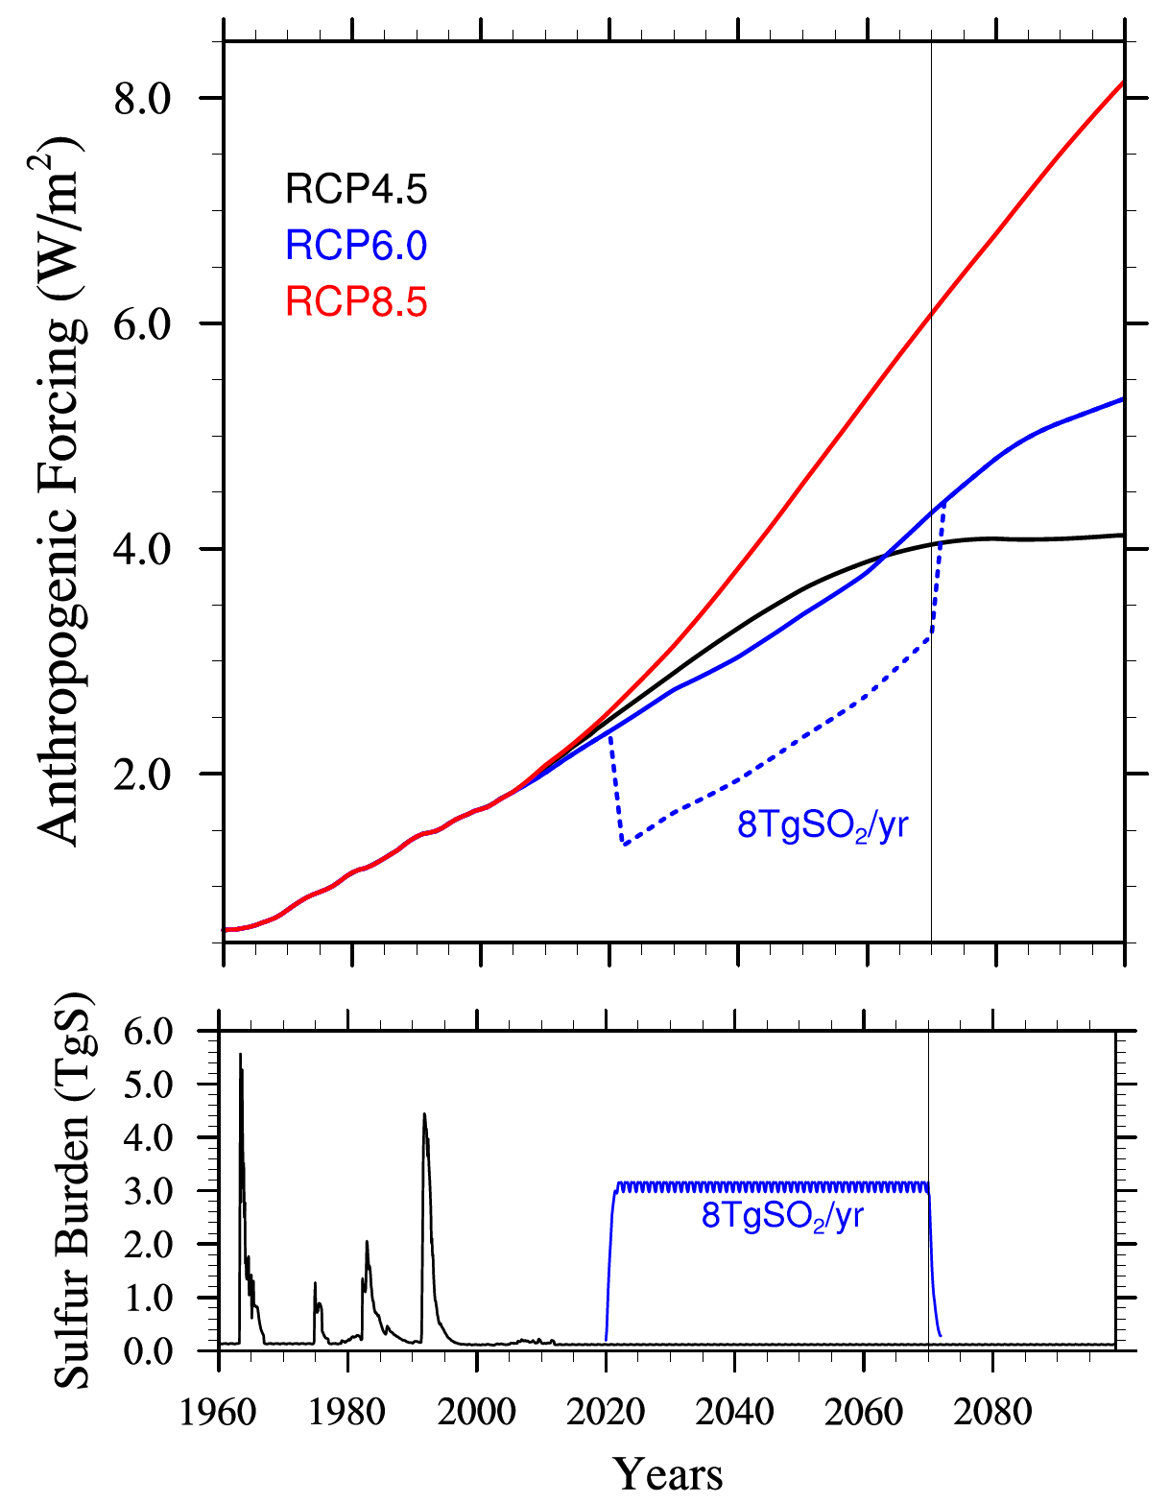
G4SSA Forcing:
Steady-state prescribed aerosol distribution, based on an 8 Tg SO₂ year⁻¹ emission scenario using the ECHAM5-HAM model, combined with RCP6.0
Tilmes, S., M. J. Mills, U. Niemeier, H. Schmidt, A. Robock, B. Kravitz, J.-F. Lamarque, G. Pitari, and J. M. English, 2015: A new Geoengineering Model Intercomparison Project (GeoMIP) experiment designed for climate and chemistry models. Geosci. Model Dev., 8, 43-49, doi:10.5194/gmd-8-43-2015.

Slide 6
Scientific questions:
- How will stratospheric chemistry and dynamics respond to stratospheric aerosols?
- How will the resulting increase in downward diffuse radiation affect the carbon cycle?
- How will the troposphere respond to changed radiation, stratosphere-troposphere exchange of ozone, volatile organic carbon (VOC) emissions from vegetation, and increased downward ultraviolet radiation?
- What will be the impacts on crops?
Xia, Lili, Alan Robock, Simone Tilmes, and Ryan R. Neely III, 2015: Stratospheric sulfate geoengineering enhances the terrestrial gross primary productivity. Atmos. Chem. Phys. Disc., 15, 25,627-25,645, doi:10.5194/acpd-15-25627-2015.

Slide 7

Simulations with:
NCAR Community Earth System Model Community Atmospheric Model 4 (CESM CAM4-chem)
- horizontal resolution of 0.9º x 1.25º lat-lon
- 26 levels from the surface to about 40 km (3.5 mb)
- coupled with Community Land Model (CLM) version 4.0 with prescribed satellite phenology (CLM4SP)
- no interactive carbon-nitrogen cycle, but nitrogen limitation is implicit because nitrogen availability limits the leaf area index in the satellite measurements used in CLM4SP
- 3 ensemble members of RCP6.0
- 3 ensemble members of G4SSA
- G4SSA-solar run now ongoing

Slide 8
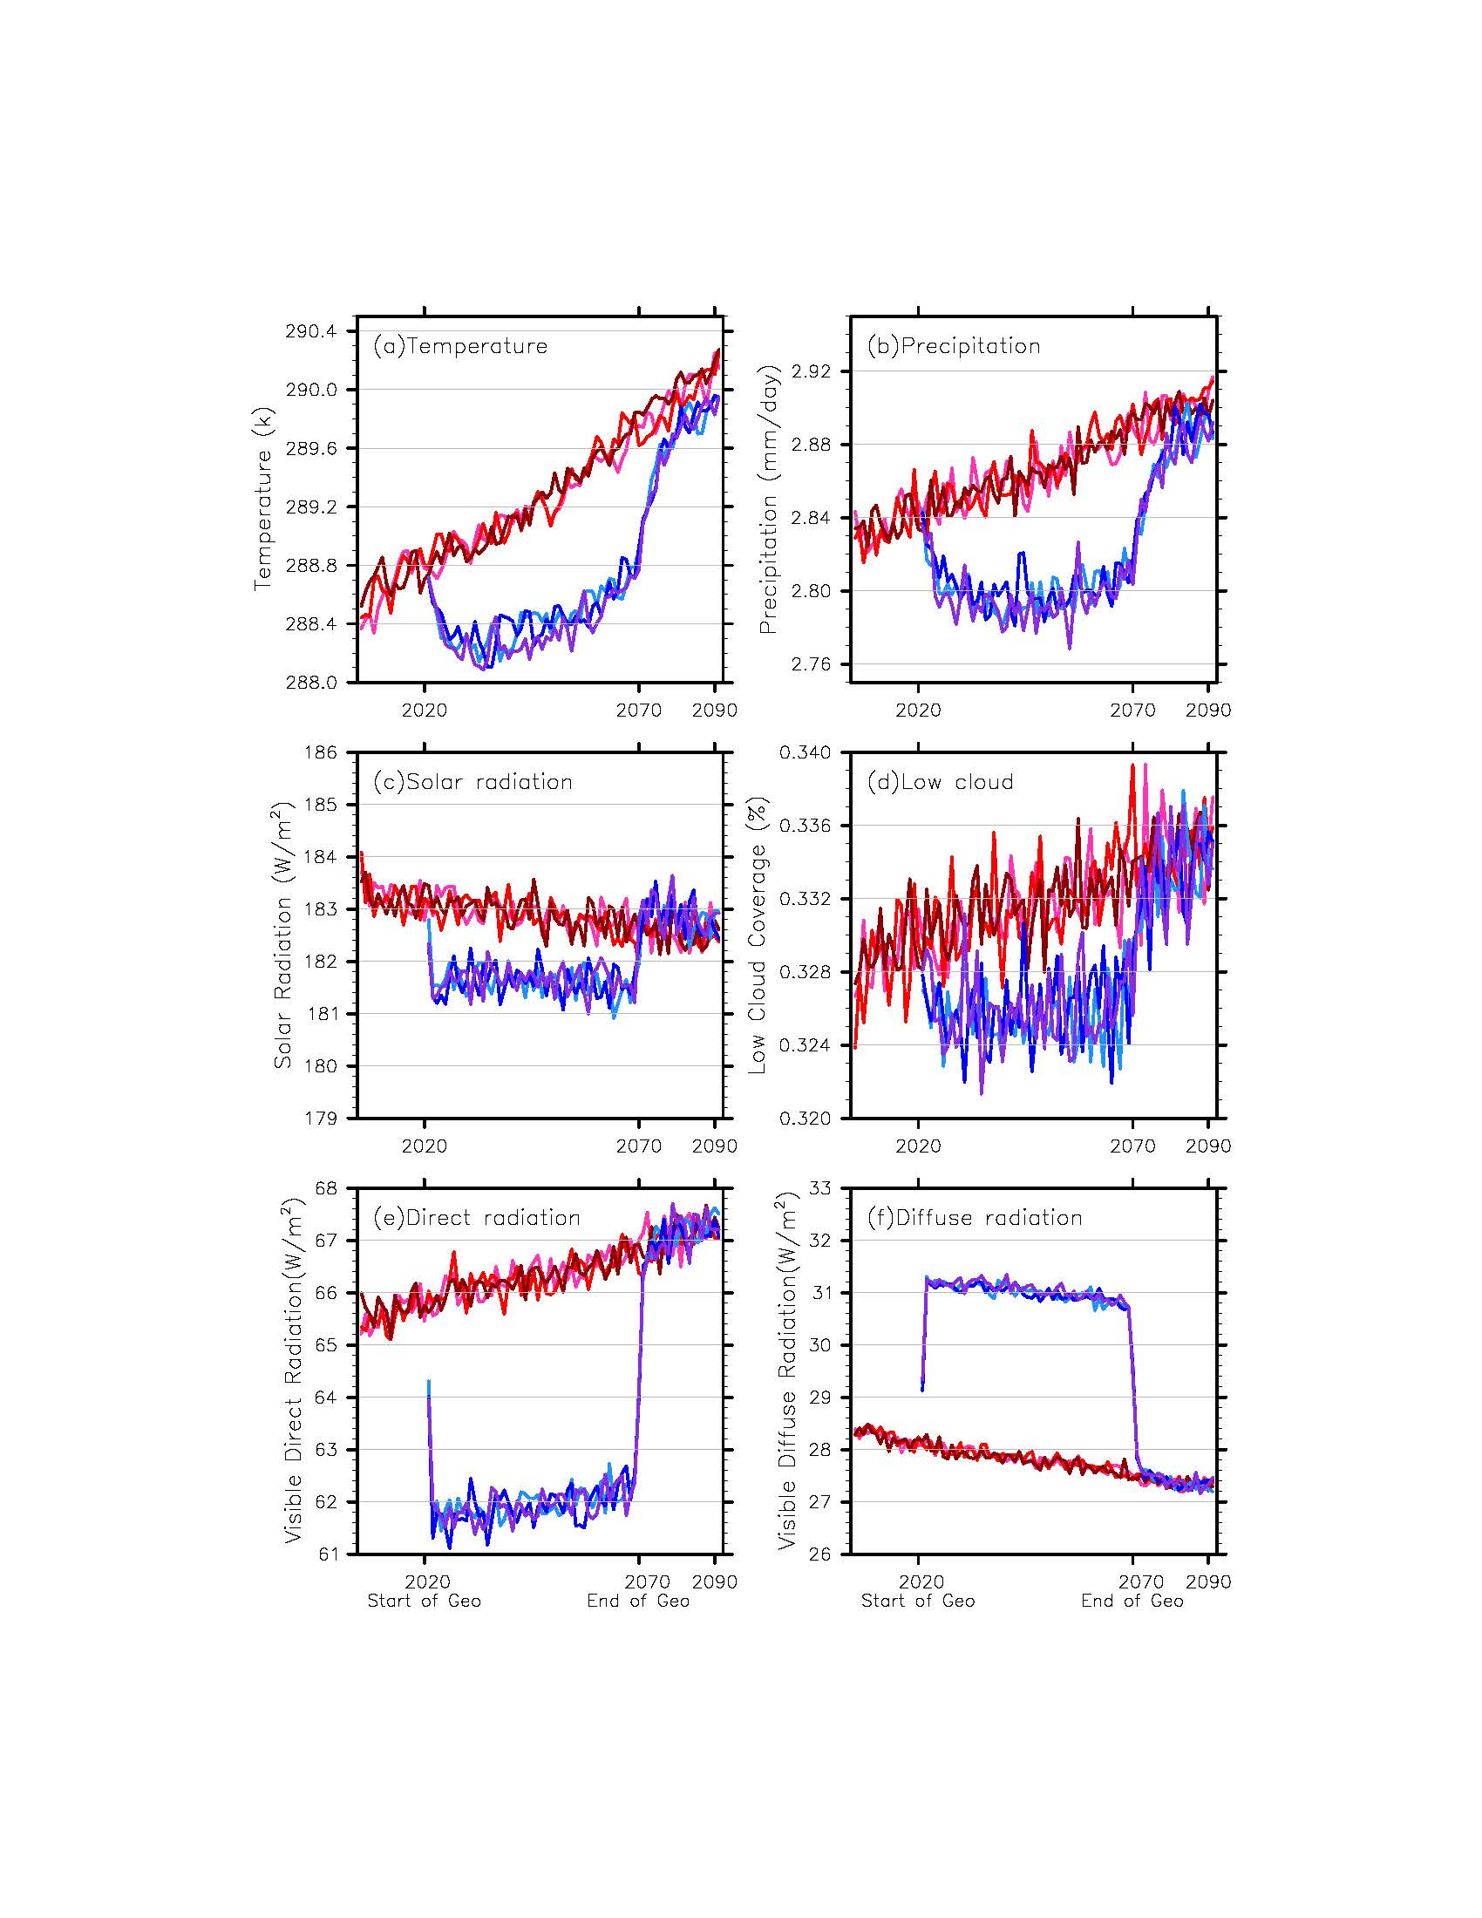
Global, annual averages
RCP6.0
G4SSA

Slide 9
Land Average of:
Direct Radiation
Diffuse Radiation
4.2 W/m²
3.0 W/m²

Slide 10
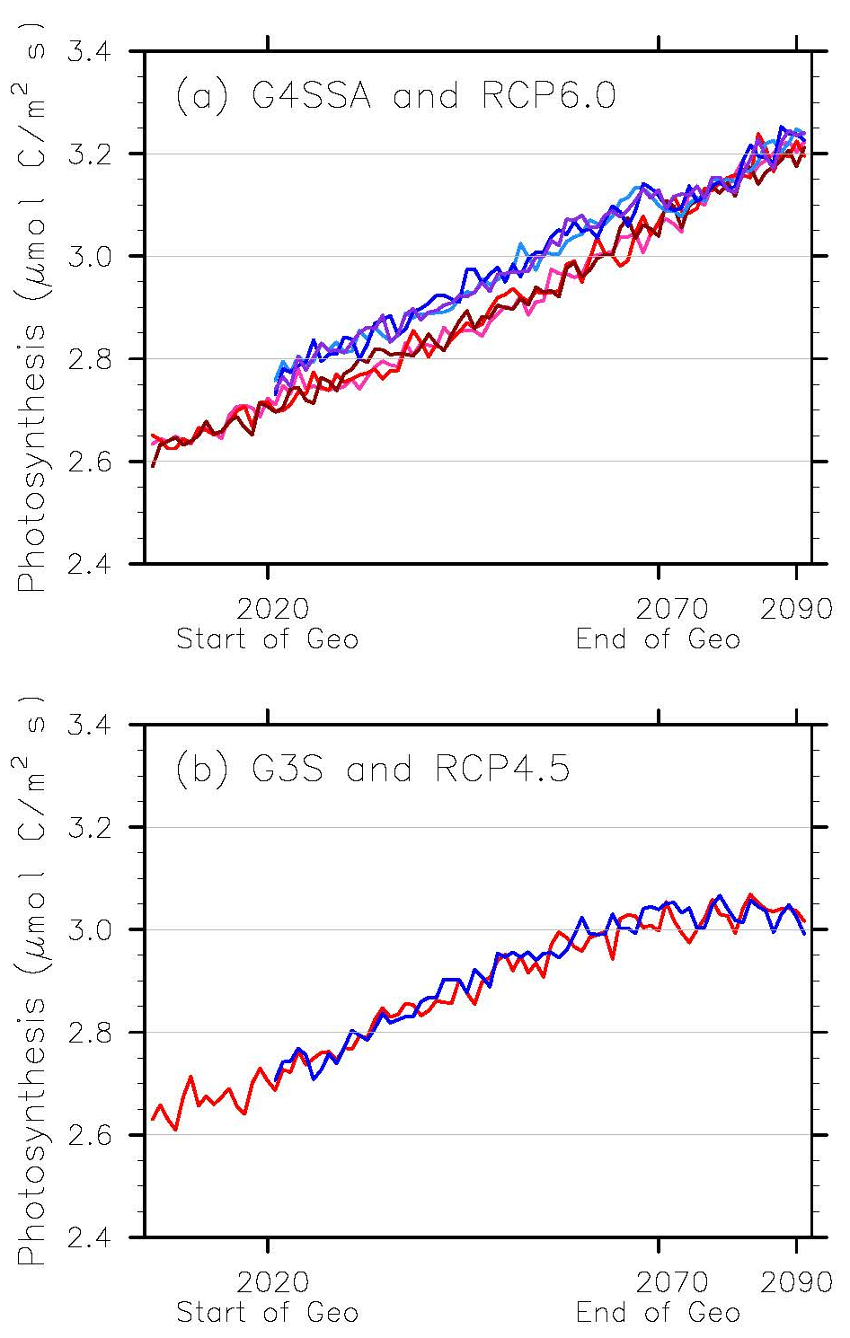
Photosynthesis
0.07 ± 0.02 µmol C m⁻² s⁻¹
Produces an additional
3.8 ± 1.1 Gt C yr⁻¹
global gross primary productivity
No change for
solar reduction forcing in related experiment

Slide 11
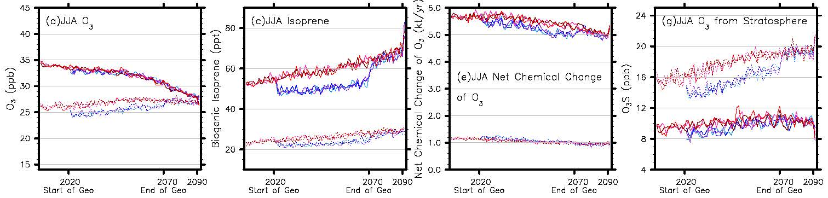
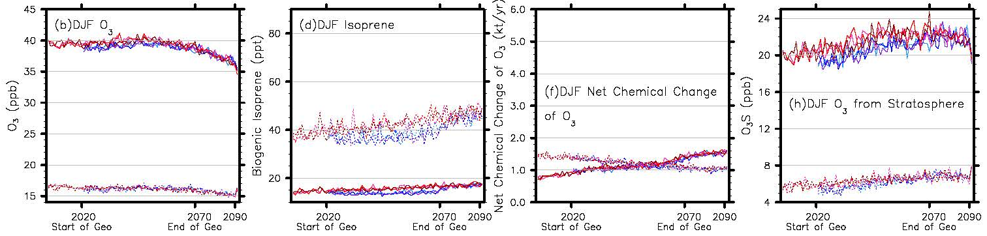
Average of Northern Hemisphere (solid lines) and Southern Hemisphere (dashed lines) surface O₃, biogenic isoprene, net chemical change of O₃, and surface O₃ transported from the stratosphere under G4SSA (blue lines) and RCP6.0 (red lines) in JJA and DJF
- changes in JJA (winter in SH) show strongest differences, due to changes in stratosphere –troposphere exchange.
- chemistry is changed mainly due to differences in isoprene (and other VOC) emissions

Slide 12
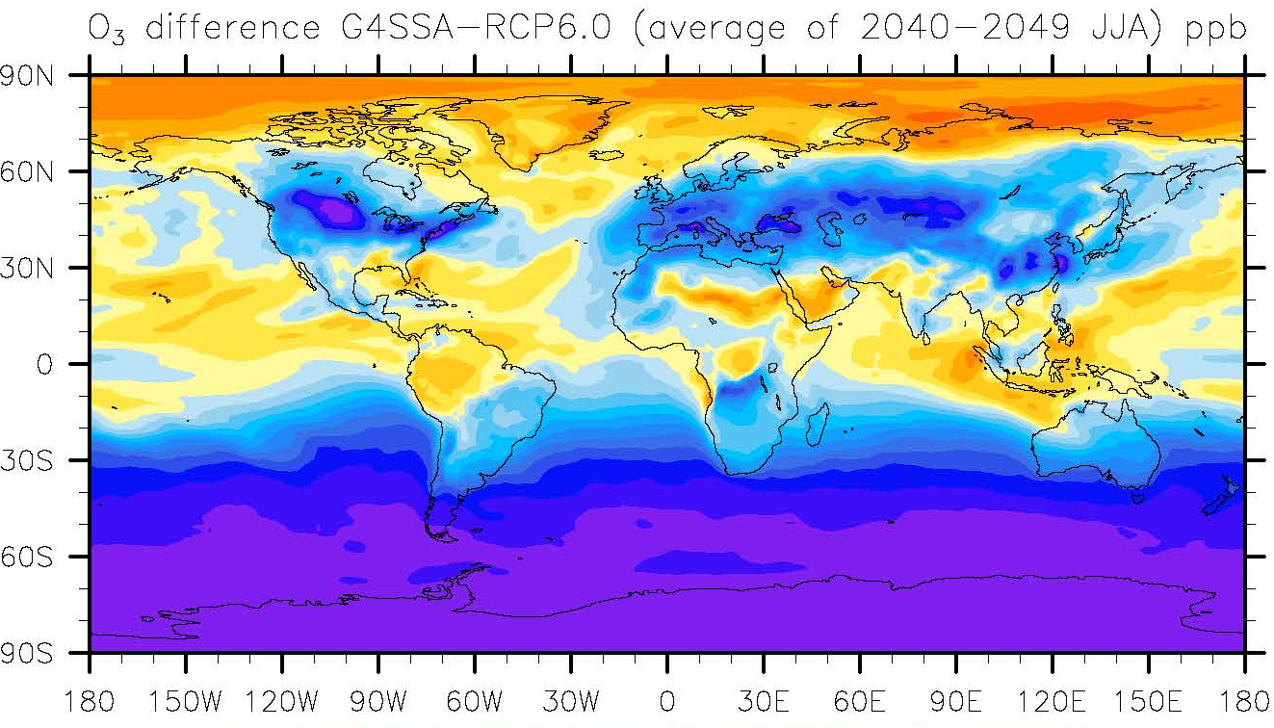
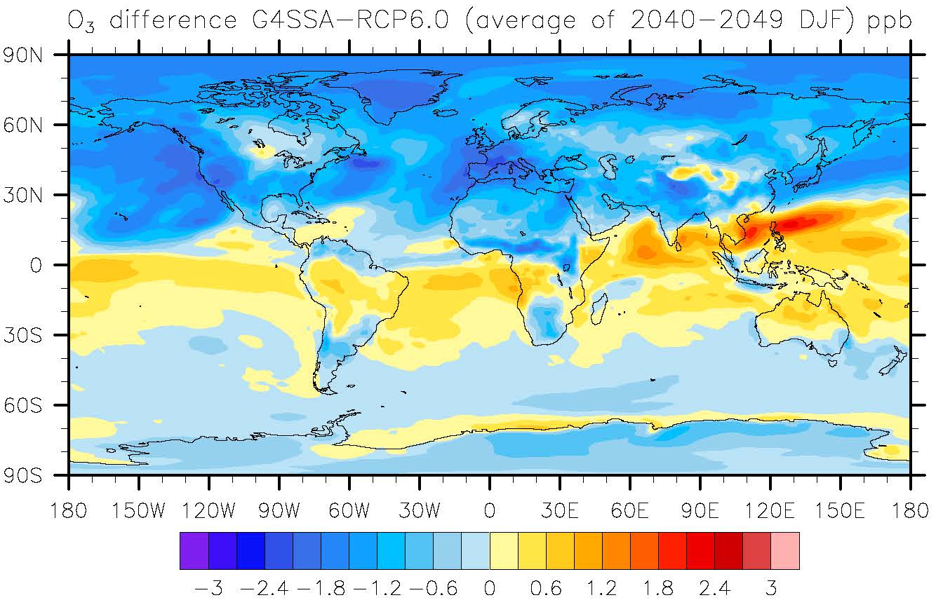
Ten-year seasonal averaged surface O₃ concentration difference (ppb) between G4SSA and RCP6.0 (2040-2049)
Tropospheric ozone reduction in high latitudes impacted by changes in stratospheric circulation and chemical changes in the stratosphere (needs to still be investigated).
Reduction in summer (JJA) in polluted areas due chemical processes

Slide 13
Crop model used for global agriculture simulation
Model: Off-line post4.5CLM-crop, coupled with the most recent O₃ impact module [Lombardozzi et al., 2015]
Resolution: 2º latitude and longitude
Crops: Maize, Rice, Soybean, Cotton, Sugarcane
Methodology:
Simulations with no O₃ impact
Fixed CO₂ (392 ppm), fertilizer (year 2000), irrigation (year 2000)
CLM-crop control run: AgMERRA reanalysis data 1978-2012
Climate model control run: RCP6.0 2004-2019
RCP6.0 monthly anomalies and G4SSA monthly anomalies (2060-2069)
Perturb 35 years AgMERRA with each year of RCP6.0/G4SSA climate anomalies
In total: 35 + 35*10 + 35*10 = 735 years of simulation
Simulations with O₃ impact
Two reference runs (G4SSA and RCP6.0) with no O₃ module, two runs with O₃ module from 2040 to 2049
Use raw climate output from GCM
Collaboration with Danica Lombardozzi and Peter Lawrence
control
G4SSA
RCP6.0

Slide 14
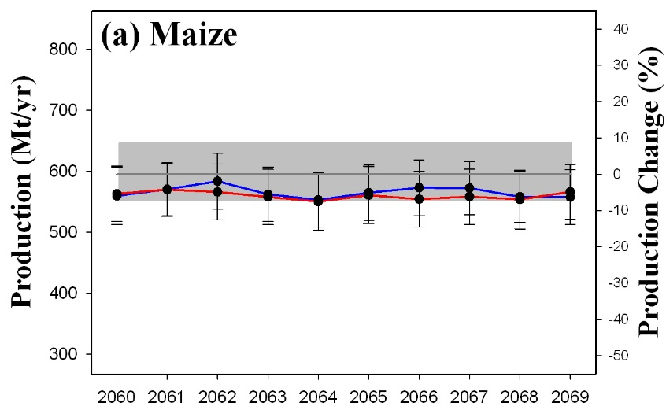
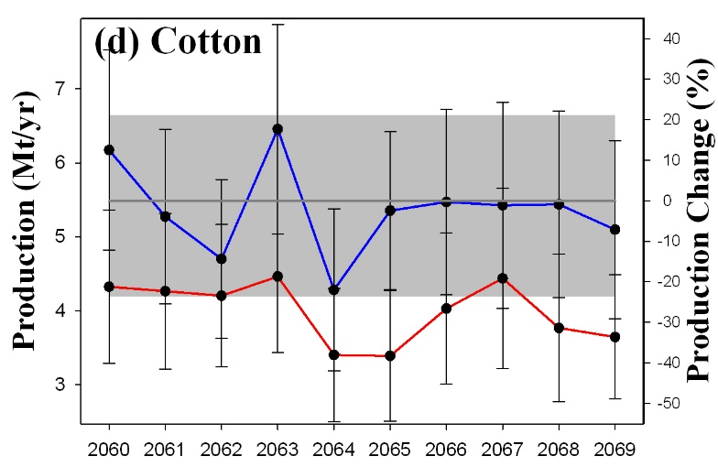
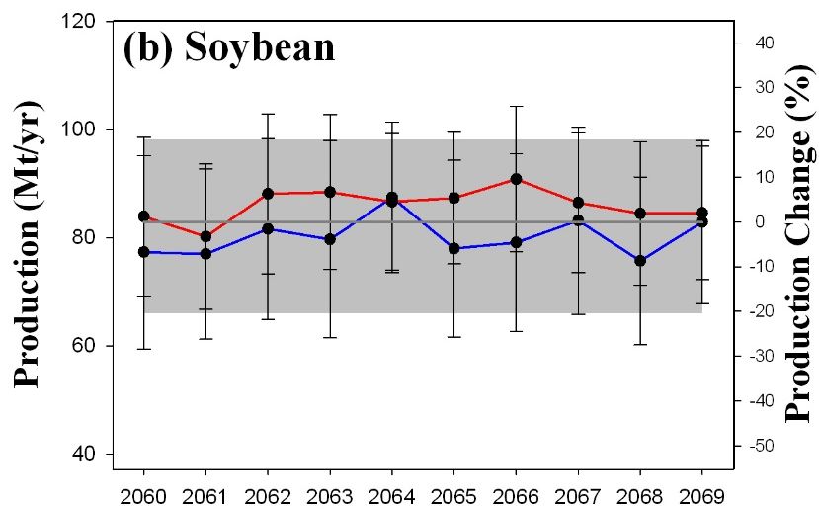
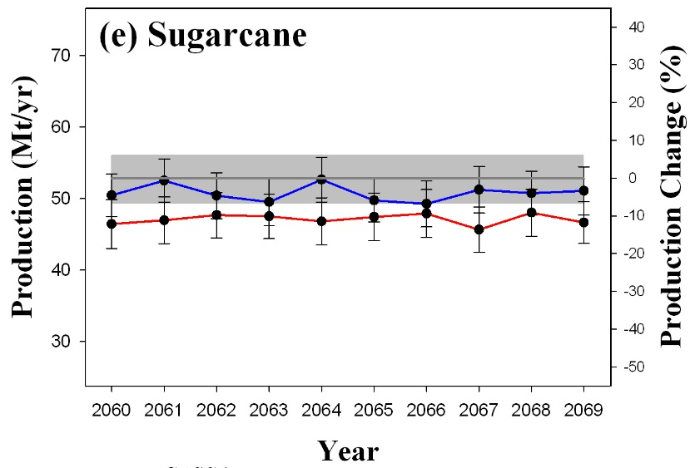
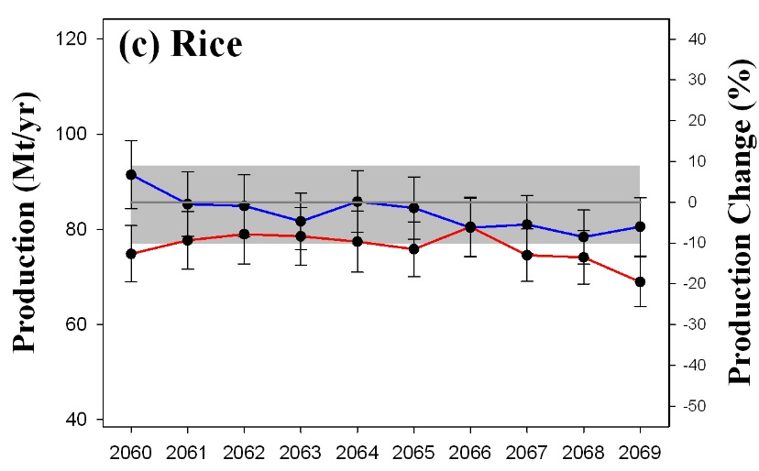
With no
ozone impacts
Global Production
(Mt/yr)
Geoengineering:
increases
production of
Cotton
Rice
Sugarcane
decreases production of
Soybeans
G4SSA
RCP6.0
no change
Control
Maize
1 standard deviation
of 35 years control

Slide 15
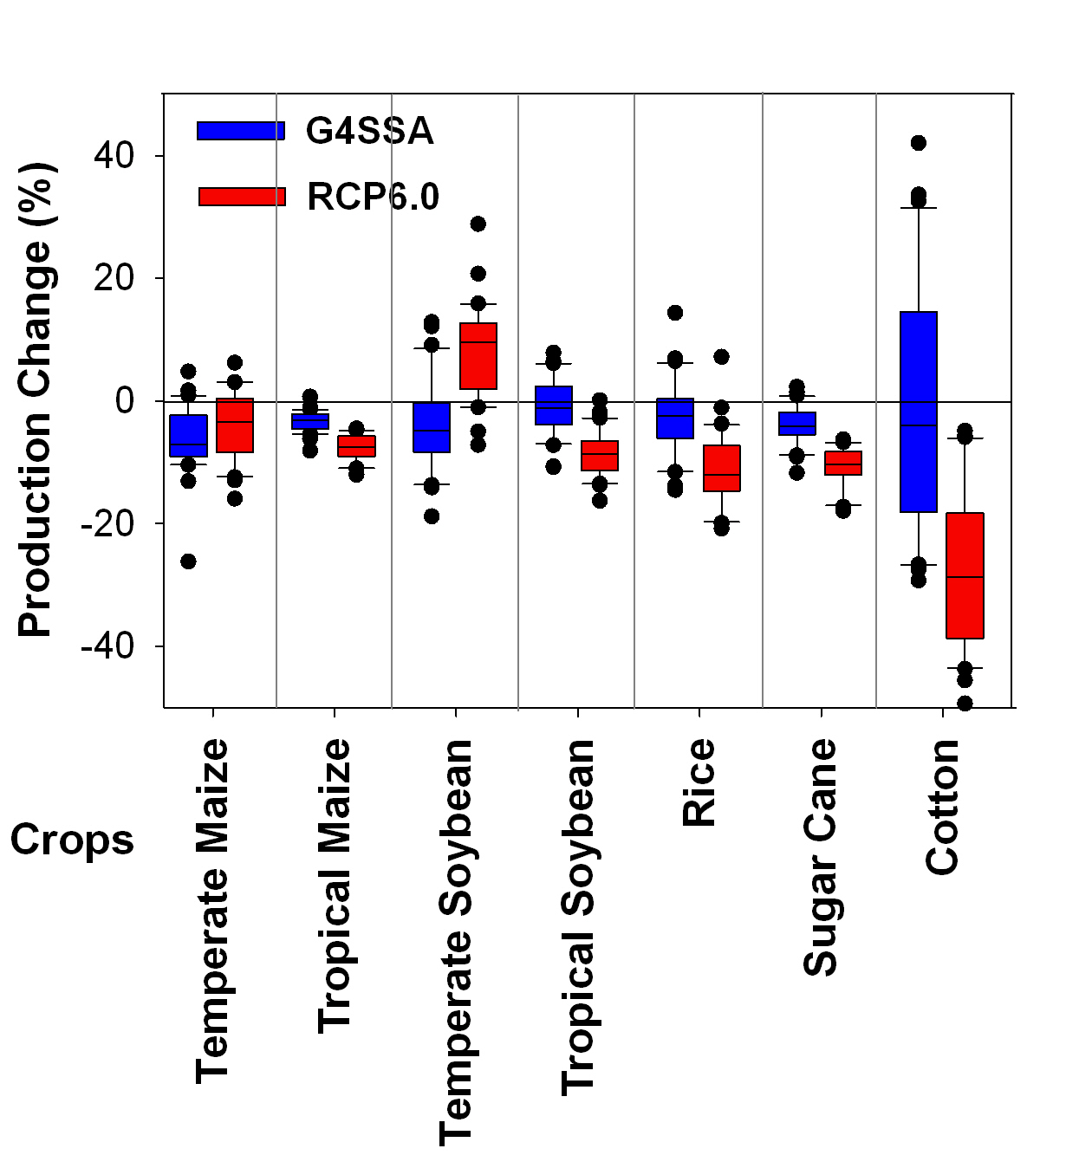
With no
ozone impacts
Temperate and tropical crops have different responses to geoengineering

Slide 16
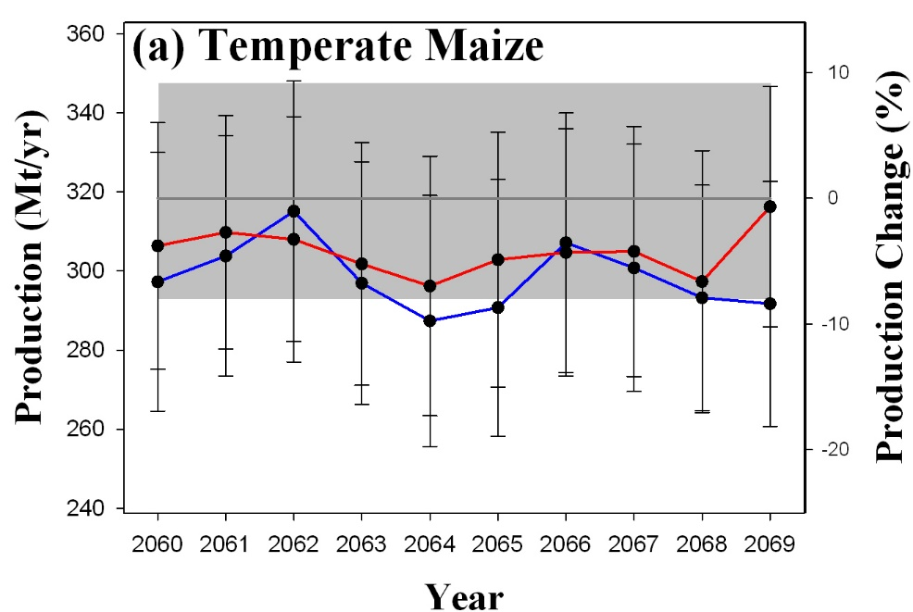
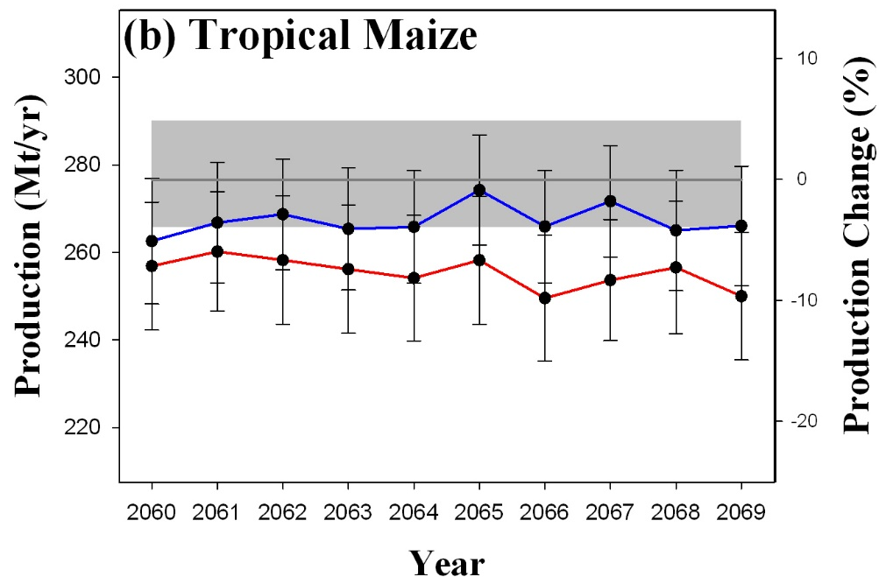
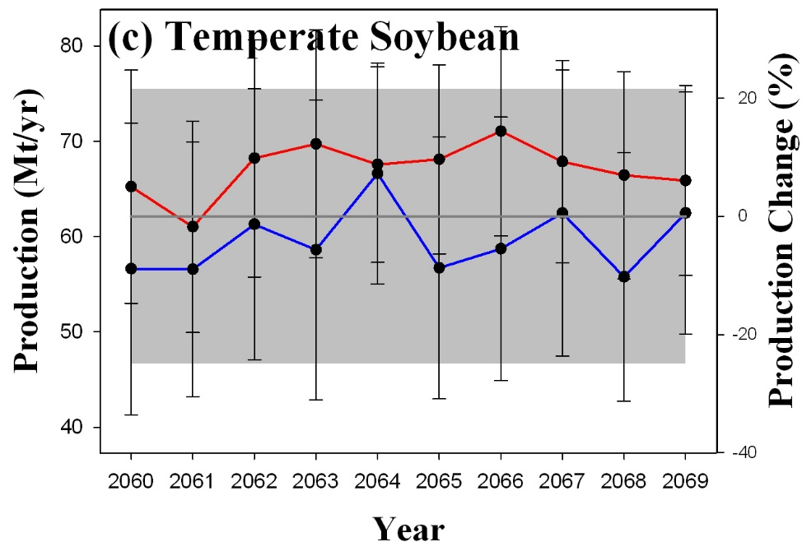
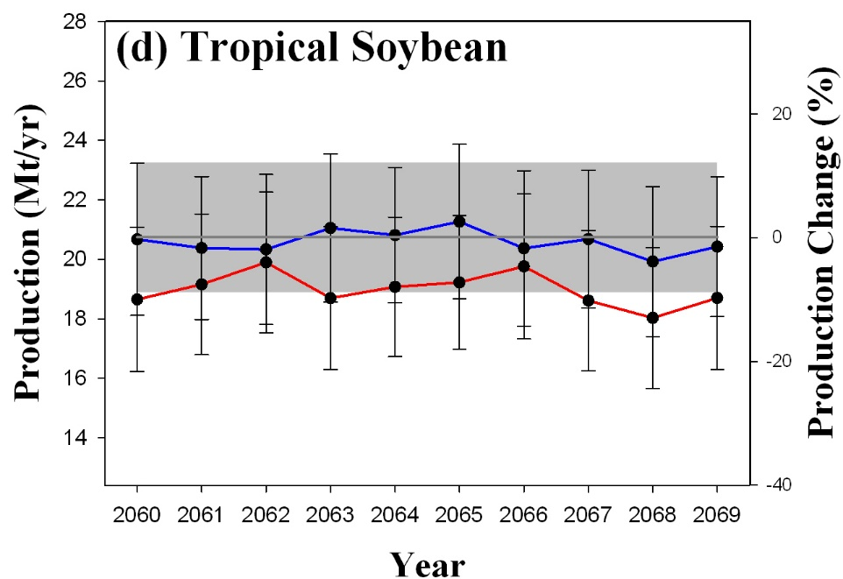
Temperate and tropical crops have different responses to geoengineering
G4SSA
Control
RCP6.0
1 standard deviation of 35 years control

Slide 17
National production change (%) (G4SSA minus RCP6.0)
(average of 2060-2069)
 | Rice | Maize | Soy | Cotton | Sugarcane
U.S. |  | -1% | -14% | 23%
China | -20% | 5% |  | 30% | 5%
India | 7% |  |  | 20% | 17%
Indonesia | 5% |  |  |  | 7%
Brazil |  | 3% | 13%
Argentina |  |  | -17%
Countries listed are the top 3 crop production nations for each crop.
With no
ozone impacts

Slide 18
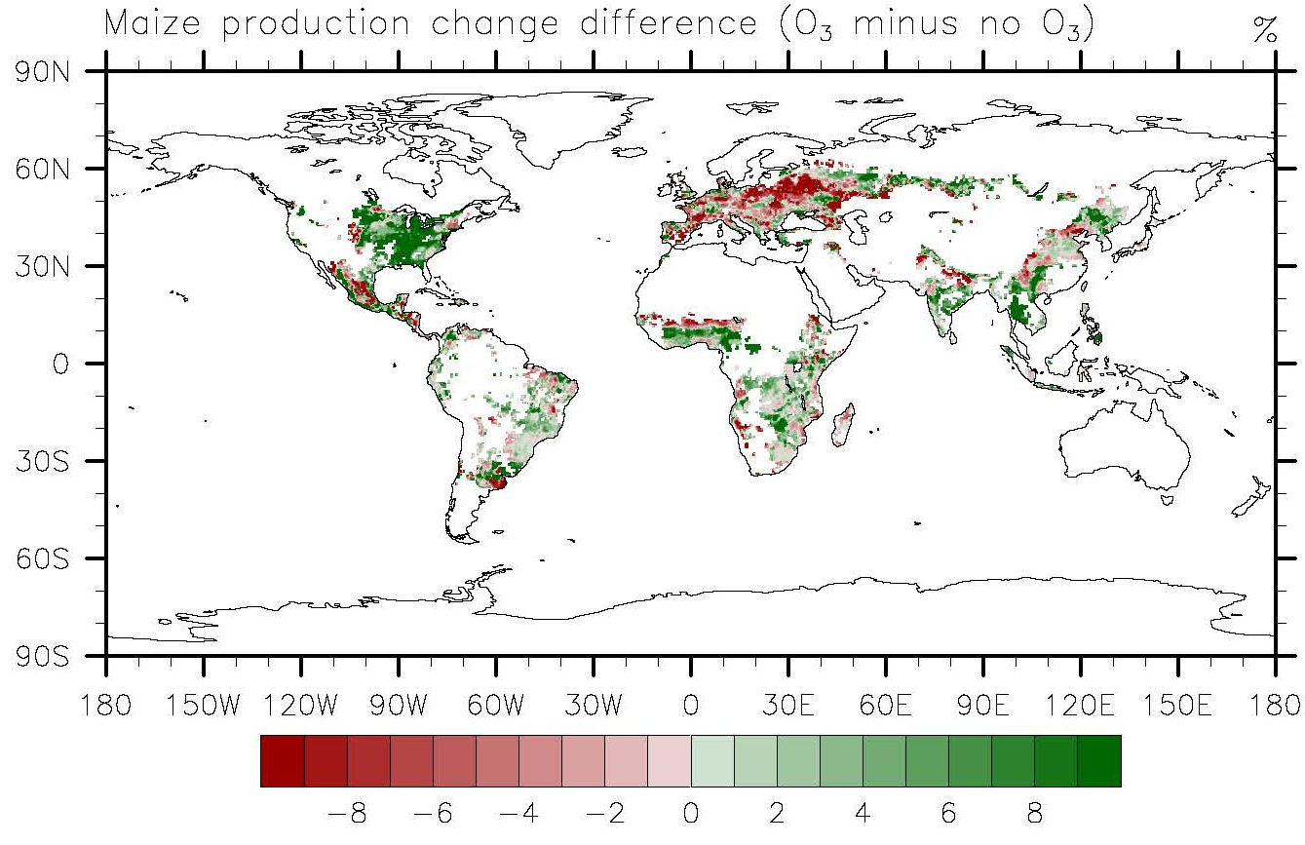
Ten-year average maize production change difference (%)
with O₃ impacts from G4SSA as compared to RCP6.0

Slide 19
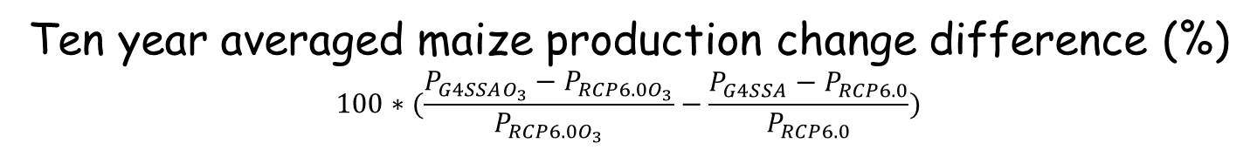
Ten year averaged maize production change difference (%)
$$100∗(\frac{P_{G4SSAO_{3}}−P_{RCP6.0O_{3}}}{P_{RCP6.0O_{3}}}−\frac{P_{G4SSA}−P_{RCP6.0}}{P_{RCP6.0}})$$

Slide 20
Conclusions: For one sulfate geoengineering scenario and one global vegetation and crop model, compared with RCP6.0, under the G4SSA scenario:
Sulfate geoengineering increases diffuse radiation by 11%, which increases global photosynthesis by 1%, with large increases in the Amazon.
Compared with a global warming scenario, the cooling effect from G4SSA benefits tropical crop production, while it decreases temperate crop production for maize and soybeans. For cotton, geoengineering has large positive impacts.
Less surface O₃ concentration in agricultural regions would reduce the negative impact and enhance the positive impact on agriculture in most regions.

Slide 21

We need to improve the following aspects of our study:
Robust climate change signal
Accurate climate input
Sufficient agricultural practice data
Improved crop model
Robust agricultural response
Geoengineering Model Intercomparison Project
Chemistry-Climate Model Initiative
Comparing different downscaling methods including methods for O₃ downscaling
Gathering agriculture practice information, such as seeds used
Add responses to diffuse radiation and UV
Agricultural Model Intercomparison and Improvement Project
Global Gridded Crop Model Intercomparison

