Slide 1
https://lu.ma/coolearth

Slide 2
https://lu.ma/coolearth

Slide 3
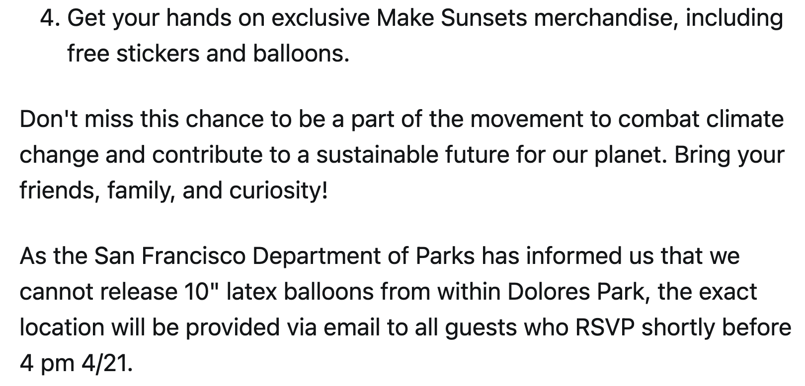
https://lu.ma/coolearth

Slide 4
Luke Iseman told me that San Francisco did not give them permission to play music or offer drinks inside the park, and that is why they did not do either, and ended up on the sidewalk.

Slide 5
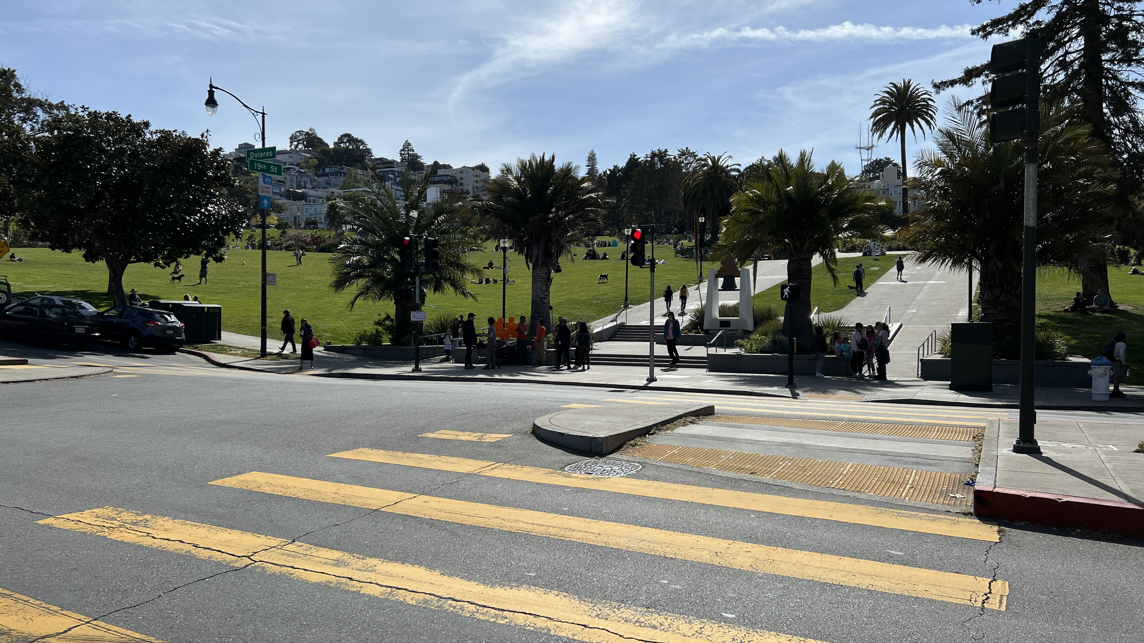
Check out the huge crowds:

Slide 6
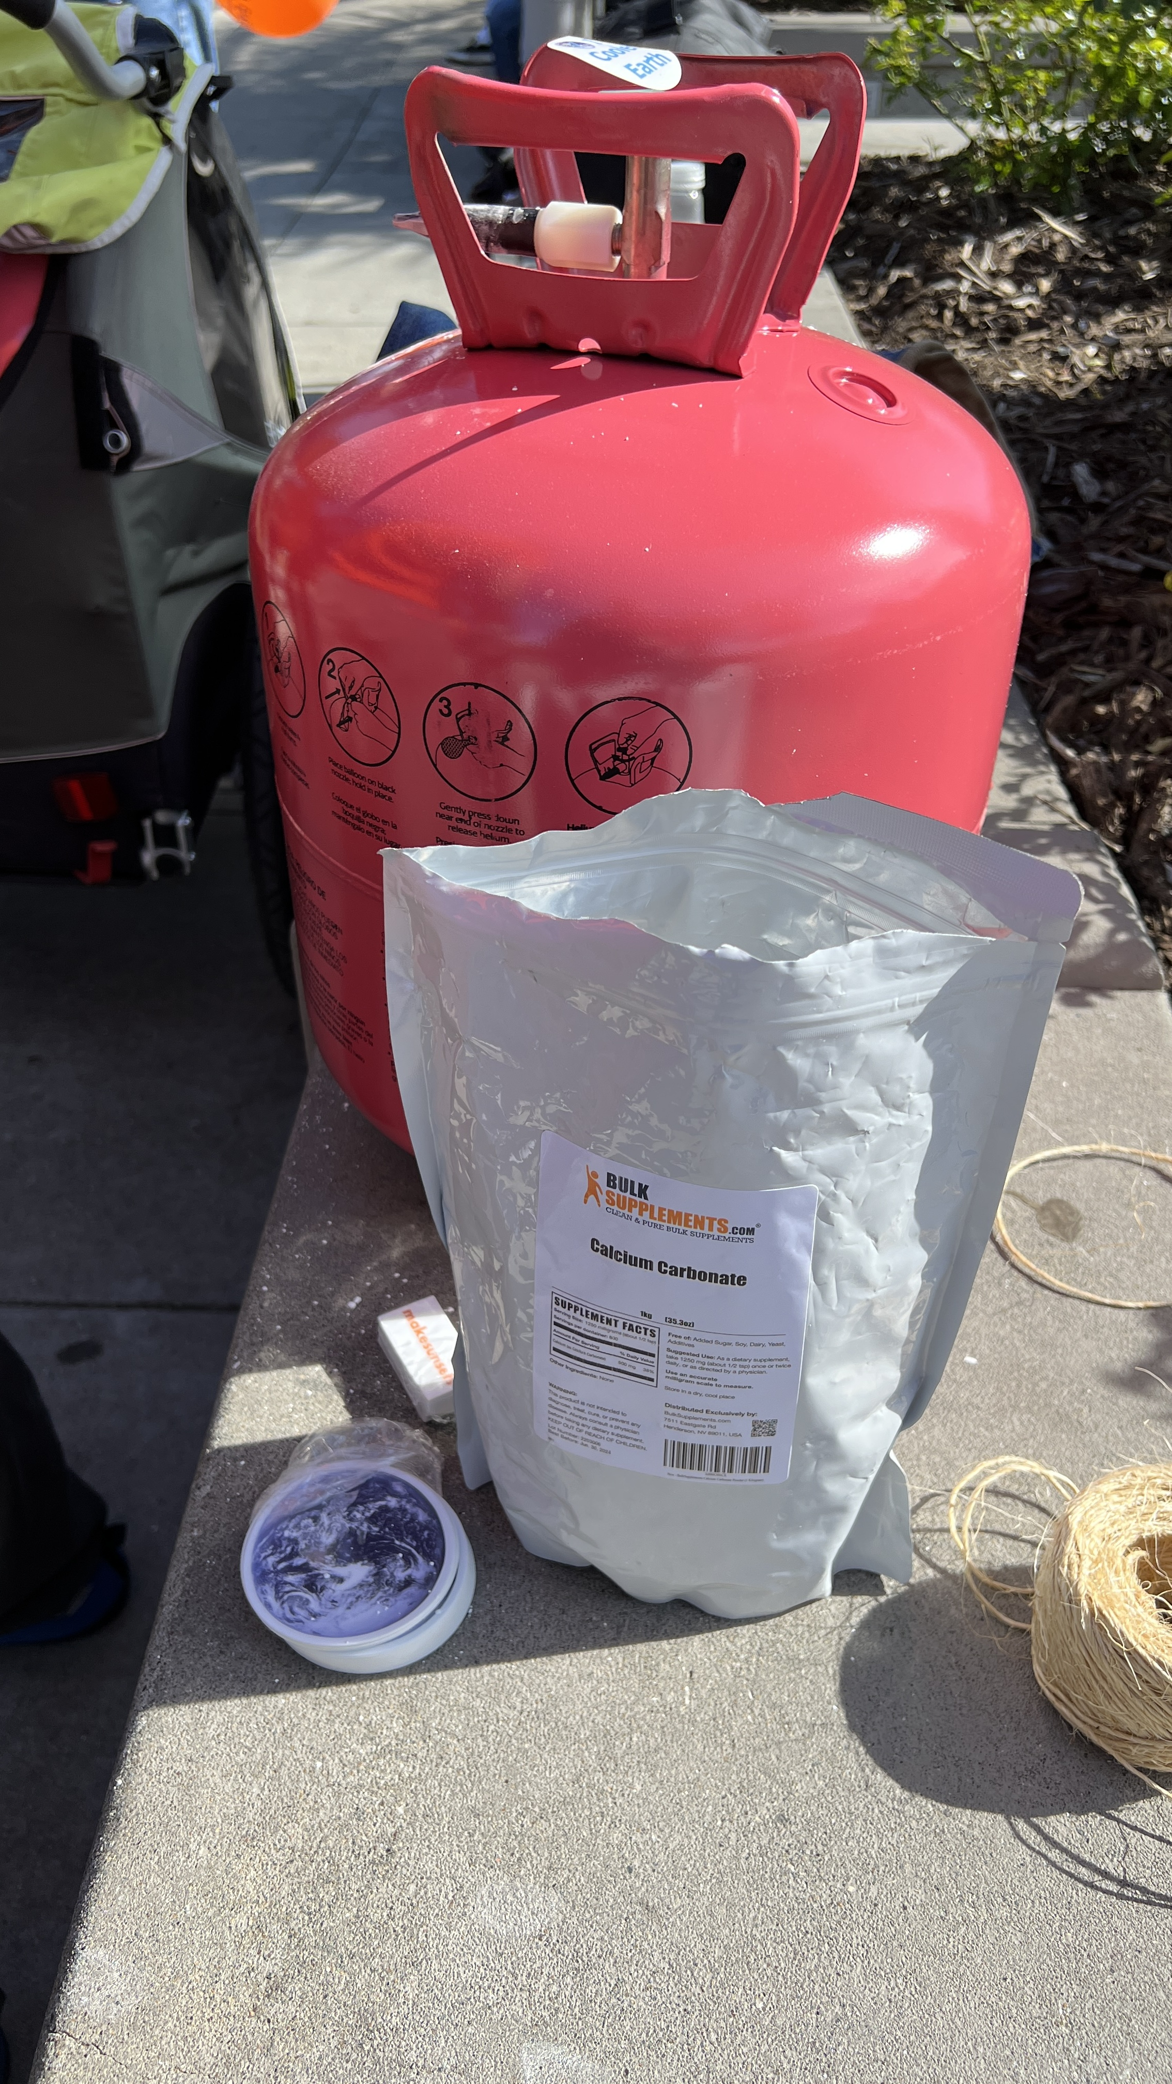
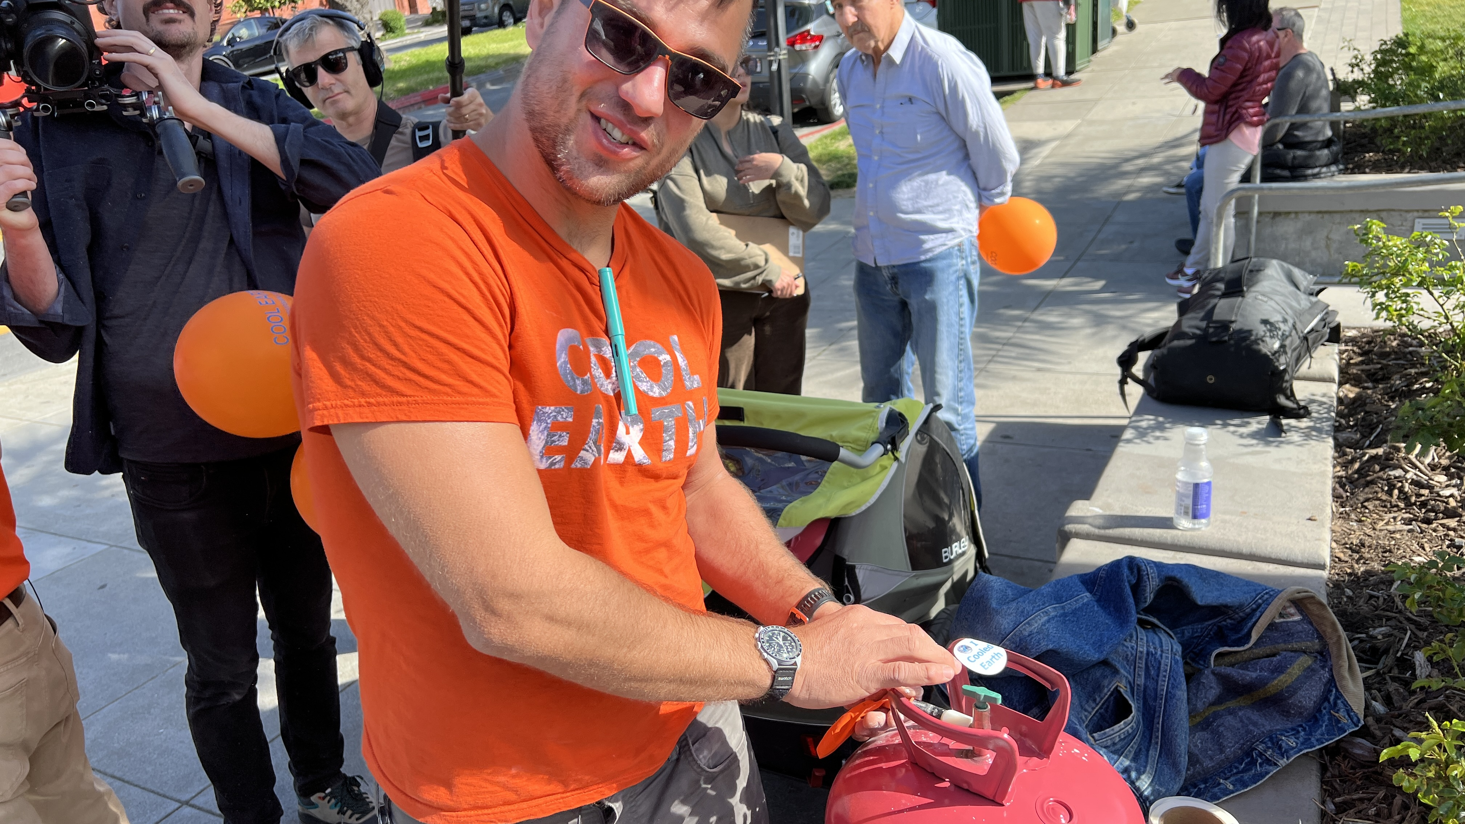
Filling a balloon after adding a pinch of calcium carbonate powder. He told me sulfur compounds are too dangerous to be used around other people.

Slide 7
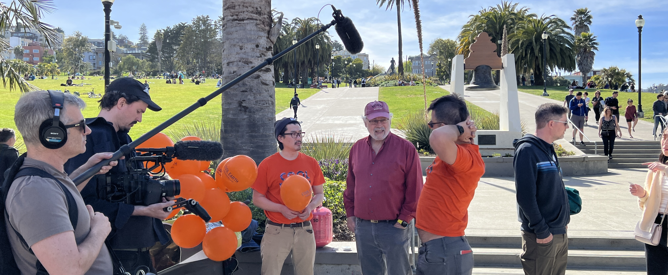
Were they uncomfortable in front of a filming crew?

Slide 8
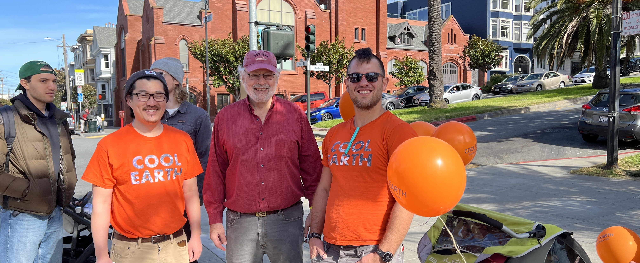
Say “sunsets”

Slide 9
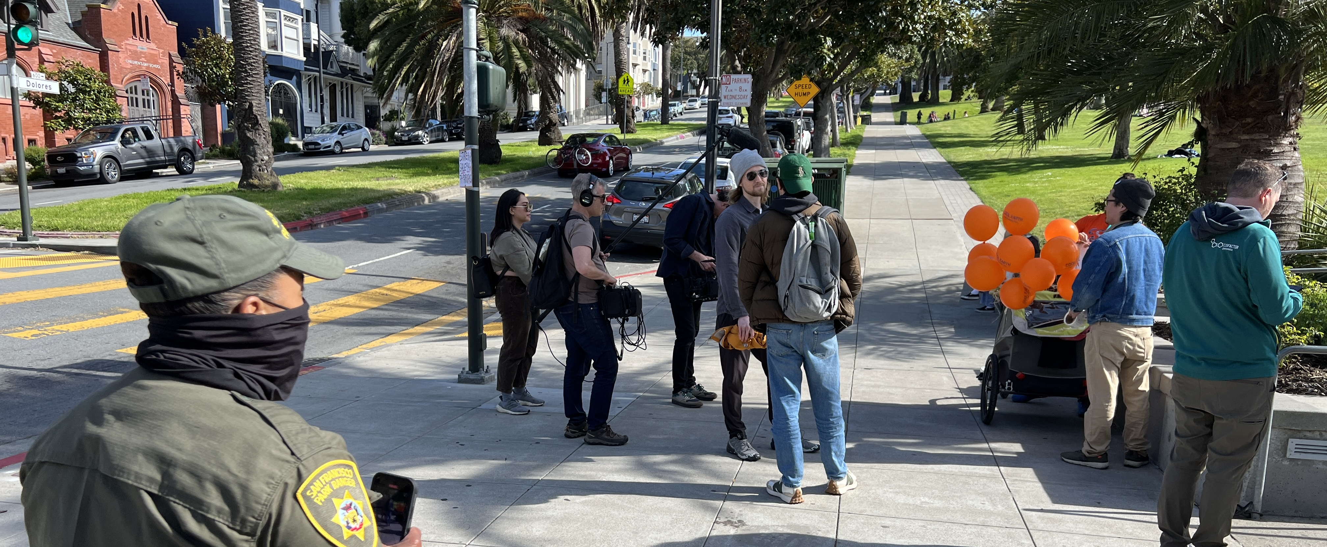
Busted by the Park Police and asked to go across the street:

Slide 10
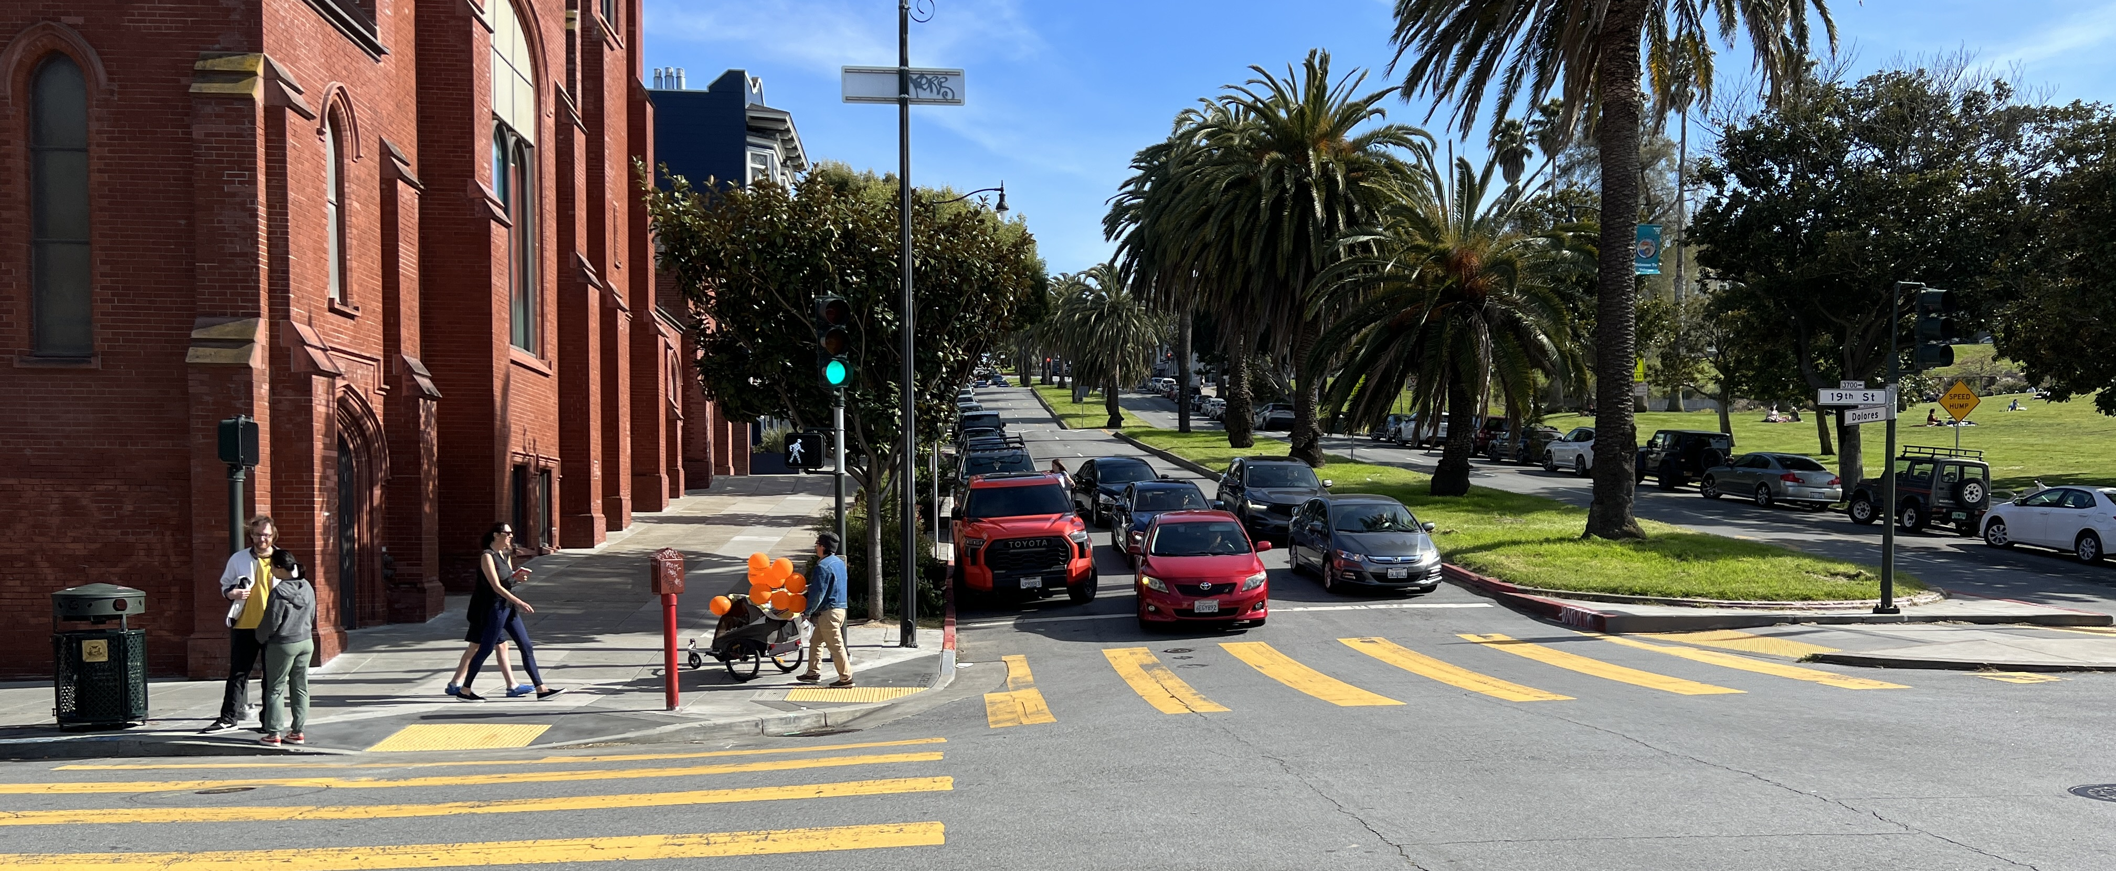
My last view of them, walking into the sunset.

Slide 11
