Slide 1

Stratospheric Sulfur Geoengineering ‐ Benefits and Risks
Alan Robock
Department of Environmental Sciences
Rutgers University, New Brunswick, New Jersey
robock@envsci.rutgers.edu
http://envsci.rutgers.edu/~robock

Slide 2
Global Warming in 10 Words
It’s real.
It’s us.
It’s bad.
Scientists agree.
There’s hope.
Anthony Leiserowitz, Yale University

Slide 3
Desire for improved well-being
Impacts on humans and ecosystems
Consumption of goods and services
SUFFERING
CONSERVATION
EFFICIENCY
ADAPTATION
Climate change
Consumption of energy
SOLAR RADIATION MANAGEMENT
CARBON DIOXIDE REMOVAL
LOW-CARBON ENERGY
CO₂ in the atmosphere
CO₂ emissions
After Ken Caldeira

Slide 4
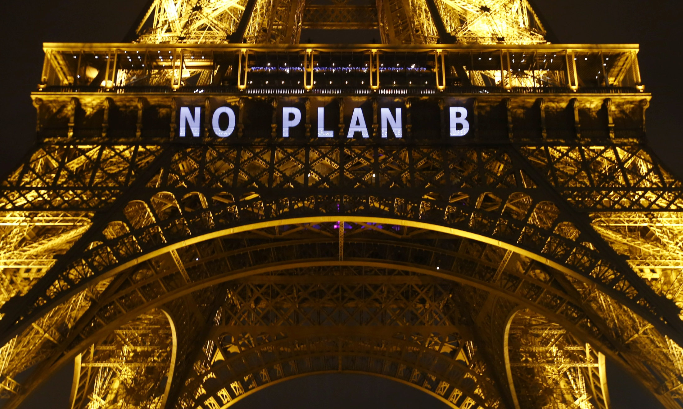

Slide 5
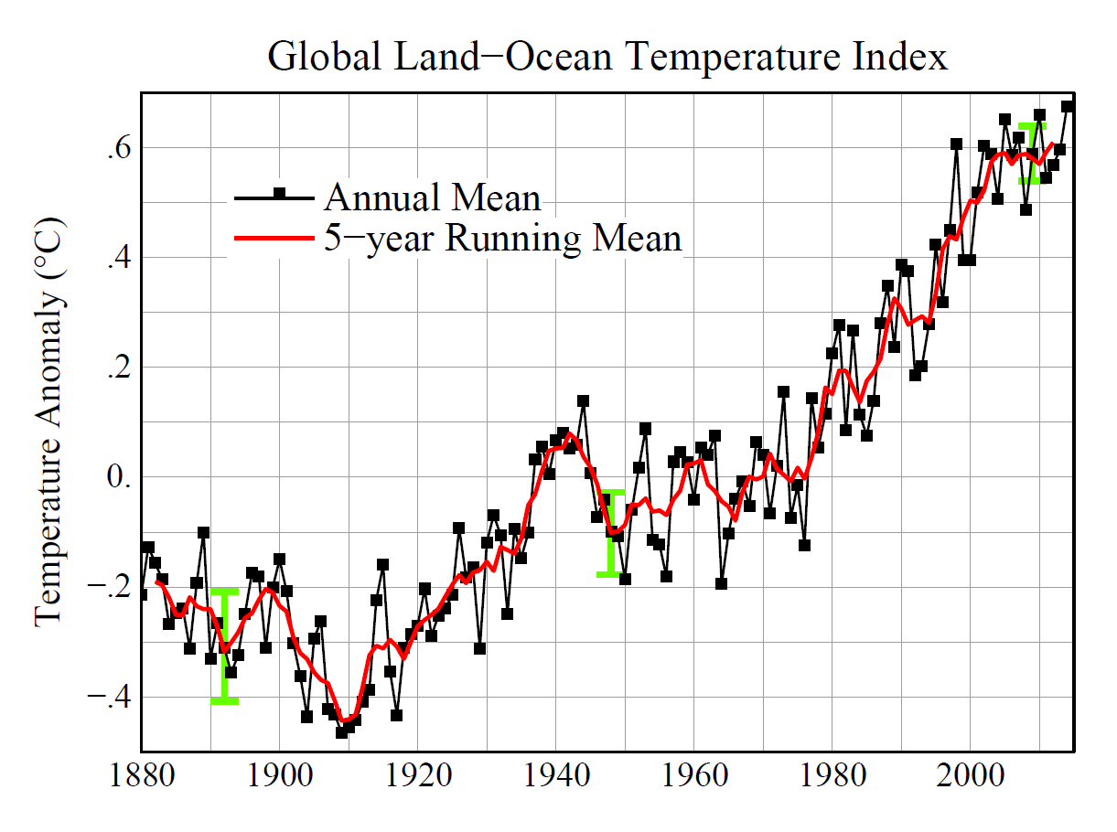
Tropospheric aerosols mask warming
(global dimming)
Greenhouse gases dominate
Recovery from volcanic eruptions dominates
http://data.giss.nasa.gov/gistemp/graphs_v3/Fig.A2.pdf

Slide 6
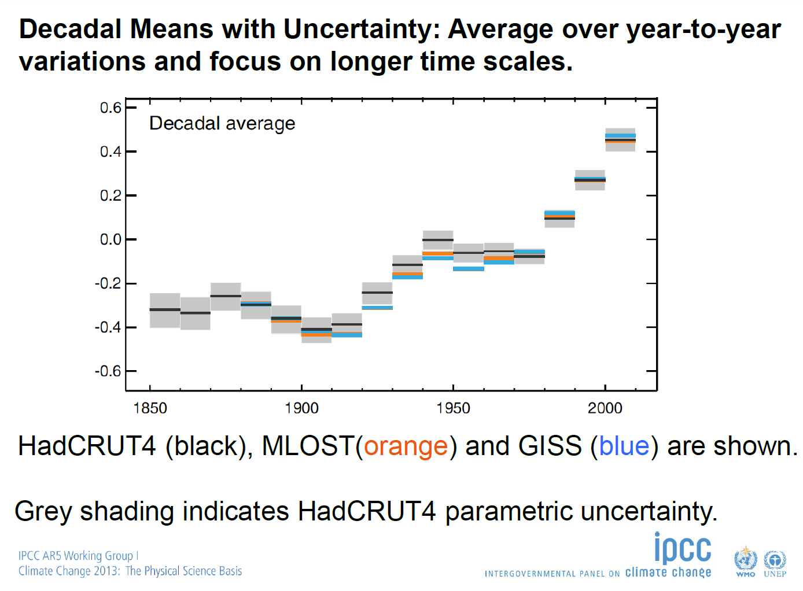

Slide 7
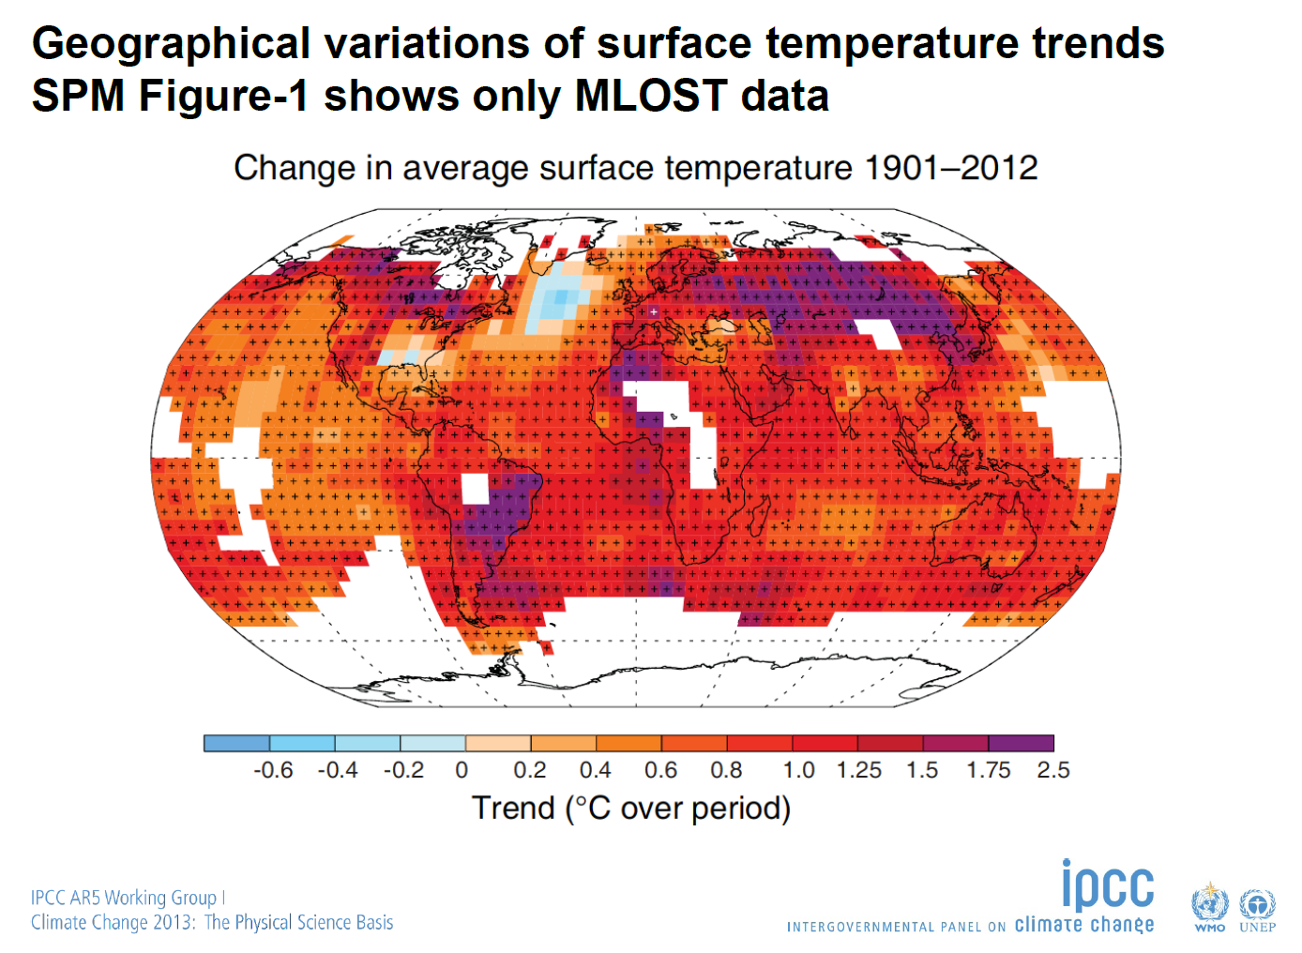

Slide 8
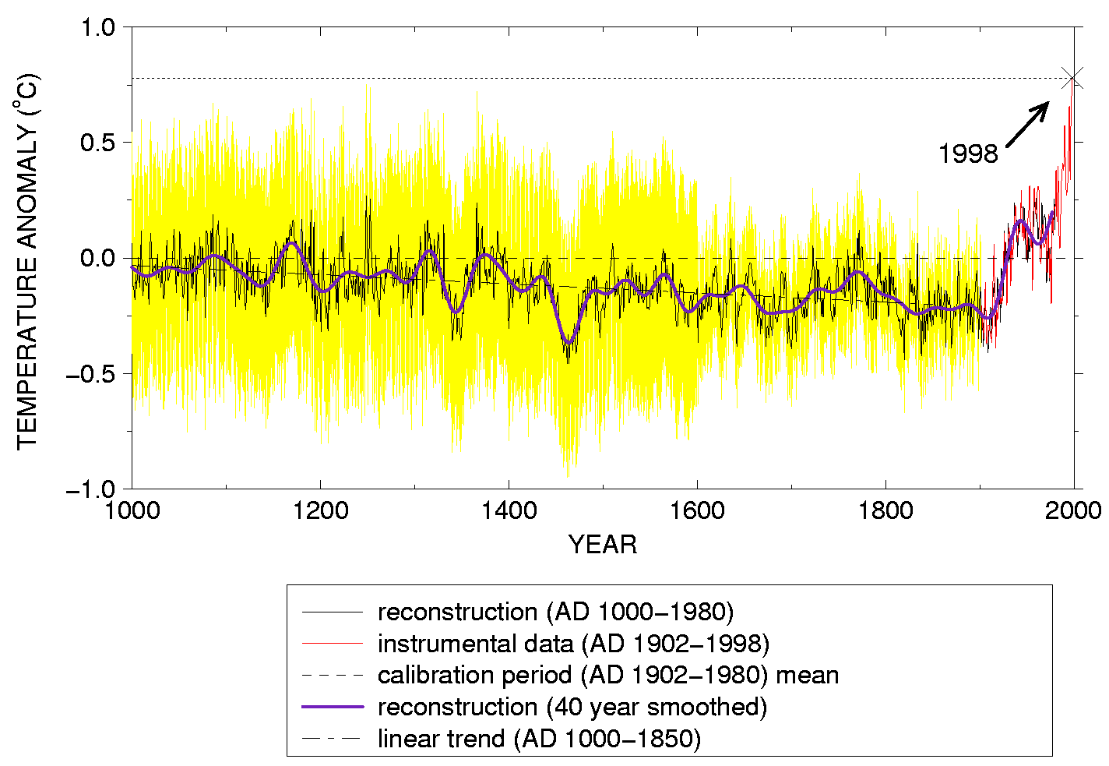
Mann et al.
(1999)

Slide 9
Global Warming Fundamental Questions
1. How will climate change in the future?
2. How will climate change affect us?
3. What should we do about it?
Considerable warming, glacier retreat, more precipitation, floods, droughts, extinctions, worse air pollution, and sea level rise
Some winners but more losers, including water, agriculture, pests, national security
Mitigation (reduce emissions) now is cheaper than waiting, study impacts, adapt, but not stratospheric geoengineering

Slide 10

Identifying Profitability In Arctic Shipping With Safe & Efficient Operations
ACI’s 7th Arctic Shipping Summit 2015 will focus on discussing the practical solutions necessary for the ship owners to decide whether they should invest in utilising the Northern Sea Route. The meeting will provide updates on key developments and regulations in the Arctic, as well as present expert views on possible future advances in governing the transport routes.
The conference will also address how to overcome the operational challenges that exist while entering the region. These include navigation, communications, risk and safety management, search and rescue, vessel design and crew training. The meeting will provide an outlook for the recent innovations in ice class vessel design as well as updates on ice breaker technology.
Joining the Summit will allow participants to better understand and evaluate the business model for operating in the Arctic.

Slide 11
Product | Total
7th Arctic Shipping Summit 2015 - Conference Pass × 1 | £1,495.00
Subtotal | £1,495.00
VAT | £299.00
Total | £1,794.00
= $2721 for a 2-day conference!

Slide 12




Slide 13
Global Warming Fundamental Questions
1. How will climate change in the future?
2. How will climate change affect us?
3. What should we do about it?
Intergovernmental Panel on Climate Change (IPCC) Working Group I (WG I)
IPCC WG II
IPCC WG III

Slide 14
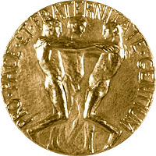
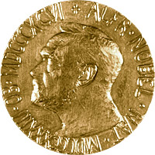
Intergovernmental Panel on Climate Change (IPCC)
Established in 1988 jointly by the World Meteorological Organization and the UN Environment Programme
  2500 scientists from more than 150 nations
Winner of 2007 Nobel Peace Prize
First Assessment Report (FAR), 1990
Second Assessment Report (SAR), 1996
Third Assessment Report (TAR), 2001
Fourth Assessment Report (AR4), 2007
Fifth Assessment Report (AR5), 2013

Slide 15
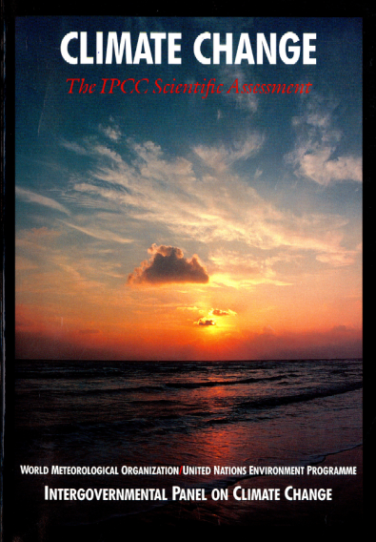
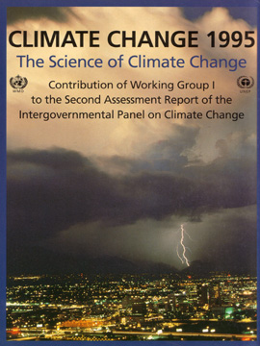
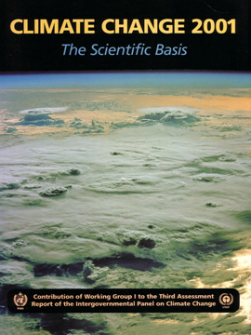
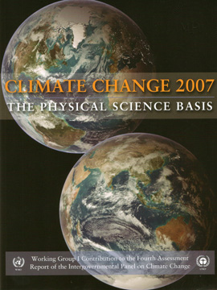
“The unequivocal detection of the enhanced greenhouse effect from observations is not likely for a decade or more.”
Climate Change – The IPCC Scientific Assessment (1990)
“The balance of evidence suggests
a discernible human influence on global climate.”
Climate Change 1995 – The Second IPCC Assessment
“Most of the observed warming over the last 50 years is likely to have been due to the increase in greenhouse gas concentrations.”
Climate Change 2001 – The Third IPCC Assessment
“Most of the observed increase in globally averaged temperatures since the mid-20th century is very likely due to the observed increase in anthropogenic greenhouse gas concentrations.”
Climate Change 2007 – The Fourth IPCC Assessment

Slide 16
“The unequivocal detection of the enhanced greenhouse effect from observations is not likely for a decade or more.”
Climate Change – The IPCC Scientific Assessment (1990)
“The balance of evidence suggests
a discernible human influence on global climate.”
Climate Change 1995 – The Second IPCC Assessment
“Most of the observed warming over the last 50 years is likely to have been due to the increase in greenhouse gas concentrations.”
Climate Change 2001 – The Third IPCC Assessment
“Most of the observed increase in globally averaged temperatures since the mid-20th century is very likely due to the observed increase in anthropogenic greenhouse gas concentrations.”
Climate Change 2007 – The Fourth IPCC Assessment

Slide 17
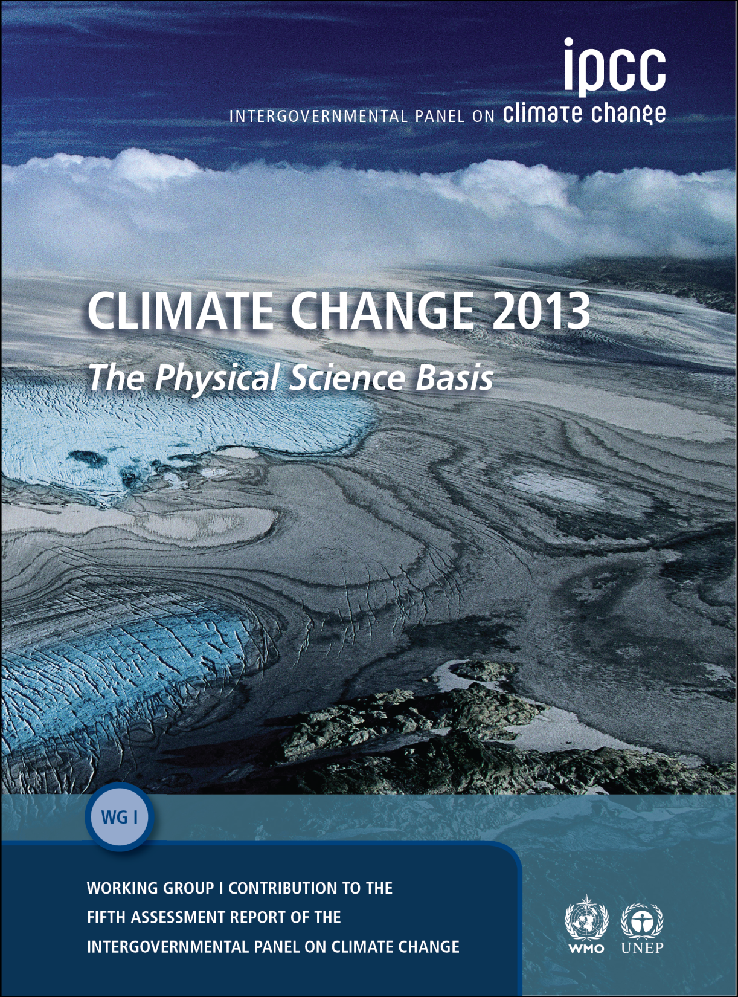
It is extremely likely that human influence has been the dominant cause of the observed warming since the mid-20th century.

Slide 18
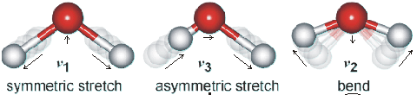
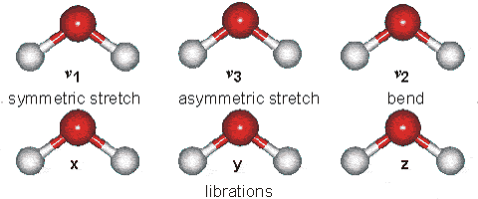
But, what is a “greenhouse gas” anyway?
Nitrogen (N₂), oxygen (O₂), and argon (Ar) make up for 99% of the atmosphere, but are not greenhouse gases.
Water vapor (H₂O), carbon dioxide (CO₂), methane (CH₄), ozone (O₃), and nitrous oxide (N₂O) are greenhouse gases.
A greenhouse gas absorbs infrared radiation, which
creates molecular vibration
and bending.
Collisions transfer energy to heat the surrounding gas.
Water vapor (H₂O) vibration modes
http://www.lsbu.ac.uk/water/vibrat.html

Slide 19
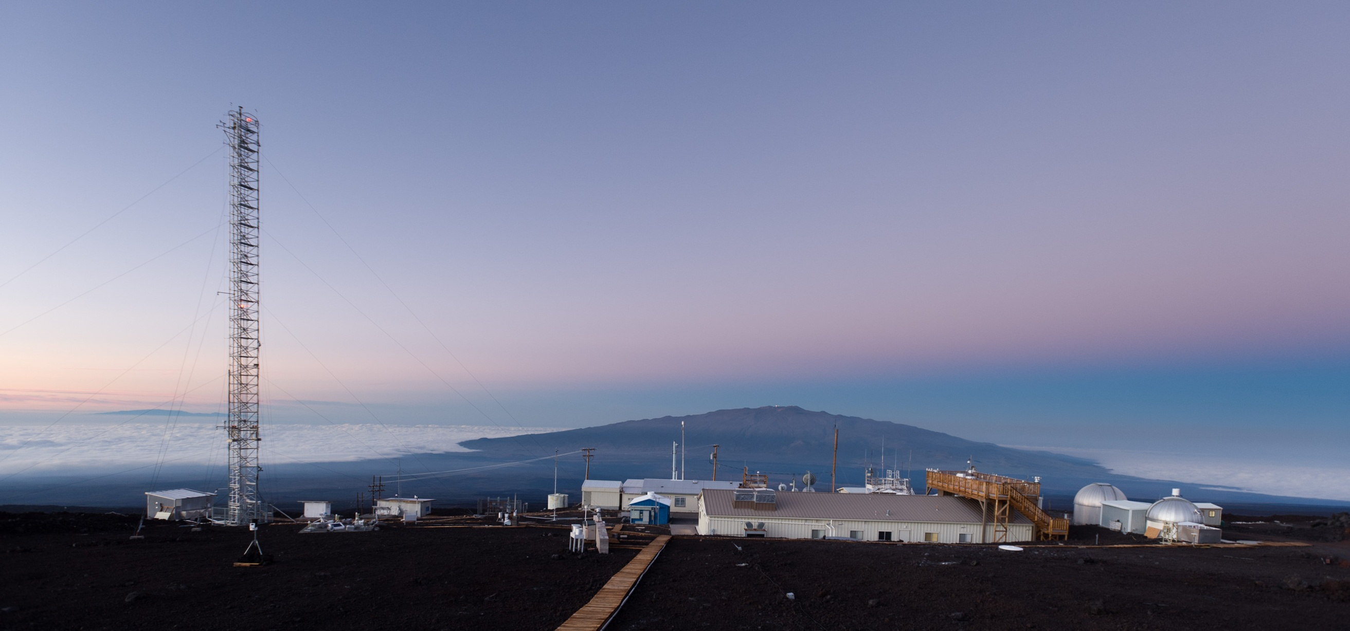
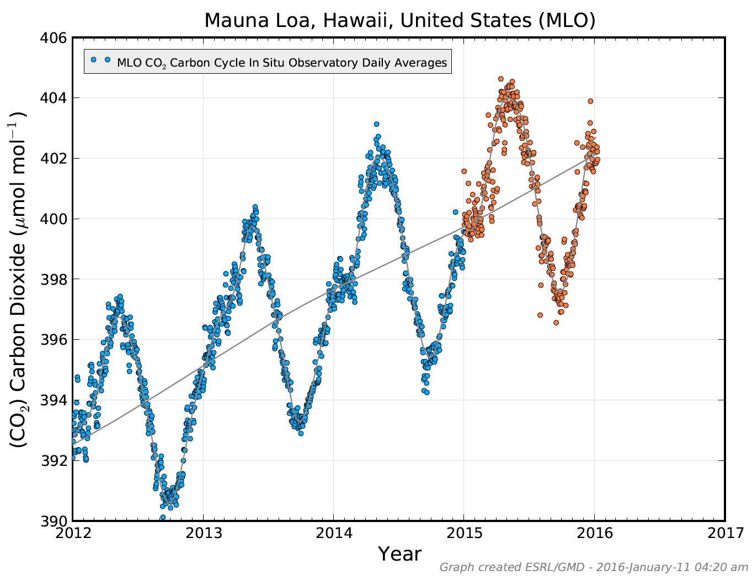
Jonathan Kingston for the New York Times, http://www.kingstonimages.com/

Slide 20
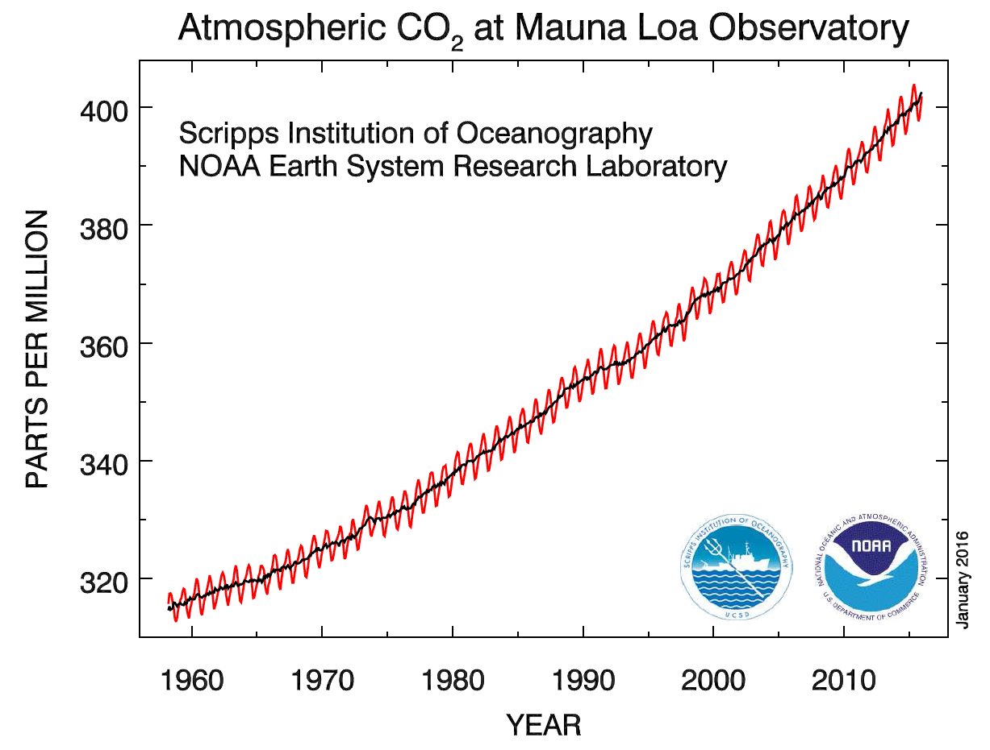

Slide 21
From IPCC AR4 Technical Summary

Slide 22
NASA GISS climate model

Slide 23
IPCC AR4 Simulations (from 13 different climate models from around the world)

Slide 24
IPCC AR4 Simulations (from 13 different climate models from around the world)

Slide 25
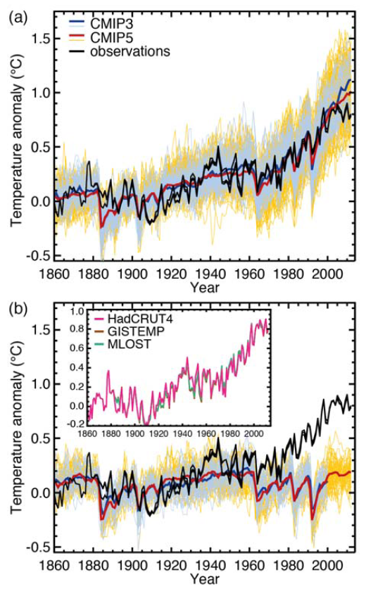
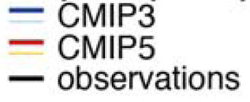
IPCC AR5 WGI, Fig. TS.9

Slide 26
IPCC AR5 WGI, Fig. TS.9

Slide 27
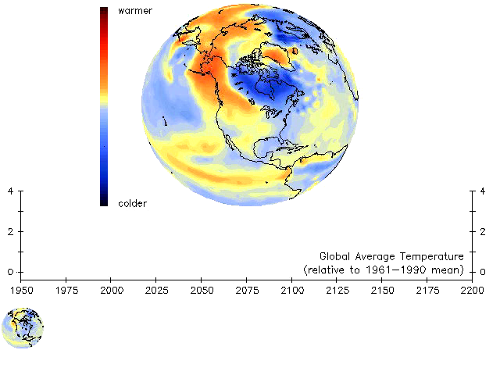
CCSM Climate “Forecasts”
(ºC)
(ºC)
Produced by Gary Strand, NCAR

Slide 28
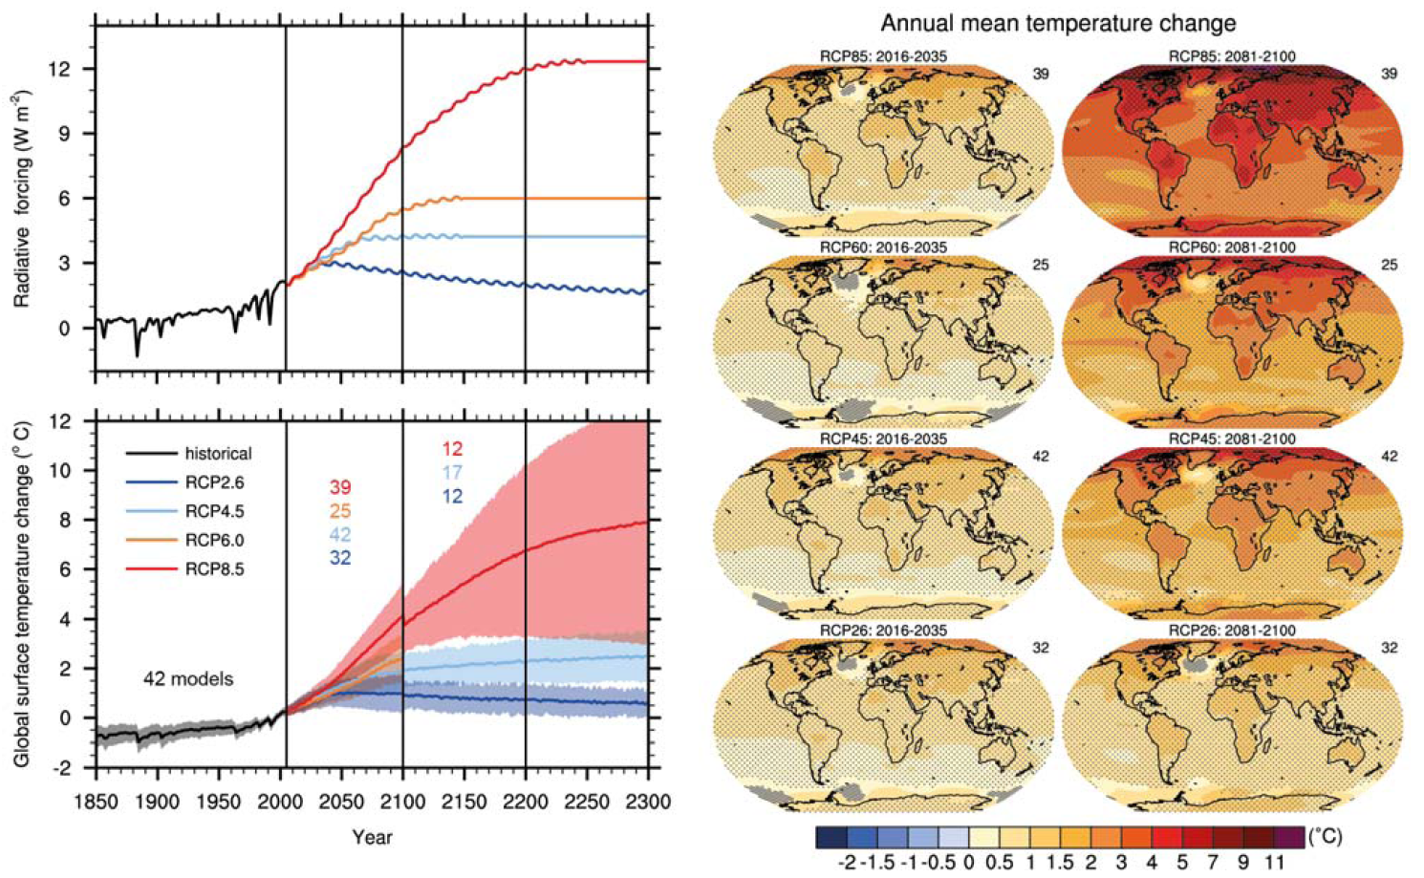
IPCC AR5 WGI, Figure TS.15

Slide 29
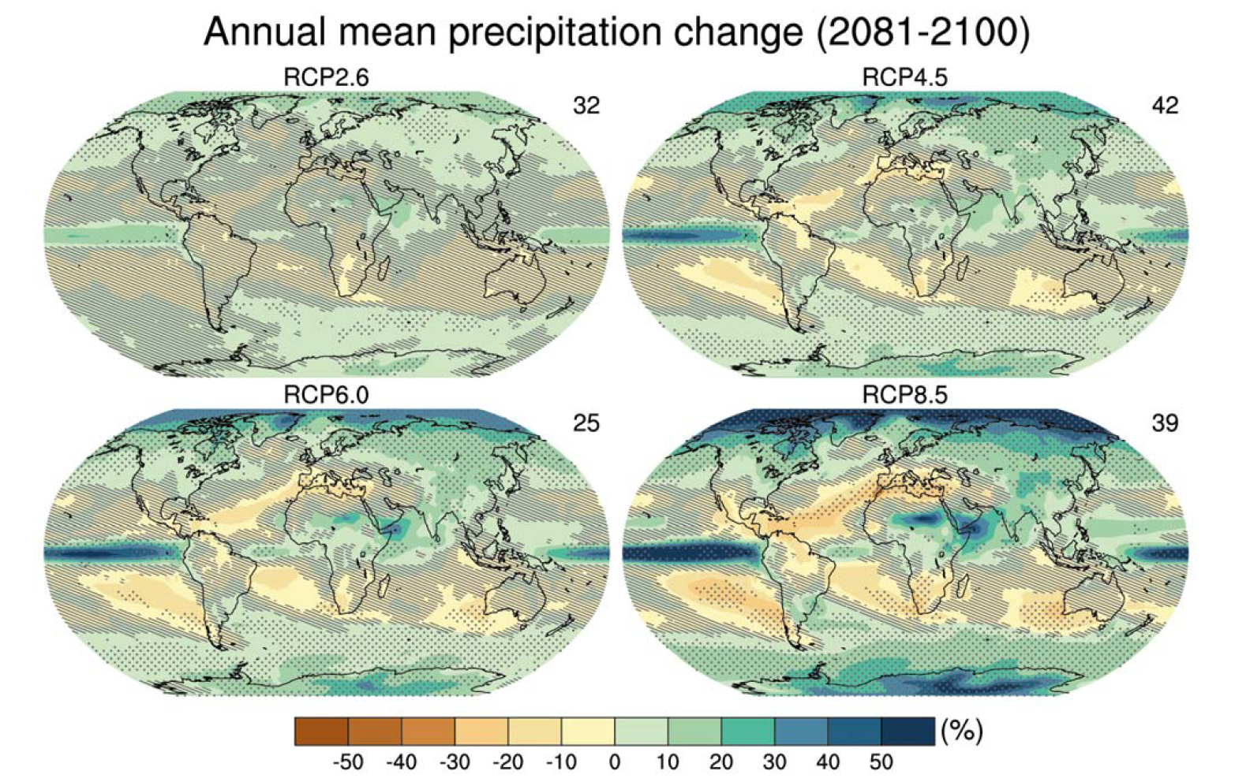
IPCC AR5 WGI, Figure TS.16

Slide 30
“For the next two decades a warming of about 0.2°C per decade is projected for a range of SRES emission scenarios.
“Even if the concentrations of all greenhouse gases and aerosols had been kept constant at year 2000 levels, a further warming of about 0.1°C per decade would be expected.”

Slide 31
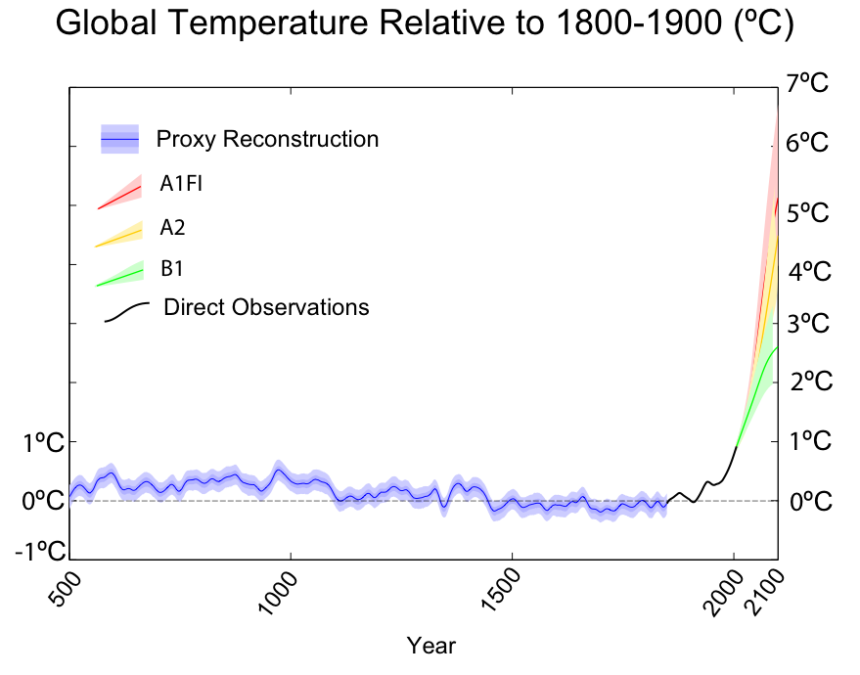

Figure 21: Reconstructed, observed and future warming projections

Slide 32
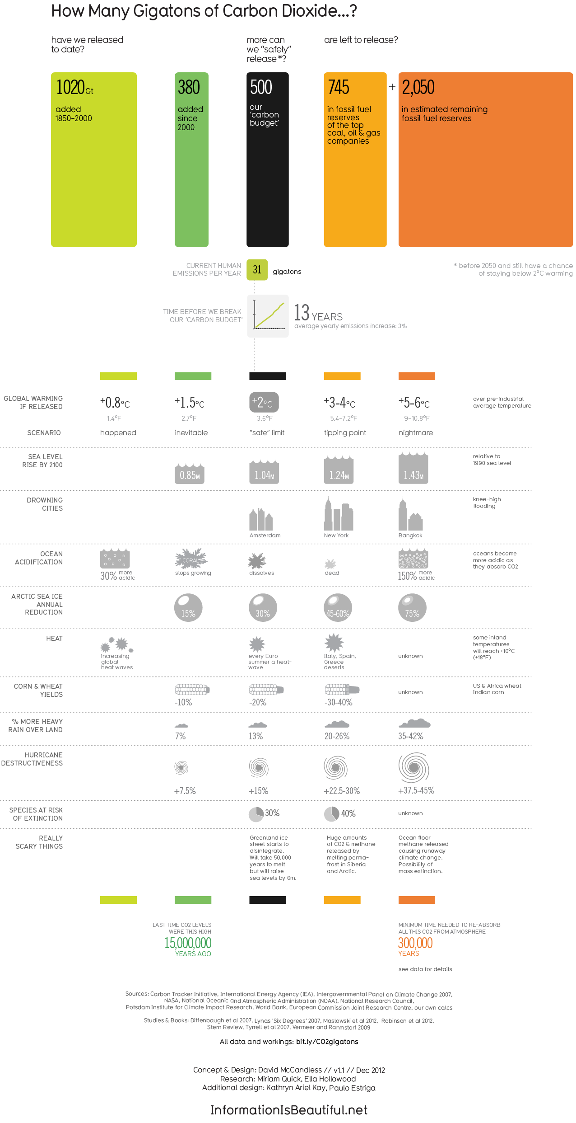

Slide 35
Geoengineering is defined as
“deliberate large-scale manipulation of the planetary environment to counteract anthropogenic climate change.”
Shepherd, J. G. S. et al., 2009: Geoengineering the climate: Science, governance and uncertainty, RS Policy Document 10/09, (London: The Royal Society).

Slide 36
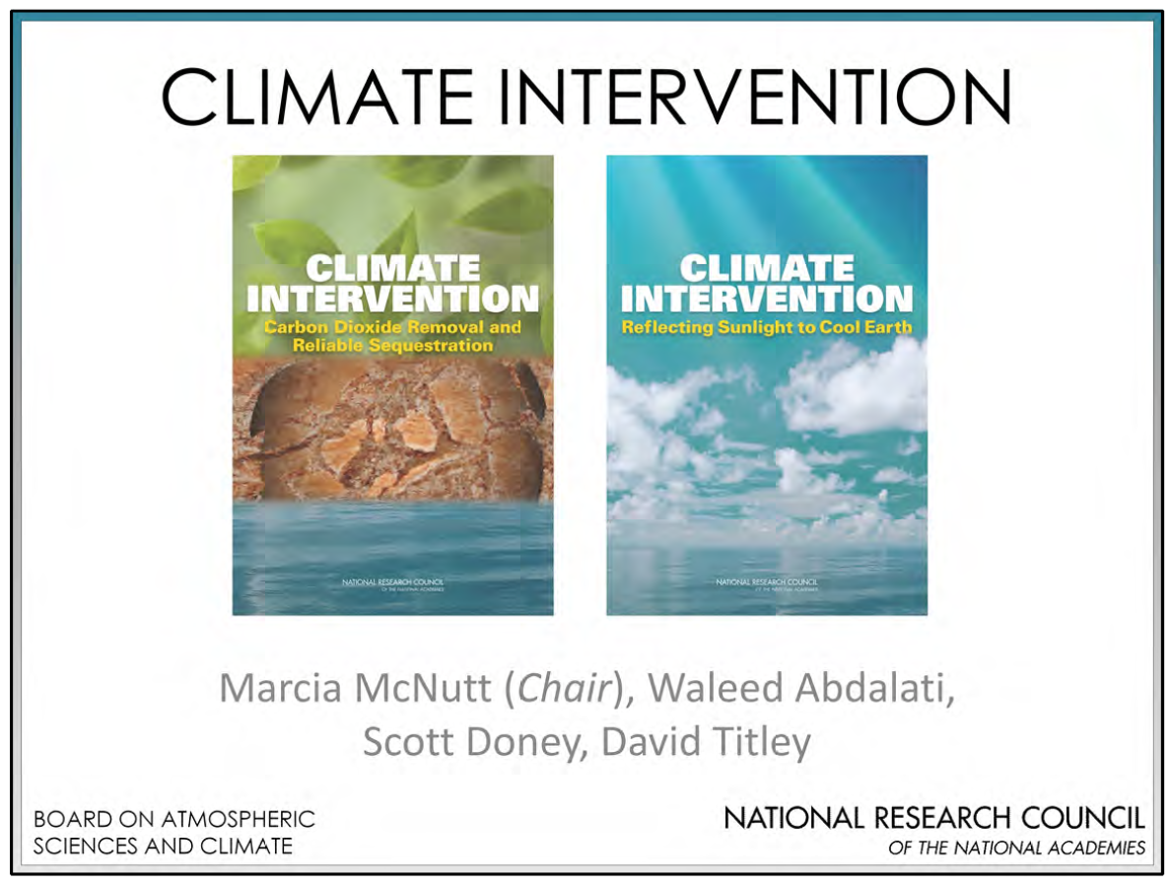
Carbon Dioxide Removal (CDR)
Solar Radiation Management (SRM)
Released February 14, 2015
Sponsors: U.S. National Academy of Sciences, U.S. intelligence community, National Aeronautics and Space Administration, National Oceanic and Atmospheric Administration, and U.S. Department of Energy

Slide 37
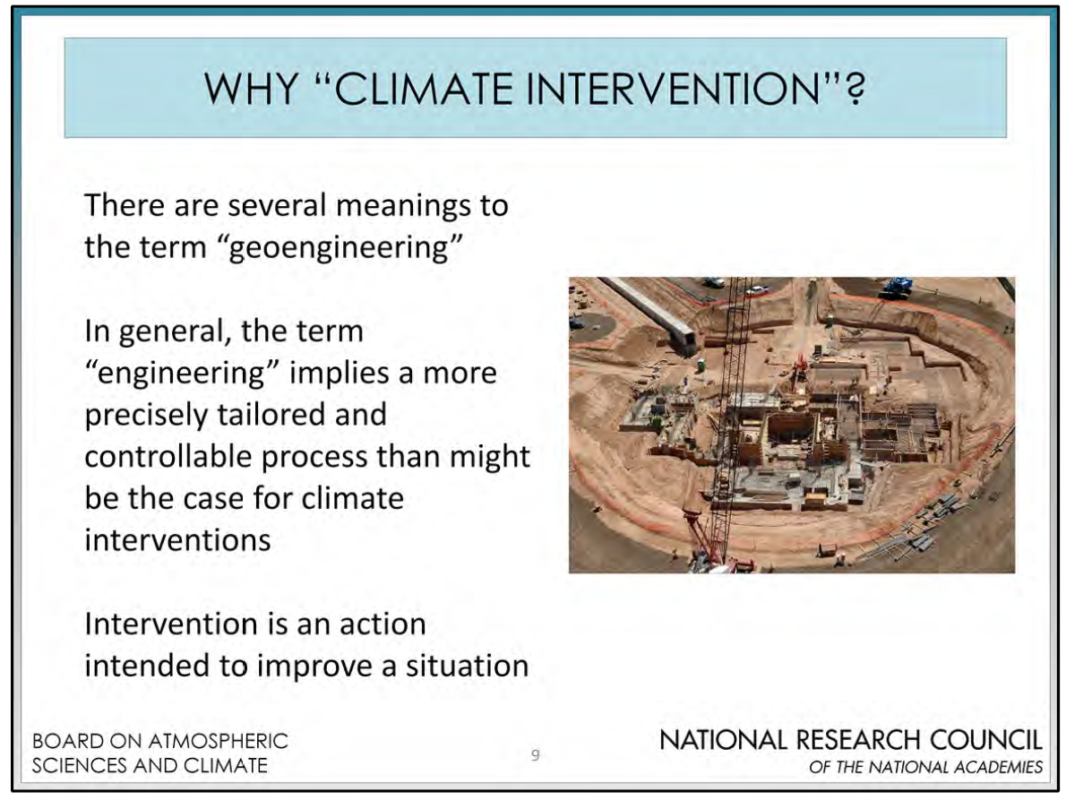

Slide 38
Some Proposed Geoengineering Schemes:
A. Space
  Modifier of solar radiation at L1 point
B. Stratospheric
  Stratospheric aerosols (sulfate, soot, dust)
  Stratospheric balloons or mirrors
C. Tropospheric
  Modifying total reflection from marine clouds
D. Surface
  Making deserts more reflective
  Modifying ocean albedo
  Reforestation (CO₂ and evapotranspiration effects, but albedo effect causes warming)
  Direct absorption of CO₂
  Ocean fertilization
Solar Radiation Management (SRM)
Carbon Dioxide
Reduction (CDR)

Slide 39
Keith, David, 2001: Geoengineering, Nature, 409, 420.

Slide 40
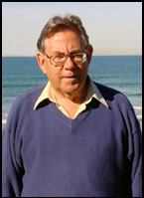
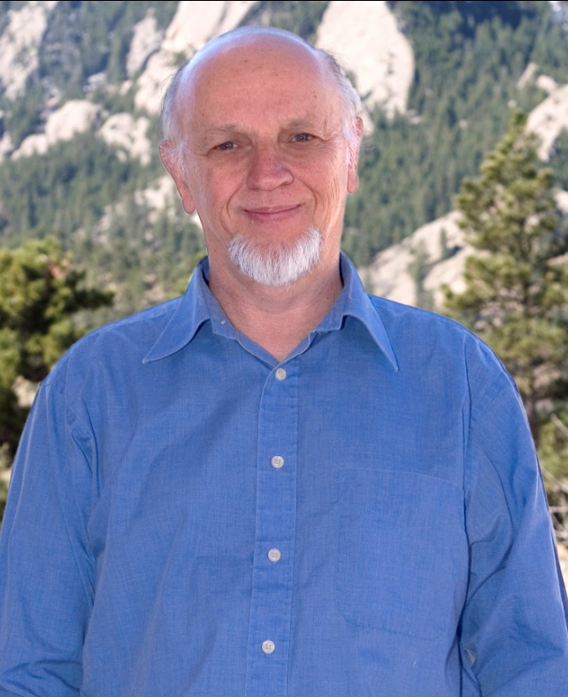
Despairing of prompt political response to global warming, in August and September 2006,
Paul Crutzen (Nobel Prize in Chemistry) and Tom Wigley (NCAR)
suggested that we consider temporary geoengineering as an emergency response.

Slide 41
This talk focuses on injecting sulfate aerosol precursors into the stratosphere to reduce insolation to counter global warming, which brings up the question:
Are volcanic eruptions an innocuous example that can be used to demonstrate the safety of geoengineering?
No.

Slide 42
Tropospheric aerosols mask warming
(global dimming)
Greenhouse gases dominate
Recovery from volcanic eruptions dominates
http://data.giss.nasa.gov/gistemp/graphs_v3/Fig.A2.pdf

Slide 43

Solar Radiation Management
Space-based reflectors
Stratospheric aerosols
Tropopause
Cloud brightening
Surface albedo modification
Earth surface

Slide 44
Matthews, H. Damon and Sarah E. Turner, 2009: Of mongooses and mitigation: ecological analogues to geoengineering. Environ. Res. Lett., 4, doi: 10.1088/1748-9326/4/4/045105.

Slide 45
Flyer concept. The 0.6 m diameter, 5 μm thick refracting disc is faceted to improve stiffness. The three 100 μm thick tabs have 2% of the disc area, and contain the MEMS solar sails, tracker cameras, control electronics and solar cells.
He envisions over a 10-yr period, vertical 2-km magnetic launchers with 800,000 flyers each, every 5 min from 20 sites simultaneously to put 20 Mt of flyers into orbit.
Angel, Roger, 2006: Feasibility of cooling the Earth with a cloud of small spacecraft near the inner Lagrange point (L1). Proc. Nat. Acad. Sci., 103, 17,184-17,189.

Slide 46
Angel, Roger, 2006: Feasibility of cooling the Earth with a cloud of small spacecraft near the inner Lagrange point (L1). Proc. Nat. Acad. Sci., 103, 17,184-17,189.

Slide 47
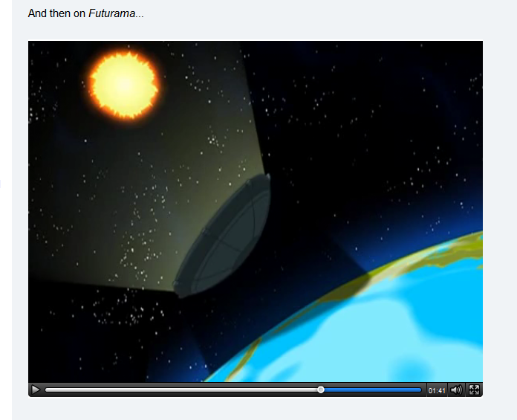
VLC
http://io9.com/5665736/blotting-out-the-sun-to-slow-down-global-warming-could-be-outlawed

Slide 48
From Web
http://io9.com/5665736/blotting-out-the-sun-to-slow-down-global-warming-could-be-outlawed

Slide 49
Media Player
http://io9.com/5665736/blotting-out-the-sun-to-slow-down-global-warming-could-be-outlawed

Slide 50
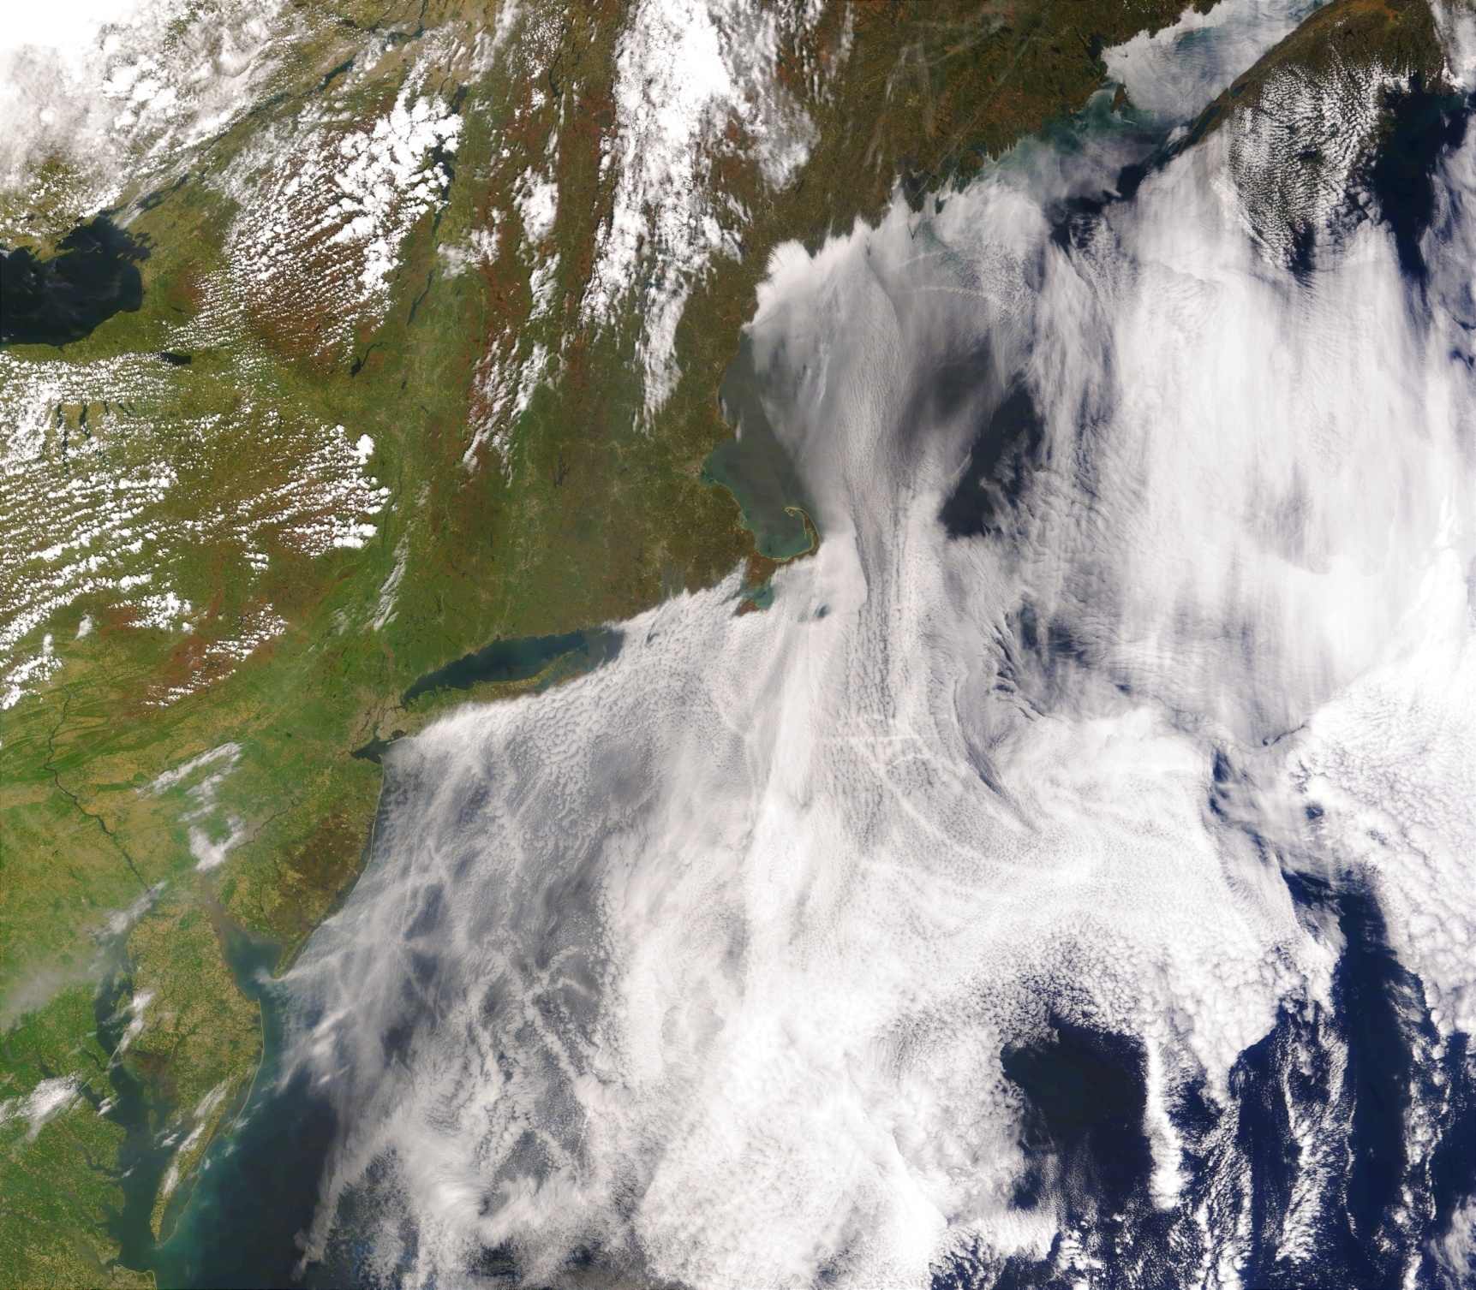
This image of ship tracks was taken by the Moderate Resolution Imaging Spectro-radiometer (MODIS) on NASA’s Terra satellite on May 11, 2005.
http://eobglossary.gsfc.nasa.gov/Newsroom/NewImages/Images/ShipTracks_TMO_2005131_lrg.jpg

Slide 51
Scheme by John Latham (University of Manchester, NCAR) and Steve Salter (University of Edinburgh) to increasing cloud albedo with by injecting more sea salt cloud condensation nuclei into marine stratus clouds.

Slide 52
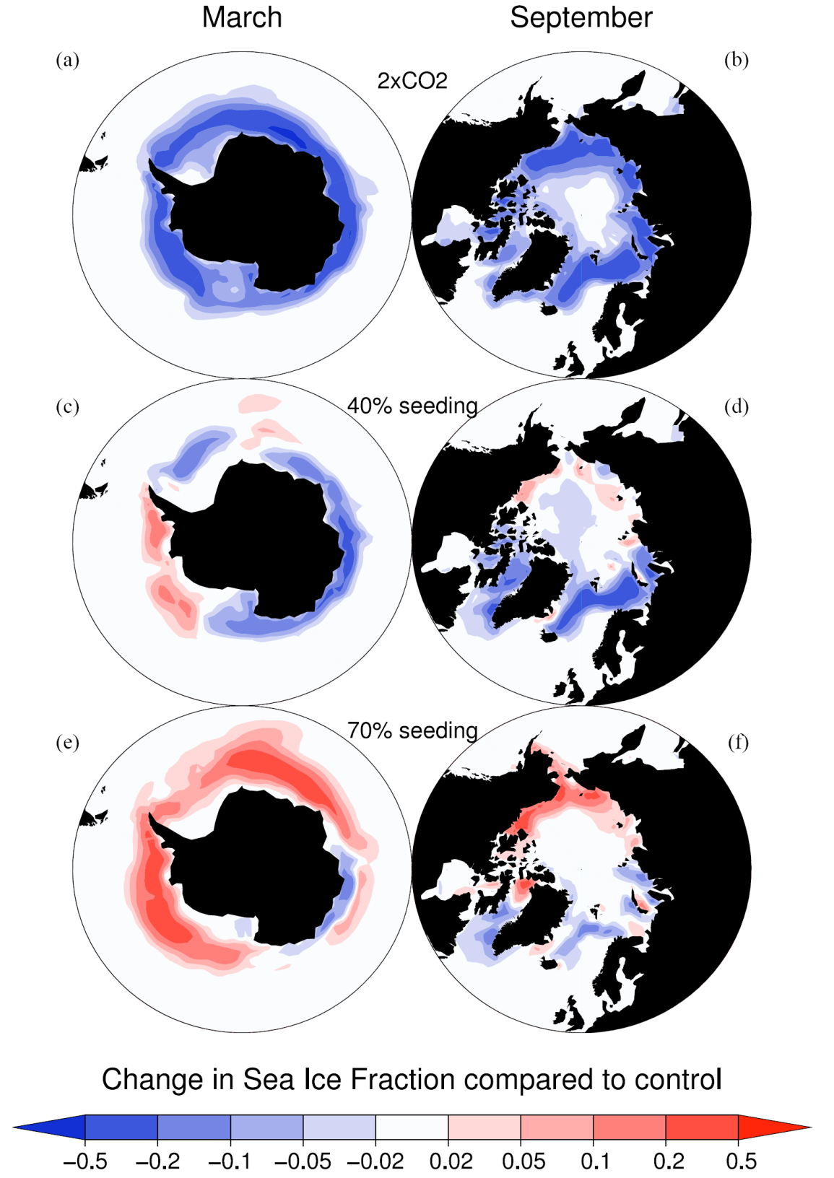
Sea ice is affected by global warming and geoengineering
Summer sea ice goes away with a doubling of CO₂
Ice returns with geoengineering
It is possible to overdo the effect
Rasch et al. (2009)

Slide 53
Precipitation change for geoengineering with brighter marine stratocumulus clouds.
Damage to Amazon would not be reversible.
(Jones et al., 2009)
Jones, Andy, Jim Haywood, and Olivier Boucher (2009), Climate impacts of geoengineering marine stratocumulus clouds, J. Geophys. Res., 114, D10106, doi:10.1029/2008JD011450.

Slide 54
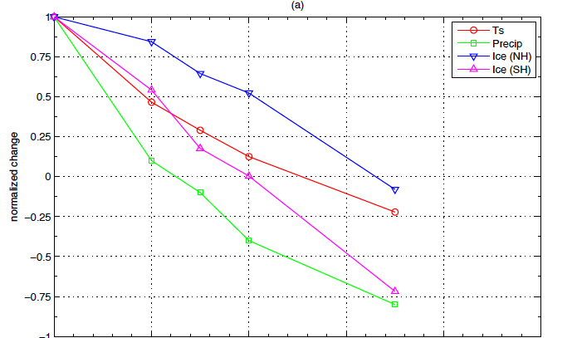
SRM will not operate “uniformly”
(even for global averages) (Rasch et al., 2009)
Global Average Like 2xCO₂
Difference compared to Present Day and 2xCO₂
Global Average Like
the Present Day
(“Amount” of Geoengineering)

Slide 55
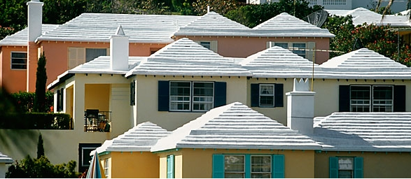
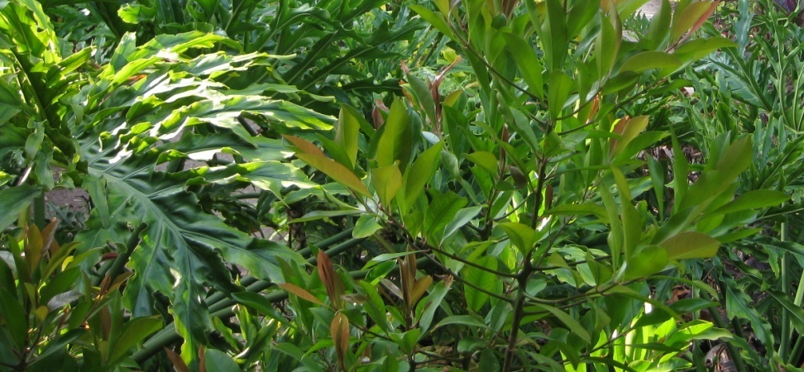
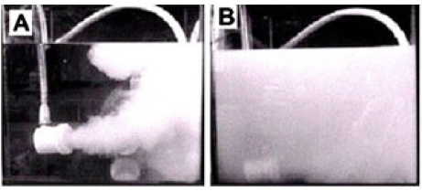
Making the surface brighter?
Oleson et al. (2010) found minimal global impacts of urban white roofs.
Oleson, K., G. Bonan, and J. Feddema, 2010: Effects of white roofs on urban temperature in a global climate model, Geophys. Res. Lett., 37, L03701, doi:10.1029/2009GL042194.
http://www.treehugger.com/white-roof.jpg
Doughty et al. (2011) found leaf brightening would have minimal effect.
Doughty, C. E., C.B. Field, and A. M. S. McMillan, 2011: Can crop albedo be increased through the modification of leaf trichomes, and could this cool regional climate? Climatic Change, 104, 379–387, doi:10.1007/s10584-010-9936-0
Seitz (2011) proposed bubbles to brighten the ocean, but Robock (2011) found many issues with proposal.
Seitz, R., 2011: Bright water: hydrosols, water conservation and climate change. Climatic Change, 105, 365-381, doi:10.1007/s10584-010-9965-8.
Robock, Alan, 2011: Bubble, bubble, toil and trouble. An editorial comment. Climatic Change, 105, 383-385, doi:10.1007/s10584-010-0017-1.
Seitz (2011), Fig. 1

Slide 56
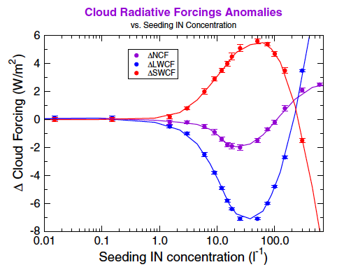
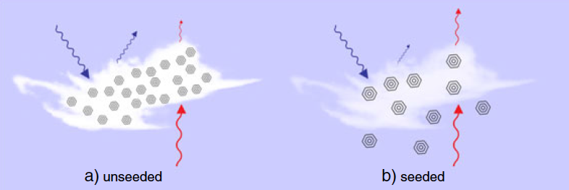
Reducing cirrus clouds to let more longwave escape
Storelvmo T., J. E. Kristjansson, H. Muri, M. Pfeffer, D. Barahona and A. Nenes (2013), Cirrus cloud seeding has potential to cool climate, Geophys. Res. Lett., 40, 178–182, doi:10.1029/2012GL054201.

Slide 57


Slide 58
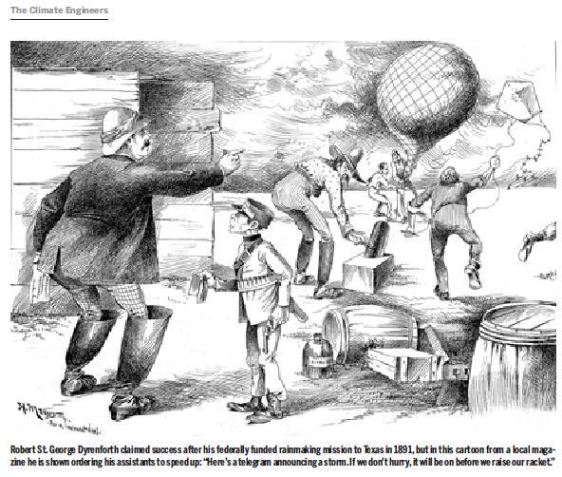

Slide 59
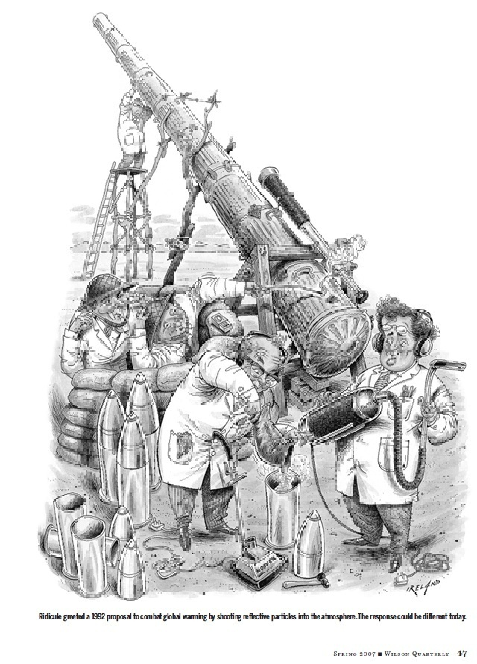

Slide 60


Can Dr. Evil
Save The World?
Forget about a future filled with wind farms and hydrogen cars. The Pentagon's top weaponeer says he has a radical solution that would stop global warming now -- no matter how much oil we burn.
Jeff Goodell
Rolling Stone
November 3, 2006

Slide 61
Reasons geoengineering may be a bad idea
Climate system response
1. Regional climate change, including temperature and precipitation
2. Rapid warming when it stops
3. How rapidly could effects be stopped?
4. Continued ocean acidification
5. Ozone depletion
6. Enhanced acid precipitation
7. Whitening of the sky (but nice sunsets)
8. Less solar radiation for solar power, especially for those requiring direct radiation
9. Effects on plants of changing the amount of solar radiation and partitioning between direct and diffuse
10. Effects on cirrus clouds as aerosols fall into the troposphere
11. Environmental impacts of aerosol injection, including producing and delivering aerosols
Robock, Alan, 2008: 20 reasons why geoengineering may be a bad idea. Bull. Atomic Scientists, 64, No. 2, 14-18, 59, doi:10.2968/064002006.

Slide 62
Stratospheric Geoengineering
Benefits | Risks
1. Reduce surface air temperatures, which could reduce or reverse negative impacts of global warming, including floods, droughts, stronger storms, sea ice melting, land-based ice sheet melting, and sea level rise | 1. Drought in Africa and Asia
 | 2. Perturb ecology with more diffuse radiation
 | 3. Ozone depletion
 | 4. Continued ocean acidification
 | 5. Will not stop ice sheets from melting
 | 6. Impacts on tropospheric chemistry
2. Increase plant productivity | 7. Whiter skies
3. Increase terrestrial CO₂ sink | 8. Less solar electricity generation
4. Beautiful red and yellow sunsets | 9. Degrade passive solar heating
5. Unexpected benefits | 10. Rapid warming if stopped
 | 11. Cannot stop effects quickly
 | 12. Human error
 | 13. Unexpected consequences
 | 14. Commercial control
 | 15. Military use of technology
 | 16. Societal disruption, conflict between countries
 | 17. Conflicts with current treaties
 | 18. Whose hand on the thermostat?
 | 19. Effects on airplanes flying in stratosphere
 | 20. Effects on electrical properties of atmosphere
 | 21. Environmental impact of implementation
 | 22. Degrade terrestrial optical astronomy
 | 23. Affect stargazing
 | 24. Affect satellite remote sensing
 | 25. More sunburn
 | 26. Moral hazard – the prospect of it working would reduce drive for mitigation
 | 27. Moral authority – do we have the right to do this?
Each of these needs to be quantified so that society can make informed decisions.
Robock, Alan, 2008: 20 reasons why geoengineering may be a bad idea. Bull. Atomic Scientists, 64, No. 2, 14-18, 59, doi:10.2968/064002006.
Robock, Alan, Allison B. Marquardt, Ben Kravitz, and Georgiy Stenchikov, 2009: The benefits, risks, and costs of stratospheric geoengineering. Geophys. Res. Lett., 36, L19703, doi:10.1029/2009GL039209.
Robock, Alan, 2014: Stratospheric aerosol geoengineering. Issues Env. Sci. Tech. (Special issue “Geoengineering of the Climate System”), 38, 162-185.
Notes:
62

Slide 63
Proposals for “solar radiation management”
using injection of stratospheric aerosols
1. Inject them into the tropical stratosphere, where winds will spread them around the world and produce global cooling, like tropical volcanic eruptions have.
2. Inject them at high latitudes in the Arctic, where they will keep sea ice from melting, while any negative effects would not affect many people.

Slide 64
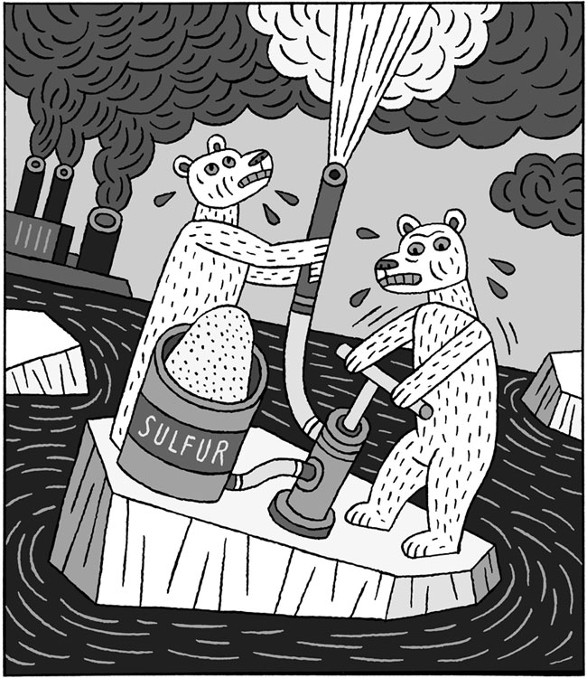
Arctic geoengineering
(In response to New York Times Op-Ed “How to Cool the Globe” by Ken Caldeira, October 24, 2007)
Screwing (with) the Planet
James Fleming
Colby College, Waterville, ME
We would all like to see the polar bears flourish, but Ken Caldiera's suggestion to “seed” the Earth's stratosphere with acidic particles using military technology is not the way to do this.
Naval artillery, rockets, and aircraft exhaust are all “manly” ways to declare “war” on global warming. “A fire hose suspended from a series of balloons” alludes to the proposal by Edward Teller's protégé Lowell Wood to attach a 25-mile long phallus to a futuristic military High Altitude Airship. If the geoengineers can't keep it up, imagine a “snake” filled with more than a ton of acid ripping loose, writhing wildly, and falling out of the sky!
© New York Times, Henning Wagenbreth, Oct. 24, 2007

Slide 65
Arctic geoengineering: continued
(In response to New York Times Op-Ed “How to Cool the Globe” by Ken Caldeira, October 24, 2007)
Screwing (with) the Planet
James Fleming
Colby College, Waterville, ME
The pair of overheated polar bears in the cartoon alludes to such nonsense. And whose warships are those in the distance? Better check with Vladimir Putin before we screw (with) the Arctic.
The geoengineers have been playing such games with the planet since computerized general circulation models were developed back in the late 1950s. While this kind research will undoubtedly continue, it should remain indoors between consenting adults. What needs to be aired out are the underlying assumptions.
© New York Times, Henning Wagenbreth, Oct. 24, 2007

Slide 66
We conducted the following geoengineering simulations with the NASA GISS ModelE atmosphere-ocean general circulation model run at 4ºx 5º horizontal resolution with 23 vertical levels up to 80 km, coupled to a 4ºx 5º dynamic ocean with 13 vertical levels and an online chemistry and transport module:
- 80-yr control run
- 40-yr anthropogenic forcing, IPCC A1B scenario: greenhouse gases (CO₂, CH₄, N₂O, O₃) and tropospheric aerosols (sulfate, biogenic, and soot), 3-member ensemble
- 40-yr IPCC A1B + Arctic lower stratospheric injection of 3 Mt SO₂/yr, 3-member ensemble
- 40-yr IPCC A1B + Tropical lower stratospheric injection of 5 Mt SO₂/yr, 3-member ensemble
- 40-yr IPCC A1B + Tropical lower stratospheric injection of 10 Mt SO₂/yr
Robock, Alan, Luke Oman, and Georgiy Stenchikov, 2008: Regional climate responses to geoengineering with tropical and Arctic SO₂ injections. J. Geophys. Res., 113, D16101, doi:10.1029/2008JD010050

Slide 67
Aerosol properties
We define the dry aerosol effective radius as 0.25 μm compared to 0.35 μm for our Pinatubo simulations. This creates hydrated sulfate aerosols approx 0.30-0.35 μm for our geoengineering runs and 0.47-0.52 μm for our Pinatubo simulations.
It is difficult to say the size at which the aerosols will end up without a microphysical model that has coagulation but by injecting daily vs. one eruption per year, coagulation would be reduced since concentrations are lower and more globally distributed. On the other hand, particles might grow larger than those typical of a volcanic eruption if existing particles grow rather than having new particles form.
The smaller size aerosols have a slightly longer lifetime so this would reduce the rate of injection needed to maintain a specific loading.

Slide 68
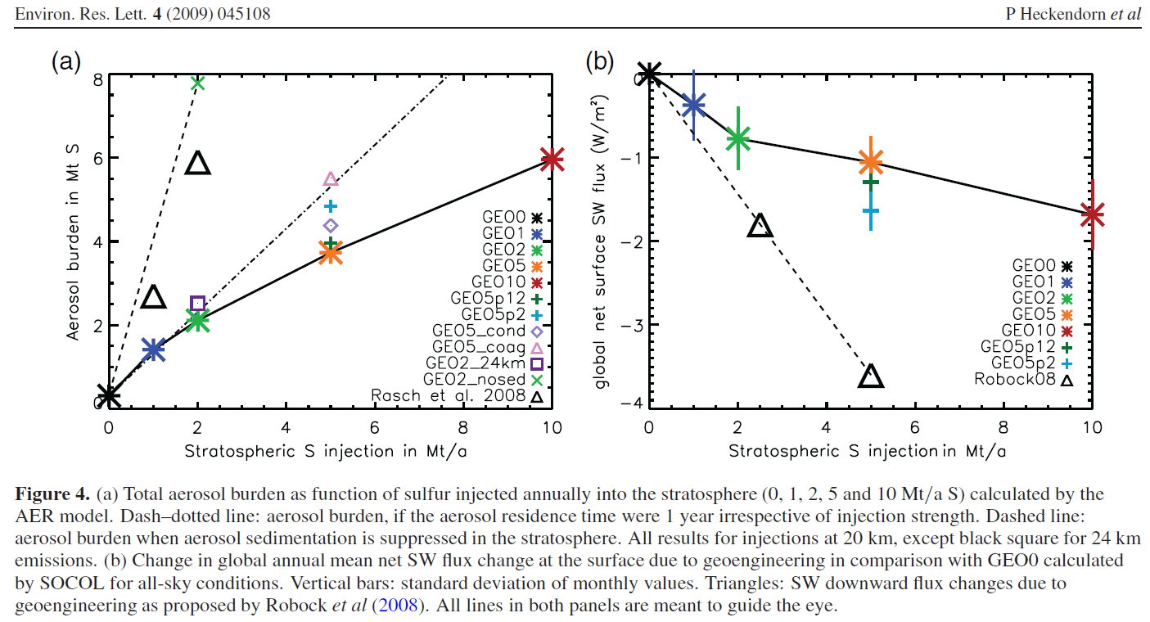
Heckendorn et al. (2009) showed particles would grow, requiring much larger injections for the same forcing.

Slide 69
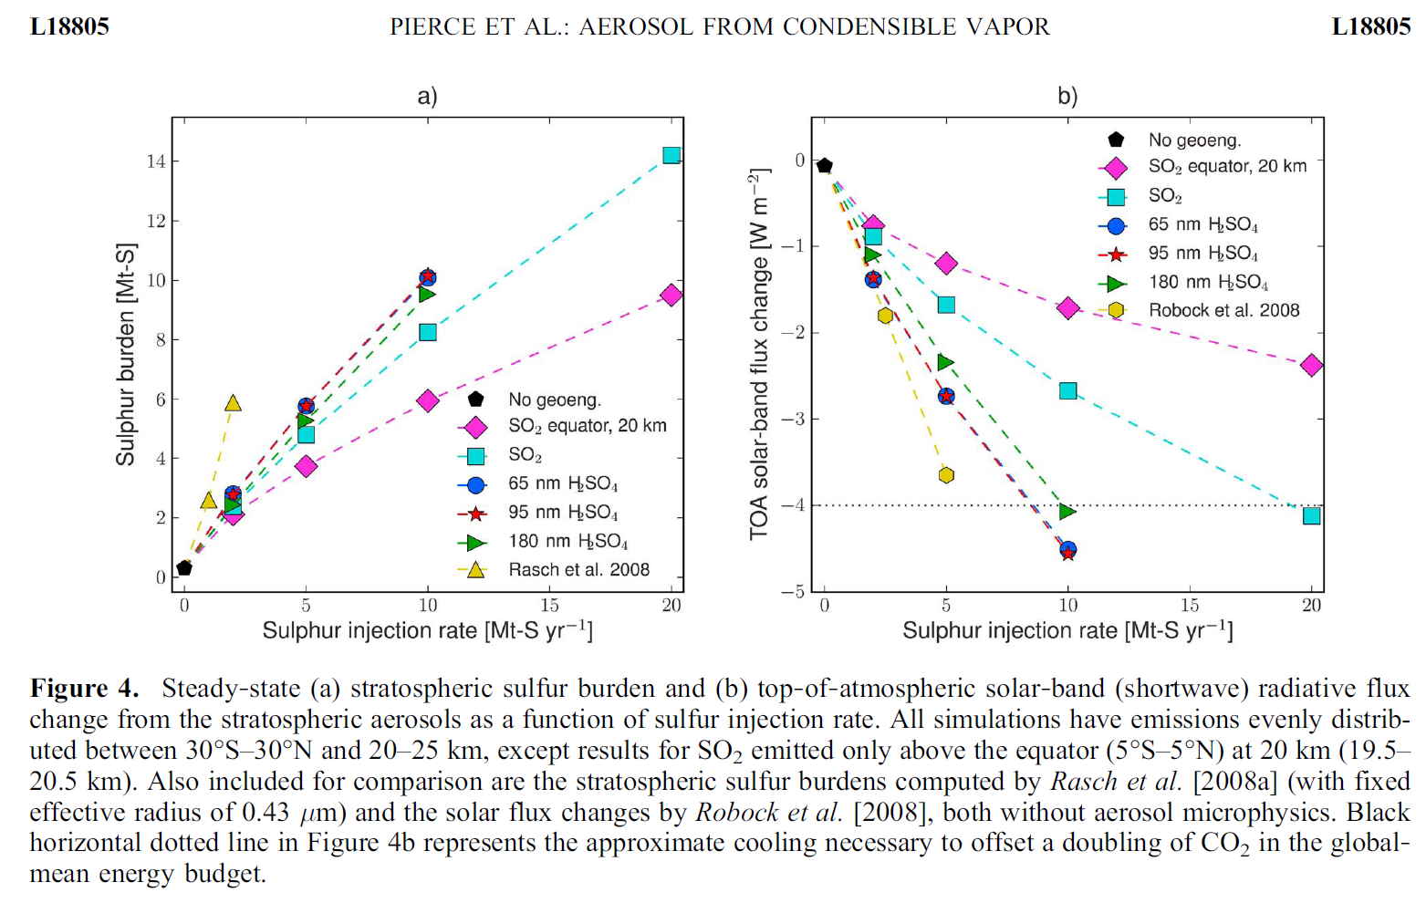
Pierce et al. (GRL, 2010) claimed that emitting sulfuric acid directly will produce larger particles, helping solve the problem of aerosol growth.

Slide 70
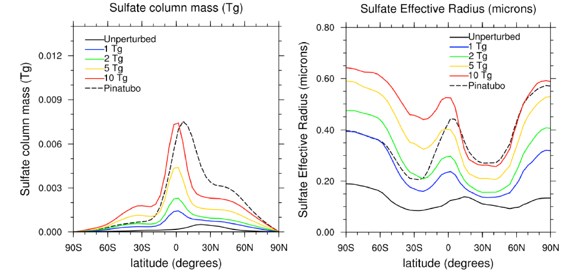
But English et al. (ACP, 2012) found that
“increasing injection rates of SO₂ in a narrow band around the equator to have limited efficacy while broadening the injecting zone as well as injecting particles instead of SO₂ gas increases the sulfate burden for a given injection rate, in agreement with previous work. We find that injecting H₂SO₄ gas instead of SO₂ does not discernibly alter sulfate size or mass, in contrast with a previous study using a plume model with a microphysical model.”

Slide 71
Aerosol properties
By using a smaller aerosol size (about 30% less than Pinatubo), there is about half the heating of the lower tropical stratosphere as compared to the equivalent loading using a Pinatubo size aerosol.
We injected it at about the same altitude as Pinatubo but if the sulfate was closer to the tropopause and larger in size it would warm the tropopause cold point and let a lot more water vapor into the stratosphere, and this could cause additional problems that would have to be considered.

Slide 72
Latitudes and Altitudes
Tropical: We put SO₂ into the lower stratosphere (16-22 km) over the Equator at a daily rate equal to
5 Mt/yr (1 Pinatubo every 4 years) or
10 Mt/yr (1 Pinatubo every 2 years) for 20 years,
and then continue to run for another 20 years to see how fast the system warms afterwards.
Arctic: We put SO₂ into the lower stratosphere (10-15 km)
at 68°N at a daily rate equal to 3 Mt/yr for 20 years,
and then continue to run for another 20 years to see how fast the system warms afterwards.

Slide 73
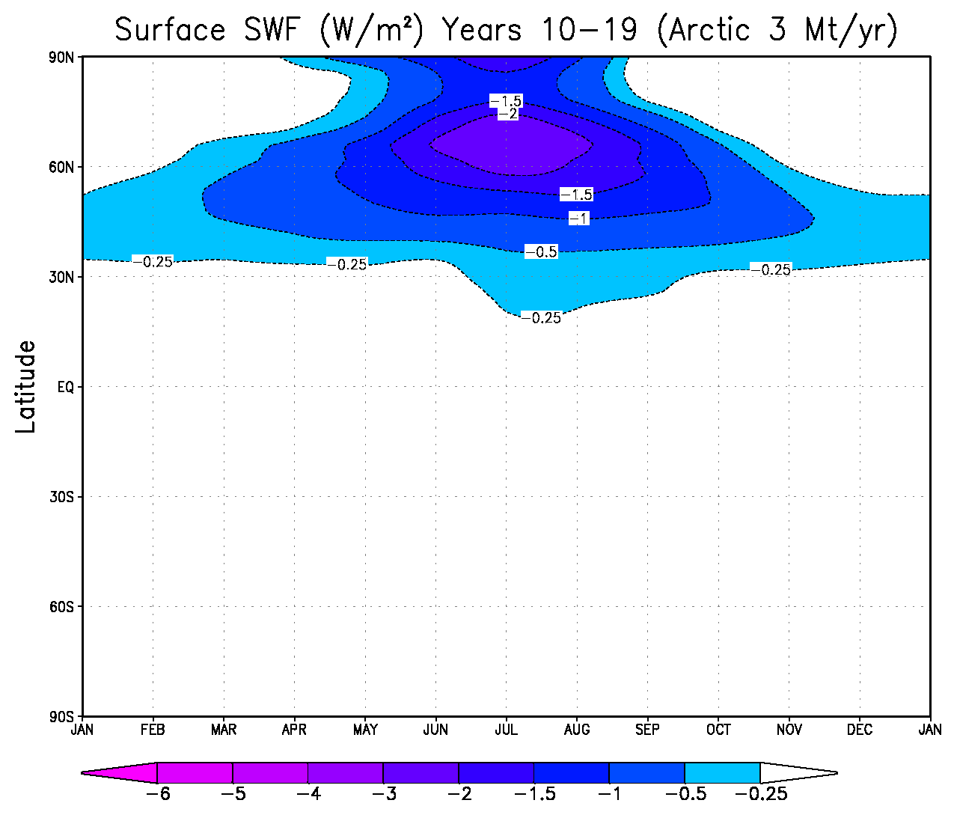
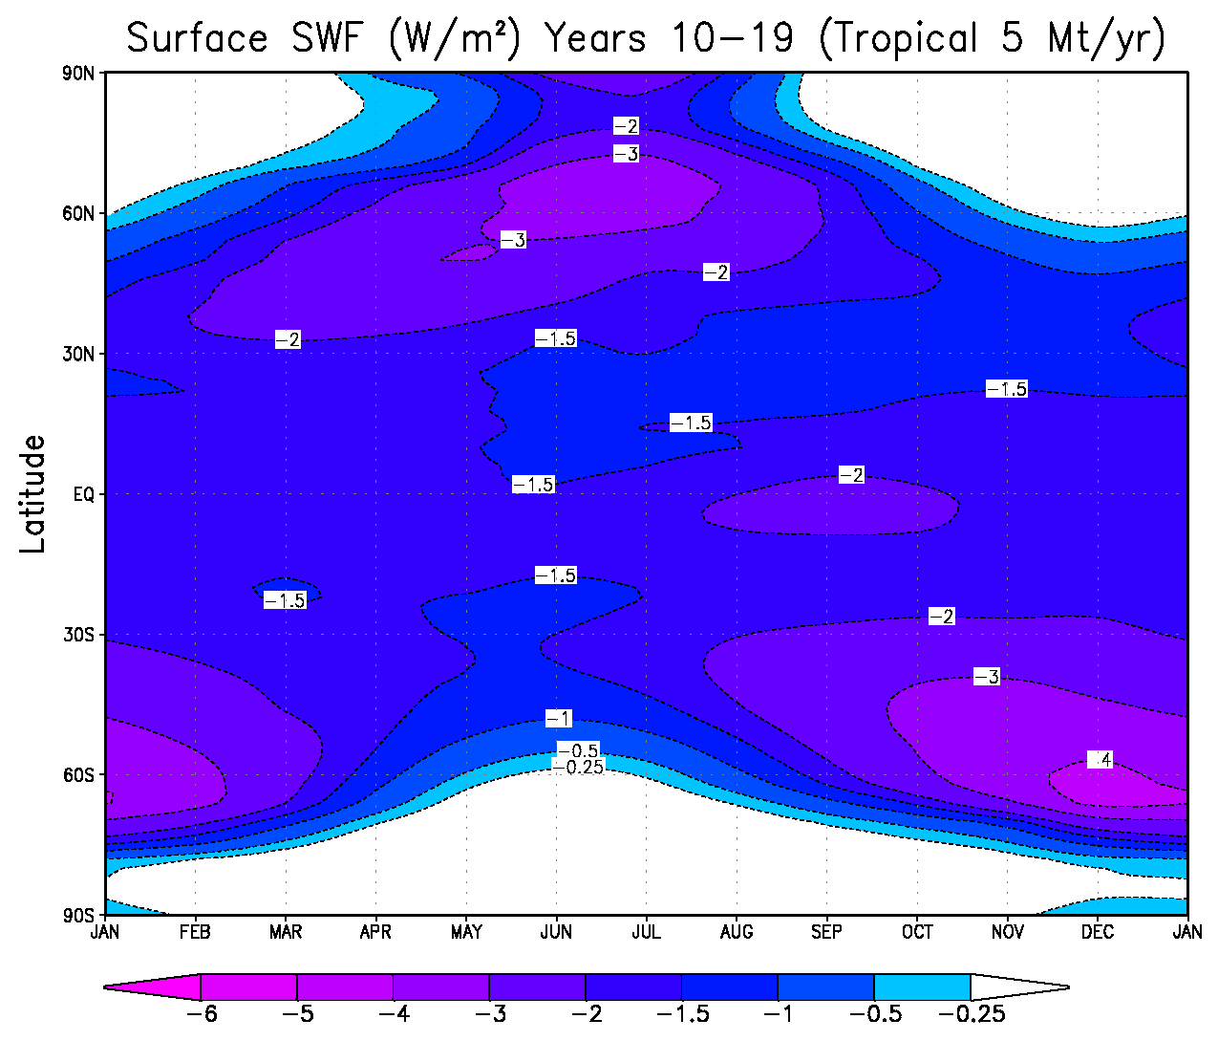
Change in downward solar radiation at Earth’s surface
Arctic emission at 68°N leaks into the subtropics
Tropical emission spreads to cover the planet

Slide 74
GISS Global Average Temperature Anomaly
+ Anthro Forcing, 3 Mt/yr Arctic,
5 Mt/yr Tropical, 10 Mt/yr Tropical

Slide 75
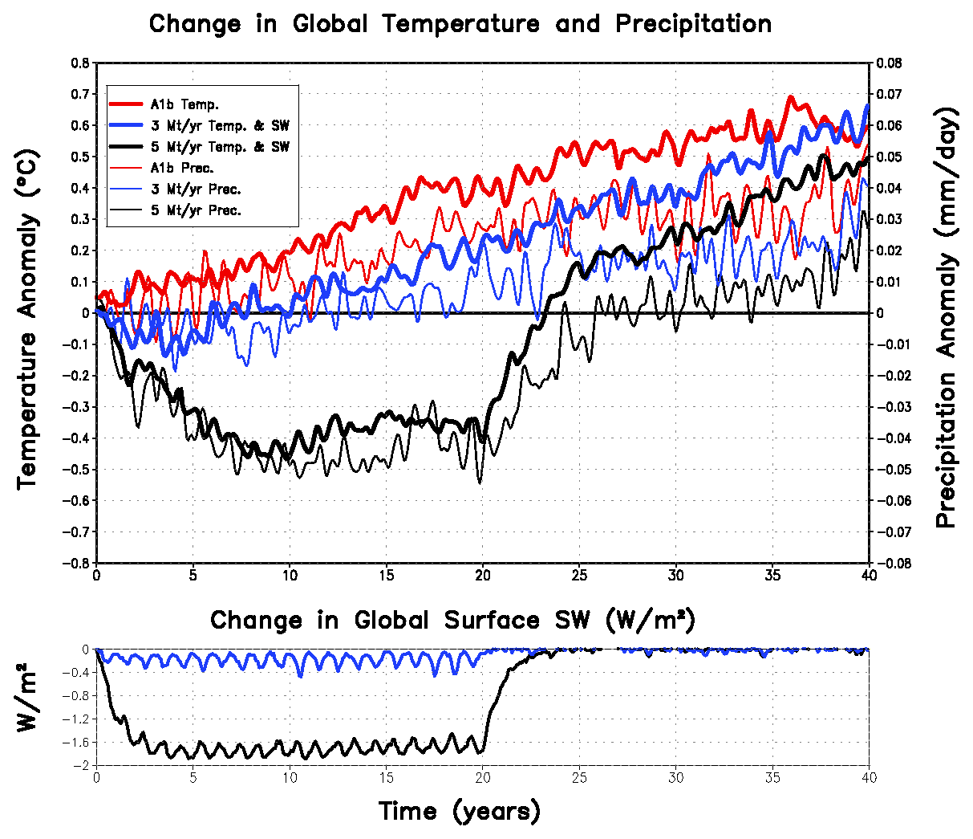
Temperature
Precipitation
Global average changes in temperature, precipitation, and downward shortwave radiation for A1B, Arctic 3 Mt/yr and Tropical 5 Mt/yr geoengineering runs.

Slide 76
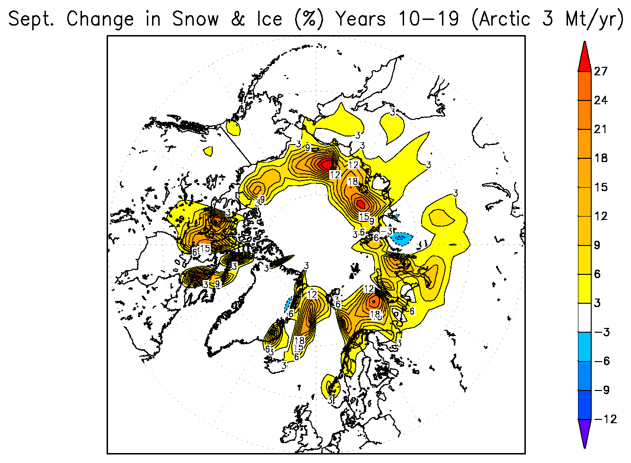
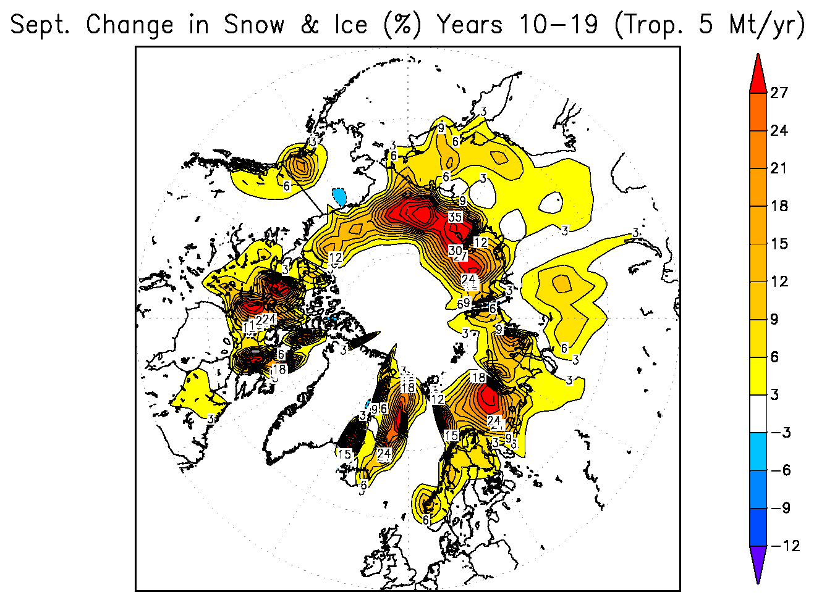
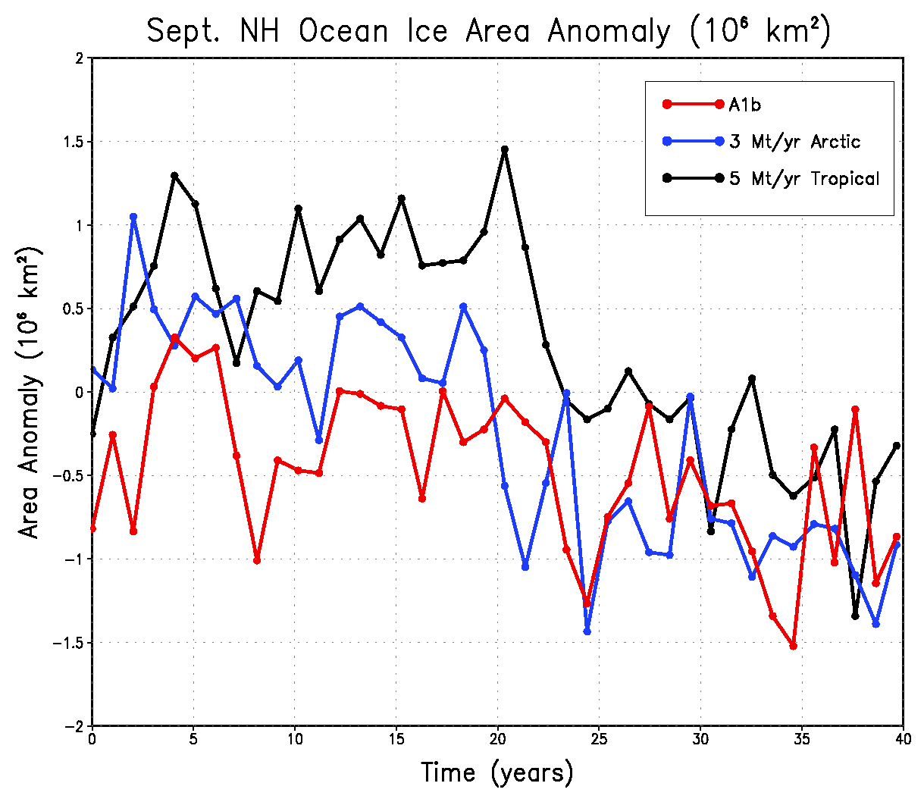

Slide 77
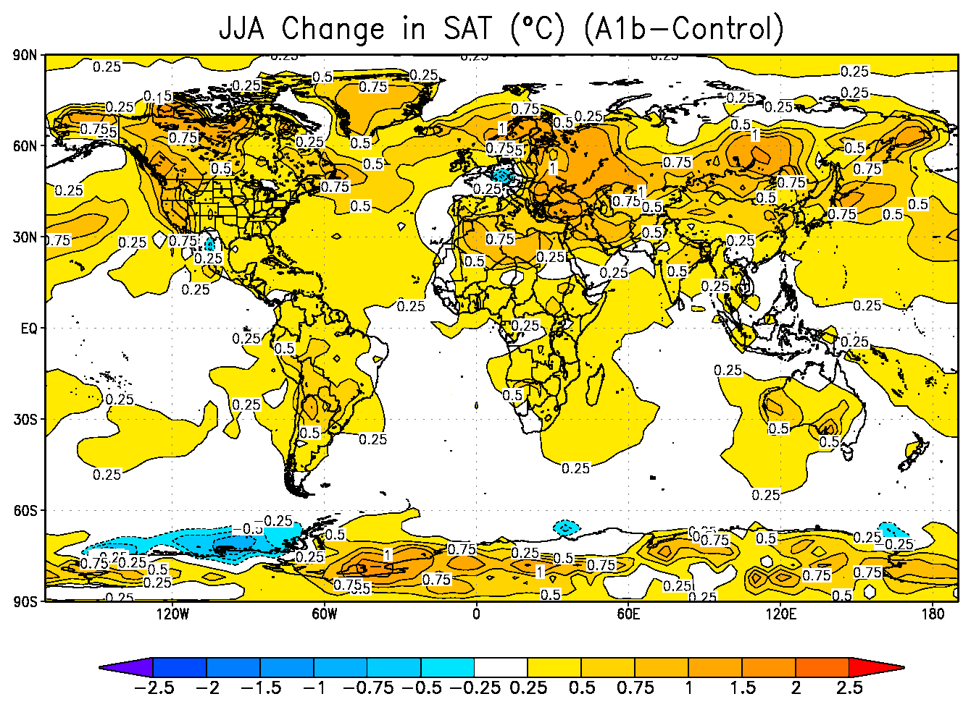


Mean response for second decade of aerosol injection
for IPCC A1B + Arctic 3 Mt/yr case for NH summer
surface air temperature

Slide 78



Mean response for second decade of aerosol injection
for IPCC A1B + Arctic 3 Mt/yr
case for NH winter
surface air temperature

Slide 79


Mean response for second decade of aerosol injection
for IPCC A1B + Tropical 5 Mt/yr case for NH winter
surface air temperature

Slide 80


Mean response for second decade of aerosol injection
for IPCC A1B + Tropical 5 Mt/yr case for NH summer
surface air temperature

Slide 81




Arctic 3 Mt/yr NH summer precipitation Tropical 5 Mt/yr

Slide 82

= significant at the 95% level

Slide 83

= significant at the 95% level

Slide 84

= significant at the 95% level
Robock, Alan, Luke Oman, and Georgiy Stenchikov, 2008: Regional climate responses to geoengineering with tropical and Arctic SO₂ injections. J. Geophys. Res., in press.

Slide 85

= significant at the 95% level
Robock, Alan, Luke Oman, and Georgiy Stenchikov, 2008: Regional climate responses to geoengineering with tropical and Arctic SO₂ injections. J. Geophys. Res., in press.

Slide 86

Met Office, Hadley Centre
5Mt/yr – A1b
ModelE
5Mt/yr – A1b
Jones, Andy, Jim Haywood, Olivier Boucher, Ben Kravitz, and Alan Robock, 2010: Geoengineering by stratospheric SO₂ injection: Results from the Met Office HadGEM2 climate model and comparison with the Goddard Institute for Space Studies ModelE. Atmos. Chem. Phys., 10, 5999-6006.

Slide 87

Rasch, Philip J., Simone Tilmes, Richard P. Turco, Alan Robock, Luke Oman, Chih-Chieh (Jack) Chen, Georgiy L. Stenchikov, and Rolando R. Garcia, 2008: An overview of geoengineering of climate using stratospheric sulphate aerosols. Phil. Trans. Royal Soc. A., 366, 4007-4037, doi:10.1098/rsta.2008.0131.

Slide 88
Conclusions
1. If there were a way to continuously inject SO₂ into the lower stratosphere, it would produce global cooling.
2. Tropical SO₂ injection would produce sustained cooling over most of the world, with more cooling over continents.
3. Arctic SO₂ injection would not just cool the Arctic.
4. Solar radiation reduction produces larger precipitation response than temperature, as compared to greenhouse gases.
5. Both tropical and Arctic SO₂ injection might disrupt the Asian and African summer monsoons, reducing precipitation to the food supply for billions of people.

Slide 89

GeoMIP
We are carrying out standard experiments with the new GCMs being run as part of CMIP5 using identical global warming and geoengineering scenarios, to see whether our results are robust.
For example, how will the hydrological cycle respond to stratospheric geoengineering? Will there be a significant reduction of Asian monsoon precipitation? How will ozone and UV change?
Kravitz, Ben, Alan Robock, Olivier Boucher, Hauke Schmidt, Karl Taylor, Georgiy Stenchikov, and Michael Schulz, 2011: The Geoengineering Model Intercomparison Project (GeoMIP). Atmospheric Science Letters, 12, 162-167, doi:10.1002/asl.316.
GeoMIP is a CMIP Coordinated Experiment, as part of the Climate Model Intercomparison Project 5 (CMIP5).

Slide 90

First GeoMIP Workshop, Rutgers University, February 10-12, 2011
http://climate.envsci.rutgers.edu/GeoMIP/events/rutgersfeb2011.html
Workshop was sponsored by the United Kingdom embassy in the United States.
Robock, Alan, Ben Kravitz, and Olivier Boucher, 2011: Standardizing Experiments in Geoengineering; GeoMIP Stratospheric Aerosol Geoengineering Workshop; New Brunswick, New Jersey, 10-12 February 2011, EOS, 92, 197, doi:10.1029/ 2011ES003424.

Slide 91

Second GeoMIP Workshop, University of Exeter, March 30-31, 2012
http://climate.envsci.rutgers.edu/GeoMIP/events/exetermarch2012.html
Workshop was sponsored by the Integrated Assessment of Geoengineering Proposals project.
Kravitz, Ben, Alan Robock, and James Haywood, 2012: Progress in climate model simulations of geoengineering: 2nd GeoMIP Stratospheric Aerosol Geoengineering Workshop; Exeter, UK, 30-31 March 2012, EOS, 93, 340, doi:10.1029/2012ES003871.

Slide 92

Third GeoMIP Workshop, Institute for Advanced Sustainability Studies, Potsdam, Germany, April 15-16, 2013
http://climate.envsci.rutgers.edu/GeoMIP/events/potsdamapril2013.html
Workshop was sponsored by IASS and NSF.
Kravitz, Ben, Alan Robock, and Peter Irvine, 2013: Robust results from climate model simulations of geoengineering: GeoMIP 2013; Potsdam, Germany, 15–16 April 2013. Eos, 94, 292, doi:10.1002/2013EO330005.

Slide 93

Fourth GeoMIP Workshop, Paris, France, April 24-25, 2014
http://climate.envsci.rutgers.edu/GeoMIP/events/parisapril2014.html
Workshop was sponsored by the Laboratoire de Météorologie Dynamique and US National Science Foundation.
Kravitz, Ben, Alan Robock, and Olivier Boucher, 2014: Future directions in simulating solar geoengineering; Fourth GeoMIP Workshop; Paris, France, 24–25 April 2014. Eos, 95 (31), 280, doi:10.1002/ 2014EO310010.

Slide 94

Fifth GeoMIP Workshop, National Center for Atmospheric Research, Boulder, Colorado, July 22-23, 2015
http://www.asp.ucar.edu/ecsa/geoengineering-workshop.php
Workshop sponsored by the University Corporation for Atmospheric Research
and the US National Science Foundation.

Slide 95
Stratospheric Geoengineering
Benefits | Risks
1. Reduce surface air temperatures, which could reduce or reverse negative impacts of global warming, including floods, droughts, stronger storms, sea ice melting, land-based ice sheet melting, and sea level rise | 1. Drought in Africa and Asia
 | 2. Perturb ecology with more diffuse radiation
 | 3. Ozone depletion
 | 4. Continued ocean acidification
 | 5. Will not stop ice sheets from melting
 | 6. Impacts on tropospheric chemistry
2. Increase plant productivity | 7. Whiter skies
3. Increase terrestrial CO₂ sink | 8. Less solar electricity generation
4. Beautiful red and yellow sunsets | 9. Degrade passive solar heating
5. Unexpected benefits | 10. Rapid warming if stopped
 | 11. Cannot stop effects quickly
 | 12. Human error
 | 13. Unexpected consequences
 | 14. Commercial control
 | 15. Military use of technology
 | 16. Societal disruption, conflict between countries
 | 17. Conflicts with current treaties
 | 18. Whose hand on the thermostat?
 | 19. Effects on airplanes flying in stratosphere
 | 20. Effects on electrical properties of atmosphere
 | 21. Environmental impact of implementation
 | 22. Degrade terrestrial optical astronomy
 | 23. Affect stargazing
 | 24. Affect satellite remote sensing
 | 25. More sunburn
 | 26. Moral hazard – the prospect of it working would reduce drive for mitigation
 | 27. Moral authority – do we have the right to do this?
Can be addressed by GeoMIP and other climate modeling
Robock, Alan, 2008: 20 reasons why geoengineering may be a bad idea. Bull. Atomic Scientists, 64, No. 2, 14-18, 59, doi:10.2968/064002006.
Robock, Alan, Allison B. Marquardt, Ben Kravitz, and Georgiy Stenchikov, 2009: The benefits, risks, and costs of stratospheric geoengineering. Geophys. Res. Lett., 36, L19703, doi:10.1029/2009GL039209.
Robock, Alan, 2014: Stratospheric aerosol geoengineering. Issues Env. Sci. Tech. (Special issue “Geoengineering of the Climate System”), 38, 162-185.
Notes:
95

Slide 96

Special Section on GeoMIP
http://onlinelibrary.wiley.com/10.1002/(ISSN)2169-8996/specialsection/GEOMIP1
15 articles published in special section
4 more GeoMIP articles published elsewhere

Slide 97


Climate Engineering Conference 2014
August 18-21, Berlin, Germany
http://www.ce-conference.org/
Deadline extended to June 23

Slide 98

Taylor et al. (BAMS, 2012)

Slide 99
G1: Instantaneously quadruple CO₂ concentrations (as measured from preindustrial levels) while simultaneously reducing the solar constant to counteract this forcing.

Slide 100

G2: In combination with 1% CO₂ increase per year, gradually reduce the solar constant to balance the changing radiative forcing.

Slide 101

G3: In combination with RCP4.5 forcing, starting in 2020, gradual ramp-up the amount of SO₂ or sulfate aerosol injected, with the purpose of keeping global average temperature nearly constant. Injection will be done at one point on the Equator or uniformly globally.

Slide 102

G4: In combination with RCP4.5 forcing, starting in 2020, daily injections of a constant amount of SO₂ at a rate of 5 Tg SO₂ per year at one point on the Equator through the lower stratosphere (approximately 16-25 km in altitude).

Slide 103
 |  |  |  |  | # of ensemble members (* in progress)
Model (CMIP5 or CCMVal participant) | Contact | Atmospheric Model Resolution | Atmospheric Model Top | Oceanic Model Resolution | Stratospheric Aerosols | Ozone | G1 | G2 | G3 | G3 solar | G4
BNU-ESM | John Moore, Duoying Ji | 2.8° lat x 2.8° lon L26 | 42 km | 200 km lat x 360 km lon | Prescribed | Prescribed | 1 | 3 | 1 |  | 1
MPI-ESM –LR (ECHAM6) | Hauke Schmidt, Ulrike Niemeier | T63L47 | 0.01 mb | 1.5° lat X 1.5° lon L40 | Prescribed AOD and surface area | Prescribed | 1 | 1 | 3
IPSLCM5A | Michael Schulz, Diana Karam, Olivier Boucher | 2.5° lat x 3.75° lon L39 | 0.1 mb (80 km) | 2° lat X 2° lon | Prescribed AOD | Calculated | 1 | 1 | *
GISS ModelE2 | Ben Kravitz | 2° lat X 2.5° lon L40 | 0.1 mb (80 km) | 1° lat X 1.25° lon L32 | Generated from SO₂ injection (Koch scheme) | Calculated | 3 | 3 | 3 |  | 3
NorESM1-M | Jón Egill Kristjánsson, Kari Alterskjær | 1.9° lat x 2.5° lon | 42 km | ~0.5° lat x ~1° lon, 1.125 degrees along the equator | Prescribed | Prescribed | 1 | 1
CESM-CAM5.1-FV | Phil Rasch, Jin-Ho Yoon | 1.9° lat x 2.5° lon L30 | 3.5 mb | gx1v6 (displaced pole) | Prescribed | Prescribed | 1 | 1 | *
CCSM4 (CESM-CAM4) | Simone Tilmes, Jean-Francois Lamarque | 0.9° lat x 1.25° lon | 42 km | ~1° lat x ~1° lon | Prescribed | Prescribed | 2 | 3 |  | 3
CESM-CAM4 Chem (G3 solar, G3, G4) | Simone Tilmes, Jean-Francois Lamarque | 1.9° lat x 2.5° lon | 42 km | ~1° lat x ~1° lon | Generated from SO₂ injection (bulk aerosol scheme) | Calculated |  |  |  | *
CESM-WACCM4 | Michael Mills | 1.9° lat x 2.5° lon | 5.9603E-6 hPa (~145 km) | ~1° lat x ~1° lon | Prescribed from SAGE, prognostic PSC growth | Calculated
MIROC-ESM | Michio Kawamiya, Shingo Watanabe | 2.8° x 2.8° (T42) | ~85 km (80 levels) | 0.56° ~1.4° lat x ~1.4° lon (44 levels) | Prescribed AOD | Prescribed | 1 | 1 |  |  | 1
MIROC-ESM-CHEM | Michio Kawamiya, Shingo Watanabe | 2.8° x 2.8° (T42) | ~85 km (80 levels) | 0.56° ~1.4° lat x ~1.4° lon (44 levels) | Prescribed AOD --> sulfate SAD | Calculated |  |  |  |  | 4
HadGEM2-ES | Andy Jones | 1.25° lat x 1.875° lon | 39.3 km | 30°N-S: 1/3°, 30°-90°N/S: 1°x1° | Generated from SO₂ injection | Prescribed | 1 | 3 | 3 | 3 | 3
CanESM2 | Jason Cole, Charles Curry | ~ 2.81° x 2.81° (T63) | ~1 hPa (35 layers) | 0.94° lat x 1.4° lon | Prescribed | Prescribed | 3 | 3 | 3 |  | 3
CMCC-CMS | Chiara Cagnazzo | ~1.8° x 1.8° (T63) | 0.01 hPa (95 levels) | 2° lat X 2° lon (31 levels) | Prescribed SO₂ or AOD | Prescribed
UMUKCA (future HadGEM3-ES) | Peter Braesicke, Luke Abraham | 2.5° lat x 3.75° lon (N48) L60 | ~84 km (60 levels) | ~2° L31 | Prescribed | Calculated | * | *
CCSRNIES / MIROC3.2 | Hideharu Akiyoshi | T42 | 0.012 mb |  | Prescribed | Calculated |  |  |  |  | 1
EMAC2 (DLR) | Martin Dameris, Patrick Jöckel, Veronika Eyring | T42L90MA | 0.01 mb |  | Prescribed | Calculated
LMDzrepro | Bekki/Marchand | 2.5° lat x 3.75° lon) | 0.07 mb |  | Prescribed | Calculated
SOCOL | Eugene Rozanov | T30 | 0.01 mb |  | Prescribed | Calculated
ULAQ | Pitari | R6/11.5° lat x 22.5° lon | 0.04 mb |  | Prescribed | Calculated
UMSLIMCAT | Martin Chipperfield | 2.5° lat x 3.75° lon | 0.01 mb |  | Prescribed | Calculated
EMAC (ECHAM5/MESSy) | Mark Lawrence | ca. 2.8° X 2.8° (T42) | ~80 km (1 Pa), 90 levels |  | Generated from SO₂ injection | Calculated
HadCM3 | Peter Irvine | 2.5° lat X 3.75° lon L19 | 5 mb (28 km) | 1.25° lat X 1.875° Lon L20 | Prescribed SO₂ or AOD | Fixed | 3 | 3
HadCM3 [27-member perturbed physics ensemble] | Peter Irvine | 2.5° lat X 3.75° lon L19 | 5 mb (28 km) | 1.25° lat X 1.875° Lon L20 | Prescribed SO₂ or AOD | Fixed | * | *
IAPRASCM | Alexander Chernokulsky | 4.5° lat X 6° lon L8 | 80 km | 4.5° lat X 6° lon L3 | Prescribed lifetime | Prescribed
GCCESM | John Moore | 2.8° x 2.8° (T42) | 42 km | 200 lat x 360 lon, 30°-90°N/S: 1°x1° | Prescribed | Prescribed
CSIRO Mk3L | Andrew Lenton | 5.6° x 3.2° (R21) | 36 km (18 levels) | 1.6° lat x 2.8° lon (21 levels) | Prescribed | Prescribed
GeoMIP Participants
Status as of November 2012

Slide 104
Current GeoMIP participants
AOGCM groups, who are participants in CMIP5:
NASA Goddard Institute for Space Studies ModelE
National Center for Atmospheric Research (NCAR; 3 versions:
CESM-CAM5, CESM-CAM4, CESM-WACCM4)
UK Met Office Hadley Centre (HadGEM2-ES)
Max Planck Institute for Meteorology (MPI-ESM/ECHAM6)
Laboratoire des Sciences du Climat et l'Environnement (LSCE; IPSLCM5A)
Japan Agency for Marine-Earth Science and Technology (MIROC-ESM)?
Norwegian Met Office (NORESM)
Additional groups, who are not participants in CMIP5:
Max Planck Institute for Chemistry (EMAC/ECHAM5)?
University of Bristol (HadCM3, perturbed physics ensemble)
Cambridge University (UMUKCA)?
Russian Institute of Atmospheric Physics (IAPRASCM)

Slide 105
Possible GeoMIP publications:
Workshop report – EOS
Overview – model results and summary of gross features – Boucher et al.
What does GeoMIP tell us about how robust models need to be for geoengineering? –Rasch et al.
Fast responses – Forster et al.
Volcanic diagnosis of CMIP5 models to interpret GeoMIP results – Driscoll et al.
Precipitation, hydrology (e.g., monsoon response) G1, G2 – Kravitz, Robock, ...
Precipitation, hydrology (e.g., monsoon response) G3, G4 – Kravitz, Robock, ...
Radiation/energy budget – Schmidt et al.
Stratospheric dynamical responses – Tilmes et al.
Chemistry and ozone (stratospheric / tropospheric responses) – Tilmes et al.

Slide 106
Possible GeoMIP publications:
Snow cover /sea ice – Kravitz et al.
Diurnal cycle – Taylor et al.
Regional focus (e.g., Mediterranean, Asia)
Benefits and risks of geoengineering (including regional differences) – Irvine et al.
Agricultural responses – Xia et al.
Natural vegetation (ecosystem) responses to temperature, precipitation, diffuse/direct radiation – Foster et al.
Ocean circulation response – Stenchikov et al.
Aerosol microphysics (G3, G4) – Mann et al.
Volcanic eruptions (observations) as analogs for geoengineering – Haywood et al.
UTLS / tropopause response – Braesicke et al.
Cryosphere / sea level response – Irvine et al.

Slide 107

The Chemistry-Climate Model Validation Activity (CCMVal) is part of Stratospheric Processes and their Role in Climate (SPARC), which was created in 1992 by the World Climate Research Programme (WCRP).
Led by Veronika Eyring, they have expressed interest in participating in GeoMIP.
http://www.pa.op.dlr.de/CCMVal/

Slide 108
CCMVal-3: Participating Models (preliminary)
 | Model | PI/Rep | TropChem | ACCMIP | ACC-MIP Meeting | Hind-cast | Help Define | GeoMIP runs | RCP runs
1 | AMTRAC3 | Austin
2 | CAM3.5 | Lamarque | Y | Y | Lamarque | Y | Y | Y | Y
3 | CCSRNIES / MIROC3.2 | Akiyoshi | Maybe | N | N | N | N | Y | Y
4 | CMAM | Plummer | Y | N | Y | Some | Y | N | maybe
5 | CNRM-ACM | Michou | in ~ 1 year | N | Y | N | Y |  | Y
6 | EMAC(DLR) | Jöckel | Y | Y | Eyring | Y | Y | maybe | Y
7 | GEOSCCM | Douglass | Y | Maybe | Y | Some | Y
8 | LMDzrepro | Bekki/Marchand | maybe | Y | Y | Some | Y | maybe
9 | HadGEM | Collins | Y (no stratchem) | Y (no stratchem) | Y | Some | Y | Y (no stratchem) | Y (no stratchem)
10 | MRI | Shibata | Y | Y | Y | N | N | TBD | N
11 | NIWA-SOCOL | Smale | N
12 | SOCOL | Rozanov | Y | Some | TBD | Some | Y | Y
13 | ULAQ | Pitari | Y | Some | N | Some | N | Y | Y
14 | UMSLIMCAT | Chipperfield | Y | N | Chipperfield | Y | Y | Y | N
15 | UMUKCA | Braesicke/ Morgenstern | Y | Some | Y | Some | Y | maybe | maybe
16 | WACCM | Kinnison | Y | Maybe | Lamarque | Some | Y | Y | Y

Slide 109
GeoMIP participation thus far
20 models participating from 12 countries
Experiment G1: 13 models
Experiment G2: 13 models
Experiment G3: 7 models
Experiment G4: 7 models

Slide 110
Results from G1 experiments
by 12 climate models.
This is a very artificial experiment, with large forcing so as to get large response.
Shown are averages from years 11-50 of the simulations, balancing 4xCO₂ with solar radiation reduction to achieve global average radiation balance.
Kravitz, Ben, et al., 2013: Climate model response from the Geoengineering Model Intercomparison Project (GeoMIP).
J. Geophys. Res. Atmos., 118, 8320-8332, doi:10.1002/jgrd.50646.

Slide 111


Surface air temperature differences (G1–piControl), averaged over years 11-50 of the simulation.
No stippling denotes agreement on the sign of the response in at least 75% of models.

Slide 112

T
P-E
NPP
Zonal average over years 11-50 of simulation

Slide 113
Results from G1 experiments
by 12 climate models
This is a very artificial experiment, with large forcing so as to get large response.
Shown are averages from years 11-50 of the simulations, balancing 4xCO₂ with solar radiation reduction to achieve global average radiation balance.
Tilmes, Simone, et al., 2013: The hydrological impact of geoengineering in the Geoengineering Model Intercomparison Project (GeoMIP). J. Geophys. Res. Atmos., 118, 11,036-11,058, doi:10.1002/jgrd.50868.

Slide 114

Global average results for all years for G1 and
for years 11-50 of simulation for 4xCO₂

Slide 115

Monsoon regions

Slide 116

Summer monsoon precipitation reduction
Years 11-50

Slide 117
Results from G2 experiments
by 11 climate models.
This is a 1%/year increase of CO₂
balanced by a reduction of insolation.
Jones, Andy, et al., 2013: The impact of abrupt suspension of solar radiation management (termination effect) in experiment G2 of the Geoengineering Model Intercomparison Project (GeoMIP). J. Geophys. Res. Atmos., 118, 9743-9752, doi:10.1002/jgrd.50762.

Slide 118

dotted lines are +1%/yr CO₂ solid lines are G2

Slide 119

Rate of change of temperature in first 10 years of G2 (K/decade)
Rate of change of temperature in 70 years of +1%/yr CO₂ (K/decade)
Ratio of G2 to +1%/yr CO₂

Slide 120

dotted lines are +1%/yr CO₂ solid lines are G2

Slide 121
Reducing solar radiation to keep temperature constant reduces precipitation
Increasing short wave to warm surface
Increasing GHG to warm surface
z
T
If we compensate for the increased downward longwave radiation from greenhouse gases by reducing solar radiation by the same amount, we can produce a net radiation balance at the surface so temperature will not change.
However, this will result in a reduction of precipitation, since changing solar radiation has a larger impact on precipitation than changing longwave radiation.
This will produce warming from drier surfaces requiring even more solar reduction and more drying.

Slide 122
Reducing solar radiation to keep temperature constant reduces precipitation
Decreasing short wave to cool surface
z
z
T
T
If we compensate for the increased downward longwave radiation from greenhouse gases by reducing solar radiation by the same amount, we can produce a net radiation balance at the surface so temperature will not change.
However, this will result in a reduction of precipitation, since changing solar radiation has a larger impact on precipitation than changing longwave radiation.
This will produce warming from drier surfaces requiring even more solar reduction and more drying.

Slide 123

dotted lines are +1%/yr CO₂ solid lines are G2

Slide 124

dotted lines are +1%/yr CO₂ solid lines are G2

Slide 125

Berdahl, Mira, Alan Robock, Duoying Ji, Andy Jones, Ben Kravitz, John C. Moore, and Shingo Watanabe, 2014: Arctic cryosphere response in the Geoengineering Model Intercomparison Project (GeoMIP) G3 and G4 scenarios. J. Geophys. Res. Atmos., 119, 1308–1321, doi:10.1002/2013JD020627.

Slide 126
Berdahl, Mira, et al., 2014: Arctic cryosphere response in the Geoengineering Model Intercomparison Project (GeoMIP) G3 and G4 scenarios. J. Geophys. Res. Atmos., 119, 1308–1321.

Slide 127

New York Times, February 9, 2011

Slide 128
Crop model - DSSAT
Main Program
Soil-Plant-Atmosphere
Weather
Management
Soil
Plant
Daily T_{max}
Planting
Physics
Maize
Daily T_{min}
Harvesting
Water
Wheat
Daily precip
Irrigation
N
Rice
Daily solar radiation
Fertilizer
P
Soybean
CO₂
Organic matter
Residue
Other crops
Tillage

Slide 129


Crop Simulations - Geoengineering – G2
Rice
Maize
Xia et al., 2014: Solar radiation management impacts on agriculture in China: A case study in the Geoengineering Model Intercomparison Project (GeoMIP). J. Geophys. Res. Atmos., 119, doi:10.1002/2013JD020630.
End of G2 geoengineering
Notes:
The error bars are one standard deviation of rice production simulated from climate forcing of 10 climate models including 30 climate conditions for each year. The bold gray lines are rice production of the control run. The gray area shows one standard deviation from the control runs, illustrating the effect of climate variability.

Slide 130

Crop Simulations - Geoengineering – G2
Crop yield changes under simulated G2 geoengineering (Years 36-50)
compared with the same period of 1pctCO2.

Slide 131

Crop Simulations - Geoengineering – G2
Rice
Maize
CO₂ fertilization effect:
raises rice production by 8.6 Mt and compensates the negative impacts from other climate changes due to G2 on rice.
contributes 42.4% of the maize production increase compared with 1pctCO2

Slide 132
Proposed GeoMIP Cloud Brightening Experiments
to be run for 50 years with solar geoengineering
followed by 20 years in which geoengineering is ceased
Experiment Description
G1ocean-albedo Instantaneously quadruple the preindustrial CO₂ concentration while simultaneously increasing ocean albedo to counteract this forcing.
G4cdnc In combination with RCP4.5 forcing, starting in 2020, increase cloud droplet number concentration by 50% over the ocean.
G4sea-salt In combination with RCP4.5 forcing, starting in 2020, increase sea salt emissions in the marine boundary layer between 30ºS and 30ºN by a uniform amount, with an additional total flux of sea salt of 100 Tg a⁻¹.
Kravitz, Ben, et al., 2013: Sea spray geoengineering experiments in the Geoengineering Model Intercomparison Project (GeoMIP): Experimental design and preliminary results. J. Geophys. Res. Atmos., 118, 11,175–11,186, doi:10.1002/jgrd.50856.

Slide 133


Slide 134


Slide 135

G4SSA Forcing:
Steady-state prescribed aerosol distribution, based on an 8 Tg SO₂ year⁻¹ emission scenario using the ECHAM5-HAM model, combined with RCP6.0
Tilmes, S., M. J. Mills, U. Niemeier, H. Schmidt, A. Robock, B. Kravitz, J.-F. Lamarque, G. Pitari, and J. M. English, 2015: A new Geoengineering Model Intercomparison Project (GeoMIP) experiment designed for climate and chemistry models. Geosci. Model Dev., 8, 43-49, doi:10.5194/gmd-8-43-2015.

Slide 136
Scientific questions:
- How will stratospheric chemistry and dynamics respond to stratospheric aerosols?
- How will the resulting increase in downward diffuse radiation affect the carbon cycle?
- How will the troposphere respond to changed radiation, stratosphere-troposphere exchange of ozone, volatile organic carbon (VOC) emissions from vegetation, and increased downward ultraviolet radiation?
- What will be the impacts on crops?
Xia, Lili, Alan Robock, Simone Tilmes, and Ryan R. Neely III, 2015: Stratospheric sulfate geoengineering enhances the terrestrial gross primary productivity. Atmos. Chem. Phys. Disc., 15, 25,627-25,645, doi:10.5194/acpd-15-25627-2015.

Slide 137

Simulations with:
NCAR Community Earth System Model Community Atmospheric Model 4 (CESM CAM4-chem)
- horizontal resolution of 0.9º x 1.25º lat-lon
- 26 levels from the surface to about 40 km (3.5 mb)
- coupled with Community Land Model (CLM) version 4.0 with prescribed satellite phenology (CLM4SP)
- no interactive carbon-nitrogen cycle, but nitrogen limitation is implicit because nitrogen availability limits the leaf area index in the satellite measurements used in CLM4SP
- 3 ensemble members of RCP6.0
- 3 ensemble members of G4SSA
- G4SSA-solar run now ongoing

Slide 138

Global, annual averages
RCP6.0
G4SSA

Slide 139
Land Average of:
Direct Radiation
Diffuse Radiation
4.2 W/m²
3.0 W/m²

Slide 140

Photosynthesis
0.07 ± 0.02 µmol C m⁻² s⁻¹
Produces an additional
3.8 ± 1.1 Gt C yr⁻¹
global gross primary productivity
No change for
solar reduction forcing in related experiment

Slide 141


Average of Northern Hemisphere (solid lines) and Southern Hemisphere (dashed lines) surface O₃, biogenic isoprene, net chemical change of O₃, and surface O₃ transported from the stratosphere under G4SSA (blue lines) and RCP6.0 (red lines) in JJA and DJF
- changes in JJA (winter in SH) show strongest differences, due to changes in stratosphere –troposphere exchange.
- chemistry is changed mainly due to differences in isoprene (and other VOC) emissions

Slide 142


Ten-year seasonal averaged surface O₃ concentration difference (ppb) between G4SSA and RCP6.0 (2040-2049)
Tropospheric ozone reduction in high latitudes impacted by changes in stratospheric circulation and chemical changes in the stratosphere (needs to still be investigated).
Reduction in summer (JJA) in polluted areas due chemical processes

Slide 143
Crop model used for global agriculture simulation
Model: Off-line post4.5CLM-crop, coupled with the most recent O₃ impact module [Lombardozzi et al., 2015]
Resolution: 2º latitude and longitude
Crops: Maize, Rice, Soybean, Cotton, Sugarcane
Methodology:
Simulations with no O₃ impact
Fixed CO₂ (392 ppm), fertilizer (year 2000), irrigation (year 2000)
CLM-crop control run: AgMERRA reanalysis data 1978-2012
Climate model control run: RCP6.0 2004-2019
RCP6.0 monthly anomalies and G4SSA monthly anomalies (2060-2069)
Perturb 35 years AgMERRA with each year of RCP6.0/G4SSA climate anomalies
In total: 35 + 35*10 + 35*10 = 735 years of simulation
Simulations with O₃ impact
Two reference runs (G4SSA and RCP6.0) with no O₃ module, two runs with O₃ module from 2040 to 2049
Use raw climate output from GCM
Collaboration with Danica Lombardozzi and Peter Lawrence
control
G4SSA
RCP6.0

Slide 144





With no
ozone impacts
Global Production
(Mt/yr)
Geoengineering:
increases
production of
Cotton
Rice
Sugarcane
decreases production of
Soybeans
G4SSA
RCP6.0
no change
Control
Maize
1 standard deviation
of 35 years control

Slide 145

With no
ozone impacts
Temperate and tropical crops have different responses to geoengineering

Slide 146




Temperate and tropical crops have different responses to geoengineering
G4SSA
Control
RCP6.0
1 standard deviation of 35 years control

Slide 147
National production change (%) (G4SSA minus RCP6.0)
(average of 2060-2069)
 | Rice | Maize | Soy | Cotton | Sugarcane
U.S. |  | -1% | -14% | 23%
China | -20% | 5% |  | 30% | 5%
India | 7% |  |  | 20% | 17%
Indonesia | 5% |  |  |  | 7%
Brazil |  | 3% | 13%
Argentina |  |  | -17%
Countries listed are the top 3 crop production nations for each crop.
With no
ozone impacts

Slide 148

Ten-year average maize production change difference (%)
with O₃ impacts from G4SSA as compared to RCP6.0

Slide 149

Ten year averaged maize production change difference (%)
$$100∗(\frac{P_{G4SSAO_{3}}−P_{RCP6.0O_{3}}}{P_{RCP6.0O_{3}}}−\frac{P_{G4SSA}−P_{RCP6.0}}{P_{RCP6.0}})$$

Slide 150
Conclusions: For one sulfate geoengineering scenario and one global vegetation and crop model, compared with RCP6.0, under the G4SSA scenario:
Sulfate geoengineering increases diffuse radiation by 11%, which increases global photosynthesis by 1%, with large increases in the Amazon.
Compared with a global warming scenario, the cooling effect from G4SSA benefits tropical crop production, while it decreases temperate crop production for maize and soybeans. For cotton, geoengineering has large positive impacts.
Less surface O₃ concentration in agricultural regions would reduce the negative impact and enhance the positive impact on agriculture in most regions.

Slide 151

We need to improve the following aspects of our study:
Robust climate change signal
Accurate climate input
Sufficient agricultural practice data
Improved crop model
Robust agricultural response
Geoengineering Model Intercomparison Project
Chemistry-Climate Model Initiative
Comparing different downscaling methods including methods for O₃ downscaling
Gathering agriculture practice information, such as seeds used
Add responses to diffuse radiation and UV
Agricultural Model Intercomparison and Improvement Project
Global Gridded Crop Model Intercomparison

Slide 152

Climate Model Intercomparison Project 6 (CMIP6)
design proposal
Meehl, G. A., R. Moss, K. E. Taylor, V. Eyring, R. J. Stouffer, S. Bony and B. Stevens, 2014: Climate model intercomparisons: Preparing for the next phase, Eos, 95, 77-78, doi:10.1002/2014EO090001.

Slide 153

Meehl, G. A., R. Moss, K. E. Taylor, V. Eyring, R. J. Stouffer, S. Bony and B. Stevens, 2014: Climate model intercomparisons: Preparing for the next phase, Eos, 95, 77-78, doi:10.1002/2014EO090001.

Slide 154

Meehl, G. A., R. Moss, K. E. Taylor, V. Eyring, R. J. Stouffer, S. Bony and B. Stevens, 2014: Climate model intercomparisons: Preparing for the next phase, Eos, 95, 77-78, doi:10.1002/2014EO090001.

Slide 155

Meehl, G. A., R. Moss, K. E. Taylor, V. Eyring, R. J. Stouffer, S. Bony and B. Stevens, 2014: Climate model intercomparisons: Preparing for the next phase, Eos, 95, 77-78, doi:10.1002/2014EO090001.

Slide 156
Additional Considerations
The proposed experiments should address new scientific questions, and not just repeat past runs, which are still available for all models to do.
Marine cloud brightening experiments are currently underway, so there is no need yet to repeat them. And they are also recommended for new models.
The termination problem is now well-understood, and there is no need for more experiments. It would be more useful to use the computer time to extend the experiments to produce better statistics.

Slide 157
GeoMIP6 plans
(All experiments to be run for 100 years, with no termination; three ensemble members requested for each experiment)
G1ext [extended]: G1, but run for 100 years.
G6sulfur: With the RCP8.5 scenario as the control, stratospheric sulfate aerosols will be injected into the model with the goal of reducing top of atmosphere net radiative flux values to those of RCP4.5. This would be similar to the scenario proposed by David Keith in his book, to slow but not stop the temperature increase, to only partially compensate for CO₂ increase.
G6solar: Same as G6, but reduce insolation to achieve the reduction in radiative forcing from RCP8.5 down to RCP4.5.
G7: With the RCP8.5 scenario as the control, starting in 2020 increase the fall speed of ice crystals in high clouds in the extratropics (poleward of 45º latitude) to thin cirrus clouds and increase longwave cooling. Coordinate with Norwegian EXPECT project.

Slide 158

Kravitz, Ben, Alan Robock, et al., 2015: The Geoengineering Model Intercomparison Project Phase 6 (GeoMIP6): Simulation design and preliminary results. Geosci. Model Dev. Disc., 8, 4697-4736, doi:10.5194/gmdd-8-4697-2015.

Slide 159

Kravitz, Ben, Alan Robock, et al., 2015: The Geoengineering Model Intercomparison Project Phase 6 (GeoMIP6): Simulation design and preliminary results. Geosci. Model Dev. Disc., 8, 4697-4736, doi:10.5194/gmdd-8-4697-2015.

Slide 160

Kravitz, Ben, Alan Robock, et al., 2015: The Geoengineering Model Intercomparison Project Phase 6 (GeoMIP6): Simulation design and preliminary results. Geosci. Model Dev. Disc., 8, 4697-4736, doi:10.5194/gmdd-8-4697-2015.

Slide 161
Successes
20 participating modeling groups (and we expect more)
Gaining confidence in model response to geoengineering
Issues
Limited resources (all time spent on GeoMIP is currently voluntary)
Some of the experiments (particularly G3) are difficult to carry out and analyze

Slide 162
Reasons geoengineering may be a bad idea
Climate system response
✓ 1. Regional climate change, including temperature and precipitation
✓2. Rapid warming when it stops
✓3. How rapidly could effects be stopped?
✓ 4. Continued ocean acidification
5. Ozone depletion
6. Enhanced acid precipitation
7. Whitening of the sky (but nice sunsets)
8. Less solar radiation for solar power, especially for those requiring direct radiation
9. Effects on plants of changing the amount of solar radiation and partitioning between direct and diffuse
10. Effects on cirrus clouds as aerosols fall into the troposphere
11. Environmental impacts of aerosol injection, including producing and delivering aerosols

Slide 163
Stratospheric Geoengineering
Benefits | Risks
1. Reduce surface air temperatures, which could reduce or reverse negative impacts of global warming, including floods, droughts, stronger storms, sea ice melting, land-based ice sheet melting, and sea level rise | 1. Drought in Africa and Asia
 | 2. Perturb ecology with more diffuse radiation
 | 3. Ozone depletion
 | 4. Continued ocean acidification
 | 5. Will not stop ice sheets from melting
 | 6. Impacts on tropospheric chemistry
2. Increase plant productivity | 7. Whiter skies
3. Increase terrestrial CO₂ sink | 8. Less solar electricity generation
4. Beautiful red and yellow sunsets | 9. Degrade passive solar heating
5. Unexpected benefits | 10. Rapid warming if stopped
 | 11. Cannot stop effects quickly
 | 12. Human error
 | 13. Unexpected consequences
 | 14. Commercial control
 | 15. Military use of technology
 | 16. Societal disruption, conflict between countries
 | 17. Conflicts with current treaties
 | 18. Whose hand on the thermostat?
 | 19. Effects on airplanes flying in stratosphere
 | 20. Effects on electrical properties of atmosphere
 | 21. Environmental impact of implementation
 | 22. Degrade terrestrial optical astronomy
 | 23. Affect stargazing
 | 24. Affect satellite remote sensing
 | 25. More sunburn
 | 26. Moral hazard – the prospect of it working would reduce drive for mitigation
 | 27. Moral authority – do we have the right to do this?
Volcanic analog
Robock, Alan, Douglas G. MacMartin, Riley Duren, and Matthew W. Christensen, 2013: Studying geoengineering with natural and anthropogenic analogs. Climatic Change, 121, 445-458, doi:10.1007/s10584-013-0777-5.
Robock, Alan, Allison B. Marquardt, Ben Kravitz, and Georgiy Stenchikov, 2009: The benefits, risks, and costs of stratospheric geoengineering. Geophys. Res. Lett., 36, L19703, doi:10.1029/2009GL039209.
Robock, Alan, 2014: Stratospheric aerosol geoengineering. Issues Env. Sci. Tech. (Special issue “Geoengineering of the Climate System”), 38, 162-185.
Notes:
163

Slide 164
More Reflected
Solar Flux
Less
Upward
IR Flux
Stratospheric aerosols
(Lifetime ≈ 1-3 years)
backscatter
H₂S
SO₂
absorption
(near IR)
Solar Heating
IR
Heating
emission
→ H₂SO₄
NET HEATING
Heterogeneous → Less
O₃ depletion Solar Heating
IR Cooling
CO₂
H₂O
absorption (IR)
emission
forward scatter
Explosive
Enhanced
Diffuse
Flux
Effects
on cirrus
clouds
Ash
Reduced
Direct
Flux
More
Downward
IR Flux
Tropospheric aerosols
(Lifetime ≈ 1-3 weeks)
Less Total
Solar Flux
SO₂ → H₂SO₄
Quiescent
NET COOLING
Indirect Effects on Clouds
Robock, Alan, 2000: Volcanic eruptions and climate. Rev. Geophys., 38, 191-219.
Notes:
This diagram shows the main components of non-explosive and explosive volcanic eruptions, and their effects on shortwave and longwave radiation.

Slide 165

1783-84, Lakagígar (Laki), Iceland
Notes:
The Laki fissure looking toward the southeast from Laki mountain. Note bus and SUVs parked at left for scale. The road across the black lava deposits. The Laki mountain did not erupt. The 1783 eruption was of the Laki fissures (Lakagígar), as shown here and in the next slide and the total length of the vent system is 27 km (Thordarson and Self, 1993). In Iceland, it is referred to as Skaftáreldar, the Skaftá Fires, because the vents poured lava into the Skaftá River gorge, turning it into a river of fire. The nearby Grímsvötn volcano, beneath the Vatnajökull glacier, also erupted at the same time, but its activity was typified by a series of minor eruptions and was not responsible for the climate change. For simplicity and consistency with recent usage, I will refer to the eruption here as the Laki eruption. Photo © Alan Robock, 2002.
Thordarson, T., and S. Self, 1993. The Laki (Skaftár Fires) and Grímsvötn eruptions in 1783-1785. Bulletin of Volcanology, 55, 233-263.

Slide 166

Notes:
Looking northwest from Laki Mountain. The fissure disappears under the Vatnajökull glacier, in the direction of the Grímsvötn volcano. Photo © Alan Robock, 2002.

Slide 167

1783-84 Laki Eruption in Iceland
(8 June 1783 – 7 February 1784)
Second largest flood lava eruption in historical time
Iceland’s biggest
natural disaster
Lava = 14.7 km³
Tephra = 0.4 km³
WVZ, EVZ, NVZ are
Western, Eastern and
Northern Volcanic Zones
Fig. 1 from Thordarson and Self (2003)
Notes:
Orange areas are Iceland’s volcanic zones. White areas are permanent ice caps. Grímsvötn is underneath the ice.
Adapted from a sllide from Thorvaldur Thordarson. For more details see:
Thordarson, T., and S. Self, 1993: The Laki (Skaftár Fires) and Grímsvötn eruptions in 1783-1785. Bulletin of Volcanology, 55, 233-263.
Thordarson T., and S. Self , 2003: Atmospheric and environmental effects of the 1783–1784 Laki eruption: A review and reassessment, J. Geophys. Res., 108 (D1), 4011, doi:10.1029/2001JD002042.

Slide 168


Slide 169


Slide 170


Slide 171

Constantin-François de Chasseboeuf, Comte de Volney
Travels through Syria and Egypt, in the years 1783, 1784, and 1785, Vol. I
Dublin, 258 pp. (1788)
“The inundation of 1783 was not sufficient, great part of the lands therefore could not be sown for want of being watered, and another part was in the same predicament for want of seed. In 1784, the Nile again did not rise to the favorable height, and the dearth immediately became excessive. Soon after the end of November, the famine carried off, at Cairo, nearly as many as the plague; the streets, which before were full of beggars, now afforded not a single one: all had perished or deserted the city.”
By January 1785, 1/6 of the population of Egypt had either died or left the country in the previous two years.
http://www.academie-francaise.fr/images/immortels/portraits/volney.jpg

Slide 172
FAMINE IN INDIA AND CHINA IN 1783
The Chalisa Famine devastated India as the monsoon failed in the summer of 1783.
There was also the Great Tenmei Famine in Japan in 1783-1787, which was locally exacerbated by the Mount Asama eruption of 1783.

Slide 173
What about other high latitude eruptions?
There have been three major high latitude eruptions in the past 2000 years:
939 Eldgjá, Iceland - Tropospheric and stratospheric
1783-84 Lakagígar (Laki), Iceland - Same as Eldgjá
1912 Novarupta (Katmai), Alaska - Stratospheric only

Slide 174

Katmai village, buried by ash from the June 6, 1912 eruption
Katmai volcano in background covered by cloud
Simulations showed same reduction in African summer precipitation.
Notes:
On June 6, 1912, the Novarupta volcano in Alaska erupted, which Photo from Martin (1913).
Martin, George C., 1913: The Recent Eruption of Katmai Volcano in Alaska. National Geographic, Feb., 131-181.

Slide 175




http://www.festivalsegou.org
Koulikoro
Aswan
Niger Basin
Malanville
Nile
Niger
http://www.isiimm.agropolis.org
Notes:
http://www.isiimm.agropolis.org/OSIRIS/map/nilebasin.jpg
http://www.festivalsegou.org/forumen.htm

Slide 176
http://www.festivalsegou.org
Koulikoro
Aswan
Niger Basin
Nile
Niger
http://www.isiimm.agropolis.org
Notes:
http://www.isiimm.agropolis.org/OSIRIS/map/nilebasin.jpg
http://www.festivalsegou.org/forumen.htm

Slide 177

High-latitude Eruptions
and the Nile River Level
The exact dating of Eldgjá is not known but it is thought to have occurred between 933 and 941 A.D.
Several points suggest 939:
Astronomical observations in Irish Annals (McCarthy and Breen, 1997)
GISP2 ice core has peak acidity in 938 ±4 years (Zielinski, 1995)
Winter of 939-940 was very severe over Europe and similar to 1783-1784 after Laki.

Slide 178

Volcanic Eruption
El Niño
La Niña
Drawn by Makiko Sato (NASA GISS)
using CRU TS 2.0 data
Notes:
Volcanic eruptions produce a reduction in global precipitation, especially in the Tropics, but it is probably not statistically significant. This figure is from
http://www.giss.nasa.gov/data/precipcru/graphs/, specifically http://www.giss.nasa.gov/data/precipcru/graphs/Fig.E.ps

Slide 179
Trenberth and Dai (2007)
Effects of Mount Pinatubo volcanic eruption on the hydrological cycle as an analog of geoengineering
Geophys. Res. Lett.

Slide 180

Trenberth and Dai (2007)
Effects of Mount Pinatubo volcanic eruption on the hydrological cycle as an analog of geoengineering
Geophys. Res. Lett.

Slide 181

Summer monsoon drought index pattern using tree rings for 750 years
Anchukaitis et al. (2010), Influence of volcanic eruptions on the climate of the Asian monsoon region. Geophys. Res. Lett., 37, L22703, doi:10.1029/2010GL044843

Slide 182


NCAR CCSM 2.0.1 simulation for past 1000 years
Peng, Youbing, Caiming Shen, Wei-chyung Wang, and Ying Xu, 2010: Response of summer precipitation over Eastern China to large volcanic eruptions. J. Climate, 23, 818-825.

Slide 183

Volcanic aerosols produce more reactive chlorine
NO_{x}
ClO
Solomon (1999)
Notes:
Volcanic aerosols serve as surfaces for heterogeneous chemistry, which destroys ozone, liberating anthropogenic chlorine, in the same way that the Antarctic Ozone Hole is produced. But in this case, you do not need polar stratospheric clouds, and the destruction can take place at lower latitudes. Figure from Solomon (1999).
Solomon, S., Stratospheric ozone depletion: A review of concepts and history, Rev. Geophys., 37, 275-316, 1999.

Slide 184

Tropospheric chlorine diffuses to stratosphere.
Volcanic aerosols make chlorine available to destroy ozone.
Solomon (1999)
Notes:
This volcanic effect on ozone can only take place when there is enough anthropogenic chlorine in the stratosphere, roughly from1980 to 2040.
The bottom panel shows how it is necessary to include the effects of volcanic eruptions to correctly model the recent ozone depletion.
Solomon, S., Stratospheric ozone depletion: A review of concepts and history, Rev. Geophys., 37, 275-316, 1999.

Slide 185

Geoengineering Run
SH
Rasch et al.
(2008)
Ozone concentration for coldest winters with and without geoengineering
WACCM3 model runs by Tilmes et al. (2008)
with 2 Tg S/yr
NH

Slide 186
SRM using stratospheric aerosols would reduce ozone and enhance surface UV-B radiation, but the details depend on the size distribution of the aerosols, and the complex interaction between upwelling of ozone-poor air in the tropics, suppression of the NOx cycle, and increases of surface area density.
The net effect for a tropical injection rate of 5 Tg SO₂ per year is a decrease in globally averaged ozone by 1.1-2.1 DU in the years 2040-2050 for three models which include heterogeneous chemistry on the sulfate aerosol surfaces. GISS-E2-R, a fully coupled general circulation model, performed simulations with no heterogeneous chemistry and a smaller aerosol size; it showed a decrease in ozone by 9.7 DU.
Pitari, Giovanni, Valentina Aquila, Ben Kravitz, Alan Robock, Shingo Watanabe, Natalia De Luca, Glauco Di Genova, Eva Mancini, and Simone Tilmes, 2014: Stratospheric ozone response in experiments G3 and G4 of the Geoengineering Model Intercomparison Project (GeoMIP). J. Geophys. Res. Atmos., doi:10.1029/2013JD020566, in press.

Slide 187


G4 minus RCP4.5 changes for 2040-2050
averaged over the South Polar region (65ºS-90ºS)
Pitari, Giovanni, Valentina Aquila, Ben Kravitz, Alan Robock, Shingo Watanabe, Natalia De Luca, Glauco Di Genova, Eva Mancini, and Simone Tilmes, 2014: Stratospheric ozone response in experiments G3 and G4 of the Geoengineering Model Intercomparison Project (GeoMIP). J. Geophys. Res. Atmos., doi:10.1029/2013JD020566, in press.

Slide 188



Slide 189
Reasons geoengineering may be a bad idea
Climate system response
✓ 1. Regional climate change, including temperature and precipitation
✓2. Rapid warming when it stops
✓3. How rapidly could effects be stopped?
✓ 4. Continued ocean acidification
✓5. Ozone depletion
6. Enhanced acid precipitation
7. Whitening of the sky (but nice sunsets)
8. Less solar radiation for solar power, especially for those requiring direct radiation
9. Effects on plants of changing the amount of solar radiation and partitioning between direct and diffuse
10. Effects on cirrus clouds as aerosols fall into the troposphere
11. Environmental impacts of aerosol injection, including producing and delivering aerosols
Robock, Alan, 2008: Whither geoengineering? Science, 320, 1166-1167.

Slide 190


Difference
= not significant
at 95% level
Ratio

Slide 191
Ranges of critical loading of pollutant deposition (including sulfur) for various sites in Europe [Skeffington, 2006]
Region | Critical Load (mEq m⁻² a⁻¹)
Coniferous forests in Southern Sweden | 13-61
Deciduous forests in Southern Sweden | 15-72
Varied sites in the UK | 24-182
Aber in North Wales | 32-134
Uhlirska in the Czech Republic | 260-358
Fårahall in Sweden | 29-134
Several varied sites in China (sulfur only) | 63-880
Waterways in Sweden | 1-44
While excess deposition will not cause significant acidification, sulfate can still damage human and ecosystem health.
= not significant
at 95% level
Kravitz, Ben, Alan Robock, Luke Oman, Georgiy Stenchikov, and Allison B. Marquardt, 2009: Sulfuric acid deposition from stratospheric geoengineering with sulfate aerosols. J. Geophys. Res., 114, D14109, doi:10.1029/2009JD011918, corrected.

Slide 192
Reasons geoengineering may be a bad idea
Climate system response
✓ 1. Regional climate change, including temperature and precipitation
✓2. Rapid warming when it stops
✓3. How rapidly could effects be stopped?
✓4. Continued ocean acidification
✓5. Ozone depletion
X6. Enhanced acid precipitation
7. Whitening of the sky (but nice sunsets)
8. Less solar radiation for solar power, especially for those requiring direct radiation
9. Effects on plants of changing the amount of solar radiation and partitioning between direct and diffuse
10. Effects on cirrus clouds as aerosols fall into the troposphere
11. Environmental impacts of aerosol injection, including producing and delivering aerosols

Slide 193

SAGE II, III
SME
Robock (1983)
Notes:
This figure shows the many ways that volcanic aerosol clouds can be measured, using El Chichón as an example. It can also be used to illustrate how red sunsets are produced following volcanic eruptions. The light from the sun is scattered by the molecules of the atmosphere (Rayleigh scattering), producing the blue sky and removing the shorter wavelengths, blue and yellow from the light, leaving red. The red light reflects off the bottom of the stratospheric cloud, producing the red color about one hour after the actual sunset. Reports of these sunsets can be used as an indication of past volcanic eruptions. By the way, there would of course also be volcanic sunrises, which would be produced the same way.
Robock, A., The dust cloud of the century, Nature, 301, 373-374, 1983.

Slide 194

Krakatau, 1883
Watercolor by William Ascroft
Figure from Symons (1888)
Notes:
This is one of about 530 watercolors done by William Ascroft in London in the years following the Krakatau eruption. It is one of six published in the frontpiece of Symons (1888), and is one of the most beautiful illustrations of a volcanic red sunset.
Symons, G. J., Editor, The Eruption of Krakatoa, and Subsequent Phenomena, Trübner, London, England, 494 pp., 1888.
Ascroft, William, 1888: Catalogue of sky sketches from September 1883 to September 1886, Eyre and Spottiswoode, London, England, 18 pp.

Slide 195

“The Scream”
Edvard Munch
Painted in 1893 based on Munch’s memory of the brilliant sunsets following the 1883 Krakatau eruption.
Notes:
Edvard Munch was also struck by the fabulous Krakatau sunsets, and in 1893 painted his famous “The Scream” with a volcanic sunset in the sky. This is a great painting for other reasons, but is one of the best renditions of a volcanic sunset.

Slide 196

Sunset over Lake Mendota, July 1982

Slide 197


Diffuse Radiation from Pinatubo Makes a Whiter Sky
Photographs by Alan Robock
Notes:
The left photo is the shadow-band sun photometer at the Mauna Loa Observatory. I placed my camera under the shadow looking up and took this picture of the sky. It is milky white and not blue, due to the forward scattering of diffuse radiation.
Photographs © Alan Robock.
Left: photograph of radiation instruments at the Mauna Loa Observatory on the Island of Hawaii, United States, looking north toward Hualalai, on March 27, 1992. Fig. 2 from Robock (2000).
Right: Fig. 5 from Robock (2000).
Robock, Alan, 2000: Volcanic eruptions and climate. Rev. Geophys., 38, 191-219.

Slide 198

- 175 W m⁻²
- 34 %
+ 140 W m⁻²
Robock (2000), Dutton and Bodhaine (2001)
Notes:
Direct and diffuse broadband radiation measurements from the Mauna Loa observatory, measured with a tracking pyrheliometer and shade disk pyranometer on mornings with clear skies at solar zenith angle of 60°, equivalent to 2 relative airmasses [Dutton and Christy, 1992]. The reduction of direct radiation and enhancement of diffuse radiation after the 1982 El Chichón and 1991 Pinatubo eruptions are clearly seen.
The blue sky produces the background diffuse radiation, about 40 W m⁻². After El Chichón, while the direct radiation was reduced by 175 W m⁻², the diffuse radiation increased by 140 W m⁻², compensating for a lot of the loss.
Years on abscissa indicate January of that year. Data courtesy of E. Dutton. Fig. 3 from Robock (2000).
Robock, Alan, 2000: Volcanic eruptions and climate. Rev. Geophys., 38, 191-219.

Slide 199


Slide 200



Nevada Solar One
64 MW
Solar steam generators requiring direct solar
Seville, Spain
Solar Tower
11 MW
http://www.electronichealing.co.uk/articles/solar_power_tower_spain.htm http://judykitsune.wordpress.com/2007/09/12/solar-seville/
Notes:
Broadband spectrally-integrated atmospheric transmission factor, measured with the pyrheliometer shown in previous slide. The calculations eliminate instrument calibration and solar constant variation dependence and show mainly the effects of aerosols. Effects of the 1963 Agung, 1982 El Chichón, and 1991 Pinatubo eruptions can clearly be seen, and small effects of the 1974 Fuego eruption can also be seen. The El Chichón effect appears larger than Pinatubo because the El Chichón cloud went right over Hawaii and the observations are from the center of the cloud, while they were only able to measure the edge of the thicker Pinatubo cloud.
Years on abscissa indicate January of that year. Data courtesy of E. Dutton. Fig. 3 from Robock (2000).
Robock, Alan, 2000: Volcanic eruptions and climate. Rev. Geophys., 38, 191-219.

Slide 201
- 34 %
Output of solar electric generating systems (SEGS) solar thermal power plants in California (9 with a combined capacity of 354 peak MW). (Murphy, 2009, ES&T)

Slide 202
Reasons geoengineering may be a bad idea
Climate system response
✓ 1. Regional climate change, including temperature and precipitation
✓2. Rapid warming when it stops
✓3. How rapidly could effects be stopped?
✓4. Continued ocean acidification
✓5. Ozone depletion
X6. Enhanced acid precipitation
✓7. Whitening of the sky (but nice sunsets)
✓8. Less solar radiation for solar power, especially for those requiring direct radiation
9. Effects on plants of changing the amount of solar radiation and partitioning between direct and diffuse
10. Effects on cirrus clouds as aerosols fall into the troposphere
11. Environmental impacts of aerosol injection, including producing and delivering aerosols

Slide 203
Mercado et al., Nature, 2009
El Chichón
Pinatubo
Additional carbon sequestration after volcanic eruptions because of the effects of diffuse radiation, but certainly will impact natural and farmed vegetation.

Slide 204

El Chichón
Fuego
Agung
Pinatubo

Slide 205
Reasons geoengineering may be a bad idea
Climate system response
✓ 1. Regional climate change, including temperature and precipitation
✓2. Rapid warming when it stops
✓3. How rapidly could effects be stopped?
✓4. Continued ocean acidification
✓5. Ozone depletion
X6. Enhanced acid precipitation
✓7. Whitening of the sky (but nice sunsets)
✓8. Less solar radiation for solar power, especially for those requiring direct radiation
✓9. Effects on plants of changing the amount of solar radiation and partitioning between direct and diffuse
?10. Effects on cirrus clouds as aerosols fall into the troposphere
✓11. Environmental impacts of aerosol injection, including producing and delivering aerosols

Slide 206
Reasons geoengineering may be a bad idea
Unknowns
✓12. Human error
✓13. Unexpected consequences (How well can we predict the expected effects of geoengineering? What about unforeseen effects?)
Political, ethical and moral issues
✓ 14. Schemes perceived to work will lessen the incentive to mitigate greenhouse gas emissions
✓15. Use of the technology for military purposes. Are we developing weapons?
✓16. Commercial control of technology
✓17. Violates UN Convention on the Prohibition of Military or Any Other Hostile Use of Environmental Modification Techniques
18. Could be tremendously expensive
19. Even if it works, whose hand will be on the thermostat? How could the world agree on the optimal climate?
20. Who has the moral right to advertently modify the global climate?

Slide 207
The claim that geoengineering is cheap and easy is likely wrong.

Slide 208

Marine cloud brightening issues
Would evaporating ocean water droplets cool and sink, and never make it to the clouds?
Cloud seeding can produce opposite effects.
Wang, H.. P. J. Rasch, and G. Feingold, 2011: Manipulating marine stratocumulus cloud amount and albedo: A process-modelling study of aerosol-cloud-precipitation interactions in response to injection of cloud condensation nuclei. Atmos. Chem. Phys., 11, 4237–4249.

Slide 209

How could we actually get
the sulfate aerosols
into the stratosphere?
Artillery?
Aircraft?
Balloons?
Tower?
Starting from a mountain top would make stratospheric injection easier, say from the Andes in the tropics, or from Greenland in the Arctic.
Robock, Alan, Allison B. Marquardt, Ben Kravitz, and Georgiy Stenchikov, 2009: The benefits, risks, and costs of stratospheric geoengineering. Geophys. Res. Lett., 36, L19703, doi:10.1029/2009GL039209.
Drawing by Brian West

Slide 210
H₂S would be lightest and cheapest precursor
to produce stratospheric aerosols.
While volcanic eruptions inject mostly SO₂ into the stratosphere, the relevant quantity is the amount of sulfur. If H₂S were injected instead, it would oxidize quickly to form SO₂, which would then react with water to form H₂SO₄ droplets. Because of the relative molecular weights, only 1 Tg of H₂S would be required to produce the same amount of sulfate aerosols as 2 Tg of SO₂. However, H₂S is toxic and flammable, so it may be preferable to use SO₂.
Here we evaluate the cost of lofting 1 Tg of H₂S into the stratosphere per year.
The total cost of geoengineering would depend on the total amount to be lofted and on the gas.
The National Academy of Sciences (1992) study estimated the price of SO₂ to be $50,000,000 per Tg, and H₂S would be much cheaper, so the price of the gases themselves is not an issue.

Slide 211
How could we use airplanes to loft gas to the stratosphere?
- Put S back into the jet fuel.
But, except for the Arctic, planes do not routinely fly that high.
- Have tanker aircraft carry it to the stratosphere.
But they can only get into the stratosphere in the Arctic.
- Have fighter planes carry it to the stratosphere.
But you would need many more planes.
- Have tanker aircraft carry it to the upper troposphere and have fighter jets carry it the rest of the way.
- Could you have a tanker tow a glider with a hose to loft the exit nozzle into the stratosphere?

Slide 212
There is currently no way to do geoengineering. No means exist to inject aerosol precursors (gases).
Even if we could get the gases up there, we do not yet understand how to produce particles of the appropriate size.
Here we investigate only the problem of lofting precursors to the lower stratosphere.
© New York Times
Henning Wagenbreth
Oct. 24, 2007

Slide 213


F-15C Eagle
Ceiling: 20 km
Payload: 8 tons gas
Cost: $30,000,000
(1998 dollars)
http://www.af.mil/shared/media/photodb/photos/060614-F-8260H-310.JPG
With 3 flights/day,
operating 250 days/year
would need 167 planes
to deliver 1 Tg gas per year
to tropical stratosphere.
http://www.fas.org/man/dod-101/sys/ac/f-15e-981230-F-6082P-004.jpg

Slide 214


KC-135 Stratotanker
Ceiling: 15 km
Payload: 91 tons gas
Cost: $39,600,000
(1998 dollars)
http://upload.wikimedia.org/wikipedia/commons/a/a8/Usaf.f15.f16.kc135.750pix.jpg
With 3 flights/day,
operating 250 days/year
would need 15 planes
to deliver 1 Tg gas per year
to Arctic stratosphere.
http://www.af.mil/shared/media/photodb/photos/021202-O-9999G-029.jpg

Slide 215


KC-10 Extender
Ceiling: 12.73 km
Payload: 160 tons gas
Cost: $88,400,000
(1998 dollars)
http://www.af.mil/shared/media/factsheet/kc_10.jpg
With 3 flights/day,
operating 250 days/year
would need 9 planes
to deliver 1 Tg gas per year
to Arctic stratosphere.
http://www.af.mil/shared/media/photodb/photos/030317-F-7203T-013.jpg

Slide 216

Costs of stratospheric aerosols (Aurora report, 2010)
(Robock et al., 2009)

Slide 217
It may be possible to take H₂S gas, which would oxidize to SO₂, or SO₂ directly, to the lower stratosphere for a few billion dollars per year per Tg S, but:
Will spraying more SO₂ into the stratosphere produce new small particles or larger particles by condensation onto existing particles?
Theory tells us larger particles, which will reflect less sunlight per unit mass of S and fall out faster, greatly reducing their effectiveness.
Robock, Alan, Martin Bunzl, Ben Kravitz, and Georgiy Stenchikov, 2010: A test for geoengineering? Science, 327, 530-531, doi:10.1126/science.1186237.

Slide 218
Costs of personnel, maintenance, and CO₂ emissions would depend on implementation strategy.
Each KC-135 costs $4,600,000 per year for total operations and support costs, including personnel, fuel, maintenance, and spare parts.*
* http://www.gao.gov/new.items/d03938t.pdf

Slide 219
16” (41 cm) naval rifles (artillery) were evaluated by the National Academy of Sciences (1992).
The annual cost to inject 1 Tg (they used Al₂O₃ dust) into the stratosphere, including ammunition, gun barrels, stations, and personnel, was estimated to be $20,000,000,000.
“The rifles could be deployed at sea or in empty areas (e.g., military reservations) where the noise of the shots and the fallback of expended shells could be managed.”

Slide 220
Balloons could be used in several ways:
- To float in the stratosphere, suspending a hose to pump gas up there.
- Aluminized long-duration balloons floating as reflectors.
- To loft a payload under the balloon, in which case the additional mass of the balloon and its gas would be a weight penalty.
- To mix H₂ and H₂S inside a balloon. Maximize the ratio of H₂S to H₂, while still maintaining a buoyancy of 20%, standard for weather balloons. When the balloons burst the H₂S is released into the stratosphere.

Slide 221
Large H₂ balloons lofting Al₂O₃ dust were also evaluated by the National Academy of Sciences (1992).
The annual cost to inject 1 Tg into the stratosphere, including balloons, dust, dust dispenser equipment, hydrogen, stations, and personnel, was also estimated to be $20,000,000,000. The cost of hot air balloon systems would be 4 to 10 times that of H₂ balloons.
“The fall of collapsed balloons might be an annoying form of trash rain.”

Slide 222
Plastic balloons (rather than rubber) would be required to get through the cold tropical tropopause or into the cold Arctic stratosphere without breaking. The largest standard weather balloon available is model number SF4-0.141-.3/0-T from Aerostar International, available in quantities of 10 or more for $1,711 each. I called, and there is currently no discount for very large numbers, but I am sure this could be negotiated. Each balloon has a mass of 11.4 kg. To fill it to the required buoyancy, would produce a mixture of 38.5% H₂, 61.5% H₂S, for a total mass of H₂S of 93.7 kg. The balloons would burst at 25 mb.
To put 1 Tg gas into stratosphere | 37,000 | balloons per day
 | 9,000,000 | balloons per year
Total (balloons only) | $16,000,000,000 | per year
 | 100,000,000 | kg (0.1 Tg) plastic per year
According to NAS (1992), the additional costs for infrastructure, personnel, and H₂ would be $3,600,000,000 per year.

Slide 223
To inject 1 Tg S (as H₂S) into the lower stratosphere per year
Method | Maximum Payload | Ceiling (km) | # of Units | Price per unit (2007 dollars) | Total Purchase Price (2008 dollars) | Annual Operation Costs
F-15C Eagle | 8 tons | 20 | 167 planes 3 flights/day | $38,100,000 | $6,362,700,000 but there are already 522 | $4,175,000,000*
KC-135 Strato-tanker | 91 tons | 15 | 15 planes 3 flights/day | $50,292,000 | $755,000,000 but there are already more than 481, and they will become surplus | $375,000,000
KC-10 Extender | 160 tons | 13 | 9 planes 3 flights/day | $112,000,000 | $1,000,000,000 but there are already 59 | $225,000,000*
Balloons | 4 tons | 30 | 37,000 per day | $1,711 |  | $30,000,000,000
Naval Rifles | 500 kg | 20 | 8,000 shots per day |  |  | $30,000,000,000
Conclusions
1. Using airplanes for geoengineering would not be costly, especially with existing military planes, but there are still questions about whether desirable aerosols could be created.
2. There are still many reasons not to do geoengineering.

Slide 224
Crude estimates show it would cost a few billion dollars to build a system, cost a few billion dollars per year to operate, and take less than a decade to implement.
Is this inexpensive?
Some say “yes” compared to other government expenditures or oil company profits.

Slide 225
There is currently no way to do geoengineering. No means exist to inject aerosol precursors (gases).
Even if we could get the gases up there, we do not yet understand how to produce particles of the appropriate size.
Putting sulfur gases into the lower stratosphere with existing military planes would cost a few billion dollars per year.
Robock, Alan, Allison B. Marquardt, Ben Kravitz, and Georgiy Stenchikov, 2009: The benefits, risks, and costs of stratospheric geoengineering. Geophys. Res. Lett., 36, L19703, doi:10.1029/2009GL039209.
© New York Times
Henning Wagenbreth
Oct. 24, 2007

Slide 226
Reasons geoengineering may be a bad idea
Unknowns
✓12. Human error
✓13. Unexpected consequences (How well can we predict the expected effects of geoengineering? What about unforeseen effects?)
Political, ethical and moral issues
✓ 14. Schemes perceived to work will lessen the incentive to mitigate greenhouse gas emissions
✓15. Use of the technology for military purposes. Are we developing weapons?
✓16. Commercial control of technology
✓17. Violates UN Convention on the Prohibition of Military or Any Other Hostile Use of Environmental Modification Techniques
X18. Could be tremendously expensive
✓19. Even if it works, whose hand will be on the thermostat? How could the world agree on the optimal climate?
✓20. Who has the moral right to advertently modify the global climate?

Slide 227

Subaru (8-m mirror) Keck 1 and 2 (10-m mirrors)
Mauna Kea Observatory, Big Island, Hawaii

Slide 228

Haleakala Observatories, Maui, Hawaii

Slide 229

Passive solar homes require direct sunlight in winter.
ENERGY SMARTS: CHECKLIST TO DETERMINE ENERGY EFFICIENCY OF A HOME
Leona K. Hawks, Utah State University
http://www.builditsolar.com/Projects/SolarHomes/UtahExtFact_Sheet_3.pdf

Slide 230
Conclusions
Of the 20 reasons why geoengineering may be a bad idea:
17 ✓ 2 X 1 ?
Since then I have added 9 more reasons:
It might mess up Earth-based optical astronomy.
It would affect nighttime stargazing.
It would mess up satellite remote sensing of Earth.
It would make passive solar heating work less well.
More sunburn from diffuse light and no sunscreen.
Effects on airplanes flying in stratosphere.
Effects on electrical properties of atmosphere.
Impacts on tropospheric chemistry.
Societal disruption, conflict between countries.
As of now, there are at least 26 reasons why geoengineering is a bad idea.

Slide 231
Stratospheric Geoengineering
Benefits | Risks
1. Reduce surface air temperatures, which could reduce or reverse negative impacts of global warming, including floods, droughts, stronger storms, sea ice melting, land-based ice sheet melting, and sea level rise | 1. Drought in Africa and Asia
 | 2. Perturb ecology with more diffuse radiation
 | 3. Ozone depletion
 | 4. Continued ocean acidification
 | 5. Impacts on tropospheric chemistry
 | 6. Whiter skies
2. Increase plant productivity | 7. Less solar electricity generation
3. Increase terrestrial CO₂ sink | 8. Degrade passive solar heating
4. Beautiful red and yellow sunsets | 9. Rapid warming if stopped
5. Unexpected benefits | 10. Cannot stop effects quickly
 | 11. Human error
 | 12. Unexpected consequences
 | 13. Commercial control
 | 14. Military use of technology
 | 15. Societal disruption, conflict between countries
 | 16. Conflicts with current treaties
 | 17. Whose hand on the thermostat?
 | 18. Effects on airplanes flying in stratosphere
 | 19. Effects on electrical properties of atmosphere
 | 20. Environmental impact of implementation
 | 21. Degrade terrestrial optical astronomy
 | 22. Affect stargazing
 | 23. Affect satellite remote sensing
 | 24. More sunburn
 | 25. Moral hazard – the prospect of it working would reduce drive for mitigation
 | 26. Moral authority – do we have the right to do this?
Each of these needs to be quantified so that society can make informed decisions.
Robock, Alan, 2008: 20 reasons why geoengineering may be a bad idea. Bull. Atomic Scientists, 64, No. 2, 14-18, 59, doi:10.2968/064002006.
Robock, Alan, Allison B. Marquardt, Ben Kravitz, and Georgiy Stenchikov, 2009: The benefits, risks, and costs of stratospheric geoengineering. Geophys. Res. Lett., 36, L19703, doi:10.1029/2009GL039209.
Robock, Alan, 2014: Stratospheric aerosol geoengineering. Issues Env. Sci. Tech. (Special issue “Geoengineering of the Climate System”), 38, 162-185.
Notes:
231

Slide 232
Stratospheric Geoengineering
Benefits | Risks
1. Reduce surface air temperatures, which could reduce or reverse negative impacts of global warming, including floods, droughts, stronger storms, sea ice melting, land-based ice sheet melting, and sea level rise | 1. Drought in Africa and Asia
 | 2. Perturb ecology with more diffuse radiation
 | 3. Ozone depletion
 | 4. Continued ocean acidification
 | 5. Impacts on tropospheric chemistry
 | 6. Whiter skies
2. Increase plant productivity | 7. Less solar electricity generation
3. Increase terrestrial CO₂ sink | 8. Degrade passive solar heating
4. Beautiful red and yellow sunsets | 9. Rapid warming if stopped
5. Unexpected benefits | 10. Cannot stop effects quickly
 | 11. Human error
 | 12. Unexpected consequences
 | 13. Commercial control
 | 14. Military use of technology
 | 15. Societal disruption, conflict between countries
 | 16. Conflicts with current treaties
 | 17. Whose hand on the thermostat?
 | 18. Effects on airplanes flying in stratosphere
 | 19. Effects on electrical properties of atmosphere
 | 20. Environmental impact of implementation
 | 21. Degrade terrestrial optical astronomy
 | 22. Affect stargazing
 | 23. Affect satellite remote sensing
 | 24. More sunburn
 | 25. Moral hazard – the prospect of it working would reduce drive for mitigation
 | 26. Moral authority – do we have the right to do this?
Being addressed by GeoMIP
Robock, Alan, 2008: 20 reasons why geoengineering may be a bad idea. Bull. Atomic Scientists, 64, No. 2, 14-18, 59, doi:10.2968/064002006.
Robock, Alan, Allison B. Marquardt, Ben Kravitz, and Georgiy Stenchikov, 2009: The benefits, risks, and costs of stratospheric geoengineering. Geophys. Res. Lett., 36, L19703, doi:10.1029/2009GL039209.
Robock, Alan, 2014: Stratospheric aerosol geoengineering. Issues Env. Sci. Tech. (Special issue “Geoengineering of the Climate System”), 38, 162-185.
Notes:
232

Slide 233
Stratospheric Geoengineering
Benefits | Risks
1. Reduce surface air temperatures, which could reduce or reverse negative impacts of global warming, including floods, droughts, stronger storms, sea ice melting, land-based ice sheet melting, and sea level rise | 1. Drought in Africa and Asia
 | 2. Perturb ecology with more diffuse radiation
 | 3. Ozone depletion
 | 4. Continued ocean acidification
 | 5. Impacts on tropospheric chemistry
 | 6. Whiter skies
2. Increase plant productivity | 7. Less solar electricity generation
3. Increase terrestrial CO₂ sink | 8. Degrade passive solar heating
4. Beautiful red and yellow sunsets | 9. Rapid warming if stopped
5. Unexpected benefits | 10. Cannot stop effects quickly
 | 11. Human error
 | 12. Unexpected consequences
 | 13. Commercial control
 | 14. Military use of technology
 | 15. Societal disruption, conflict between countries
 | 16. Conflicts with current treaties
 | 17. Whose hand on the thermostat?
 | 18. Effects on airplanes flying in stratosphere
 | 19. Effects on electrical properties of atmosphere
 | 20. Environmental impact of implementation
 | 21. Degrade terrestrial optical astronomy
 | 22. Affect stargazing
 | 23. Affect satellite remote sensing
 | 24. More sunburn
 | 25. Moral hazard – the prospect of it working would reduce drive for mitigation
 | 26. Moral authority – do we have the right to do this?
Volcanic analog
Robock, Alan, Douglas G. MacMartin, Riley Duren, and Matthew W. Christensen, 2013: Studying geoengineering with natural and anthropogenic analogs. Climatic Change, 121, 445-458, doi:10.1007/s10584-013-0777-5.
Robock, Alan, 2008: 20 reasons why geoengineering may be a bad idea. Bull. Atomic Scientists, 64, No. 2, 14-18, 59, doi:10.2968/064002006.
Robock, Alan, Allison B. Marquardt, Ben Kravitz, and Georgiy Stenchikov, 2009: The benefits, risks, and costs of stratospheric geoengineering. Geophys. Res. Lett., 36, L19703, doi:10.1029/2009GL039209.
Robock, Alan, 2014: Stratospheric aerosol geoengineering. Issues Env. Sci. Tech. (Special issue “Geoengineering of the Climate System”), 38, 162-185.
Notes:
233

Slide 234
Stratospheric Geoengineering
Benefits | Risks
1. Cool planet | 1. Drought in Africa and Asia
2. Reduce or reverse sea ice melting | 2. Perturb ecology with more diffuse radiation
3. Reduce or reverse ice sheet melting | 3. Ozone depletion
4. Reduce or reverse sea level rise | 4. Continued ocean acidification
5. Increase plant productivity | 5. Impacts on tropospheric chemistry
6. Increase terrestrial CO₂ sink | 6. Whiter skies
7. Beautiful red and yellow sunsets | 7. Less solar electricity generation
8. Control of precipitation? | 8. Degrade passive solar heating
9. Unexpected benefits | 9. Rapid warming if stopped
 | 10. Cannot stop effects quickly
 | 11. Human error
 | 12. Unexpected consequences
 | 13. Commercial control
 | 14. Military use of technology
 | 15. Societal disruption, conflict between countries
 | 16. Conflicts with current treaties
 | 17. Whose hand on the thermostat?
 | 18. Effects on airplanes flying in stratosphere
 | 19. Effects on electrical properties of atmosphere
 | 20. Environmental impact of implementation
 | 21. Degrade terrestrial optical astronomy
 | 22. Affect stargazing
 | 23. Affect satellite remote sensing
 | 24. More sunburn
 | 25. Moral hazard – the prospect of it working would reduce drive for mitigation
 | 26. Moral authority – do we have the right to do this?
IPCC
WG I
WG II
WG III
Notes:
234

Slide 235
Released February 14, 2015
Sponsors: U.S. National Academy of Sciences, U.S. intelligence community, National Aeronautics and Space Administration, National Oceanic and Atmospheric Administration, and U.S. Department of Energy

Slide 236


Slide 238


Slide 239


Slide 240


Slide 241


Slide 242


Slide 243
Stratospheric Geoengineering
Benefits | Risks
1. Reduce surface air temperatures, which could reduce or reverse negative impacts of global warming, including floods, droughts, stronger storms, sea ice melting, land-based ice sheet melting, and sea level rise | 1. Drought in Africa and Asia
 | 2. Perturb ecology with more diffuse radiation
 | 3. Ozone depletion
 | 4. Continued ocean acidification
 | 5. Will not stop ice sheets from melting
 | 6. Impacts on tropospheric chemistry
2. Increase plant productivity | 7. Whiter skies
3. Increase terrestrial CO₂ sink | 8. Less solar electricity generation
4. Beautiful red and yellow sunsets | 9. Degrade passive solar heating
5. Unexpected benefits | 10. Rapid warming if stopped
 | 11. Cannot stop effects quickly
 | 12. Human error
 | 13. Unexpected consequences
 | 14. Commercial control
 | 15. Military use of technology
 | 16. Societal disruption, conflict between countries
 | 17. Conflicts with current treaties
 | 18. Whose hand on the thermostat?
 | 19. Effects on airplanes flying in stratosphere
 | 20. Effects on electrical properties of atmosphere
 | 21. Environmental impact of implementation
 | 22. Degrade terrestrial optical astronomy
 | 23. Affect stargazing
 | 24. Affect satellite remote sensing
 | 25. More sunburn
 | 26. Moral hazard – the prospect of it working would reduce drive for mitigation
 | 27. Moral authority – do we have the right to do this?
Not testable with modeling or the volcanic analog
Robock, Alan, Douglas G. MacMartin, Riley Duren, and Matthew W. Christensen, 2013: Studying geoengineering with natural and anthropogenic analogs. Climatic Change, 121, 445-458, doi:10.1007/s10584-013-0777-5.
Robock, Alan, Allison B. Marquardt, Ben Kravitz, and Georgiy Stenchikov, 2009: The benefits, risks, and costs of stratospheric geoengineering. Geophys. Res. Lett., 36, L19703, doi:10.1029/2009GL039209.
Robock, Alan, 2014: Stratospheric aerosol geoengineering. Issues Env. Sci. Tech. (Special issue “Geoengineering of the Climate System”), 38, 162-185.
Notes:
243

Slide 244



Confronting the Crisis of Global Governance
Report of the Commission on Global Security, Justice & Governance, June 2015
http://www.stimson.org/images/uploads/research-pdfs/Commission_on_Global_Security_Justice%20_Governance.pdf

Slide 245
American Meteorological Society and American Geophysical Union
Policy Statement on Geoengineering
“The AMS and AGU recommend:
“Enhanced research on the scientific and technological potential for geoengineering the climate system, including research on intended and unintended environmental responses.
“Coordinated study of historical, ethical, legal, and social implications of geoengineering that integrates international, interdisciplinary, and intergenerational issues and perspectives and includes lessons from past efforts to modify weather and climate.
“Development and analysis of policy options to promote transparency and international cooperation in exploring geoengineering options along with restrictions on reckless efforts to manipulate the climate system.”

Slide 246
A well-funded national or international research program, as part of the currently ongoing Intergovernmental Panel on Climate Change Fifth Scientific Assessment, would be able to look at several other aspects of geoengineering and provide valuable guidance to policymakers trying to decide how best to address the problems of global warming.
We currently lack the capability to monitor the evolution and distribution of stratospheric aerosol clouds. A robust space-based observing system would allow monitoring future volcanic eruptions or any geoengineering experiments.
Testing SRM in the stratosphere at less than full-scale will not allow the evaluation of cloud creation in the presence of a cloud nor of the climate response to the cloud.
Robock, Alan, 2008: Whither geoengineering? Science, 320, 1166-1167.
Robock, Alan, Martin Bunzl, Ben Kravitz, and Georgiy Stenchikov, 2010: A test for geoengineering? Science, 327, 530-531, doi:10.1126/science.1186237.

Slide 247

Some advocate “small-scale” in situ cloud brightening or stratospheric injection experiments.
But what is “small-scale?” How large a region? For how long? How much material would be injected?
Until the governance issues are dealt with, the research needs to be limited to theoretical and laboratory work, with no in situ cloud brightening or stratospheric injection.
http://www.srmgi.org/

Slide 248
If there will be a significant reduction of Asian monsoon precipitation, how will this affect food production?
Reduced precipitation will be countered by two factors which would increase plant growth: increased CO₂ and increased fraction of diffuse radiation.
This needs studies with agricultural experts and models, driven by climate change scenarios from the standardized runs.

Slide 249
New York Times, February 9, 2011

Slide 250

Yields of major crops and annual weather anomalies in mainland China
Lili Xia and Alan Robock
Department of Environmental Sciences

Slide 251

Using the DSSAT crop model, rice production in China would decrease 11±3% (13±4 Mt) in response to a 5 Tg SO₂ per year stratospheric injection, averaged over the second decade of geoengineering.
% change in yield
Lili Xia and Alan Robock
Department of Environmental Sciences

Slide 252
Temperature
Precipitation
No SRM
SRM
Moreno-Cruz, Ricke & Keith (2011)
Notes:
Moreno-Cruz & David Keith

Slide 253
Conclusions
A well-funded national or international research program, as part of the currently ongoing Intergovernmental Panel on Climate Change Fifth Scientific Assessment, would be able to look at several other aspects of geoengineering and provide valuable guidance to policymakers trying to decide how best to address the problems of global warming.
Such research should include theoretical calculations as well as engineering studies. Small-scale experiments could examine nozzle properties and initial formation of aerosols, but they could not be used to test the climatic response of stratospheric aerosols.
We currently lack the capability to monitor the evolution and distribution of stratospheric aerosol clouds. A robust space-based observing system would allow monitoring future volcanic eruptions or any geoengineering experiments.

Slide 254
Volcanic eruptions warn us
that stratospheric geoengineering could:
- Cool the surface, reducing ice melt and sea level rise, produce pretty sunsets, and increase the CO₂ sink, but
Reduce summer monsoon precipitation,
Destroy ozone, allowing more harmful UV at the surface,
Produce rapid warming when stopped,
Make the sky white,
Reduce solar power,
Perturb the ecology with more diffuse radiation,
Damage airplanes flying in the stratosphere,
Degrade astronomical observations,
Affect remote sensing, and
Affect stargazing

Slide 255
Reasons mitigation is a good idea
Proponents of geoengineering say that mitigation is not possible, as they see no evidence of it yet. But it is clearly a political and not a technical problem.
Mitigation will not only reduce global warming but it will also
- reduce ocean acidification,
- reduce our dependence on foreign sources of energy,
- stop subsidizing terrorism with our gas dollars,
- reduce our military budget, freeing resources for other uses,
- clean up the air, and
- provide economic opportunities for a green economy, to provide solar, wind, cellulosic ethanol, energy efficiency, and other technologies we can sell around the world.

Slide 256
But does SRM make it more dangerous?
Business as usual
Mitigation
Radiative Forcing →
Climate change →
Dangerous?
CDR
SRM
Impacts, adaptation, and suffering
Time (yr)→ 2000 2100

Slide 258
The United Nations
Framework Convention On Climate Change
1992
Signed by 194 countries and ratified by 188
(as of February 26, 2004)
Signed and ratified in 1992 by the United States
The ultimate objective of this Convention ... is to achieve ... stabilization of greenhouse gas concentrations in the atmosphere at a level that would prevent dangerous anthropogenic interference with the climate system.

Slide 259
The UN Framework Convention on Climate Change thought of “dangerous anthropogenic interference” as due to the inadvertent effects on climate from anthropogenic greenhouse gases .
We now must include geoengineering in our pledge to “prevent dangerous anthropogenic interference with the climate system.”
© New York Times, Henning Wagenbreth, Oct. 24, 2007

Slide 260
London Sunset After Krakatau
4:40 p.m., Nov. 26, 1883
Watercolor by William Ascroft
Figure from Symons (1888)
Notes:
The satellite carries SAGE II, which has measured stratospheric aerosols for more than 20 years.
Symons, G. J., Editor, The Eruption of Krakatoa, and Subsequent Phenomena, Trübner, London, England, 494 pp., 1888.
Ascroft, William, 1888: Catalogue of sky sketches from September 1883 to September 1886, Eyre and Spottiswoode, London, England, 18 pp.

Slide 261
“The Scream”
Edvard Munch
Painted in 1893 based on Munch’s memory of the brilliant sunsets following the 1883 Krakatau eruption.
Notes:
Edvard Munch was also struck by the fabulous Krakatau sunsets, and in 1893 painted his famous “The Scream” with a volcanic sunset in the sky. This is a great painting for other reasons, but is one of the best renditions of a volcanic sunset.

