Slide 1
The peace sign was designed in 1958 by Gerald Holtom, and taken as the symbol for the Campaign for Nuclear Disarmament (CND) in Britain.
It uses the semaphore signals for the letters N and D to spell out Nuclear Disarmament.

Slide 2
N

Slide 3
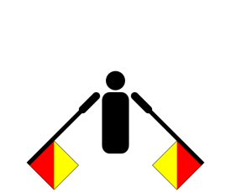
N

Slide 4
Nuclear

Slide 5
Nuclear
D

Slide 6
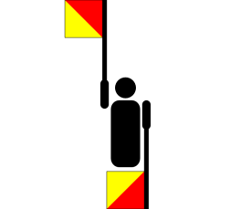
Nuclear
D

Slide 7
Nuclear
Disarmament

Slide 8
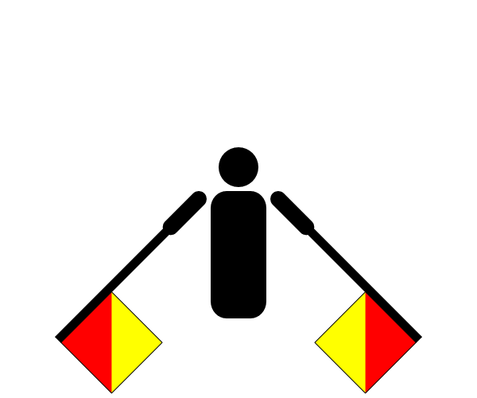
Nuclear
Disarmament

Slide 9
Nuclear
Disarmament

Slide 10
Nuclear
Disarmament

Slide 11
Nuclear
Disarmament

Slide 12
Nuclear
Disarmament
Designed in 1958 by Gerald Holtom, and taken as the symbol for the Campaign for Nuclear Disarmament (CND) in Britain.

