Slide 1
The Physicists Coalition for Nuclear Threat Reduction
DC Days
April 14-16, 2024

Slide 2

The Physicists Coalition for Nuclear Threat Reduction
http://physicistscoalition.org/
Mission Statement:
The Physicists Coalition for Nuclear Threat Reduction works to reduce the threats from nuclear weapons by mobilizing advocacy within the physical sciences communities in the United States and internationally. Given the civilization-ending potential of the use of nuclear weapons, we advocate for substantive changes in nuclear arsenals, force postures, and declaratory policies. We also call for fulfillment of the long-standing international obligation to achieve nuclear disarmament.

Slide 3


The Physicists Coalition for Nuclear Threat Reduction, http://physicistscoalition.org/, a project to engage and activate the US physics community.
Supported by the American Physical Society and Carnegie Corporation for two years. Beginning in October 2022, the Coalition began a partnership with the Arms Control Association.
Steered through the Princeton Program on Science and Global Security

Slide 4
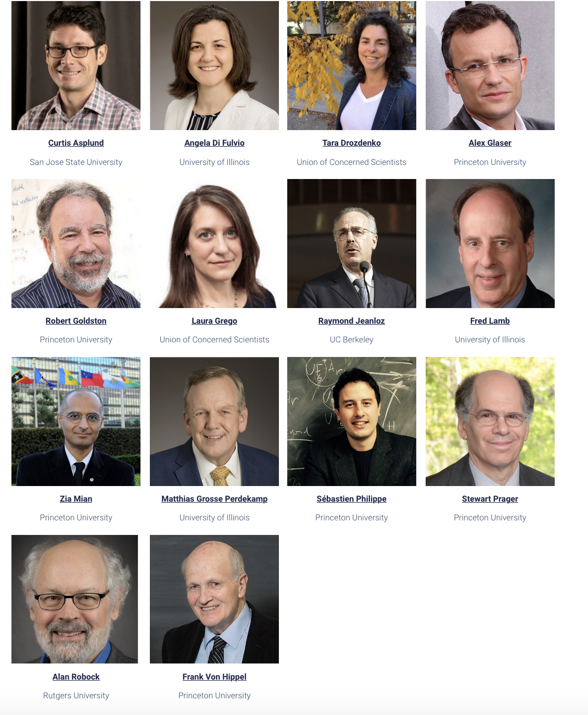
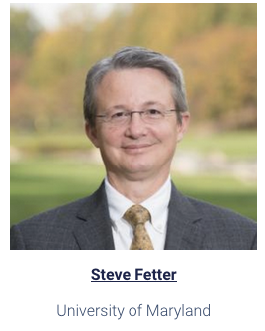
Team delivering colloquia
Curtis Asplund, San José State Univ.
Angela di Fulvio, Univ. of Illinois
Tara Drozdenko, UCS
Alex Glaser, Princeton Univ.
Rob Goldston, Princeton Univ.
Laura Grego, UCS
Raymond Jeanloz, Univ. of California, Berkeley
Fred Lamb, Univ. of Illinois
Zia Mian, Princeton Univ.
Matthias Grosse Perdekamp, Univ. of Illinois
Sebastien Philippe, Princeton Univ.
Stewart Prager, Princeton Univ.
Alan Robock, Rutgers Univ.
Frank von Hippel, Princeton Univ.
Steve Fetter, Univ. of Maryland

Slide 5
The Physicists Coalition for Nuclear Threat Reduction
http://physicistscoalition.org/
The Coalition’s 2024 Advocacy Strategy
Building support for U.S. diplomatic engagement with Russia and China on nuclear risk reduction and arms control to avoid miscalculation, reduce arsenals, and prevent arms racing (current advocacy campaign)
Building support in Congress to block the addition of new nuclear technologies to the U.S. nuclear arsenal which are destabilizing, such as a new nuclear-armed sea-launched cruise missile
Mobilizing scientists through initiatives that encourage U.S. and global leaders to reinforce norms against nuclear weapons use and threats of use

Slide 6
To date
Delivered 150 colloquia in nearly all 50 states
To university physics depts, nuclear engineering depts, and national labs
Audiences vary from 15 to 200
Also 10 webinars on various topics (average ~ 200 attendees)

Slide 7
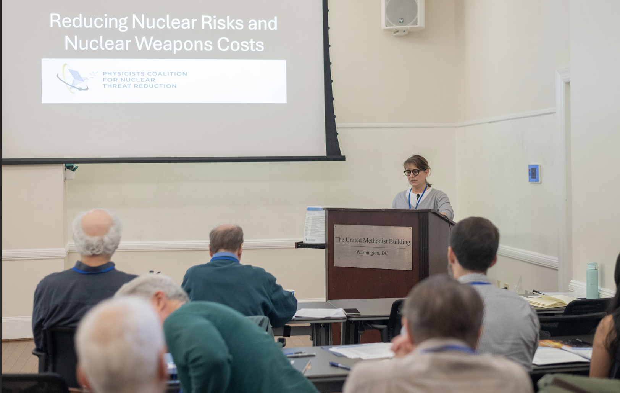
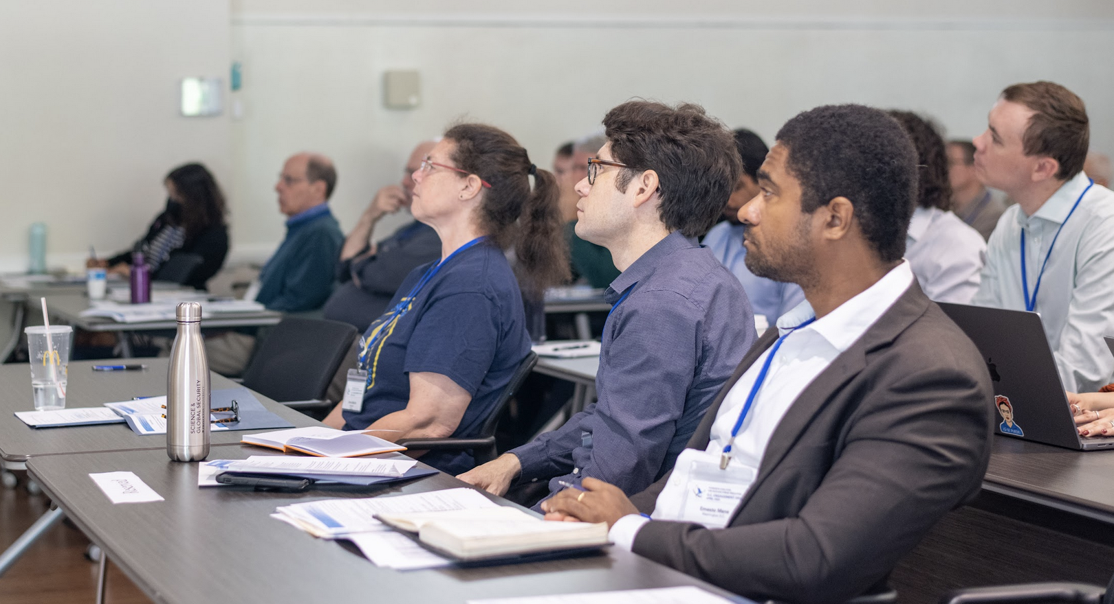
Congressional advocacy
DC Days
40 Coalition members in DC for advocacy (April 14 – 16, 2024)
1 day of training, 2 days of lobbying
Visited 53 Congressional offices
Strong participation from all ages

Slide 8
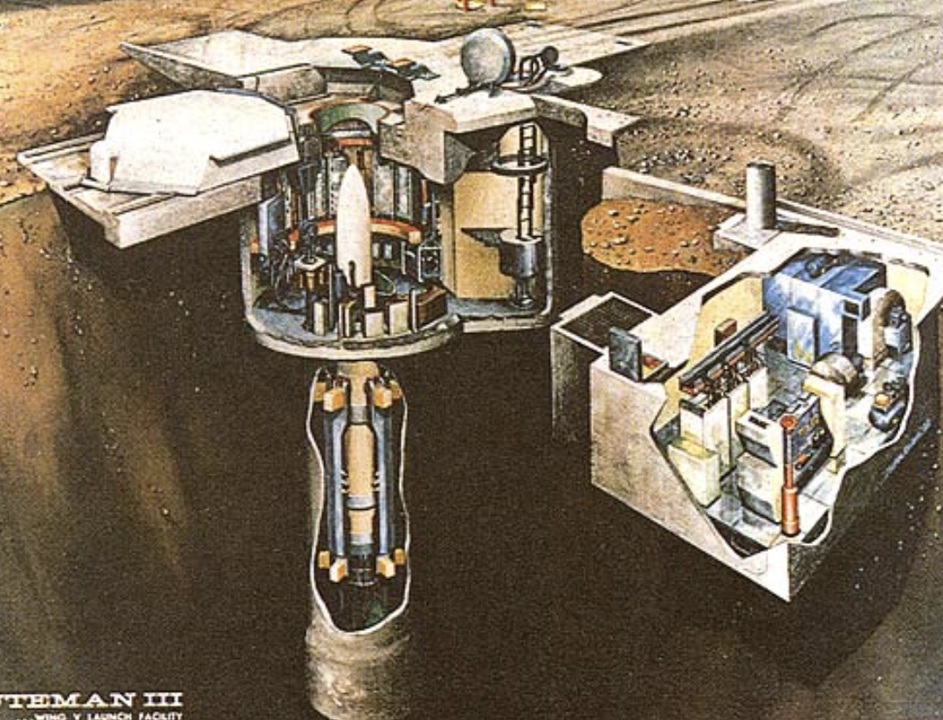
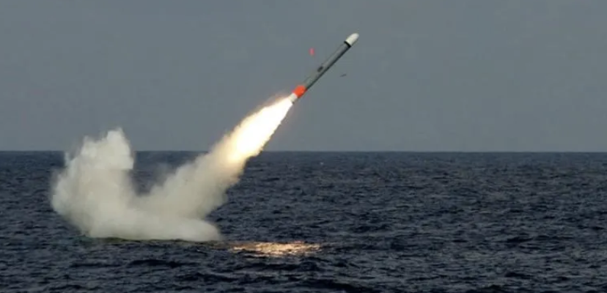
Advocacy on DC Days
ICBMs: Cancel the new Sentinel ICBM
Eliminate all ICBMs
Oppose funding to upload more warheads on ICBMs
Plutonium pits: Produce a scaled-down plan and study aging
SLCM-N: Do not fund
Diplomacy: Co-sponsor Foster/Markey/Merkeley bills to condemn
nuclear threats and urge diplomacy with Russia and China

Slide 9
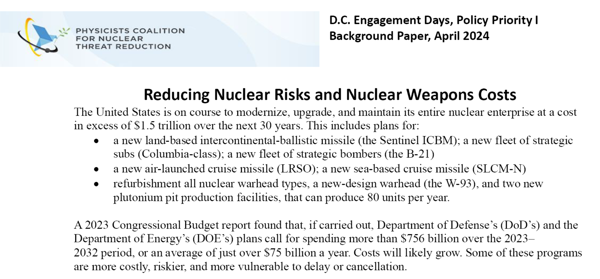

Slide 10
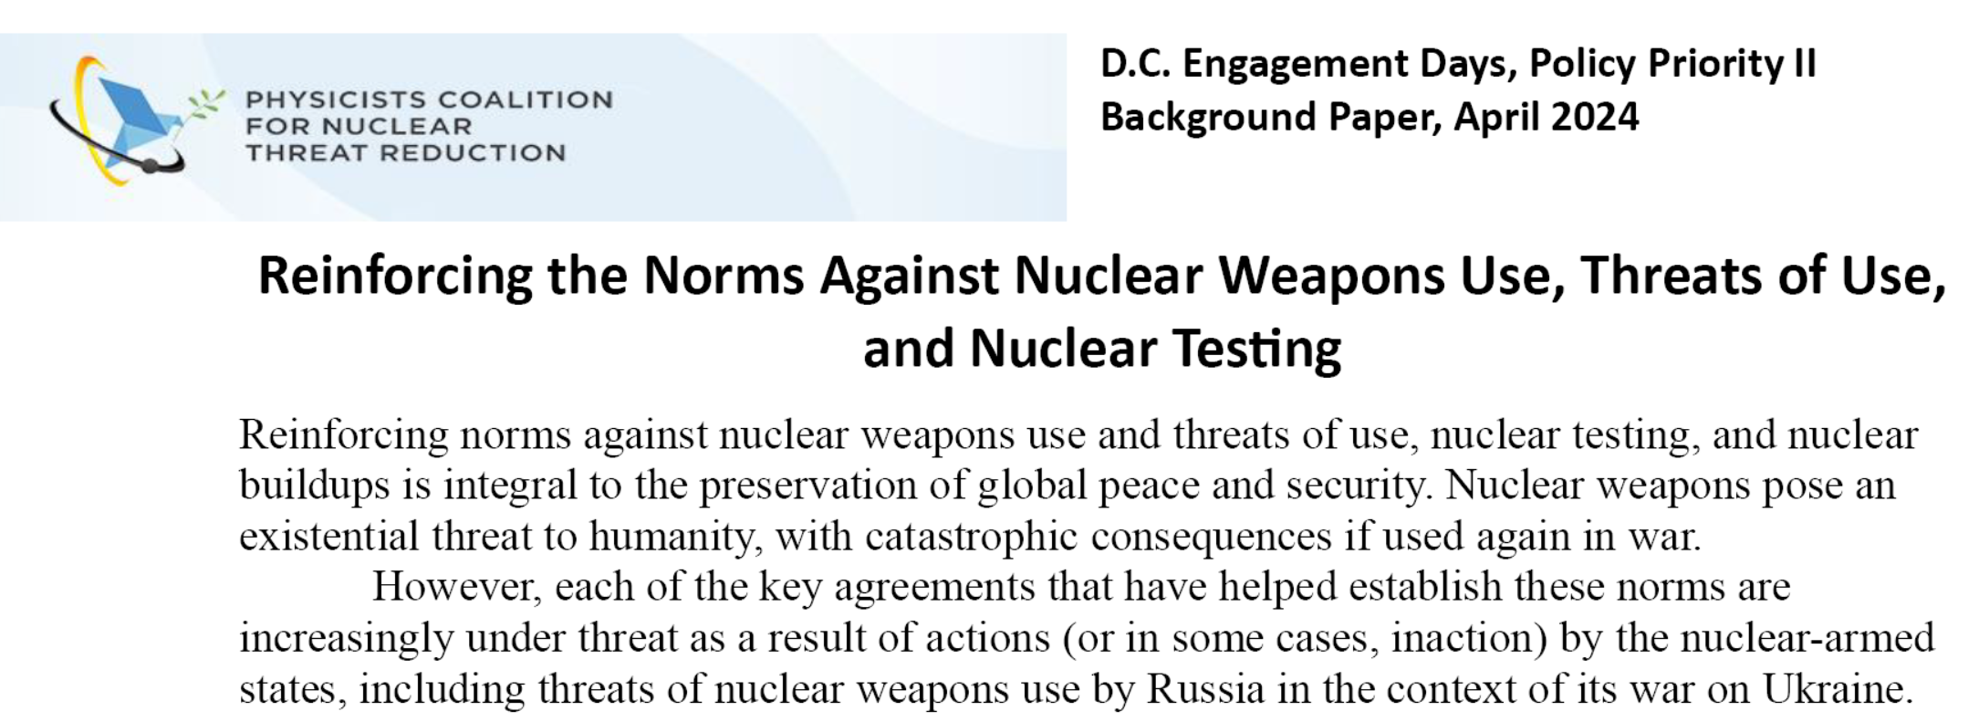
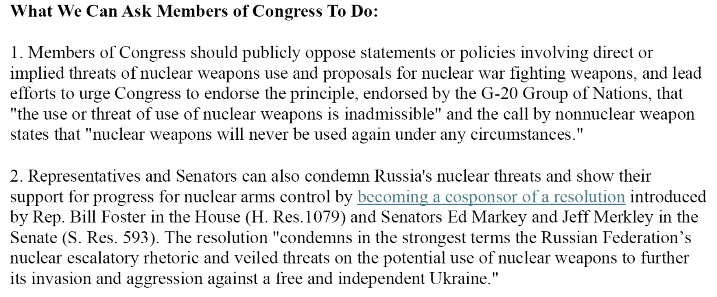

Slide 11
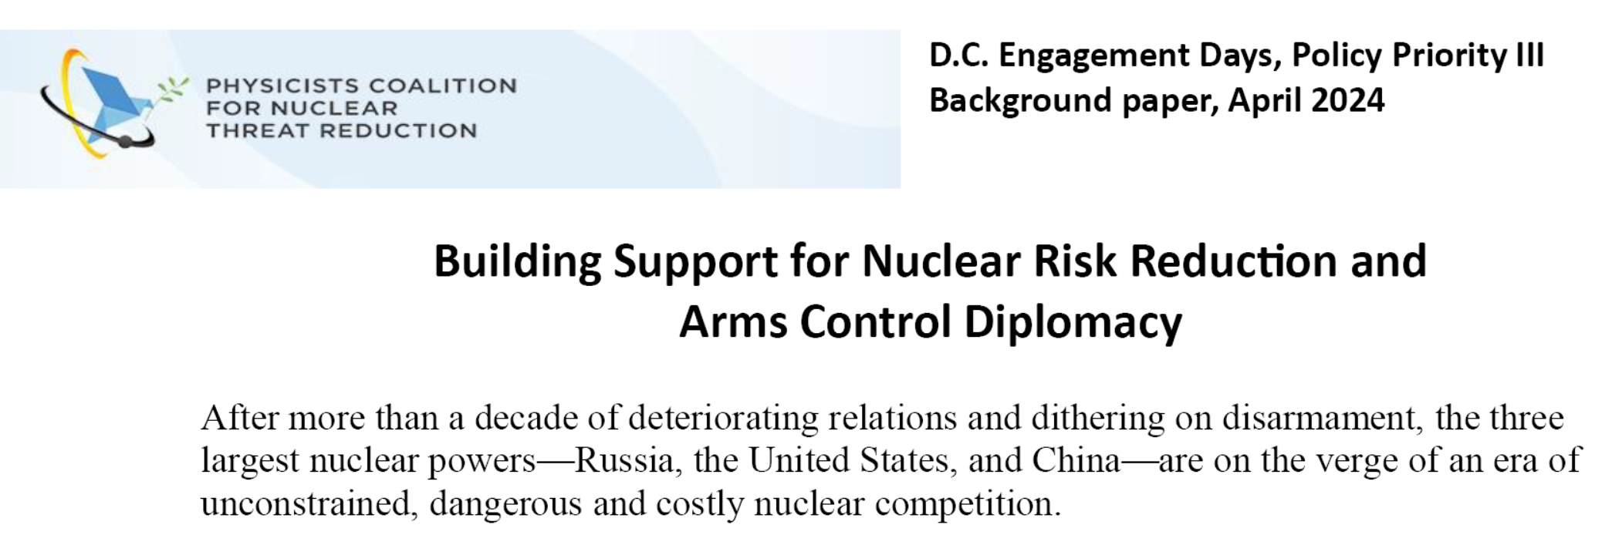
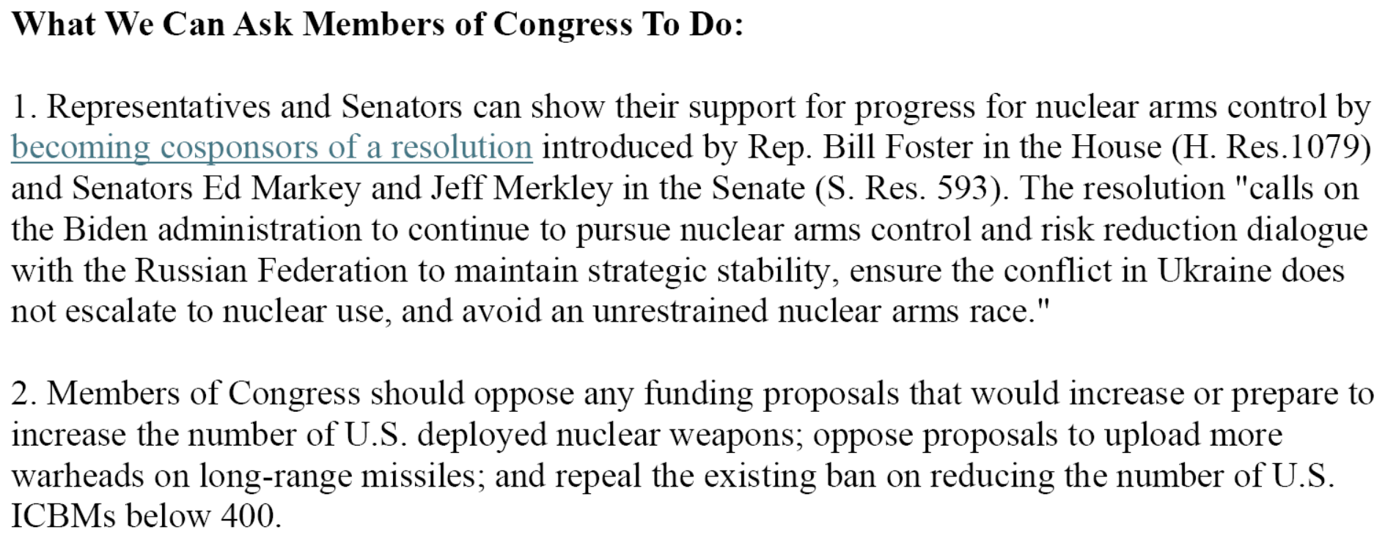

Slide 12
4/15 Monday Meetings |  | District | Party
Greg Stanton | AZ | 4 | D
Rep. Troy Carter | LA | 2 | D
Sen. Jack Reed | RI | x | D
Rep. Pocan | WI | 2 | D
Rep. Betty McCollum | MN | 4 | D
Rep. Jim McGovern | MA | 2 | D
Rep. Dutch Ruppersberger | MD | 2 | D
Rep. Scott Peters | CA | 50 | D
Sen. Mark Warner | VA | x | D
Sen. Lindsey Graham | SC | x | R
Rep. Nikki Budzinski | IL | 13 | D
Sen. Jon Kennedy | LA | x | R
Sen. Tammy Baldwin | WI | x | D
Rep. Bill Keating | MA | 9 | D
Sen. Ron Johnson | WI | x | R
Rep. Joe Courtney | CT | 2 | D
Sen. Dick Durbin | IL | x | D
Senator Sinema | AZ | x | D
State Department Event | x | x | X
Sen. Patricia Murray | WA | x | D
NEW: Mike Rogers | AL | 3 | R
Rep. David Trone | MD | 6 | D
Rep. Bill Foster | IL | 11 | D
Rep. Jennifer McClellan | VA | 4 | D
Rep. Jamie Raskin | MD | 8 | D
Sen. Gary Peters | MI | x | D
Sen. Joni Ernst | IA | x | R
Sen. Cory Booker | NJ | x | D
Rep. John Garamendi | CA | 8 | D
4/16 Tuesday Meetings | State | District | Party
Sen. Chris Murphy | CT | x | D
Rep. Doris Matsui | CA | 7 | D
Sen. Jeanne Shaheen | NH | x | D
Sen. Ben Cardin | MD | x | D
NEW: Sen. Ed Markey | MA | x | D
Sen. Jeff Merkley | OR | x | D
Sen. Bill Cassidy | LA | x | R
Sen. Jon Tester | MT | x | D
Rep. Bonnie Watson-Coleman | NJ | 12 | D
Rep. Adam Smith | WA | 9 | D
Sen. Todd Young | IN | x | R
Sen. Kirsten Gillibrand | NY | x | D
Sen. Chris Van Hollen | MD | x | D
Rep. Seth Moulton | MA | 6 | D
Rep. Andy Kim | NJ | Running for Senate | D
Sen. Elizabeth Warren | MA | x | D
Rep. Randy Feenstra | IA | 4 | R
Sen. Ron Wyden | OR | x | D
Sen. Blumenthal | CT | x | D
NEW: Sen. Mark Kelly | AZ | x | D
Sen. Mike Braun | IN | x | R
Sen. Maggie Hassan | NH | x | D
Sen. Schatz | HI | x | D

Slide 13
4/15 Monday Meetings |  | District | Party
Greg Stanton | AZ | 4 | D
Rep. Troy Carter | LA | 2 | D
Sen. Jack Reed | RI | x | D
Rep. Pocan | WI | 2 | D
Rep. Betty McCollum | MN | 4 | D
Rep. Jim McGovern | MA | 2 | D
Rep. Dutch Ruppersberger | MD | 2 | D
Rep. Scott Peters | CA | 50 | D
Sen. Mark Warner | VA | x | D
Sen. Lindsey Graham | SC | x | R
Rep. Nikki Budzinski | IL | 13 | D
Sen. Jon Kennedy | LA | x | R
Sen. Tammy Baldwin | WI | x | D
Rep. Bill Keating | MA | 9 | D
Sen. Ron Johnson | WI | x | R
Rep. Joe Courtney | CT | 2 | D
Sen. Dick Durbin | IL | x | D
Senator Sinema | AZ | x | D
State Department Event | x | x | X
Sen. Patricia Murray | WA | x | D
NEW: Mike Rogers | AL | 3 | R
Rep. David Trone | MD | 6 | D
Rep. Bill Foster | IL | 11 | D
Rep. Jennifer McClellan | VA | 4 | D
Rep. Jamie Raskin | MD | 8 | D
Sen. Gary Peters | MI | x | D
Sen. Joni Ernst | IA | x | R
Sen. Cory Booker | NJ | x | D
Rep. John Garamendi | CA | 8 | D
4/16 Tuesday Meetings | State | District | Party
Sen. Chris Murphy | CT | x | D
Rep. Doris Matsui | CA | 7 | D
Sen. Jeanne Shaheen | NH | x | D
Sen. Ben Cardin | MD | x | D
NEW: Sen. Ed Markey | MA | x | D
Sen. Jeff Merkley | OR | x | D
Sen. Bill Cassidy | LA | x | R
Sen. Jon Tester | MT | x | D
Rep. Bonnie Watson-Coleman | NJ | 12 | D
Rep. Adam Smith | WA | 9 | D
Sen. Todd Young | IN | x | R
Sen. Kirsten Gillibrand | NY | x | D
Sen. Chris Van Hollen | MD | x | D
Rep. Seth Moulton | MA | 6 | D
Rep. Andy Kim | NJ | Running for Senate | D
Sen. Elizabeth Warren | MA | x | D
Rep. Randy Feenstra | IA | 4 | R
Sen. Ron Wyden | OR | x | D
Sen. Blumenthal | CT | x | D
NEW: Sen. Mark Kelly | AZ | x | D
Sen. Mike Braun | IN | x | R
Sen. Maggie Hassan | NH | x | D
Sen. Schatz | HI | x | D

Slide 14
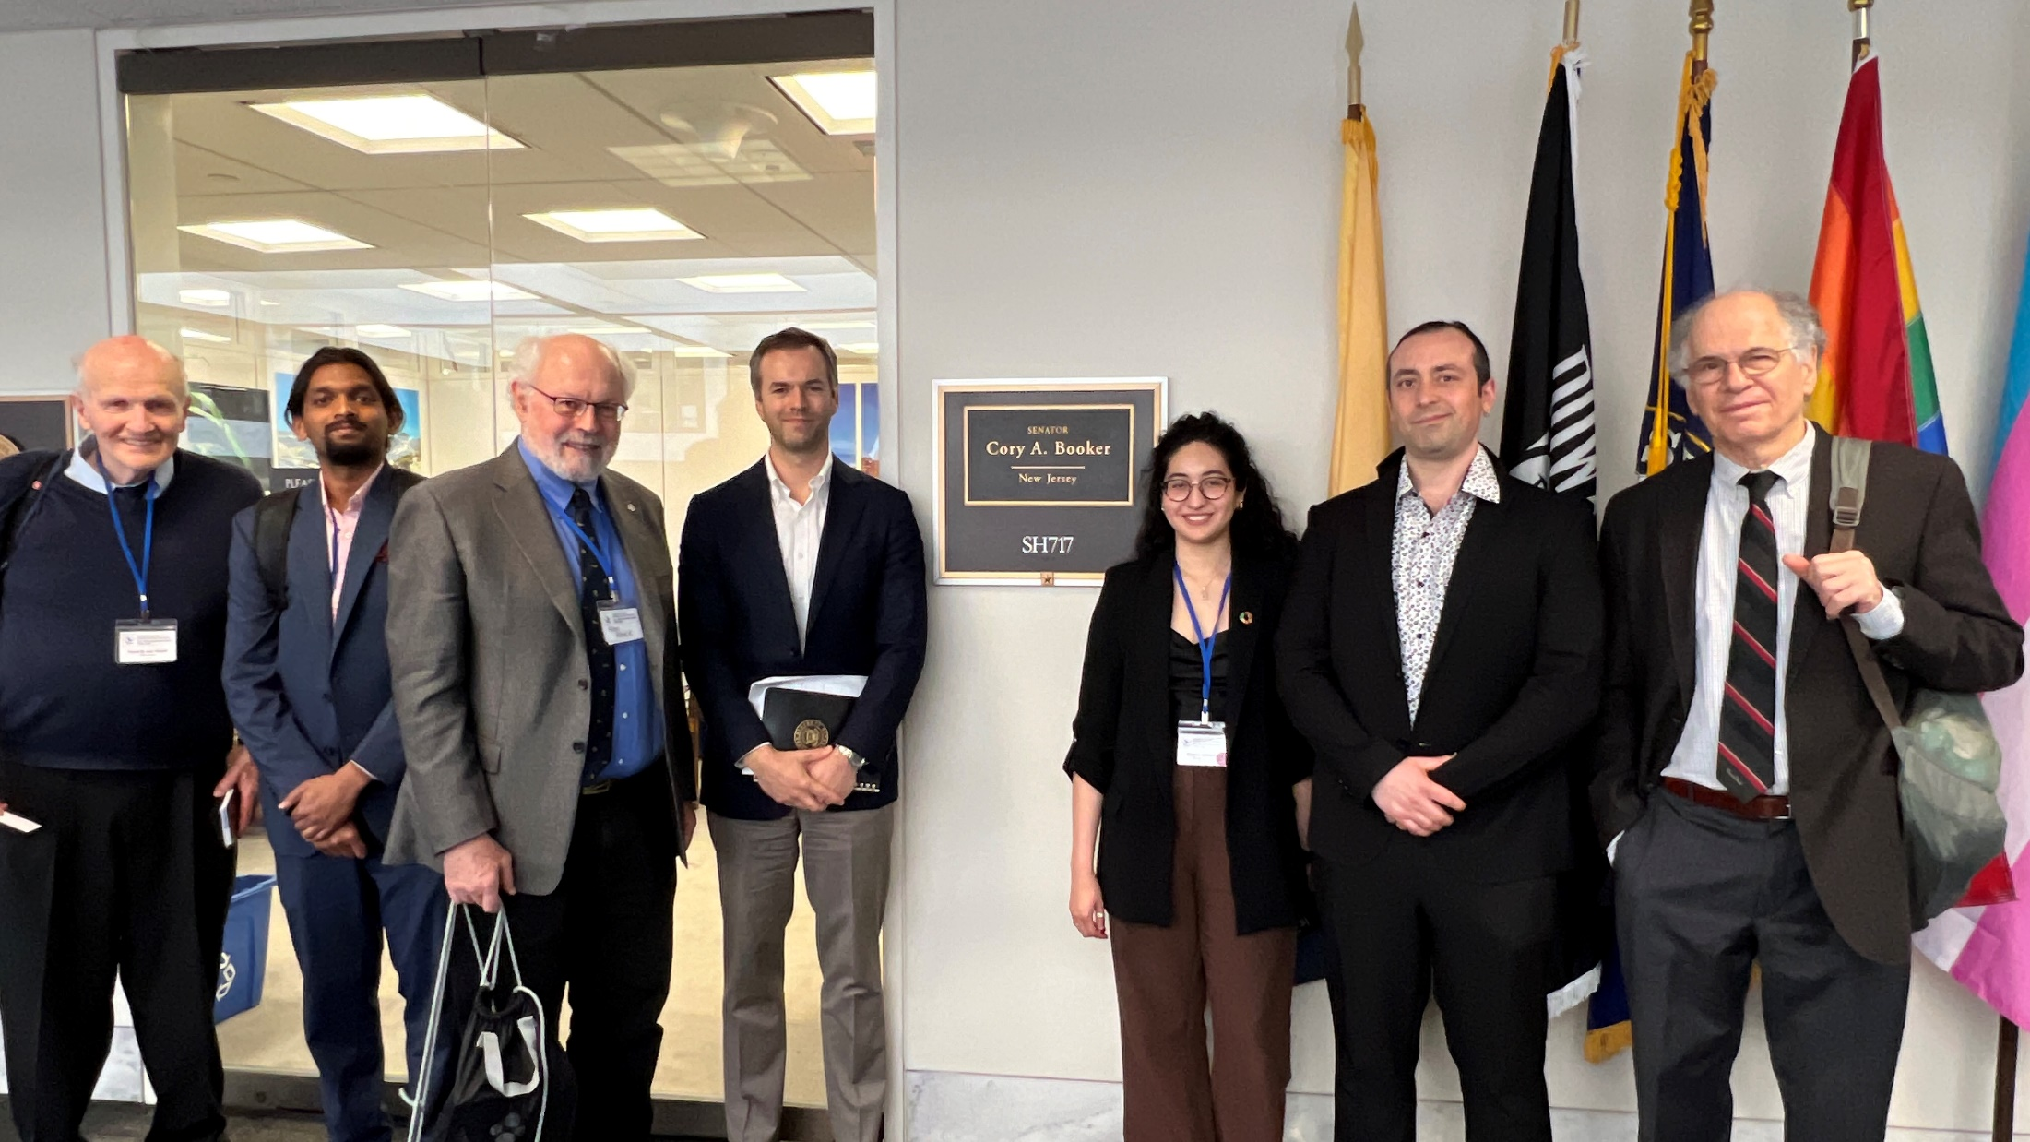

Slide 15
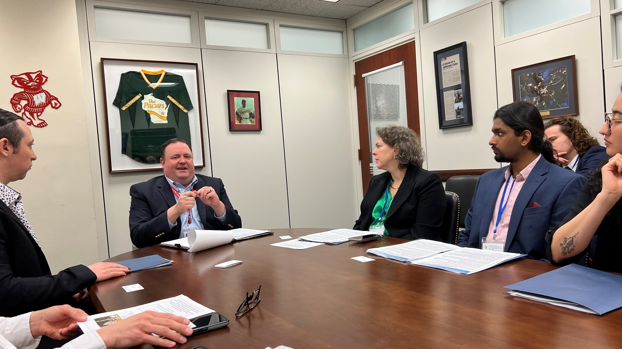

Slide 16
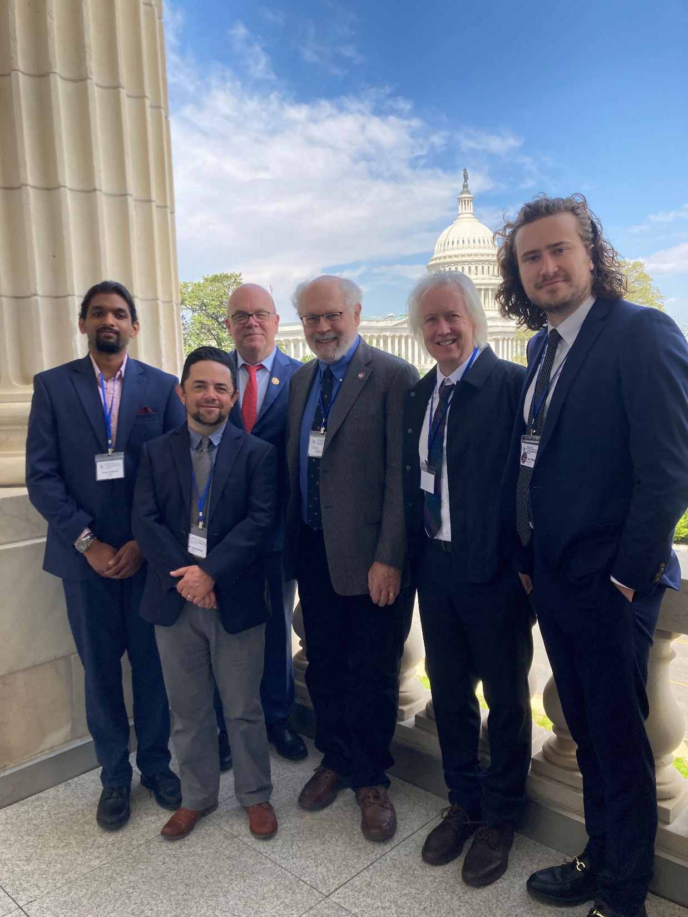

Slide 17
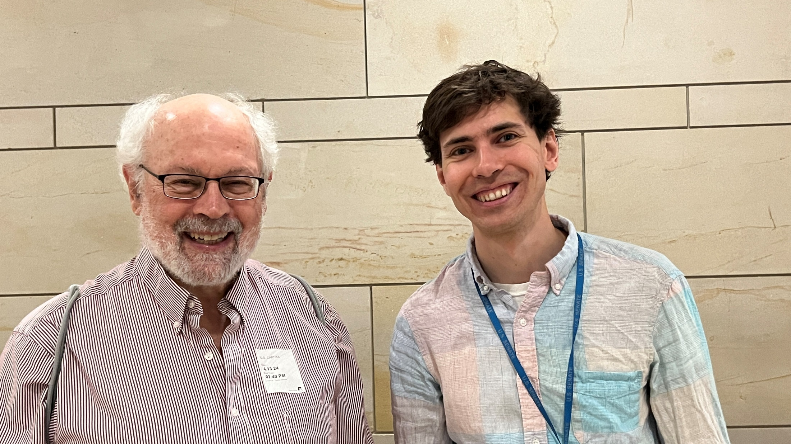
Martin Wolf, Legislative Assistant for Senator Markey

Slide 18
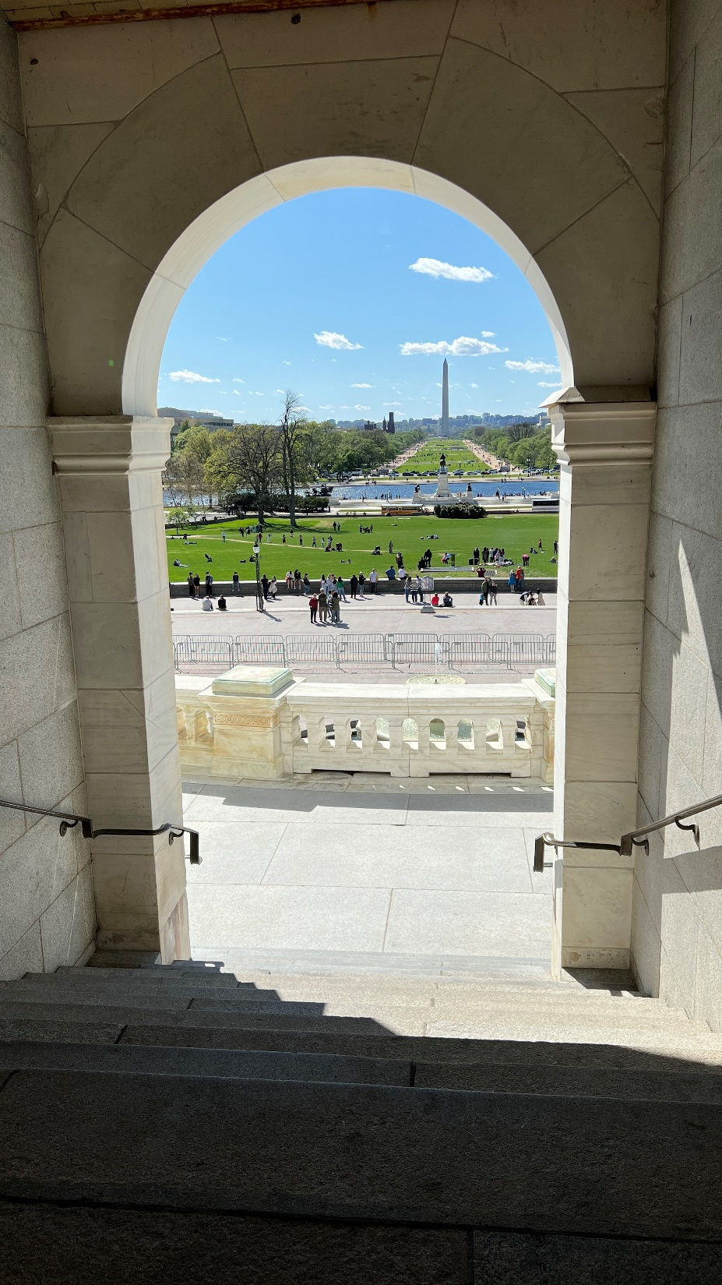
View to the location for Presidential Inaugurations

Slide 19
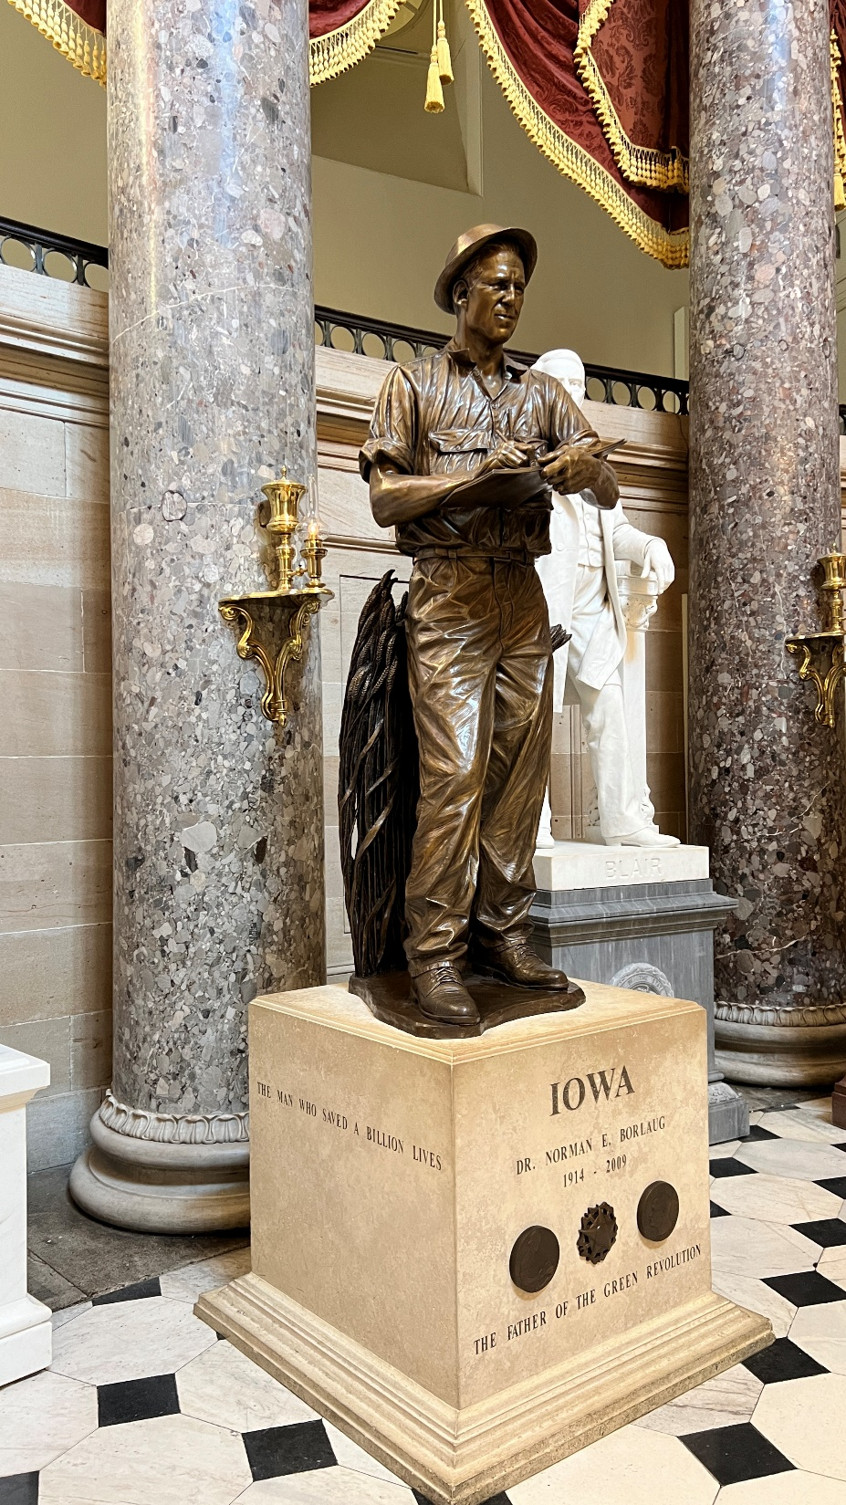
Norman Borlaug
in
Statuary Hall

Slide 20
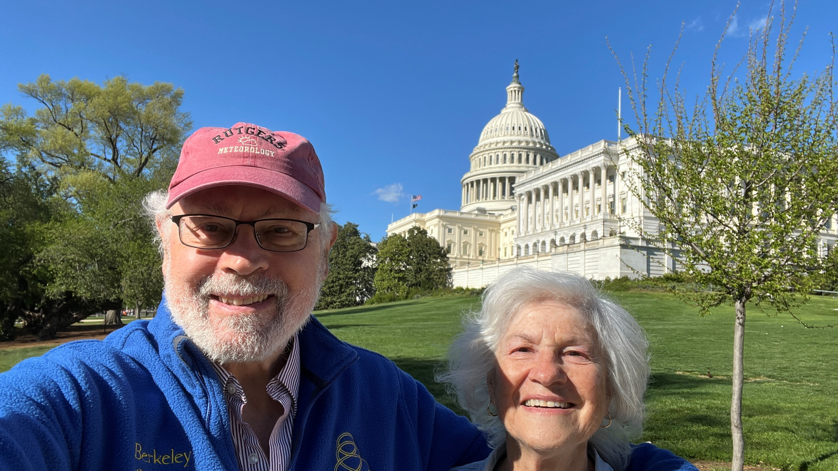

Slide 21
