Slide 1

Global Famine
after Nuclear War
Alan Robock
Department of Environmental Sciences
Rutgers University, New Brunswick, New Jersey USA
robock@envsci.rutgers.edu
Notes:
This presentation shows the environmental effects of both regional and large-scale nuclear wars.
The greatest environmental threat in the world is the potential for nuclear winter. The current nuclear arsenal is still large enough to produce nuclear winter. Nuclear winter is still the accepted theory to predict the global environmental consequences of a nuclear holocaust.
More people would die in regions far removed from the targets than in the targeted regions.
Even a “smalll” nuclear war between India and Pakistan would produce climate change unprecedented in human history.

Slide 2
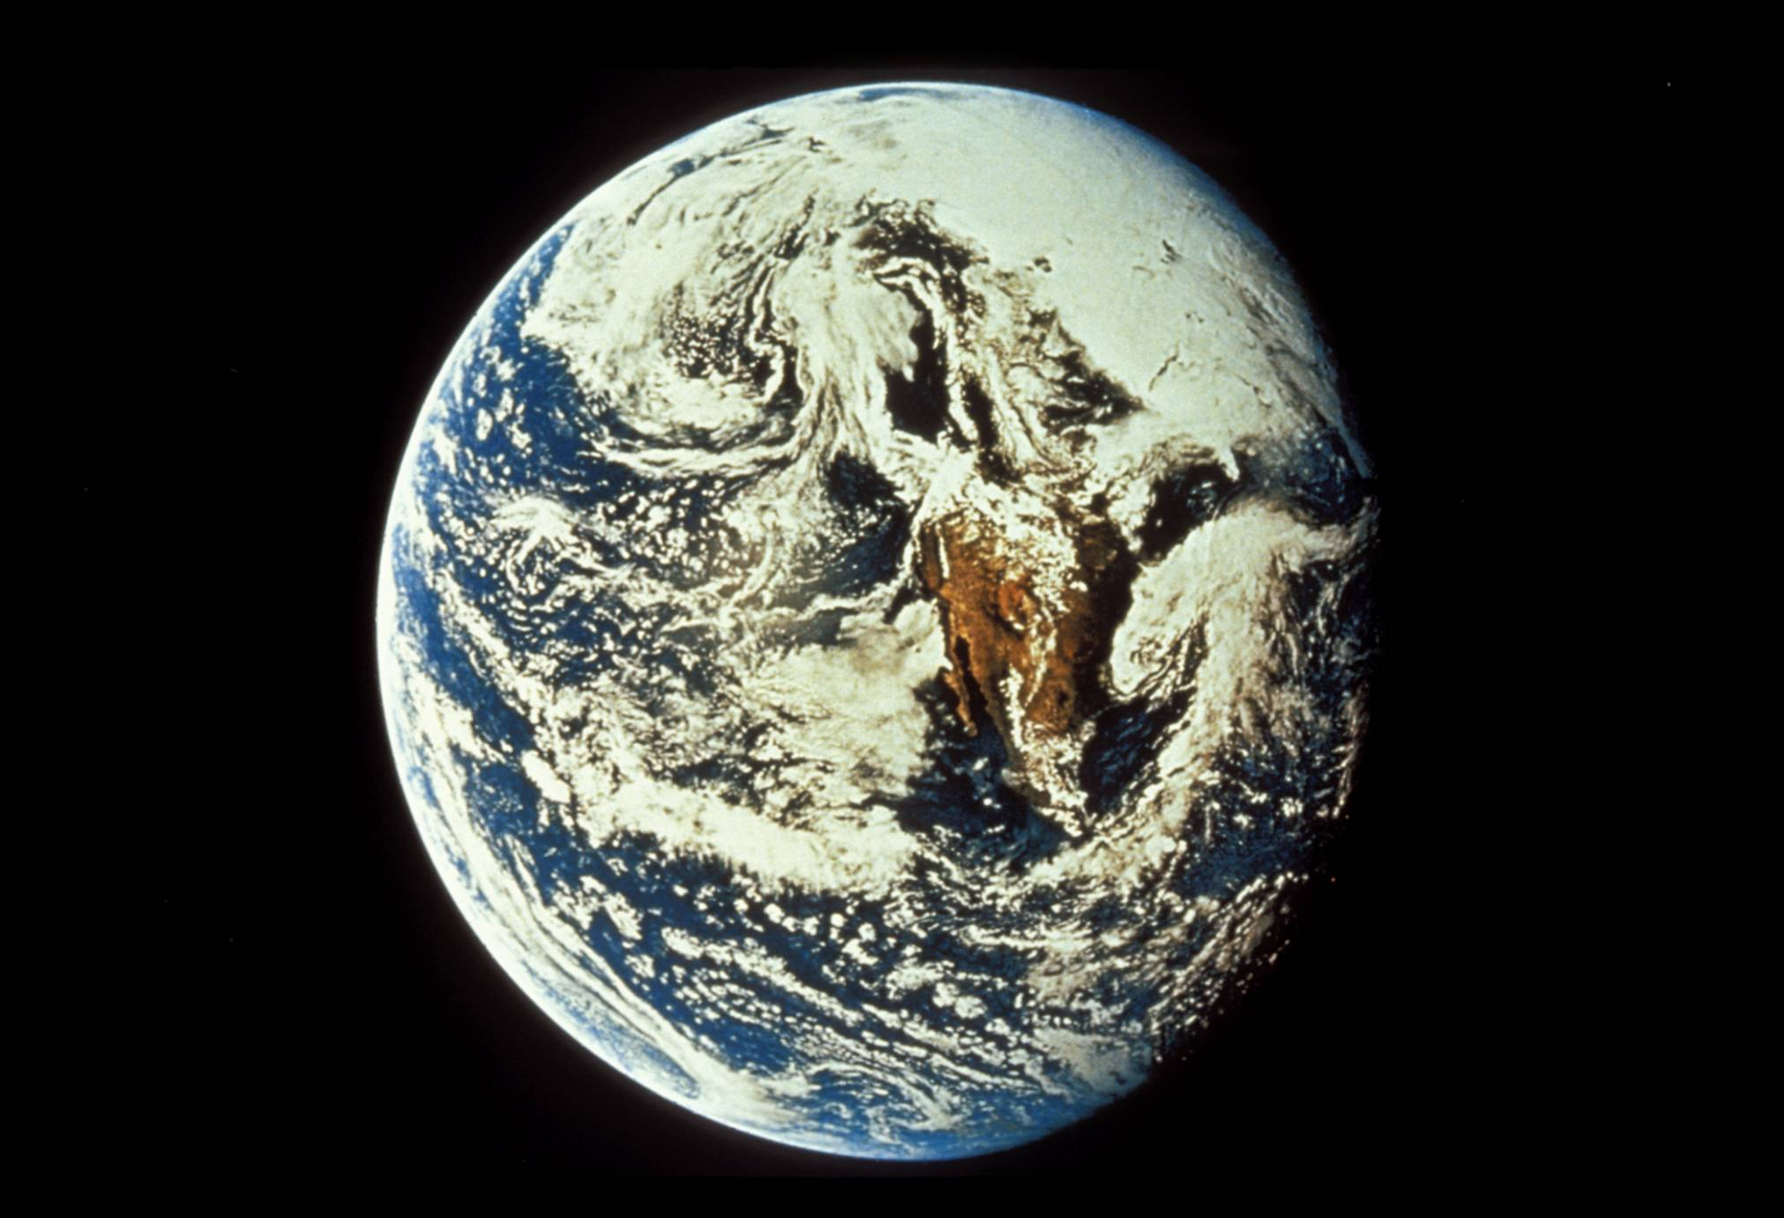
Notes:
An Apollo 10 view of Earth (May 18, 1969) from 26,000 nautical miles photographed from the spacecraft during its journey toward the Moon. You can see Mexico and Baja California in the center of the image. Above that, clouds cover most of the US, producing needed rainfall for the crops that are growing that year.
Photo courtesy of NASA (AS10-34-5013).

Slide 3
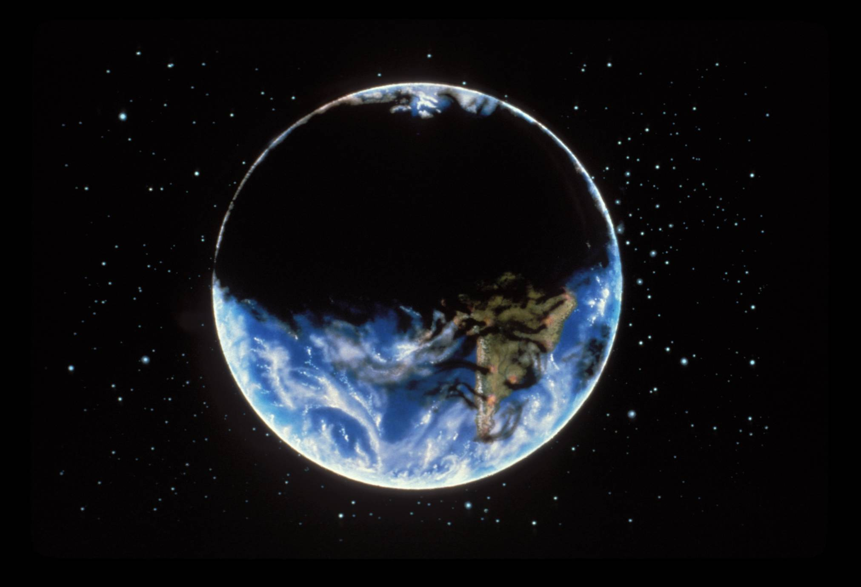
Illustration by Jon Lomberg
Notes:
This is what the world would look like, however, after a large-scale nuclear holocaust. Thick clouds of smoke from the resulting fires would initially cover the Northern Hemisphere, making it cold and dark at the Earth’s surface.
Image used by permission of the National Resources Defense Council.

Slide 4

Illustration by Jon Lomberg

Slide 5
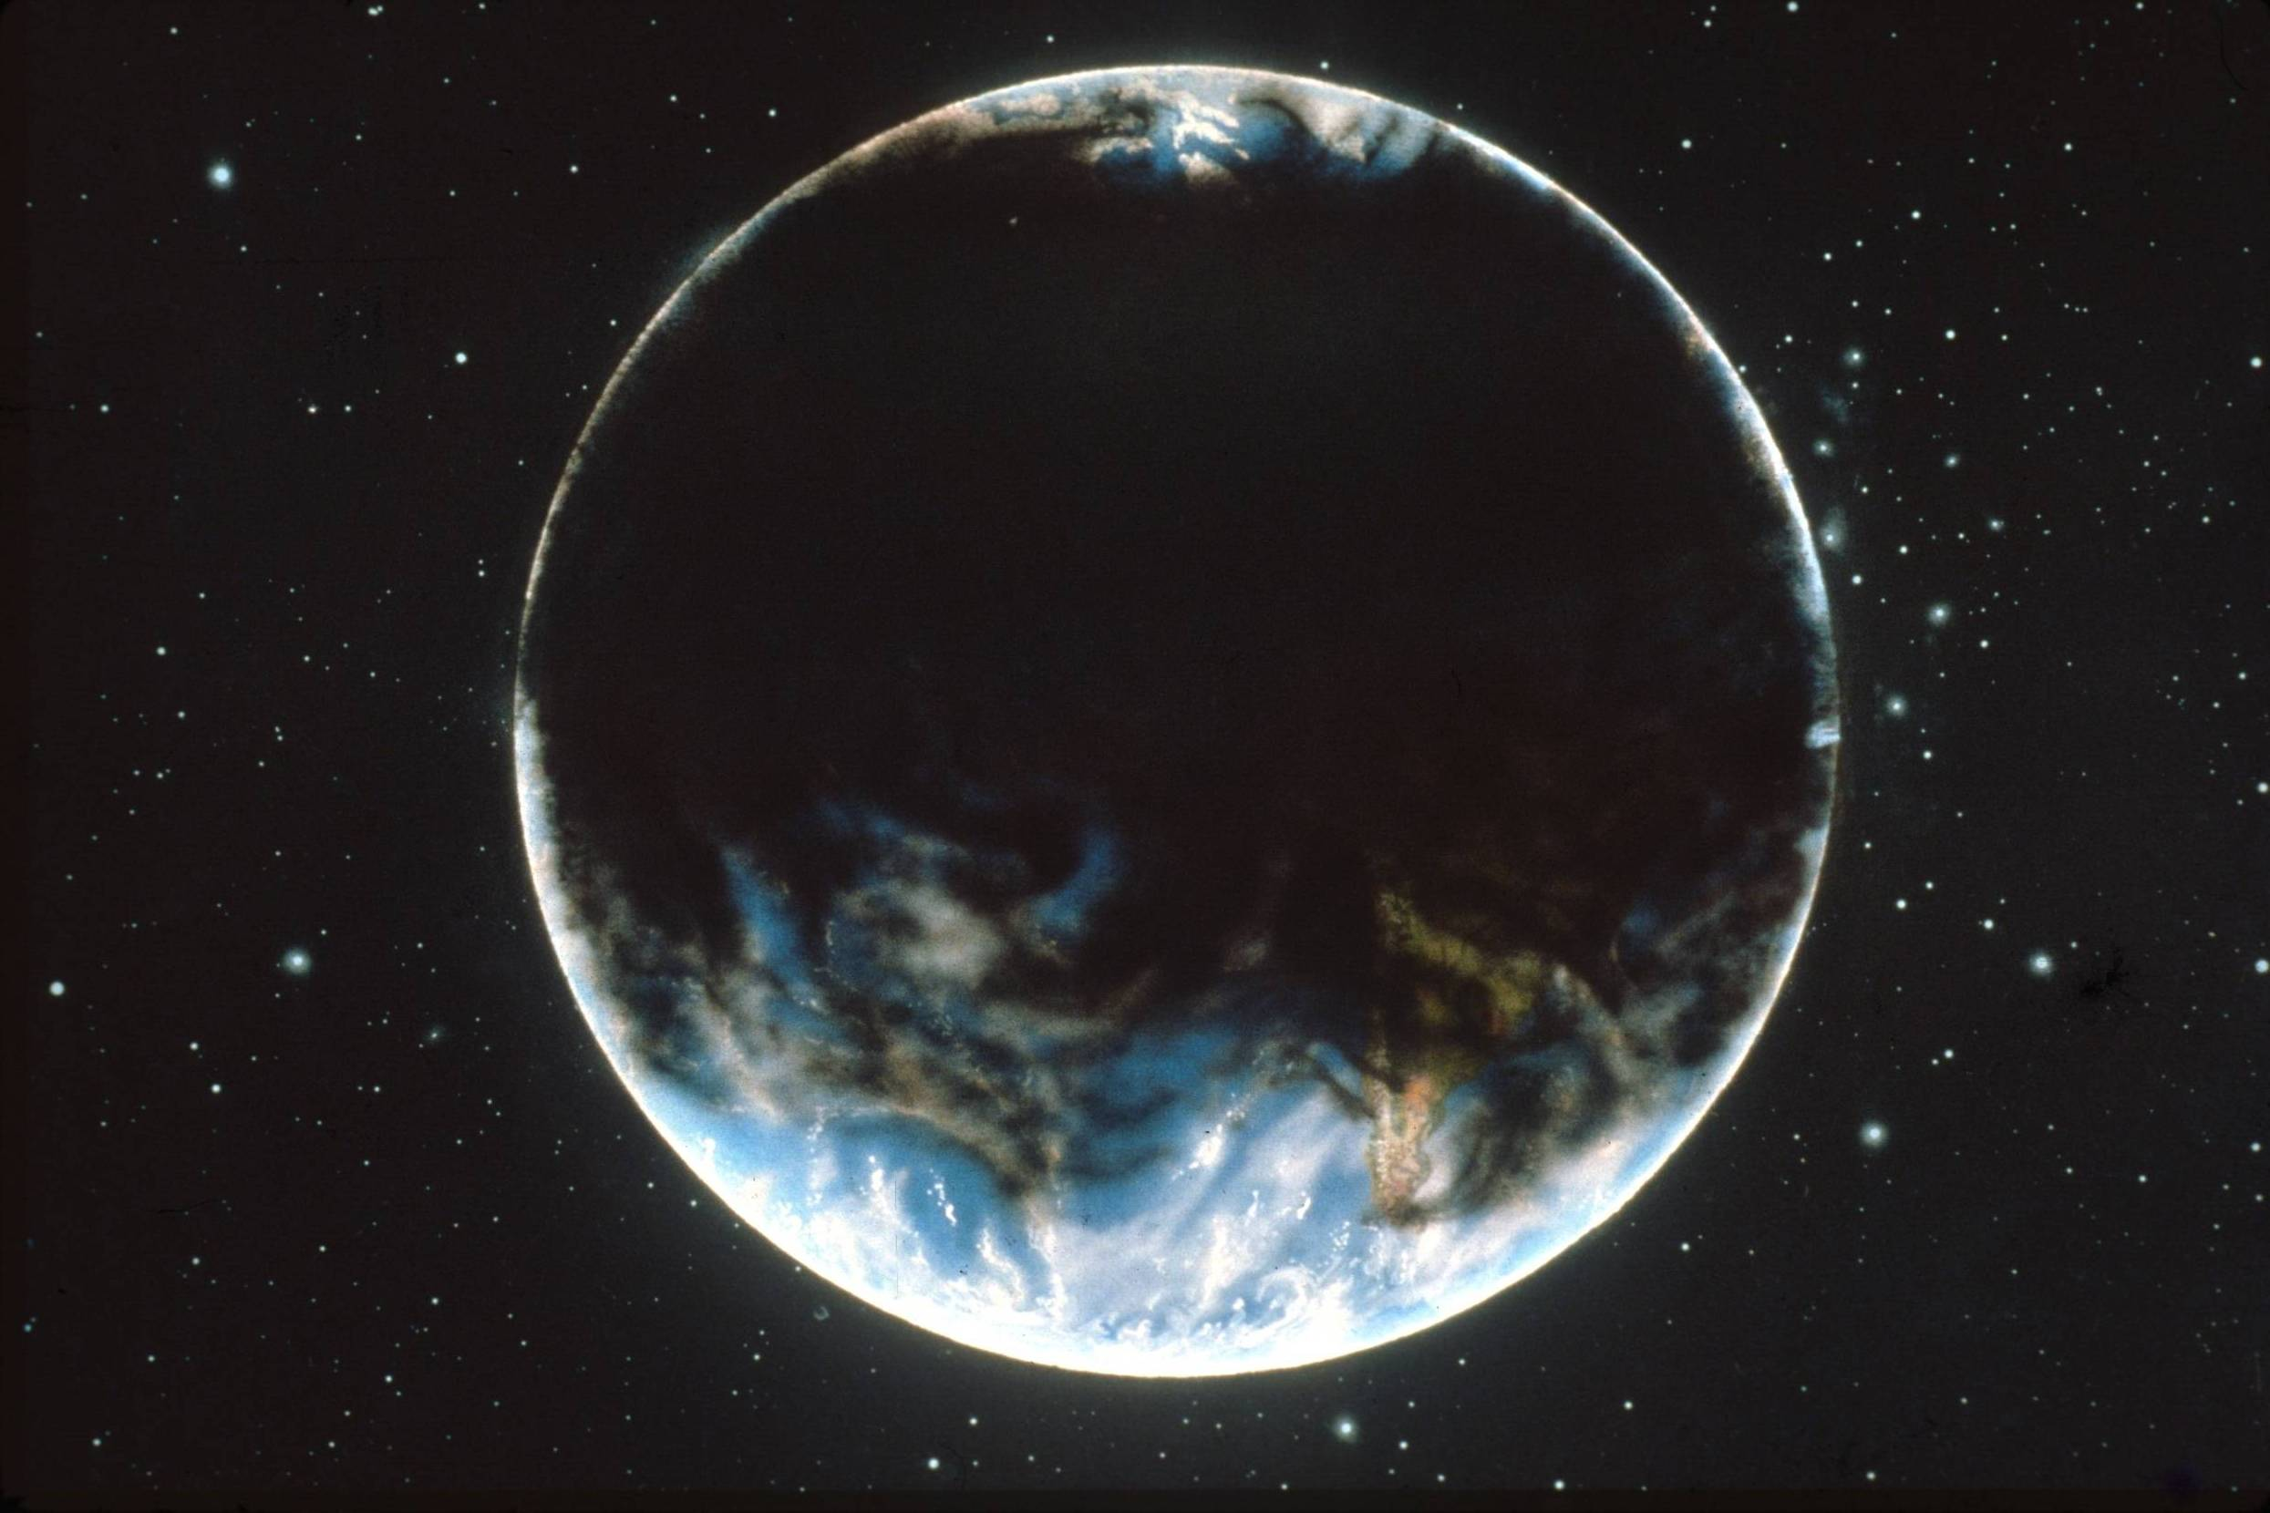
Illustration by Jon Lomberg

Slide 6
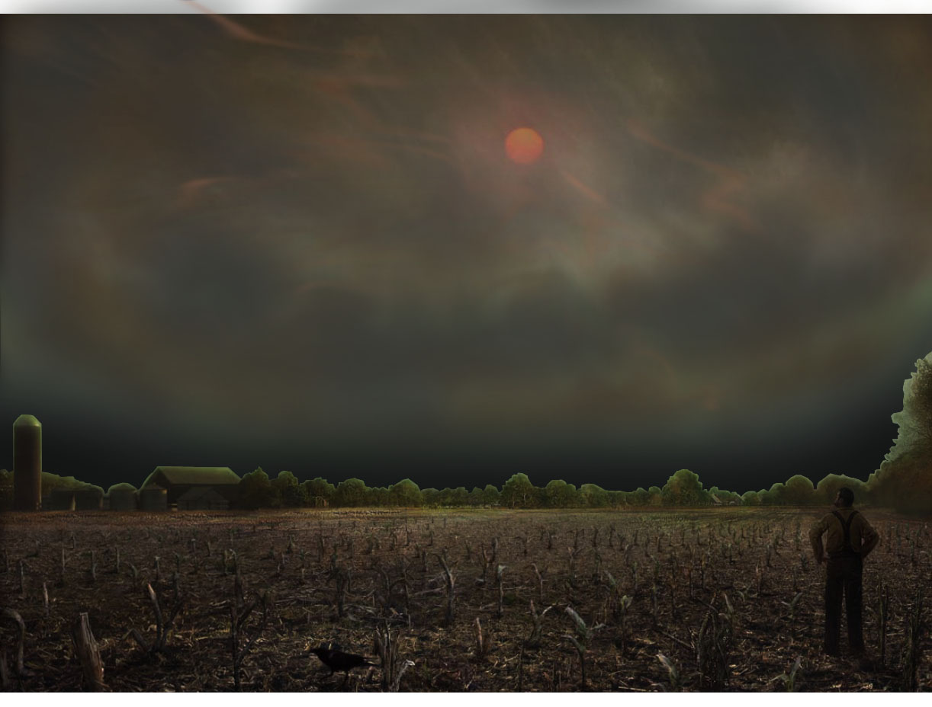
Nuclear Winter
Cold, Dry, Dark, and More UV
Crops Dying and Global Famine
© 2009 Scientific American Inc

Slide 7
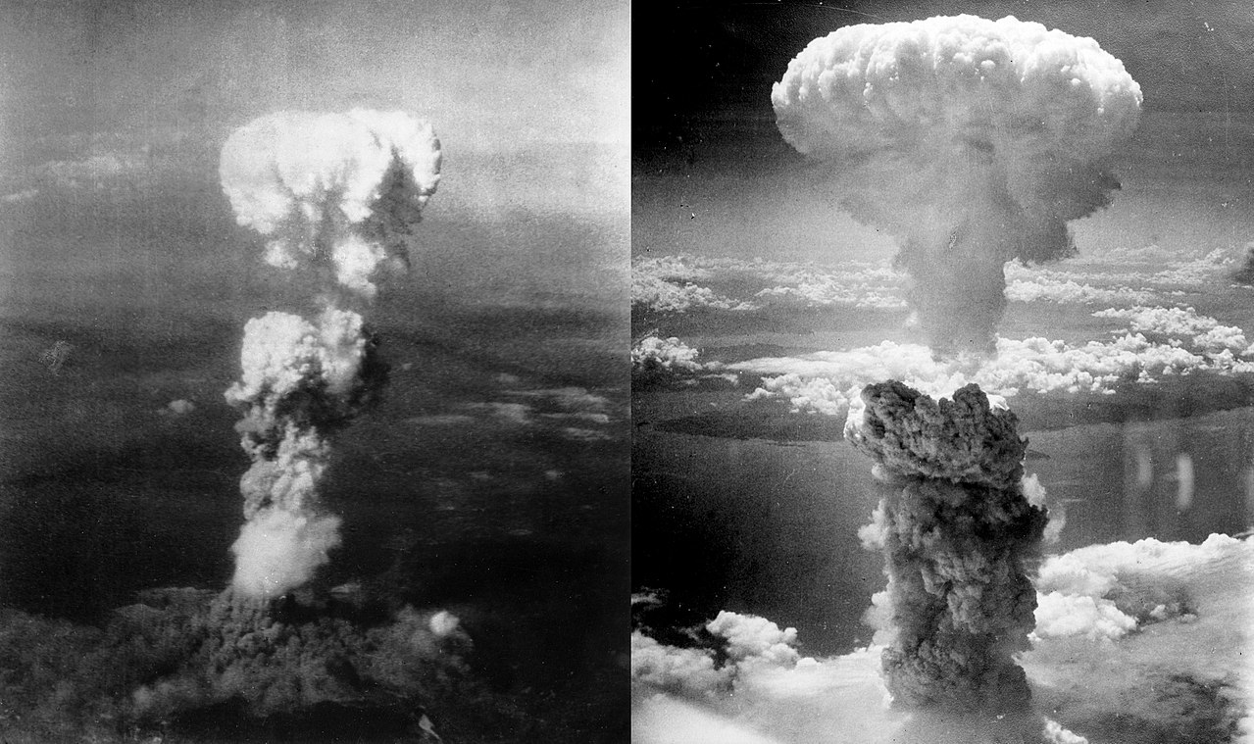
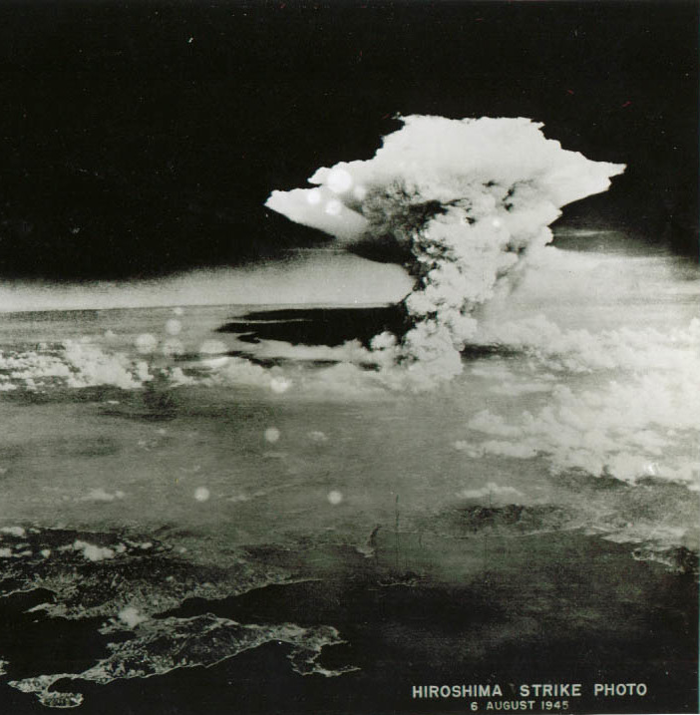
Mushroom cloud, minutes after the bombing, taken by Bob Caron, tail gunner of the Enola Gay
Pyrocumulonimbus smoke plume
more than 3 hours after attack
https://www.nytimes.com/2016/05/24/science/hiroshima-atomic-bomb-mushroom-cloud.html

Slide 8
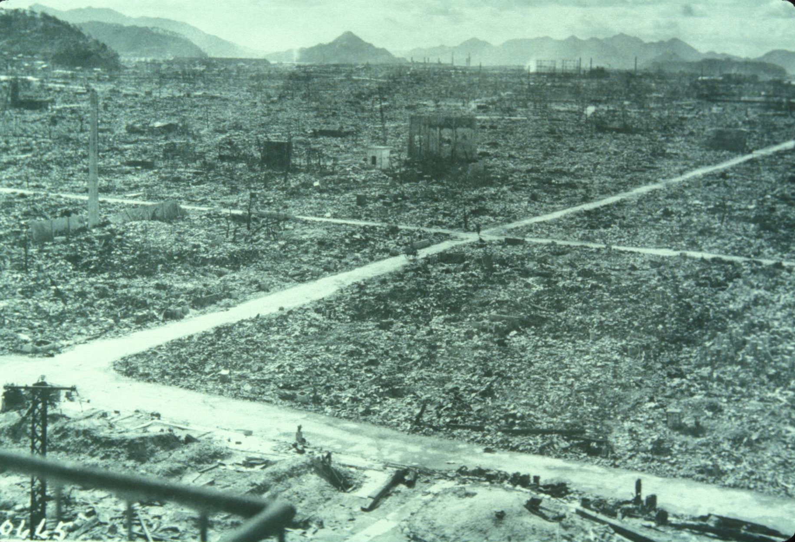
Notes:
This is a photograph of Hiroshima from the US Air Force photo library, showing the city after some roads were cleared off. As most of the buildings were wood and paper, they all burned in the resulting firestorm.
From this and the following examples, we learn that cities can burn, whether ignited by an atomic bomb or “conventional weapons.” In fact, in World War II, more people died from “conventional firebombing” than from nuclear firebombing.

Slide 9
Nagasaki
Aug. 9, 1945
11:02 am

Slide 10
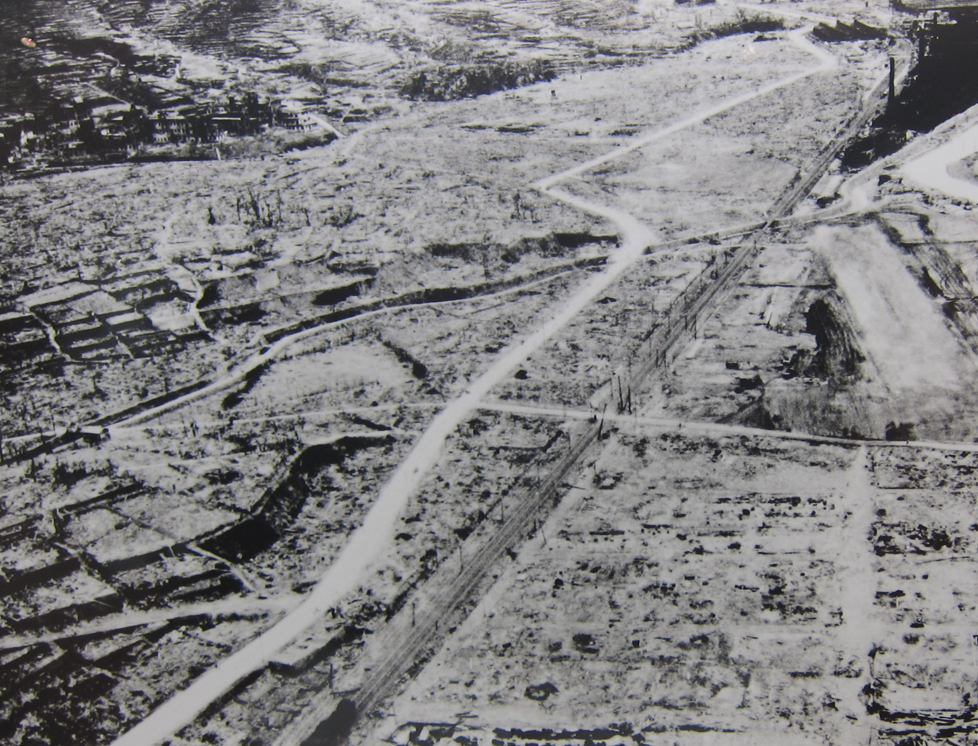
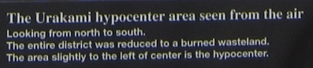

Slide 11
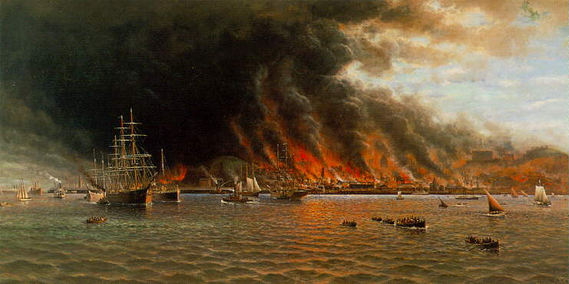
THE STORY OF AN EYEWITNESS
By Jack London
Collier's, the National Weekly
May 5, 1906
Within an hour after the earthquake shock the smoke of San Francisco’s burning was a lurid tower visible a hundred miles away. And for three days and nights this lurid tower swayed in the sky, reddening the sun, darkening the day, and filling the land with smoke.
... I watched the vast conflagration from out on the bay. It was dead calm. Not a flicker of wind stirred. Yet from every side wind was pouring in upon the doomed city. East, west, north, and south, strong winds were blowing upon the doomed city. The heated air rising made an enormous suck. Thus did the fire of itself build its own colossal chimney through the atmosphere. Day and night this dead calm continued, and yet, near the flames, the wind was often half a gale, so mighty was the force.
Notes:
Jack London lived in Oakland, across the Bay from San Francisco. The 1906 earthquake broke water mains and started fires in the city. Here is his account. Thus we learn that firestorms can result from burning cities no matter how they are started. [I always read this to the audience, emphasizing the last part of the last sentence.]
Painting from http://www.sfmuseum.org/1906/coulter.html :
Lurid flames sweep San Francisco in William Alexander Coulter’s (1849-1936) panorama of the largest maritime rescue in United States history, where more than thirty-thousand people were taken from the shoreline between Fort Mason and the foot of Lombard Street. Mr. Coulter’s painting depicts the flotilla of rescue vessels ferrying survivors from the burning city to Sausalito.
Mr. Coulter painted from sketches drawn as he helped during the Dunkirk-like evacuation, and he took certain liberties with the San Francisco skyline to give this magnificent picture balance.
The eye, at first, is drawn to the large sailing ships highlighted against the thick, black smoke which obscured the downtown area. He moved the Hall of Justice near Chinatown to just left of center, the Call Building to just right of center, and depicted the burning of Nob Hill on the far right. True perspective would place almost all of these landmarks within the ominous smoke cloud.
This painting, executed on a 5 X 10-foot windowshade, hung for many years in San Francisco’s Commercial Club, and was later sold by Maxwell Galleries, Ltd.
Gladys Hansen
From Denial of Disaster

Slide 12
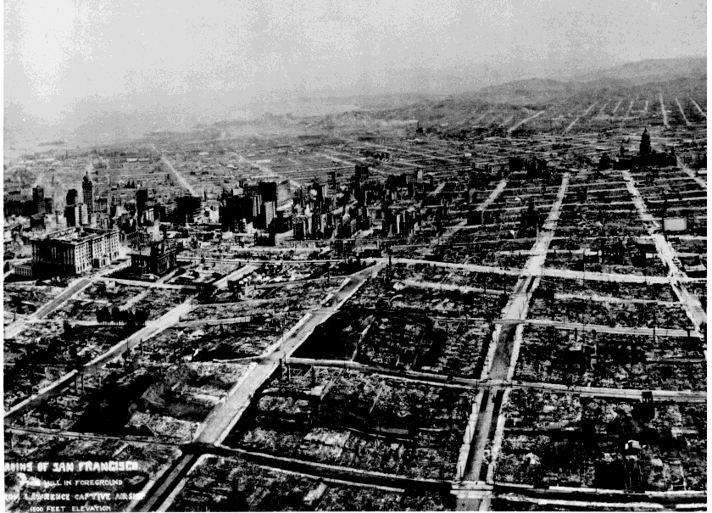
This photograph, taken from a series of kites five weeks after the great earthquake of April 18, 1906, shows the devastation brought on the city of San Francisco by the quake and subsequent fire. (photo courtesy of Harry Myers)
Notes:
This photograph, taken by George Lawrence from a series of kites five weeks after the great earthquake of April 18, 1906, shows the devastation brought on the city of San Francisco by the quake and subsequent fire. The view is looking over Nob Hill toward business district, South of the Slot, and the distant Mission. The Fairmont Hotel, far left. dwarfs the Call Building. (photo courtesy of Harry Myers).
http://earthquake.usgs.gov/regional/nca/1906/18april/images/sf06.city.html

Slide 13
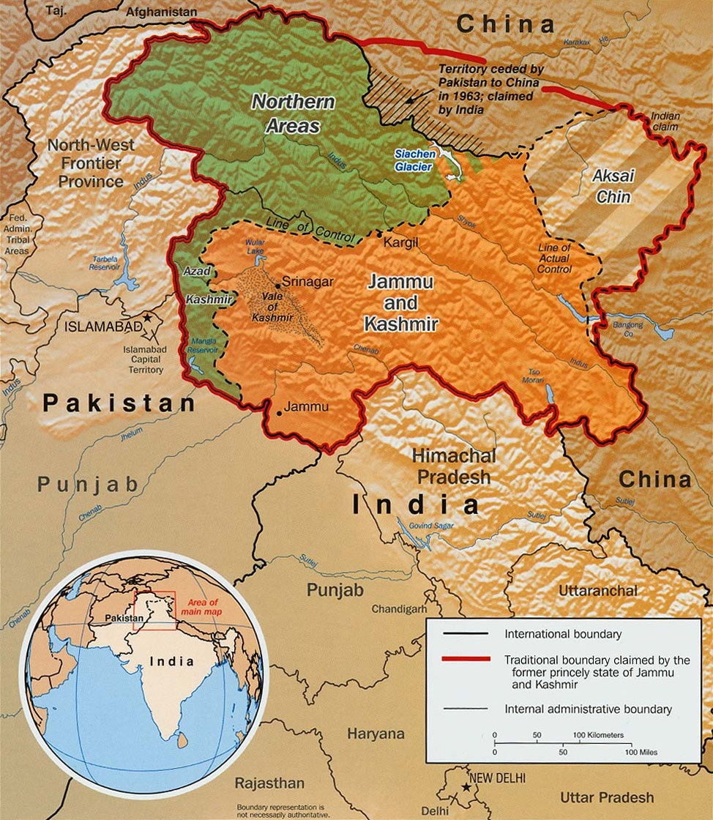
What if India and Pakistan had a nuclear war?
Imagine a skirmish in Kashmir escalating, due to poor communication, misunderstanding, panic, and fear.
http://upload.wikimedia.org/wikipedia/commons/0/0e/Kashmir_map.jpg
Notes:
Toon, Owen B., Richard P. Turco, Alan Robock, Charles Bardeen, Luke Oman, and Georgiy L. Stenchikov, 2007: Atmospheric effects and societal consequences of regional scale nuclear conflicts and acts of individual nuclear terrorism. Atm. Chem. Phys., 7, 1973-2002.
Robock, Alan, Luke Oman, Georgiy L. Stenchikov, Owen B. Toon, Charles Bardeen, and Richard P. Turco, 2007: Climatic consequences of regional nuclear conflicts. Atm. Chem. Phys., 7, 2003-2012.

Slide 14
What would be the consequences of a regional nuclear war using 100 15-kT (Hiroshima-size) weapons?
This would be only 0.03% of the current world arsenal.
Scenario: Weapons dropped on the 50 targets in each country that would produce the maximum smoke.
27,000,000 people would die from direct effects, half of the total fatalities from all of World War II.
Portions of megacities attacked with nuclear devices or exposed to fallout of long-lived isotopes would likely be abandoned indefinitely.
5 million tons of smoke injected into the upper atmosphere, accounting for fuel loading, emission factors and rainout.
Robock, Alan, Luke Oman, Georgiy L. Stenchikov, Owen B. Toon, Charles Bardeen, and Richard P. Turco, 2007: Climatic consequences of regional nuclear conflicts. Atm. Chem. Phys., 7, 2003-2012.
Notes:
Toon, Owen B., Richard P. Turco, Alan Robock, Charles Bardeen, Luke Oman, and Georgiy L. Stenchikov, 2007: Atmospheric effects and societal consequences of regional scale nuclear conflicts and acts of individual nuclear terrorism. Atm. Chem. Phys., 7, 1973-2002.
Robock, Alan, Luke Oman, Georgiy L. Stenchikov, Owen B. Toon, Charles Bardeen, and Richard P. Turco, 2007: Climatic consequences of regional nuclear conflicts. Atm. Chem. Phys., 7, 2003-2012.

Slide 15
What would be the consequences of a regional nuclear war using 100 15-kT (Hiroshima-size) weapons?
We use the NASA GISS ModelE atmosphere-ocean general circulation model.
- 4ºx5º lat-lon horizontal resolution
- 23 vertical levels including stratosphere and mesosphere, extending 0-80 km, 13 layers in ocean
- 5 Tg of smoke into the 300-150 mb layer (upper troposphere) at 30ºN, 70ºE on May 15
- 30-yr control run
- 3-member ensemble for 10 yr
Robock, Alan, Luke Oman, Georgiy L. Stenchikov, Owen B. Toon, Charles Bardeen, and Richard P. Turco, 2007: Climatic consequences of regional nuclear conflicts. Atm. Chem. Phys., 7, 2003-2012.
Notes:
Toon, Owen B., Richard P. Turco, Alan Robock, Charles Bardeen, Luke Oman, and Georgiy L. Stenchikov, 2007: Atmospheric effects and societal consequences of regional scale nuclear conflicts and acts of individual nuclear terrorism. Atm. Chem. Phys., 7, 1973-2002.
Robock, Alan, Luke Oman, Georgiy L. Stenchikov, Owen B. Toon, Charles Bardeen, and Richard P. Turco, 2007: Climatic consequences of regional nuclear conflicts. Atm. Chem. Phys., 7, 2003-2012.

Slide 16
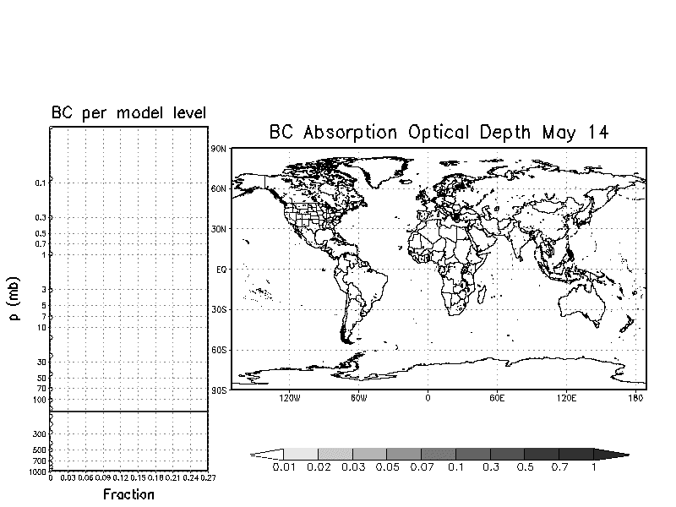
Robock et al., 2007a
Daily smoke loading from one ensemble member.
Absorption optical depth of 0.1 means that 90% of radiation reaches the surface.
Notes:
Robock, Alan, Luke Oman, Georgiy L. Stenchikov, Owen B. Toon, Charles Bardeen, and Richard P. Turco, 2007: Climatic consequences of regional nuclear conflicts. Atm. Chem. Phys., 7, 2003-2012.

Slide 17
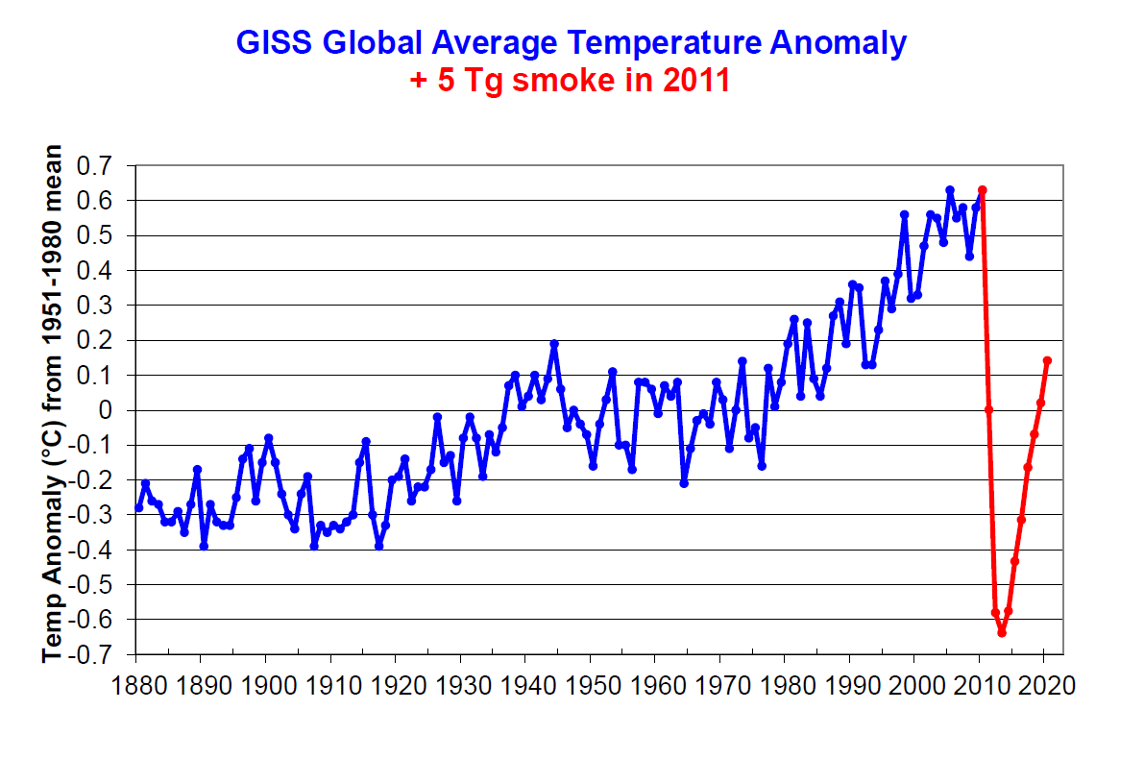
Global climate change unprecedented in recorded human history
Robock et al., 2007a
Notes:
Global average surface air temperature change from the 5 Tg standard case (red) in the context of the climate change of the past 125 years. Observations are from the GISS analysis (Hansen et al., 2001, updated at http://data.giss.nasa.gov/gistemp/2005/).
Robock, Alan, Luke Oman, Georgiy L. Stenchikov, Owen B. Toon, Charles Bardeen, and Richard P. Turco, 2007: Climatic consequences of regional nuclear conflicts. Atm. Chem. Phys., 7, 2003-2012.
Reference:
Hansen, J. E., Ruedy, R., Sato, M., Imhoff, M., Lawrence, W., Easterling, D., Peterson, T., and Karl, T., 2001 : A closer look at United States and global surface temperature change, J. Geophys. Res., 106, 23,947-23,963, doi:10.1029/2001JD000354.

Slide 18
Three other climate models simulated the impacts of 5 million tons of smoke injected into the upper atmosphere from fires from nuclear attacks.
Stenke, Andrea, et al., 2013: Climate and chemistry effects of a regional scale nuclear conflict, Atmos. Chem. Phys., 13, 9713-9729, doi:10.5194/acp-13-9713-2013.
Mills, Michael J., Owen B. Toon, Julia Lee-Taylor, and Alan Robock, 2014: Multi-decadal global cooling and unprecedented ozone loss following a regional nuclear conflict. Earth’s Future, 2, 161-176, doi:10.1002/2013EF000205.
Wagman, Benjamin M., Katherine A. Lundquist, Qi Tang, Lee G. Glascoe, and David C. Bader, 2020: Examining the climate effects of a regional nuclear weapons exchange using a multiscale atmospheric modeling approach. J. Geophys. Res. Atmos., 125, e2020JD033056, doi:10.1029/2020JD033056
All find global cooling for more than a decade, unprecedented in recorded human history.
(This is from “only” 100 15-kt bombs,
much less than 1% of the global nuclear arsenal.)

Slide 19
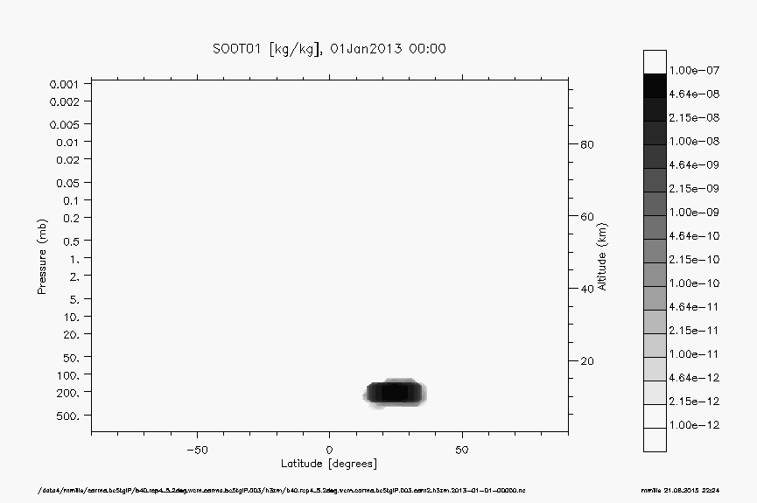
Black carbon mass mixing ratio
100
32
10
3.2
1
0.32
0.1
0.032
0.01
0.0032
0.001
90
80
70
60
50
40
30
20
10
Mesosphere
Altitude (km)
Stratosphere
Troposphere
South
pole
60ºS 30ºS Equator 30ºN 60ºN
North
pole
kg BC per
10⁹ kg air
Latitude
Mills et al. (2014)

Slide 20
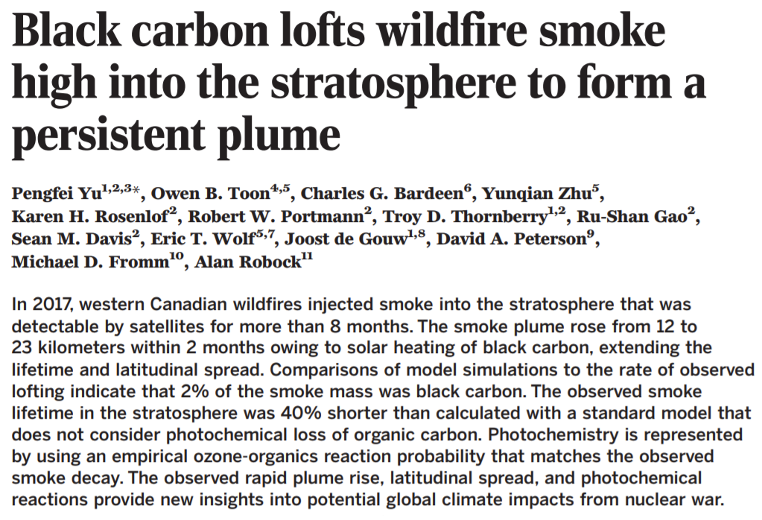

Slide 21
Rapid ascent in first 10 days, observed and modeled.

Slide 22
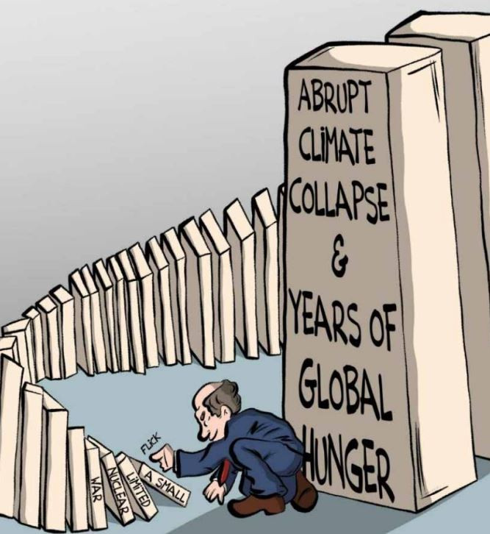
https://nepalitimes.com/editorial/thinking-the-thinkable
December 24, 2024

Slide 23
What would be the consequences of a full-scale nuclear war between the US and Russia?
We use the NASA GISS ModelE atmosphere-ocean general circulation model.
- 50 Tg or 150 Tg of smoke into the 300-150 mb layer (upper troposphere) over the US and Russia on May 15
- 30-yr control run, two 10-yr runs (50 Tg or 150 Tg)
What could produce 150 Tg of smoke?
- standard nuclear winter scenario of 40 years ago
- entire current arsenal if targeted the same way
- only 4000 weapons (2023 global arsenals of New START treaty)
Robock, Alan, Luke Oman, and Georgiy L. Stenchikov, 2007b: Nuclear winter revisited with a modern climate model and current nuclear arsenals: Still catastrophic consequences. J. Geophys. Res., 112, D13107, doi:10.1029/2006JD008235.
Notes:
We took advantage of our new modeling capability to go back to the nuclear winter scenarios and re-do the experiments. Unlike all previous studies, this model was able to consider the atmosphere from the surface up to 80 km (50 miles), explicitly model ocean circulation changes, and conduct multiple simulations for 10 year periods.
Robock, Alan, Luke Oman, and Georgiy L. Stenchikov, 2007: Nuclear winter revisited with a modern climate model and current nuclear arsenals: Still catastrophic consequences. J. Geophys. Res., 112, D13107, doi:10.1029/2006JD008235.

Slide 24
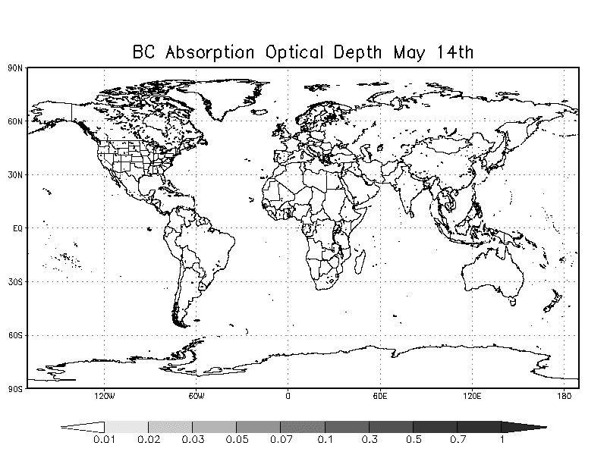
Robock et al., 2007a

Slide 25
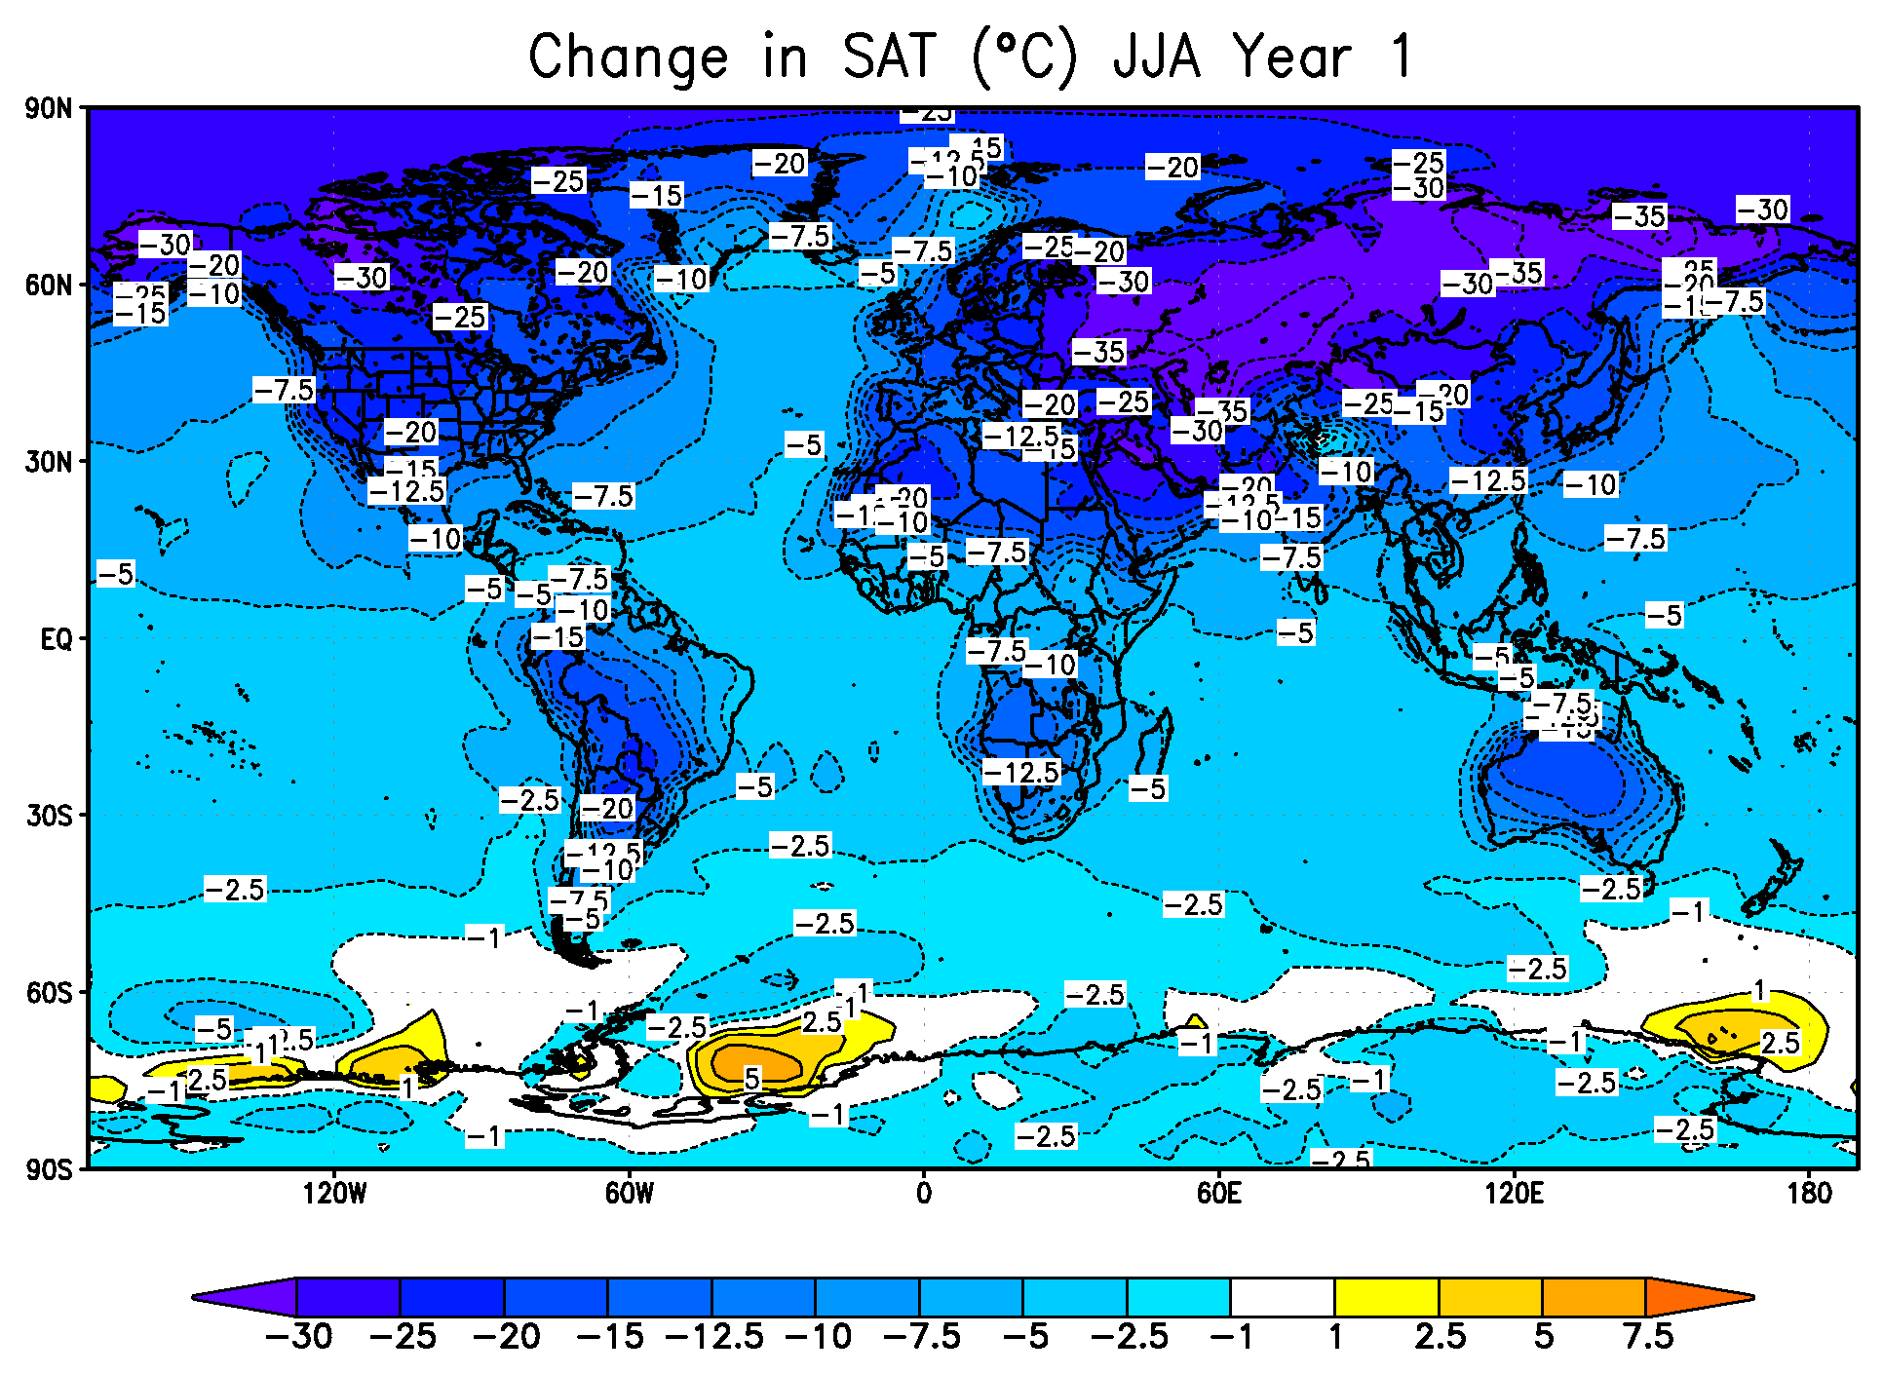
Robock et al., 2007a
Notes:
Surface air temperature changes for the 150 Tg case averaged for June, July, and August of the year after smoke injection. Effects are largest over land, but there is substantial cooling over oceans, too. Also shown as a red burst is a location in Ukraine, for which time series of temperature are shown in the next slide.
Robock, Alan, Luke Oman, and Georgiy L. Stenchikov, 2007: Nuclear winter revisited with a modern climate model and current nuclear arsenals: Still catastrophic consequences. J. Geophys. Res., 112, D13107, doi:10.1029/2006JD008235.

Slide 26
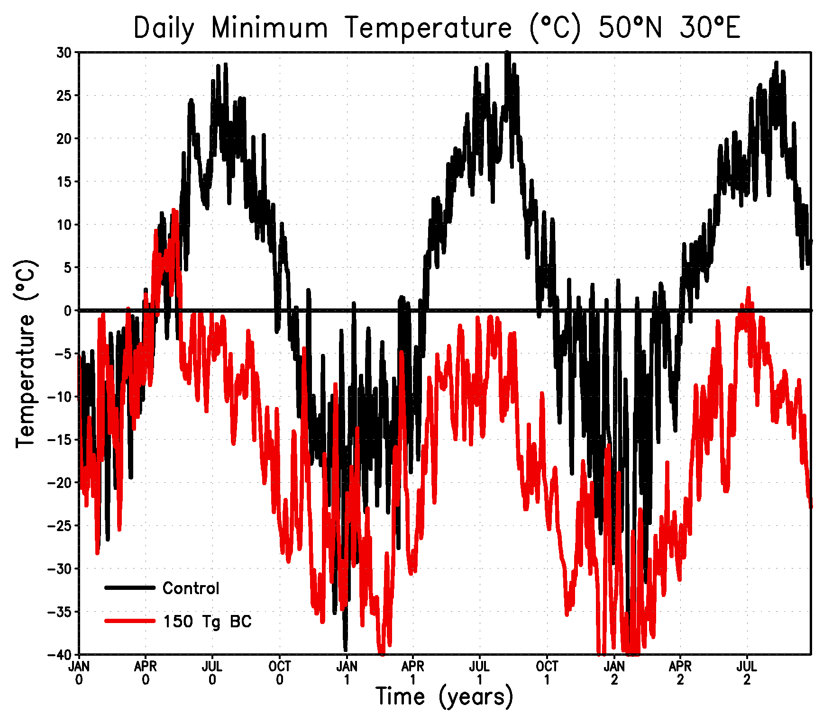
Robock et al., 2007a
Notes:
Time series of daily minimum temperature from the control and 150 Tg cases for an important agricultural region shown on the previous slide, Ukraine at 50°N, 30°E. You will see that the temperature did not exceed freezing in the year of the smoke injection or the next year, and barely exceeded it two years later. Clearly agriculture would be impossible for the entire period shown.
Robock, Alan, Luke Oman, and Georgiy L. Stenchikov, 2007: Nuclear winter revisited with a modern climate model and current nuclear arsenals: Still catastrophic consequences. J. Geophys. Res., 112, D13107, doi:10.1029/2006JD008235.

Slide 27
Pakistan and India may have 400 to 500 nuclear weapons by 2025 with yields from tested 12- to 45-kt values to a few hundred kilotons. If India uses 100 strategic weapons to attack urban centers and Pakistan uses 150, fatalities could reach 50 to 125 million people, and nuclear-ignited fires could release 16 to 37 Tg of black carbon in smoke, depending on yield.
Toon, Owen B., Charles G. Bardeen, Alan Robock, Lili Xia, Hans Kristensen, Matthew McKinzie, R. J. Peterson, Cheryl Harrison, Nicole S. Lovenduski, and Richard P. Turco, 2019: Rapid expansion of nuclear arsenals by Pakistan and India portends regional and global catastrophe. Science Advances, 5, eaay5478, doi:10.1126/sciadv.aay5478.

Slide 28
New simulations with the Whole Atmosphere Community Climate Model, version 4 (WACCM4)
horizontal resolution of 1.9º×2.5º (lat-lon)
66 vertical layers
model top of 140 km
transport and removal of soot from fires is handled by the Community Aerosol and Radiation Model for Atmospheres (CARMA), a sectional aerosol model that treats soot as fractal particles and allows them to grow
Coupe, Joshua, Charles G. Bardeen, Alan Robock, and Owen B. Toon, 2019: Nuclear winter responses to global nuclear war in the Whole Atmosphere Community Climate Model Version 4 and the Goddard Institute for Space Studies ModelE. J. Geophys. Res. Atmos., 124, 8522-8543, doi:10.1029/2019JD030509.
Toon, Owen B., Charles G. Bardeen, Alan Robock, Lili Xia, Hans Kristensen, Matthew McKinzie, R. J. Peterson, Cheryl Harrison, Nicole S. Lovenduski, and Richard P. Turco, 2019: Rapid expansion of nuclear arsenals by Pakistan and India portends regional and global catastrophe. Science Advances, 5, eaay5478, doi:10.1126/sciadv.aay5478.

Slide 29
WACCM4 global average surface temperature changes for different soot amounts
Toon et al. (2019)

Slide 30
HOW NUCLEAR WAR WOULD AFFECT AGRICULTURE
Darkness
Cold
Slower growth
Shortened frost-free growing season
Increased time for crop maturation
Cold spells during growing season that could kill crops
Less rainfall
Toxic chemicals in the atmosphere and soil
Highly engineered genetic stocks
Lack of fuel for machinery
Lack of water supplies
Lack of pesticides (but not of pests)
Lack of distribution system
Enhanced UV (later)

Slide 31
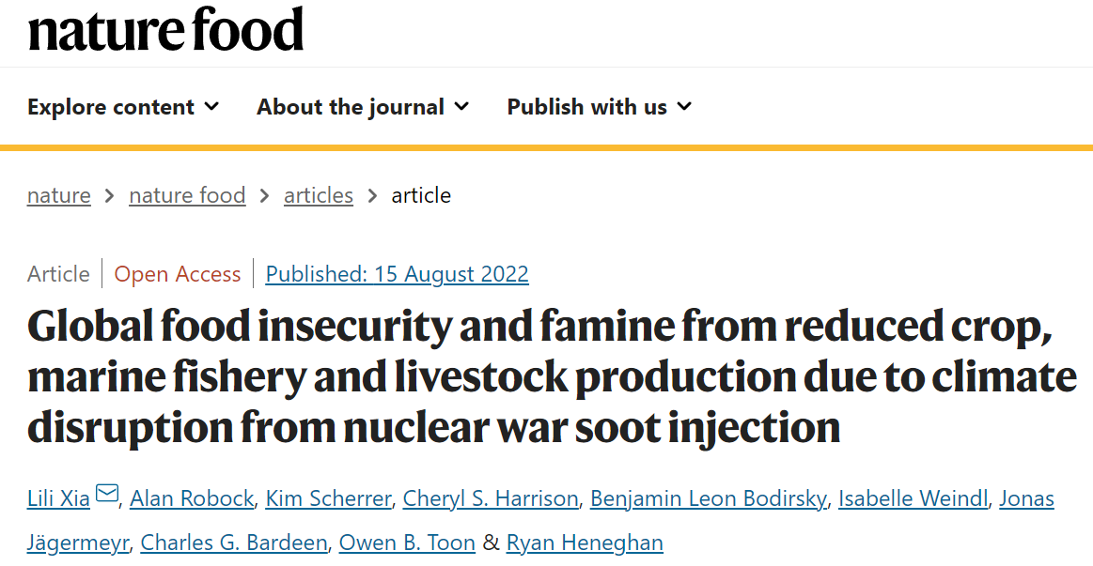
https://www.nature.com/articles/s43016-022-00573-0

Slide 32
Food Calculations
We used the Community Land Model version 5 crop model in the Community Earth System Model version 2 to simulate maize, rice, soybeans, wheat, and grasses, and the Bioeconomic Marine Trophic Size-spectrum model to simulate marine fisheries.
For cattle and sheep, on average half are fed by pasture, and half are fed by crops and processed products. We used data for each animal and each country in our calculations.
We used Food and Agricultural Organization data for the calorie content of each food, and for the national import, export, and consumption of all the different foods.

Slide 33
Nuclear War Scenarios
[1 teragram (Tg) = 1 million tons]
Combatants | Smoke | Number of weapons | Yield | Number of direct fatalities
India - Pakistan | 5 Tg | 100 | 15 kt | 27,000,000
 | 16 Tg | 250 | 15 kt | 52,000,000
 | 27 Tg | 250 | 50 kt | 97,000,000
 | 37 Tg | 250 | 100 kt | 127,000,000
 | 47 Tg | 500 | 100 kt | 164,000,000
U.S. - Russia | 150 Tg | 4400 | 100 kt | 360,000,000

Slide 36
Combatants | Smoke | Number of weapons | Yield | Number of direct fatalities | Number of people without food at the end of Year 2
India - Pakistan | 16 Tg | 250 | 15 kt | 52,000,000 | 926,000,000
 | 37 Tg | 250 | 100 kt | 127,000,000 | 2,081,000,000
U.S. - Russia | 150 Tg | 4400 | 100 kt | 360,000,000 | 5,341,000,000
A war between India and Pakistan
could kill 1 to 2 billion people.
A Russia-U.S.-NATO war
could kill most of Earth’s population.

Slide 37
Not yet considered in these calculations:
Effects of ultraviolet radiation
Effects of ozone changes
More complex economic responses, including:
Some international trade
Food distribution within countries
Agricultural adaptations, including different crops

Slide 38
Nuclear Winter Analogs
Seasonal cycle
Diurnal cycle (day and night)
Firestorm: 1906 San Francisco earthquake
Fires: World War II firestorms
  Dresden, Hamburg, Darmstadt, Tokyo (“conventional” bombs)
  Hiroshima, Nagasaki (nuclear bombs)
Smoke and dust transport, Surface temperature effects
  Martian dust storms
  Asteroid impact → dinosaur extinction
  Forest fires
  Saharan dust
  Volcanic eruptions
Notes:
Nuclear winter is not a theory we can test in the atmosphere. (Or if we did test it, it would be too late.) So how can we test its validity. It turns out that many aspects of the theory can be tested by examining analogs for parts of the theory – naturally occurring phenomena that correspond to these aspects of the theory. Here several of these analogs are described.
The seasonal cycle: This has given the name to nuclear winter. We all know that when the days get shorter and the angle of the sun makes it less intense that summer turns to winter.
The diurnal cycle: When the Sun goes down, it gets cold at the surface. What if the Sun did not come up the next day, but the heat from the surface could escape to space (as would the case with small smoke particles in the atmosphere?

Slide 39
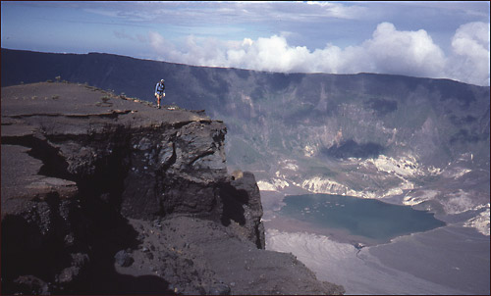
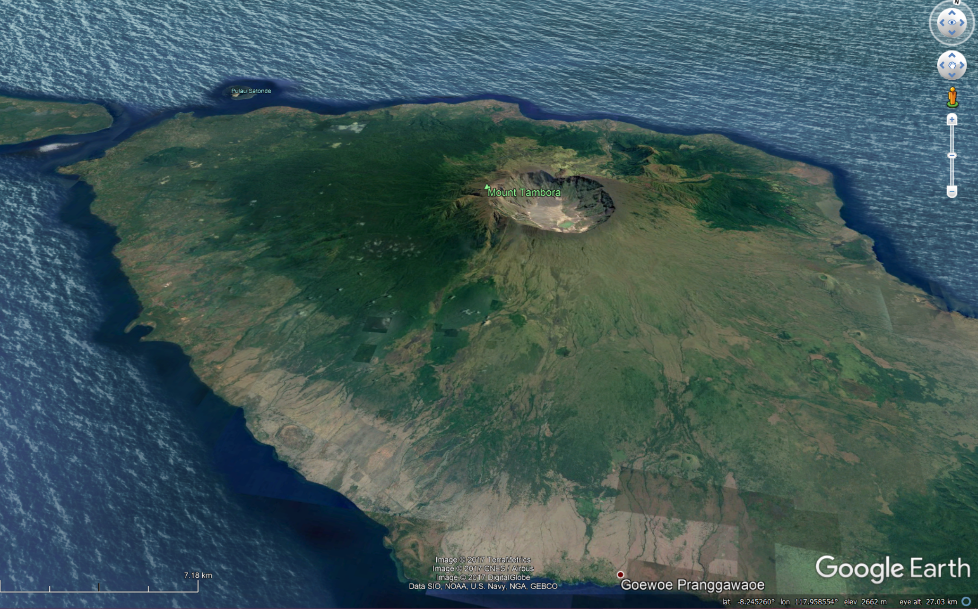
Tambora in 1815, together with an eruption from an unidentified volcano in 1809, produced the “Year Without a Summer” (1816)

Slide 40
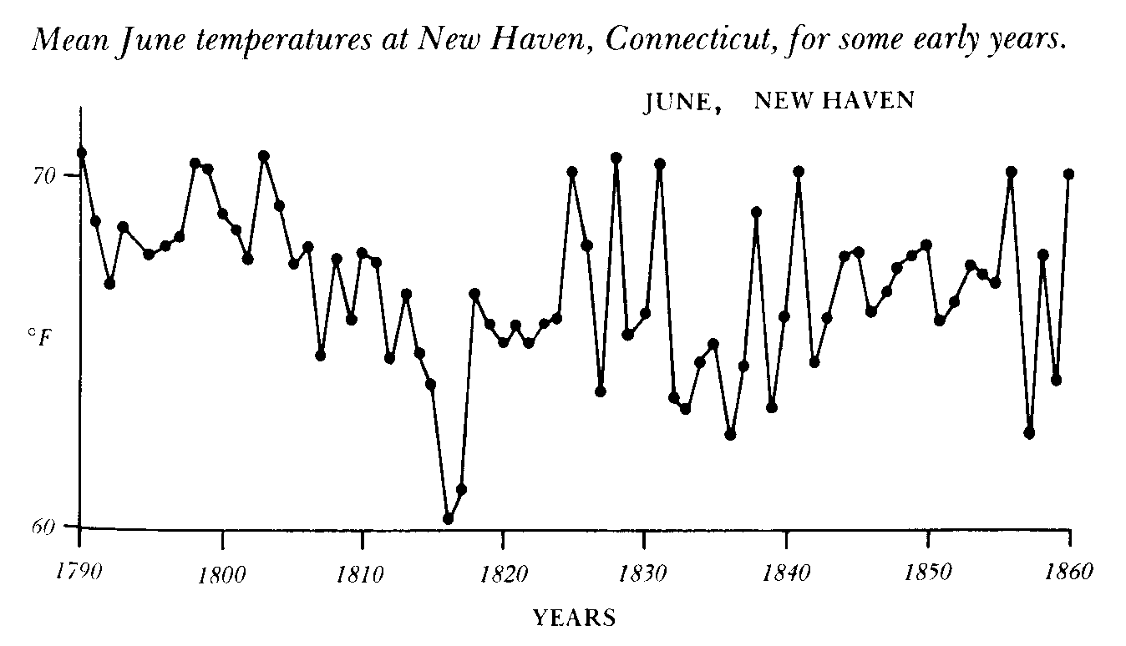
Figure from Stommel and Stommel (1983)
Gillen D'Arcy Wood, Tambora: The Eruption That Changed the World (2014): “For three years following Tambora’s explosion, to be alive, almost anywhere in the world, meant to be hungry.”

Slide 41
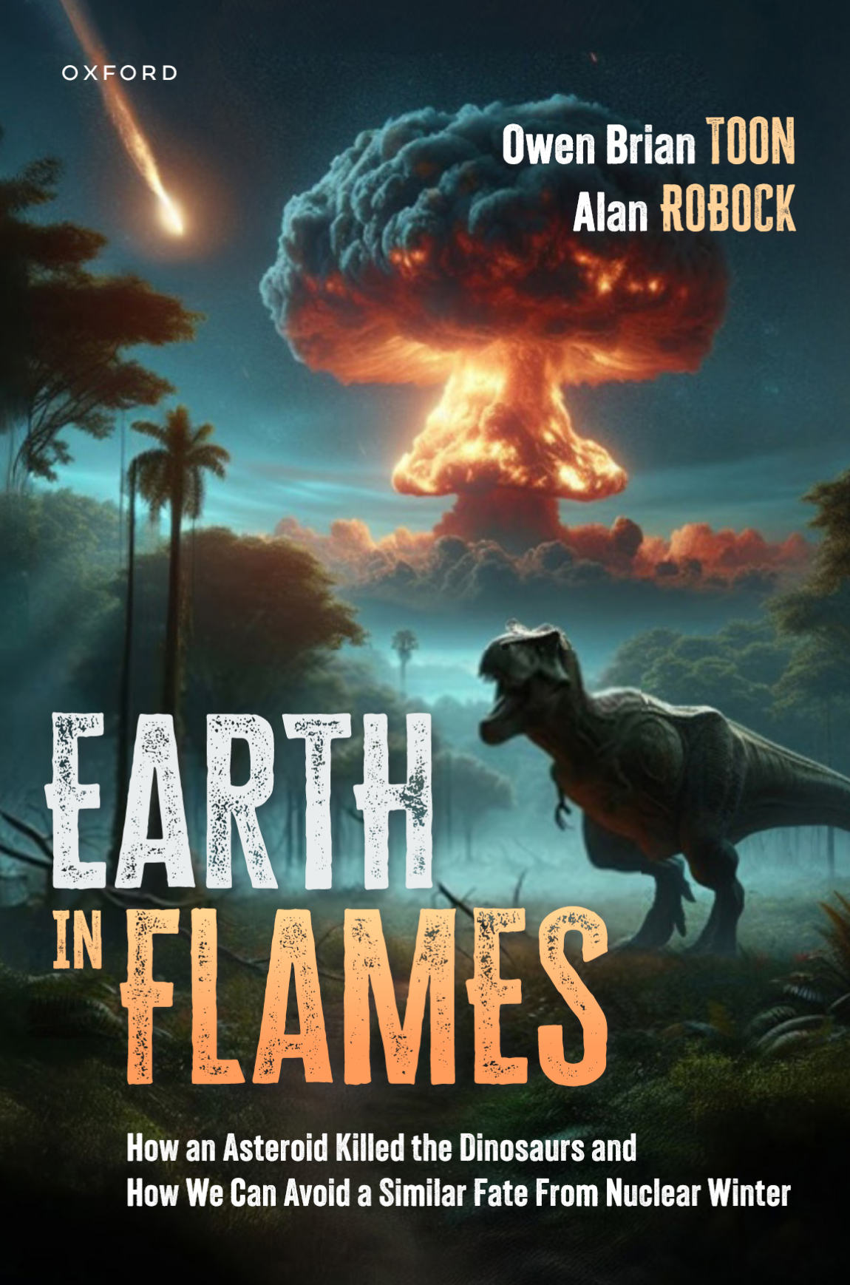
Published
in June 2025 by
Oxford University Press

Slide 42
Published
in June 2025 by
Oxford University Press
Available from Amazon as a hardcover book or Kindle.
Audiobook will be available in September.

Slide 43
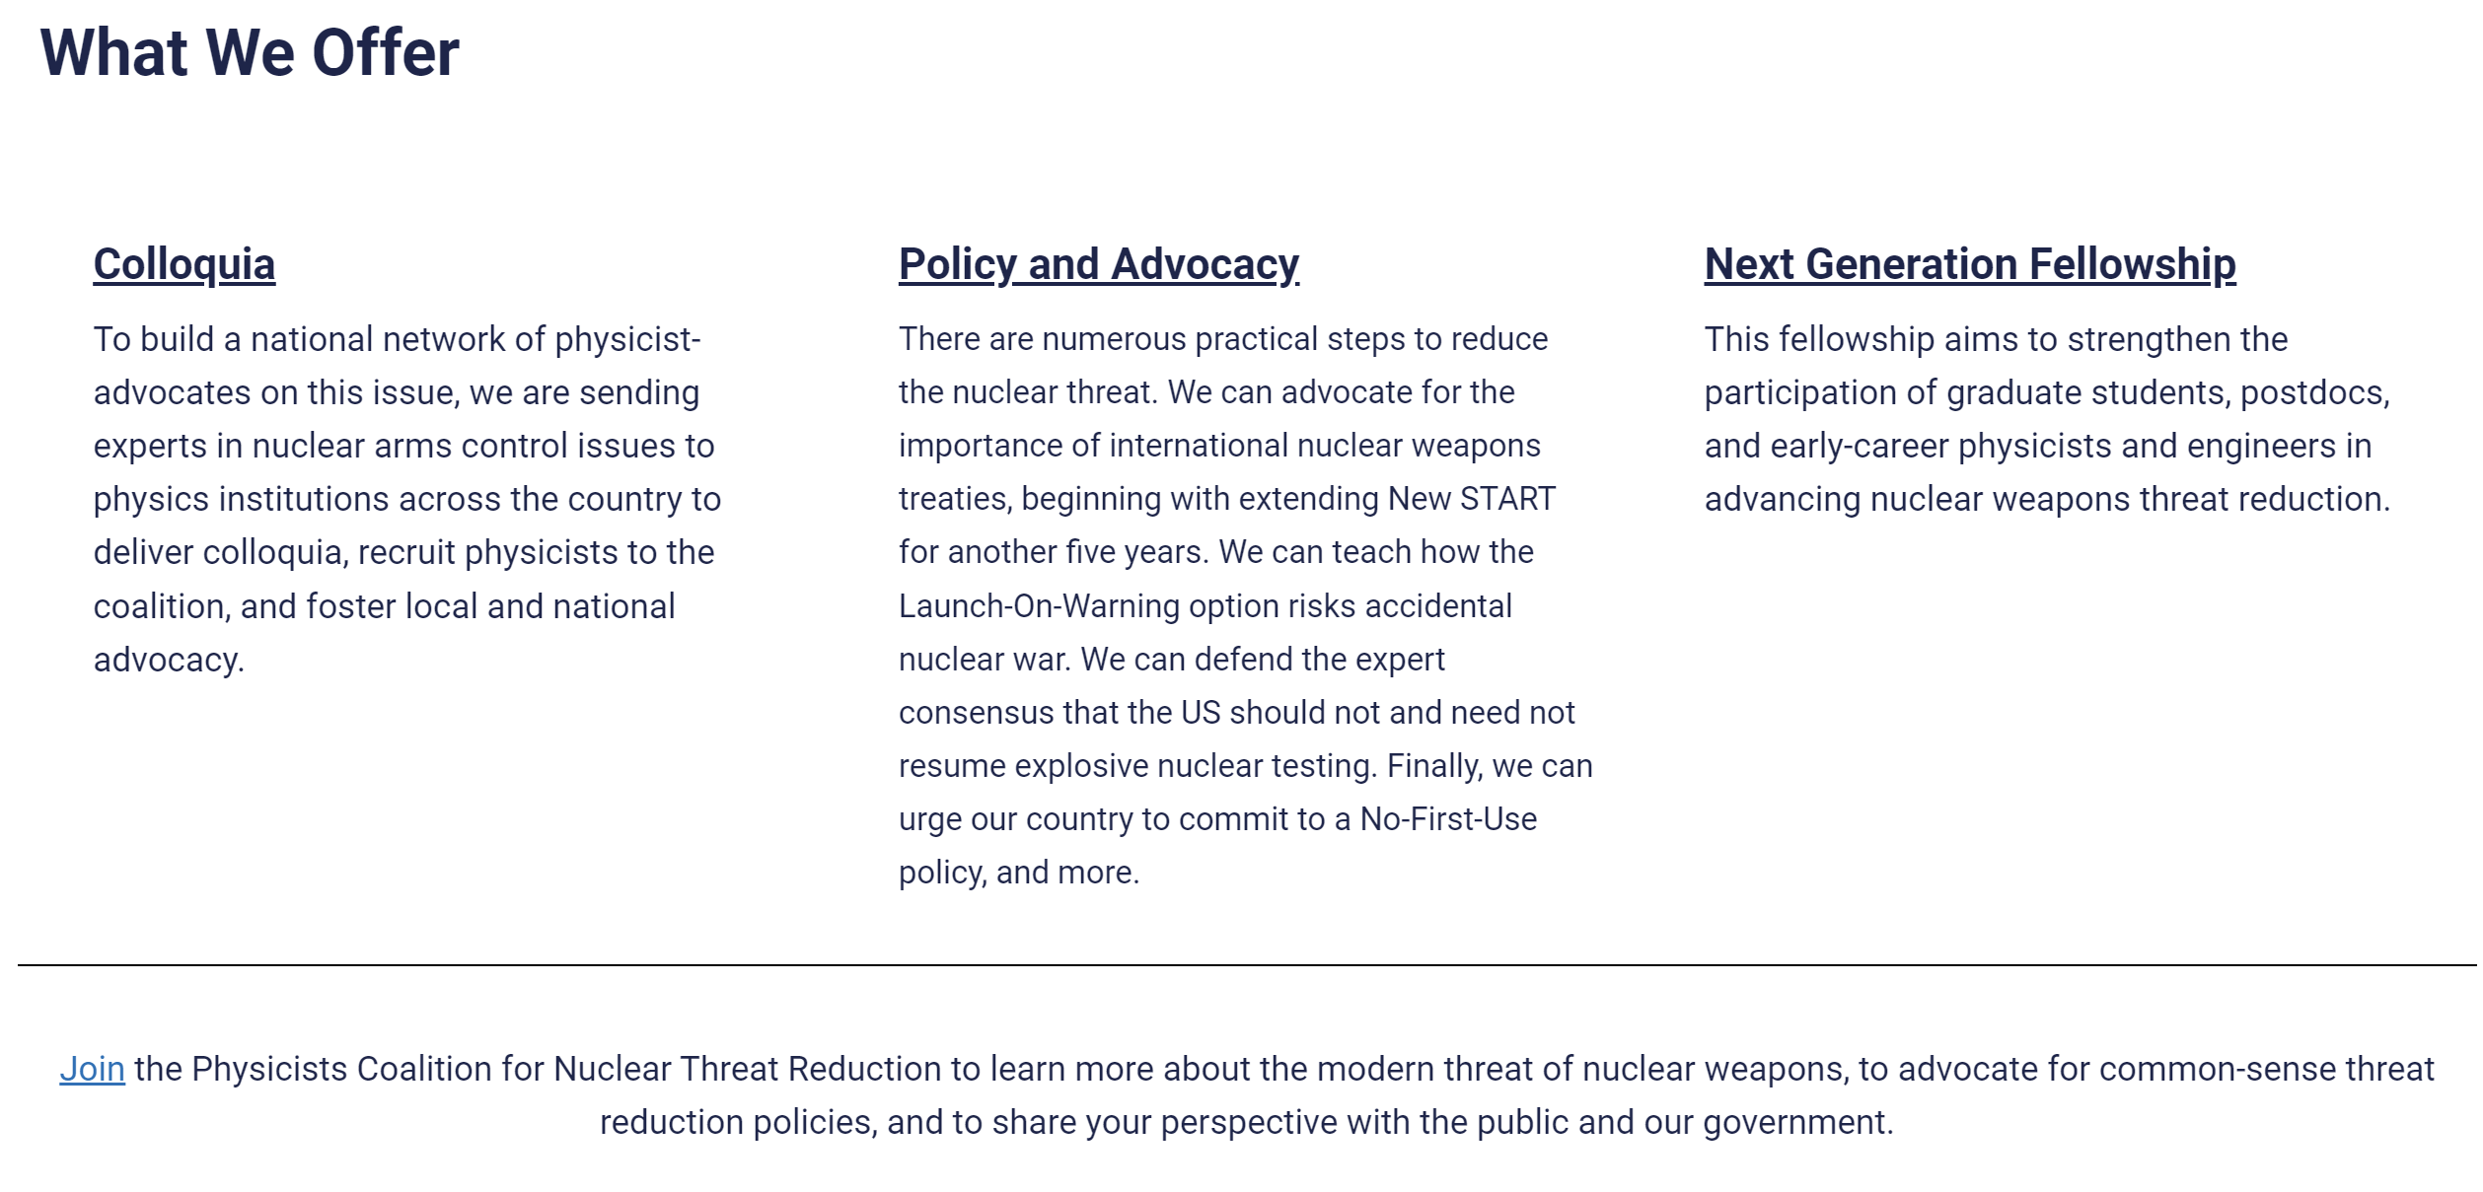

You can join the Physicists Coalition for Nuclear Threat Reduction at http://physicistscoalition.org/, a project to engage and activate the US and global physics community. We have over 1600 members.
Supported by the American Physical Society and Carnegie Corporation for two years. Beginning in October 2022, the Coalition began a partnership with the Arms Control Association.
Steered through the Princeton Program on Science and Global Security.
Webinars on Nuclear Threat Reduction Issues

Slide 44


You can join the Physicists Coalition for Nuclear Threat Reduction at http://physicistscoalition.org/, a project to engage and activate the US physics community.
Supported by the American Physical Society and Carnegie Corporation for two years. Beginning in October 2022, the Coalition began a partnership with the Arms Control Association.
Steered through the Princeton Program on Science and Global Security
Team members:
Curtis Asplund, San José State University
Angela di Fulvio, University of Illinois
Tara Drozdenko, Union of Concerned Scientists
Alex Glaser, Princeton University
Laura Grego, Union of Concerned Scientists
Rob Goldston, Princeton University
Raymond Jeanloz, Univ. of California, Berkeley
Fred Lamb, University of Illinois
Zia Mian, Princeton University
Sebastien Philippe, Princeton University
Stewart Prager, Princeton University
Alan Robock, Rutgers University
Frank von Hippel, Princeton University

Slide 45

The Physicists Coalition for Nuclear Threat Reduction
http://physicistscoalition.org/
Mission Statement:
The Physicists Coalition for Nuclear Threat Reduction works to reduce the threats from nuclear weapons by mobilizing advocacy within the physical sciences communities in the United States and internationally. Given the civilization-ending potential of the use of nuclear weapons, we advocate for substantive changes in nuclear arsenals, force postures, and declaratory policies. We also call for fulfillment of the long-standing international obligation to achieve nuclear disarmament.

Slide 46

The Physicists Coalition for Nuclear Threat Reduction
http://physicistscoalition.org/

Slide 47
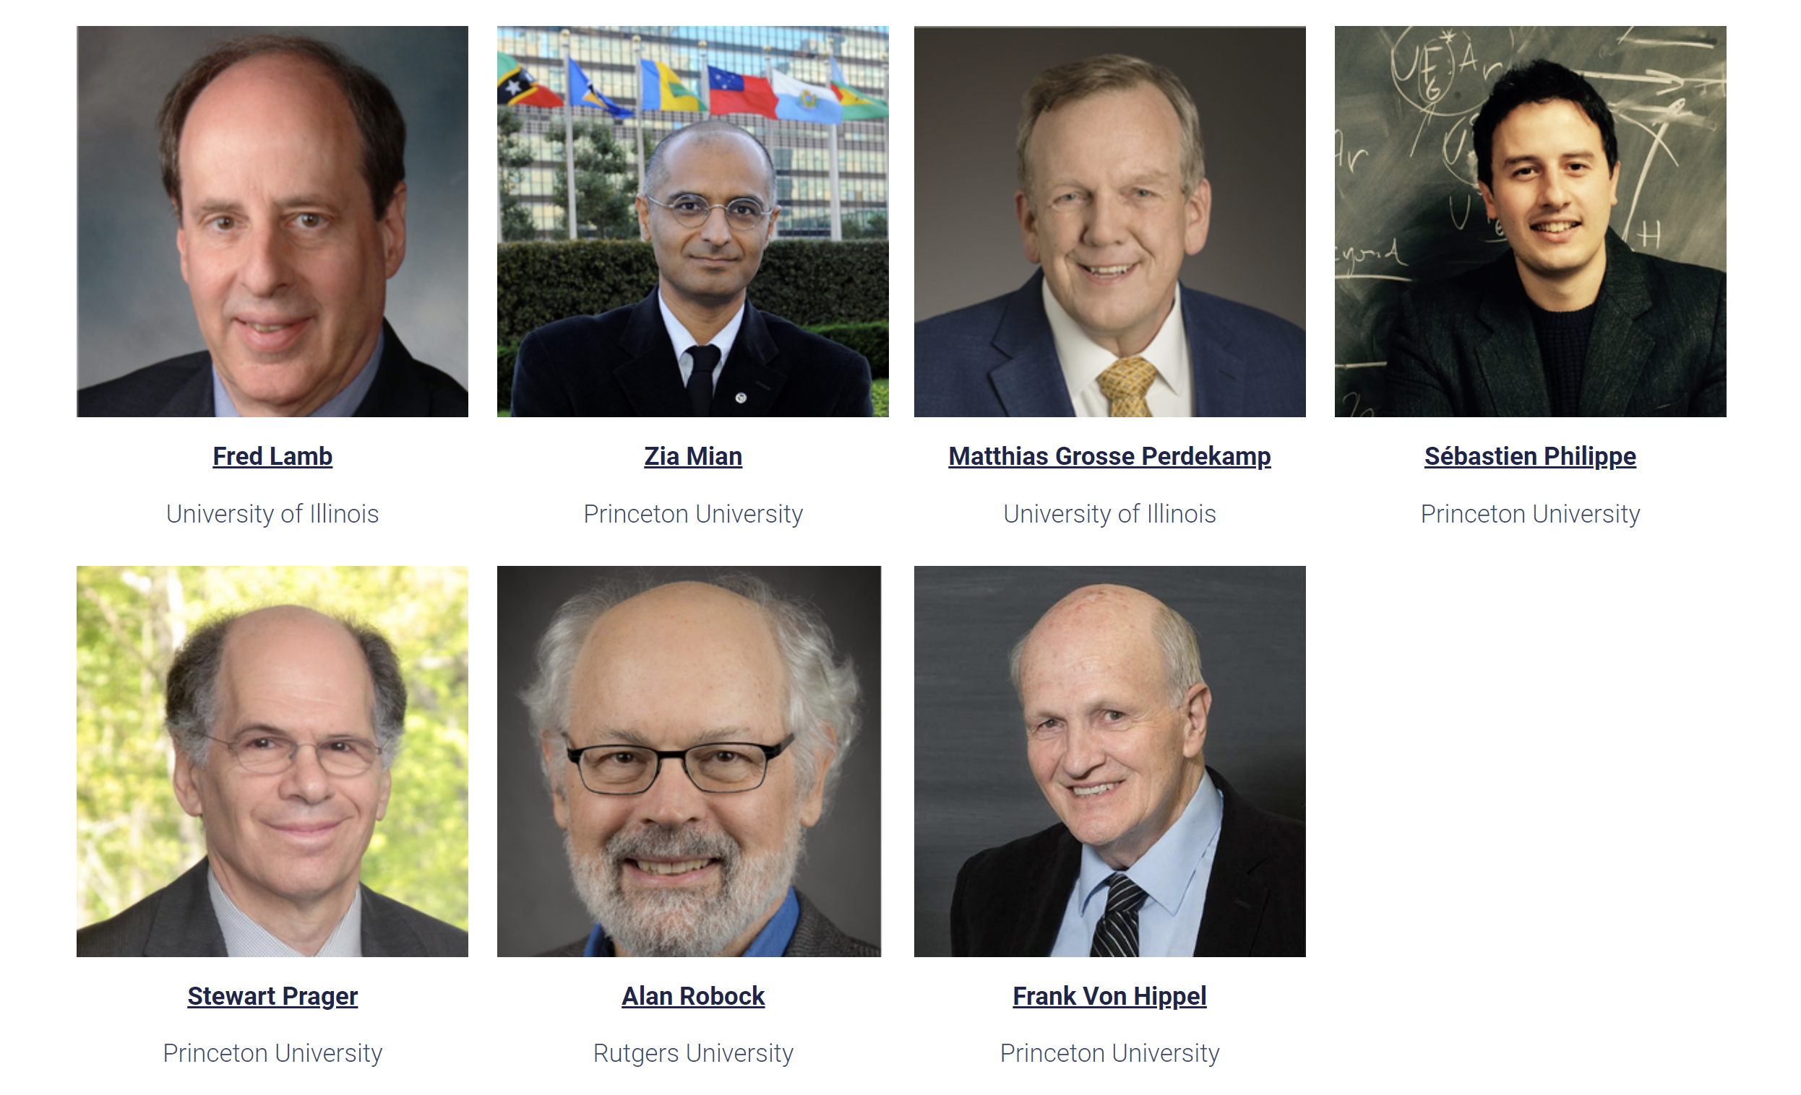
The Physicists Coalition for Nuclear Threat Reduction
http://physicistscoalition.org/
Total of 168 colloquia by this team so far.

Slide 48
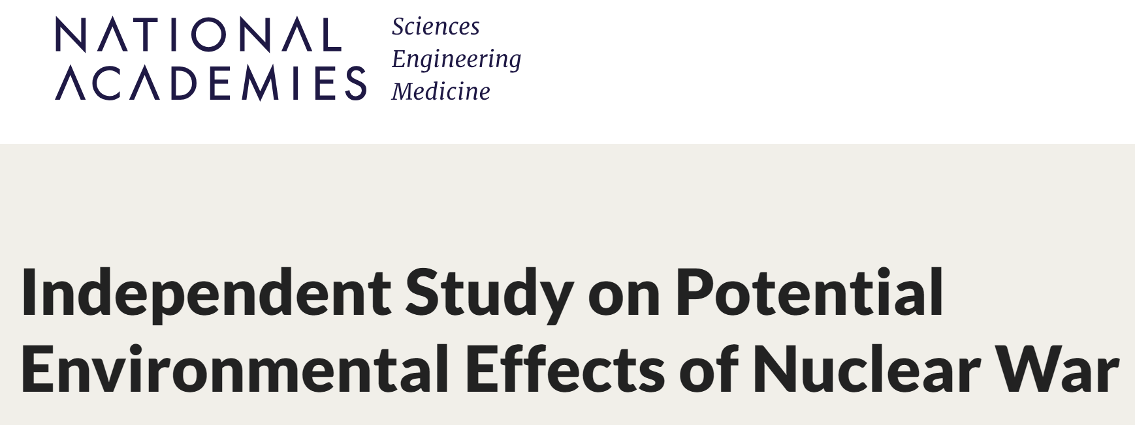

https://www.nationalacademies.org/our-work/independent-study-on-potential-environmental-effects-of-nuclear-war

Slide 49
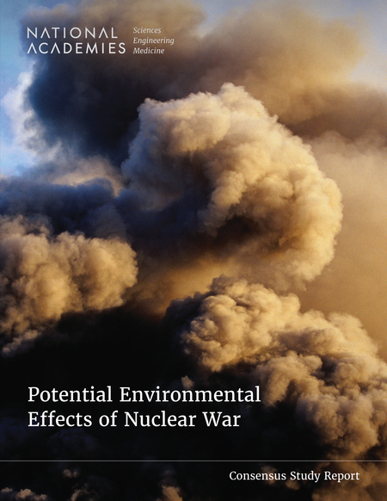
Published
June 25, 2025
“Potential Environmental Effects of Nuclear War identifies major uncertainties and data gaps at each stage of the causal pathway that currently limit researchers' ability to understand and model the effects of a nuclear war. This report recommends that relevant U.S. agencies coordinate the development of and support for a suite of model intercomparison projects to organize and assess models to reduce uncertainties in projections of the climatic and environment effects of nuclear war.”
https://nap.nationalacademies.org/catalog/27515/potential-environmental-effects-of-nuclear-war

Slide 50
FIGURE S-1 Causal pathway of possible physical Earth system, ecosystem, and societal and economic impacts as an outcome of the detonation of a nuclear weapon. Colors are used for clarity; boxes mean collective impact on other aspects of the pathway; and double-headed arrows identify feedback between subsystems and interconnectedness across the systems. Gradation across the figure is used to distinguish between subsystems and represent the propagating uncertainty across the system.
p. 2
National Academies of Sciences, Engineering, and Medicine. 2025. Potential
Environmental Effects of Nuclear War. Washington, DC: The National Academies
Press. https://doi.org/10.17226/27515.

Slide 51
“Fires from large nuclear detonations could potentially alter life on Earth to a degree never seen before in human history if a large quantity of smoke is produced. Fire-produced smoke could be injected into the stratosphere, then circulate around the globe for years blanketing the planet, shielding the sunlight and cooling the planet surface, thereby disrupting the food chain and production ecosystem.”
p. xiii
National Academies of Sciences, Engineering, and Medicine. 2025. Potential
Environmental Effects of Nuclear War. Washington, DC: The National Academies
Press. https://doi.org/10.17226/27515.

Slide 52
“Two key disruption pathways are identified: global climatic disruption from large exchanges between major powers and localized environmental degradation from smaller exchanges. These can be further amplified by the complex global and regional societal and economic interconnectedness.
“Potential impacts on agriculture and food production could be extensive, with widespread cooling and precipitation decreases leading to lower crop yields, reduced livestock productivity, and disrupted planting and harvesting cycles. Impacts would likely vary regionally, with temperate areas above 30ºN latitude facing major effects. Marine and freshwater fisheries could also experience significant disruptions. Environmental quality would deteriorate through air, water, and soil pollution from infrastructure damage, fires, and waste mismanagement.”
p. 171
National Academies of Sciences, Engineering, and Medicine. 2025. Potential
Environmental Effects of Nuclear War. Washington, DC: The National Academies
Press. https://doi.org/10.17226/27515.

Slide 53
“Direct health impacts include blast injuries, radiation exposure, lack of continued care, and effects from environmental changes. Complex, indirect impacts over longer timescales could involve disease transmission, malnutrition, mental illness, and broader public health crises from compromised health systems. Persistent exposure to environmental contamination and psychosocial stressors may have intergenerational consequences. …
“Mass displacement would severely strain provision of shelter, healthcare, food, water, and protection, potentially leading to exploitation and violence. Psychological impacts on the public and responders could be profound, while broader societal effects may include panic, hoarding, and disruptions to civil liberties. Moreover, substantial uncertainties in predicting complex human behavioral responses, detecting societal tipping points, quantifying the effects of cascading failures across critical systems, and assessing long-term psychological harms will hamper development of approaches to improving preparedness and building community resilience that would mitigate risk.”
p. 171
National Academies of Sciences, Engineering, and Medicine. 2025. Potential
Environmental Effects of Nuclear War. Washington, DC: The National Academies
Press. https://doi.org/10.17226/27515.

Slide 54
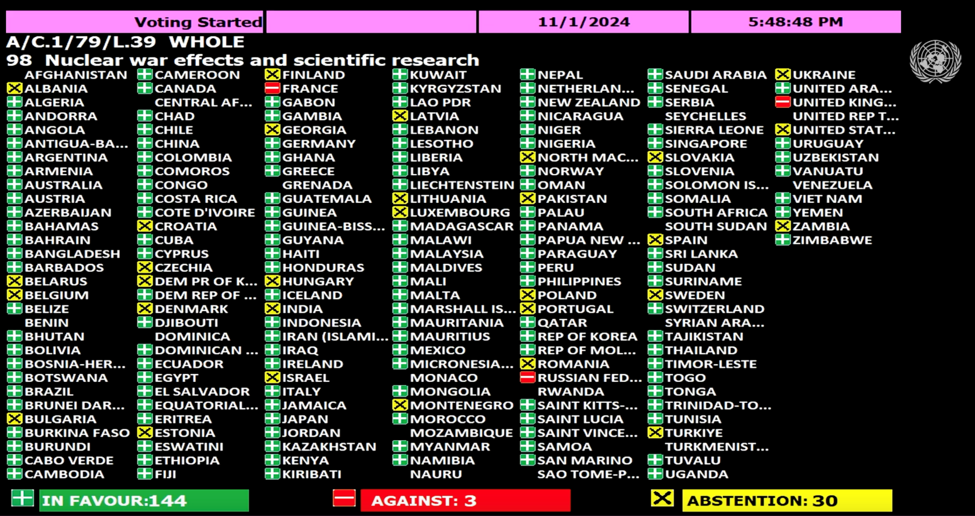
On Nov. 1, 2024, the UN First Committee on Peace and Security voted to establish an expert panel to study the effects of nuclear war. The new study, the first of its kind in 35 years, will examine the physical effects and societal consequences of a nuclear war on a local, regional and planetary scale, including, climatic, environmental and radiological effects, and impacts on public health, global socioeconomic systems, agriculture and ecosystems. It will lead to a comprehensive report, presented at the General Assembly.

Slide 55
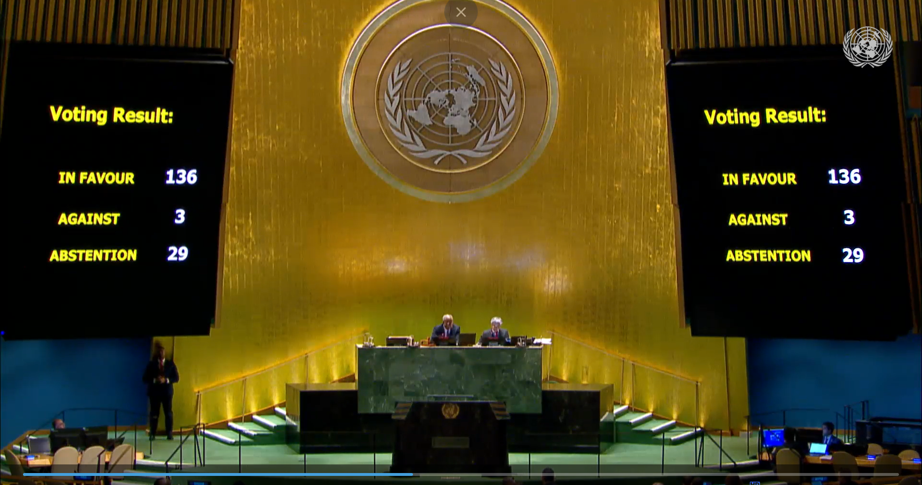
On December 24, 2024, the resolution that would establish this scientific panel was adopted
by the UN General Assembly.

Slide 56
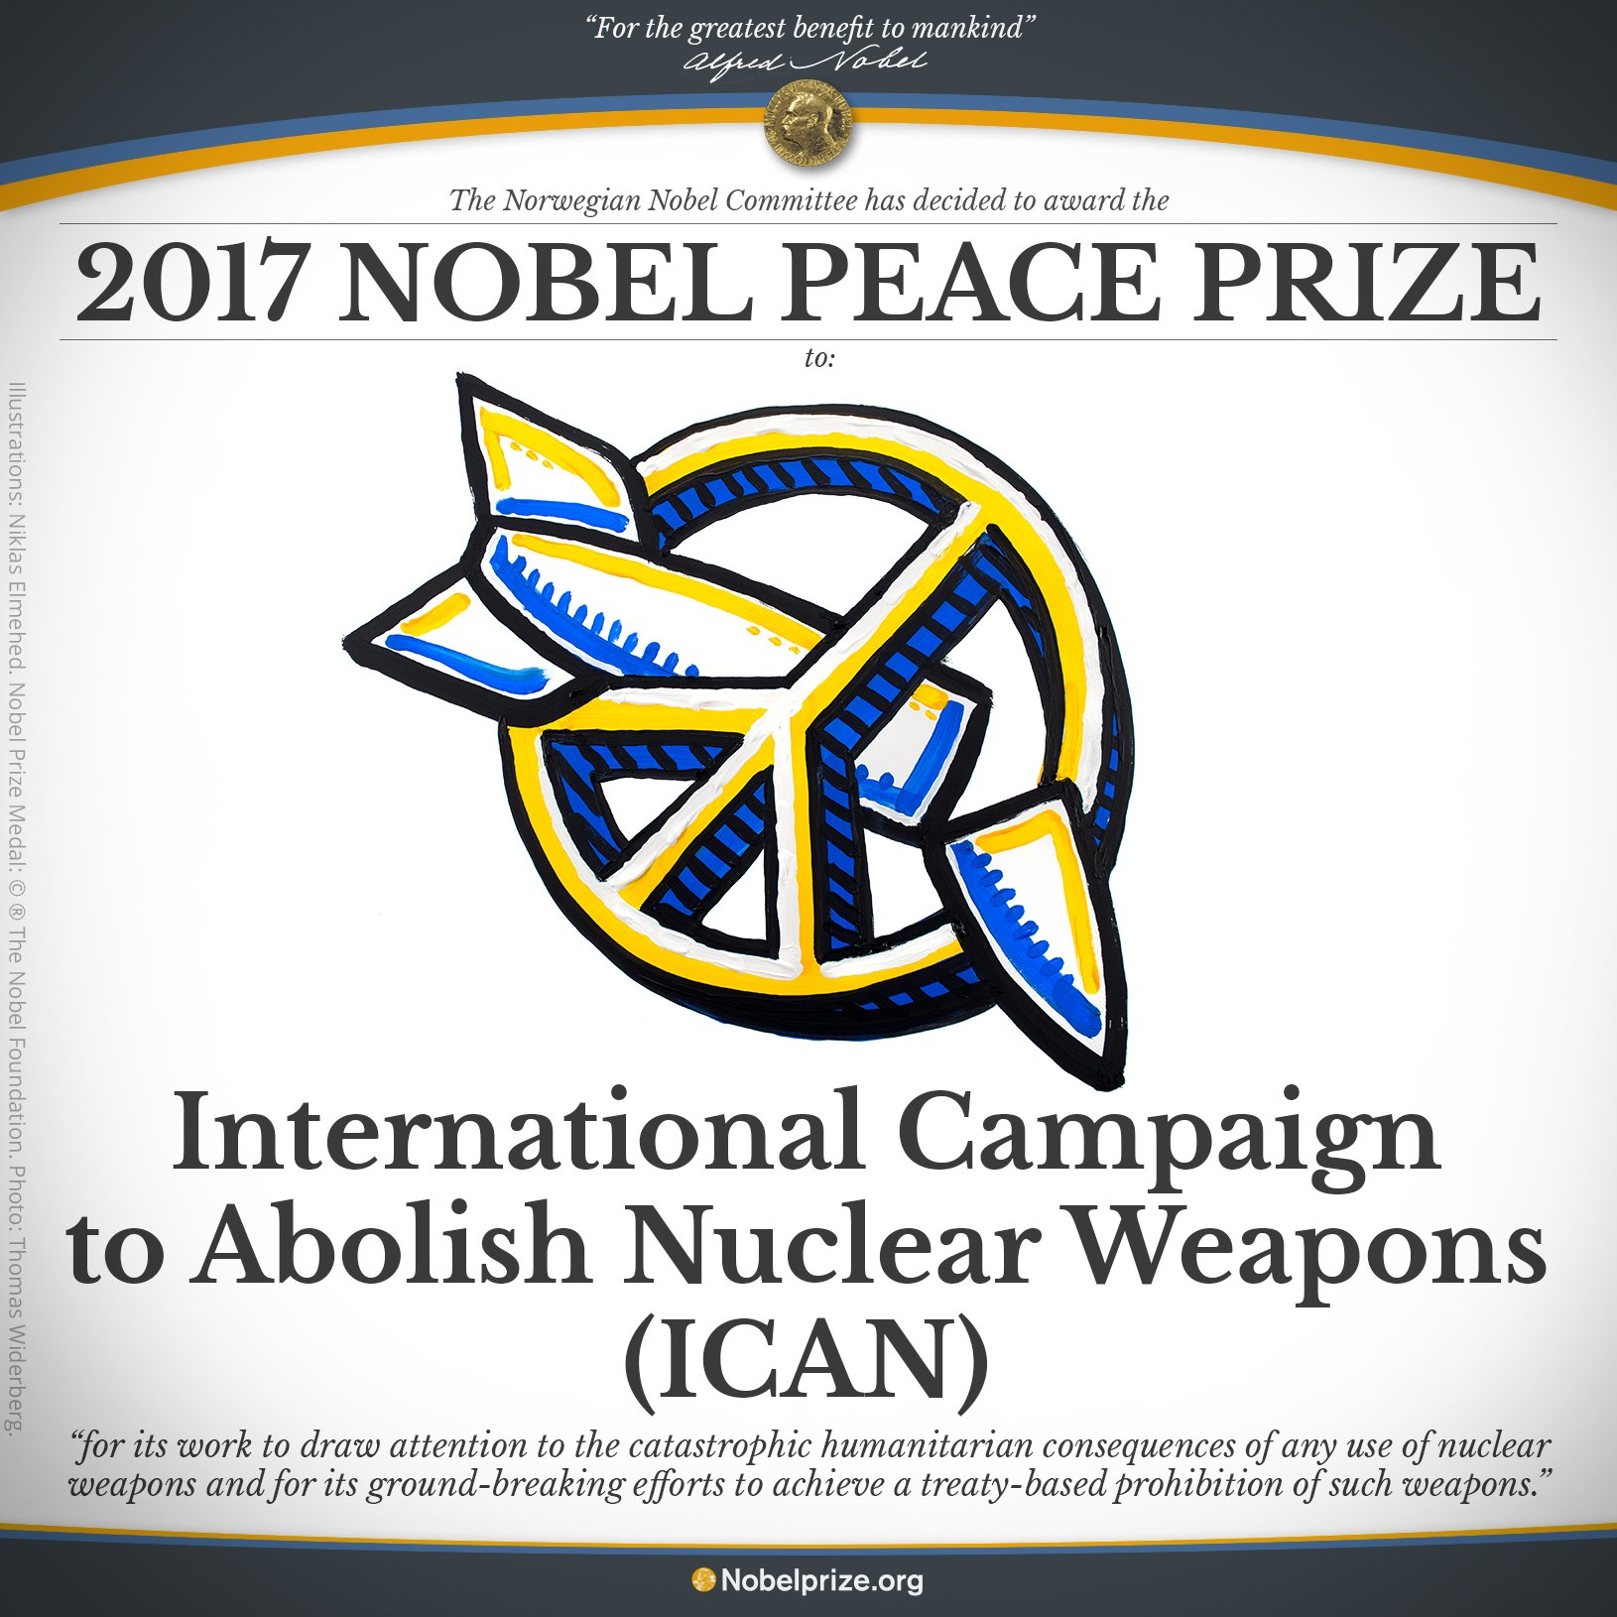

Slide 57

Beatrice Fihn
Executive Director of ICAN
Nobel Peace Prize Lecture
December 10, 2017
The story of nuclear weapons will have an ending, and it is up to us what that ending will be.
Will it be the end of nuclear weapons, or will it be the end of us? One of these things will happen.
The only rational course of action is to cease living under the conditions where our mutual destruction is only one impulsive tantrum away.

Slide 58

“For myself, I would far rather have a world in which the climatic catastrophe cannot happen, independent of the vicissitudes of leaders, institution, and machines. This seems to me elementary planetary hygiene, as well as elementary patriotism.”
-Carl Sagan
“Elementary planetary hygiene” demands that we eliminate nuclear weapons faster than the current pace.
Sagan, Carl, 1983: Nuclear war and cimatic catastrophe: Some policy implications, Foreign Affairs , Winter, 1983, Vol. 62, No. 2, 257-292.

Slide 59
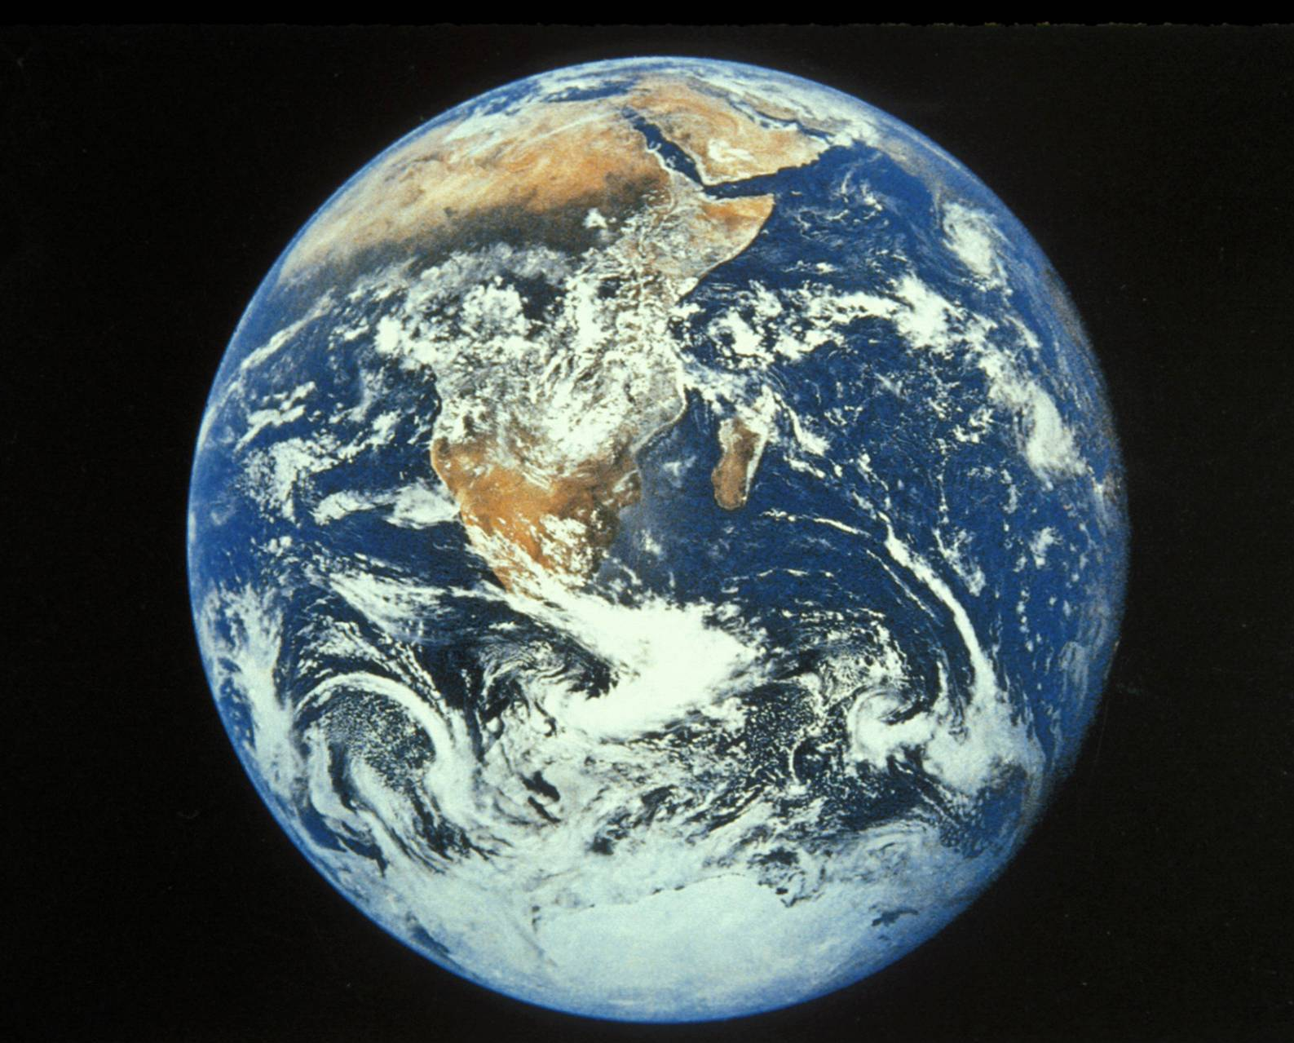
Notes:
I hope we learn the lessons of nuclear winter well enough to keep our beautiful planet looking this way for a long time to come.
Apollo 17 photograph of Earth, taken on the way to the Moon, December 17, 1972.
Photo from NASA. NASA Photo ID: AS17-148-22727 File Name: 10075945.jpg
http://nssdc.gsfc.nasa.gov/image/planetary/earth/apollo17_earth.jpg

Slide 60
For more about this work, go to
http://climate.envsci.rutgers.edu/nuclear/

