Slide 1


Welcome to the 15th
Annual GeoMIP Workshop
Alan Robock, Rutgers University
robock@envsci.rutgers.edu
http://envsci.rutgers.edu/~robock

Slide 2
Workshop Goals
Review recent work
Plan joint analyses and collaborations
Plan future GeoMIP simulations
Behave ethically and have fun

Slide 3
Thanks to DEGREES and the local hosts for arranging a fabulous meeting and Daniele Visioni for planning today’s workshop.
Thanks to the National Science Foundation (through a grant to Alan Robock) and the Quadrature Climate Foundation (through a grant to Dan Visioni) for support.

Slide 4
Desire for improved well-being
Impacts on humans and ecosystems
Consumption of goods and services
SUFFERING
CONSERVATION
Geoengineering (Climate Intervention)
EFFICIENCY
ADAPTATION
Climate change
Consumption of energy
SOLAR RADIATION MODIFICATION
CARBON DIOXIDE REMOVAL
LOW-CARBON ENERGY
CO₂ in the atmosphere
CO₂ emissions
Treat the symptoms
Treat the illness
After Ken Caldeira

Slide 5
Geoengineering is defined as
“deliberate large-scale manipulation of the planetary environment to counteract anthropogenic climate change.”
(We now use the term “climate intervention.”)
Shepherd, J. G. S. et al., 2009: Geoengineering the climate: Science, governance and uncertainty, RS Policy Document 10/09, (London: The Royal Society).

Slide 6
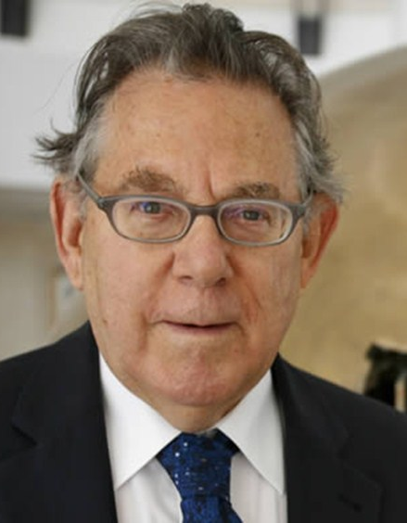
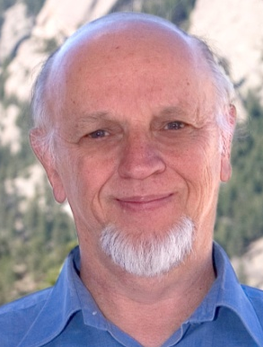
Despairing of prompt political response to global warming,
in August and September 2006,
Paul Crutzen (Nobel Prize in Chemistry) and Tom Wigley (NCAR)
suggested that we consider temporary geoengineering as an emergency response.

Slide 7


Can Dr. Evil Save The World?
Forget about a future filled with wind farms and hydrogen cars. The Pentagon's top weaponeer says he has a radical solution that would stop global warming now -- no matter how much oil we burn.
Jeff Goodell, Rolling Stone, November 3, 2006
Lowell Wood

Slide 8
Stratospheric Geoengineering
Benefits | Risks or Concerns
1. Reduce surface air temperatures, which could reduce or reverse negative impacts of global warming, including floods, droughts, stronger storms, sea ice melting, and sea level rise | Physical and biological climate system | Esthetics
 | 1. Drought in Africa and Asia | 17. Whiter skies
 | 2. Perturb crops and ecology with more diffuse radiation and UV 3. Ozone depletion | Affect stargazing Unknowns 19. Human error during implementation
 | 4. Continued ocean acidification 5. Additional acid rain and snow 6. May not stop ice sheets from melting | 20. Unexpected consequences Governance
2. Increase plant productivity 3. Increase terrestrial CO₂ sink 4. Beautiful red and yellow sunsets |  | 21. Cannot stop effects quickly 22. Commercial control
 | 7. Impacts on tropospheric chemistry 8. Rapid warming if stopped | 23. Whose hand on the thermostat?
5. Unexpected benefits 6. Prospect of implementation could increase drive for mitigation |  | 24. Societal disruption, conflict between countries
 | Human impacts 9. Less solar electricity generation | 25. Moral hazard – could reduce drive for mitigation
 | 10. Degrade passive solar heating 11. Effects on airplanes flying in stratosphere | 26. Conflicts with current treaties Ethics 27. Military use of technology
 | 12. Effects on electrical properties of atmosphere 13. Affect satellite remote sensing 14. Degrade terrestrial optical astronomy 15. More sunburn | 28. Moral authority – do we have the right to do this?
 | 16. Environmental impact of implementation
Robock, Alan, 2008: 20 reasons why geoengineering may be a bad idea. Bull. Atomic Scientists, 64, No. 2, 14-18, 59, doi:10.2968/064002006.
Robock, Alan, 2016: Albedo enhancement by stratospheric sulfur injection: More research needed. Earth’s Future, 4, 644-648, doi:10.1002/2016EF000407.
Each of these needs to be quantified so that society can make informed decisions.
Robock, Alan, 2020: Benefits and risks of stratospheric solar radiation management for climate intervention (geoengineering). The Bridge, 50, 59-67.

Slide 9
Stratospheric Geoengineering
Benefits | Risks or Concerns
1. Reduce surface air temperatures, which could reduce or reverse negative impacts of global warming, including floods, droughts, stronger storms, sea ice melting, and sea level rise | Physical and biological climate system | Esthetics
 | 1. Drought in Africa and Asia | 17. Whiter skies
 | 2. Perturb crops and ecology with more diffuse radiation and UV 3. Ozone depletion | Affect stargazing Unknowns 19. Human error during implementation
 | 4. Continued ocean acidification 5. Additional acid rain and snow 6. May not stop ice sheets from melting | 20. Unexpected consequences Governance
2. Increase plant productivity 3. Increase terrestrial CO₂ sink 4. Beautiful red and yellow sunsets |  | 21. Cannot stop effects quickly 22. Commercial control
 | 7. Impacts on tropospheric chemistry 8. Rapid warming if stopped | 23. Whose hand on the thermostat?
5. Unexpected benefits 6. Prospect of implementation could increase drive for mitigation |  | 24. Societal disruption, conflict between countries
 | Human impacts 9. Less solar electricity generation | 25. Moral hazard – could reduce drive for mitigation
 | 10. Degrade passive solar heating 11. Effects on airplanes flying in stratosphere | 26. Conflicts with current treaties Ethics 27. Military use of technology
 | 12. Effects on electrical properties of atmosphere 13. Affect satellite remote sensing 14. Degrade terrestrial optical astronomy 15. More sunburn | 28. Moral authority – do we have the right to do this?
 | 16. Environmental impact of implementation
Robock, Alan, 2008: 20 reasons why geoengineering may be a bad idea. Bull. Atomic Scientists, 64, No. 2, 14-18, 59, doi:10.2968/064002006.
Robock, Alan, 2016: Albedo enhancement by stratospheric sulfur injection: More research needed. Earth’s Future, 4, 644-648, doi:10.1002/2016EF000407.
Can be addressed by GeoMIP and other climate modeling
Robock, Alan, 2020: Benefits and risks of stratospheric solar radiation management for climate intervention (geoengineering). The Bridge, 50, 59-67.

Slide 10
Latitudes and Altitudes
Tropical: We put SO₂ into the lower stratosphere (16-22 km) over the Equator at a daily rate equal to
5 Mt/yr (1 Pinatubo every 4 years) or
10 Mt/yr (1 Pinatubo every 2 years) for 20 years,
and then continue to run for another 20 years to see how fast the system warms afterwards.
Arctic: We put SO₂ into the lower stratosphere (10-15 km)
at 68ºN at a daily rate equal to 3 Mt/yr for 20 years,
and then continue to run for another 20 years to see how fast the system warms afterwards.
Robock, Alan, Luke Oman, and Georgiy Stenchikov, 2008: Regional climate responses to geoengineering with tropical and Arctic SO₂ injections. J. Geophys. Res., 113, D16101, doi:10.1029/2008JD010050

Slide 11
GISS Global Average Temperature Anomaly
+ Anthropogenic Forcing (A1B), 3 Mt SO₂/yr Arctic,
5 Mt SO₂/yr Tropical, 10 Mt SO₂/yr Tropical
Robock, Alan, Luke Oman, and Georgiy Stenchikov, 2008: Regional climate responses to geoengineering with tropical and Arctic SO₂ injections. J. Geophys. Res., 113, D16101, doi:10.1029/2008JD010050

Slide 12
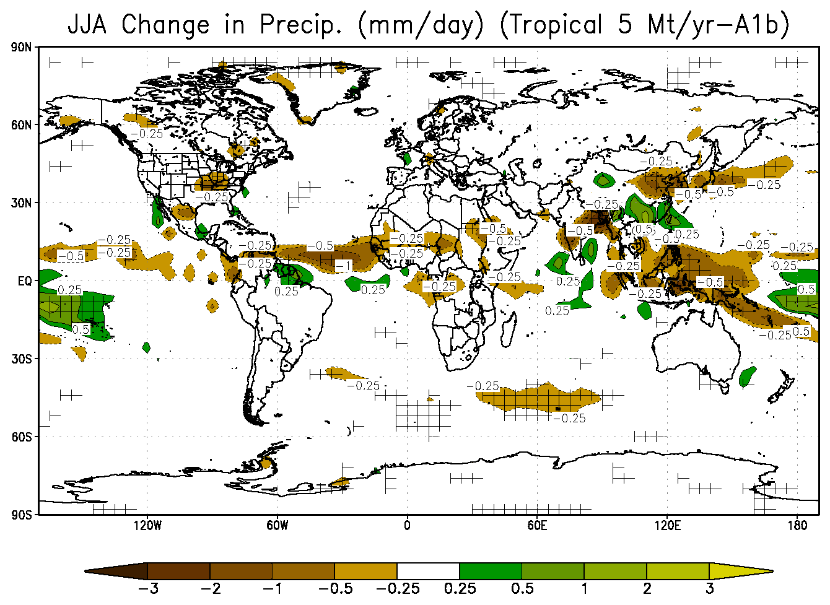
=
significant at the 95% level
Robock, Alan, Luke Oman, and Georgiy Stenchikov, 2008: Regional climate responses to geoengineering with tropical and Arctic SO₂ injections. J. Geophys. Res., 113, D16101, doi:10.1029/2008JD010050.

Slide 13
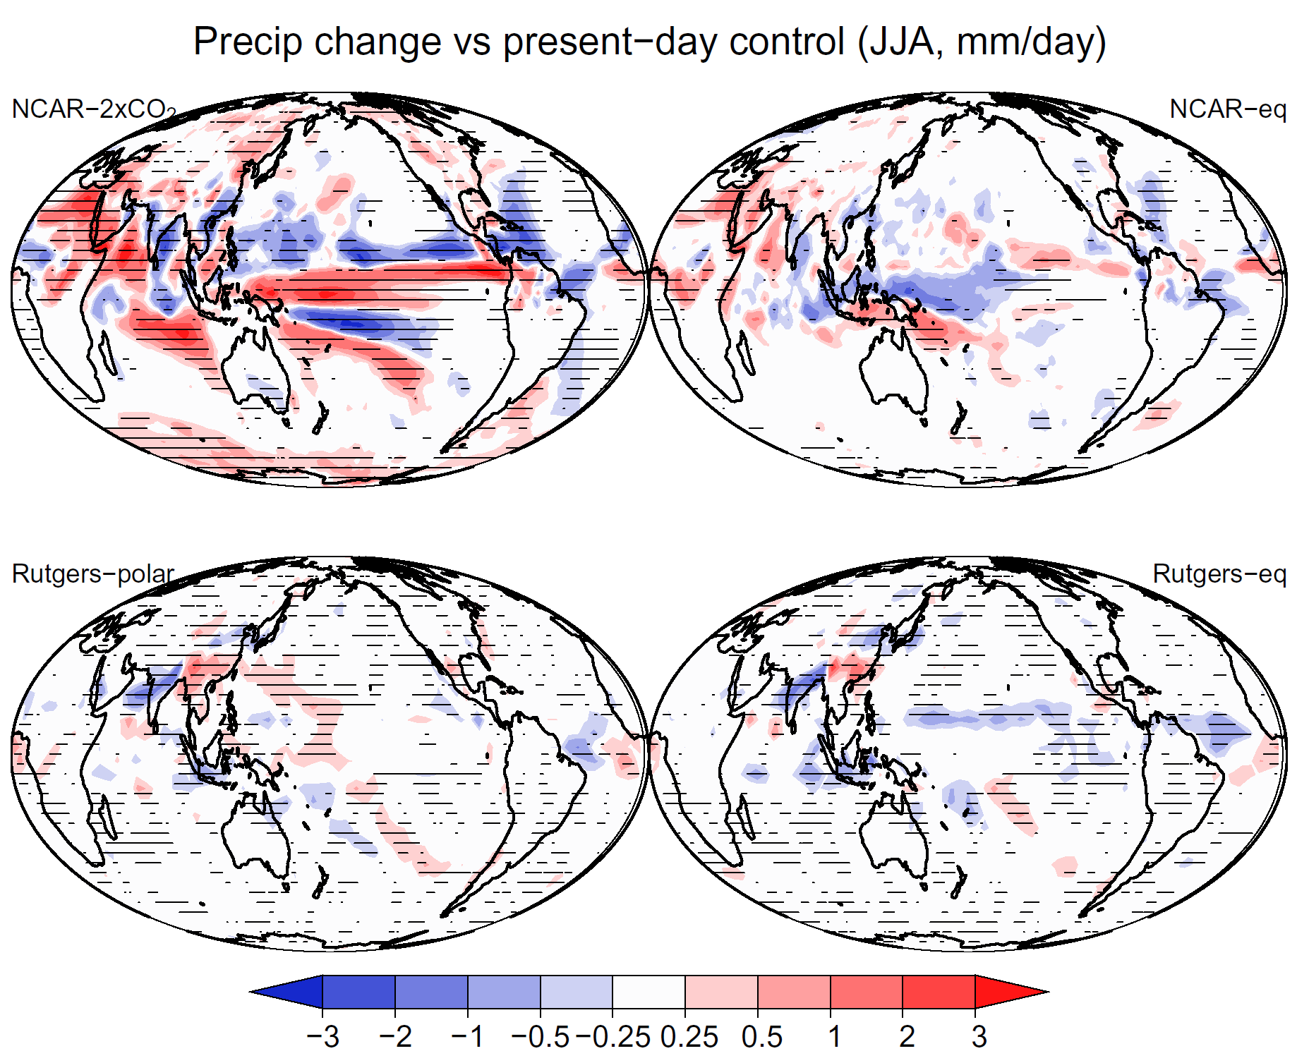
Rasch, Philip J., Simone Tilmes, Richard P. Turco, Alan Robock, Luke Oman, Chih-Chieh (Jack) Chen, Georgiy L. Stenchikov, and Rolando R. Garcia, 2008: An overview of geoengineering of climate using stratospheric sulphate aerosols. Phil. Trans. Royal Soc. A., 366, 4007-4037, doi:10.1098/rsta.2008.0131.

Slide 14
At the
Strategic Workshop on
Geoengineering Research
Hamburg, Germany
November 25-26, 2009
I gave an invited talk:
A Proposal for Standardized Geoengineering Experiments for CMIP5

Slide 15
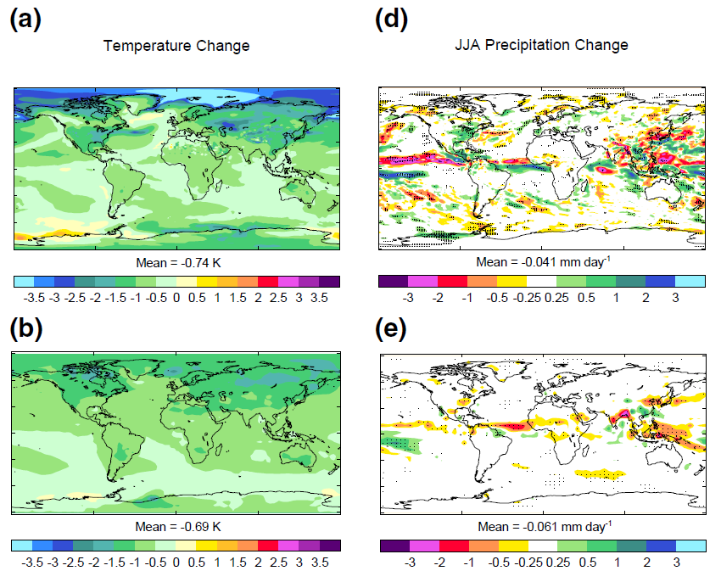
Met Office, Hadley Centre
5Mt/yr – A1b
ModelE
5Mt/yr – A1b
Jones, Andy, Jim Haywood, Olivier Boucher, Ben Kravitz, and Alan Robock, 2010: Geoengineering by stratospheric SO₂ injection: Results from the Met Office HadGEM2 climate model and comparison with the Goddard Institute for Space Studies ModelE. Atmos. Chem. Phys., 10, 5999-6006.

Slide 16

Geoengineering Model Intercomparison Project (GeoMIP)
We have carried out standard experiments as part of CMIP5 and CMIP6 using identical global warming and geoengineering scenarios, to see whether our results are robust.
For example, how will the hydrological cycle respond to stratospheric geoengineering? Will there be a significant reduction of Asian monsoon precipitation? How will ozone and UV change?
As of now, 157 peer-reviewed GeoMIP publications and counting, many of which are in the special sections of Journal of Geophysical Research – Atmospheres and Atmospheric Chemistry and Physics / Geoscientific Model Development, and the third GeoMIP special issue, in Atmospheric Chemistry and Physics / Earth System Dynamics.
Kravitz, Ben, Alan Robock, Olivier Boucher, Hauke Schmidt, Karl Taylor, Georgiy Stenchikov, and Michael Schulz, 2011: The Geoengineering Model Intercomparison Project (GeoMIP). Atmospheric Science Letters, 12, 162-167, doi:10.1002/asl.316.
GeoMIP is a CMIP Coordinated Experiment, as part of the Coupled Model Intercomparison Projects 5, 6, and 7 (CMIP5, CMIP6, CMIP7).
http://climate.envsci.rutgers.edu/GeoMIP/publications.html

Slide 17
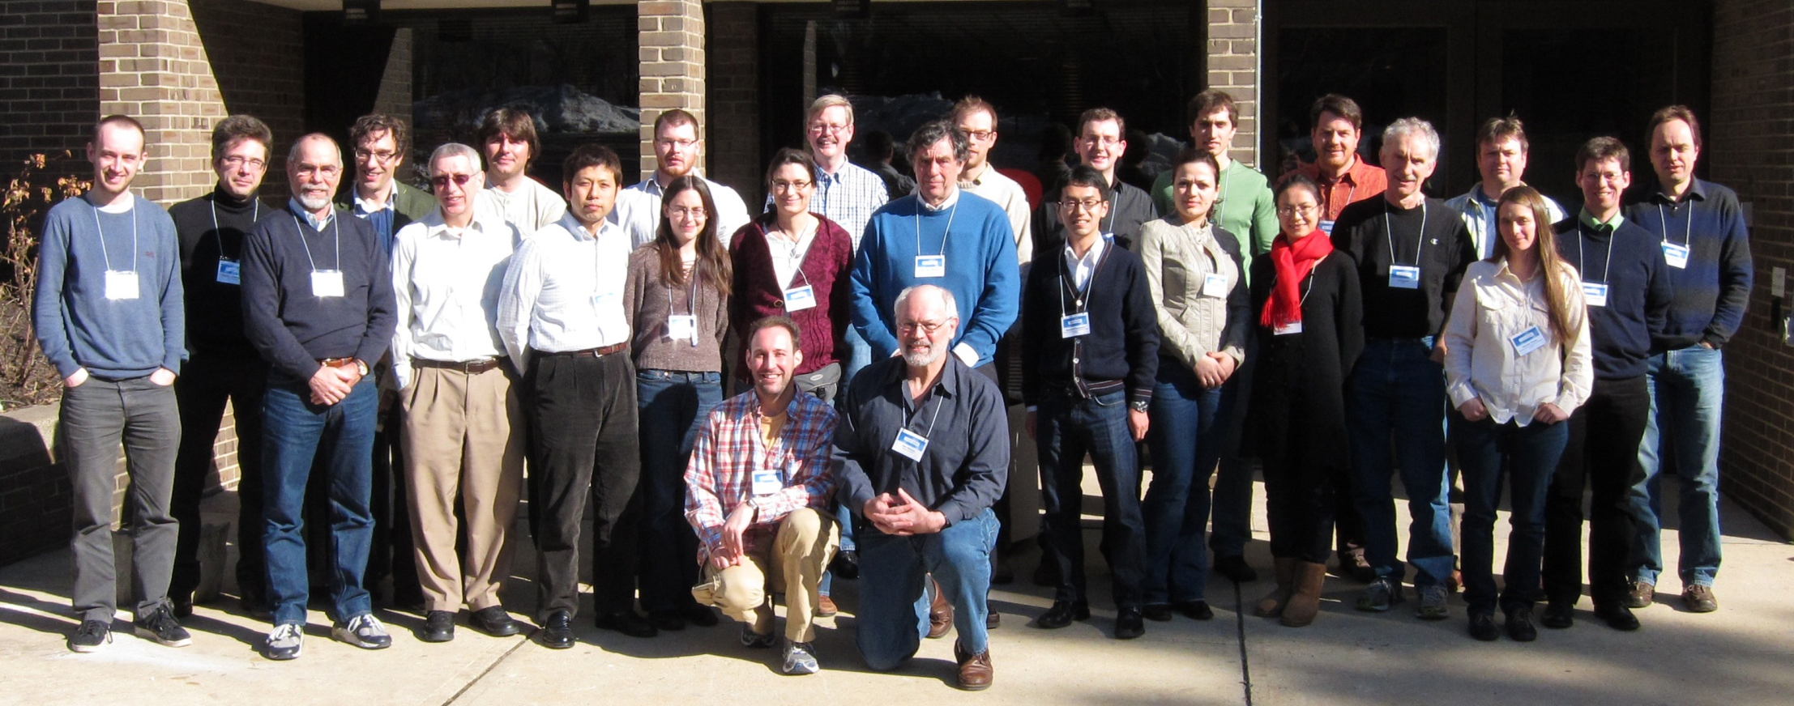
First GeoMIP Workshop, Rutgers University, February 10-12, 2011
http://climate.envsci.rutgers.edu/GeoMIP/events/rutgersfeb2011.html
Workshop was sponsored by the United Kingdom embassy in the United States.
Robock, Alan, Ben Kravitz, and Olivier Boucher, 2011: Standardizing Experiments in Geoengineering; GeoMIP Stratospheric Aerosol Geoengineering Workshop; New Brunswick, New Jersey, 10-12 February 2011, EOS, 92, 197, doi:10.1029/ 2011ES003424.

Slide 18
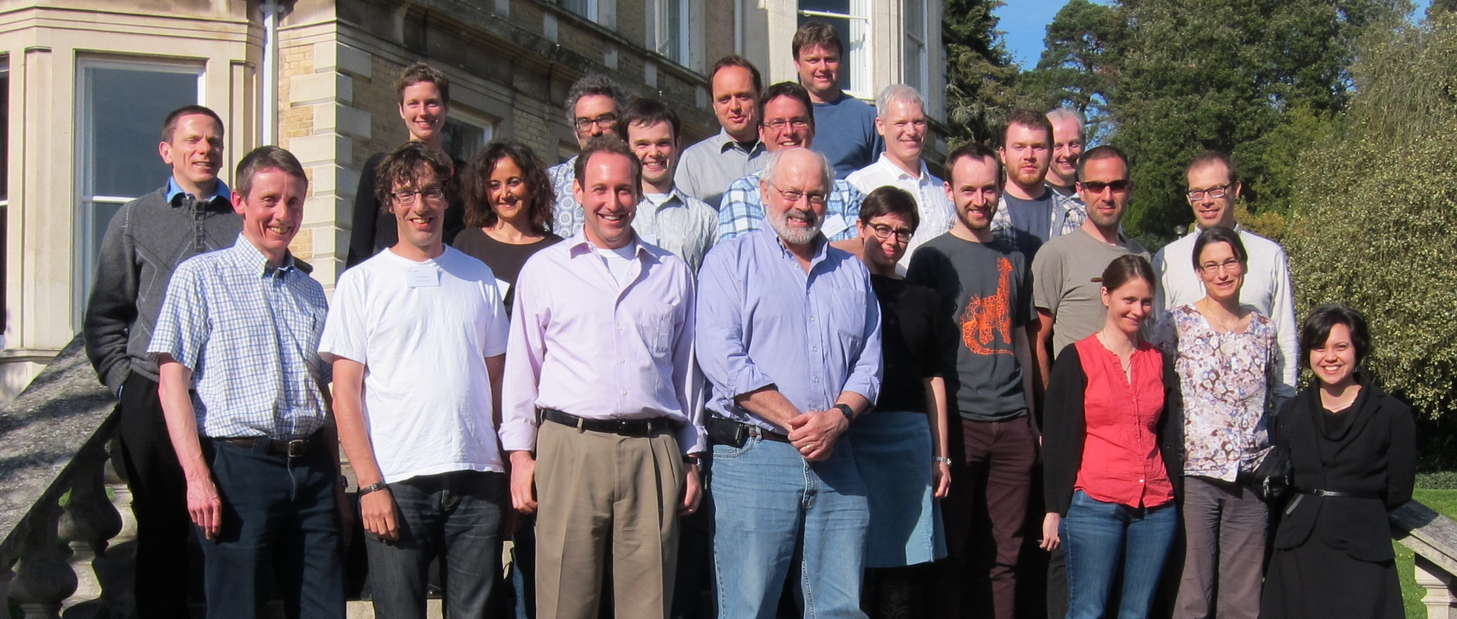
Second GeoMIP Workshop, University of Exeter, March 30-31, 2012
http://climate.envsci.rutgers.edu/GeoMIP/events/exetermarch2012.html
Workshop was sponsored by the Integrated Assessment of Geoengineering Proposals project.
Kravitz, Ben, Alan Robock, and James Haywood, 2012: Progress in climate model simulations of geoengineering: 2nd GeoMIP Stratospheric Aerosol Geoengineering Workshop; Exeter, UK, 30-31 March 2012, EOS, 93, 340, doi:10.1029/2012ES003871.

Slide 19
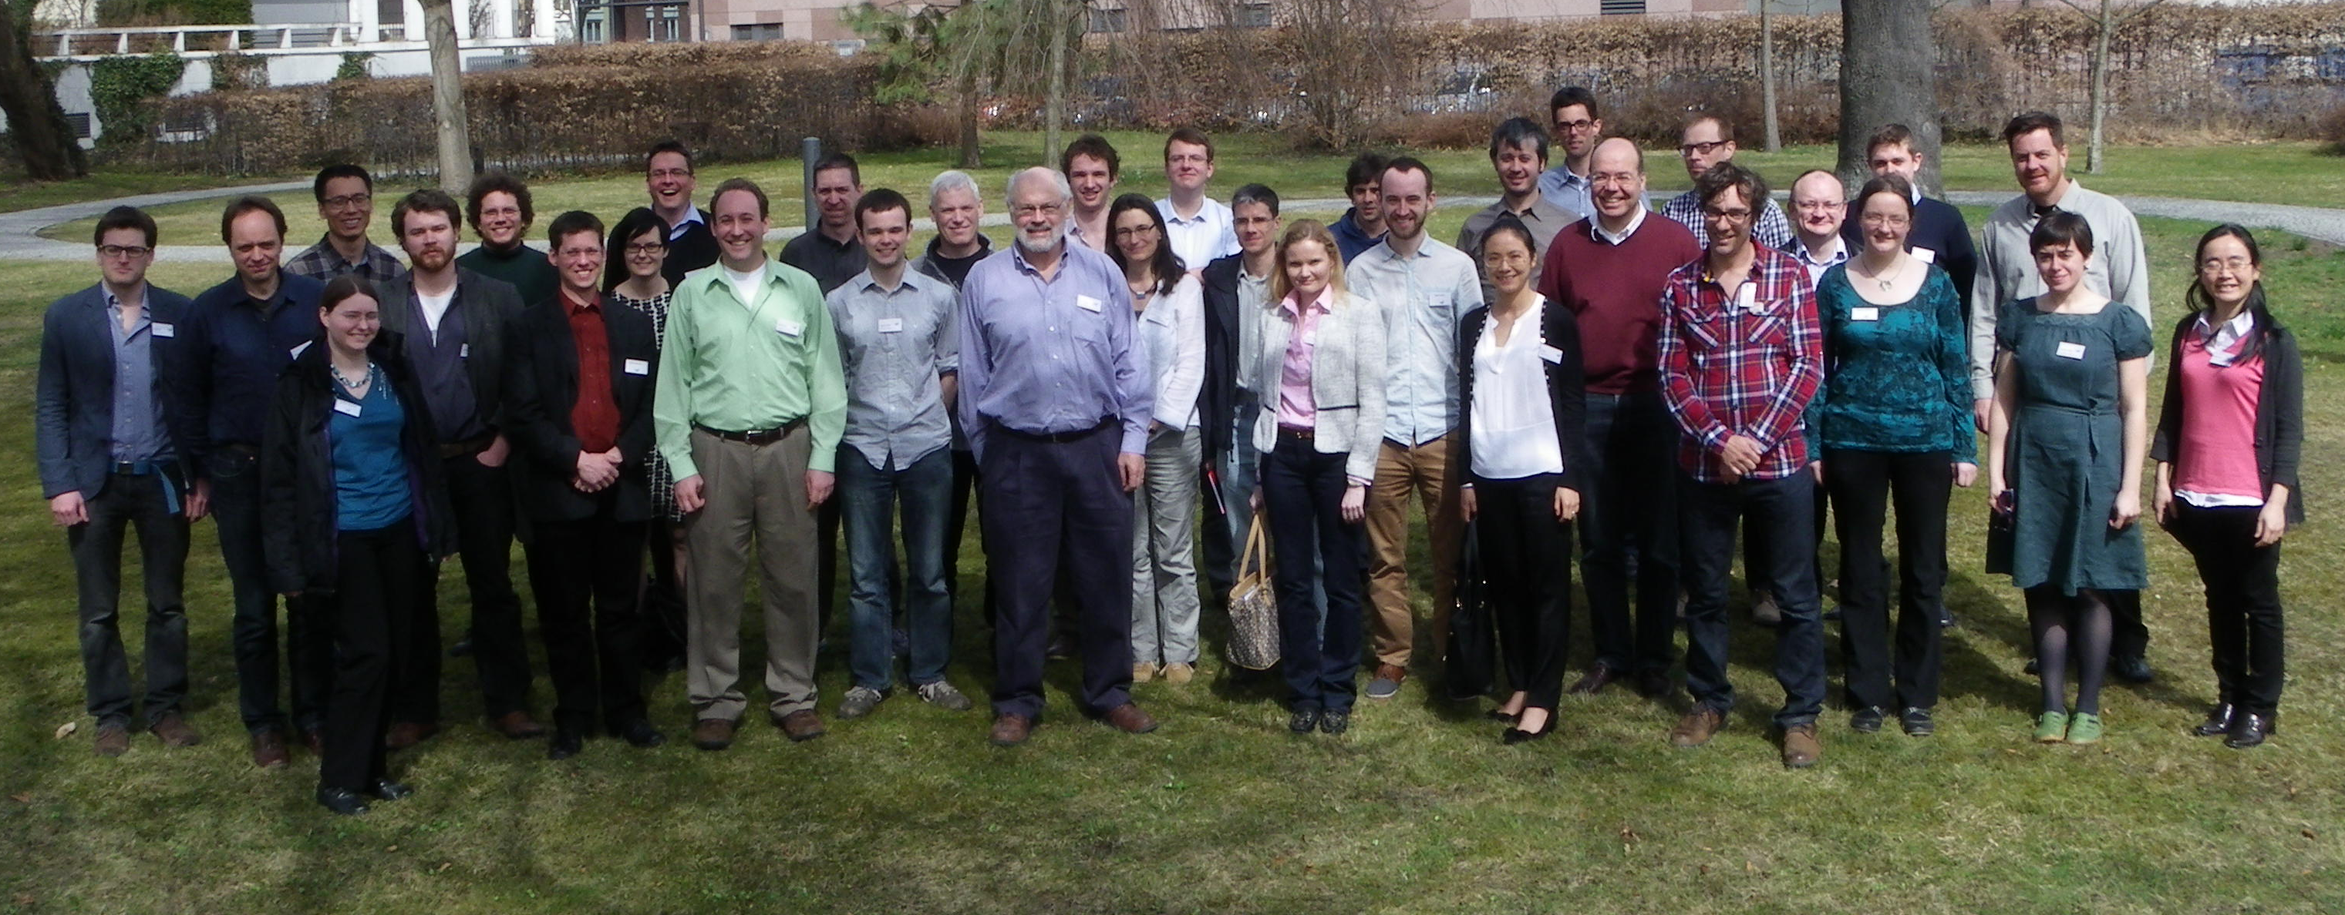
Third GeoMIP Workshop, Institute for Advanced Sustainability Studies, Potsdam, Germany, April 15-16, 2013
http://climate.envsci.rutgers.edu/GeoMIP/events/potsdamapril2013.html
Workshop was sponsored by IASS and NSF.
Kravitz, Ben, Alan Robock, and Peter Irvine, 2013: Robust results from climate model simulations of geoengineering: GeoMIP 2013; Potsdam, Germany, 15–16 April 2013. Eos, 94, 292, doi:10.1002/2013EO330005.

Slide 20
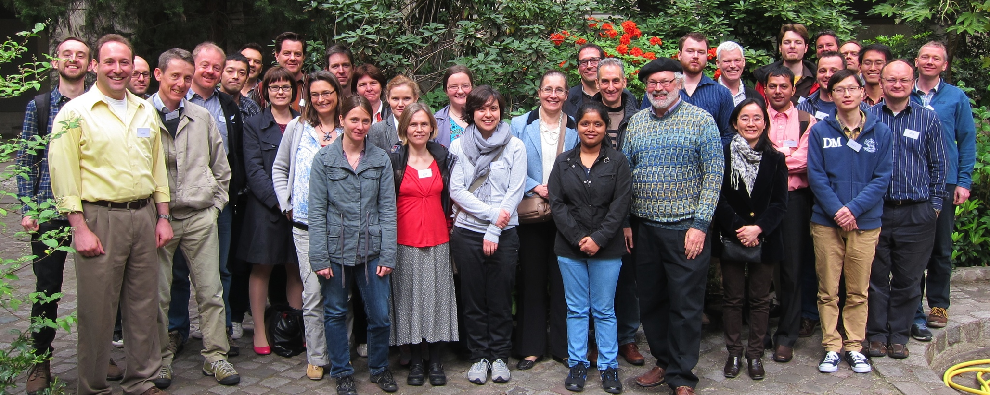
Fourth GeoMIP Workshop, Paris, France, April 24-25, 2014
http://climate.envsci.rutgers.edu/GeoMIP/events/parisapril2014.html
Workshop was sponsored by the Laboratoire de Météorologie Dynamique and US National Science Foundation.
Kravitz, Ben, Alan Robock, and Olivier Boucher, 2014: Future directions in simulating solar geoengineering; Fourth GeoMIP Workshop; Paris, France, 24–25 April 2014. Eos, 95 (31), 280, doi:10.1002/ 2014EO310010.

Slide 21
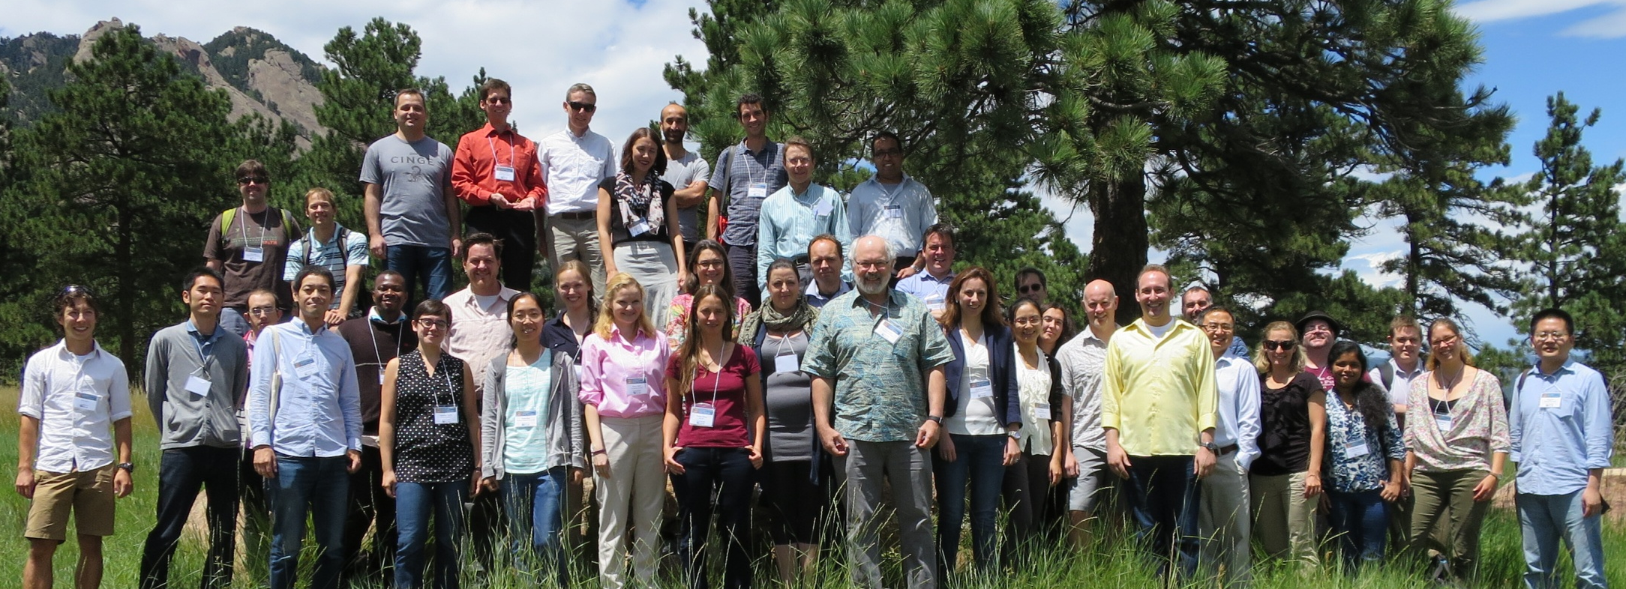
Fifth GeoMIP Workshop, National Center for Atmospheric Research, Boulder, Colorado, July 22-23, 2015
http://www.asp.ucar.edu/ecsa/geoengineering-workshop.php
Workshop sponsored by the University Corporation for Atmospheric Research
and the US National Science Foundation.
Kravitz, Ben, Alan Robock, and Simone Tilmes, 2016: New Paths in Geoengineering; National Center for Atmospheric Research Fifth Annual Geoengineering Model Intercomparison Workshop and Early Career Summer School; Boulder, Colorado, 20–24 July 2015. Eos, 97, doi:10.1029/2016EO045915.

Slide 22
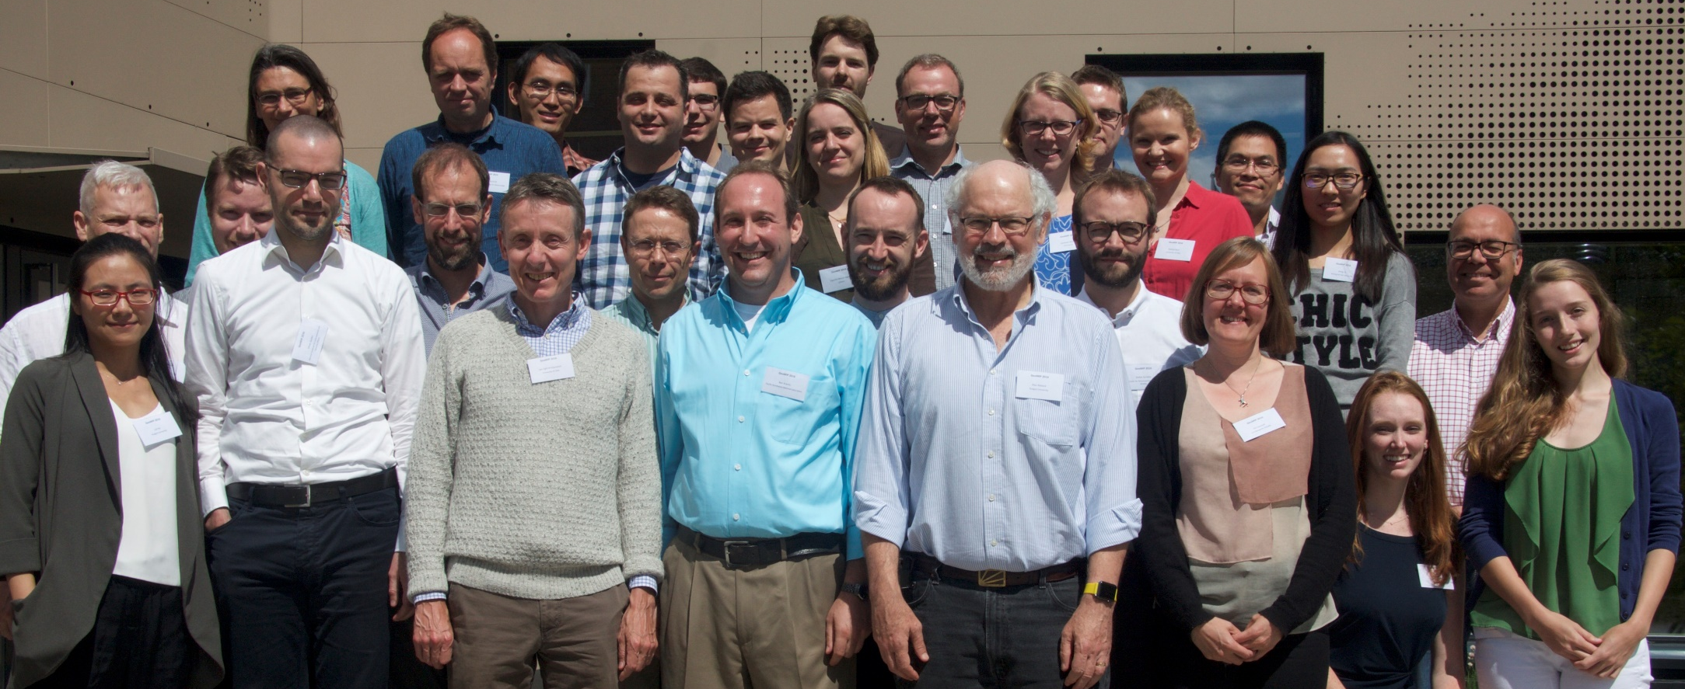
Sixth GeoMIP Workshop, University of Oslo, Norway,
June 21-22, 2016
http://www.asp.ucar.edu/ecsa/geoengineering-workshop.php
Workshop sponsored by the Research Council of Norway and the US National Science Foundation.
Kravitz, Ben, Alan Robock, and Jón Egill Kristjánsson, 2017: Understanding How Climate Engineering Can Offset Climate Change; Sixth Meeting of the Geoengineering Model Intercomparison Project (GeoMIP); Oslo, Norway, 21–22 June 2016. Eos, 98, No. 4, p. 11, doi:10.1029/2016EO005279.

Slide 23
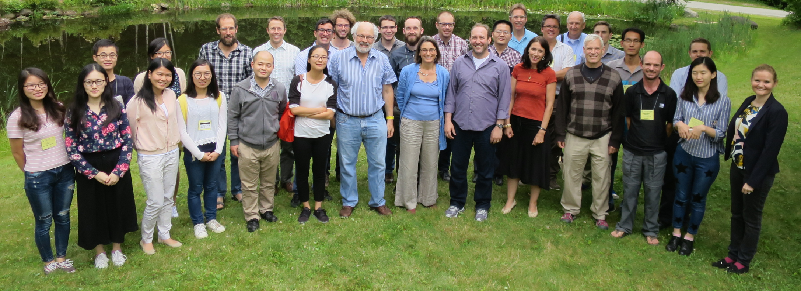

Seventh GeoMIP Workshop, Sunday River, Newry, Maine, USA,
July 27, 2017
Workshop sponsored by the US National Science Foundation.
Kravitz, Ben, and Alan Robock, 2017: Vetting new models of climate responses to geoengineering: The Seventh Meeting of the Geoengineering Model Intercomparison Project; Newry, Maine, 26 July 2017, Eos, 98, doi:10.1029/2017EO089383.

Slide 24
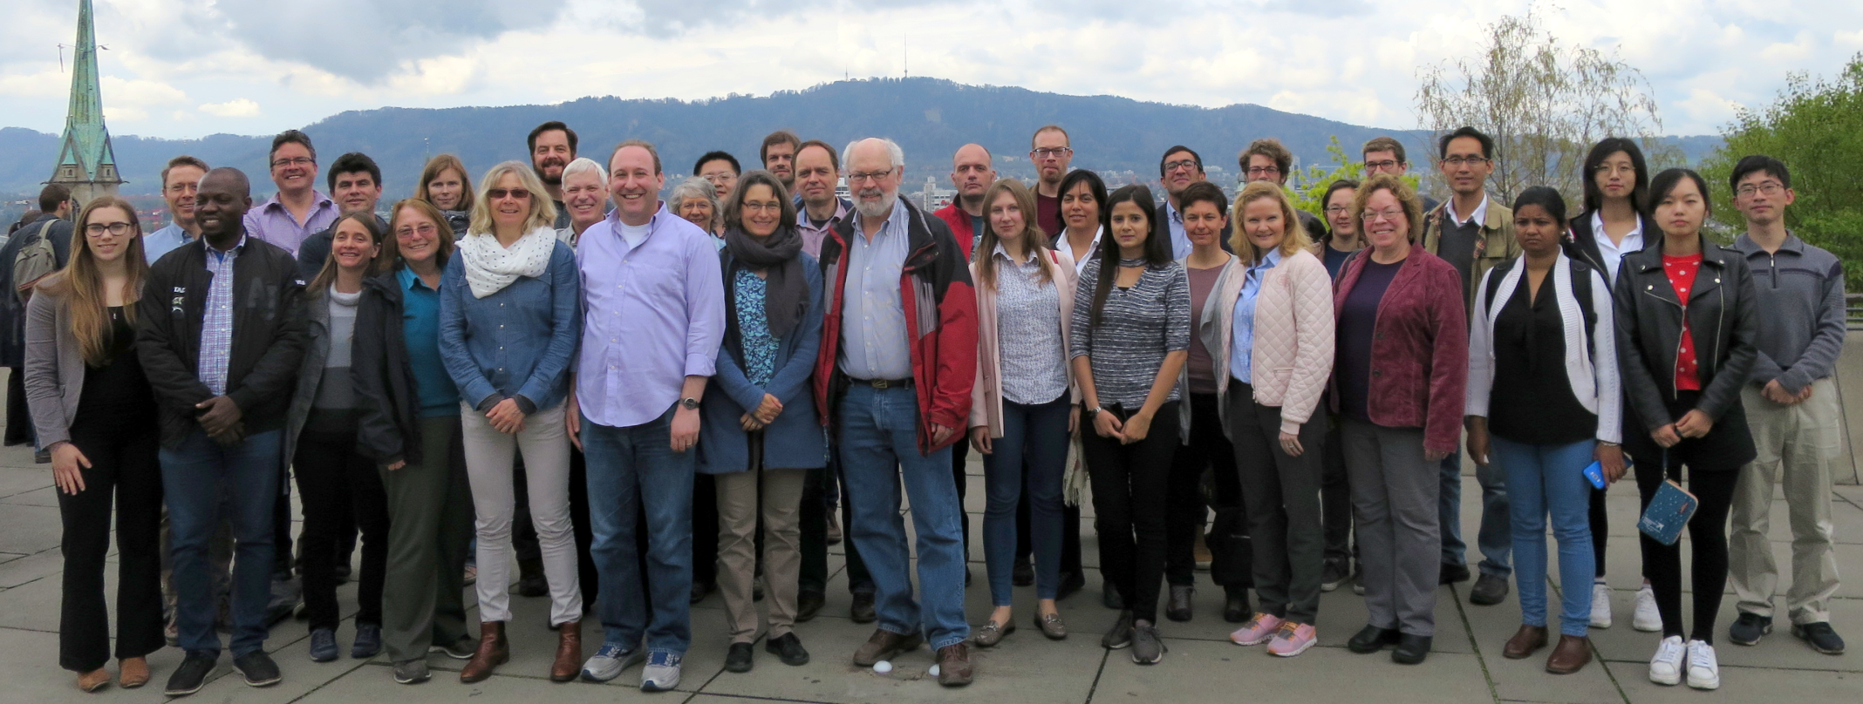
Eighth GeoMIP Workshop, ETH Zürich, Switzerland
April 16-17, 2018
Workshop sponsored by the US National Science Foundation.
Kravitz, Ben, Alan Robock, and Ulrike Lohman, 2018: Modeling the impacts of geoengineering: Report on the Eighth Annual GeoMIP Meeting, 16-17 April 2018, Zürich, Switzerland, Eos, 99, doi:10.1029/2018EO103333.

Slide 25
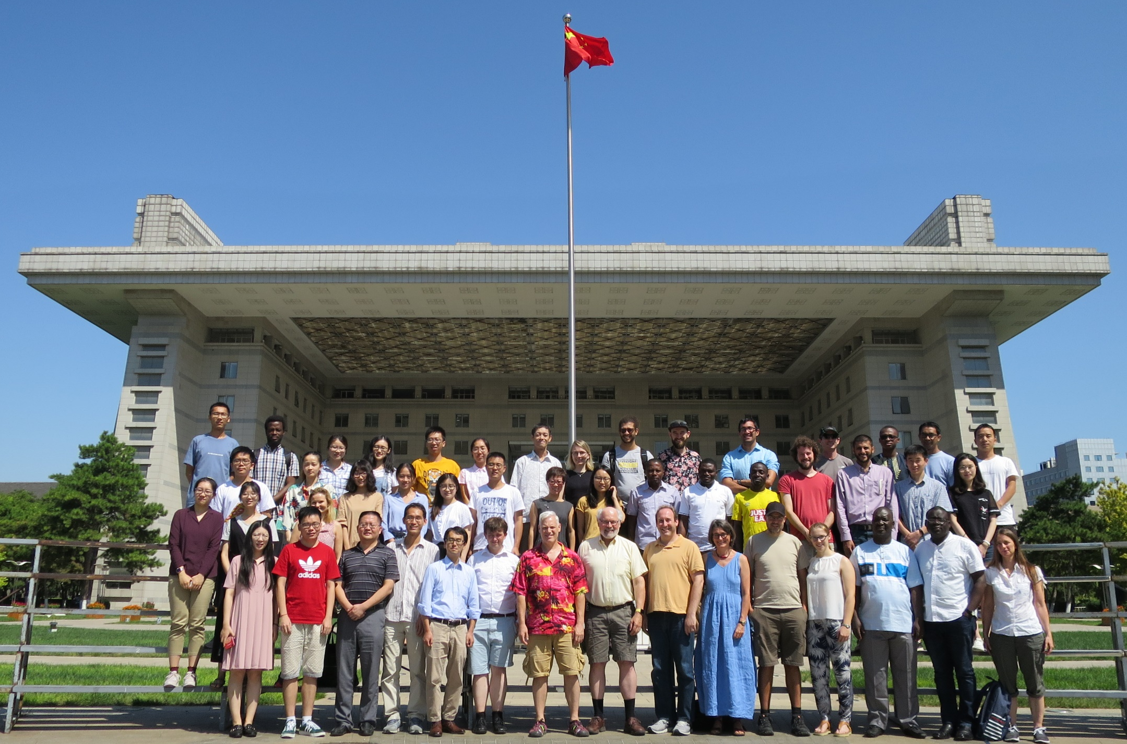
Ninth GeoMIP Workshop
Beijing Normal University
Beijing, China
August 15-16, 2019
Workshop sponsored by the US National Science Foundation
and Beijing Normal University.
Kravitz, Ben, Alan Robock, and John C. Moore, 2020: New frontiers in geoengineering research. Bull. Amer. Meteor. Soc., doi:10.1175/BAMS-D-19-0327.1.

Slide 26
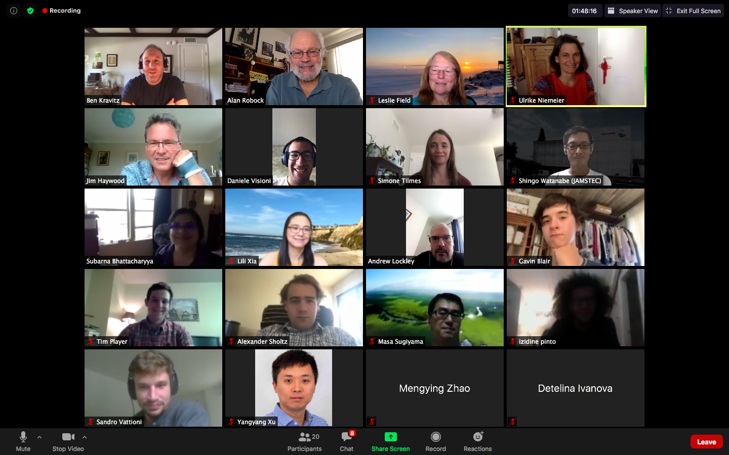
Tenth GeoMIP Workshop, Online, July 15, 2020
Kravitz, Ben, Alan Robock, and Douglas G. MacMartin, 2020: The road toward process-level understanding of solar geoengineering through a multi-model intercomparison. Bull. Amer. Meteor. Soc., 101(9), E1572-E1575, doi:10.1175/BAMS-D-20-0209.1.

Slide 27
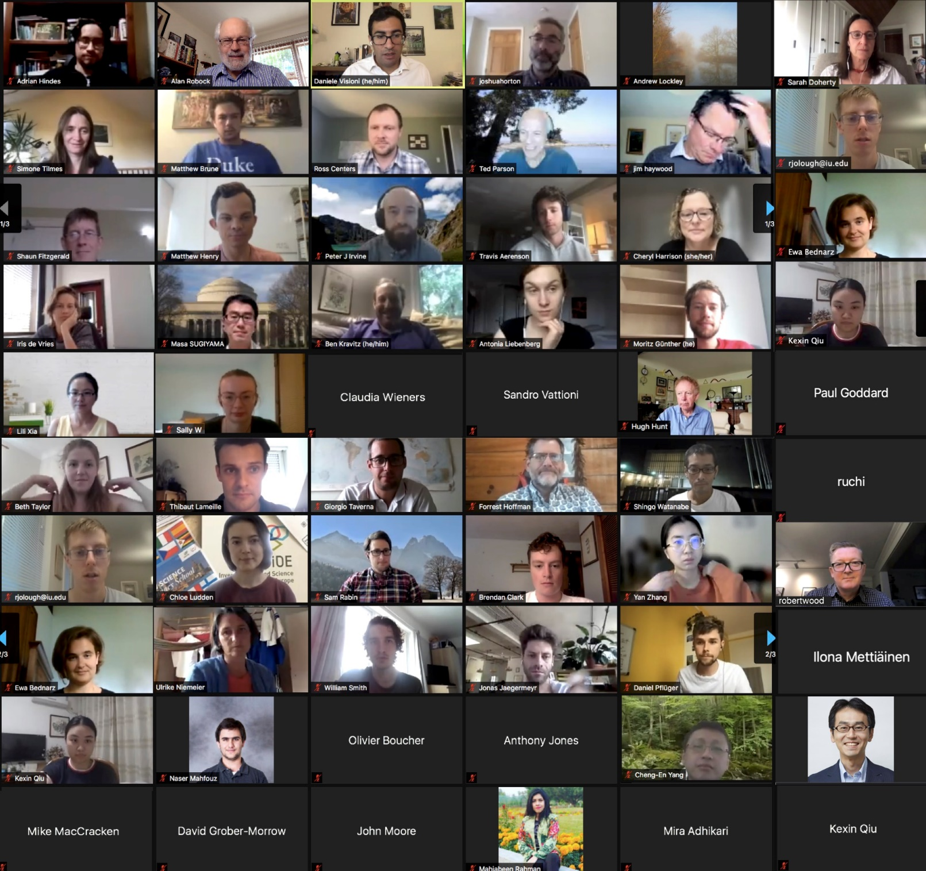
Eleventh GeoMIP Workshop, Online, July 8-9, 2021
Visioni, Daniele, and Alan Robock, 2021: Future geoengineering scenarios: Balancing policy relevance and scientific significance, Bull. Amer. Meteor. Soc., 103, E817-E820, doi:10.1175/BAMS-D-21-0201.1.

Slide 28
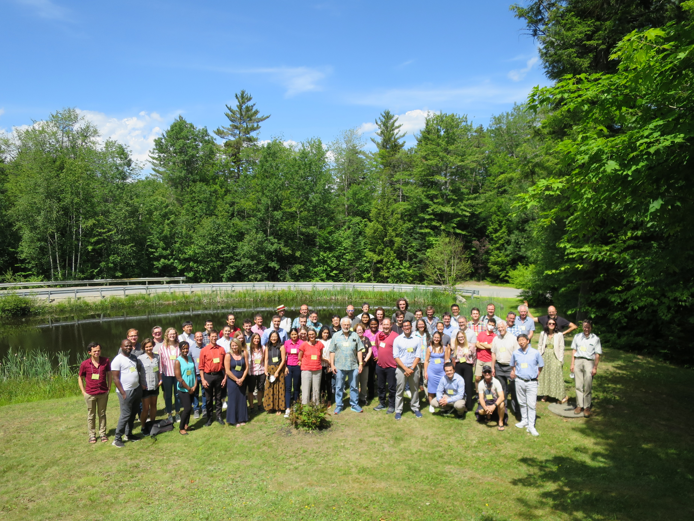
Twelfth GeoMIP Workshop, Sunday River, Newry, Maine, USA,
June 29, 2022
Visioni, Daniele, Alan Robock, Alistair Duffey, and Ilaria Quaglia, 2023: Process-level experiments and policy-relevant scenarios in future GeoMIP iterations. Bull. Amer. Meteor. Soc., 104, E501-E503, doi:10.1175/BAMS-D-22-0281.1
Workshop sponsored by the US National Science Foundation.

Slide 29
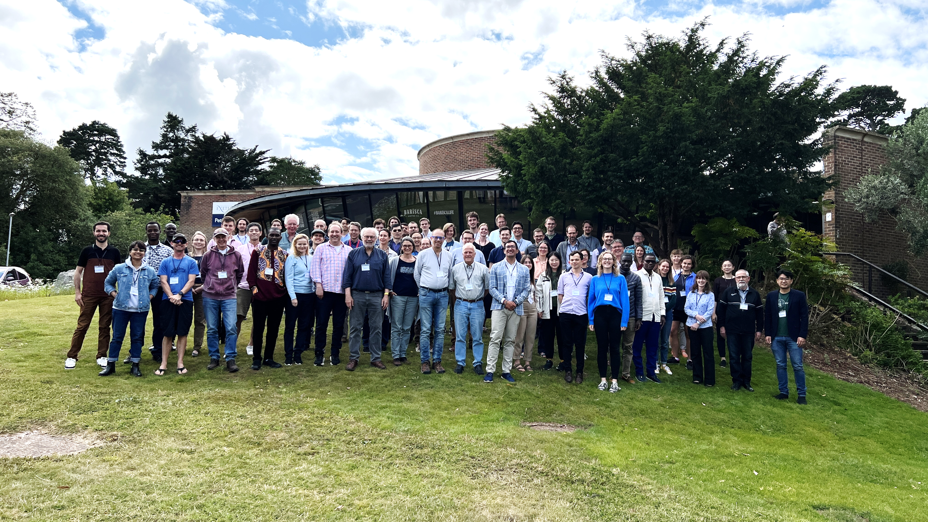

Thirteenth GeoMIP Workshop, University of Exeter, UK
July 3-7, 2023
Workshop sponsored by the US National Science Foundation and University of Exeter
Visioni, Daniele, Alan Robock, Jim Haywood, Matthew Henry, and Alice Wells, 2023: A new era for the Geoengineering Model Intercomparison Project (GeoMIP): Meeting report for the 13th GeoMIP meeting held in Exeter, UK, 3-7 July, 2023. Bull. Amer. Meteor. Soc., 104, E1950–E1955, doi:10.1175/BAMS-D-23-0232.1.

Slide 30
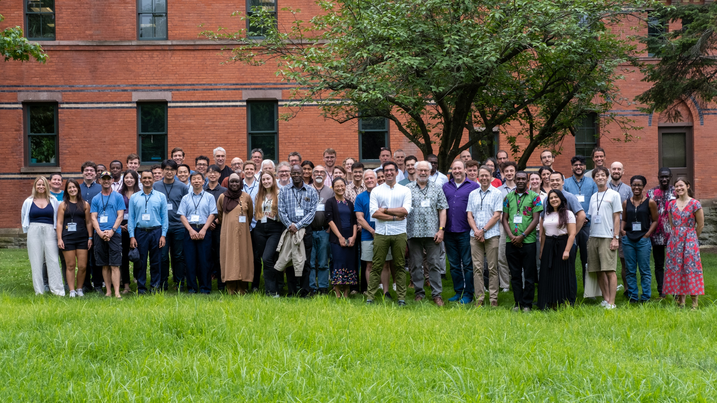
Fourteenth GeoMIP Workshop, Cornell University, Ithaca, NY
July 10-12, 2024
Workshop sponsored by the US National Science Foundation, the Quadrature Climate Foundation, and Cornell University
Visioni, Daniele, Alan Robock, Douglas G. MacMartin, Ilaria Quaglia, Ezra Brody, and Jared Farley, 2024: The community-based road to CMIP7 in the Geoengineering Model Intercomparison Project (GeoMIP), Bull. Amer. Meteor. Soc., 105, E2324-E2329, doi:10.1175/BAMS-D-24-0274.1.

Slide 31
Fifteenth GeoMIP Workshop
Capetown, South Africa
May 12-16, 2025
at the 2025 Degrees Global Forum
https://www.degrees.ngo/

Slide 32
Sixteenth GeoMIP Workshop
Tokyo, Japan
March 17-19, 2026

Slide 33
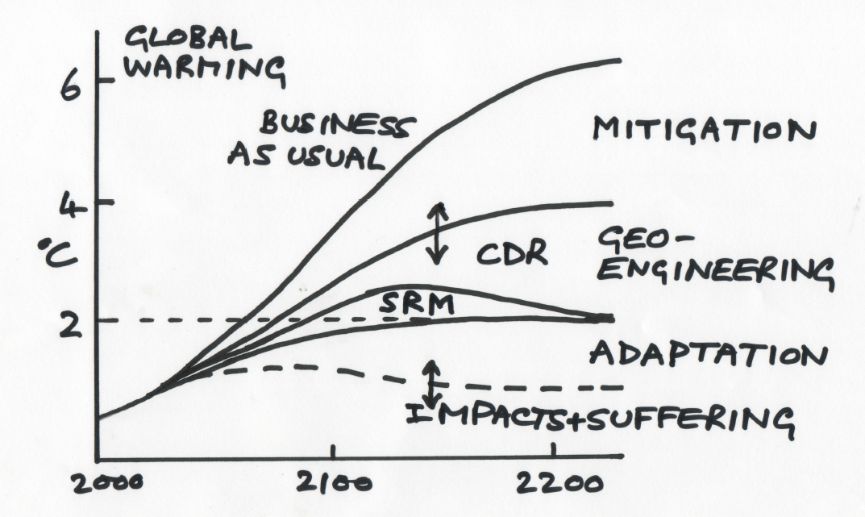

The Napkin Diagram
Drawn by John Shepherd on a napkin at the Asilomar International Conference on Climate Intervention Technologies, Pacific Grove, California, March 22-26, 2010
OVERSHOOT
Long, Jane C. S., and John G. Shepherd, 2014: The Strategic Value of Geoengineering Research, Chapter 87 of Global Environmental Change, Bill Freedman (ed.), (Springer, Dordrecht), 757-770, doi:10.1007/978-94-007-5784-4_24.

Slide 34
Stratospheric Geoengineering
Benefits | Risks or Concerns
1. Reduce surface air temperatures, which could reduce or reverse negative impacts of global warming, including floods, droughts, stronger storms, sea ice melting, and sea level rise | Physical and biological climate system | Esthetics
 | 1. Drought in Africa and Asia | 17. Whiter skies
 | 2. Perturb crops and ecology with more diffuse radiation and UV 3. Ozone depletion | Affect stargazing Unknowns 19. Human error during implementation
 | 4. Continued ocean acidification 5. Additional acid rain and snow 6. May not stop ice sheets from melting | 20. Unexpected consequences Governance
2. Increase plant productivity 3. Increase terrestrial CO₂ sink 4. Beautiful red and yellow sunsets |  | 21. Cannot stop effects quickly 22. Commercial control
 | 7. Impacts on tropospheric chemistry 8. Rapid warming if stopped | 23. Whose hand on the thermostat?
5. Unexpected benefits 6. Prospect of implementation could increase drive for mitigation |  | 24. Societal disruption, conflict between countries
 | Human impacts 9. Less solar electricity generation | 25. Moral hazard – could reduce drive for mitigation
 | 10. Degrade passive solar heating 11. Effects on airplanes flying in stratosphere | 26. Conflicts with current treaties Ethics 27. Military use of technology
 | 12. Effects on electrical properties of atmosphere 13. Affect satellite remote sensing 14. Degrade terrestrial optical astronomy 15. More sunburn | 28. Moral authority – do we have the right to do this?
 | 16. Environmental impact of implementation
Robock, Alan, Douglas G. MacMartin, Riley Duren, and Matthew W. Christensen, 2013: Studying geoengineering with natural and anthropogenic analogs. Climatic Change, 121, 445-458, doi:10.1007/s10584-013-0777-5.
Robock, Alan, 2016: Albedo enhancement by stratospheric sulfur injection: More research needed. Earth’s Future, 4, 644-648, doi:10.1002/2016EF000407.
Volcanic analog
Robock, Alan, 2020: Benefits and risks of stratospheric solar radiation management for climate intervention (geoengineering). The Bridge, 50, 59-67.

Slide 35
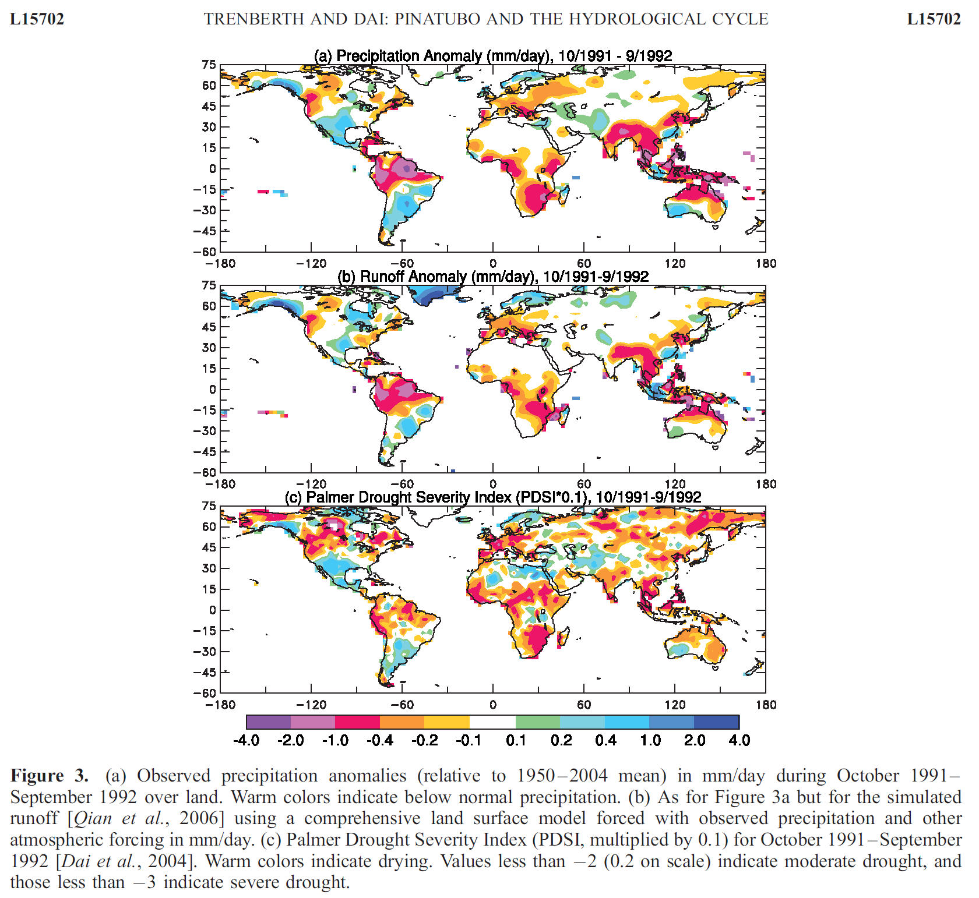
Trenberth, K. E., and A. Dai, 2007: Effects of Mount Pinatubo volcanic eruption on the hydrological cycle as an analog of geoengineering. Geophys. Res. Lett., 34, L15702, doi: 10.1029/2007GL030524.

Slide 36
Volcanic eruptions tell us
that stratospheric geoengineering could:
- Cool the surface, reducing ice melt and sea level rise, produce pretty sunsets, and increase the CO₂ sink, but
Reduce summer monsoon precipitation,
Destroy ozone, allowing more harmful UV at the surface,
Produce rapid warming when stopped,
Make the sky white,
Reduce solar power,
Perturb the ecology with more diffuse radiation,
Damage airplanes flying in the stratosphere,
Degrade astronomical observations,
Affect remote sensing, and
Affect stargazing

Slide 37
Stratospheric Geoengineering
Benefits | Risks or Concerns
1. Reduce surface air temperatures, which could reduce or reverse negative impacts of global warming, including floods, droughts, stronger storms, sea ice melting, and sea level rise | Physical and biological climate system | Esthetics
 | 1. Drought in Africa and Asia | 17. Whiter skies
 | 2. Perturb crops and ecology with more diffuse radiation and UV 3. Ozone depletion | Affect stargazing Unknowns 19. Human error during implementation
 | 4. Continued ocean acidification 5. Additional acid rain and snow 6. May not stop ice sheets from melting | 20. Unexpected consequences Governance
2. Increase plant productivity 3. Increase terrestrial CO₂ sink 4. Beautiful red and yellow sunsets |  | 21. Cannot stop effects quickly 22. Commercial control
 | 7. Impacts on tropospheric chemistry 8. Rapid warming if stopped | 23. Whose hand on the thermostat?
5. Unexpected benefits 6. Prospect of implementation could increase drive for mitigation |  | 24. Societal disruption, conflict between countries
 | Human impacts 9. Less solar electricity generation | 25. Moral hazard – could reduce drive for mitigation
 | 10. Degrade passive solar heating 11. Effects on airplanes flying in stratosphere | 26. Conflicts with current treaties Ethics 27. Military use of technology
 | 12. Effects on electrical properties of atmosphere 13. Affect satellite remote sensing 14. Degrade terrestrial optical astronomy 15. More sunburn | 28. Moral authority – do we have the right to do this?
 | 16. Environmental impact of implementation
Robock, Alan, 2008: 20 reasons why geoengineering may be a bad idea. Bull. Atomic Scientists, 64, No. 2, 14-18, 59, doi:10.2968/064002006.
Robock, Alan, 2016: Albedo enhancement by stratospheric sulfur injection: More research needed. Earth’s Future, 4, 644-648, doi:10.1002/2016EF000407.
Not testable with modeling or the volcanic analog
Robock, Alan, 2020: Benefits and risks of stratospheric solar radiation management for climate intervention (geoengineering). The Bridge, 50, 59-67.

Slide 38
Any questions?

